Slide 1
Systemic Varicella Zoster Infection Causing Cerebral Venous Thrombosis and Revealing Prothrombotic State
Ayman Mahmoud Alboudi
MD, MSc
Rashid Hospital , Dubai, UAE

Slide 2
CVT is a rare disorder with incidence rate is around 1/100000[1]
We are having about 6 cases per year in our hospital (Rashid hospital in dubai)

Slide 3
Heller et al found in his study on CVST in children that the majority of cases are multifactorial, as a combination of prothrombotic risk factors and/or underlying condition such as infection.^{[1]}
Even more, CVST can be precipitated by systemic infection.^{[2]}

Slide 4
Of the etiologic factors:
  Prothrombotic conditions, either genetic or acquired
  Oral contraceptives
  Pregnancy and the puerperium
  Malignancy
  Infection
  Head injury and mechanical precipitants

Slide 5
previously it was thought that infections contributing in high percentage in the etiology, but nowadays it is recognized that they form 6-12 % only [1]
The pathophysiology of CVT still not will known , even there was some theories [2]

Slide 6
Now speaking about our case:
  This patient is 31y old male, previously healthy with no past medical history;
  presented with a history of skin rash started 14d ago, accompanied with low grade fever at the first few days, with progression consistent with VZV.
  5d ago he started to have headache, holocephalic, accompanied with nausea and vomiting.
  On the day of admission he had 2 GTCS.

Slide 7
  The neurological exam was totally normal apart from mild bilateral pupil edema.
  General examination showed skin rash in crusting stage. There was no fever or meningeal signs.

Slide 8
CT brain was done and showed small haemorrhagic infarction on the left occipital area (fig 1),

Slide 9
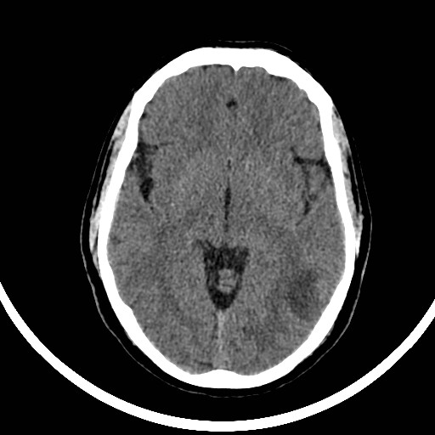

Slide 10
CT venogram showed CVST on the left transverse, lateral sinuses and superior sinus (fig 2).

Slide 11
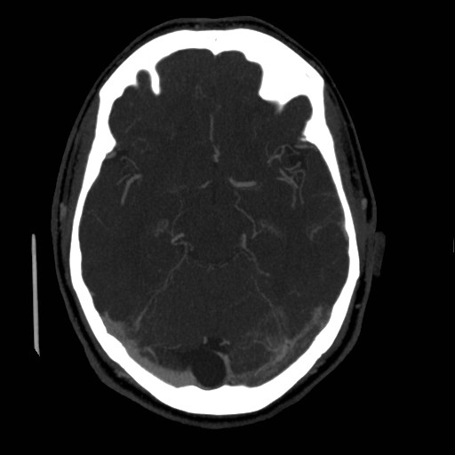

Slide 12
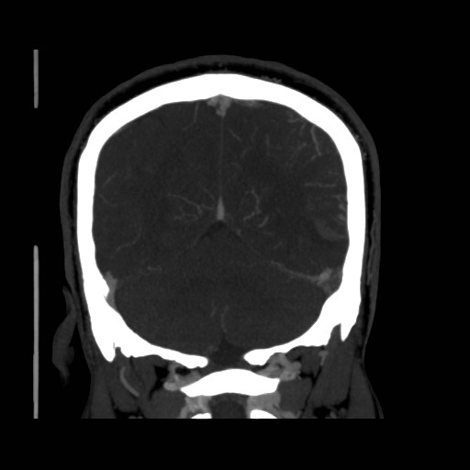

Slide 13
And because there is systemic viral infection, encephalitis was a concern
Unfortunately the patient refused LP
MRI was done

Slide 14
MRI showed no signs of encephalitis, there was only signs of the infarction already seen on CT

Slide 15
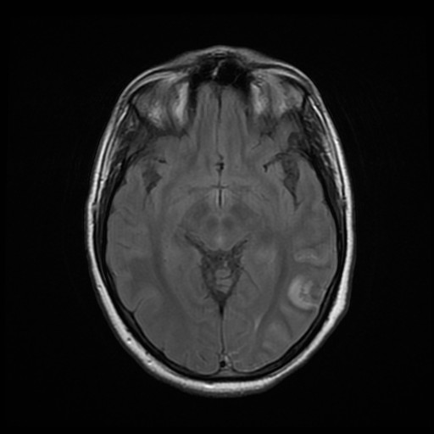

Slide 16
On blood tests the patient was found to have:
  positive IgG, IgM Ab for VZV, also
  positive :
    Antinuclear sntibodies
    phosphatidyl serin
    Anticardiolipin antibodies
    B2 microglobulin.
  Other investigations as Anti dsDNA, HCV ab, HBV ag, ANCA p,c all were negative. Normal urine test.

Slide 17
Thrombotic profile of :
  Prothrombine ,
  Protein C deficiency
  Protein S deficiency
  Antithrombin deficiency
  Factor V Leiden mutation
  G20210A prothrombin gene mutation
  All were negative

Slide 18
The patient was treated as CVT and anticoagulation started
Negative MRI in VZV encephalitis was described [1]
That is why antiviral treatment was started with acyclovir

Slide 19
VZV is a commonly seen infection as febrile illness with a vesicular rash, especially in pediatric population.
However, the neurological complications in adults specifically, are not commonly encountered, but include arterial vasculopathy, which can cause ischemic strokes, aneurysms, subarachnoid or cerebral hemorrhages, and carotid dissection^{[1-3]}.

Slide 20
Our patient was like Saddiqi et al patients [1], without any signs of purpura fulminans, but he was unique in the fact that he has positive antinuclear, phosphatidyl serin, anticardiolipin antibodies, B2 microglobulin, and VZV IgG, IgM (which were negative in Saddiqi patients).

Slide 21
Those lab tests were repeated after 3 months when the patient was seen in the clinic , and they came positive again
The anticoagulation was recommended for the patient for life

Slide 22
Take home messages
Encephalitis is a major concern in infectious diseases, but CVT is very important treatable complication to think about it
Thrombotic profile should be evaluated in all CVT patients, as this can change the patient’s management
Multifactorial etiology is a possibility in CVT, and should not be ignored

Slide 23
Thank You

