Slide 1
Guney Formation Oil Reservoir Rock Characterization, Eregli-Ulukisla Basin
Ayfer ÖZDEMİR

Slide 2
CONTENT
Aim
Why?
Study Area
Geology of the study area
Petroleum Reservoir Rock Properties of Guney Formation
  Petrographic Examinations
  Reservoir Rock Analyses
  Diagenetic steps of the Guney Formation
Results

Slide 3
Aim
to demonstrate petroleum reservoir rock properties of Guney formation in Eregli-Ulukisla Basin in Turkey

Slide 4
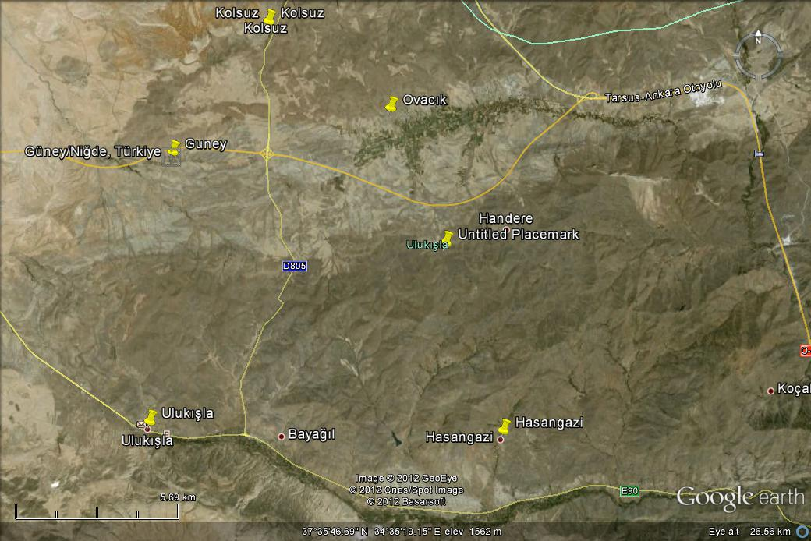
Study Area

Slide 5
Why?
Eregli-Ulukışla basin is related to Tuz Golu Basin.
  The studies of hydrocarbon investigation in Tuz Golu Basin have yielded positive results until now, and
  The previous studies indicated that there was occurence of natural gas
There can be hydrocarbon potential in Ereğli-Ulukisla basin
  The previous studies indicated that Ciftehan, Halkapınar and Hasangazi formations in Eregli-Ulukısla Basin have poor-medium petroleum source rock properties
  Guney formation is laterally transitive to Hasangazi formation which carries petroleum source rock properties.
TOC analysis results of Guney formation
  below 0.5% represents that Guney Formation can not be evaluated as a petroleum source rock
Sedimentary rock properties of formation
  The formation is a typical turbiditic formation (petroleum source rock properties, reservoir rock ).
Notes:
They are very similar to each other due to sediments filled in the basin having lithological similarities and their basin’s occurence time.
Since there is a sedimentary rock appearing as considerably thick petroleum source rock on the Guney formation which generate hydrocarbon and can store itself in its own reservoir rock by migrating oneself into other layers, the aim of this study is to demonstrate reservoir rock properties of the Guney Formation.

Slide 6
Geology

Slide 7
Geology
North
South
Notes:
Study area is in the Ulukışla-Bor basin and between the Ulukisla, Bor and Camardi (figure 1).

Slide 8
Petroleum Reservoir Rock Properties of
Guney Formation
Petrographic Examinations

Slide 9
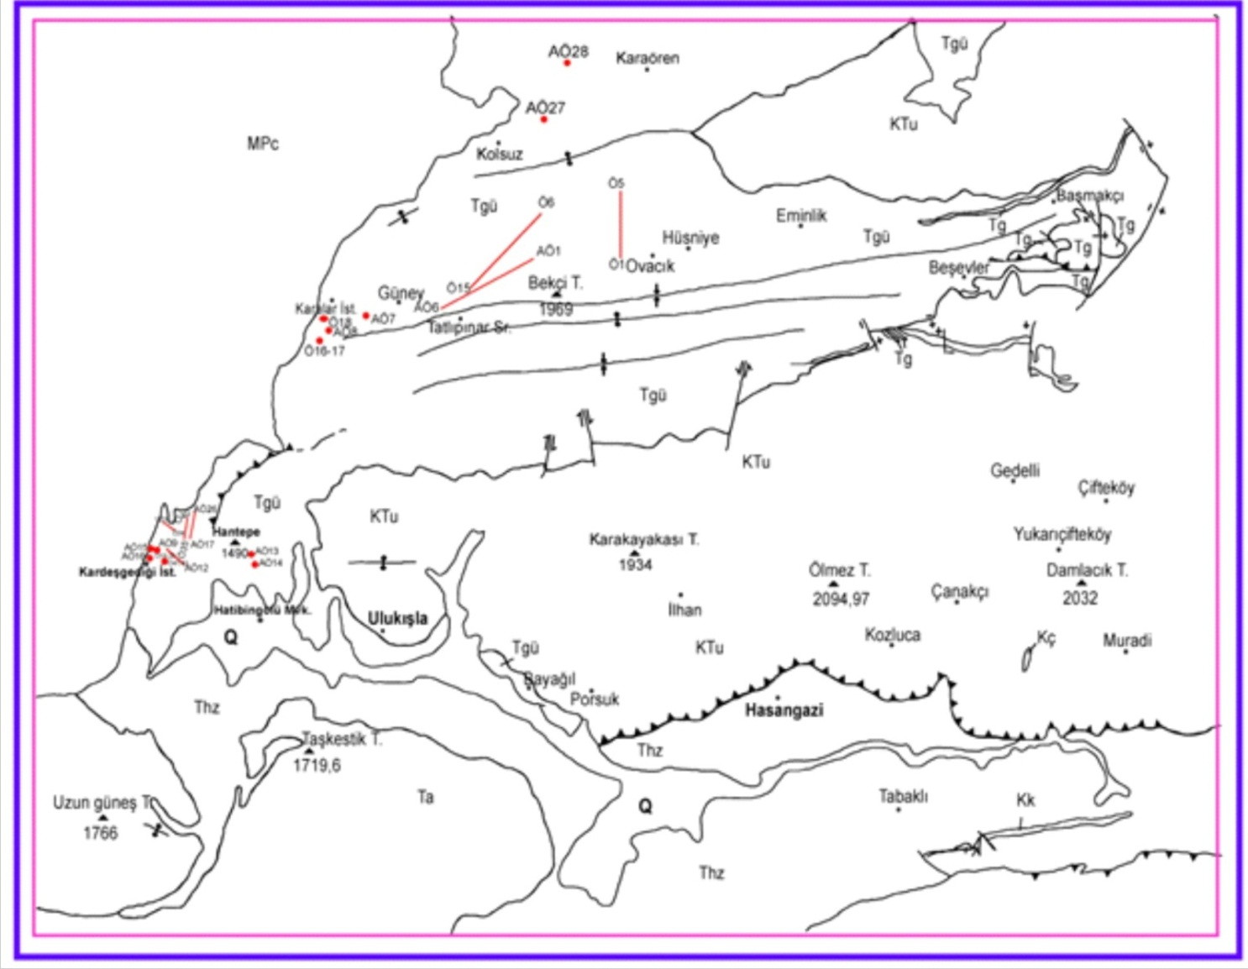
Map of samples

Slide 10
Petrographic examinations on Guney formation’s sandstones
Sample number | Grain length Min-Max(mm) | Average grain length(mm) | Grain roundness | sorting | Type of contact | Cement type % | Porosity type
AÖ-1 | 0,2-1 | 0,4 | Less sorted | medium | tangential | Clay %10 | Inter grain
AÖ-12 | 0,4-5 | 1,2 | Less sorted | worse | exact | Clay %3 | Inter grain
AÖ-16 | 0,3-7 | 2,2 | Less sorted | worse | tangential | Clay+Carb. %10 | Inter grain
AÖ-17 | 1,2-4 | 1,2 | Less sorted | well | exact | Clay %3 | Inter grain
AÖ-20 | 0,3-3,8 | 0,8 | sorted | medium | tangential | Carbonate%8 | Inter grain
AÖ-22 | 0,4-6,7 | 1,2 | Less sorted | worse | tangential | Carbonate%10 | Inter grain
AÖ-23 | 0,9-10,3 | 2,2 | sorted | worse | exact | Clay %4 | Inter grain
AÖ-24 | 0,4-7,3 | 2,4 | sorted | medium | tangential | Clay %3 | Inter grain
AÖ-25 | 1,2-13 | 4,3 | Less sorted | worse | tangential | Carbonate%4 | Inter grain
AÖ-27 | 0,5-2,2 | 0,8 | sorted | medium | tangential | Clay %10 | Inter grain
Ö3 | 0,2-0,4 | 0,2 | Less sorted | worse | tangential | Clay +Fe %10 | Inter grain
Ö7 | 0,3-12 | 0,6 | Less sorted | medium | exacttangential | Clay %6 | Inter grain
Ö10 | 0,5-12 | 1,3 | Less sorted | worse | tangential | Clay %13 | Inter grain
Ö12 | 0,2-1,2 | 0,4 | Less sorted | worse | Exactangential | Clay %4 | Inter grain
Ö15 | 0,4-1,4 | 0,6 | sorted | well | tangential | Clay %4 | Inter grain
Ö34 | 0,6-2,4 | 1,4 | Less sorted | medium | tangential | Clay %4 | Inter grain

Slide 11
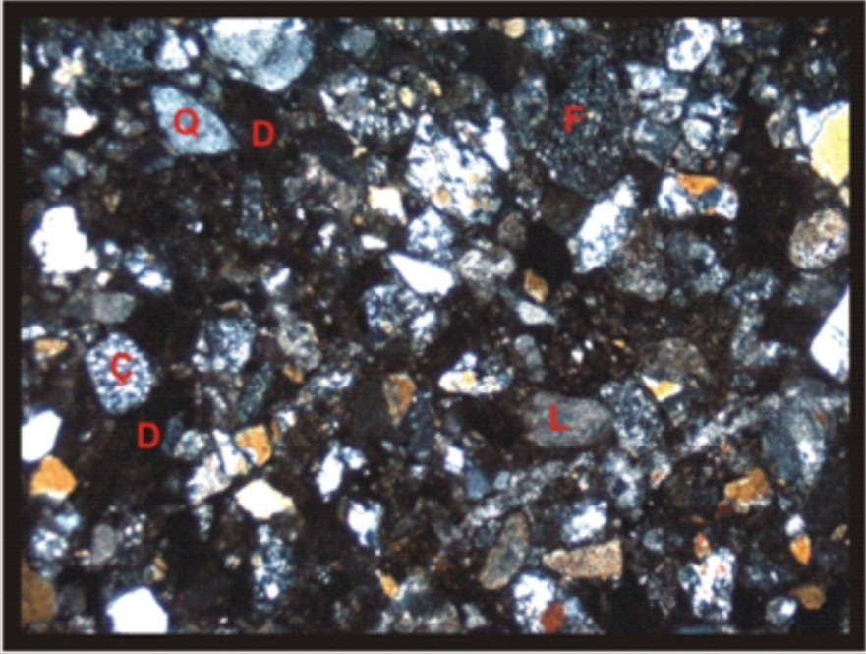
Image of petrographic examinations
c
a
b
d
Notes:
A thin section (single nickol, 10X), Ferric oxide cement
B thin section (diagonal nickol, 10X) sandstones are less roundness and worse sorting
C thin section (diagonal nickol, 10X) sandstones are less roundness and medium sorting
D (diagonal nickol, 10X) sandstones are less roundness and worse sorting

Slide 12
Root grain of Guney Formation’s sandstones
Sample Number | %Qt | %Qm | %Qp | %F | %rock fragment | %Other mineral
AÖ-1 | 60 | 45 | 15 | 8 | 30 | 2
AÖ-12 | 50 | 40 | 10 | 2 | 40
AÖ-16 | 12 | 4 | 8 | 5 | 80
AÖ-17 | 50 | 15 | 35 | 10 | 40
AÖ-18 | 15 | 5 | 10 | 5 | 80
AÖ-19 | 11 | 6 | 5 | 4 | 85
AÖ-20 | 13 | 10 | 8 | 75 | 4
AÖ-22 | 40 | 25 | 15 | 8 | 48 | 4
AÖ-23 | 45 | 15 | 30 | 5 | 50
AÖ-24 | 50 | 40 | 10 | 10 | 40
AÖ-25 | 30 | 5 | 25 | 5 | 65
AÖ-27 | 60 | 45 | 15 | 10 | 30
Ö3 | 55 | 45 | 10 | 10 | 35
Ö7 | 60 | 45 | 15 | 10 | 30
Ö10 | 40 | 25 | 15 | 10 | 50
Ö11 | 40 | 25 | 15 | 10 | 50
Ö12 | 40 | 25 | 15 | 10 | 50
Ö15 | 40 | 25 | 15 | 10 | 50
Ö16 | 20 | 4 | 16 | 5 | 75
Ö22 | 40 | 25 | 15 | 5 | 55
Ö34 | 30 | 25 | 5 | 5 | 65
Notes:
The average grain structure of the Guney formation ;
quartz %11-65,
monocrystal quartz %4-45, polycrystal quartz %5-40,
feldspar %28-15,
rock fragment %28-85,
content of other mineral ranged %2 and 4

Slide 13
As a result of the petrographic examinations of the Guney formation,
the sandstones are feldspar liticharenite and liticharenite (figure 5) with respect to Folk et al., 1970.

Slide 14
Petroleum Reservoir Rock Properties of
Guney Formation
Reservoir Rock Analyses

Slide 15
Permeability-porosity analyses of Guney formation
Sample number | Porosity values % | Permeability values (md)
 |  | Gas permeability | Fluid Permeability
Ö-3 | 7,75 | 0,67 | 0,4
Ö-7 | 13,42 | 0,46 | 0,4
Ö-10 |  | 0,24 | 0,2
Ö-11 | 9,75 | 0,39 | 0,32
Ö-12 | 9,06 | 0,31 | 0,2
Ö-14 | 24,48 | 0,71 | 0,4
Ö-15 | 28,74 | 0,55 | 0,4
Ö-16 | 31,66 | 4,65 | 4,4
Ö-19 | 29,11 | 0,77 | 0,2
Ö-22 | 20,38
Ö-34 | 15,86 | 2,21 | 2,2
Ö-36 | 31,79 | 0,91 | 0,5
Ö-38 | 34,37 | 0,62 | 0,3
AÖ-1 | 6,44 | 0,32 | 0,22
AÖ12 | 11,73 | 19,14 | 13
AÖ-16 | 17,44 | 26,85 | 22
AÖ-17 | 35,14
AÖ-20 | 10,77
AÖ-22 | 2,84
AÖ-23 | 18,56 | 24,96 | 19,2
AÖ-24 | 14,71 | 35,8 | 33
AÖ-25 | 15,8 | 12,93 | 11
AÖ-27 | 14,94 | 4,49 | 4,3

Slide 16
Reservoir rock evaluation
Porosity (%) | Permeability (md) | Evaluation
0-5 5-10 10-15 15-20 20-25 | - - 1-10 10-100 100-1000 | Not important Medium good best
Reservoir rock evaluation (Levorsen, 1967)

Slide 17
Petroleum Reservoir Rock Properties of
Guney Formation
Diagenetic evaluation of Guney Formation

Slide 18
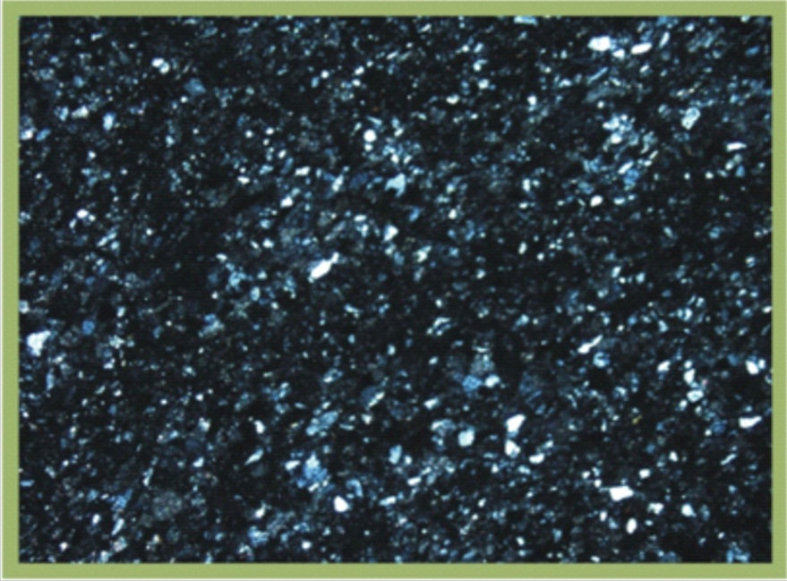
Diagenetic evaluation of Guney Formation
The diagenesis processes on the Guney formation sandstones were observed lithification and authigenesis.
Notes:
The Guney formation sandstones were packaged closely in the deep marine environment.
The sandstone grains contact with each other either tangential or entire.
Pore space in the sandstones connected with clay cement on the deep marine environment; however, they connected with carbonate cement on the shallow marine environment. Quartz cement mainly was observed on the Guney formatin sandstones as syntaxial overgrowth.

Slide 19
Results
Guney Formation sandstone grains showed less-angular roundness and medium-worse sorting properties
Porosity-permeability values were affected negatively by worse sorting and less- angular roundness
Pore spaces in the sandstones were reduced by
  clay cement,
  ferric-oxides cement,
  altered rock fragments and
  recryctalization of quartz minerals
Although the results of porosity-permeability analyses show Guney formation has worse reservoir rock properties, the sandstones samples taken from canal fillings in the study area indicate medium-well petroleum reservoir properties due to have high porosity-permeability values.
According to petrographic examinations and the porosity-permeability analyses, the Guney formation shows worse petroleum reservoir properties.

Slide 20
THANK YOU FOR YOUR PATIENCE

