Slide 1

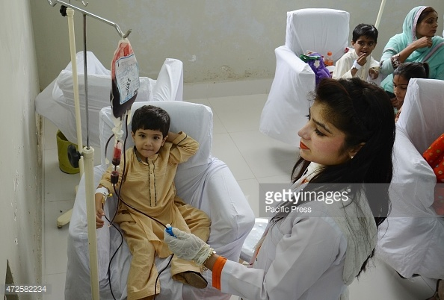
RESOLVE OF THE MINORS IN THE INHERITED BLOOD DISORDERS
Dr.Ayesha Junaid
MBBS,MCPS,FCPS.
Professor of Pathology
National Hemovigilance Coordinator
Supervisor & Program Director Haematology CPSP
Incharge Blood transfusion services
Shifa International hospital-Islamabad

Slide 2

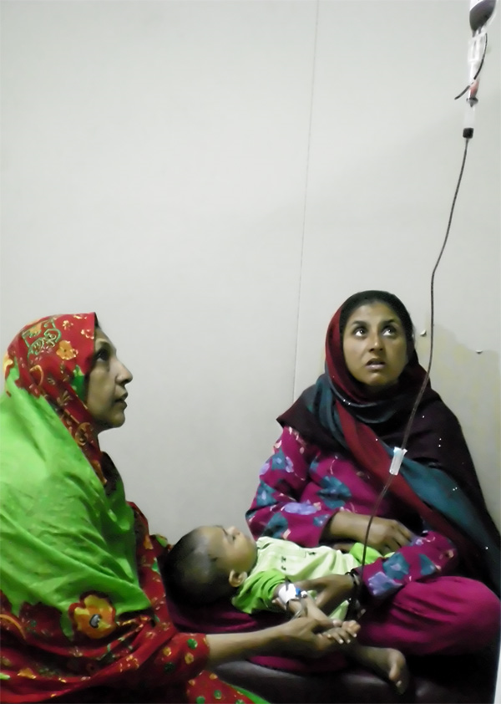
My Talk Today:
The reason
The disease & care givers
Present situation
Two good organizations
Future challenges & goals
Your suggestions & advice

Slide 3

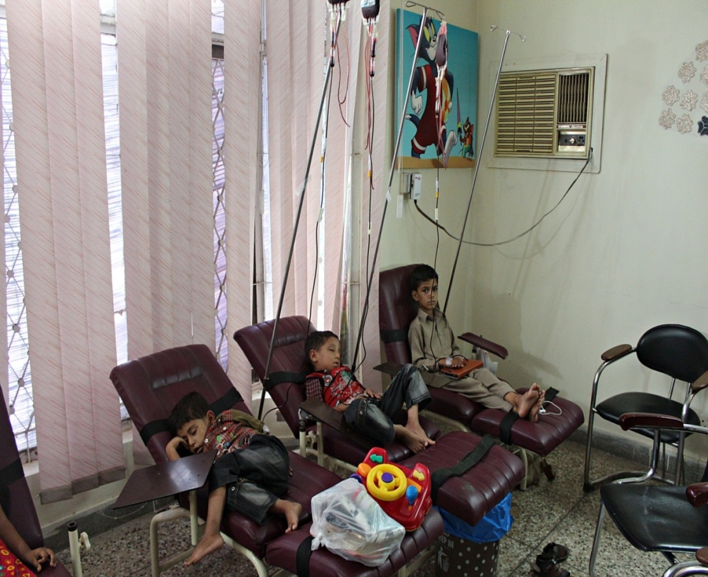
Blood disorders: Thalassemia
& Hemophilia
Genetically transmitted, life time crippling disorders
Require frequent repeated transfusions & exhibit risks of repeated transfusions
Disabilities due to complications of disease & lead to premature deaths

Slide 4
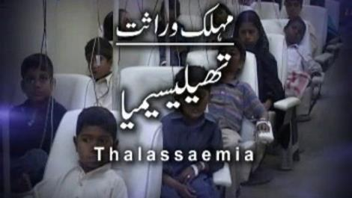
Blood disorders: Thalassemia
& Hemophilia
Thalassemias :
Among the commonest autosomal recessive disorders worldwide
The most common hereditary disorder in Pakistan
Over 5000 homozygotes born each year
Estimated carrier status is around 7%
Molecular epidemiology of β-thalassemia in Pakistan: Far reaching implications-Indian J Hum Genet. 2012 May Aug; 18(2): 193–197.
Research gate:https://www.researchgate.net/publication/267779210)

Slide 5
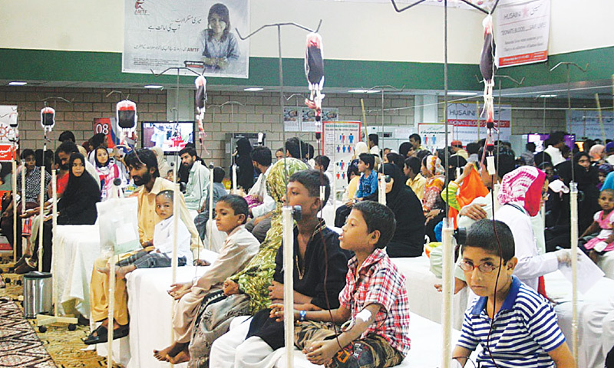
Blood disorders: Thalassemia
& Hemophilia
Up to 70% of all blood collection in Pakistan is given to thalassemic children.
About 1 in 10 of all childhood deaths in Pakistan are due to thalassemia.
Approximately nine million carriers of beta-thalassemia

Slide 6
Blood disorders: Thalassemia
& Hemophilia
Up to 80 % of adult thalassemia patients are infected with
HCV in the world
Although the incidence of HCV infection has decreased in developed countries, it remains high in developing countries.
Up to alarming 41% in a recent study on 200 patients
Management of HCV infection in thalassemia is complicated by severe anemia limiting the use of ribavirin and co-existing iron overload
Angelucci E. Antibodies to hepatitis C virus in thalassemia. Haematologica.1994;79(4):353–5.
Prevalence of HCV in β thalassemia major patients visiting tertiary care hospitals in
Lahore Pakistan Advancement in life sciences Vol1, Issue 4 8/5/2014

Slide 7
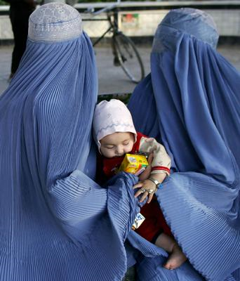
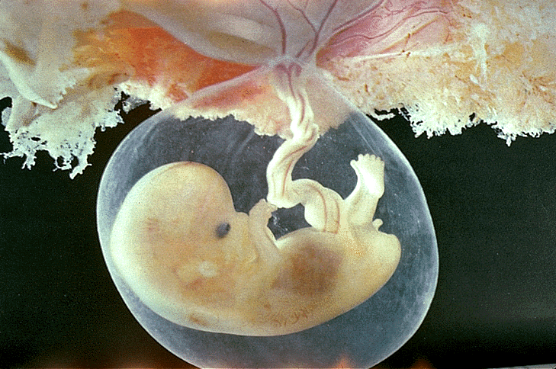
Blood disorders: Thalassemia
& Hemophilia
Thalassemia Management
PRENATAL DIAGNOSIS
Technical expertise
Social issues
Religious issues
Expensive

Slide 8
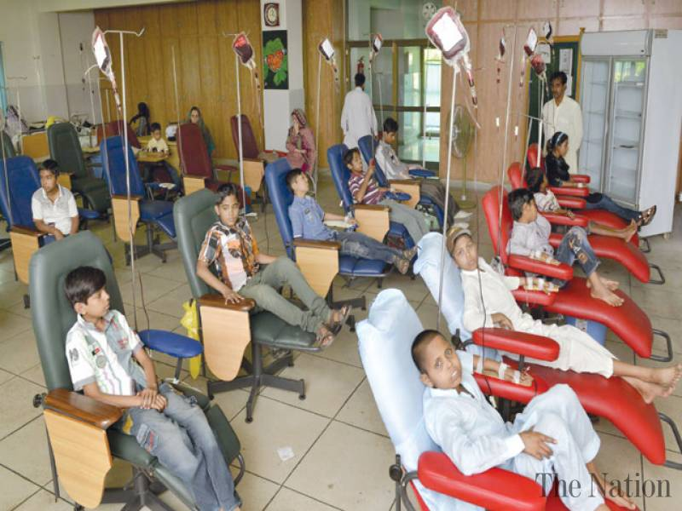
Blood disorders: Thalassemia
& Hemophilia
Thalassemia Management:
Non availability of a standard approach
to diagnose and provide care
Lack of system to monitor the affected
children for bloodborne pathogens
Weak /absent networking of specialized
health-care centers to promote the
management and prevention of complications

Slide 9
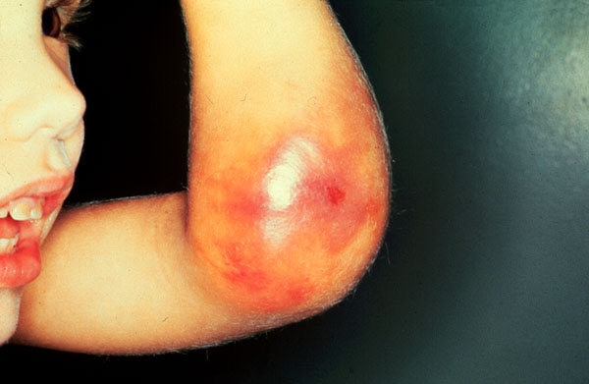
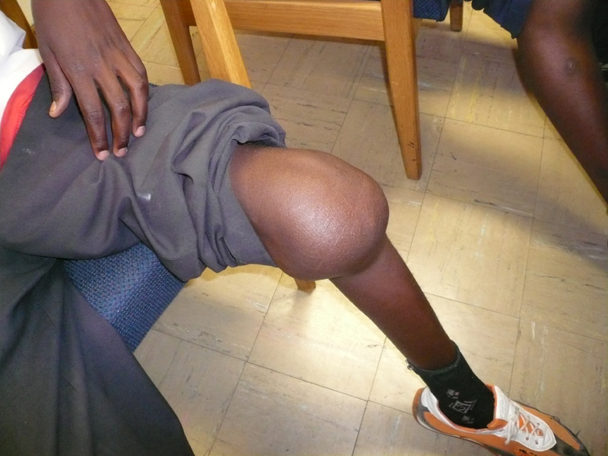
Blood disorders: Thalassemia
& Hemophilia
Hemophilia:
Rare bleeding disorder with global prevalence of 1:10,000
Pakistan has the the second highest number of global patients with hemophilia A.
Patients with severe hemophilia A constitute nearly 70% of patients with bleeding disorders

Slide 10
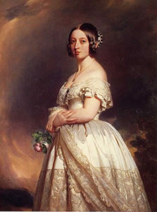
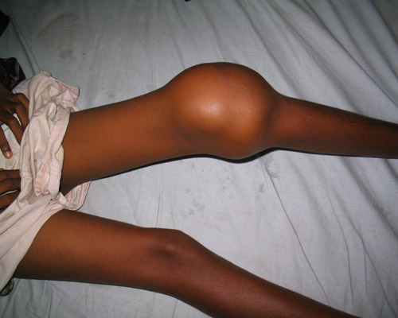
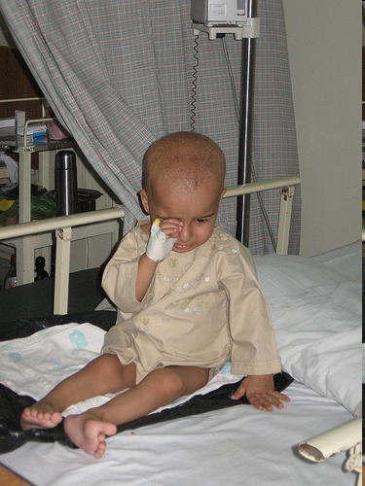
Blood disorders: Thalassemia
& Hemophilia
Hemophilia
In Pakistan, there are 18,000 patients
with hemophilia by statistical projection
Registration of patients to various treatment
facilities of hemophilia care is less than10%

Slide 11
Blood disorders: Thalassemia
& Hemophilia
Joint damage: Primary prophylaxis
regular factor instead of episodic
factor replacement at the time of bleed
Alloantibodies: Immune tolerance regimens
Hepatitis B vaccination?
Routine screening for HIV?
Training and competency development of health
professionals
Psychosocial support & Rehabilitation
Hemophilia Management

Slide 12
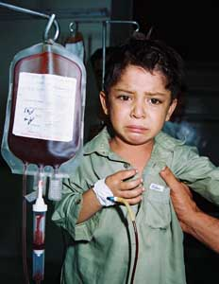
Blood disorders: Thalassemia
& Hemophilia
Comprehensive Management Programs
Carrier detections
Molecular diagnostics
Genetic counseling
Prenatal diagnosis
Multidisciplinary interventions
Health education
Social support
Well coordinated referral systems

Slide 13
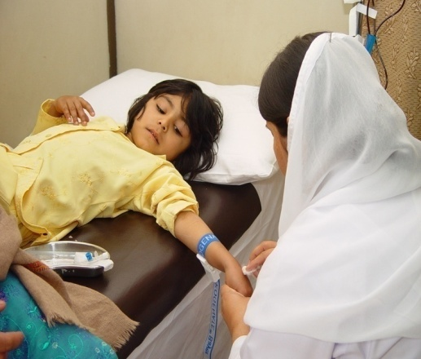
Blood disorders: Thalassemia
& Hemophilia
Management of inherited
bleeding disorders:
Managing these disorders put unbearable burden on families, as beside caring for chronically sick children spending 20-30 % of their meager income, they suffer from emotional & psychological stress
Health Economics Research Group, Brunel University, Uxbridge, UK,(Ostrowsky JT, Lippman A, Scriver CR. Cost-benefit analysis of thalassemia disease Prevention Program.
(Am J Public Health 1985 July;75(7): 732-736)

Slide 14
Blood disorders: Thalassemia
& Hemophilia
Pakistan Health Services:
Two types of services are available
Provision of therapeutic & preventive services
Public Sectors & NGO
No effective eradication plans
No National Policy

Slide 15
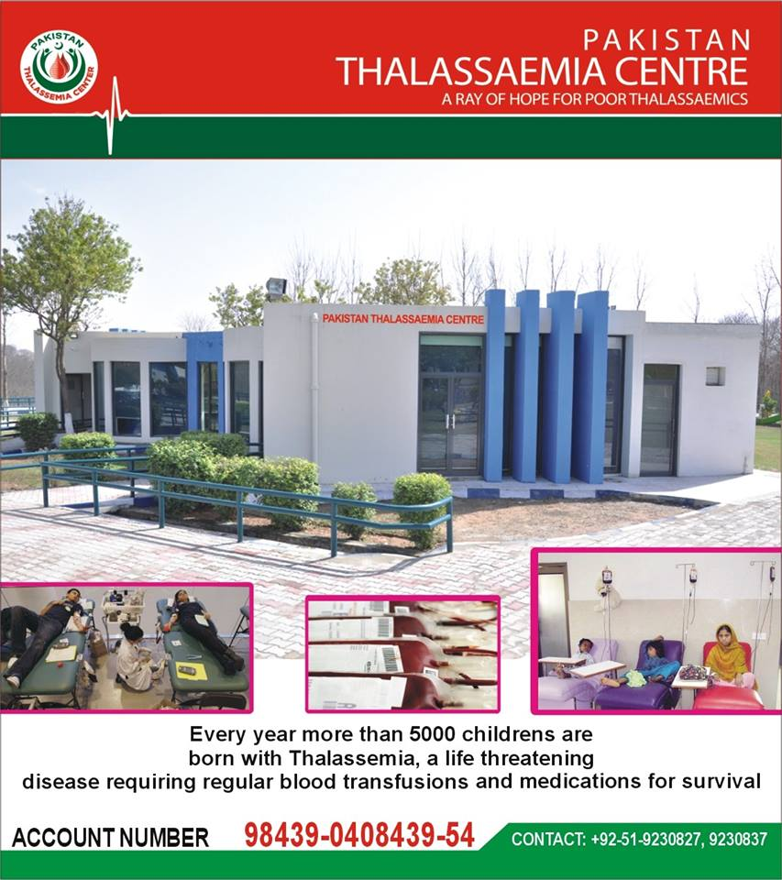
Blood disorders: Thalassemia
& Hemophilia
Public sector
Big Pediatric units, diagnostic laboratories, transfusion network, consultants, trained staff, own buildings
Major weaknesses
Lack of/multiple registrations for continuous management
Lack of referral liaison among various disciplines
Almost non-existing social services

Slide 16
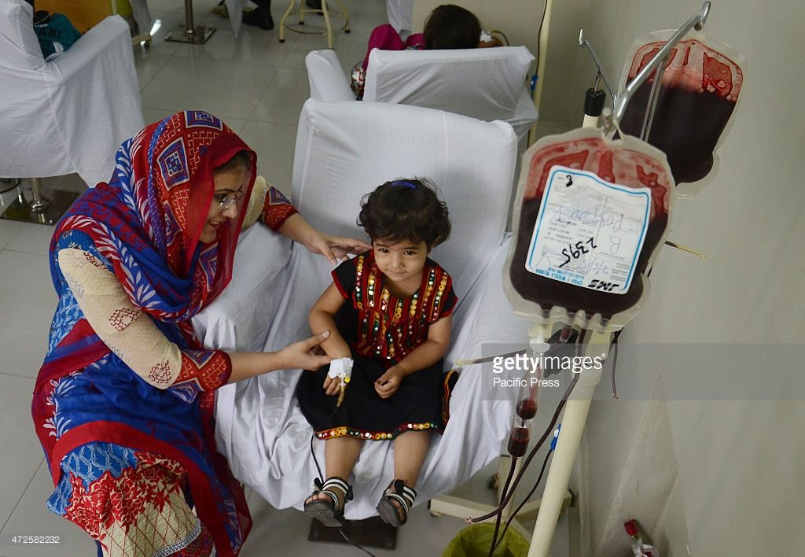
Blood disorders:Thalassemia
& Hemophilia
NGO’s
90.0% registration for both disorders, doing continuous management.
Have good screening facilities & good transfusion facilities
Full strength staff, functional equipment, but in rented buildings
Lack of physical infrastructure at provincial level
There is no clear policy of the government for
working relation and coordination with NGOs,
World Bank. Pakistan Towards a Health Sector Strategy 1998 health, Nutrition and Population Unit South Asia Region World Bank. 50-52)

Slide 17
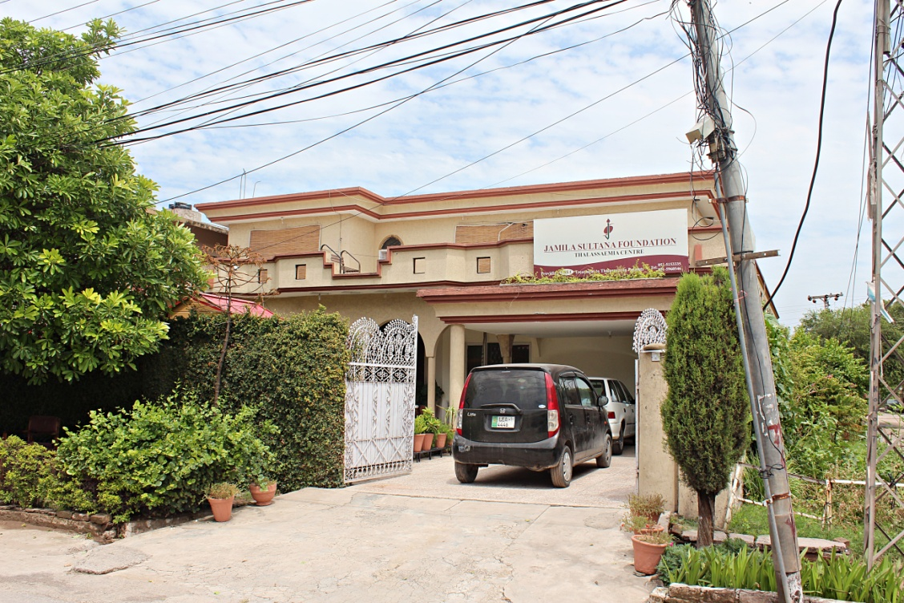
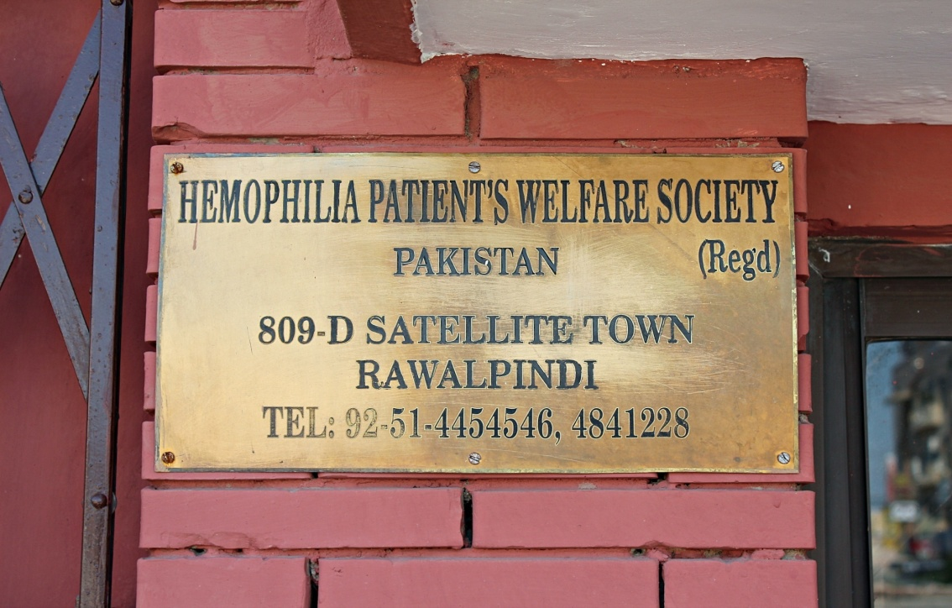
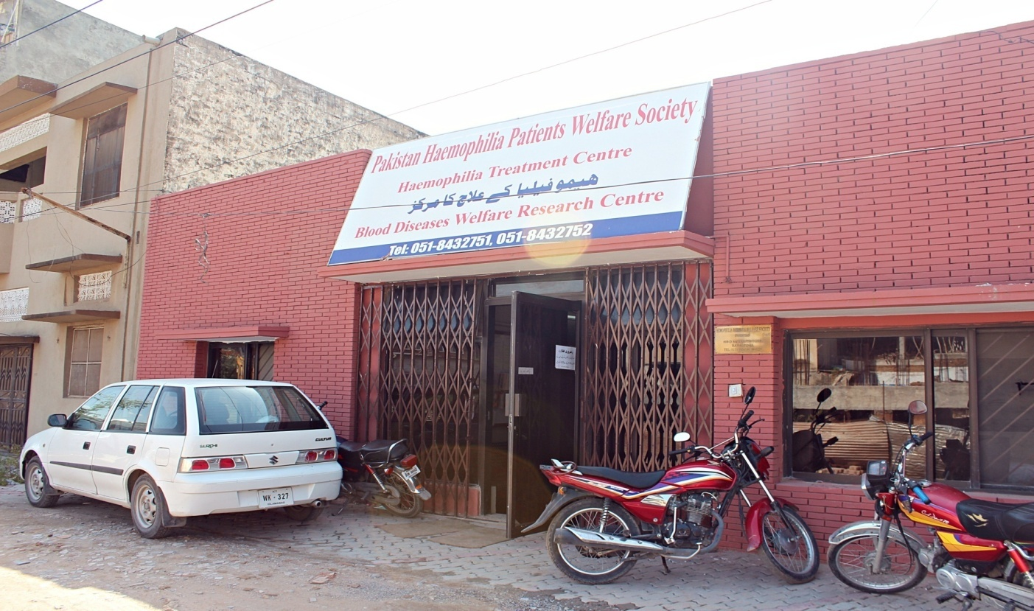
Blood disorders: Thalassemia
& Hemophilia

Slide 18

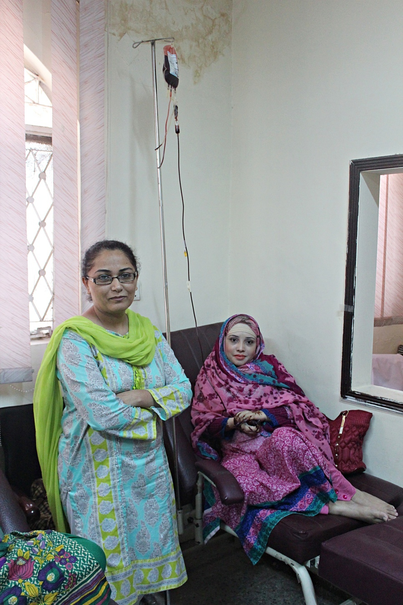
Blood disorders: Thalassemia
& Hemophilia
JSF was established in 2004
It is providing FREE treatment
to children suffering from Thalassaemia.
JSF has 611 registered patients
On average daily transfusion15 - 20/day.
Provides thalassemia screening, Prenatal
diagnosis & psychological support
Oldest registered patient is 38 years

Slide 19
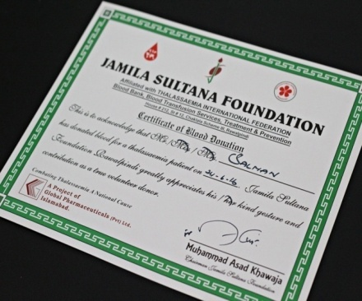
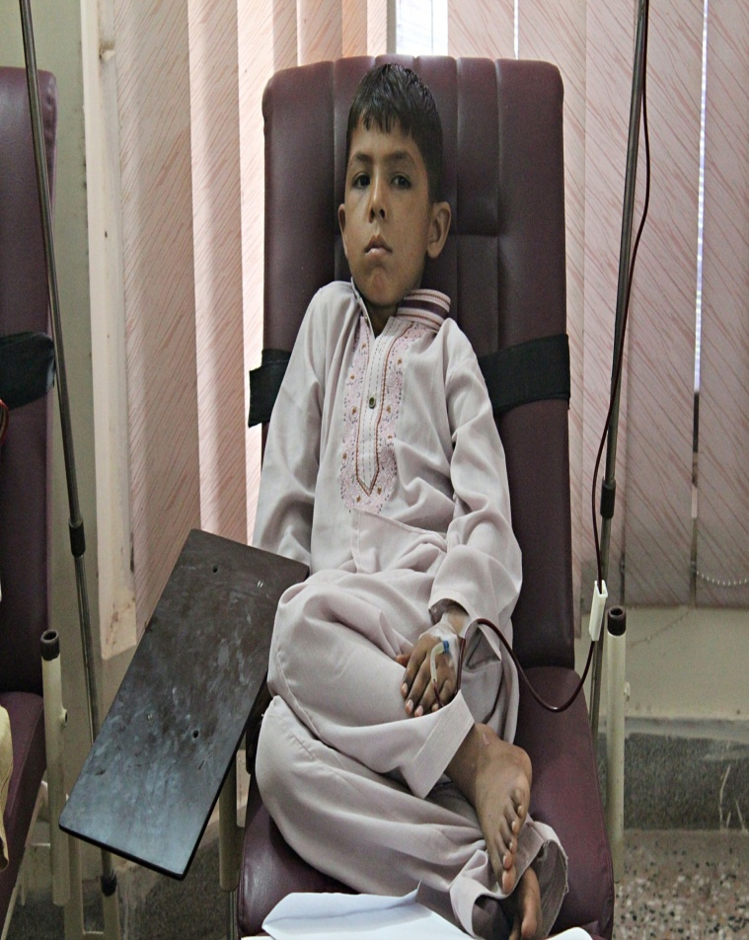
Blood disorders: Thalassemia
& Hemophilia
2015
100% voluntary donors
Blood Collection 3092
Blood Transfusion 3385
CVS Testing 10
Desferal Injections 48165
Ferinil Tablets 1074

Slide 20
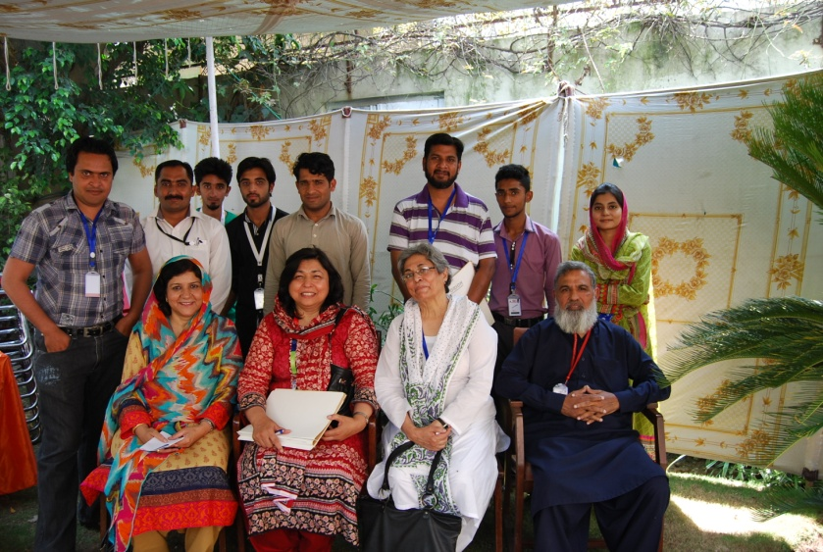
Blood disorders: Thalassemia
& Hemophilia
Pakistan Haemophilia Patients Welfare Society
(PHPWS Rwp/Isb)
was founded in 1999.
Collective efforts of a group of
Professionals & Haemophilia patients
808 registered patients.
Part of WFH, collaborates with
Blood disease & Welfare Centre
Provides treatment & education
regarding disease transmission

Slide 21
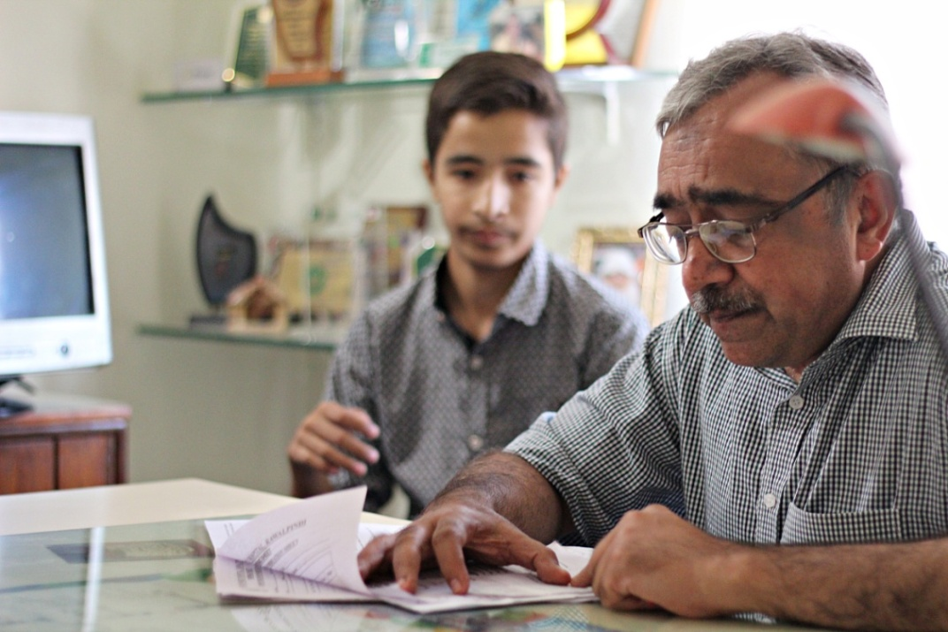
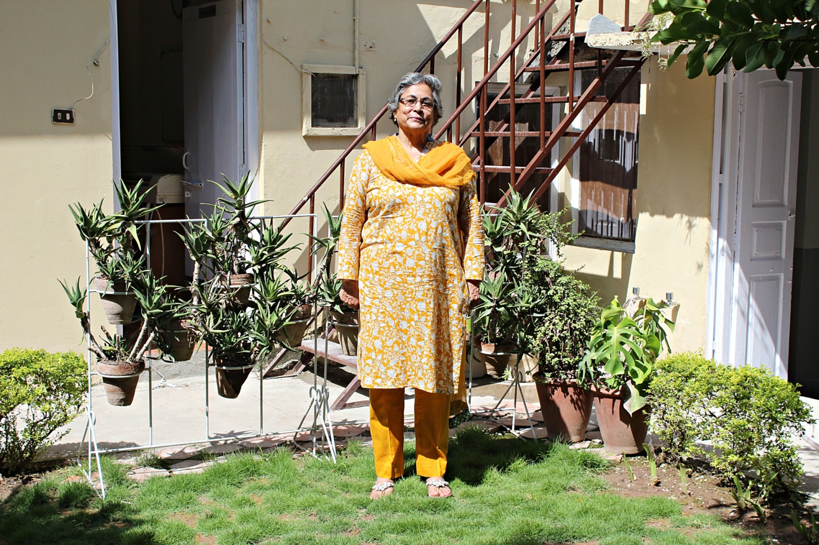
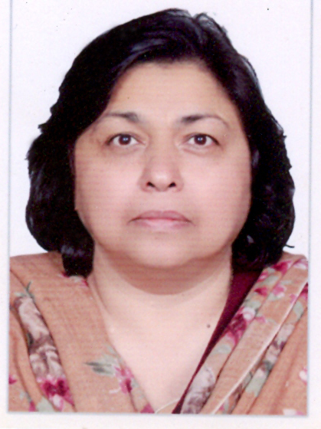
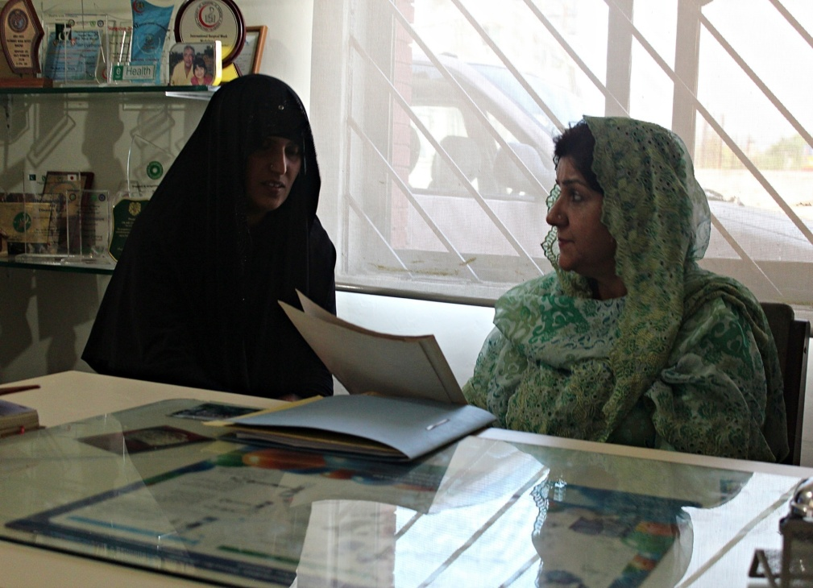
Blood disorders: Thalassemia
& Hemophilia

Slide 22
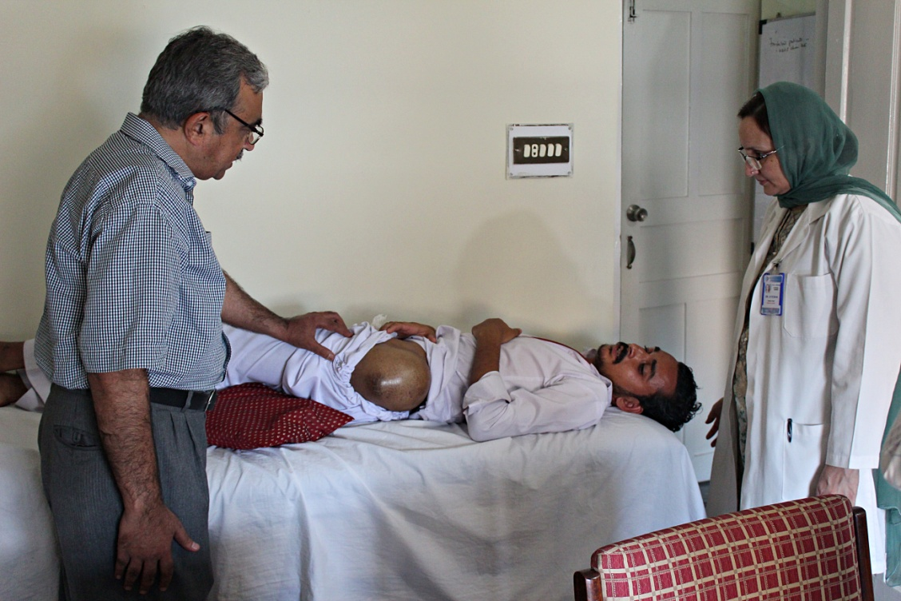
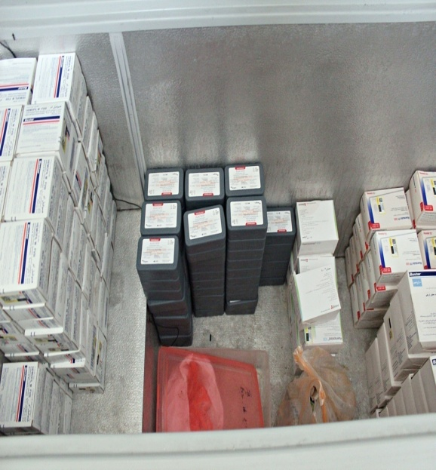
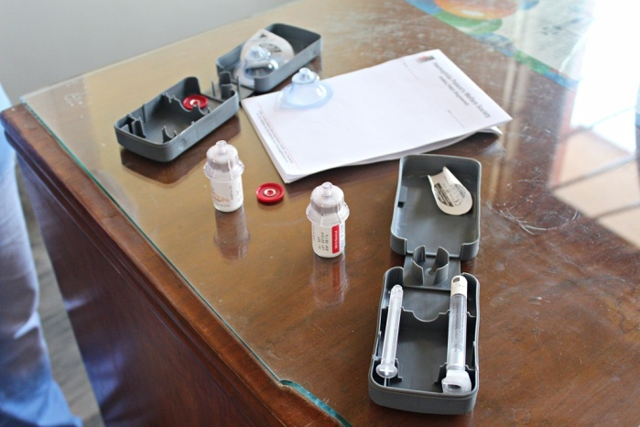
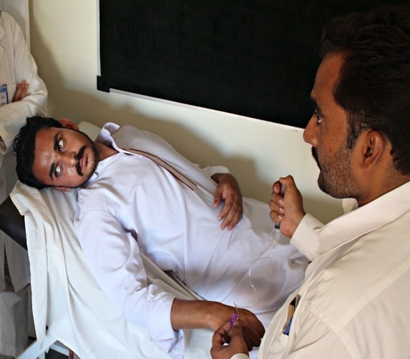
Blood disorders: Thalassemia
& Hemophilia
Factor Concentrates
Provision
Safe storage
Emergency Service
Factor concentrate
cover during surgical
Procedures
Successful obstetric cover
for VWD & Platelet disorders

Slide 23


Slide 24
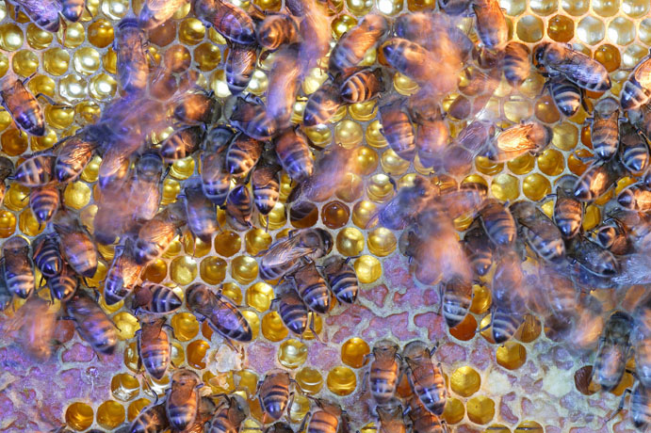
Blood disorders: Thalassemia
& Hemophilia
The Way Forward
Define our goals
JOINT EFFORT
Planned
Consistent
Honest
Comprehensive

Slide 25

Blood disorders: Thalassemia
& Hemophilia
Way forward:
Urgent & effective Partnership between NGOs and public sector to deliver the diagnostic and therapeutic services.
Assigning & Monitoring the specific roles to each delivering segment

Slide 26
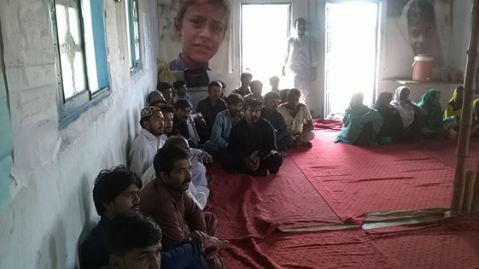
Blood disorders: Thalassemia
& Hemophilia
Biggest Challenge:
Creating awareness
Prevention Plans
Educating masses with regard to
transmission of these disorders
Carrier Counseling & Screening
TTI

Slide 27
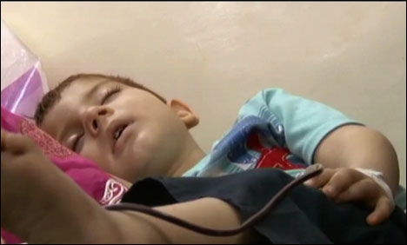
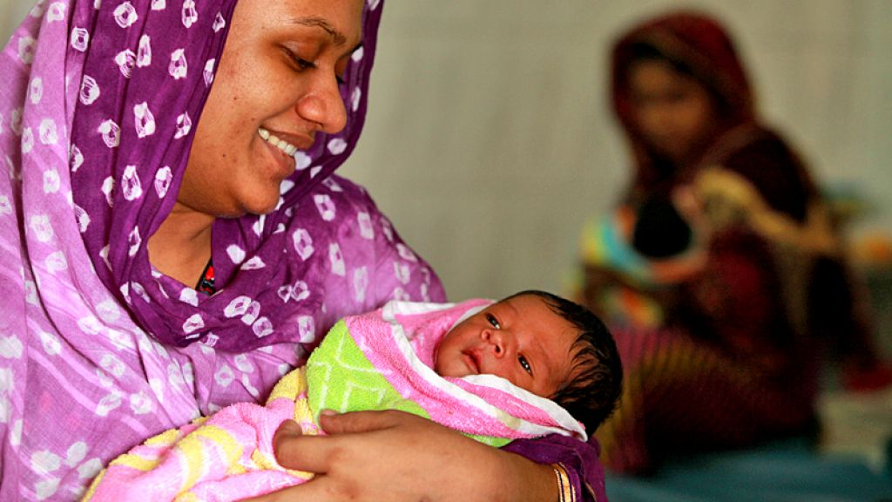
Blood disorders: Thalassemia
& Hemophilia
Way forward
Training and competency development of health service staff
Prompt referral services on both sides
Strengthening the social and the financial aspects of the services.

Slide 28
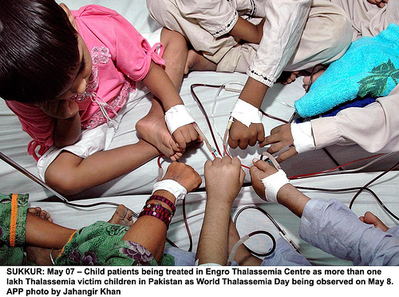

Thalassemia & Hemophilia
Great things are not
done by impulse, but
series of small things
brought together

Slide 29


POLYCYTHEMIA RUBRA VERA
Thank you
TREATMENT
Therapeutic phlebotomy
Hydroxyurea
Without treatment, death may result
from
bleeding or thrombosis

