Slide 1


Slide 2


Slide 3


Slide 4
PHYSICAL ACTIVITY AWARENESS and CHANGES DURING PREGNANCY
Aybuke ERSIN, PT, MSc
Lecturer in Istanbul Medipol University

Slide 5
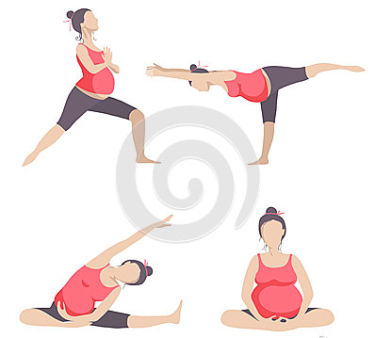
INTRODUCTION
Physical activity during pregnancy is important for the health of the mother and child and may reduce the risk of adverse maternal, fetal, and neonatal outcomes.

Slide 6
Exercise provides mainly;
Stronger upper extremity and pelvic floor muscles,
Body weight control,
Avoid gestational diabetes mellitus,
Easier labour.

Slide 7
American College of Obstetricians and Gynecologists recommended;
30 minutes of moderate activity,
8,000 steps/day,
approximately 7.5 metabolic equivalent (MET) hr/wk activity
BENEFICAL FOR PREGNANT WOMEN

Slide 8
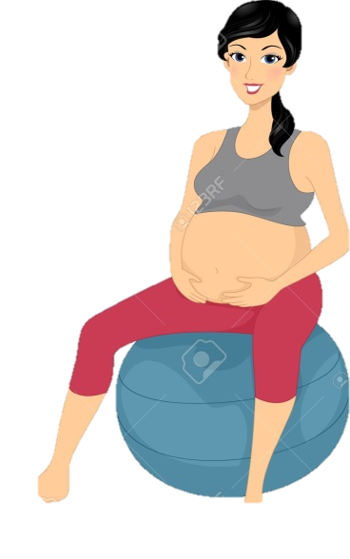
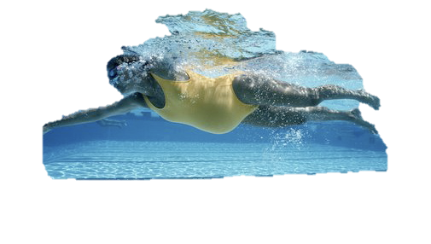


Slide 9
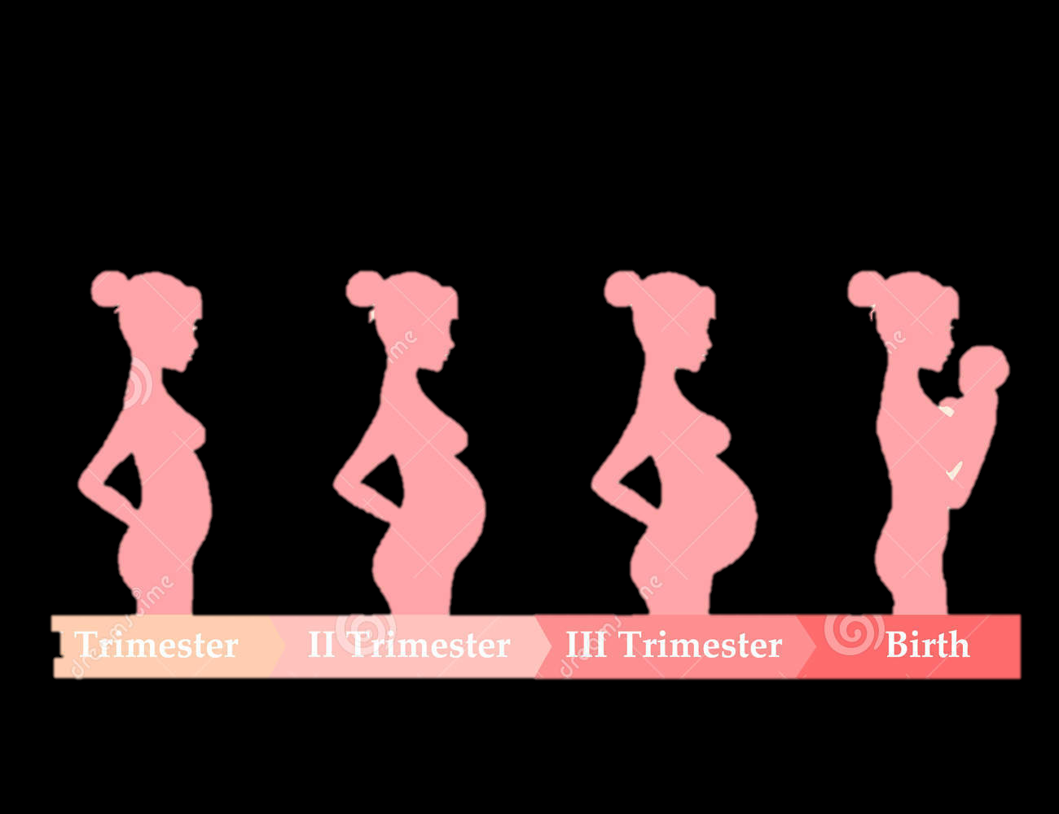
The aim of this study was to investigate changes in physical activity level during period of gestation and relationship between physical activity awareness and doing exercise.

Slide 10
METHOD
130 pregnant women,
  the average age of participants was determined as 27.99 ± 5.21 years,
  the average weeks of gestation was 30.36 ± 5.33 weeks.

Slide 11
METHOD-II
Pregnant women information form was filled to inquire about the sociodemographic characteristics;
To determine their level of physical activity, Pregnancy Physical Activity Questionnaire (PPAQ) was used.

Slide 12
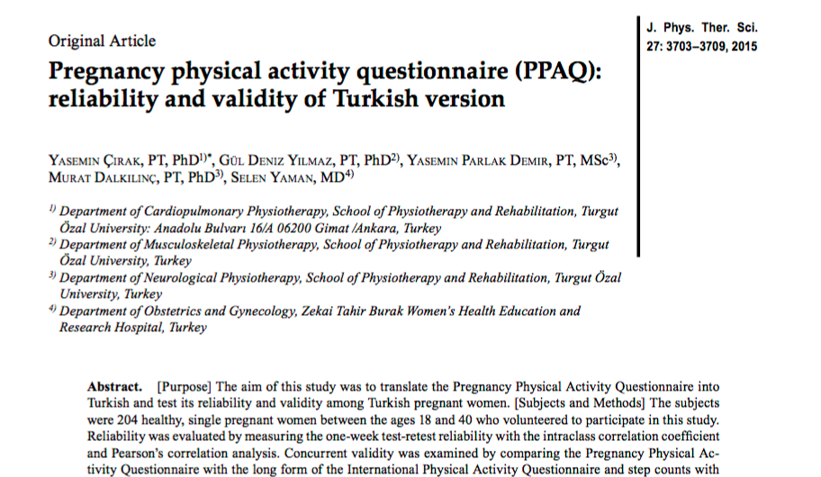

Slide 13
RESULTS-I
No relationship was found between physical activity level and weeks of gestation (r = - 0.06, p> 0.05).

Slide 14
RESULTS-III
The correlation was found between doing exercise during pregnancy with who thought that physical activity is benefical at pregnancy (r =0.210, p= 0.008)

Slide 15
RESULTS-IV
Doing exercise during pregnancy and pre-gravid period had correlation
(r= 0,199 , p = 0.01)

Slide 16
DISCUSSION
Pregnant women, who think exercise is effective, do exercise during their pregnancy. Women who do exercise before pregnancy also do exercise at their pregnancy.

Slide 17
DISCUSSION
It is very important for the mother and baby to do physical activity before and during pregnancy time.

Slide 18
DISCUSSION
Physical activity awareness should be increased in both pregnant or women thinking of pregnancy.

