Slide 1
Management & Treatment of PCOS Patients Undergoing ART
dR. awatif albahar
Dubai health authority
United arab emirates

Slide 2
Epidemiology
PCOS affects 5% to 10% of women of reproductive age - 4 million individuals.
  It’s prevalence among infertile women is 15% to 20%.
Most common endocrine disorder of women within this age group.
Observed within the student health population & general medical practice, though most often when a woman presents with infertility.

Slide 3
Epidemiology Continued…
PCOS
  95% of all cases of hyperandrogenism
  20% of all cases of amenorrhea
  75% of all cases of anovulatory infertility

Slide 4
Economic Cost to Health Care
According to the Health Care-Related Economic Burden of the Polycystic Ovary Syndrome, they stated,
  “We estimated the mean annual cost of the initial evaluation to be $93 million, that of hormonally treating menstrual dysfunction/abnormal uterine bleeding to be $1.35 billion, that of providing infertility care to be $533 million, that of PCOS-associated diabetes to be $1.77 billion, and that of treating hirsutism to be $622 million.”

Slide 5
Treatment Recommended
Induction of Ovulation
  Clomid
  Recombinant FSH
  Metformin
  Invitro Fertilization

Slide 6
Clomiphene (Simulate Ovulation)
n = 5268
Ovulation – 3858 (73%)
Pregnancies – 1909 (36%)
Miscarriage – 20%
Multiple Pregnancy Rate – 8%
Homburg, Hum Reprod, 2005

Slide 7
Should we monitor Clomiphene cycles with ultrasound?
 | With U/S + hCG | No U/S or hCG
n | 105 | 150
Cumulative Pregnancy Rate | 48% | 34.7%
Deliveries | 35.6% | 26.7%
Multiple Pregnancies | 0 | 1

Slide 8
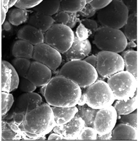
Anti-Estrogen Effect on Endometrium
Endometrial thinning in 15-50%
Causes ER down regulation and depletion
Suppresses pinopode formation
Less pregnancies when endometrial thickness at midcycle < 7mm
Not dose related and recurs in repeat cycles

Slide 9
Aromatase Inhibitors
Letrozole
Advantages:
  Do not block estrogen receptors
    No detrimental effect on endometrium or cervical mucus.
    Negative feedback mechanism not turned off – less chance of multiple follicular development.

Slide 10
Letrozole vs. Clomiphene
Legro et al, NEJM 2014
N = 750 PCOS, RCT
 | Letrozole | CC | P
Ovulation | 61.4% | 48.3% | 0.001
Pregnancy Loss | 31.8% | 28.2% | NS
Twins | 3.2% | 7.4% | NS
Live Births | 27.5% | 19.5% | 0.007

Slide 11
Insulin-Sensitizing Drugs for Women with PCOS, Oligo/Amenorrhea & Subfertility
Tang et al. Cochrane Database, 2009
There is no evidence that metformin improves live birth rates whether it is used alone or in combination with clomiphene.
Therefore, the use of metformin is improving reproductive outcomes in women with PCOS appears to be limited.

Slide 12
Metformin
Useful but not recommended for ovulation induction.
Less multiple pregnancies than CC.
May be useful for CC resistance.

Slide 13
Metformin in IVF
Short term co-treatment with metformin for PCOS in IVF/ICSI:
  Does not improve response to stimulation
  Improves pregnancy rates
  Reduces the risk of OHSS
No difference:
  Total dose FSH
  No. of oocytes
  Fertilization rates

Slide 14
Gonadotropin Treatment:
Why is PCOS Different?
Greater sensitivity to gonadotropin stimulation, therefore, multiple (“explosive”) follicular development.

Slide 15
Incremental Dose Rise
50 IU starting dose; increments of 25 or 50 IU
n=158
Start
day 3 of
menses
150 IU daily
125 IU daily
100 IU daily
7 days
50 IU daily
75 IU daily
7 days
7 days
7 days
7 days
1
8
15
22
29
35
250 IU daily
200 IU daily
150 IU daily
7 days
100 IU daily
7 days
50 IU daily
7 days
7 days
7 days
1
8
15
22
29
36
Days of treatment
FSH increments: Only allowed when no follicle ≥12 mm
hCG: 1 follicle ≥18 mm
Cancellation: ≥3 follicles ≥15 mm
Leader et al, 2006

Slide 16
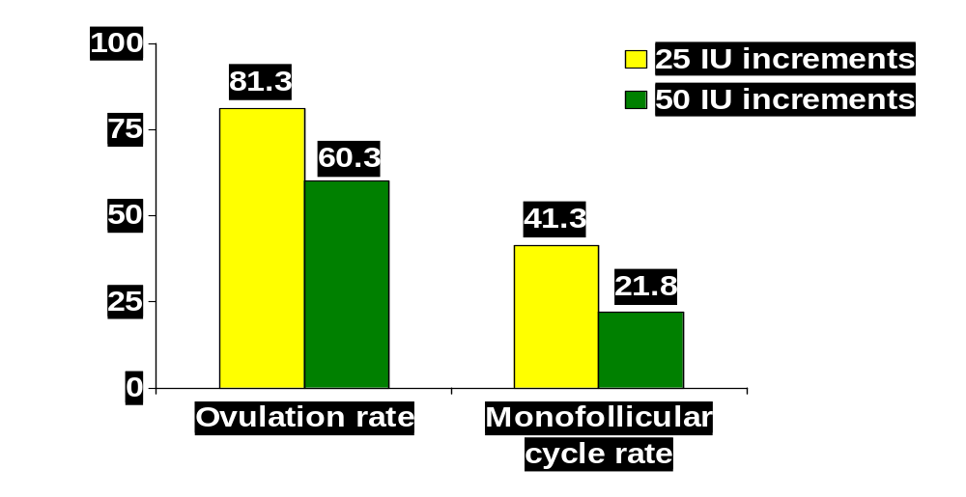
P=0.009
P=0.009
Higher cancellation rate with 50 IU increments
Duration and Pregnancy rate – same
Leader et al, 2006

Slide 17
Low dose rec-FSH
100-150 IU
75-112.5 IU
50-75 IU
14
7
7
Days

Slide 18
Only Minimal Dose
Increment Needed
Incremental dose rise of 8.3 IU each week
N=25, PCOS, CC failures, 69 cycles
64.6 IU
58.3 IU
50 IU
7 14 21
Days
Orvieto & Homburg, 2008

Slide 19
Low-Dose Gonadotropins:
Summary of Results
Patients – 1040, Cycles 2472
Pregnancies | 411 (40%)
Fecundity/ovarian cycle | 23%
Uniovulation | 71%
OHSS | 0.14%
Multiple Pregnancies | 5.1%
Updated from Homburg & Howles, 1999

Slide 20
Conventional Regimen With Gonadotropins
75
75
75
5
5
5
5
Days

Slide 21
Results of Conventional Therapy:
14 Series, 1966-1984, WHO I &II
Conceived | 46% (16-78)
Multiple Pregnancies | 34% (22-50)
Miscarriages | 23% (12-30)
Severe OHSS | 4.6% (1.3-9.4)
Updated from Homburg & Howles, 1999

Slide 22
How Long Does It Take?
With a starting dose of 75 IU FSH, unchanged for a minimum of 14 days
  90% will get to the criteria for hCG

Slide 23
PCOS – Why Antagonist?
Shorter duration of stimulation with GnRH antagonist
Gonadotropin requirements are decreased compared to GnRH agonists
OHSS incidence decreased
Allows the use of an agonist trigger

Slide 24
High Responders
(AMH > 20 pmol/L)
Treatment strategy:
  Control GnRH antagonist – starting day S4 (3)
  Daily FSH dose = 150 IU hMG (obese = 225)

Slide 25
0.25mg/day antagonist
FSH
Day 5 , 6 or 7 antagonist start
hCG
0.25mg/day antagonist
FSH
GnRH agonist
FSH
hcg

Slide 26
0.25mg/day antagonist
FSH
Day 5 start FIXED
GnRH agonist
Luteal phase support possibilities:
1. Massive doses Progesterone (i/m 50mg/day) +E2
2. 1500 IU hCG on day OPU (Humaidan 2009)
3. Freeze all embryos and transfer in natural cycle
FSH
hcg

Slide 27
0.25mg/day antagonist
FSH
Day 5 start FIXED
GnRH agonist
Luteal phase support:
1500 IU hCG on day OPU
No significant difference in outcome compared with hCG trigger
FSH
hcg

Slide 28
Iliodromiti et al, Human Reproduction, 28 : 2529-36, 2013
N=275 at high risk of OHSS
  Agonist trigger + hCG 1500 IU on day of OPU
  Vaginal progesterone + E2 valerate b.d.
  Clinical pregnancy rate = 41.8%
  Severe OHSS – 2 cases (0.72%)

Slide 29
Overcoming the Problems for PCOS in IVF
Avoid OHSS!
Diagnosis and mild stimulation
Oral contraceptive pre-treatment
Antagonist
GnRH agonist to trigger ovulation
Medication – Metformin
Freeze embryos

Slide 30
Best Advice
If > 25 follicles > 11mm
Freeze all embryos! Replace a natural cycle.

Slide 31
Thank You !!!
                - Dr. Awatif

Slide 32
References
Azziz, R. et al., Health Care-Related Economic Burden of the Polycystic Ovary Syndrome during the Reproductive Life Span, J Clin Endocrinol Metab, August 2005, 90(8):4650–4658.
Badaway, A., Elnashar, A,. Treatment options for polycystic ovary syndrome, International Journal of Women’s Health 2011;3:25-35
Boomsma CM, Fauser BC, Macklon NS. Pregnancy complications in women with polycystic ovary syndrome, Semin Reprod Med 2008, 26 (1), 72–84.
Eid GM, Cottam DR, Velcu et al. Effective treatment of polycystic ovarian syndrome with Roux-en-Y gastric bypass. Surg. Obes. Relat. Dis. 1(2), 77-80 (2005).
Escobar-Morreale HF, Botella-Carretero JI, Alvarez-Blasco F, Sancho J, San Millan JL. The polycystic ovary syndrome association with morbid obesity may resolve after weight loss induced by bariatric surgery. J. Clin. Endocrinol. Metab. 90, 6364-6369 (2005).
Goldenberg N, Glueck C. Medical therapy in women with polycystic ovarian syndrome before and during pregnancy and lactation, Minerva Ginecol 2008, 60 (1), 63–75.

Slide 33
References continued
Norman RJ, Noakes M, Wu R, Davies MJ, Moran L, Wang XJ. Improving reproductive performance in overweight/obese women with effective weight management. Hum. Reprod. Update 10, 267-280 (2004).
Pasquali, R., Gambineri, A., Insulin-sensitizing agents in polycystic ovary syndrome, European Journal of Endocrinology June 1, 2006; 154:763-775.
Sjostrom L, Narbro K, Sjostrom CD et al. Effects of bariatric surgery on mortality in Swedish obese subjects. N. Engl. J. Med. 357, 741-52 (2007).
Teede, Helena j. et al., Assessment and management of polycystic ovary syndrome: summary of an evidence-based guideline, Med J Aust 2011; 195 (6): S65-S112.
Trolle B, Flyvbjerg A, Kesmodel U, Lauszus FF. Efficacy of metformin in obese and non-obese women with polycystic ovary syndrome: a randomized, double-blinded, placebo-controlled, cross-over trial. Hum. Reprod. 22(11), 2967-2973 (2007).
Vigil P, Contreras P, Alvarado JL, Godoy A, Salgado A, Cortes ME. Evidence of subpopulations with different levels of insulin resistance in women with polycystic ovary syndrome. Hum. Reprod. 22(11), 2974-2980 (2007).
Vryonidou A, Papatheodorou A, Tauridou A et al. Association of hyperandrogenism and metabolic phenotype with carotid intima-media thickness in young women with polycystic ovary syndrome. J. Clin. Endocrinol. Metab. 90, 2740-2746 (2005).

Slide 34
Books on the PCOS
Androgen Excess Disorders in Women:PCOS and Other Disorders, by Azziz,Nestler, Dewailly, Humana Press, 2006
PCOS, by Balen,Conway,Homburg,Lego, Taylor & Francis Publishers, 2005
PCOS, by Chang,Heindel, Dunaif, Marcel Dekker, Inc. 2002
PCOS, by Roy Homburg, Martin Dunitz, 2001
PCOS, by Gabor T.Kovac, Cambridge University Press, 2000
PCOS the Hidden Epidemic,by S. Thatcher, Perspectives Press, 2000

Slide 35
Patient Support Groups
PCOSA-Polycystic Ovarian Syndrome Association, Inc.(Patient Support Group)
  Telephone: 877-775-PCOS
  Mail: P.O.Box 7007, Rosemont, Il 60018
  Email:info@pcosupport.org
  Internet:www.pcosupport.org

