Slide 1
5th International Conference and Exhibition on Pharmaceutical Regulatory Affairs, August 03-05, 2015 Florida, USA
Prospects and Challenges of Providing Pharmacovigilance Services in Resource Limited Countries
Avong YK¹, Jatau B¹, Ekong E¹, Ndembi N¹, Okuma J¹, Obieze AI², Osakwe A², Akang G³, Agbaje A¹, Mensah C¹, Dakum P¹
1.Institute of Human Virology, Nigeria, Maina Court, Herbert Macaulay Way, Abuja, Nigeria
2. National Agency for Food and Drug Administration and Control (NAFDAC), Abuja
3. National Tuberculosis and Leprosy Control Program, Abuja, Nigeria

Slide 2
Introduction
Pharmacovigilance (PV) systems ensure the safety of medicine through efficient and timely collection, assessment, and communication of risks and benefits to support decision making at various levels of the healthcare system [1, 2, 3]
In Africa, pharmacovigilance is increasingly being recognized as countries have introduced pharmacovigilance systems in public health programs [1].
In this presentation, we shall highlight the prospects and challenges of PV in Africa, using the case of Nigeria

Slide 3
Methods
We reviewed current literature, policy documents and the Nigeria Pharmacovigilance Database.
We interviewed principal officers at the Nigeria National Pharmacovigilance Center, National Agency for Food and Drug Administration Control (NAFDAC)

Slide 4
The Prospects
According to many researchers [1, 2, 3, 4, 5, 6], the following factors promote the emergence of PV systems:
An administrative structure
A legal frame work, illustrated by a national policy
Tools for training and providing guidance and standards for PV systems

Slide 5
Prospects
Reporting of ADRs by health workers and consumers
A system for national tracking of ADRs
Collaboration with the World Health Organization
A robust pharmaceutical manufacturing sector
We observed an interplay of these factors in Nigeria

Slide 6
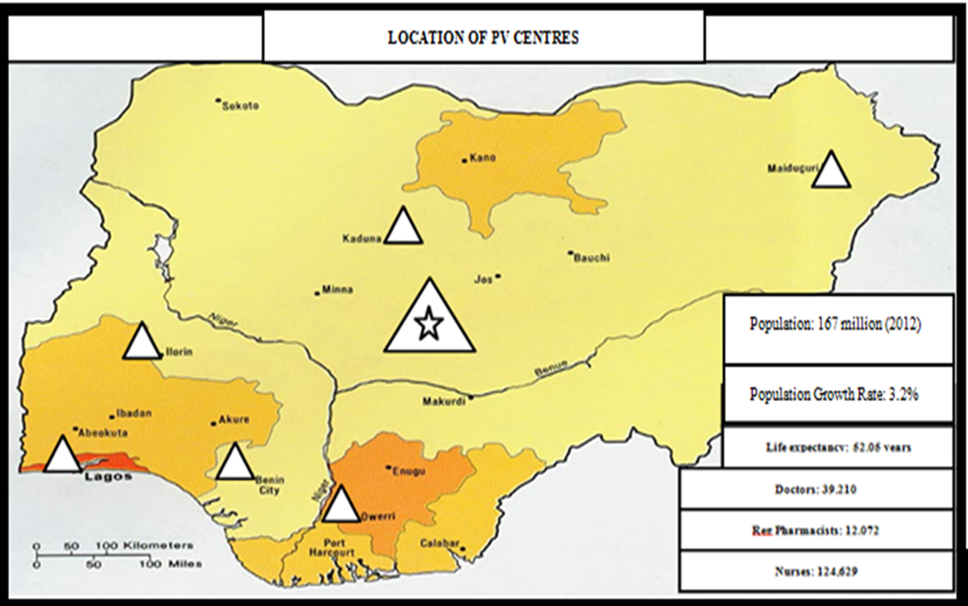
An administrative structure
Notes:
A strong PV system can only revolve on a strong administrative structure

Slide 7
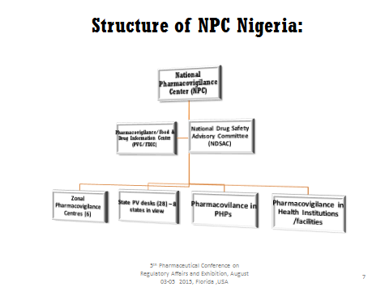
National PV Center
Notes:
The structure must be national in scope

Slide 8
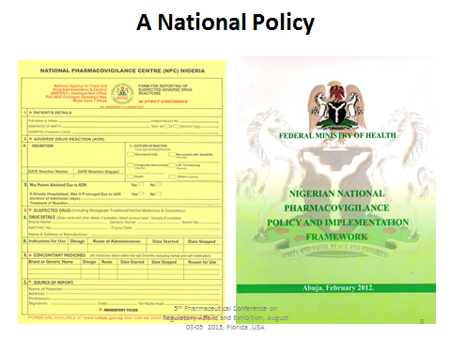
A legal frame work
Notes:
PV incorporates a lot of legal issues from compliance to GMP, post-marketing surveillance and rational use of medications. As such, a legal frame work is needed.

Slide 9
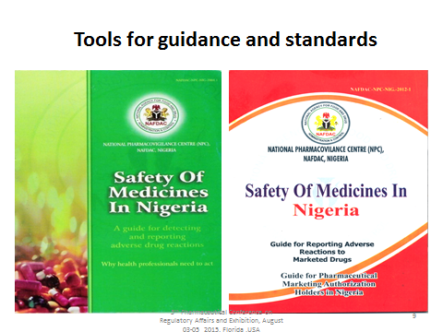
Tools
Notes:
Being an emerging field, PV demands training of health workers and standards for operation. These can only be achieved in the right tools are available.

Slide 10
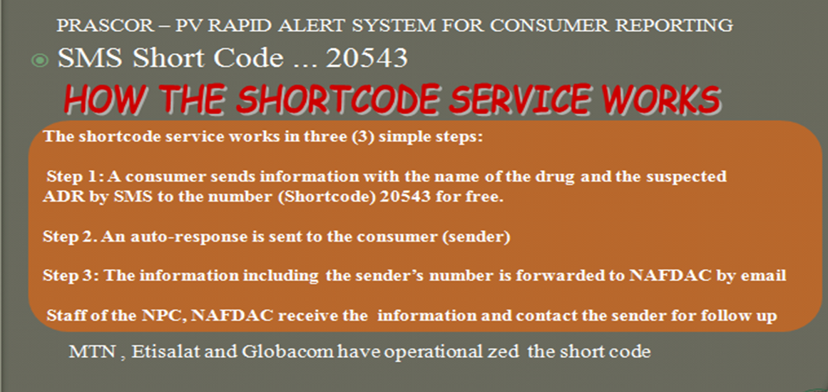
Reporting of ADRs
Notes:
Health workers and consumers are the primary sources of adverse drug reactions [2]

Slide 11
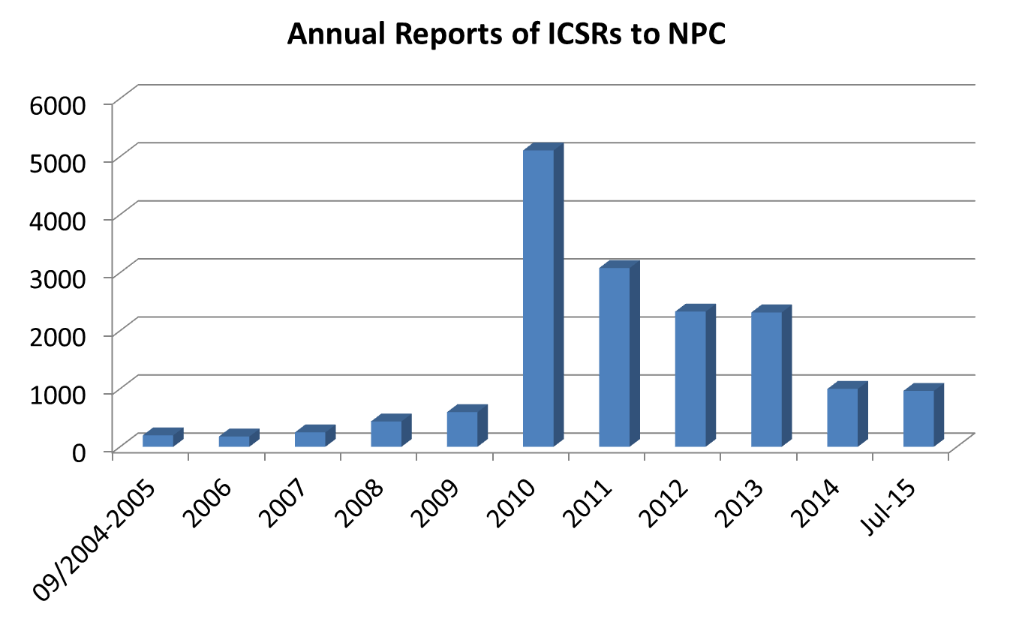
Tracking of ADRs

Slide 12
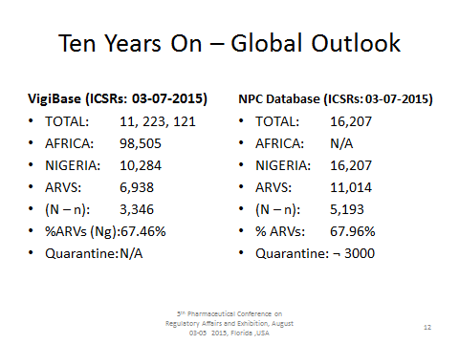
Collaboration with the WHO
Notes:
Source: NAFDAC

Slide 13
Robust pharmaceutical sector
Pharmaceutical companies complying with the WHO good manufacturing practice (GMP) manufacture safe and efficacious drugs.
Nigeria has joined the league of countries meeting the WHO GMP with at least 6 big pharmaceutical companies prequalified by the WHO in 2014
The NAFDAC central laboratory currently has an ISO/IEC 17025: 2005 certification status to support the pharmaceutical companies in drug stability tests
Notes:
The entire business of PV is based on the availability of medications. Pharma companies play a big role in this respect.

Slide 14
Global Challenges
According to Gerald [2], there are 5 major global challenges affecting the growth of PV in developed and developing nations:
Engaging the public
Collaboration and partnerships
Incorporating informatics
Adopting a global approach
Assessing the impact of efforts

Slide 15
Engaging the public
Patients and health care givers are the primary sources for ADRS reports [2]
Engaging health workers by way of training and incentives has been shown to improve the quantity and quality of ADRs reports [7, 8]
Lack of engagement leads to poor reporting and poor quality reports

Slide 16
Collaboration and partnerships
Pharmacovigilance has a broad scope; collaboration between pharmacovigilance systems and other public health agencies or pharmacovigilance centers is critically required [2]
The recent outbreak of methanol poisoning in Nigeria was quickly addressed through collaboration between the national pharmacovigilance center, the public health department and other government agencies

Slide 17
Incorporating informatics
Informatics can provide ADRs reports through data mining of large spontaneous-reporting databases [9]
Informatics can develop active surveillance systems, allow new sources of data to be used for identifying drug safety signals, and facilitate reporting of suspected adverse drug reactions [10,11]

Slide 18
Adopting a global approach
Pharmacovgilance is a global endeavor. As such:
Infrastructure and capacity for meaningful pharmacovigilance systems in the low- and middle income countries that do not yet have fully functional drug regulatory systems is needed
Harmonization of terms and standards is needed.

Slide 19
Assessing the impact of efforts
The impact of pharmacovigilance towards human health need to be systematically examined
Future development and growth of PV systems will rely on the impact that is recorded.

Slide 20
Conclusion
High prospects of PV in Africa
Challenges to be addressed:
Collaborative and global approach and engagement of patients and practitioners
Incorporate Informatics system
Strengthening pharmacovigilance systems
Assess the impact of PV systems.

Slide 21
Acknowledgement
Institute of Human Virology, Nigeria
National Pharmacovigilance Center, National Agency for Food and Drug Administration and Control
National Tuberculosis and Leprosy Control Program, Nigeria

Slide 22
References
1. Skalli S, H Sefiani, R Soulaymani, R Ouled Errkhis, R Benkirane. Current status of pharmacovigilance in Africa. 2nd International Conference on Prevention and Infection Control (ICPIC 2013) Geneva, Switzerland. 25-28 June 2013
2. Gerald JDP . Ongoing challenges in pharmacovigiance; Drug Saf (2014) 37:1–8 DOI 10.1007/s40264-013-0123-x
3. Hazel L and Shakir SAW. Under-reporting of adverse drug reactions: A systematic review. Drug Safety 2006; 29 (5): 385-396
4. Edwards I, Olssons. WHO Program-global monitoring. In. Mann RD, Andrews E. editors. Pharmacovigilance. Chichester: John Wiley and Sons, 2002: 169-82

Slide 23
References
5. Waller PC, Bahri. Regulatory pharmacovigilance in the EU. In. Mann RD, Andrews E, editors. Pharmacovigilance. Chichester: John Wiley and Sons, 2002: 183-94.
6. Griffin JP. Survey of spontaneous adverse drug reactions reporting schemes in fifteen different countries. British journal of Clinical Pharmacology 1986; 22: 83S-100S
7. Pedro´s C, Vallano A, Cereza G, Mendoza-Aran G, Agustı´ A,mAguilera C, Dane´s I,Vidal X, Arnau JM.An intervention to improve spontaneous adverse drug reaction reporting by hospital physicians: a time series analysis in Spain. Drug Saf. 2009;32:77–83
8. Osakwe, A.I.; Oreagba, I.; Adewunmi, A.J.; Adekoya, A.; Fajolu, I. (2013). Impact of training on Nigerian healthcare professional's knowledge and practice of Pharmacovigilance. International Journal of Risk Safe Medicine. 25(4):219-27

Slide 24
References
9. Bakare N, Edwards IR, Stergachis A, Pal S, Holmes CB, et al. (2011) Global Pharmacovigilance for Antiretroviral Drugs: Overcoming Contrasting Priorities. PLoS Med 8(7): e1001054. doi:10.1371/journal.pmed.1001054
10. Almenoff J, Tonning JM, Gould AL, Szarfman A, Hauben M, Ouellet-Hellstrom R, Ball R, Hornbuckle K, Walsh L, Yee C, Sacks ST, Yuen N, Patadia V, Blum M, Johnston M, Gerrits C, Seifert H, Lacroix K. Perspectives on the use of data mining in pharmacovigilance. Drug Saf. 2005; 28: 981–1007.
11. Warrer P, Hansen EH, Juhl-Jensen L, Aagaard L. Using textmining techniques in electronic health patient records to identify ADRs from medicine use. Br J Clin Pharmacol. 2011; 75: 674–84.

