Slide 1

ABLATIVE LASER/MASS SPECTROMETRY FOR DEPTH-PROFILING AND SURFACE STUDIES – AN ^{OVERVIEW}
Presenter: Avin Pillay, The Petroleum Institute, Abu Dhabi, UAE

Slide 2
OUTLINE
Introduction
Instrumentation/Sample Handling
Results/Discussion
Future Work

Slide 3
INTRODUCTION
Laser Ablation-ICP-MS is a hyphenated technique that has the following advantages:
Quick
Accurate
Multi-elemental
Easy sample handling

Slide 4
Methodology
Instrumentation
Sample Handling

Slide 5

Ablative Laser Technique
Useful for surface uniformity studies
Has depth-profiling capabilities
Semi-quantitative
Can be used on soft sample after pre-treatment with liquid nitrogen

Slide 6

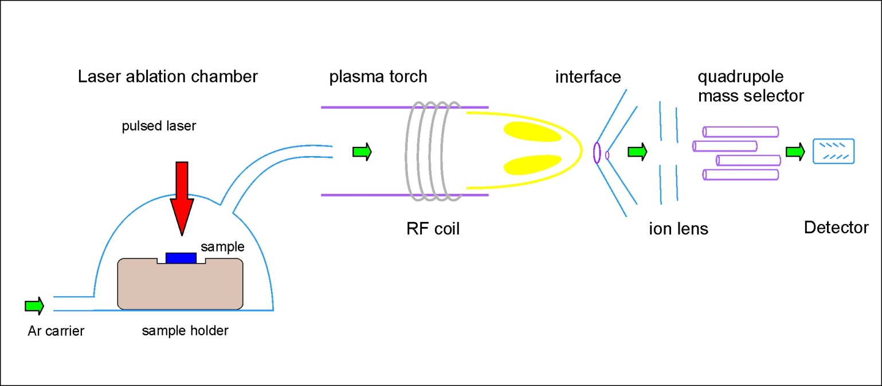
Laser Ablation ICP-MS
Samples are irradiated with a 213 nm laser micro-beam.
The vapor is transported to ICP-MS for analysis

Slide 7
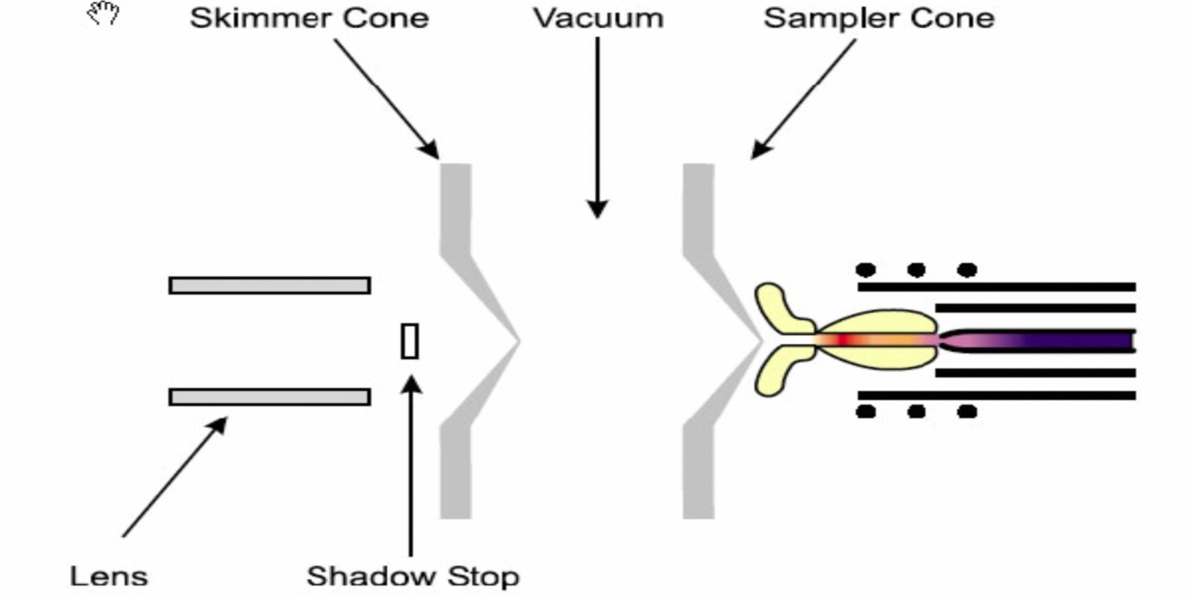
Atomization/Ionisation in Plasma
Vapors are atomized and ionized in hot plasma and the ions are collimated

Slide 8
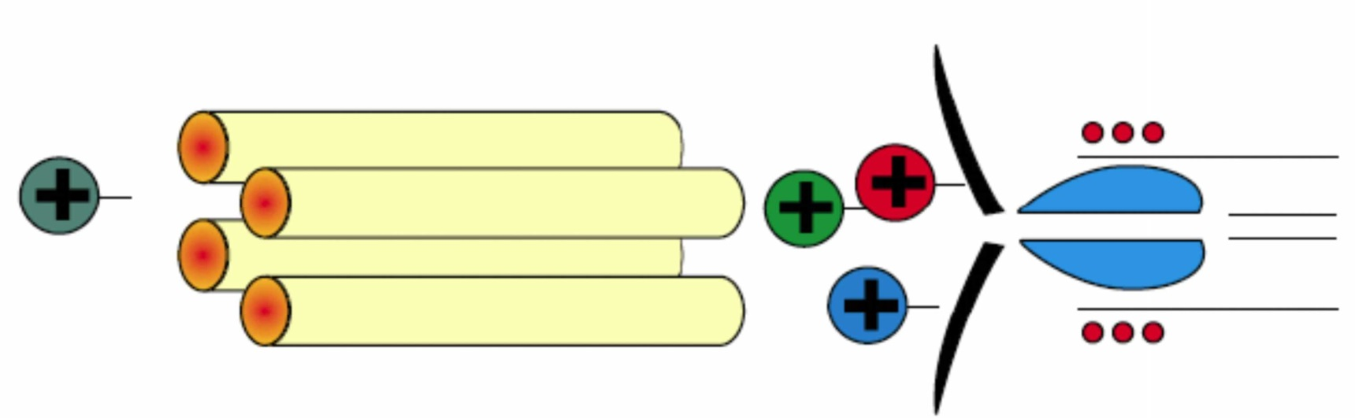
Quadrupole mass selection for fine resolution
A set four magnets deflects ions of varying mass to the mass detector

Slide 9
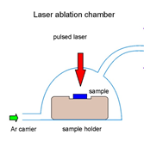
Depth-Profiling
The laser “drills” through the sample and measures the characteristic intensity of metals beneath the surface

Slide 10

Surface studies – Grid Analysis
The laser scans the surface at selected points on a grid
Uniformity of signal obtained predicts surface uniformity

Slide 11

Validation of ICP-MS
Technique is calibrated with certified standards in the aqueous phase to establish performance of the system
Element | Certified value (ppb) | Measurement 1 Fluka 70007 (ppb) | Relative Error | Measurement 2 Fluka 70007 (ppb) | Relative Error
Be | 10 | 10.20 | +2.0% | 10.75 | +7.5%
Mg | 10 | 9.32 | -6.8% | 9.92 | -0.80%
Co | 10 | 9.74 | -2.6% | 9.98 | -0.2%
Ni | 10 | 9.93 | -0.70% | 10.10 | +1.0%
In | 10 | 9.94 | -0.60% | 9.94 | -0.60%
Pb | 10 | 10.70 | +7.0% | 11.19 | +11.2%
Bi | 10 | 10.06 | +0.60% | 10.36 | +3.6%

Slide 12
Results/Discussion
Impact of the study

Slide 13
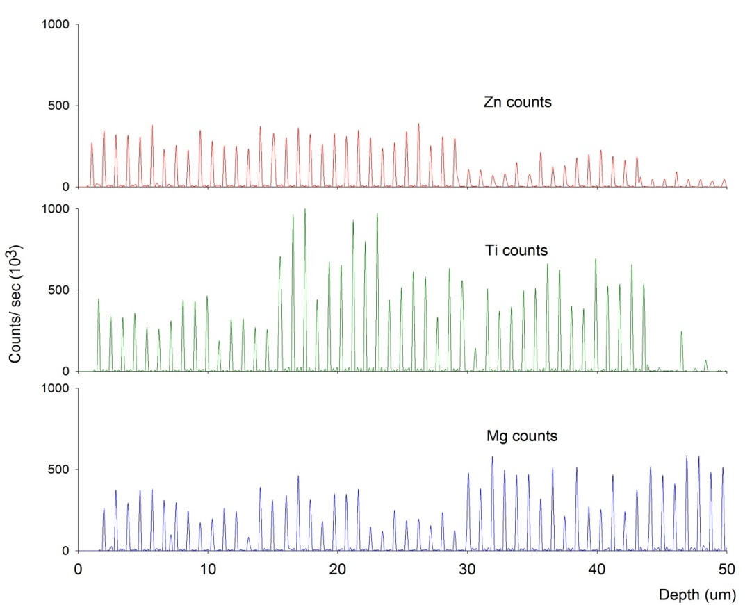
Homogeneity in Doped Polymers
General uniformity of dopant in sample can be established by studying consistency of signal output
Aberrations in beam strength could create slight fluctuations

Slide 14
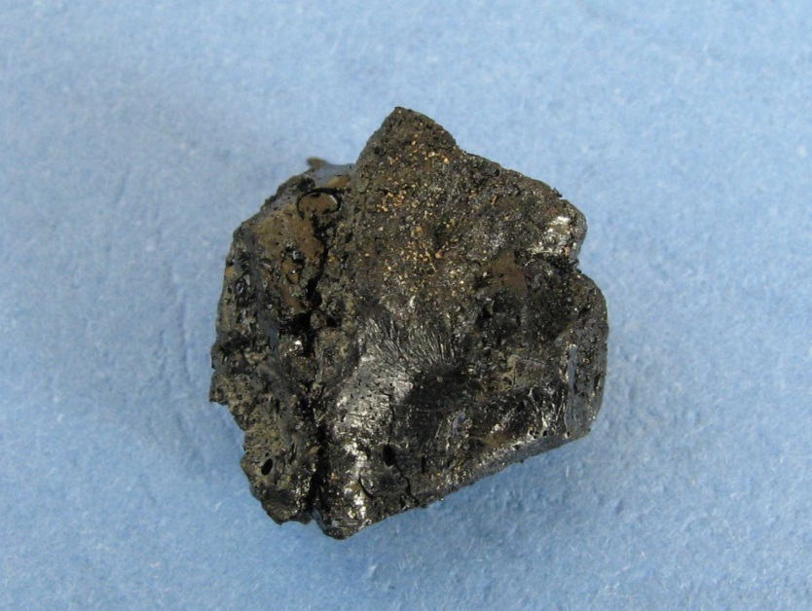
Untreated Asphaltenes
Some asphaltene samples are sufficiently coalesced to withstand direct irradiation without splashing effects

Slide 15
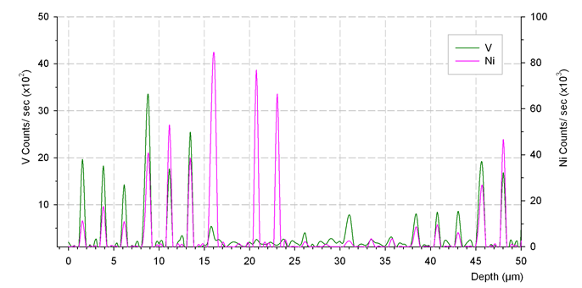
Metal inclusions/Hotspots in untreated asphaltenes
Nickel hotspots observed at different depths
Evidence of isolated metal inclusions

Slide 16
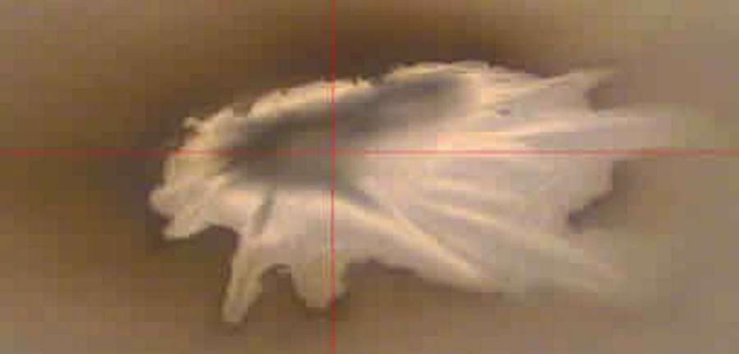
Screen-shot of “splashing” effects in a soft sample
If samples are soft and gelatinous, splashing occurs on irradiation with the laser as shown below

Slide 17
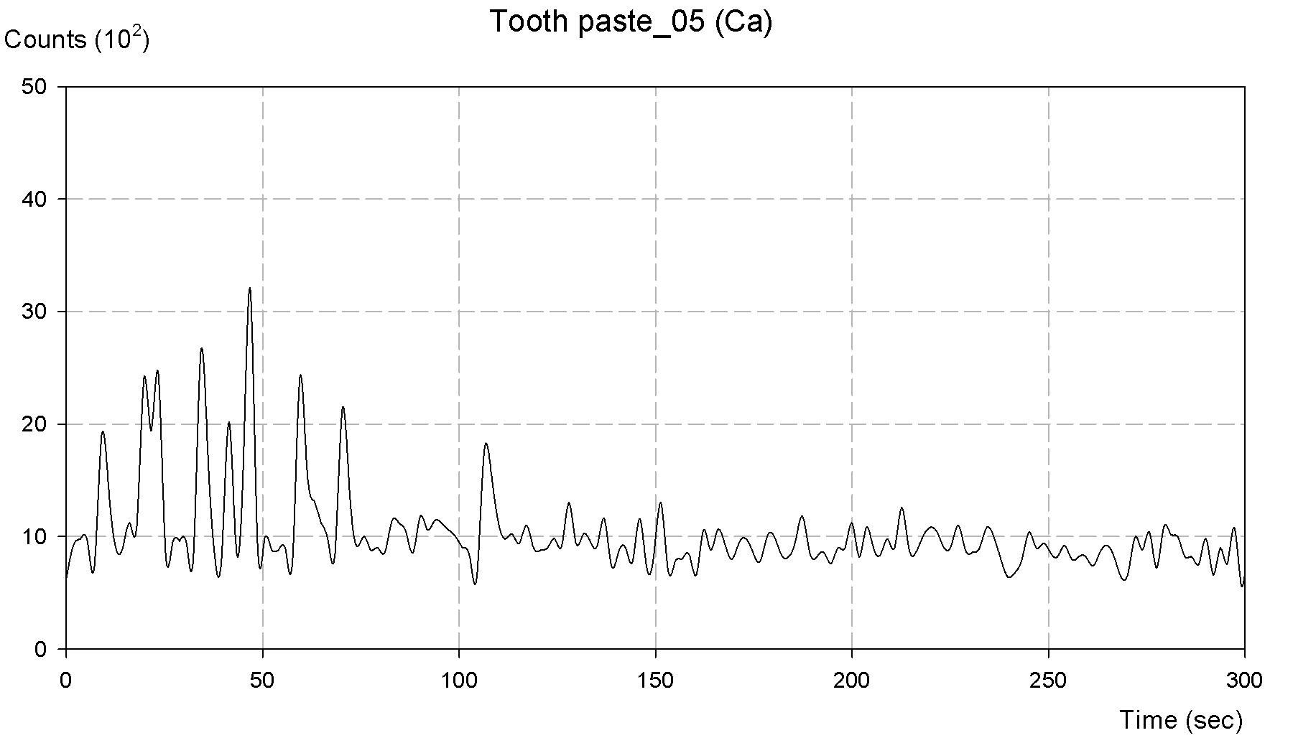
Spectrum of a “splashed” gelatinous sample showing erratic features

Slide 18
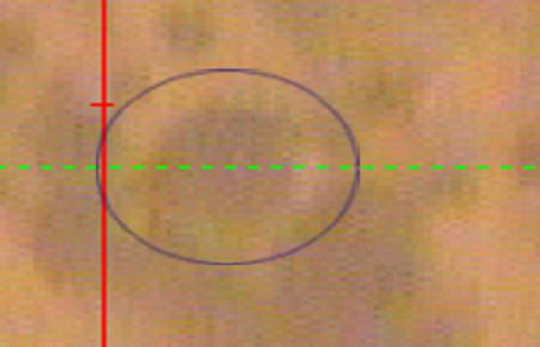
No splashing indicates sample is solid

Slide 19
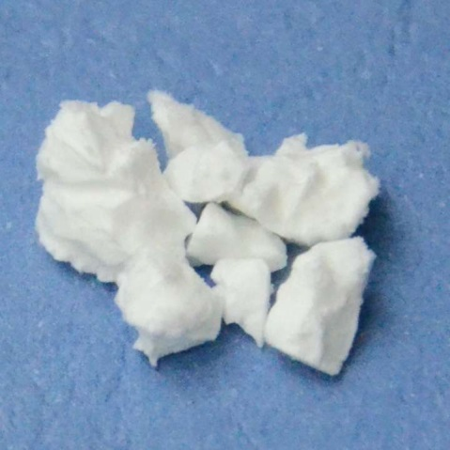
Treatment of samples with liquid nitrogen
Samples are solidified by pouring liquid nitrogen over them – see wax sample below
The solid sample is then quickly subjected to laser ablation

Slide 20
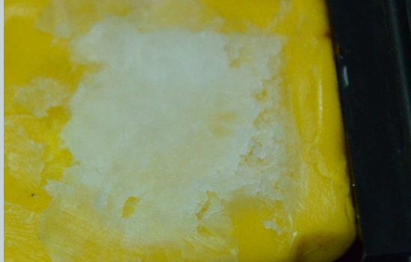
Point of thawing in sample chamber
Analysis must be done before thawing
Thaw time can be roughly 3 minutes

Slide 21
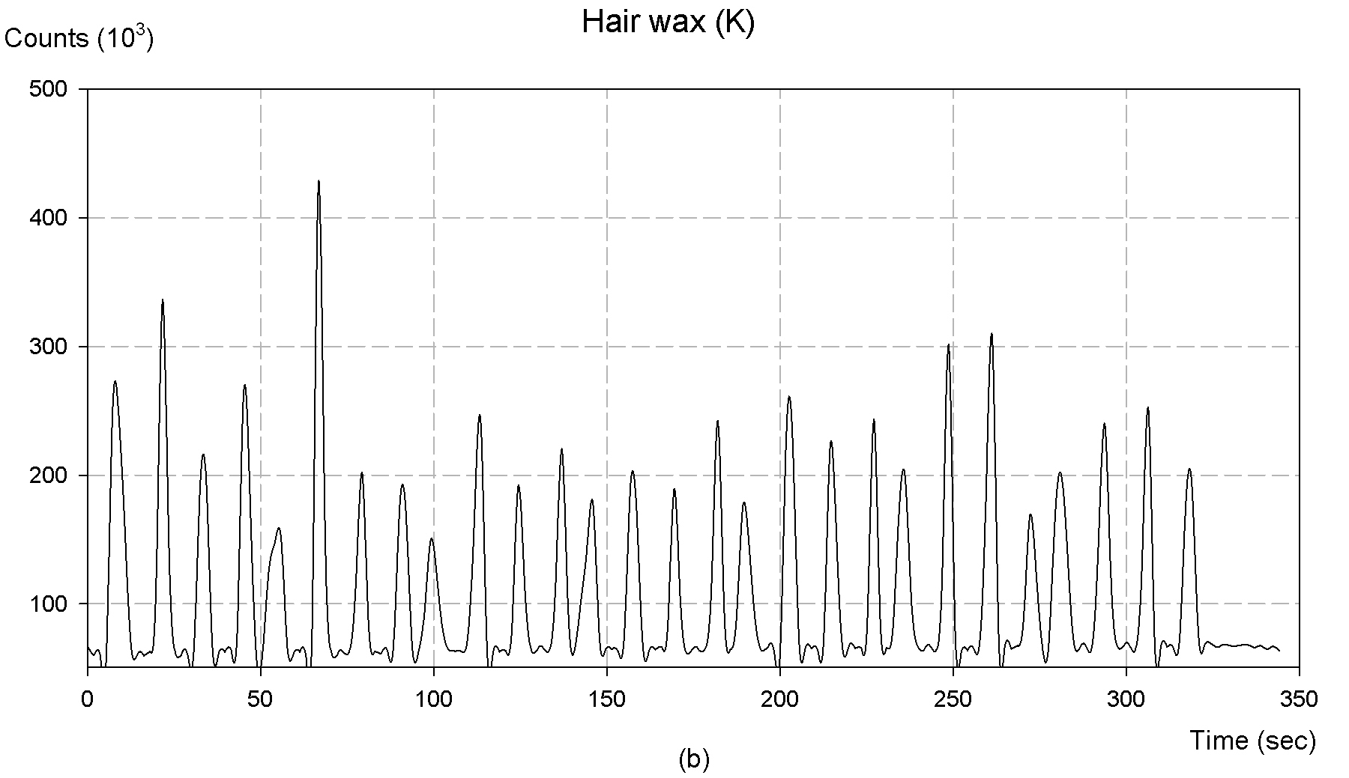
Typical depth-profiling spectra from samples pre-treated with liquid nitrogen
Spectrum of a petrified wax sample shows from consistency of peaks that the liquid nitrogen approach is successful

Slide 22
Future Studies: Carbon in steels
Our next study is to measure homogeneity of carbon in steels to determine integrity and uniformity
This can be extended to evaluation of nickel, manganese, chromium and cobalt in steels

Slide 23
ACKNOWLEDGEMENTS
The Petroleum Institute for financial support
Mr. Sasi Stephen for operating the laser ablation system
Collaborators for their assistance

Slide 24

THANK YOU
QUESTIONS

