Slide 1

Predictors of pap screening rates among female university students in Maritime Canada
Steenbeek^{1,2}, A. Cragg², M. Asbridge², P. Andreou² & D. Langille²
¹Department of Nursing, Dalhousie University
² Department of Community Health & Epidemiology, Dalhousie University
Presenter: Dr. Audrey Steenbeek
Associate Professor
Dalhousie University School of Nursing
a.steenbek@dal.ca

Slide 2
Background
The human papillomavirus (HPV) is highly prevalent in Canada
  ~75-80% of young adults will contract HPV
HPV puts those infected at increased risk for genital warts and various cancers
PAP screening is effective in detecting cervical pre-cancerous cells (dysplasia) among women with HPV but many young women do not access it
Little is known about predictors of HPV screening among Canadian female university students especially among those in Maritime Canada

Slide 3
Objective
To identify predictors (barriers and facilitators) of PAP testing among sexually active female university students (ages 19-29) at 8 Maritime universities, to create targets for promotion of HPV screening

Slide 4
Methods
Data Source: The Maritime University Student Sexual Health Services Survey (2012)
  A cross-sectional, anonymous, online survey of university students at eight Maritime Canadian universities (n =10,361)- 30.8% response rate among females
  Sample Population: 4007 vaginally sexually active female university students (age 19-29)
  Data were weighted based on the age demographics at each school and underwent multiple imputation (x5) for missing values
Statistical Analysis: Descriptive analysis of the sample population and simple/multiple logistic regression analyses on factors associated with screening
  All variables achieving marginal significance (p<0.2) during simple regressions were included in the multiple logistic regression
Notes:
46, 969 approximate total of undergraduate students

Slide 5
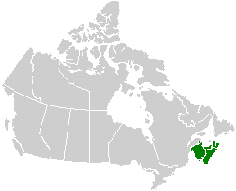

Slide 6
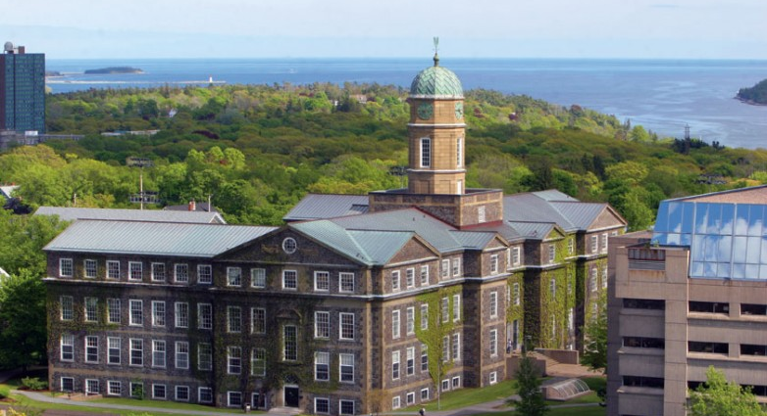

Participating universities
Dalhousie University , Nova Scotia
St Mary’s University, Nova Scotia

Slide 7
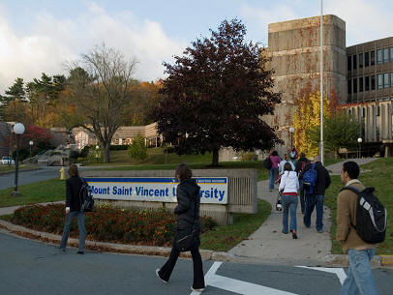
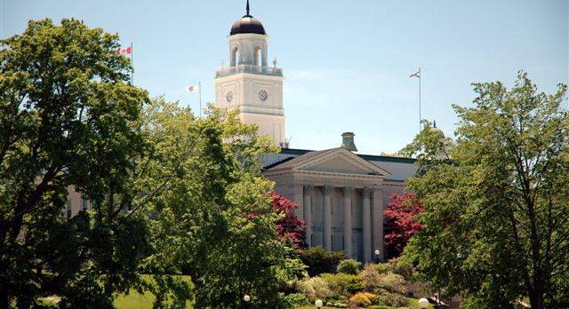
Participating university
Mount Saint Vincent’s University, Nova Scotia
Acadia University, Nova Scotia

Slide 8
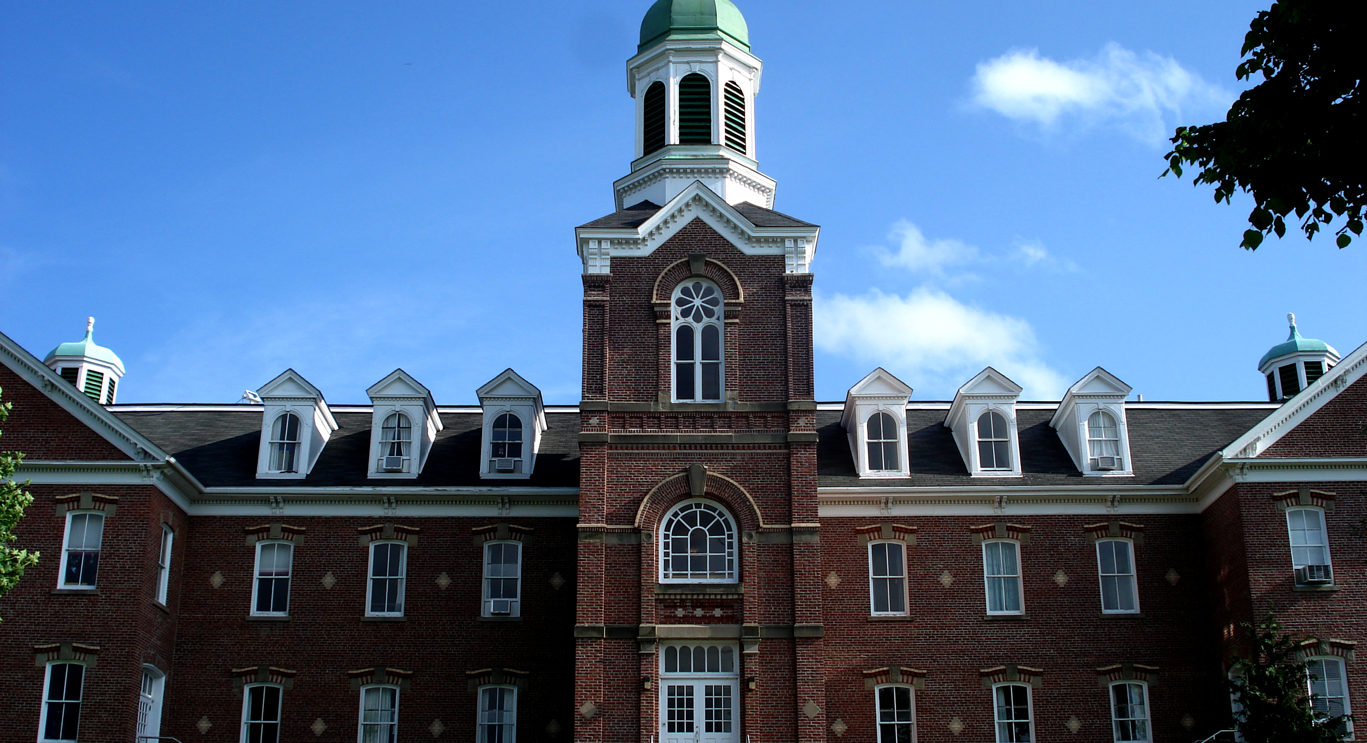
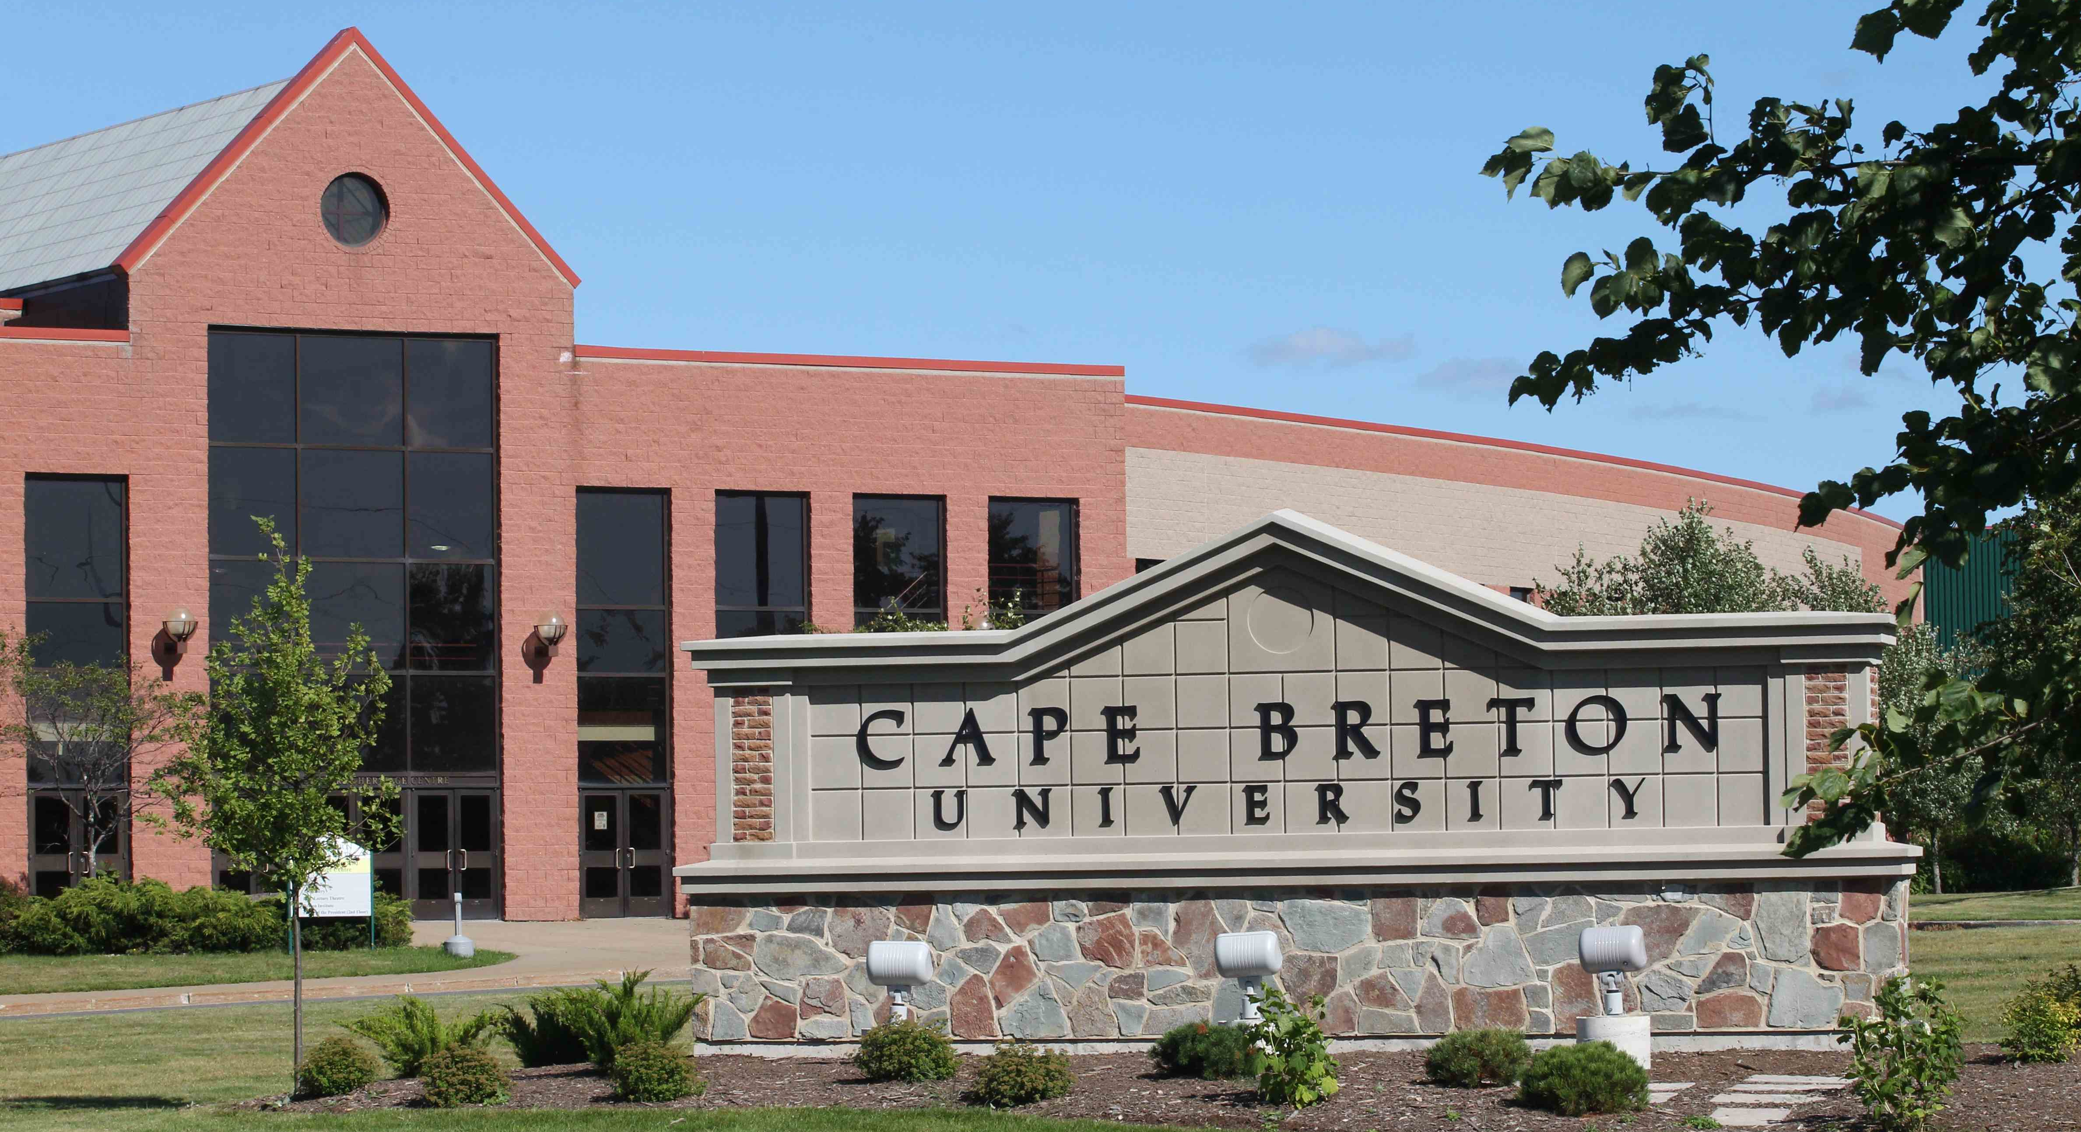
Participating universities
Saint Francis Xavier University – Nova Scotia
University of Cape Breton –Nova Scotia

Slide 9
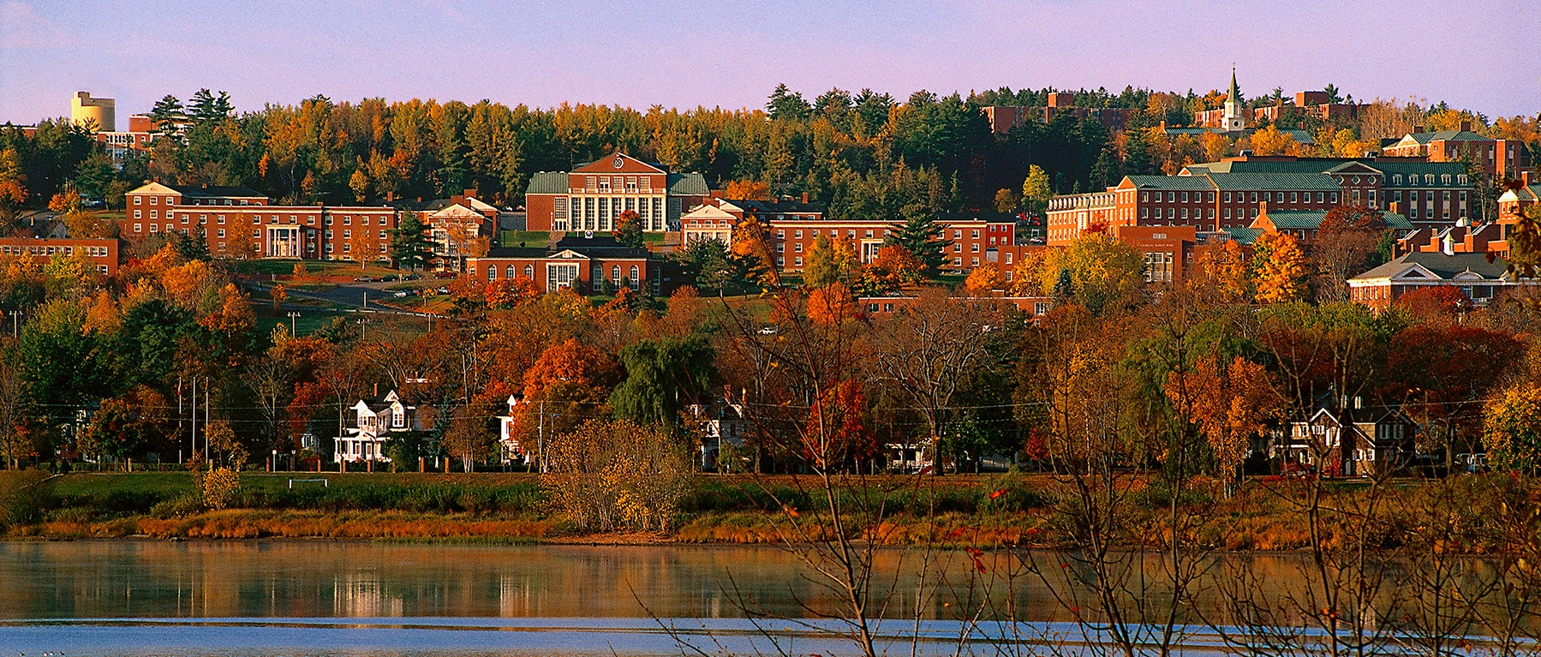
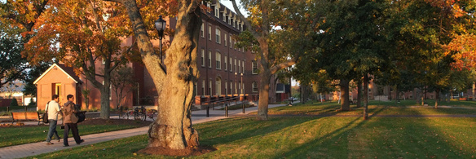
Participating universities
University of New Brunswick, NB
University of Prince Edward Island

Slide 10
Results
Demographic Variables of Interest | Weighted Population Mean or Proportion (95% CI)
Age (range: 19-29) | 21.6 (21.5-21.7)
Year of Study
First | 10.2% (9.2 – 11.2)
Second | 24.7% (23.3 – 26.2)
Third | 26.5% (25.0 – 28.0)
Fourth | 27.8% (26.3 – 29.3)
Other (>Fourth) | 10.7% (9.7 – 11.8)
Not Caucasian | 7.4% (6.5 – 8.3)
Not 100% Heterosexual | 36.7% (35.1– 38.4)
Consider Religion Very/Fairly Important | 27.4% (25.9 – 29.0)
Living Arrangement
Student Residence | 13.5% (12.4 – 14.7)
Alone | 7.5% (6.6 – 8.4)
Parent(s) | 20.9% (19.5 – 22.3)
Romantic Partner | 20.0% (18.6 – 21.4)
Roommate(s) | 38.0% (36.4 – 39.6)
Table 1a. Demographic characteristics of the weighted sample population (N=4007)

Slide 11
Results
Behavioural & Psychosocial Variables of Interest | Weighted Population Mean or Proportion (95% CI)
Forced to Have Sex | 8.6% (7.6 – 9.7)
Frequent Binge Drinker | 53.1% (51.5 – 54.8)
Heavy Marijuana User | 4.7% (4.0 – 5.4)
Level of HPV Risk
Lower | 33.6% (32.0 – 35.2)
Moderate | 49.8% (48.1 – 51.5)
Higher | 16.6% (15.3 – 17.8)
Higher Self-Perceived Risk | 6.9% (6.1 – 7.8)
Perception of Peer Sexual Risk Taking Score (range: 9-45) | 19.7 (19.5-19.9)
Sexual Health Knowledge Score (range: 0-12) | 8.9 (8.8 – 8.9)
Barriers to Help Seeking Score (range: 8-40) | 22.6 (22.4-22.8)
At-Risk of Depression | 34.9% (33.3 – 36.5)
Never PAP Tested | 22.2% (20.8 – 23.5)
Table 1b. Behavioural & psychosocial characteristics of the weighted sample population (N=4007)
Notes:
Interesting to note that the level of perceived risk did not equal that of the actual risk determined based on sexual risk behaviours.
Over 22% of the sexually active female university students aged 19-29 in the sample population had never had been screened for HPV

Slide 12
Results
Level of HPV Risk Behaviour | Weighted Proportion (95% CI) | Unadjusted OR (95% CI) * | p-values
Higher (n=676) | 82.5 (79.6, 85.5) | 2.07 (1.64, 2.62) | <.0001
Moderate (n=1992) | 81.9 (80.1, 83.6) | 1.98 (1.74, 2.26) | <.0001
Lower (n=1339) | 69.5 (66.9, 72.1) | 1.00 | -
* Intraclass correlation at the university-level accounted for statistically without including university in the model
Table 2. Weighted proportion of the study population (N=4007) ever PAP tested stratified by level of HPV risk behaviour and the unadjusted association between ever PAP and level of HPV risk behaviour
Notes:
According to the univariable analyses, those engaging in moderate or higher risk HPV sexual behaviours were more likely to have undergone HPV screening than those engaging in lower risk sexual behaviours. This could be because practitioners are pushing the testing as opposed to student driven
There was not a significant difference in lifetime HPV screening between the higher and moderate risk groups (as seen by the overlapping confidence intervals) but there was a significant difference between moderate/high and low risk

Slide 13
Results
Covariates of Interest | OR (95% CI) | p-value
Age | 1.30 (1.22-1.38) | <.0001
Caucasian | 2.08 (1.62-2.67) | <.0001
Not 100% Heterosexual | 1.19 (1.01-1.40) | 0.0384
Year of Study
First | 1.0
Second | 1.02 (0.64-1.63) | 0.9392
Third | 1.19 (0.73-1.96) | 0.4813
Fourth | 1.46 (0.85-2.51) | 0.1654
Other | 1.89 (0.92-3.85) | 0.0810
Religion Less/Not Important | 1.19 (1.02-1.38) | 0.0313
Living Arrangements
Parent(s) | 1.0
Alone | 1.33 (0.71-2.52) | 0.3741
Romantic Partner | 1.87 (1.36-2.57) | 0.0001
Student Residence | 0.61 (0.44-0.83) | 0.0019
Roommate(s) | 0.92 (0.73-1.15) | 0.4487
¥ University intraclass correlation statistically adjusted for using a clustering correction
Table 3a. Odds ratios (95% confidence intervals) for the associations between the demographic correlates of ever having had a PAP test (adjusted for behavioural and psychosocial correlates) ¥
Notes:
Significant facilitators of use (green)
Significant barriers to use (orange)
So as they increase in age they are more likely to get tested OR is greater than 1
Not 100% heterosexual includes- mostly heterosexual, bisexual, mostly homosexual or homosexual

Slide 14
Results
Covariates of Interest | OR (95% CI) | p-value
Forced to Have Sex | 1.10 (0.86-1.41) | 0.4567
Heavy Marijuana User | 1.84 (0.73-4.64) | 0.1951
Level of HPV Risk
Lower | 1.0
Moderate | 1.82 (1.49-2.23) | <.0001
Higher | 2.08 (1.73-2.49) | <.0001
Peer Sexual Risk Taking Score | 1.02 (1.02-1.03) | <.0001
Sexual Health Knowledge Score | 1.19 (1.15-1.24) | <.0001
Barriers to Help Seeking Score | 0.95 (0.94-0.97) | <.0001
At- Risk of Depression | 0.97 (0.80-1.17) | 0.7436
¥ University intraclass correlation statistically adjusted for using a clustering correction
Table 3b. Odds ratios (95% confidence intervals) for the associations between the behavioral, and psychosocial correlates of ever having had a PAP test (adjusted for demographic correlates)¥
Notes:
Significant facilitators of use (green)
Significant barriers to use (orange)

Slide 15
Discussion
Facilitators of HPV Screening
Barriers to HPV Screening
Increased age
Caucasian descent
Being bisexual or lesbian
Lower religiosity
Living with a romantic partner vs. with parent(s)
More sexual health knowledge
Perceiving peers as having more liberal attitudes towards sex
Engaging in moderate or high vs. lower HPV risk behaviour
Living in student residence vs. with parent(s)
Barriers to help seeking
  Fear of seeming weak
  Excessive independence/self-reliance
  Fear of giving up control to others

Slide 16
Discussion
Over 22% of the women in the target population have yet to be screened
  Implies that the Canadian screening recommendations have yet to be met
The women in the study that had never been tested were more likely to be younger, non-Caucasian, religious, heterosexuals, living in student residence that had conservative peer groups, more barriers to help seeking and less sexual health knowledge
  Health promotion initiatives should target first-year residence populations with programming designed to reduce potential barriers to help seeking attitudes and improve sexual health knowledge
Notes:
May want to put special programming in place for international students to meet their unique language/cultural needs.

Slide 17
Limitations
Cross-sectional data
  Potential endogeneity for some variables (e.g. that testing improves sexual health knowledge)
Self-reported PAP testing
  Potential over/under-reporting of the outcome of interest
University-based sample
  Not necessarily generalizable to other populations of young women
Lower response rate (30.8%)
  Potential non-response bias if those that did not respond had characteristics in common
Notes:
Wide range of topics included in the knowledge score makes this less likely

Slide 18

Acknowledgements
Dr. Donald Langille
Amber Cragg
Dr. Mark Asbridge
Dr. Pantelis Andreou

