Slide 1

Vasoactive effects of a new nitric oxide donating acetylsalicylic derivative
World Heart Congress
May 22- 24, 2017 Osaka, Japan
Attila Czompa, Istvan Bak, Kitti Szoke, Istvan Lekli, Aniko Borbas, Pal Herczegh, Arpad Tosaki
University of Debrecen, Hungary

Slide 2
Introduction
Vasoactive effects of a new nitric oxide donating acetylsalicylic derivative – Attila Czompa
Source: WHO statistics
Ischemic heart disease:
Narrowed coronary artery
Ischemia
Heart muscle is not recieving enough oxygen
The role of acetylsalicylic acid and nitric oxyde in ischemic heart diseases

Slide 3
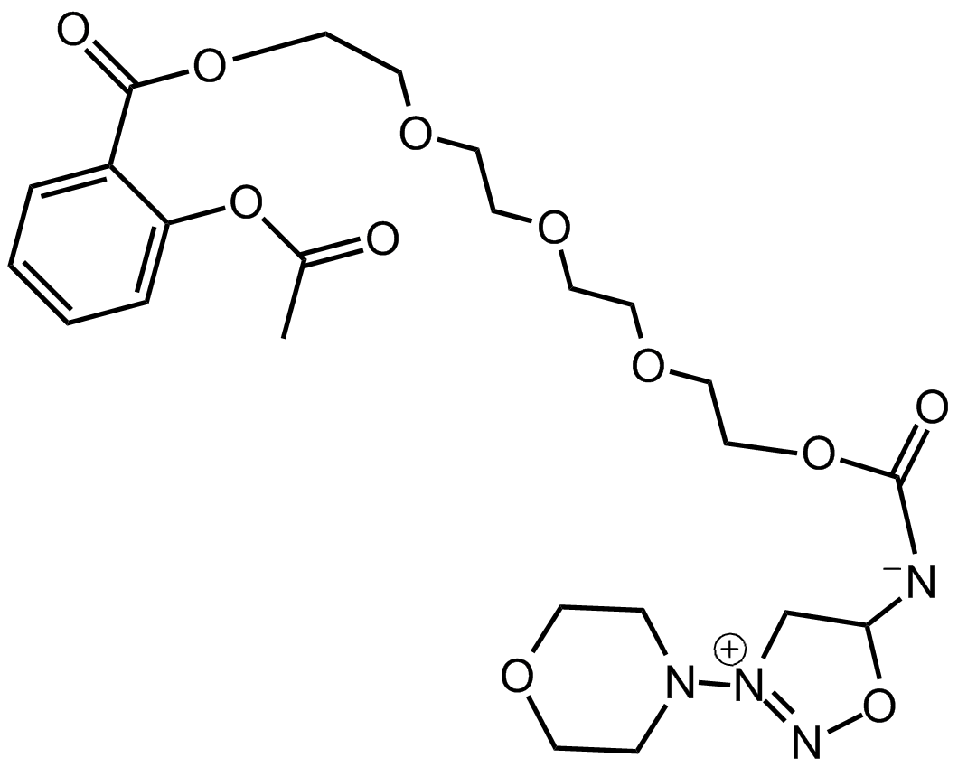
Our aims
Vasoactive effects of a new nitric oxide donating acetylsalicylic derivative – Attila Czompa
Specify the pharmacological properties
      Phase I metabolic reactions
      Cytotoxicity
Specify the possible vasoactive effect
of the new NO donating acetylsalicylic derivative
(synthetised by Department of Pharmaceutical Chemistry, University of Debrecen, Hungary)

Slide 4
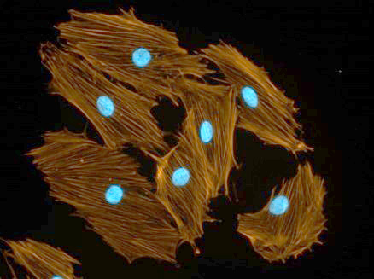
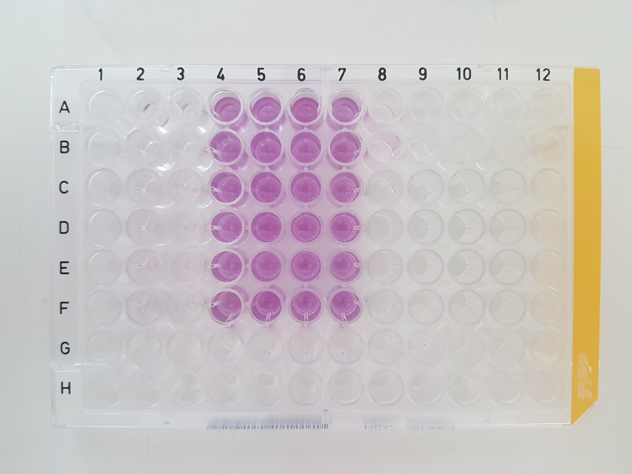
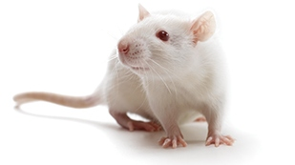
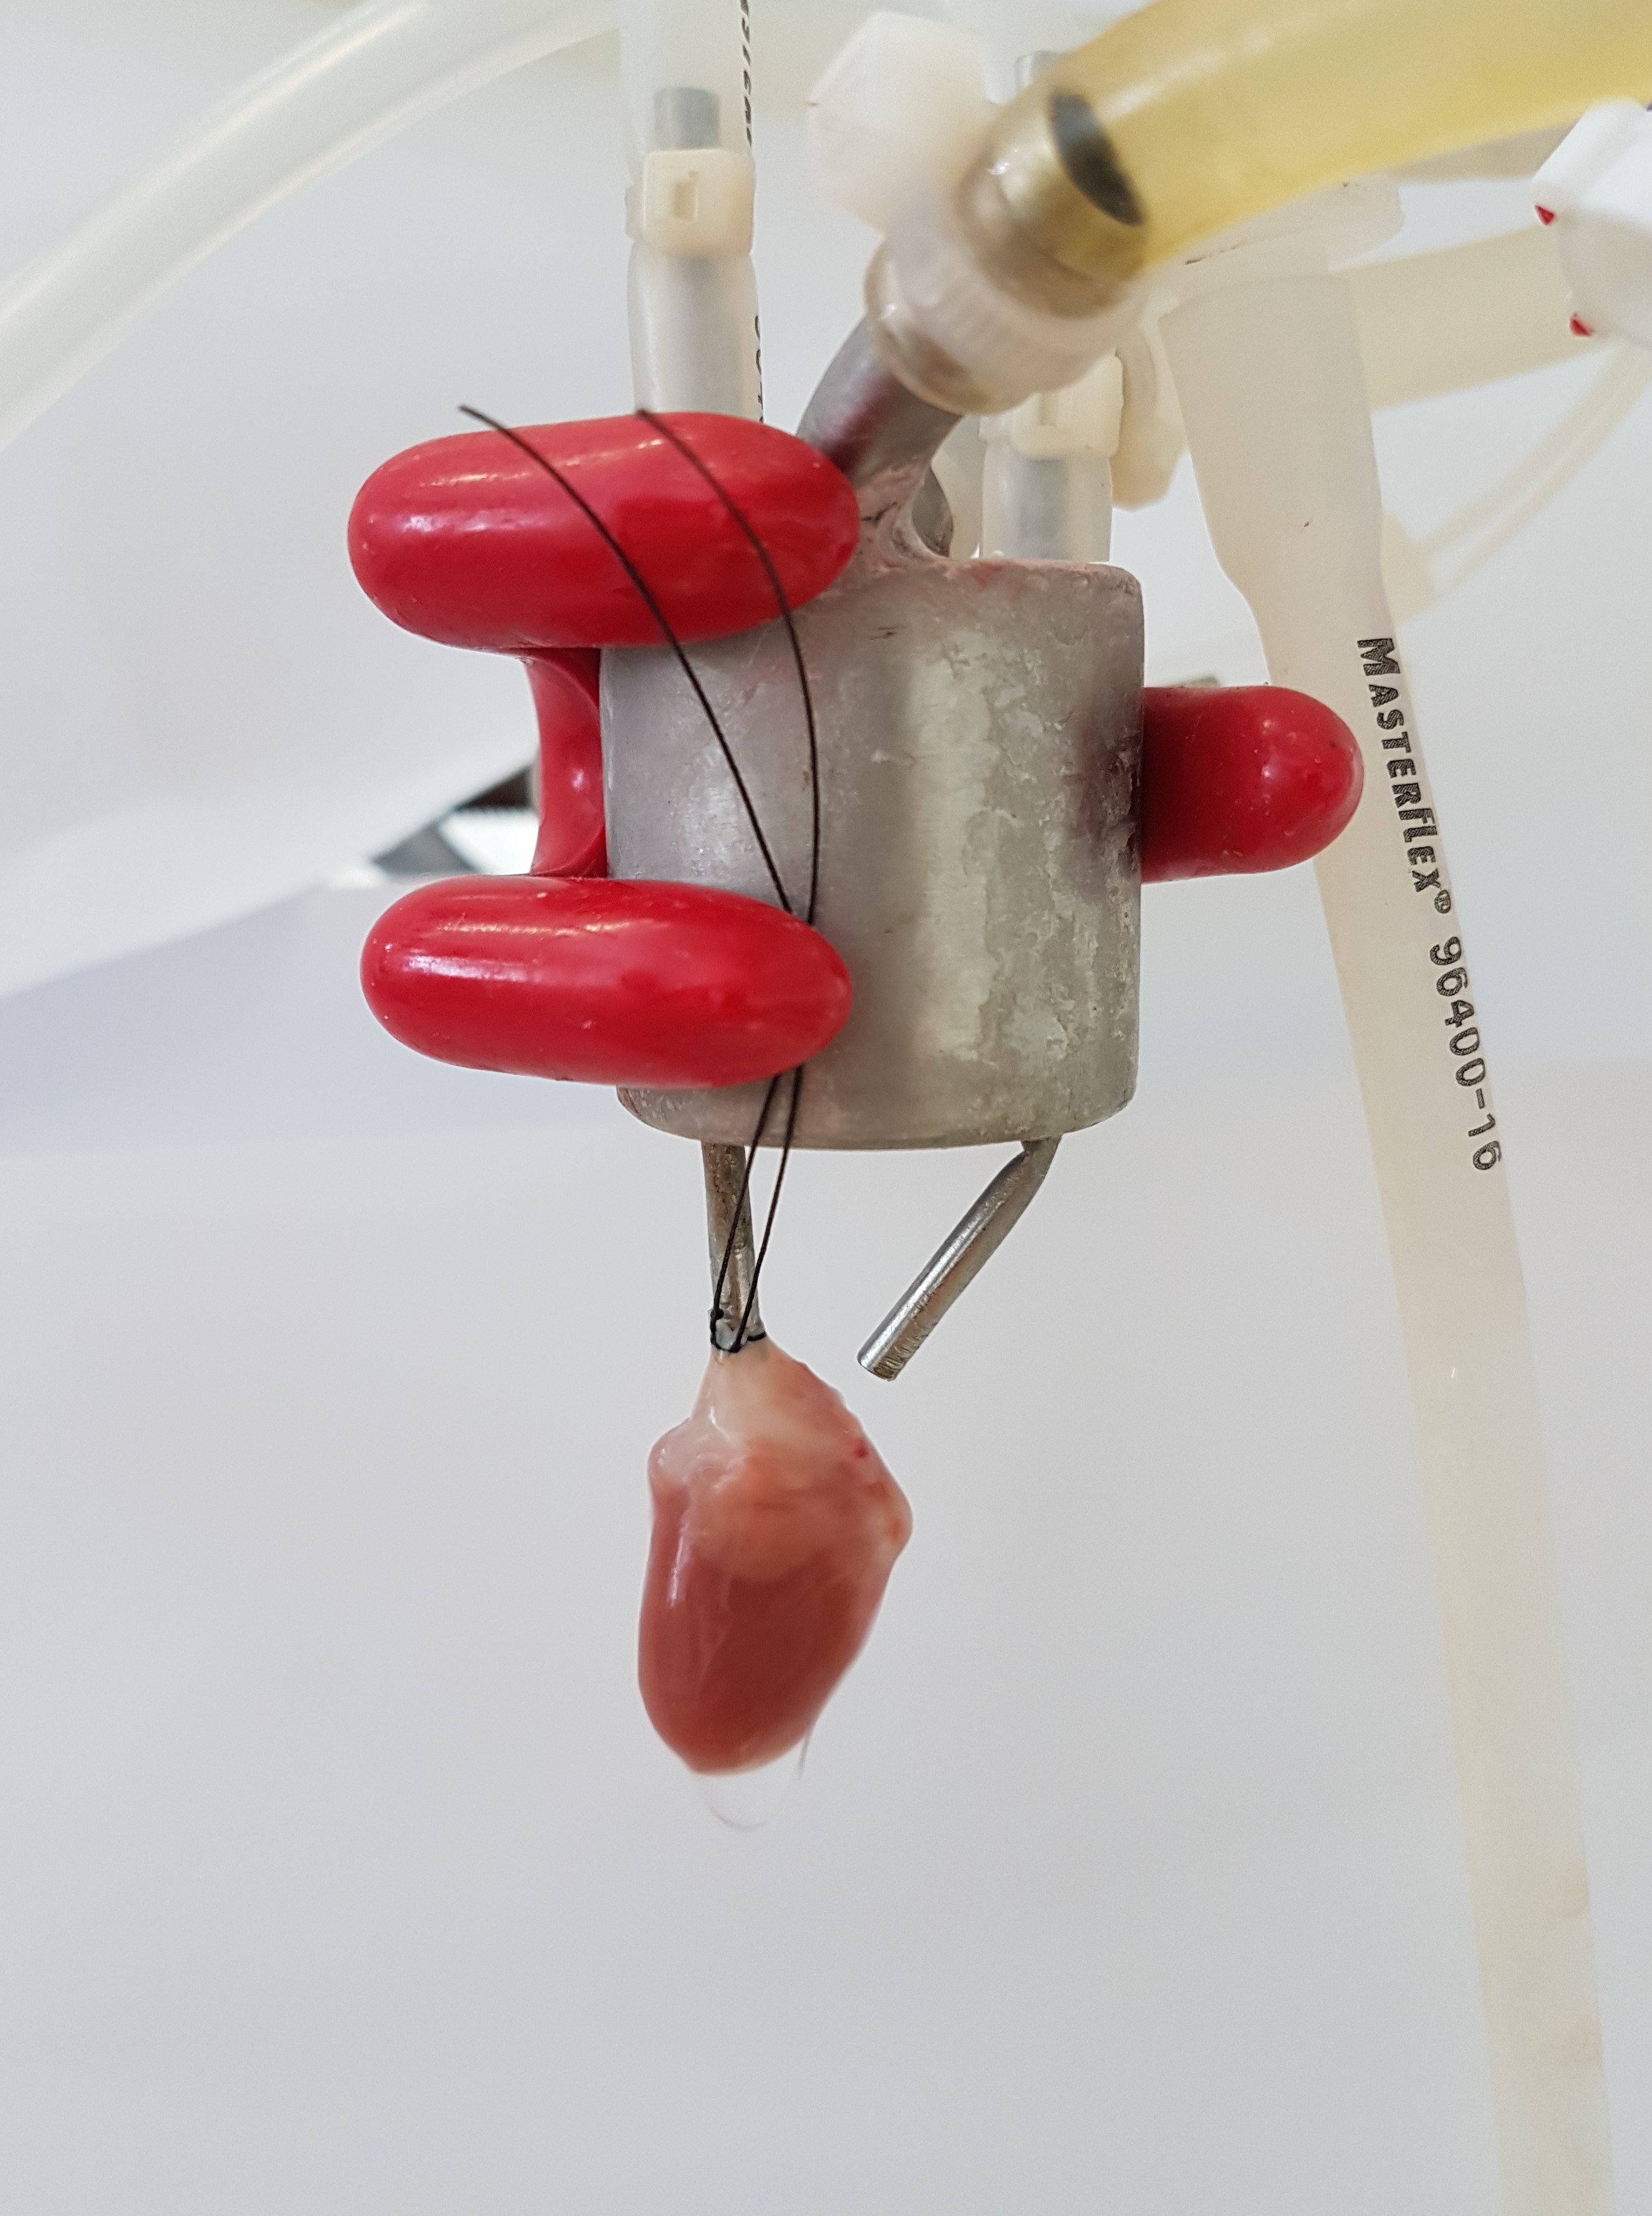
Vasoactive effects of a new nitric oxide donating acetylsalicylic derivative – Attila Czompa
Materials and methods an overview
Phase I. metabolic reactions
  Oxidation by Artificial Porphyrin (similar to CYP450)
  The Chemical Fenton System
Cytotoxicity
  MTT assay (H9c2 cell line)
  Hemolysis test (eryithrocytes from rat blood)
„Langendorff” heart perfusion
    On isolated Sprague Dawley rat hearts
  Coronary flow
  Heart rate
Notes:
Oxidation by Artificial Porphyrin The porphyrin system was prepared based on a method reported previously by Johansson et al. [21]. The reaction mixture consisted of 50 μL 10 mM 865 in acetonitrile, 35 μL acetonitrile, 315 μL 100 mM formic acid, 50 μL 10 mM Fe(III) meso-tetra(4-sulfonatophenyl)porphine chloride and 50 μL 30% H2O2. The control sample in the absence of hydrogen peroxide and the blank sample without the test compound were prepared. The mixtures were shaken at 37 °C for 30 min at 700 rpm in a shaking water bath. One hundred microliters of the reaction mixture were diluted to 2 mL with acetonitrile/ water (50:50). After HPLC separation (column: Kinetex XB-C18 2.6 μm, eluent: 0.1% formic acid in water and acetonitrile with 0.1% formic acid, gradient elution), the samples were introduced into an LTQ XL linear ion trap mass spectrometer (Thermo Fisher Scientific, Waltham, MA, USA) under the following conditions: sheath gas flow rate 35.00 a.u., spray voltage 5000 V, capillary temperature 300 °C, capillary voltage 31 V, tube lens voltage 150 V, skimmer voltage 34 V.
The Chemical Fenton System The chemical Fenton system was prepared based on a method reported previously by Jurva et al. [23] The reaction mixture consisted of 400 μL 2.5 mM 865 in acetonitrile, 50 μL 20 mM FeCl3 and 50 μL 20 mM EDTA-Na2 in acetonitrile/water (50:50), 500 μL 10 mM ascorbic acid in acetonitrile/water (50:50) and 1 μL 30% hydrogen peroxide. The control sample in the absence of hydrogen peroxide and the blank sample without the test compound were prepared. The mixtures were stirred at room temperature at 600 rpm.

Slide 5
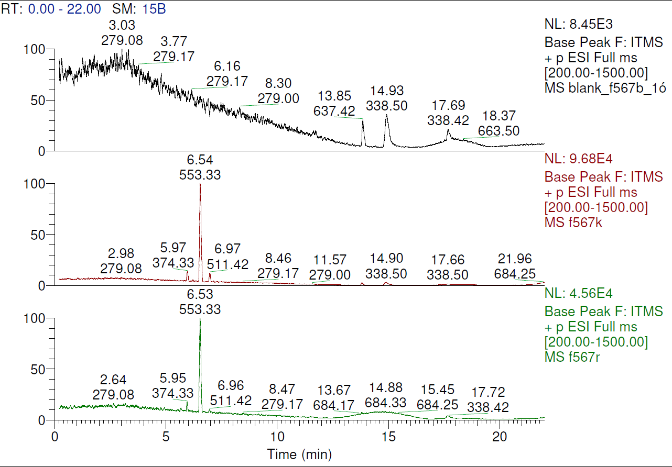
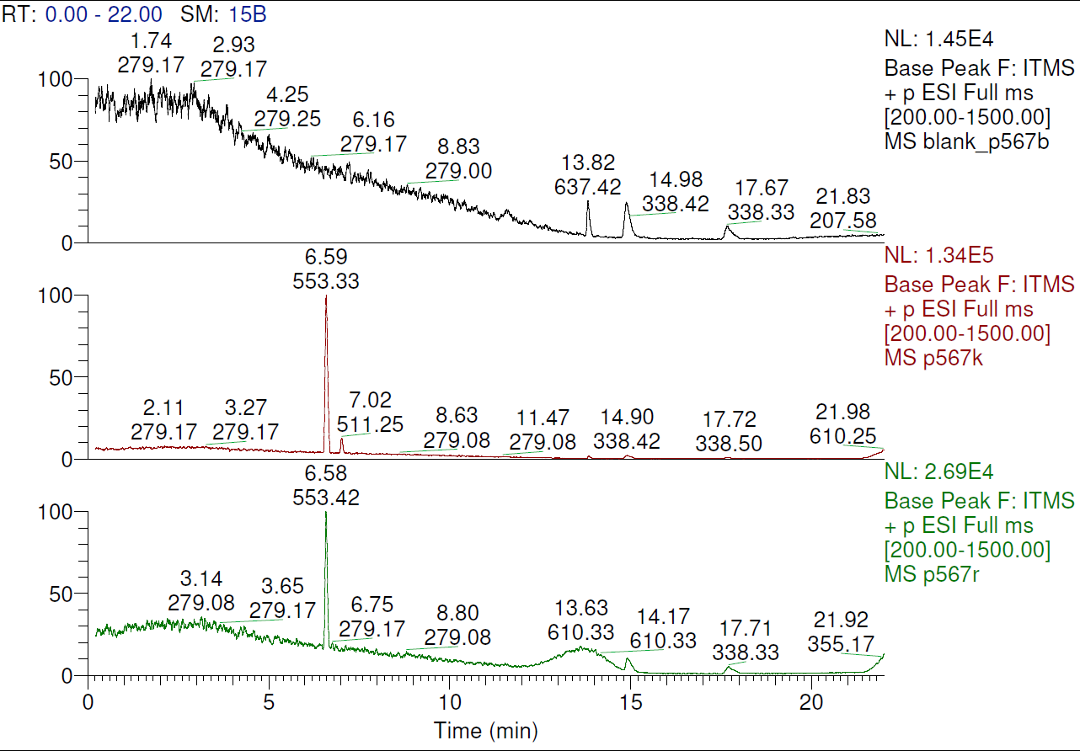
Results I.
Vasoactive effects of a new nitric oxide donating acetylsalicylic derivative – Attila Czompa
Phase I. reactions:
  Oxidation by Artificial Porphyrin
  The Chemical Fenton System
Conclusion:
No change in such conditions
Notes:
Oxidation by Artificial Porphyrin The porphyrin system was prepared based on a method reported previously by Johansson et al. [21]. The reaction mixture consisted of 50 μL 10 mM 865 in acetonitrile, 35 μL acetonitrile, 315 μL 100 mM formic acid, 50 μL 10 mM Fe(III) meso-tetra(4-sulfonatophenyl)porphine chloride and 50 μL 30% H2O2. The control sample in the absence of hydrogen peroxide and the blank sample without the test compound were prepared. The mixtures were shaken at 37 °C for 30 min at 700 rpm in a shaking water bath. One hundred microliters of the reaction mixture were diluted to 2 mL with acetonitrile/ water (50:50). After HPLC separation (column: Kinetex XB-C18 2.6 μm, eluent: 0.1% formic acid in water and acetonitrile with 0.1% formic acid, gradient elution), the samples were introduced into an LTQ XL linear ion trap mass spectrometer (Thermo Fisher Scientific, Waltham, MA, USA) under the following conditions: sheath gas flow rate 35.00 a.u., spray voltage 5000 V, capillary temperature 300 °C, capillary voltage 31 V, tube lens voltage 150 V, skimmer voltage 34 V.
The Chemical Fenton System The chemical Fenton system was prepared based on a method reported previously by Jurva et al. [23] The reaction mixture consisted of 400 μL 2.5 mM 865 in acetonitrile, 50 μL 20 mM FeCl3 and 50 μL 20 mM EDTA-Na2 in acetonitrile/water (50:50), 500 μL 10 mM ascorbic acid in acetonitrile/water (50:50) and 1 μL 30% hydrogen peroxide. The control sample in the absence of hydrogen peroxide and the blank sample without the test compound were prepared. The mixtures were stirred at room temperature at 600 rpm.

Slide 6
Results II. cell viability
Vasoactive effects of a new nitric oxide donating acetylsalicylic derivative – Attila Czompa
Conclusion:
No adverse effects on
cell viability
and it should be a safe molecule

Slide 7
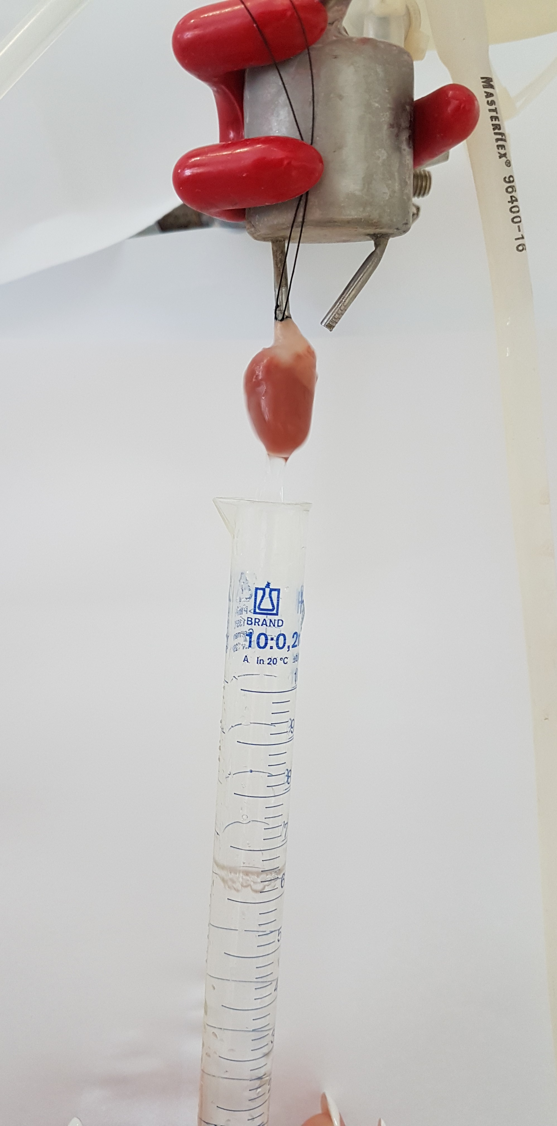
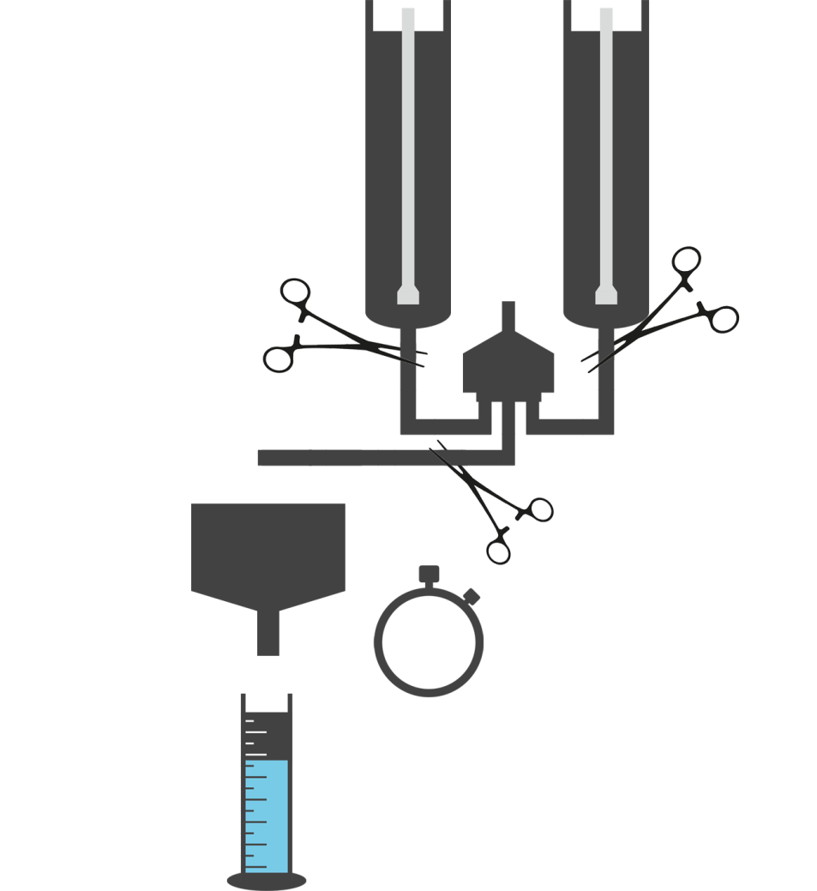

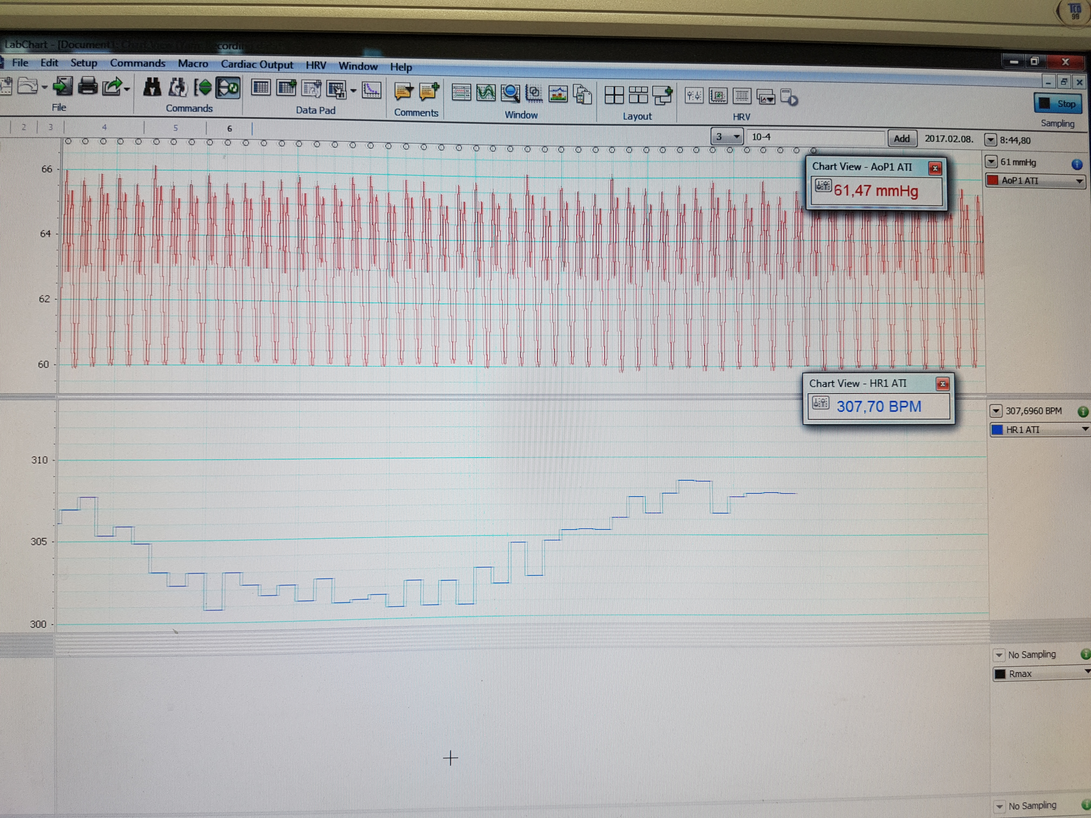



Protocol of measuring the possible vasoactive effect
Vasoactive effects of a new nitric oxide donating acetylsalicylic derivative – Attila Czompa
Normal
Test molecule containing
Tested concentrations: 100µM, 30µM, 10µM, 1µM
KH buffer
5’
10’
10’
10’
Test molecule
Wash out
Test molecule
Continuus measurement of coronary flow and heart rate
Baseline
parameters
Timed collection of coronary effluent

Slide 8
Results III. vasoactive effects of the NO donating ASA derivative test molecule
Vasoactive effects of a new nitric oxide donating acetylsalicylic derivative – Attila Czompa
*
*
N=6 *p<0,05 compared to baseline
Conclusion: powerful vasodilation with no significant effect on heart rate

Slide 9
Summary- outcome and further experiments
Vasoactive effects of a new nitric oxide donating acetylsalicylic derivative – Attila Czompa
Experiments | Metabolic reactions | Cytotoxicity | Physiological effects
Our results | Phase I. reactions Not oxydized Stable molecule | Cell viability Not harmful | Isolated heart- ex vivo Powerful vasodilation Cardioprotection?
Future plans | Phase II. reactions Conjugation In vivo metabolism in a rat model | In vivo studies Oral and parenteral administration | Anticoagulant effects Working heart experiments- Ischemia/reperfusion injury in a rat model
Notes:
Ethical license!

Slide 10
Acknowledgement
Vasoactive effects of a new nitric oxide donating acetylsalicylic derivative – Attila Czompa
Thankful for the support and appreciate the help for
Arpad Tosaki, Pharm. D, PhD, D.Sc.
Pal Herczegh, PhD, D.Sc
Aniko Borbas, PhD, D.Sc
Istvan Lekli, Pharm.D., PhD
Istvan Bak, PhD., Habil.
Kitti Szőke, Pharm D.
Péter Szabados-Fürjesi
This investigation was supported by the NTP-NFTÖ-16 project by the Human Capacities Grant Management Office and the Hungarian Ministry of Human Capacities, OTKA K-104017, OTKA-PD-111794, TÁMOP 4.2.4. A/2-11-1-2012-0001 and GINOP-2.3.2-15-2016-00043.

Slide 11

Thank you for your attention!
Thank you for your
attention
Vasoactive effects of a new nitric oxide donating acetylsalicylic derivative – Attila Czompa

