Slide 1

Algorithms for Optimal Scheduling of Multiple Spacecraft Maneuvers
Motivation Maneuvers SSV P2P Conclusions
. . . . . . . . . . . . . . . . . . . . . . . . . . . . . . . . . . . . . . . . . . . . . . . . . . . .
Atri Dutta
Aerospace Engineering Wichita State University
International Conference and Exhibition on Satellite Houston, TX
August 19, 2015

Slide 2
WSU Astronautics Research Laboratory (2014 –)
Motivation Maneuvers SSV P2P Conclusions
Multi-rendezvous mission planning
All-electric satellites Spacecraft attitude control
CubeSat for science experiments and technology demonstration

Slide 3





Presentation Overview
Motivation Maneuvers SSV P2P Conclusions
Motivation
Optimal Transfer for a Spacecraft
3
Maneuvers by a Single Servicing Spacecraft
4 Peer-to-Peer Maneuvers
5
Concluding Remarks

Slide 4
Active Debris Removal
Motivation Maneuvers SSV P2P Conclusions
Recent studies have indicated that at least 5 objects need to be removed every year for stable on-orbit debris management
Many debris removal techniques likely require multi-rendezvous mission planning

Slide 5
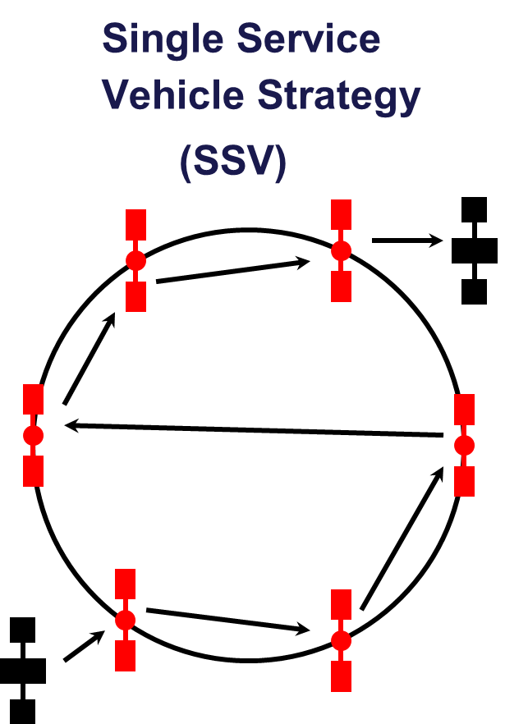
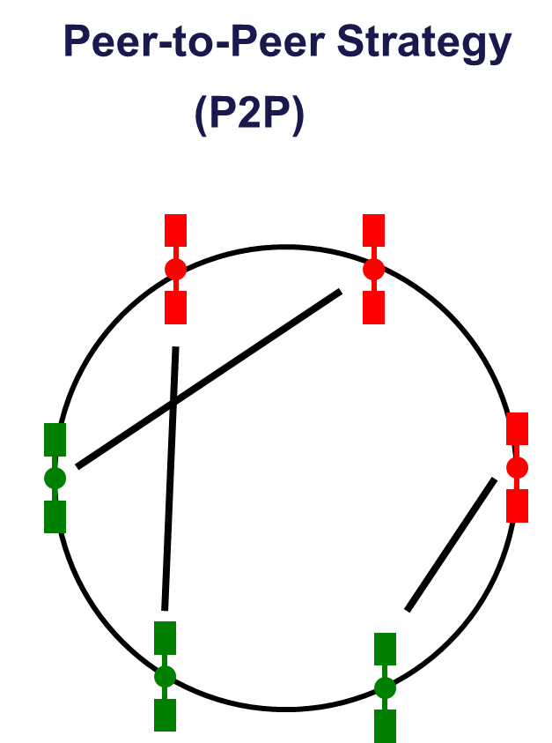
Servicing of Satellite Constellations
Motivation Maneuvers SSV P2P Conclusions

Slide 6
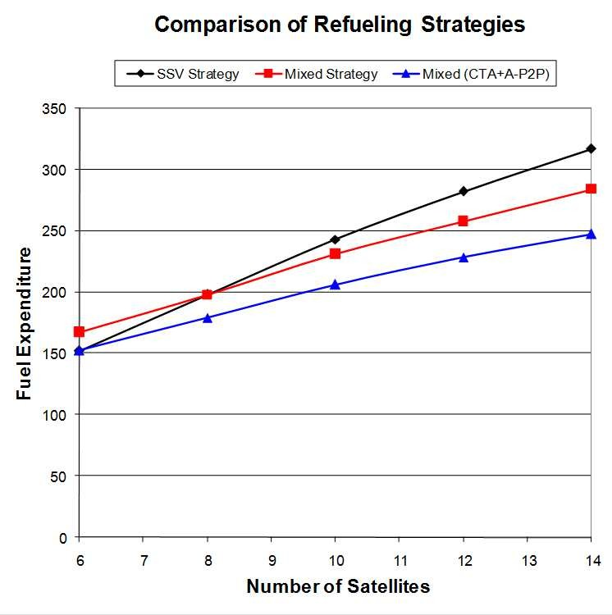
Mixed Servicing Strategy
Motivation Maneuvers SSV P2P Conclusions
Mixed strategy outperforms the single service vehicle strategy with increasing number of satellites in the constellation
Mixed strategy does even better with asynchronous maneuvers and optimal P2P trip times
*Dutta and Tsiotras, “Asynchronous Optimal Mixed Peer-to-Peer Satellite Refueling Strategies,” Journal of the Astronautical Sciences, Vol. 54 (3-4), Dec 2006, pp. 543-565.

Slide 7
Challenges
Motivation Maneuvers SSV P2P Conclusions
Continuous optimization: optimization over transfers
Combinatorial aspects: target selection, optimization over sequences
NP-hard: polynomial time algorithm
Researchers have used genetic algorithms, branch-and-bound methods, Greedy random adaptive search procedures

Slide 8
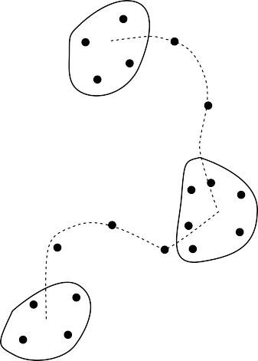
Greedy Random Adaptive Search Procedure
Motivation Maneuvers SSV P2P Conclusions
X
X
X
Widely used in operations research community to solve k-assignment problem
Multiple phases: construction of a basic feasible solution, local search, path relinking
Known to yield good quality solutions

Slide 9


Presentation Overview
Motivation Maneuvers SSV P2P Conclusions
Motivation
Optimal Transfer for a Spacecraft
3
Maneuvers by a Single Servicing Spacecraft
4 Peer-to-Peer Maneuvers
5
Concluding Remarks

Slide 10
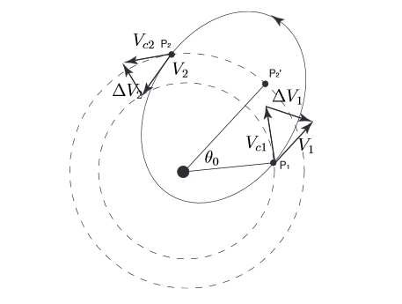
Two-Impulse Transfer
Motivation Maneuvers SSV P2P Conclusions
Multi-revolution solutions to Lambert’s Problem

Slide 11
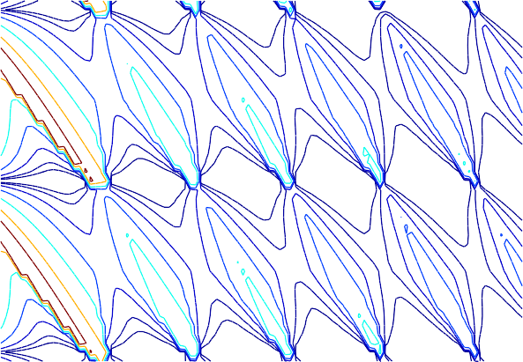
Circular Orbit Rendezvous Cost (1 of 2)
Motivation Maneuvers SSV P2P Conclusions
300
0.3
0.5
1
10 7 ₄ 2
200
₂ 4
1 ₂ ₄
Lead angle θ ₀ (deg)
100
0
0.3
0.5
0.3
2 0.5
−100
4 1
−200
−300
1
2
3 4
5
6
Transfer time t _{f} (TU)

Slide 12
Circular Orbit Rendezvous Cost (2 of 2)
Motivation Maneuvers SSV P2P Conclusions
14
12
No coasting Coasting
10
8
6
4
2
Δ V (TU)
0
0
1
2
3
Time (TU)
4
5
6

Slide 13
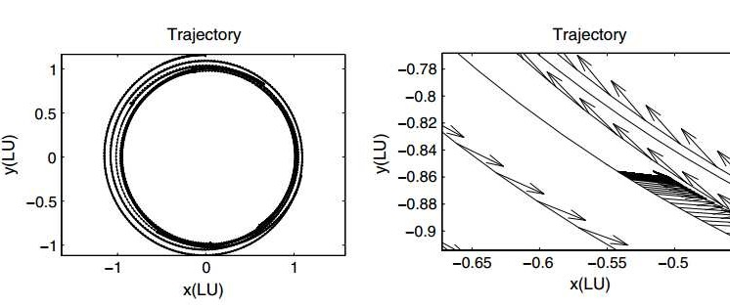
Low-Thrust Rendezvous
Motivation Maneuvers SSV P2P Conclusions
Lower the propulsive cost of missions
Enhance the flexibility of missions

Slide 14

Presentation Overview
Motivation Maneuvers SSV P2P Conclusions
Motivation
Optimal Transfer for a Spacecraft
3
Maneuvers by a Single Servicing Spacecraft
4 Peer-to-Peer Maneuvers
5
Concluding Remarks

Slide 15
Problem Statement
Motivation Maneuvers SSV P2P Conclusions
Service vehicle needs to visit m out of n candidate targets
s₁, s₂, . . . , s_{n}
Sequence σ : J ›→ I, where J = {1, 2, . . . , m} and
I = {1, 2, . . . , n}
Time at which transfers take place: τ_{i} , where i ∈ J , Time duration of the maneuvers: t (σ(i ), σ(j )), where i , j ∈ J , Maximum mission time T
Objective is to minimize cost of a sequence
min C(σ(I))
σ(I)

Slide 16
Basic Feasible Solution
Motivation Maneuvers SSV P2P Conclusions
Set time duration for the transfers to be equal at the beginning
T
m + 1
t (σ(i ), σ(i + 1)) =
, for all i ∈ I
Cost is uniquely defined for each transfer (i , j ), only a subset of these transfers are considered based on some user-defined value η
E₀ = E\{(i , j ) : c (i , j ) > c + η(c¯ − c )}
The elements of σ(J ) are picked in m iterations, with the element k being picked in the k ^{th} iteration
(k − 1, k ) ∈ E_{k−1}
Selection of a target will make irrelevant several transfers that are dropped from the set being considered

Slide 17
Local Search (1 of 2)
Motivation Maneuvers SSV P2P Conclusions
Difference between two sequences:
δ (σ₁, σ₂) = {k : σ₁(k ) ƒ= σ₂(k )}
Distance between two sequences is simply the cardinality of the difference between them:
d (σ₁, σ₂) = |δ (σ₁, σ₂) |
Neighborhood of the sequence is given by all sequences that have distance less than or equal to k

Slide 18
Local Search (2 of 2)
Motivation Maneuvers SSV P2P Conclusions
We consider k ≤ 2
(a) {0, 3, 4, 1, 0} and {0, 3, 2, 1, 0}
(b) {0, 3, 4, 1, 0} and {0, 3, 1, 4, 0}
S3
S3
S2
S2
S0
S0
S4
S4
S1
S1
(a)
(b)

Slide 19
Numerical Example
Motivation Maneuvers SSV P2P Conclusions
Visiting 5 satellites out of 8 in a circular orbit.
 | Basic Feasible Solution | Cost (DU/TU) | Targets Not Visited
- | s₀ → s₅ → s₂ → s₇ → s₃ → s₈ → s₀ | 0.6730 | s₁, s₄, s₆
1 | s₀ → s₅ → s₂ → s₇ → s₃ → s₁ → s₀ | 0.6166 | s₄, s₆, s₈
2 | s₀ → s₅ → s₁ → s₇ → s₃ → s₂ → s₀ | 0.5820 | s₄, s₆, s₈
3 | s₀ → s₅ → s₁ → s₇ → s₄ → s₂ → s₀ | 0.0036 | s₃, s₆, s₈
4 | s₀ → s₅ → s₁ → s₆ → s₄ → s₂ → s₀ | 0.0025 | s₃, s₇, s₈
5 | s₀ → s₅ → s₁ → s₆ → s₄ → s₂ → s₀ | 0.0025 | s₃, s₇, s₈

Slide 20
Optimal Transfer Time Allotments
Motivation Maneuvers SSV P2P Conclusions
6 _{A}
i0
5
4
3
2
Δ V (TU)
B A
1
i1 i1
B ₂ A
i
^{i2}B
A _{B}
^{A} B ^{A} B
i3
0
i3 i4
^{i4} i5 ^{i5} i6
5 6
0 1
2 3 4
Time (TU)
Binary Integer Programming Problem (Shen and Tsiotras, 2003)
Iterative algorithm: avoid the solution of the binary integer programming problem (ASC, 2015)

Slide 21

Presentation Overview
Motivation Maneuvers SSV P2P Conclusions
Motivation
Optimal Transfer for a Spacecraft
3
Maneuvers by a Single Servicing Spacecraft
4 Peer-to-Peer Maneuvers
5
Concluding Remarks

Slide 22
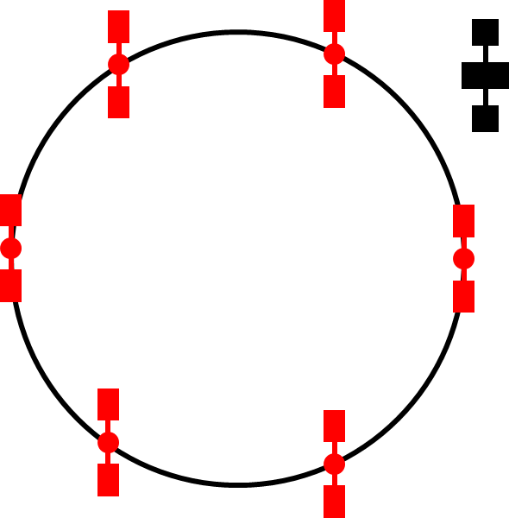
Problem Statement
Motivation Maneuvers SSV P2P Conclusions
Given
Fuel-deficient satellites Service spacecraft Satellite characteristics
Maximum time for mission Allow
Orbital transfers for delivery of fuel to fuel-deficient satellites
Goal
Minimum fuel expenditure during the overall refueling mission
All satellites must be fuel-sufficient at the end of refueling mission

Slide 23
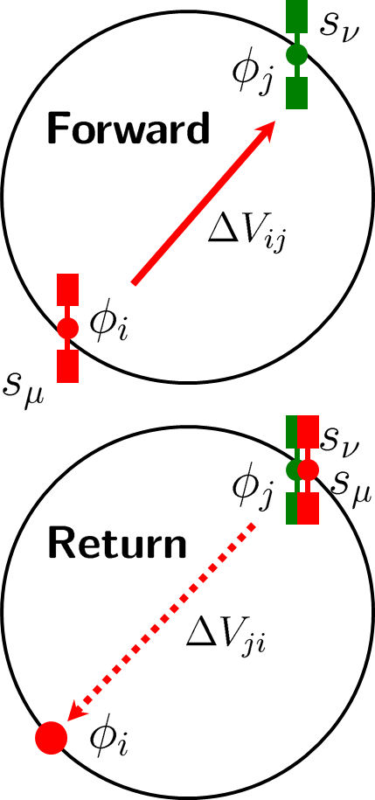
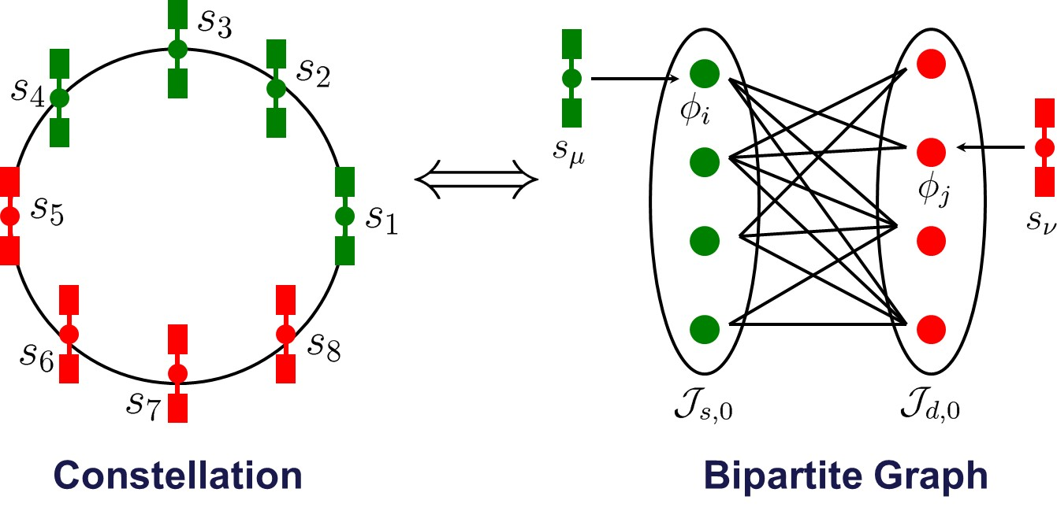
P2P Maneuver and Constellation Graph
Motivation Maneuvers SSV P2P Conclusions
Feasible P2P Maneuvers
Active satellites have enough fuel to complete their forward trips
Both satellites must be fuel-sufficient at the end of a P2P maneuver
Satellite roles (active/ passive) not known apriori!

Slide 24
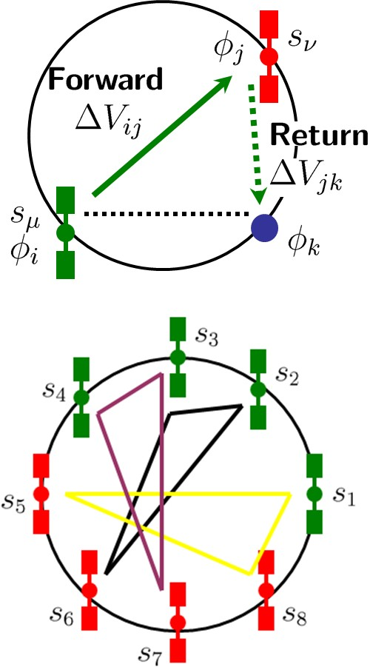
NP-hard P2P Problem
Motivation Maneuvers SSV P2P Conclusions
Assumption: All satellites are similar, perform similar functions and can interchange their orbital positions.
3-index assignment problem
Good-quality solutions
*Dutta and Tsiotras, “An Egalitarian Peer-to-Peer Satellite Refueling Strategy,” Journal of Spacecraft and Rockets, Vol. 45 (3), 2008, pp. 608-618.
*Coene, Spieksma, Dutta and Tsiotras, “On the Computational Complexity of P2P Refueling Strategies,” INFOR: Information Systems and Operational Research, Vol. 50, No. 2, 2012, pp. 88-94.
Figure: E-P2P Maneuver.

Slide 25
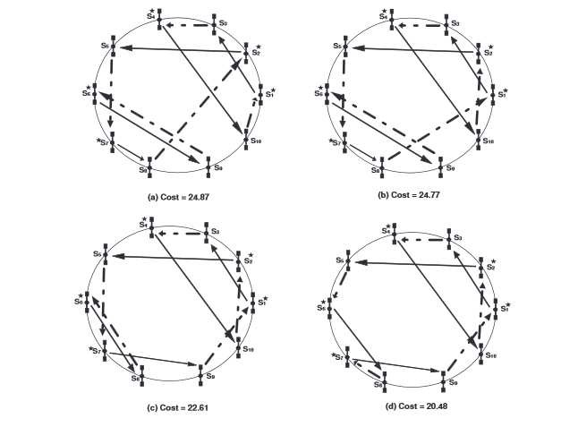
P2P Local Search
Motivation Maneuvers SSV P2P Conclusions

Slide 26

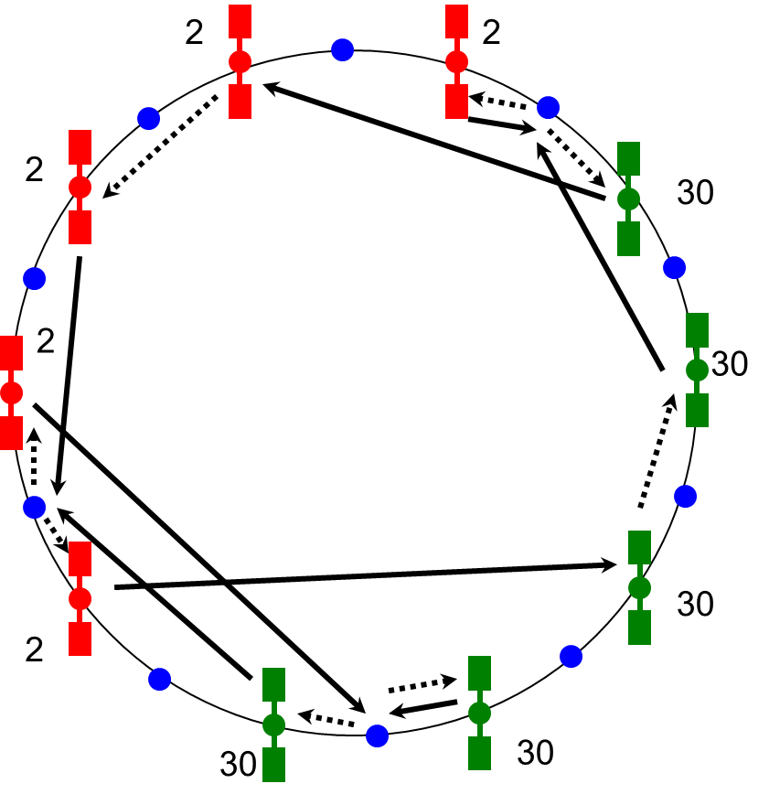
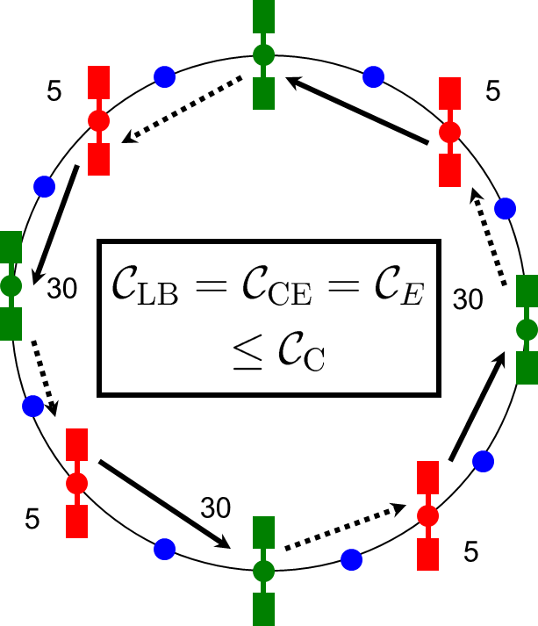
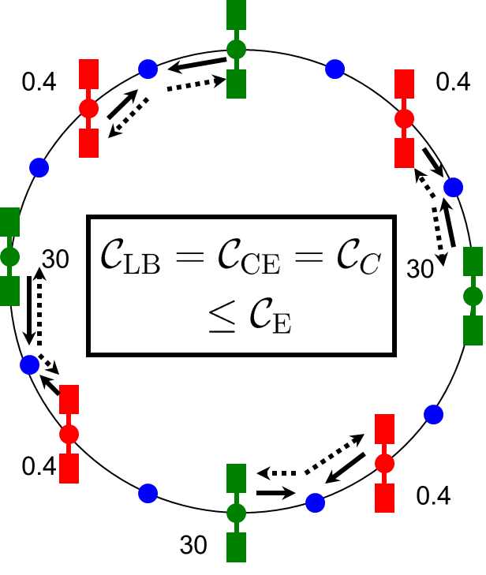
General P2P Strategy
Motivation Maneuvers SSV P2P Conclusions
Lower Bound Computation
Bipartite matching Solvable in polynomial time
C-P2P + E-P2P
Theorem
C_{LB} ≤ C_{CE} ≤ min{C_{C}, C_{E}}
Figure: C-P2P Maneuver. Figure: Global Minima (Cost = Lower Bound).
*Dutta and Tsiotras, “A Network Flow Formulation for Cooperative Peer-to-Peer Refueling Strategies,” Journal of Guidance, Control and Dynamics, Vol. 33(5), 2010, pp. 1539-1549.

Slide 27
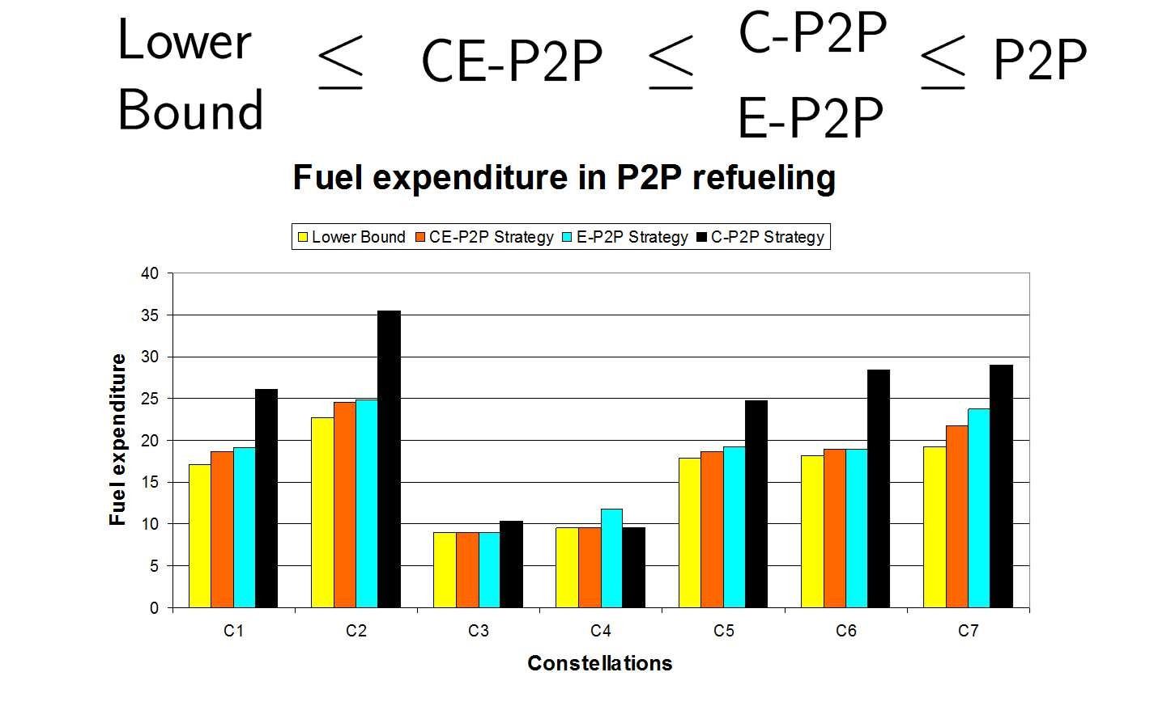
Comparison of (Impulsive) P2P Strategies
Motivation Maneuvers SSV P2P Conclusions
*Dutta, “Optimal Cooperative and Non-Cooperative Peer-to-Peer Maneuvers for Refueling Satellites in Circular Constellations,” Ph.D. Dissertation, Georgia Institute of Technology, Atlanta GA USA, 2009.

Slide 28

Presentation Overview
Motivation Maneuvers SSV P2P Conclusions
Motivation
Optimal Transfer for a Spacecraft
3
Maneuvers by a Single Servicing Spacecraft
4 Peer-to-Peer Maneuvers
5
Concluding Remarks

Slide 29
Concluding Remarks
Motivation Maneuvers SSV P2P Conclusions
GRASP Methodology is useful for both types of multi-rendezvous maneuver planning problem
Good-quality solutions for P2P servicing problem
Preliminary framework developed for SSV case
Straightforward to incorporate operational constraints like mandatory target visits and imposed roles on satellites
GRASP methodology can incorporate low-thrust transfers and cooperative rendezvous maneuvers
Future research focussed on extending the studies in a number of ways

