Slide 1
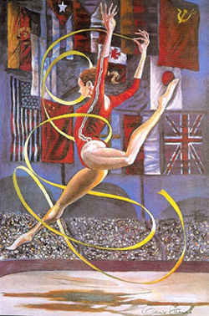
Too much of a good thing
The Female Athlete Triad:
Toward improved screening
and management
Asma Javed
Pediatric and Adolescent Gynecology
Mayo Clinic, Rochester

Slide 2
Disclosure
No relevant financial disclosure
No conflict of interest

Slide 3
Objectives
Define the components of the female athlete triad and their epidemiology.
Review current screening and management guidelines and address barriers to identification.
Devise a plan for primary care physicians to screen for, identify and treat the triad.

Slide 4

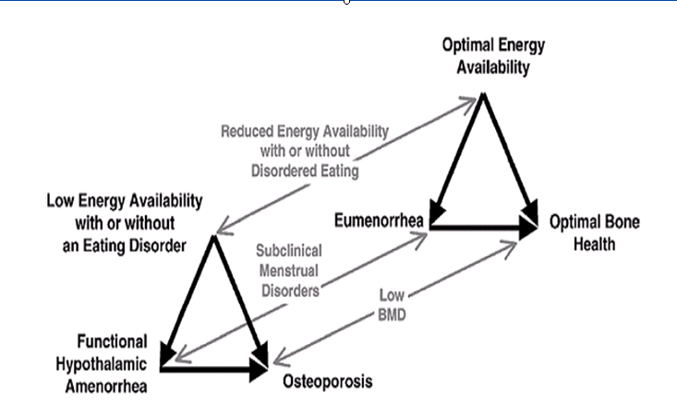


Female Athlete Triad
First defined in 1992 by American College of Sports Medicine as presence of:
Eating disorder
Amenorrhea
Osteoporosis
Med Sci Sports Exerc 1992 revised 2007. American College of Sports Medicine position stand. The female athlete triad.

Slide 5



Trends: ‘Think of them as epidemics’
Malcolm Gladwell ‘The Tipping point’
Notes:
5
little changes can have big effects; when small numbers of people start behaving differently, that behavior can ripple outward until a critical mass or "tipping point" is reached, changing the world. Gladwell's thesis that ideas, products, messages and behaviors "spread just like viruses do" remains a metaphor as he follows the growth of "word-of-mouth epidemics" triggered with the help of three pivotal types. These are Connectors, sociable personalities who bring people together; Mavens, who like to pass along knowledge; and Salesmen, adept at persuading the unenlightened. (Paul Revere, for example, was a Maven and a Connector). Gladwell's applications of his "tipping point" concept to current phenomena--such as the drop in violent crime in New York, the rebirth of Hush Puppies suede shoes as a suburban mall favorite, teenage suicide patterns and the efficiency of small work units--may arouse controversy. For example, many parents may be alarmed at his advice on drugs: since teenagers' experimentation with drugs, including cocaine, seldom leads to hardcore use, he contends, "We have to stop fighting this kind of experimentation. We have to accept it and even embrace it." While it offers a smorgasbord of intriguing snippets summarizing research on topics such as conversational patterns, infants' crib talk, judging other people's character, cheating habits in schoolchildren, memory sharing among families or couples, and the dehumanizing effects of prisons, this volume betrays its roots as a series of articles for the New Yorker, where Gladwell is a staff writer: his trendy material feels bloated and insubstantial in book form

Slide 6
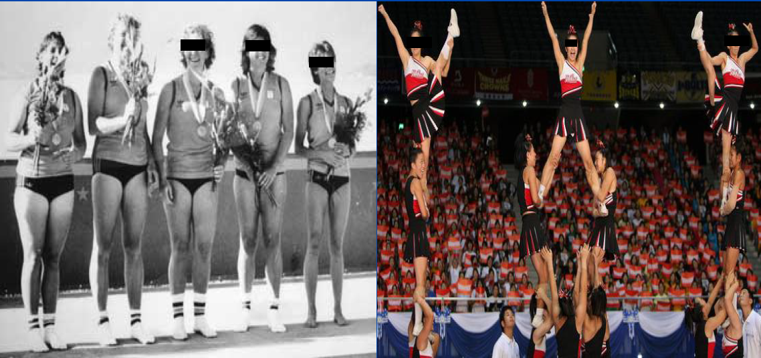
“Tipping Point” in female athletics
Title IX: Educational Amendment Act 1972
1972 - 1 in 27 high school girls played a varsity sport.
2010- 1 in 2 high school girls played a varsity sport.
NFSHSA. 2009-10 high school athletics participation survey.
Notes:
6
the Educational Amendment Act of 1972 mandated equal access to sports participation in public schools and universities for men and women.

Slide 7
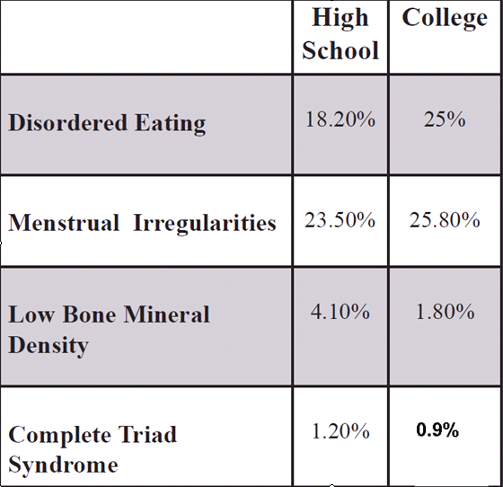
How common is the Female Athlete Triad?
Lean/aesthetic sport Vs. Non-Lean sport athletes - Prevalence 2-3 times higher
The Prevalence of Disordered Eating, Menstrual Dysfunction, and Low Bone Mineral Density among US Collegiate Athletes. International Journal of Sport Nutr Exercise Metab; 2006
Prevalence of the Female Athlete Triad Syndrome Among High School Athletes. Archives of Pediatrics & Adolescent Medicine 2006

Slide 8
How does the triad occur?
Key Feature: Low energy availability
Energy availability = Energy Intake – Exercise Energy Expenditure
Energy Availability > Resting Metabolic Rate
Low energy availability < Resting Metabolic Rate
Normal energy availability- 45 kcal/kg FFM/day
LH pulsatility disrupted < 30 kcal/kg FFM/day
No specific body fat percentage below which athlete is at risk
Loucks A & Nattiv A. The female athlete triad. Lancet 2009; 366:549-550.

Slide 9
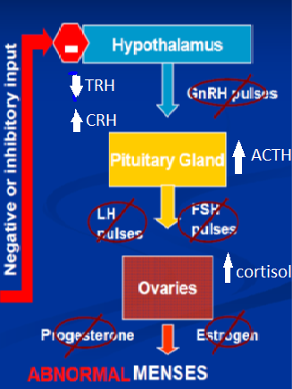
Female Athlete Triad: Pathophysiology
Menstrual dysfunction
Primary Amenorrhea
Secondary Amenorrhea
Oligomenorrhea
Subclinical menstrual disorders
Menstrual dysfunction
is not a normal part of
training!
Javed et al Female Athlete Triad: Toward improved screening and management. Mayo Clin Proc 2013

Slide 10
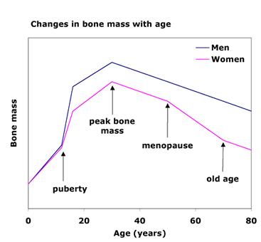
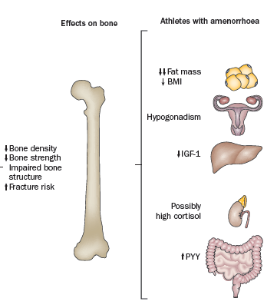
Female Athlete Triad: Pathophysiology
Bone Mineral Loss (Low estrogen and energy)
Females gain more than 50% of skeletal mass during adolescence
Amenorrheic adolescent athletes lose 2% of bone mass/yr (menopause)
Female athlete triad and stress fractures. Orthop Clin North Am. 2009
Increased vertebral bone mineral in response to reduced exercise in amenorrheic runners.West J Med.1987

Slide 11
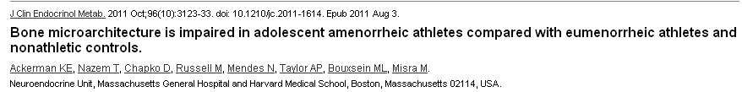
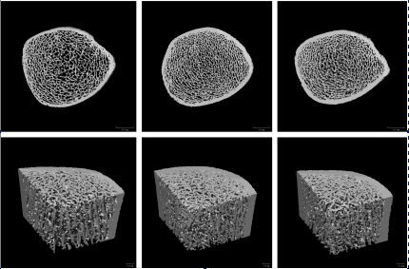
Is exercise good or bad?
Amenorrheic Eumenorrheic Non athletes
athletes (AA) athletes (EA)
Notes:
11
Athletes with amenorrhea have 2-4 risk of stress fractures than athletes with normal menstrual function
Exercise is good in the presence of normal menstrual function

Slide 12
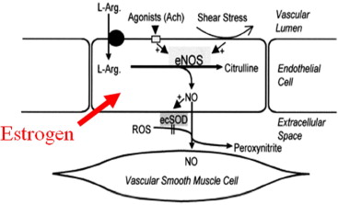
Female Athlete Tetrad?
Endothelial dysfunction has been reported in young athletes, similar to post-menopausal woman
May herald premature cardiovascular events and further adverse effects on bone in amenorrheic athletes.
Lanser EM et al The female athlete triad and endothelial dysfunction. PM R.2011
Notes:
22 dancers

Slide 13
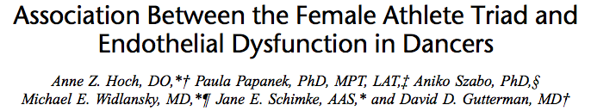
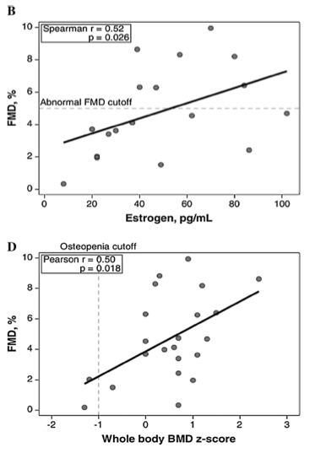
Study population: professional dancers 18-35 yo
N = 22
Outcome: flow mediated dilation (FMD)
Result: FMD values significantly correlated with estrogen and BMD
Conclusion: Endothelial dysfunction in professional dancers correlates with low estrogen and BMD which has implications on CV and bone health.
Hoch et al Association between the female triad athlete and endothelial dysfunction in dancers Clin J Sport Med, 2011

Slide 14
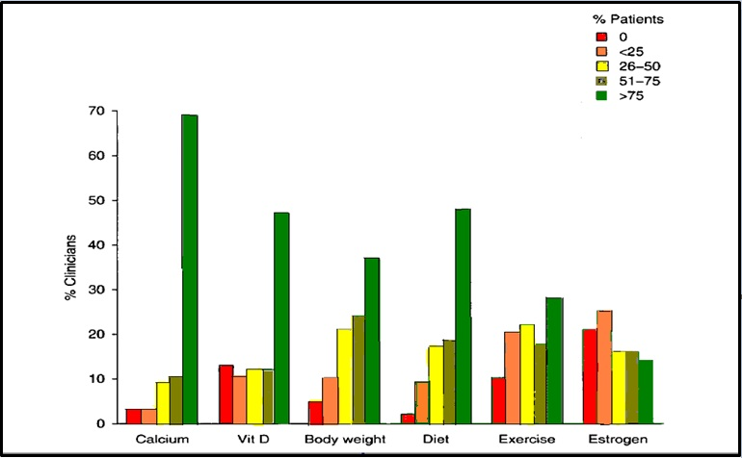

Female athlete triad: How are we doing?
2009- 29% of 128 physicians surveyed correctly identified all 3 triad components.
Clinician practices for the management of amenorrhea in the adolescent and young adult athlete. J Adolesc Health 2007 Apr
Physician Recognition, Evaluation, and Treatment of the Female Athlete Triad Elizabeth Joy Abstract 793 ACSM 2009

Slide 15
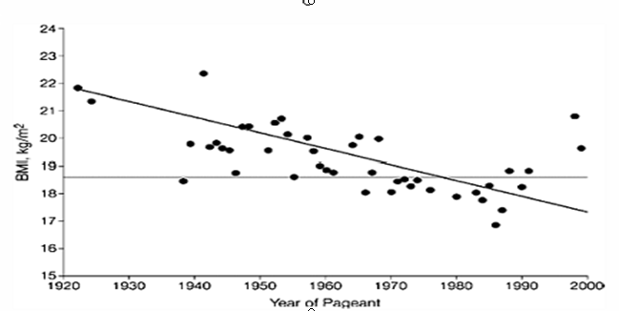
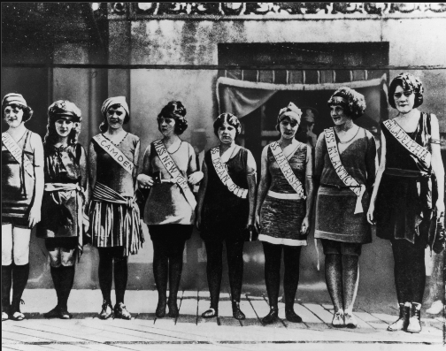
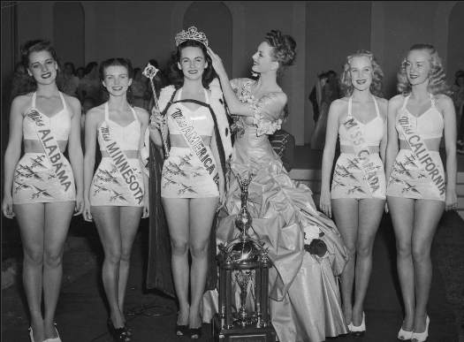

What are the barriers to evaluation?
BMI changes over time
What is the ‘ideal’ body weight?
1927
1946
2012
Is Miss America an undernourished role model? JAMA. 2000 Mar 22-29;283(12):1569.
Notes:
15
59% of high school student girls dissatisfied with body image

Slide 16
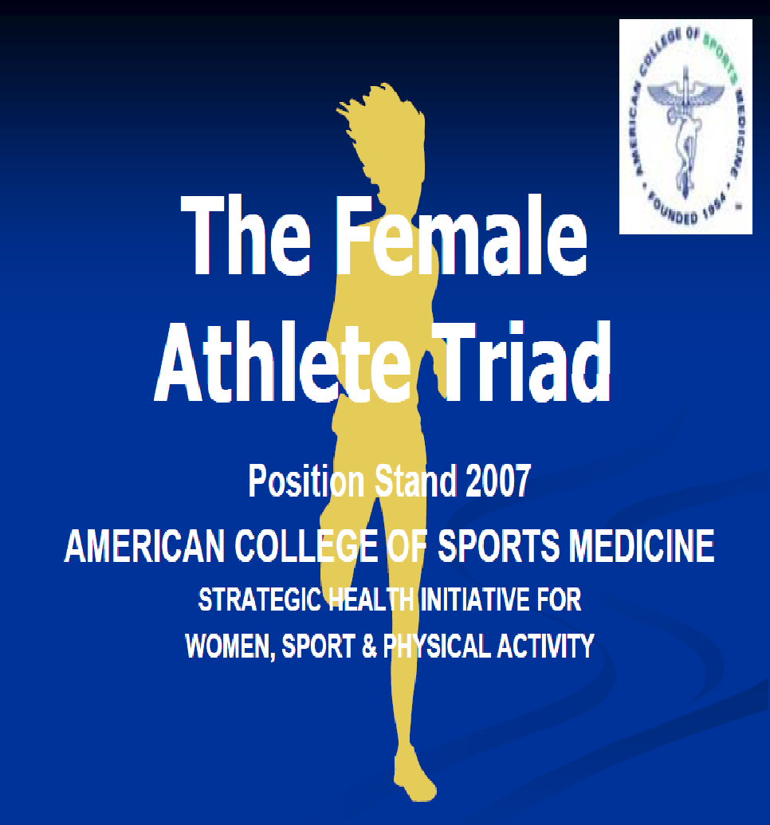
Female Athlete Triad
Screening, Diagnosis and Management
Current recommendations provided by The Female Athlete Triad Coalition

Slide 17
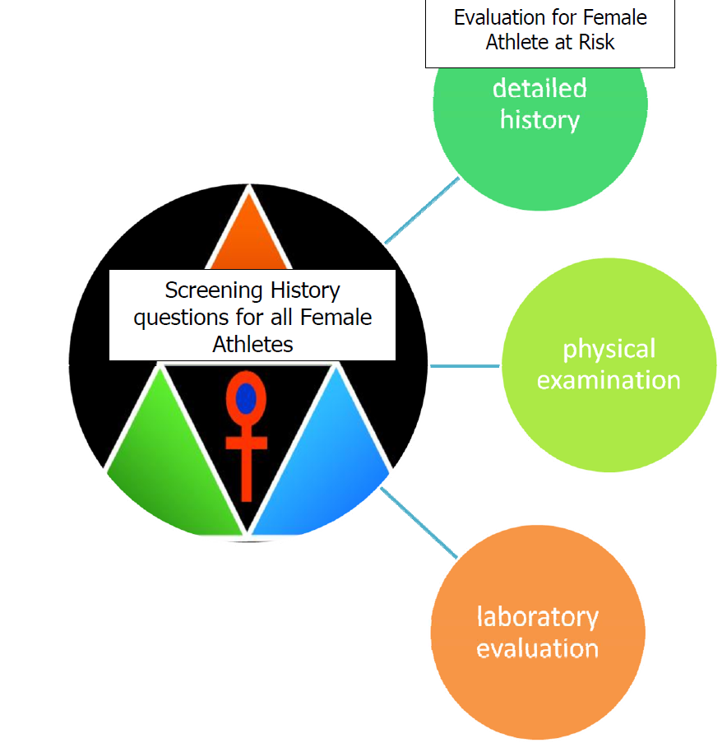
Screening recommendations
Screen all female athletes with a 12 question yes/no female athlete triad questionnaire
For those defined as ‘at risk’ for the triad, detailed interview and additional physical examination and/or laboratory testing recommended.
Female athlete Triad coalition 2009, revised 2014

Slide 18
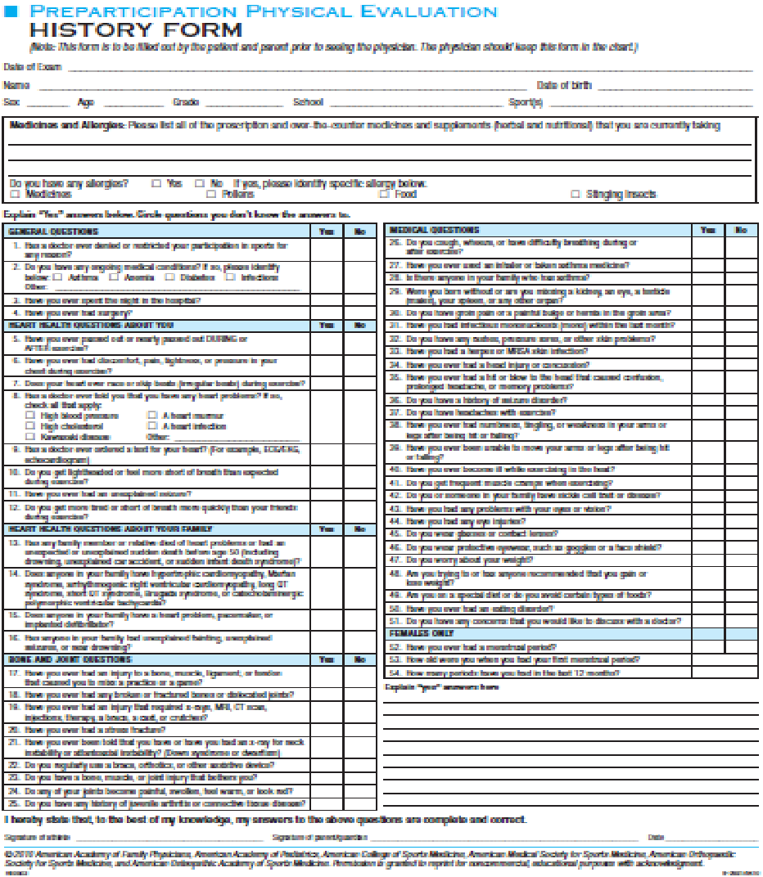
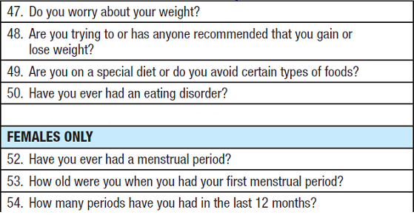

AAP/AAFP Screening
7 of 12 items recommended by triad coalition present
2010 American Academy of Family Physicians, American Academy of Pediatrics, American College of Sports Medicine, American Medical Society for Sports Medicine, American Orthopaedic Society for Sports Medicine, and American Osteopathic Academy of Sports Medicine.

Slide 19
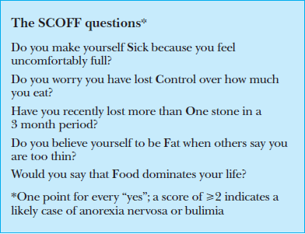
The ‘at risk’ female athlete:
Detailed Evaluation
Low energy Availability
Screening Tools for
Eating Disorders:
ESP, SCOFF* for physicians
Referral to registered dietitian
3- or 7-day food record
Resting and Exercise energy expenditure
Morgan JF, Reid F, Lacey JH (2000). "The SCOFF questionnaire: a new screening tool for eating disorders.". West J Med 172 (3)

Slide 20
The ‘at risk’ female athlete
Detailed Evaluation
Athletic amenorrhea
Diagnosis of exclusion
Rule out pregnancy
Chronic illness - CBC, CMP, ESR
Thyroid or ovarian dysfunction – TSH, LH, FSH
Pituitary tumor- Prolactin, consider imaging
Adrenal pathology- testosterone, DHEA-S, 17-OHP
Progesterone Challenge
  - Medroxyprogesterone acetate orally 5-10 mg for 10 days
Medical concerns in the female athlete Pediatrics Sept 2000, revised 2010

Slide 21
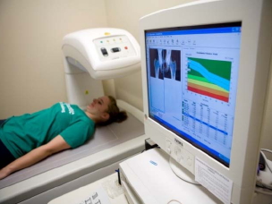
The ‘at risk’ female athlete
Detailed Evaluation
Bone Mineral Loss
(ISCD) recommends use of age and sex matched Z-scores
The ACSM recommends DXA scans for premenopausal women with
(i) oligomenorrhea or amenorrhea >6 months or
(ii) disordered eating > 6 months;
(iii) stress fracture
Sports Med. 2011 Jul. Ducher. Obstacles in the optimization of bone health outcomes in the female athlete triad.

Slide 22

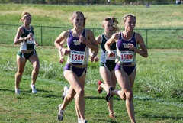
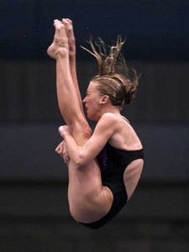
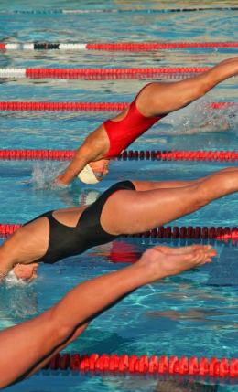
Female athlete Triad: Management
Multidisciplinary Management
Non pharmacologic
Pharmacologic
Waldrop, J. Early identification and interventions for female athlete triad. Journal of Pediatric Health Care. 2005
Temme KE, Hoch AZ. Recognition and rehabilitation of the female athlete triad/tetrad: a multidisciplinary approach. Curr Sports Med Rep. 2013

Slide 23

Non pharmacologic Management
Increase energy intake, Reduce energy expenditure
Strongest evidence- Wt. gain (1-2 kg) or 10% less exercise - Resumption of menses in 11 months
Eat by discipline, not appetite
Psychotherapy for athletes with ED
Early referral to mental health provider
Loucks A & Nattiv A. The female athlete triad. Lancet 2005
J. Casper et al Resumption of menses with non-pharmacologic management in
amenorrheic collegiate athletes Clin J Sport Med 2006

Slide 24

Non pharmacologic Management
Change work-out routine from
cardiovascular to weight-training
Progressive high intensity training
Plyometric exercises
The role of the physical therapist is crucial
Papanek PE. The female athlete triad: an emerging role for physical therapy. J Orthop Sports Phys Ther 2003; 33(10); 594-614
Pantano KJ. Strategies used by physical therapists in the U.S. for treatment and prevention of the female athlete triad. Phys Ther Sport 2009

Slide 25
What are the barriers to evaluation?
Inadequate knowledge regarding the triad, brief visits
Menstrual cycles >35 days in 65% of girls 1-2 years post menarche
Athletes may welcome menstrual interruption
What is the ‘ideal’ body weight?

Slide 26
Pharmacologic Management
Estrogen therapy- Where is the evidence?
Few trials in athletes, mixed results
OCPs not of benefit in bone mass accrual in Anorexia.
Cyclic menses induced by OCP falsely reassuring.
OCPs decreases IGF-1 levels and free testosterone.
Estrogen Therapy: AAP Current recommendations
OCPs to prevent further loss of BMD in an athlete with amenorrhea > 16 years of age if BMD is decreasing despite adequate nutrition and body weight.
Cobh KL et al. The effect of oral contraceptives on hone mass and stress fractures in female runners. Med Sei Sports Exerc 2007
Warren MP et al. Persistent osteopenia in ballet dancers with amenorrhea and delayed menarche despite hormone therapy: a longitudinal study. Fértil Steril 2003
Rickenlund et al. Effects of oral contraceptives on body composition and physical performance in female athletes. Journal of Clinical Endocrinology & Metabolism 2004
Notes:
26
One hundred fifty competitive female runners ages 18-26 yr were randomly assigned to OC (30 microg of ethinyl estradiol and 0.3 mg of norgestrel) or control (no intervention) for 2 yr. Bone mineral density (BMD) and content (BMC) were measured yearly by dual x-ray absorptiometry. Stress fractures were confirmed by x-ray, magnetic resonance imaging, or bone scan. oligo/amenorrheic (N=50) or eumenorrheic runners (N=100

Slide 27

Pharmacologic Management
Calcium and vitamin D supplementation
Never prospectively assessed
IOC recommends calcium intake of 1500 mg/d
Vitamin D is 400 to 800IU/d
Future Directions
Bisphosphonates, Rh-IGF-1, Rh-Human Leptin, Transdermal estrogen
Recombinant Human Leptin in Women with Hypothalamic Amenorrhea Welt et al N Engl J Med 2004
Grinspoon et al. Effects of recombinant human IGF-I and oral contraceptive administration on bone density in anorexia nervosa. J Clin Endocrinol Metab 2002
Stewart GW, Brunet ME, Manning MR, et al. Treatment of stress fraetures in athletes with intravenous pamidronate. Clin J Sport Med 2005

Slide 28

Female Athlete Triad: Prevention
Change the Mindset, Involve Athlete: Educate physicians, physical therapists, dietitians, coaches, athletes, parents, athletic trainers and school administrators
Nutrition education: Reduce emphasis on body weight
Position of the American Dietetic Association, Dietitians of Canada, and the American College of Sports Medicine: Nutrition and Athletic Performance 2009
Female athlete triad coalition 2009
www.olympic.org/hbi

Slide 29

Resources
American College of Sports Medicine www.acsm.org
2. ACSM Female Athlete Triad Position Stand, 2007
http://www.femaleathletetriad.org/~triad/wpcontent/uploads2008/10ACSM_Fe
male_Athlete_Triad_Position_Stand_2007.pdf
3. American Dietetic Association Sports, Cardiovascular, and Wellness
Nutritionists (SCAN) Dietetic Practice Group www.scandpg.org
4. Female Athlete Triad Coalition www.femaleathletetriad.org/
5. International Olympic Committee NCAA Coaches Handbook, Managing the
Female Athlete Triad http://www.femaleathletetriad.org/wp-content/uploads/
2008/10/NCAA-Managing-the-Female-Athlete-Triad.pdf
6. National Athletic Trainers Association Position Statement: Preventing,
Detecting, and Managing Disordered Eating in Athletes, 2008
http://www.ncbi.nlm.nih.gov/pmc/articles/PMC2231403/
7. Nutrition and Athletic Performance Joint Position Paper
http://www.eatright.org/About/Content.aspx?id=8365
8. Women’s Sports Foundation www.womenssportsfoundation.org/

Slide 30
Thank You!
Please direct any questions to
Javed.asma@mayo.edu

