Slide 1

Consequences of Calcination:
A characterisation of composites
Ashutosh Naik

Slide 2
Focus Points
Introduction
Aims
Materials and Methods
Results
Conclusion

Slide 3
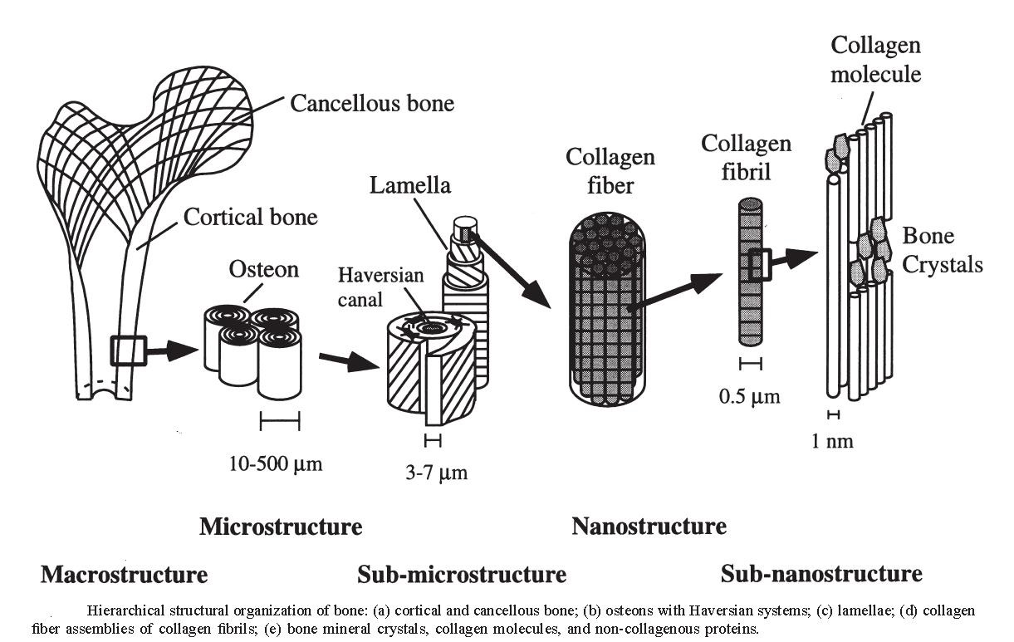
Introduction
Bone is a composite at the nanoscale.
*Jae Young Rho, Liisa Kuhn Spearing, Peter Zioupos- Mechanical properties and the hierarchical structure of bone. Medical Engineering and Physics. 20 1998, 92-102.

Slide 4
Introduction
HA (Ca₁₀ (PO₄)₆(OH) ₂) is used as a filler in polymer based composites.
One of the ways of altering the properties of the filler is calcination.
The atmosphere in which the calcination is carried out may also influence the properties of the filler and hence that of the composite.

Slide 5
Aims
Calcination of Hydroxyapatite (HA): Presence of surface OH groups.
Consequences: Effect on degradation and mechanical properties.

Slide 6
Materials and Methods
HA synthesis
Composite production
Degradation study
Mechanical properties

Slide 7
HA Synthesis
Synthesis of HA: HA was synthesized using an aqueous precipitation method based on the following formula
10Ca (OH)₂+ 6 H₃PO₄ Ca₁₀ (PO₄)₆ (OH)₂ + 18H₂O
The HA synthesised was then calcined in an atmosphere of air (calcined in air) as well as an atmosphere of humidified argon (calcined in wet) or left untreated (uncalcined HA).
The three powders were used as fillers in composites produced.

Slide 8
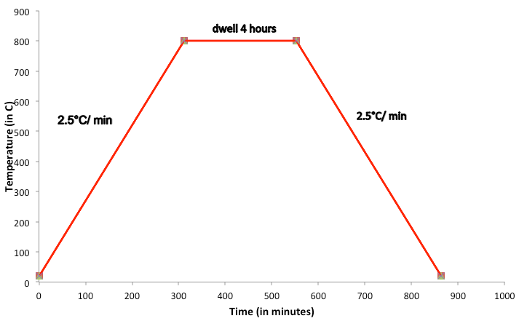
Temperature profile for Calcination
Fig: Temperature profile for calcining of HA powders

Slide 9
Composite production
PLGA (50:50) (Lakeshore Biomaterials) was used as the polymer and composites containing 30-wt% HA were produced.
The composites were produced using two steps;
-Solvent casting using acetone followed by
  -Injection moulding (12cm³, DSM Xplore).
Conditions | Values
Mould temperature | 35°C
Melt temperature | 140°C
Injection pressure | 5.0 bar
Filling and holding pressure | 2.0 bar each
Holding time | 3-6 seconds

Slide 10
Degradation study
Cylindrical shaped specimens produced using the method described were cut into discs of 2mm x 2mm using the Struers Accutom5(cutting speed 0.015-0.050m/s). The samples were then immersed in PBS in the ratio of 6mg/ml.
Total number of time points =24
Number of repeats = 3
Total number of samples =216

Slide 11
Mechanical properties
Elastic mechanical properties: DMTA (DMA Q800, TA Instruments, USA) was used. Dumbbell shaped specimens were used. Three repeats were carried out for each sample.
Conditions | Values
Sample length | 35mm
Sample width | 4.1 mm
Sample thickness | 2.1 mm
Frequency | 1, 10, 20,50 Hz
Temperature | -10°C to 120°C
Heating rate | 3°C/min

Slide 12
Mechanical properties
Plastic mechanical properties:
The Hounsfield (5 kN) machine was used.
Cylindrical shaped specimens were used.
The dimensions of the samples were 12mm x 6mm.
Three repeats were carried out for each sample.

Slide 13
Results
XRD spectrum of HA.
Effect of calcination- Degradation study.
Degradation Schematic.
Effect of calcination- Mechanical properties.

Slide 14
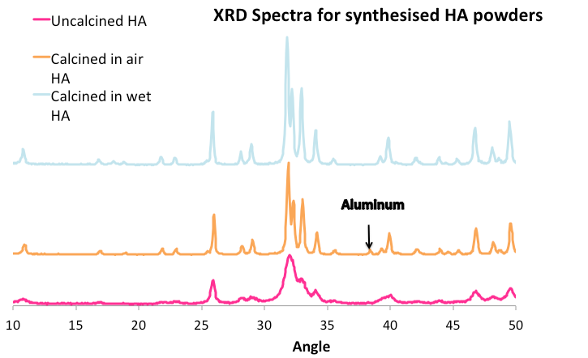
X-Ray Diffraction spectra for Synthesised HA

Slide 15
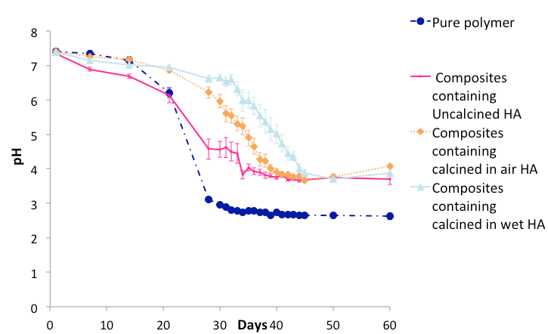
Effect of calcination-Degradation study

Slide 16
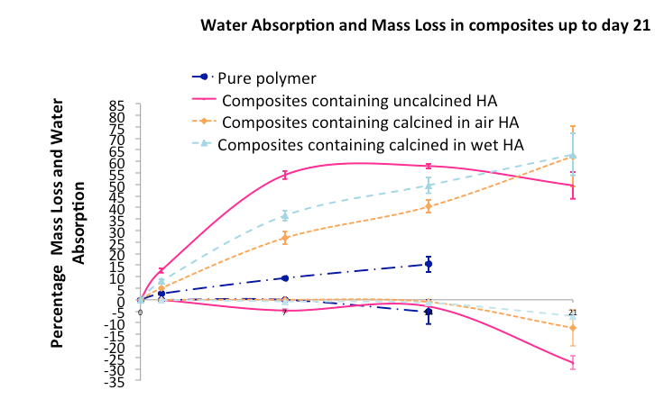
Effect of calcination-Degradation study

Slide 17
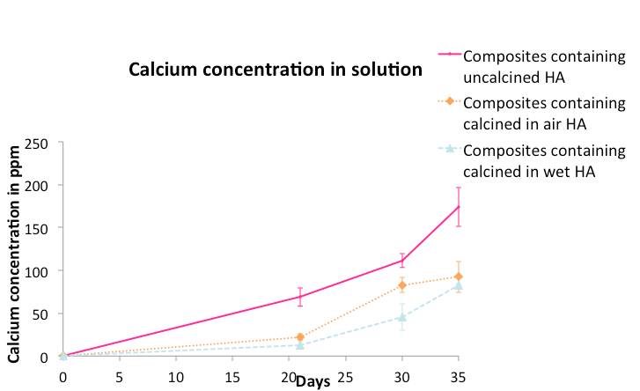
Effect of calcination-Degradation study

Slide 18
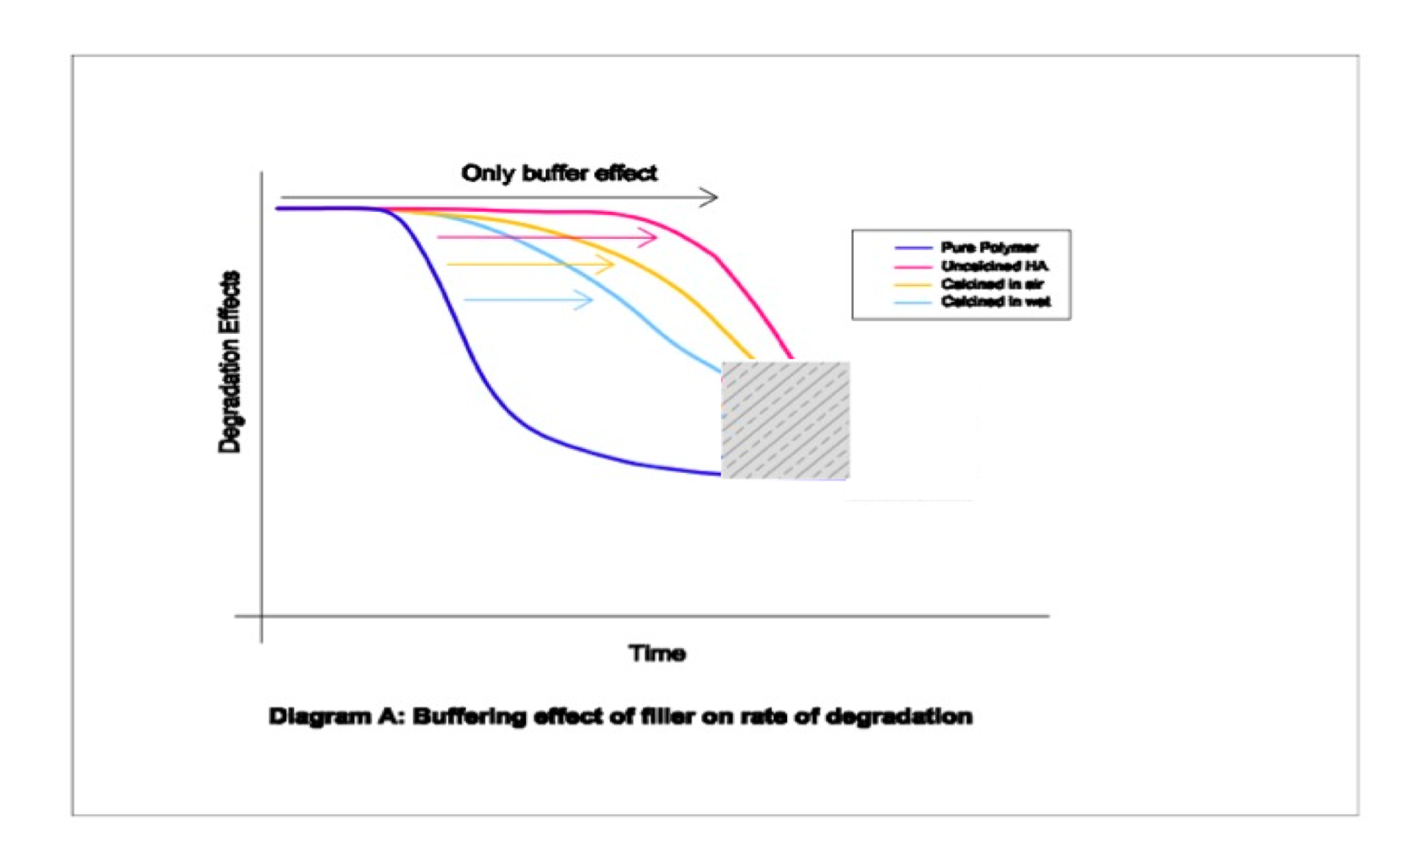
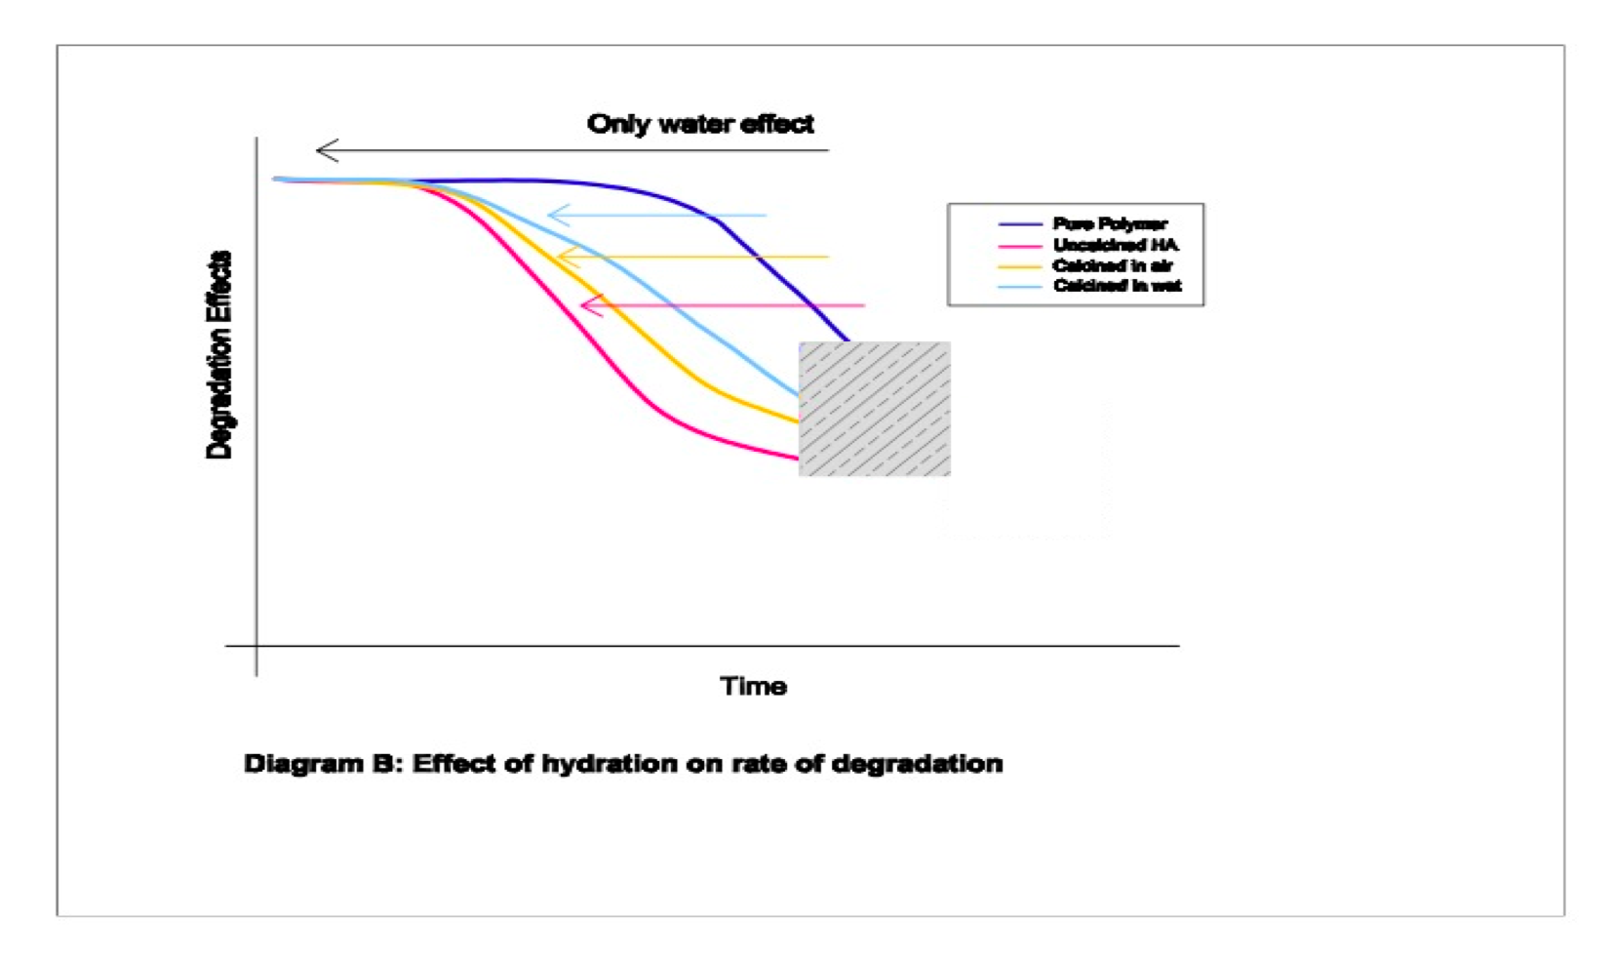
Degradation schematic

Slide 19
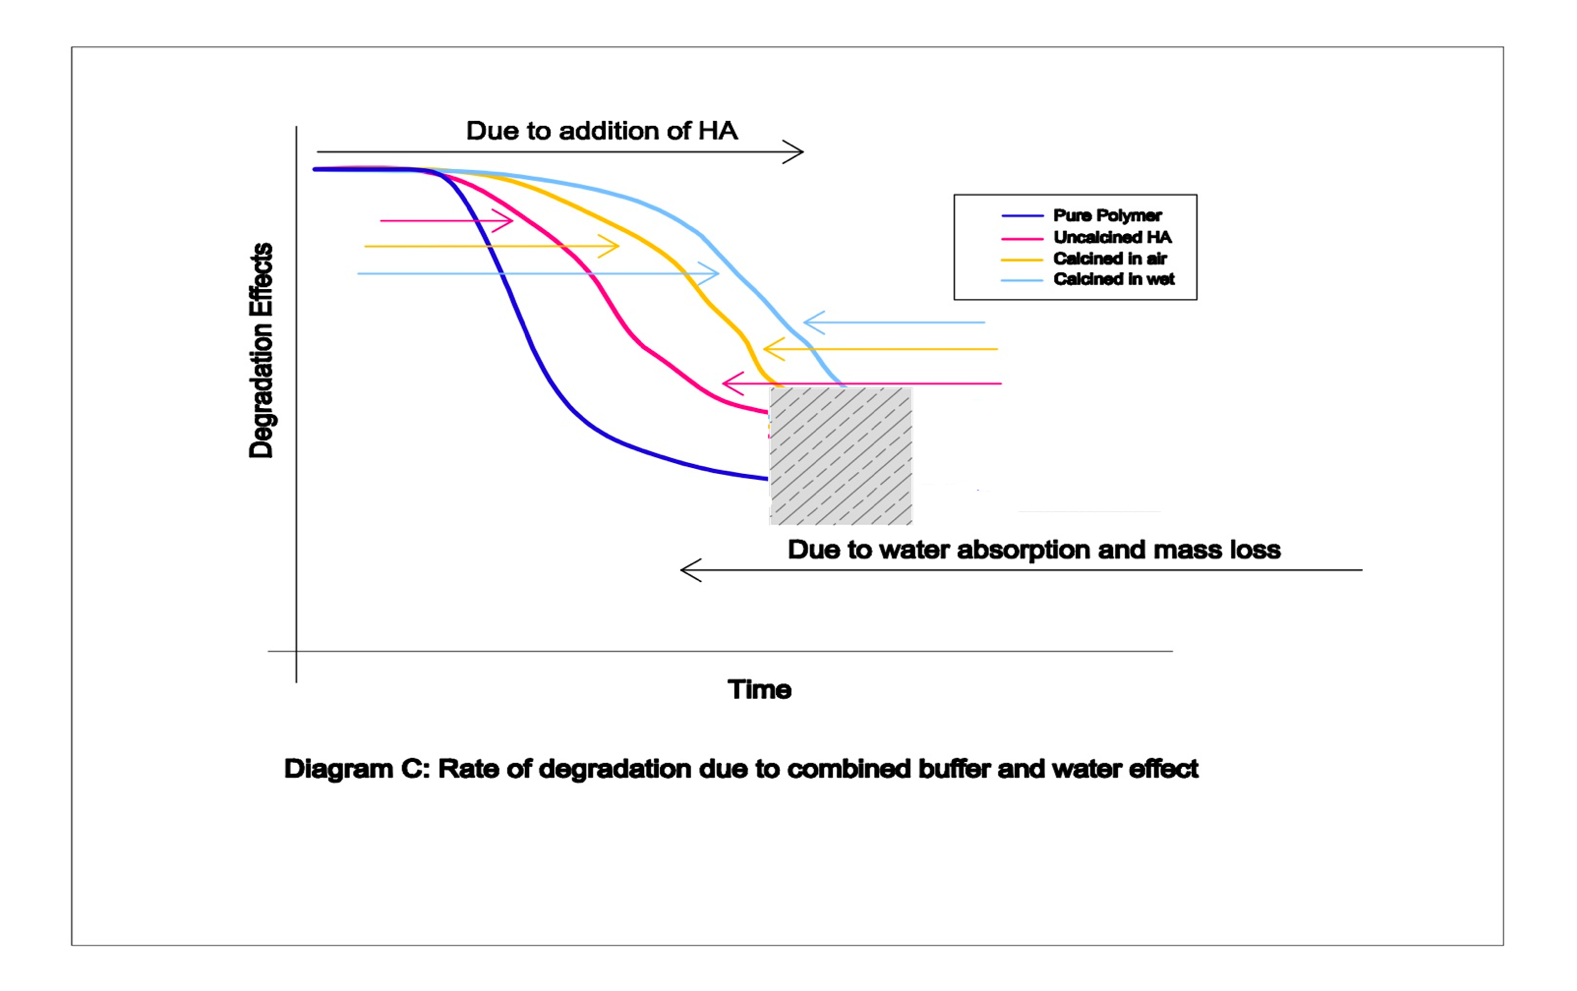
Degradation schematic

Slide 20
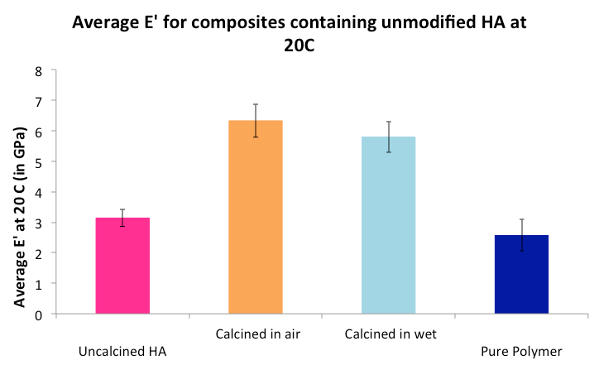
Effect of calcination-
Elastic mechanical properties

Slide 21
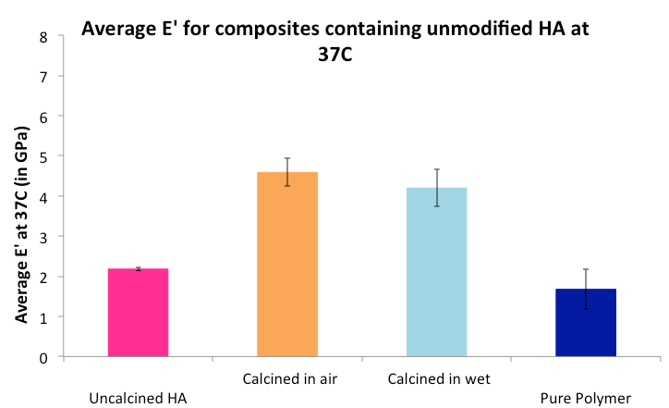
Effect of calcination-
Elastic mechanical properties

Slide 22
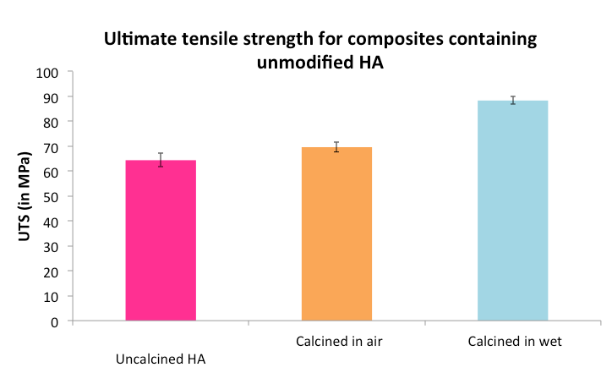
Effect of calcination-
Plastic mechanical properties

Slide 23
Conclusions
Calcination in different atmospheres improves the buffering effect of filler thus leading to a better degradation profile of the composite.
The values of dynamic storage modulus (E’) obtained under elastic loading conditions 5.8(±0.5)GPa,6.3(±0.5)GPa for HA calcined in an argon atmosphere and HA calcined in air were much higher compared to 3.1(±0.3) GPa for uncalcined HA.

Slide 24
Conclusions
The competing effects of particle-mediated water absorption and buffering have been demonstrated.
Further studies need to be conducted to understand the effect of calcination temperature on the properties of a composite.

Slide 25

Questions

