Slide 1
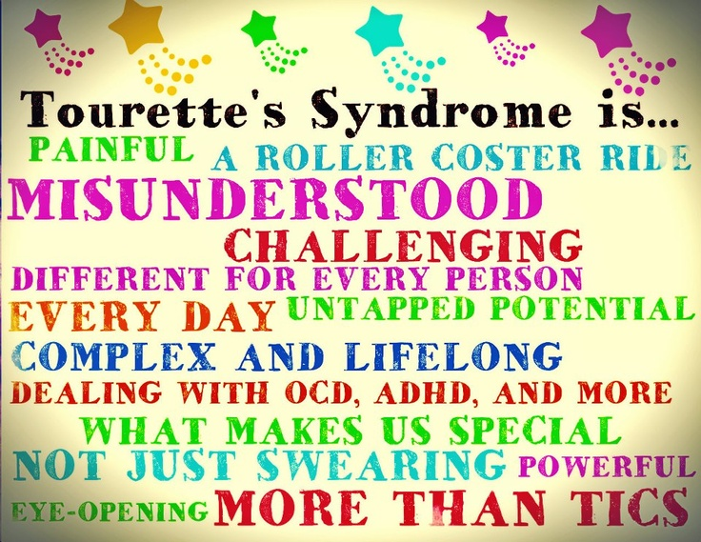

Slide 2
Tourette Syndrome and Comorbid Neuropsychiatric Conditions
Ashutosh Kumar, MBBS, MD
Assistant Professor
Department of pediatrics and neurology
Penn state milton hershey medical center
Notes:
-Good morning. I am very pleased to be here in the beautiful city of Prague and am very thankful to the organizing committee for giving me this opportunity to review TS and its comorbidities.

Slide 3
Disclosures
None for this presentation
Notes:
I have no disclosures to declare.

Slide 4
Objectives
Upon completion of the session, participants will be able to:
  List the criteria for Tourette Syndrome.
  Describe the natural history of TS.
  Describe the associated co-morbidities in patients with TS.
  Describe appropriate treatment goals and strategies for TS and associated co-morbidities.
Notes:
Upon completion…..

Slide 5
Introduction
Gilles de la Tourette syndrome (TS) is a neuropsychiatric condition characterized by both motor and phonic tics with the onset in childhood or adolescence.
First described by French physician Georges Gilles de la Tourette in 1885.
(DSM-V): TS is diagnosed clinically by:
  presence of multiple motor and one or more phonic tics
  lasting at least 1 year with the onset prior to age 18.
TS is commonly diagnosed between 2 and 15 years of age with the mean age of onset is 5–7 years.
Notes:
TS is a neuropsych…

Slide 6
Tics
Brief stereotypic paroxysmal motor activity or vocalization which is often preceded by a premonitory urge or sensation.
Premonitory urges are a cardinal feature of tics; often difficult to elicit this history in younger children.
Variable, with typically a waxing and waning course; however, severity typically peaks during early teenage years.
Tics typically start as simple tics and become more complex over the time.
Motor tics typically predate vocal tics.
Tend to abate in most patients by late teenage or adult years.
Notes:
What are tics?

Slide 7
Epidemiology of TS
Variable epidemiology depending on the population studied.
In one study, the prevalence of TS, reported to be 0.52 % .
More commonly affects males than females (ratio of approximately 4:1).
The prevalence of comorbidities: 85.7 %.
Over 70 % of patients had attention deficit hyperactivity disorder or obsessive compulsive disorder, and in around 30 % of the patients, mood, anxiety, and disruptive behavior were reported.
There are rare but serious cases of associated cervical myelopathy, stroke, and dissection secondary to violent motor tics.
Reports of increased prevalence of migraine in patients with TS.
Notes:
Tics are fairly prevalent as my next slide indicates…..

Slide 8
Pathophysiology
The exact pathophysiology is unclear.
It is considered to be a complex disorder, thought to be the effect of environment (infection, autoimmunity as well as perinatal problems) in a genetically predisposed individual.
Various studies suggested that TS is due to dysfunction in the cortico-striato- thalamo-cortical circuit.
The cause of the dysfunction in the cortico-basal ganglia structures is not clearly defined; abnormalities of the GABA pathway are postulated to cause the disinhibition seen in TS patients.
To simplify, the basal ganglia (caudate, striatum, and globus pallidus) is involved in the control of voluntary movements and abnormalities affecting these areas result in a variety of movement disorders including TS.
Notes:
Why do we get tics? The pathophysiology is rather complex however I have attempted to simplify this.

Slide 9
Treatment of Tics
Tics are often mild and do not impair function.
Most of these children can be managed with education and support at home and in school.
If tics reach the level of impairing function, treatment can involve CBIT (comprehensive behavioral intervention for tics) or pharmacologic interventions.

Slide 10
Treatment of tics: CBIT
CBIT is a cognitive behavioral treatment where a trained clinician can teach the patient to recognize the premonitory urge and then use habit reversal methods to “block” tics.
CBIT was shown to be efficacious in reducing tics in over 50% of patients in a controlled, prospective study.
Due to low side effects and good outcomes, this should be first line of treatment for all patients who are cognitively capable to participate.
Unfortunately, due to lack of trained clinicians and the time investment needed by families, CBIT is often not feasible.
Notes:
CBIT is…..

Slide 11
Treatment of Tics: Pharmacotherapy
Three classes of oral medication used in the treatment of tics; alpha agonists, antipsychotics and newer tic medications.
None of these medications can completely eliminate tics and all have side effects.
The first line: usually one of the alpha-agonists.
Several studies have demonstrated the efficacy of guanfacine and clonidine in decreasing tic severity.
No studies have looked at alpha-agonists efficacy vs. antipsychotics but it is generally accepted that the alpha-agonist efficacy is less as is the side effect profile.
Both clonidine and guanfacine are useful for relieving symptoms of ADHD so can be helpful in children with TS who have ADHD as comorbidity.
Notes:
We know that pharmacotherapy play an important role and may go hand in hand with CBIT. These drugs include…..
-The decision to start a medication should be a careful analysis of risks and benefits.
-The most common side effects from alpha-agonists are sedation, dizziness, irritability and headaches. Hypotension is usually not a problem for patients. Guanfacine tends to be less sedating than clonidine. Clonidine has a patch which is helpful for patients who cannot swallow pills. There is a long acting form of guanfacine.

Slide 12
Pharmacotherapy cont.
The only FDA-approved anti-psychotic medications for TS are haloperidol and pimozide, both block dopamine receptors.
Controlled clinical trials support their efficacy.
Risperidone, a newer atypical antipsychotic agent has been shown to lower tic severity in a randomized controlled trial also.
Due to extensive and more severe side effects, antipsychotics are not routinely used as a first line drug but can be very useful for patients with severe tics
Notes:
- The most frequent side effects of all antipsychotics are sedation, weight gain, depression and tardive dyskinesia. Tardive dyskinesia is very rare in this patient population. It is theorized that this may be because the inherent state of their dopamine receptors is possibly protective. Pimozide has been associated with prolongation of the the Q-T segment so close monitoring of EKG is required for patients on pimozide.

Slide 13
Pharmacotherapy cont.
Two of the newer drugs being used for tic treatment are tetrabenazine and topiramate.
Tetrabenazine is a dopamine depletor and has been shown in a case study to decrease tic severity.
Topiramate was shown to be effective in reducing tics in a small clinical study.
Notes:
-Side effects of Tetrabenazine include sedation, insomnia, restlessness and depression but not tardive dyskinesia. The absence of tardive dyskinesia as a side effect makes tetrabenazine an attractive option for treatment. No studies have compared Tetrabenazine to any of the other drug options. Randomized, larger studies with long term follow up are necessary to evaluate tetrabenazine.
- Side effects from Topamax include appetite suppression and cognitive side effects.

Slide 14
Botulinum toxin injection: Other Treatment options
Local intramuscular injections of botulinum relieve some focal motor and vocal tics temporarily (for 3-6 months) as seen in a small randomized controlled clinical trial.
Botox injections have been used for eye blinking and shoulder tics.
These injections seem to be effective in reducing tics as well as premonitory urge and pain.
Notes:
For non pharmacological options , botox appears to have some effectiveness in small clinical trials.

Slide 15
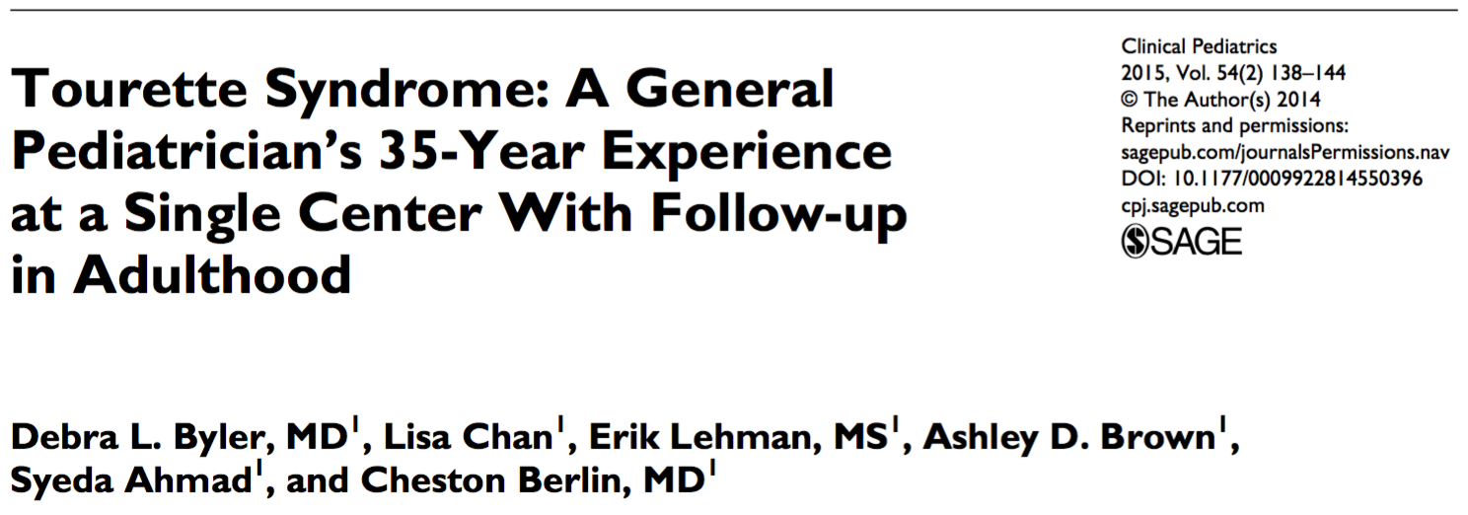
Penn State Experience of Tourette Syndrome
Notes:
I’d now like to briefly discuss our experience with TS at Penn state.

Slide 16
TS: Penn State experience
A retrospective analysis of a 35-year single-center experience with pediatric tics and Tourette syndrome.
482 charts from 1972 to 2007 were reviewed.
Follow-up surveys were mailed to last known address and 83 patients responded (17%).
Males constituted 84%.
Mean tic onset was 6.6 years.
At first visit, 83% had multiple motor tics and >50% had comorbidities.
Of those indicating a poor outcome, mean educational level was lower and attention deficit/hyperactivity disorder and learning disabilities were significantly higher.

Slide 17
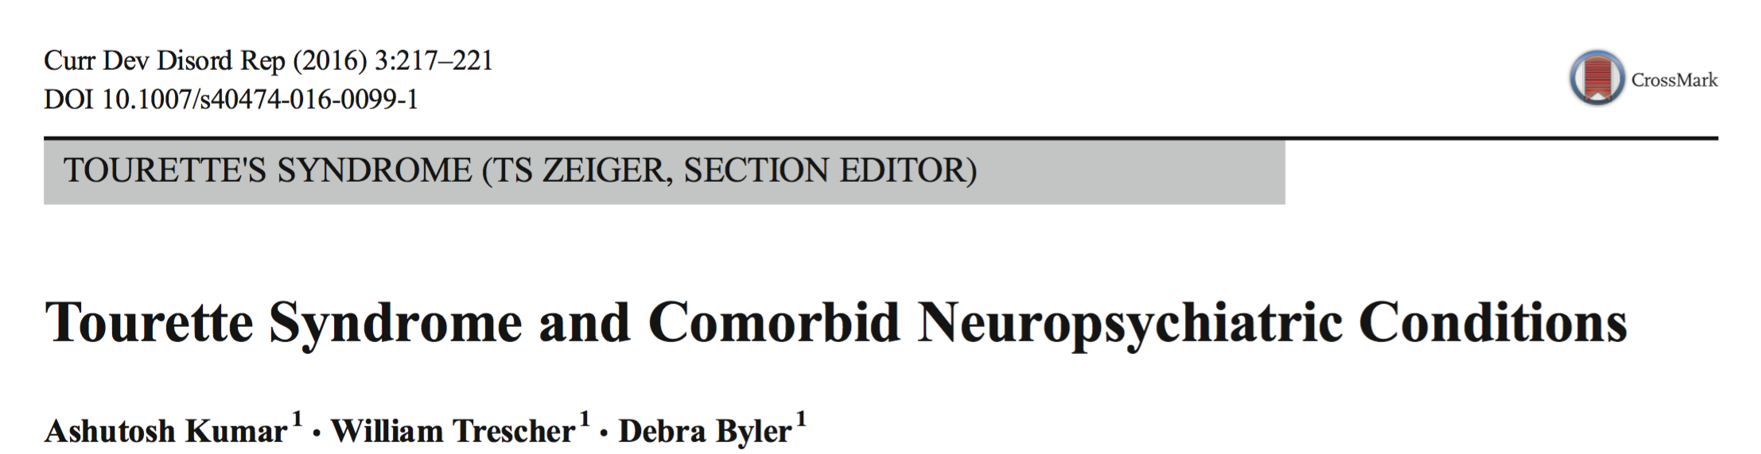
Notes:
- Our experience at Penn State prompted us to review comorbidities associated with TS and we are thankful to have had the opportunity to publish our review in the auspicious journal Current Dev. Disorders Rep. So for the next few minutes I will focus on the review article.

Slide 18
Neuropsychiatric Comorbidities
Comorbid conditions are often the main source of impairment in the TS patients.
They compromise overall well-being much more than the tic severity.
Because of the high rate of comorbidity, any patient presenting with tics should have a thorough evaluation for associated comorbidities.
Notes:
So….

Slide 19
ADHD
Most common comorbidity in the TS patients, ranging between 60 and 80 %.
Characterize by symptoms of inattention and hyperactivity/impulsivity.
ADHD symptoms precede the onset of tics by 2–3 years and begin around the age of 3–5 years.
The hyperactive subtype is predominant in the younger patients.
Inattentive type is more common in adult patients, who also have higher risk of substance abuse and aggressive behavior.
The pathogenesis of ADHD in TS patients is complex and includes environmental, genetic, and neurobiological factors.
Abnormal level of neurotransmitters (dopamine and glutamate) along with loss of normal globus pallidus symmetry is reported in both.
Notes:
- One of the most common comorbidity includes ADHD…

Slide 20
ADHD cont..
The treatment is multimodal : Combination of psychoeducation to the patient and family, cognitive behavioral therapy, and pharmacological interventions.
Three classes of medications are commonly used for the treatment of ADHD in TS patients.
  stimulants (methylphenidate, dextroamphetamine)
  alpha- agonists (clonidine, guanfacine),
  and norepinephrine reuptake inhibitors (atomoxetine).
Notes:
The treatment…..

Slide 21
ADHD cont.
Alpha-2 agonist (clonidine, guanfacine) are considered to be the first line treatment given proven efficacy for both tics and ADHD symptoms.
Stimulants are the second line of treatment, especially useful in children requiring immediate relief of ADHD symptoms, while it has a very little evidence to support for the treatment of the tics.
In the past, there has been concern regarding the effect of stimulant on the exacerbation of tics. However, recent studies have not supported this.
More recently, the partial dopamine agonist (aripiprazole) has been recommended for the treatment, if TS with mild ADHD symptoms.
A non-invasive modality known as repetitive transcranial magnetic stimulation (rTMS), in which changing magnetic fields stimulate targeted areas of the brain, shown to alter cortical activity, has been tried for the treatment of ADHD and TS, with conflicting results.
Notes:
-In the past, there has been concern regarding the effect of stimulant on the exacerbation of tics. However, recent studies have not supported that and in fact shown beneficial effect of stimulants in TS patients with comorbid ADHD symptoms.
Of all the options, Clonidine….

Slide 22
Obsessive compulsive disorder (OCD)
Defined by the presence of obsessions (intrusive thoughts) and compulsions (repetitive behavior) leading to adaptive malfunctioning and emotional maladjustment.
The prevalence ranges from 11 to 80 % of patients with TS.
The exact etiology of OCD in TS patients is unclear; however, studies have suggested an involvement of the basal ganglia circuit, especially disruption of the indirect pathway resulting in repetitive behaviors and thoughts.
Compulsive symptoms are more common than obsessions if OCD is the presenting symptom in TS patients.
The presentation of OCD symptoms in TS patients can be different than the primary OCD.
  TS patients are reported to have greater rates of symmetric obsession, obsessional counting (arithmomania), and “just right” perception,
  whereas primary OCD patients reports higher prevalence of cleaning rituals, compulsive washing, and fears of contaminations.
Notes:
The next comorbidity which is fairly debilitating is ….

Slide 23
OCD cont.
Treatment of OCD in TS patients is multimodal
  Cognitive behavioral therapy
  Pharmacotherapy.
Recommended pharmacotherapy include atypical antipsychotics (risperidone) combined with a selective serotonin reuptake inhibitor (SSRI).
Thalamic deep brain stimulation has been suggested in selected cases of refractory TS with comorbid OCD; however, existing data is inconclusive, and the procedure remains experimental.
Notes:
Treatment for OCD

Slide 24
Rage Attacks
25-75% of TS patients have episodic behavioral outburst and anger issues.
Significantly increased prevalence of impulse control disorder (especially intermittent explosive disorder) in adult TS patients.
Atypical antipsychotic (risperidone) have been reported to be effective in reducing the intensity and frequency of the rage attacks.
Notes:
Another comorbidity is

Slide 25
Depression
13-76% of patients with TS reported to have depressive symptoms.
The mechanism of development of depression is multifactorial including:
  A psychological reaction to potentially disabling condition and associated social stigma (many children experience bullying, teasing, and receive derogatory nicknames)
  Multiple neurotransmitter abnormalities
  And potential side effect of medications commonly used to treat tics (especially neuroleptics).
Selective serotonin reuptake inhibitors and tricyclic antidepressants have been reported to be effective in the treatment of depression in TS patients.
Notes:
These patients also present with depression…..

Slide 26
Sleep Issues
12-62 % of patients with TS have various sleep problems including REM (nightmares), NREM sleep disorders (night terrors, somnambulism), trouble initiating sleep, and restlessness.
Clonidine and melatonin have been reported to be effective in these patients.
Notes:
Also importantly are sleep issues such as …….

Slide 27
Migraine
Kwak et al.: 25 % of TS patients satisfied the diagnostic criteria of migraine compared to 10– 13 % of general adult population with p value of <.001 and concluded that migraine is an another comorbidity in TS patients.
Similar observation made by Barabas et al. : 27 % of patients with TS met the diagnostic criteria for migraine headache.
Mechanism is unclear; however, a defect in the serotonin metabolism has been postulated
Notes:
Another commonly encountered complaint in our put patient clinic includes

Slide 28
Learning Disabilities
In a large study (n = 5450), 23 % of patients with TS had associated learning disabilities, whereas older studies with small patient population have reported even higher prevalence (50 %) of learning disabilities (LD).
Learning disability was more common in males than females (p < .001).
Learning disabilities in math and spelling are the most frequent. The patients also have increased rate of reading disorder.
In most patients, LD is present by the time TS is diagnosed, and therefore, patients need to be evaluated by neuropsychological testing so that they can receive appropriate educational accommodations.
Notes:
The most important impact on social functioning especially in children include……

Slide 29
Other Rare Neurological Complications
TS can rarely be associated with more severe complications:
  cervical myelopathy,
  cervical disk herniation,
  compressive neuropathy,
  stroke, and arterial dissection.
Patterson et al. recently published four cases of cervical myelopathy and arterial dissection, leading to spinal cord injury and stroke secondary to violent motor tics involving the neck in patients with TS.
They suggested aggressive treatment of violent tics to prevent these dreaded complications and recommended using cervical collar for stabilization and prevention of initial injury and to halt progression of existing injury.
Termine et al. suggested treatment with botulinum toxin to prevent these severe complications.
Notes:
Other unusual manifestations include….

Slide 30
Approach to the Patient with a Tic Disorder
Patients are often focused on the involuntary movements or noises that bring them to medical attention.
The diagnosis of a tic disorder/TS is often made without much difficulty.
However, a thorough knowledge of the comorbidities often associated is essential in the evaluation and longitudinal care of these patients.
Patients and families may be unaware or minimize neuropsychiatric comorbidities, and specific inquiry and investigation are often quite rewarding and guides treatment.
The conditions which are causing the most distress and alteration in life quality are given priority in the treatment plan, and very often, these are not the motor tics which may have brought the patient initially to medical attention.
Notes:
In the outpatient setting a complete h and p is important…..

Slide 31
Acknowledgements
Thanks to the Tourette’s Syndrome clinical research group at Penn State Hershey Medical Center especially to my mentors Dr. Debra Byler and Dr. William Trescher.
The Tourette Syndrome Registry.
The organizing committee for giving me this opportunity.
My lovely wife for tolerating my “leaving every thing to her” and baby boy “Krish”. This is his first ever international journey.
My parents for all their support and most importantly God Almighty.

Slide 32

Thank you for your attention
Questions?

