Slide 1
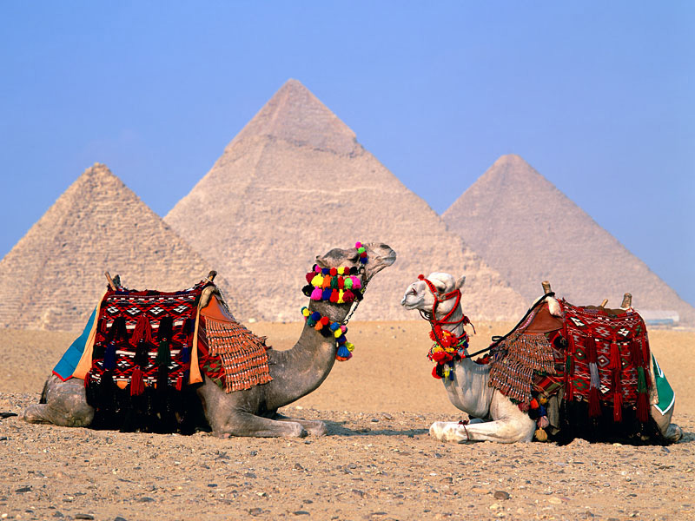

Slide 2
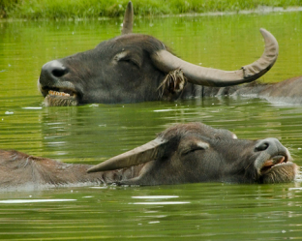
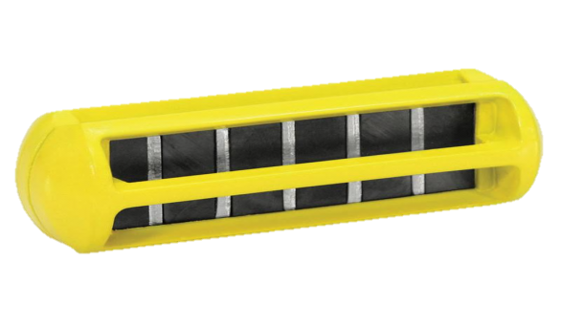
Is it enough to use rumen magnet once a life to permanently prevent hardware disease in buffaloes?
By
Ashraf M. Abu-Seida
Professor of Surgery, Anesthesiology & Radiology
Faculty of Veterinary Medicine - Cairo University

Slide 3
Introduction

Slide 4

Buffaloes are an important part of livestock agriculture in Asia since 5000 years, producing milk, meat, hides and draft power.
Foreign body syndrome of bovine is still a matter of concern in different veterinary practices all over the world.
Hardware disease is an alternative term for bovine traumatic reticuloperitonitis and sharp foreign body syndrome.

Slide 5
Ingestion of a sharp object
Settlement in the reticulum
Several complications.
Irritation or penetration of the reticular wall

Slide 6
Traumatic Reticulitis
Diaphragmatic Hernia
Hernia
hepatic abscess
Vagal Indigestion
Rupture of left gastro-epiploic artery
Traumatic Reticuloperitonitis (local and diffuse)
Traumatic Pericarditis
Reticular Abscess
Hepatic Abscess
Splenic Abscess
Pleurisy and Mediastinal Abscess
Traumatic Pneumonia

Slide 7
The incidence of the disease is high in all developing countries as
Egypt
Iraq
Economic losses
Sharp drop in milk yield
Reduction in meat production
Economic losses
Treatment costs
Fetal Losses
Potential fatalities
India
losses in affected pregnant animals

Slide 8
Reticular magnets has become a popular preventive routine for the hardware disease but there is no report concerning its efficacy as a long term preventive measure

Slide 9

Aim of the study
Is it enough to use rumen magnet once a life to permanently prevent hardware disease in buffaloes?

Slide 10
Materials and Methods

Slide 11
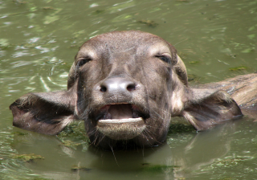

Animals
3100 buffaloes
Time of the study:
8 years
Iraq

Slide 12
Group I
1200 buffaloes suffered from hardware disease.
Group I
Rumenotomy was carried out for these buffaloes and rumen magnet was dropped into the reticulum.
Group I
Follow up for seven years was done. Repeated rumenotomy was carried out in all buffaloes that had recurrent hardware disease

Slide 13
Group II
1900 healthy buffalo heifers given prophylactic ruminal magnets orally at the age of 6-9 months
Group II
These animals were followed up for seven years for any complications and possible occurrence of hardware disease
Group II
Rumenotomy was carried out in hardware diseased buffaloes

Slide 14
Statistical analysis:
Proportions of buffaloes which developed hardware disease during the first 4 years and at 5 , 6 and 7 year after the use of magnet were compared using chi-square test in IBM SPSS (version 20) within and between group I and group II and all data were reported.

Slide 15
Results

Slide 16
In group I:
The affected animals were 1195 females and 5 buffalo bulls of 2-9 years old.
No complications were reported after dropping of magnets into the reticulum
Recurrent hardware disease was recorded in 110 animals representing10.8% of the total examined buffaloes.

Slide 17
In group II:
Regurgitation was recorded in 1.5% of the total examined heifers.
Hardware disease was diagnosed in 155 animals representing 8.9% of the total examined animals.

Slide 18
The incidence of developing a hardware disease during the first 4 years after the use of rumen magnet was 0% in both groups.
Starting from 5^{th.} year, a time dependent increase in the proportion of buffaloes developing a hardware disease was noticed in both groups

Slide 19
Numbers of animals | Group I | Group II
Total examined buffaloes | 1200 | 1900
Discarded buffaloes | 185 | 154
Followed up buffaloes | 1015 | 1746
Hardware diseased buffaloes during 1^{st.} – 4^{th.} year post magnet use | 0ª | 0ª
Hardware diseased buffaloes during 5th. year post magnet use | 23 (2.3%) ^{b} | 35 (2.0%) ^{b}
Hardware diseased buffaloes during 6th. year post magnet use | 39 (3.8%) ^{b} | 43 (2.5%) ^{b*}
Hardware diseased buffaloes during 7th. year post magnet use | 48 (4.7%) ^{c} | 77 (4.4%) ^{c*}
Total hardware diseased buffaloes | 110 (10.8%) | 155 (8.9%)
Different alphabets indicate significant difference within the same group at P< 0.01 *Asterisks denote a statistical difference between groups at P < 0.05

Slide 20
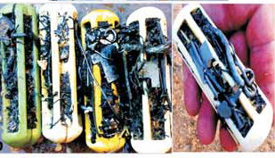
Complete filling of cage magnets with foreign bodies. The magnetic power of the retrieved reticular magnets was similar to the new one

Slide 21
The trapped metallic foreign objects included wires, nails, needles, knives, keys, coins, screws, rings, can-openers and iron pieces of various sizes.
In addition, other non-metallic foreign bodies as bones, feathers, gravels, stones, sand, pieces of rubber, glass and clothes, shoes, ropes and plastic bags were also removed during rumenotomy.

Slide 22
Traumatic Reticulitis (n=608)
Reticular Abscess (n=191)
Splenic Abscess (n=9)
Diaphragmatic Hernia (n=32)
Traumatic Pericarditis (n=68)
Diffuse Traumatic Reticuloperitonitis (n=96)
LocalTraumatic Reticuloperitonitis (n=461)

Slide 23
Conclusions

Slide 24
Administration of the rumen magnets is an effective prophylaxis for hardware disease in buffaloes.
It is not enough to use rumen magnet once a life to permanently prevent this disease in buffaloes at high risk.
Reapplication of a new magnet is recommended four years later.

Slide 25

Thank You

