Slide 1
Role and involvement of General Practitioners in a Public Community Mental Health Clinic in Metropolitan Melbourne
Dr Ashish Mordia *(MBBS, MD, FRANZCP)
*Consultant Psychiatrist, Mercy Mental Health, 117-129, Warringa Crescent, Hoppers Crossing Vic 3029 Australia

Slide 2
General Practice and Mental health
Objectives of today’s presentation/workshop
- to provide an understanding of how public mental health services are structured in Australia
-Role of General practitioners in delivering mental health care to patients
-Triaging and assessment of common mental illnesses
Notes:
I don’t want this to be a didactic lecture and would endeavour to make it as interactive as possible.

Slide 3
General Practice and Mental health
-The first part of the presentation describes a prototypical adult area mental health service in Australia.

Slide 4
General Practice and Mental Health
Second part deals with relationship and importance of primary care sector represented by General Practitioners (GPs). This part attempts to describe different domains of collaboration between GPs and Area Mental Health Services (AMHS)

Slide 5
General Practice and Mental Health
-The last part of the presentation is to assist General Practitioners for initial assessment and triaging of common mental health conditions including common investigations/laboratory tests to exclude organic/general medical conditions with psychiatric manifestations.

Slide 6
General Practice and Mental Health
-In Australia
-Public and private sector services and NGOs
-Slight differences in how MHS are structured in various states
-State Specific Mental Health Acts but with similar conceptual basis
Now I will focus on the mental health care delivery systems as it exists in the state of Victoria.

Slide 7
Mental health Services in Victoria
-Area Based Clinical services
Three main program areas deliver clinical mental health services
-Child and Adolescent (0-18 years)
-Adult (18-64 years)
-Aged persons (65 years or older)
Continuum of Services from acute inpatient to community based subacute, Chronic and residential rehabilitation options
-Specialist State-wide services like Mother and Baby Services, Spectrum Personality Disorder program, Eating disorder services, Forensic MHS, Victorian transcultural Psychiatry Unit etc

Slide 8
General Practice and Mental Health
Now a Typical Adult Area Mental Health Service
in Metropolitan Melbourne

Slide 9
Mercy Mental health
Mercy Mental Health is an adult area MHS subserving three municipal councils in the south western suburbs of Metropolitan Melbourne
-Two acute inpatient psychiatric units Clare Moore Building (27 beds) and Ursula Frayne Centre (16 beds)
-Crisis assessment and treatment team (CATT)
-Three Community mental health integrated teams (outpatient CMHC)
-Prevention and Recovery Care (PARC) a 10 bedded facility
-Community Care Unit CCU-20 bedded residential rehabilitation facility
-Homeless service
-Post discharge Follow-up service
-Consultation Liaison services (for three hospitals in our catchment area
-Secure extended care unit (AMHRU beds)

Slide 10
Mercy Mental health
Mercy Mental Health is an adult area MHS subserving three municipal councils in the south western suburbs of Metropolitan Melbourne
-Two acute inpatient psychiatric units Clare Moore Building (27 beds) and Ursula Frayne Centre (16 beds)
-Crisis assessment and treatment team (CATT)
-Three Community mental health integrated teams (outpatient CMHC)
-Prevention and Recovery Care (PARC) a 10 bedded facility
-Community Care Unit CCU-20 bedded residential rehabilitation facility
-Homeless service
-Post discharge Follow-up service
-Consultation Liaison services (for three hospitals in our catchment area
-Secure extended care unit (AMHRU beds)

Slide 11
Mercy Mental health
Mercy Mental Health is an adult area MHS subserving three municipal councils in the south western suburbs of Metropolitan Melbourne
-Two acute inpatient psychiatric units Clare Moore Building (27 beds) and Ursula Frayne Centre (16 beds)
-Crisis assessment and treatment team (CATT)
-Three Community mental health integrated teams (outpatient CMHC)
-Prevention and Recovery Care (PARC) a 10 bedded facility
-Community Care Unit CCU-20 bedded residential rehabilitation facility
-Homeless service
-Post discharge Follow-up service
-Consultation Liaison services (for three hospitals in our catchment area
-Secure extended care unit (AMHRU beds)

Slide 12
Mercy Mental health
Mercy Mental Health is an adult area MHS subserving three municipal councils in the south western suburbs of Metropolitan Melbourne
-Two acute inpatient psychiatric units Clare Moore Building (27 beds) and Ursula Frayne Centre (16 beds)
-Crisis assessment and treatment team (CATT)
-Three Community mental health integrated teams (outpatient CMHC)
-Prevention and Recovery Care (PARC) a 10 bedded facility
-Community Care Unit CCU-20 bedded residential rehabilitation facility
-Homeless service
-Post discharge Follow-up service
-Consultation Liaison services (for three hospitals in our catchment area
-Secure extended care unit (AMHRU beds)

Slide 13
Mercy Mental health
Mercy Mental Health is an adult area MHS subserving three municipal councils in the south western suburbs of Metropolitan Melbourne
-Two acute inpatient psychiatric units Clare Moore Building (27 beds) and Ursula Frayne Centre (16 beds)
-Crisis assessment and treatment team (CATT)
-Three Community mental health integrated teams (outpatient CMHC)
-Prevention and Recovery Care (PARC) a 10 bedded facility
-Community Care Unit CCU-20 bedded residential rehabilitation facility
-Homeless service
-Post discharge Follow-up service
-Consultation Liaison services (for three hospitals in our catchment area
-Secure extended care unit (AMHRU beds)

Slide 14
Mercy Mental health
Mercy Mental Health is an adult area MHS subserving three municipal councils in the south western suburbs of Metropolitan Melbourne
-Two acute inpatient psychiatric units Clare Moore Building (27 beds) and Ursula Frayne Centre (16 beds)
-Crisis assessment and treatment team (CATT)
-Three Community mental health integrated teams (outpatient CMHC)
-Prevention and Recovery Care (PARC) a 10 bedded facility
-Community Care Unit CCU-20 bedded residential rehabilitation facility
-Homeless service
-Post discharge Follow-up service
-Consultation Liaison services (for three hospitals in our catchment area
-Secure extended care unit (AMHRU beds)

Slide 15
Mercy Mental health
Mercy Mental Health is an adult area MHS subserving three municipal councils in the south western suburbs of Metropolitan Melbourne
-Two acute inpatient psychiatric units Clare Moore Building (27 beds) and Ursula Frayne Centre (16 beds)
-Crisis assessment and treatment team (CATT)
-Three Community mental health integrated teams (outpatient CMHC)
-Prevention and Recovery Care (PARC) a 10 bedded facility
-Community Care Unit CCU-20 bedded residential rehabilitation facility
-Homeless service
-Post discharge Follow-up service
-Consultation Liaison services (for three hospitals in our catchment area
-Secure extended care unit (AMHRU beds)

Slide 16
Mercy Mental health
Mercy Mental Health is an adult area MHS subserving three municipal councils in the south western suburbs of Metropolitan Melbourne
-Two acute inpatient psychiatric units Clare Moore Building (27 beds) and Ursula Frayne Centre (16 beds)
-Crisis assessment and treatment team (CATT)
-Three Community mental health integrated teams (outpatient CMHC)
-Prevention and Recovery Care (PARC) a 10 bedded facility
-Community Care Unit CCU-20 bedded residential rehabilitation facility
-Homeless clinician
-Post discharge Follow-up service
-Consultation Liaison services (for three hospitals in our catchment area
-Secure extended care unit (AMHRU beds)

Slide 17
General Practice and Mental Health
Moving on to the second part of today’s presentation……

Slide 18
General Practice and Mental Health
Second part deals with relationship and importance of primary care sectors represented by General Practitioners (GPs). This part attempts to describe different domains of collaboration between GPs and Area Mental Health Services (AMHS):
Primary Care Psychiatry Consultations
-Clozapine Shared Care program
-24/7 Crisis Response Service for GPs, Patients and Carers
-Phone Consultations to GPs for urgent Psychotropic Medication issues
-Continuing Medical Education programs to GPs to upskill them in handling common mental illnesses and their treatments (both high prevalence and low prevalence disorders)
-Close liaison with GPs for physical comorbidities (like Diabetes, Thyroid related conditions, cardiac issues).

Slide 19
General Practice and Mental Health
Primary Care Psychiatry Consultations
-Clozapine Shared Care program
-24/7 Crisis Response Service for GPs, Patients and Carers
-Phone Consultations to GPs for urgent Psychotropic Medication issues
-Continuing Medical Education programs to GPs to upskill them in handling common mental illnesses and their treatments (both high prevalence and low prevalence disorders)
-Close liaison with GPs for physical comorbidities (like Diabetes, Thyroid related conditions, cardiac issues).

Slide 20
General Practice and Mental Health
Primary Care Psychiatry Consultations
(modification of an earlier program which used to called CLIPP –Consultation Liaison in Primary care Psychiatry)

Slide 21
General Practice and Mental Health
Primary Care Psychiatry Consultations
-Clozapine Shared Care program
-24/7 Crisis Response Service for GPs, Patients and Carers
-Phone Consultations to GPs for urgent Psychotropic Medication issues
-Continuing Medical Education programs to GPs to upskill them in handling common mental illnesses and their treatments (both high prevalence and low prevalence disorders)
-Close liaison with GPs for physical comorbidities (like Diabetes, Thyroid related conditions, cardiac issues).

Slide 22
General Practice and Mental Health
-Clozapine GP Shared Care program

Slide 23
General Practice and Mental Health
Clozapine is an atypical antipsychotic agent which is the drug of choice for treatment-resistant Schizophrenia or Schizoaffective disorder.
Clozapine: improves social functioning and quality of life
lessens the need for hospitalization;
reduces violent behaviour;
reduces abuse of alcohol and illegal drugs; and
reduces suicidality by 80-85% in the treatment-resistant group of clients.

Slide 24
General Practice and Mental Health
CLOZAPINE continued
Hematological side effects: Agranulocytosis- severe decrease in white cells, which, without monitoring and treatment, can be fatal.
Neutropenia - decrease in Neutrophils
Cardiac side effects: Myocarditis and Cardiomyopathy.
Epileptogenic potential at higher doses
Metabolic side effects:
Common but non life threatening side effects: sedation, weight gain, hypersalivation, constipation, urinary incontinence etc

Slide 25
General Practice and Mental Health
-Primary Care Psychiatry Consultations
-Clozapine Shared Care program
-24/7 Crisis Response Service for GPs, Patients and Carers
-Phone Consultations to GPs for urgent Psychotropic Medication issues
-Continuing Medical Education programs to GPs to upskill them in handling common mental illnesses and their treatments (both high prevalence and low prevalence disorders)
-Close liaison with GPs for physical comorbidities (like Diabetes, Thyroid related conditions, cardiac issues).

Slide 26
General Practice and Mental Health
-24/7 Crisis Response Service for GPs, Patients and Carers

Slide 27
General Practice and Mental Health
-Primary Care Psychiatry Consultations
-Clozapine Shared Care program
-24/7 Crisis Response Service for GPs, Patients and Carers
-Phone Consultations to GPs for urgent Psychotropic Medication issues
-Continuing Medical Education programs to GPs to upskill them in handling common mental illnesses and their treatments (both high prevalence and low prevalence disorders)
-Close liaison with GPs for physical comorbidities (like Diabetes, Thyroid related conditions, cardiac issues).

Slide 28
General Practice and Mental Health
-Phone Consultations to GPs for urgent Psychotropic Medication issues

Slide 29
General Practice and Mental Health
-Primary Care Psychiatry Consultations
-Clozapine Shared Care program
-24/7 Crisis Response Service for GPs, Patients and Carers
-Phone Consultations to GPs for urgent Psychotropic Medication issues
-Continuing Medical Education programs to GPs to upskill them in handling common mental illnesses and their treatments (both high prevalence and low prevalence disorders)
-Close liaison with GPs for physical comorbidities (like Diabetes, Thyroid related conditions, cardiac issues).

Slide 30
General Practice and Mental Health
-Primary Care Psychiatry Consultations
-Clozapine Shared Care program
-24/7 Crisis Response Service for GPs, Patients and Carers
-Phone Consultations to GPs for urgent Psychotropic Medication issues
-Continuing Medical Education programs to GPs to upskill them in handling common mental illnesses and their treatments (both high prevalence and low prevalence disorders)
-Close liaison with GPs for physical comorbidities (like Diabetes, Thyroid related conditions, cardiac issues).

Slide 31
General Practice and Mental Health
Now the third part of the presentation……

Slide 32
General Practice and Mental Health
This part of the presentation is to provide General Practitioners with an overview for initial assessment and triaging of common mental health conditions including common laboratory tests to exclude organic/general medical conditions with psychiatric manifestations.

Slide 33
General Practice and Mental Health

Slide 34
General practice and Mental health
Identifying Data
Reasons for &Source of referral
History of Presenting Illness
Current Medication
Past Psych. History
Past med./surg. History
Substance abuse
Forensic History

Slide 35
Initial Assessment- history taking
Collateral
Family History
Personal History
Education
Psychosexual History
Pre morbid Functioning

Slide 36
Initial Assessment- history taking
Identifying data:
Who
Where
Marital status
Children
Income /Employment
Reason and source of referral:
Who
Where
Reasons

Slide 37
Initial Assessment- history taking
History of presenting illness
Onset
Duration
Precipitants
Aggravating factors
Relieving factors
Associated factors
Current medications
Past Psychiatric History
Medical/surgical History
Substance abuse

Slide 38
Initial Assessment- history taking
Forensic history
History of violence and its context
Family history
Parents
Siblings
Children
Other
Domestic setting

Slide 39
Initial Assessment- history taking
Personal History
Mode of Delivery
Perinatal Difficulties
Developmental Milestones
Anxiety Symptoms of Childhood
Other
Collateral information:
Psychosexual history:
Libido ;current/prior
Fantasy life
Medication effects
Other effects

Slide 40
Initial Assessment- history taking
Level of education obtained
Behavioural Problems
interpersonal Relationships
Tertiary Education
Pre-morbid functioning
Mood
Interpersonal relationships
Personality

Slide 41
Mental State examination
Appearance/Behaviour/Speech
Affect/Mood
Thought
Perception
Cognition
Abstracting ability
Intelligence
Insight & Judgement

Slide 42
General Practice and Mental Health

Slide 43
The American Psychiatric Publishing
Textbook of Psychiatry, Fifth Edition. Edited by Hales RE, Yudofsky SC,
Gabbard GO. © 2008 American Psychiatric Publishing, Inc. All rights reserved. www.appi.org

Slide 44
Investigations/laboratory tests
LABORATORY APPROACH TO SPECIFIC CLINICAL
SITUATIONS IN PSYCHIATRY
  New-Onset Psychosis
  Mood Disturbance: Depressive or Manic Symptoms
  Anxiety
  Altered Mental Status
  Cognitive Decline
    Dementias
    Mild Cognitive Impairment
  Substance Abuse

Slide 45
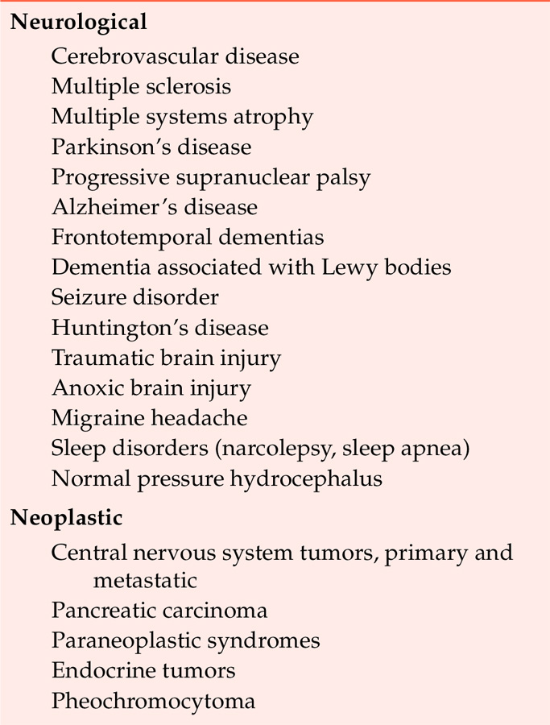
TABLE 2–1. Selected medical conditions with psychiatric manifestations
Table 2–1 lists some of the many medical and neurological illnesses that may present with prominent neuropsychiatric symptoms. Clinical laboratory assessment and diagnostic testing can help determine which of the many potential causes is responsible for a patient’s symptoms. Because a number of these etiologies may have potentially curative remediations, accurate diagnosis is critical.
Source. Adapted from Ringholz 2001; Sadock and Sadock 2007; Wallach 2000.
(continued)

Slide 46
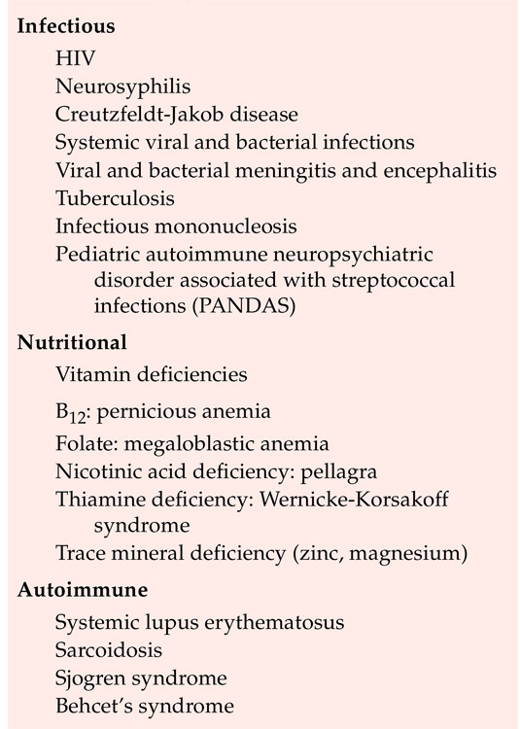
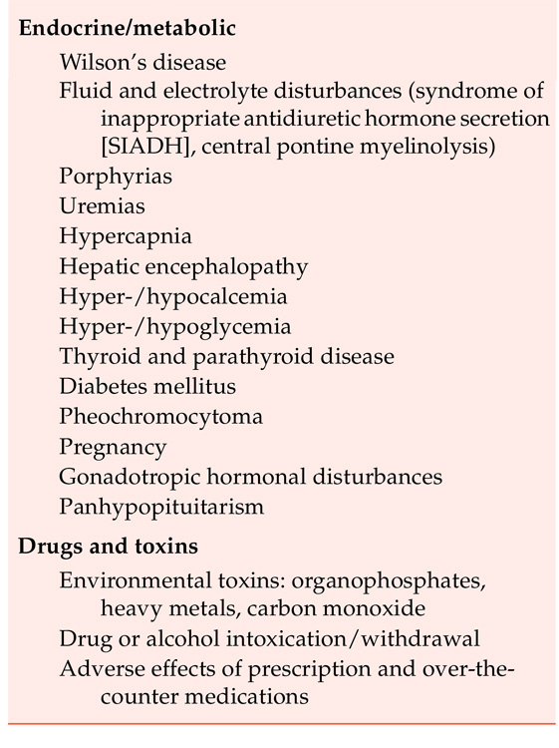
TABLE 2–1. (continued)

Slide 47
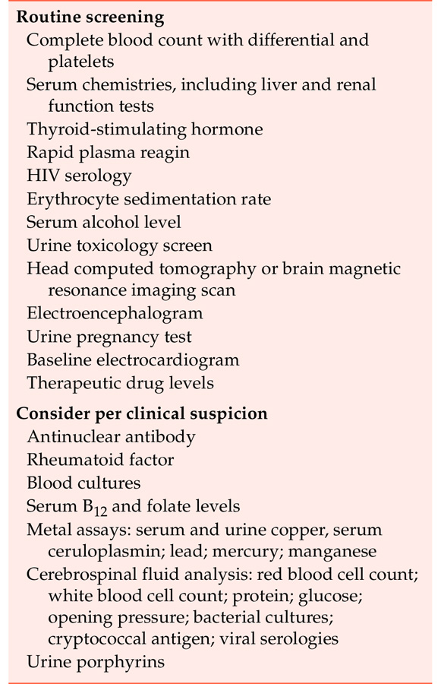
TABLE 2–3. Recommended diagnostic workup for a patient with new-onset psychosis
A careful evaluation is important for a patient with a first episode of psychosis in order to rule out the many possible medical and neurological causes of psychosis. Table 2–3 summarizes some of the recommended tests in the diagnostic approach to a patient with new-onset psychosis.

Slide 48
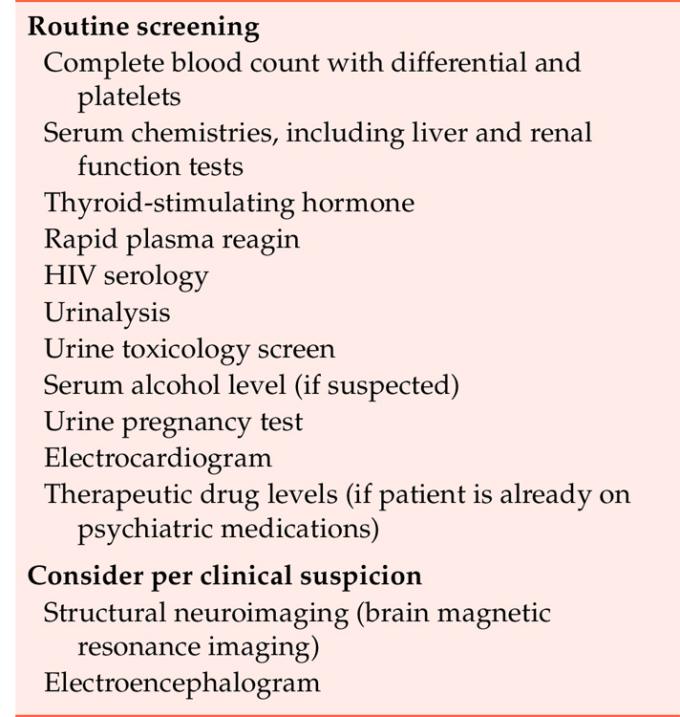
TABLE 2–4. Recommended diagnostic workup for a patient with new-onset depressive or manic symptoms
Neuroimaging and electroencephalography are often helpful as well in understanding the etiology of a patient’s mood symptoms. Multiple neurological and medical disorders have mood manifestations that may often be the presenting complaint. The diagnostic approach to a patient with new-onset depressive or manic symptoms is summarized in Table 2–4.

Slide 49
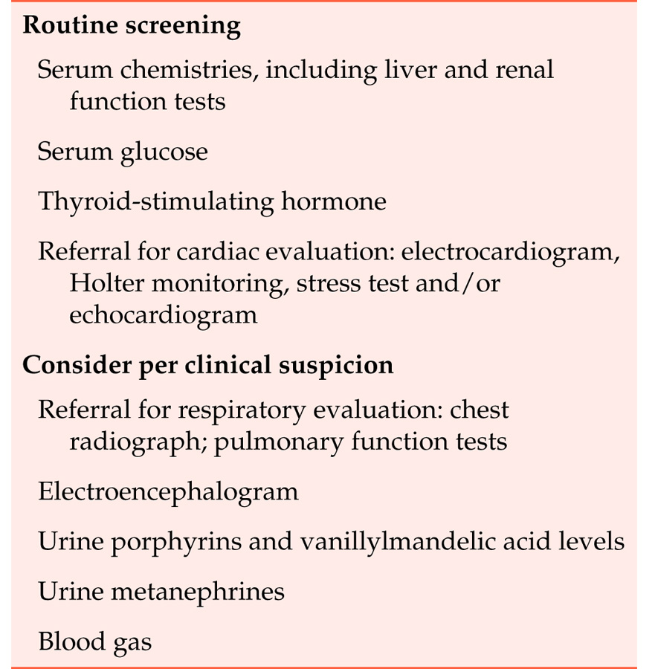
TABLE 2–5. Recommended diagnostic workup for a patient with new-onset anxiety symptoms
Many different medical diseases can manifest anxiety, including angina and myocardial infarction, mitral valve prolapse, substance intoxication and withdrawal, and metabolic and endocrine disorders such as thyroid abnormalities, pheochromocytoma, and hypoglycemia. Neurological disorders, such as many forms of dementia, can also present with anxiety. The diagnostic approach to a patient with new-onset anxiety is summarized in Table 2–5.

Slide 50
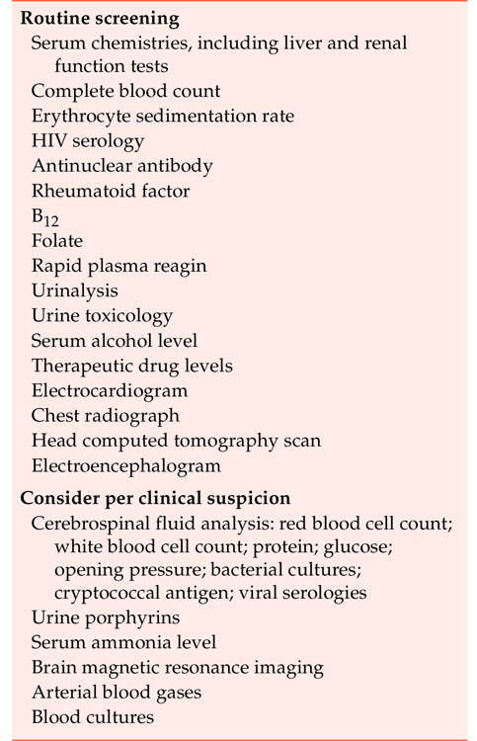
TABLE 2–6. Recommended diagnostic workup for a patient with altered mental status
Patients with a fluctuating mental status of acute onset most likely will have one or more underlying medical or neurological causes for their impaired consciousness. This often constitutes a medical emergency, and comprehensive laboratory and diagnostic testing are indicated on an emergency basis, as summarized in Table 2–6.

Slide 51
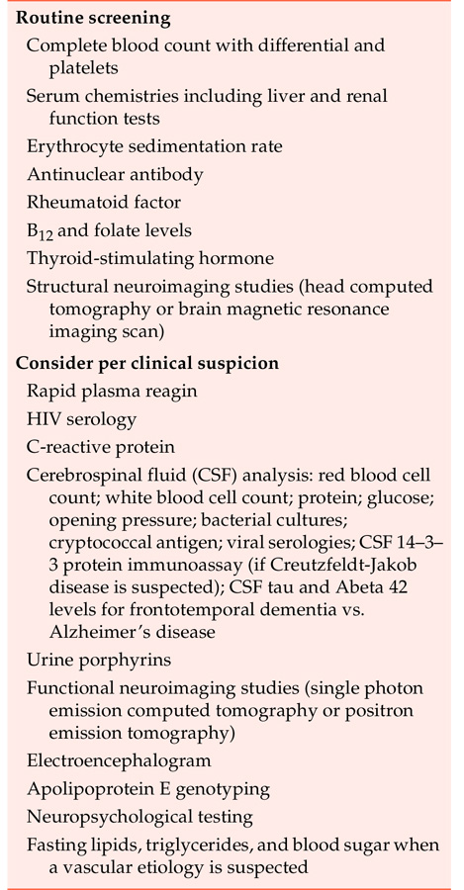
TABLE 2–7. Recommended diagnostic workup for a patient with cognitive decline
Table 2–7 lists the laboratory and diagnostic tests that would be included in the workup of a patient with cognitive impairment.

Slide 52
General Practice and Mental Health
Questions and Answers
Feel free to email me for any queries: ashishmordia@gmail.com

Slide 53
Thank You

