Slide 1



Nanosystems formed by amphiphilic antimony(V) complexes incorporating Amphotericin B for the treatment of Leishmaniasis
Dr. Arshad Islam
Post-doctorate- Department of Physiology and Biophysics
Insititute of Biological Sciences, Universidade Federal de Minas Gerais
Supervisor: Prof. Dr. Frédéric J. G. Frézard
August 20, 2015
Frankfurt, Germany
Notes:
My name is Arshad Islam, doing post-doc with Prof. Frederic Frezard in ICB. I will present my Ph.D work regarding the synthesis, structural characterization of some novel organoantimony or organobismuth complexes and the antileishmanial & cytotoxic activities of these complexes, as well the their activities on tumor cell lines as well bacterial cells.

Slide 2
Outlines
Introduction
  What is Leishmaniasis
  Geographical distribution
  Current chemotherapeutics
  Amphotericin B (AmB) as antileishmanial drug
Objectives of the study
Results and Discussion
  Preparation of the nanosystems
  Incorporation of AmB in the system
  Stability of the formulations in solutions on dilution
  Efficacy of the formulations as antileishmanial drug
Conclusions

Slide 3
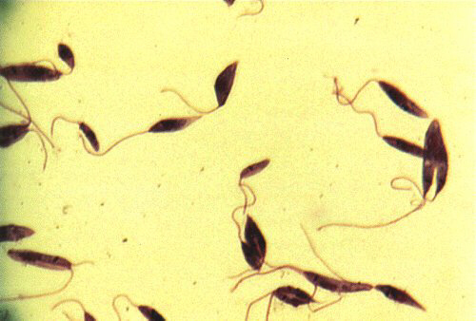
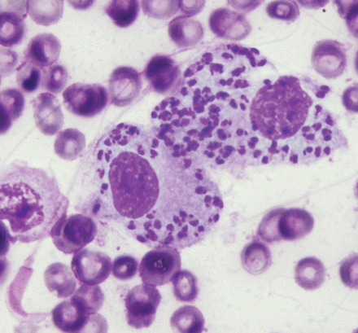
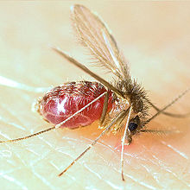
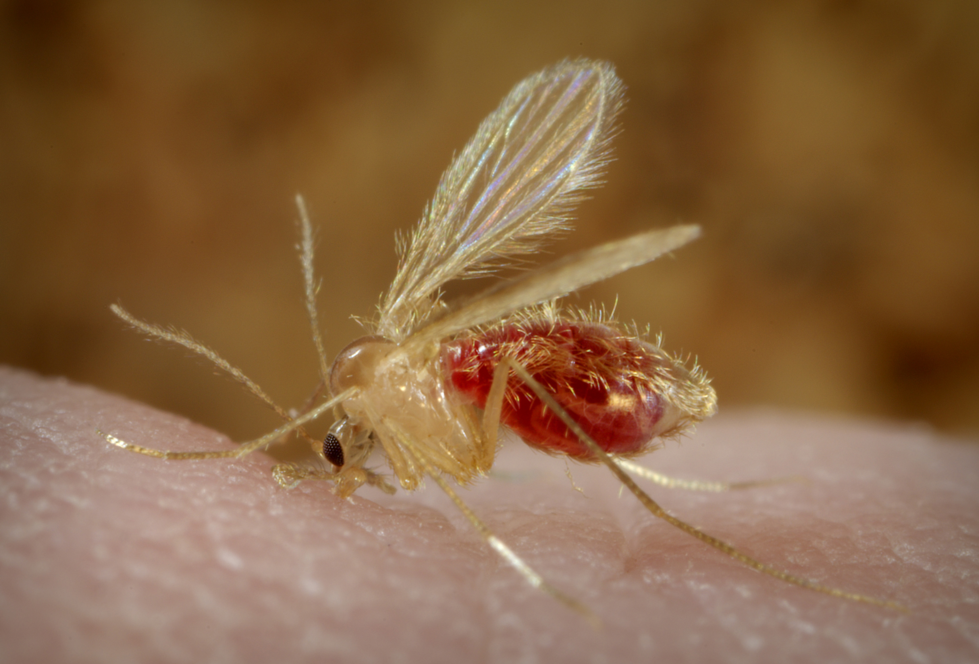
Introduction
Leishmaniasis
A Significant Neglected Tropical Disease
A diverse group of diseases, also known as sandfly or black fever disease
Infection transmitted by the bite of sandfly of genus Phlebotamine and Leutzomia.
Two morphological forms (Unicellular Eukaryotes):
1. Amastigotes (Non-motile and round)
2. Promastigotes (Flagellated)
Motile promastigote
Non-motile Amastigote
Leutzomia
Phlebotamine
Mishra, J. et al. 2007. Current Medicinal Chemistry, 14, 1153-1169.
Notes:
There are many strains of Leishmania. L. Major, L. amazonensis, L. donovani, L. infantum chagasis, etc.

Slide 4
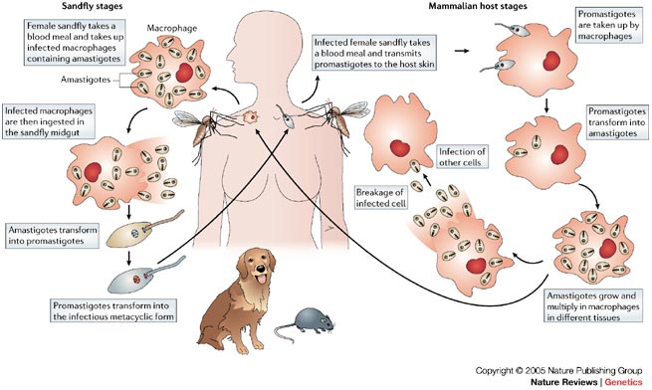
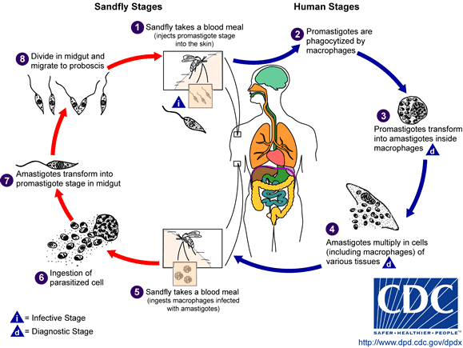
Introduction
Life Cycle – Leishmaniasis
Mishra, J. et al. 2007. Current Medicinal Chemistry, 14, 1153-1169.
Notes:
L. Major, L. amazonensis, L. donovani, L. infantum chagasis, etc.

Slide 5

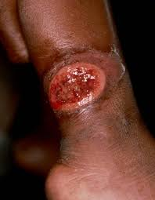
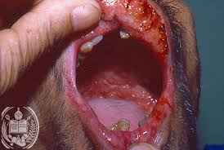
Introduction
Types of Leishmaniasis
21 species are known to cause disease in humans
Visceral Leishmaniasis (Fatal: 90%)
L. donovani; L. infantum
fever, substantial weight loss, spleen and liver swelling.
Cutaneous Leishmaniasis
L. amazonensis; L. major; L. mexicana
skin ulcers
Mucocutaneous Leishmaniasis
L. amazonensis; L. brazilliensis
disorders of the mucous membranes
Mishra, J. et al. 2007. Current Medicinal Chemistry, 14, 1153-1169.
Notes:
L. Major, L. amazonensis, L. donovani, L. infantum chagasis, etc.

Slide 6
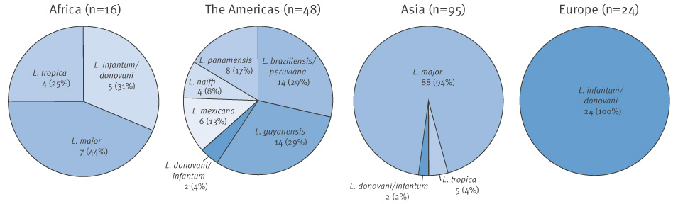
Introduction
Risk & Geographical Distribution: Leishmaniasis
Endemic in 98 countries
350 million people are at risk
12 million people are affected
60,000 death annually
1.5-2 million cases each year
Bangladesh, Brazil, India, Nepal, Sudan, Afghanistan, Iran, Peru, Syria
Mishra, J. et al. 2007. Current Medicinal Chemistry, 14, 1153-1169.
Notes:
L. Major, L. amazonensis, L. donovani, L. infantum chagasis, etc.

Slide 7
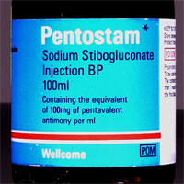
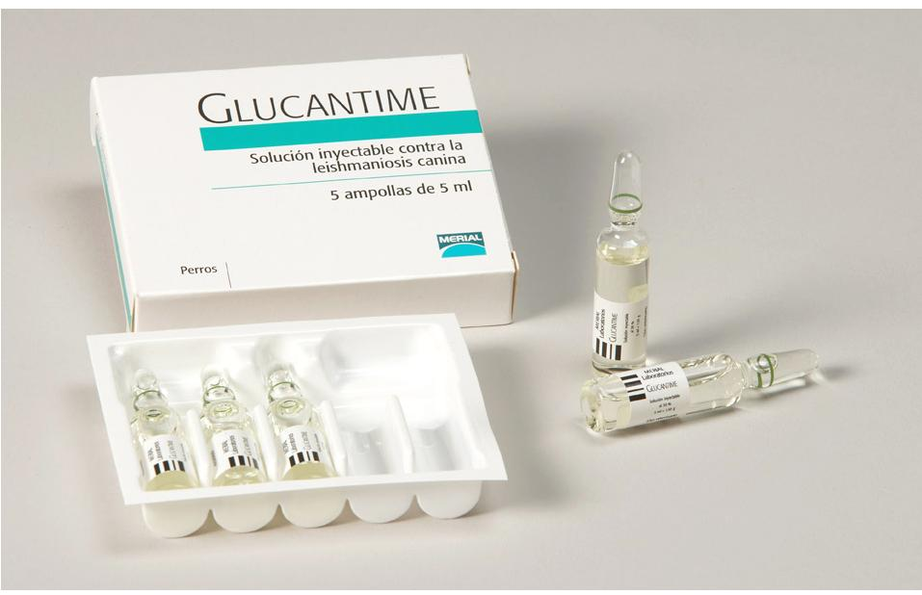
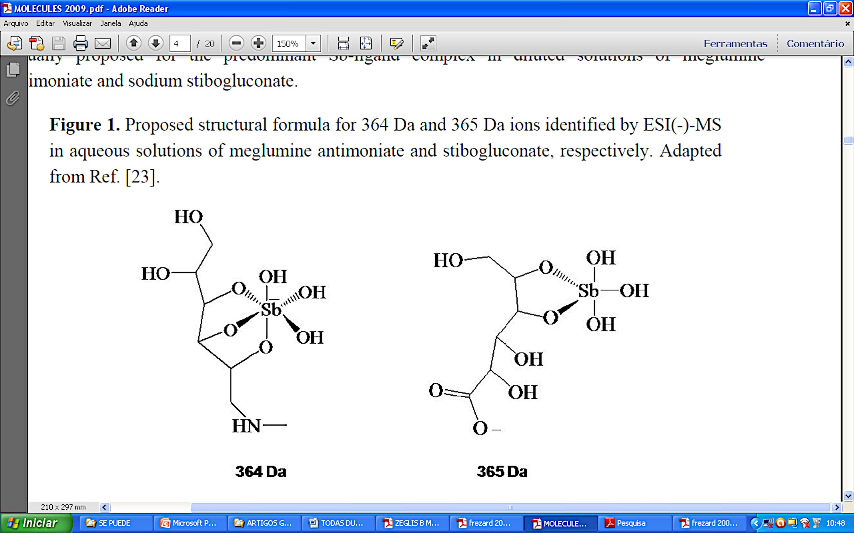
Introduction
Currents Therapeutics for Leishmaniasis
Pentavalent Antimonials
Glucantime® and Pentostam®
First line of drugs in developing countries for
cutaneous and visceral
(B)
Mechanism of action???
Sb(V) reduces to Sb(III)
Interaction with DNA or may block metabolic pathway
Disadvantages
Cytotoxic, side-effects
Resistance & high cost
Frezard et al., 2009 Mishra, J. et al. 2007. Current Medicinal Chemistry, 14, 1153-1169.

Slide 8
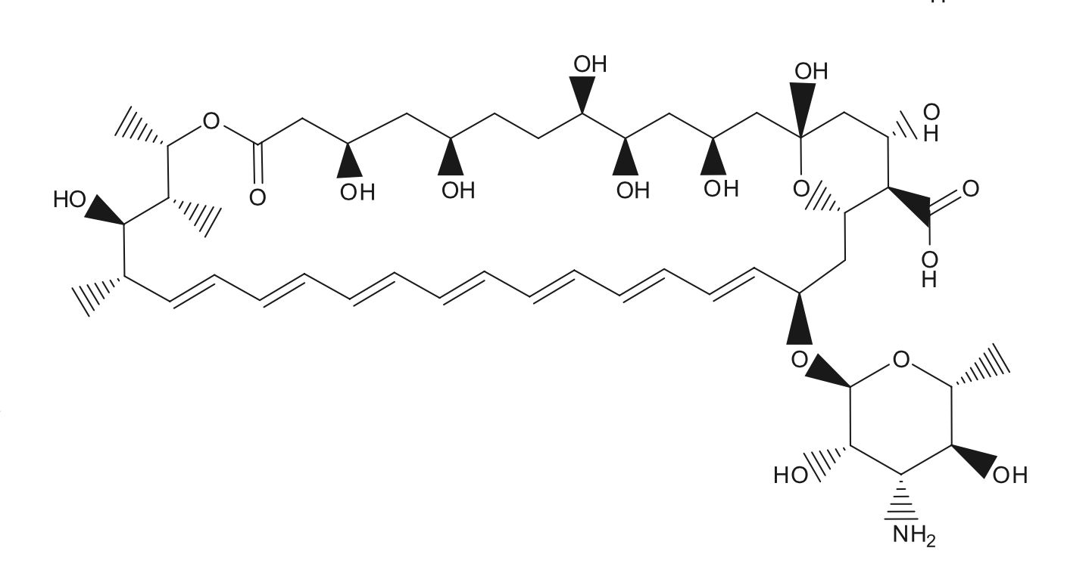
Introduction
Amphotericin B as antileishmanial drug
  Standard antifungal drug
  antileishmanial drug
  highly toxic in aggregated form
Amphotericin B (AmB)
To reduce its cytotoxicity and to target macrophages, various strategies have been used to incorporate AmB in different nano-carriers
e.g. nanoemsulsions, micelles, liposomes

Slide 9
Objectives
Objectives of the current research
NEW APPROACHES TO ANTILEISHMANIAL CHEMOTHERAPEUTICS
Investigate (SYNTHESIZE NOVEL DRUGS & IMPROVE EXISTING)
NEW
SAFER (minimum side effects)
COST-EFFECTIVE
Orally Administrable (TIME & AVOID MUSCULAR PAIN)
Mishra, J. et al. 2007. Current Medicinal Chemistry, 14, 1153-1169.

Slide 10
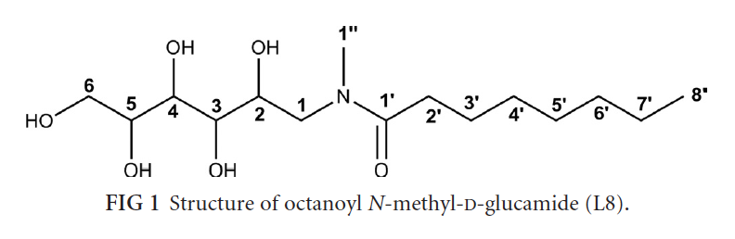
Objectives
Specific Objectives
Incorporation of AmB in nanosystem to reduce its cytotoxicity
Kinetics and stability studies of the SbL8-AmB and SbL10-AmB formulation
Evaluation of the antileishmanial activity of the new formulations in vivo

Slide 11
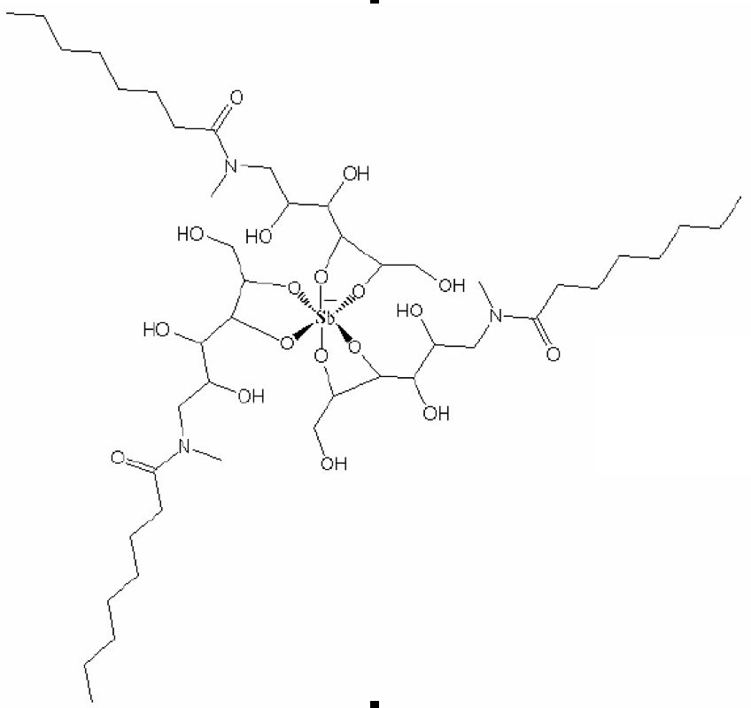
Preparation and characterization of amphiphilic antimony(V) based dispersions SbL8 and SbL10 (alkylmethylglucamide series)
Preparation
KSb(OH)₆ _{(aq)} + 3(L8) ➔ Sb-(L8)₃
KSb(OH)_{6 (aq)} + 3(L10) ➔ Sb-(L10)₃
(Stir for 1 h at 60-70 °C then allowed to evaporate) ➔ Freeze dried)
Formation of the dispersions was confirmed by ELEMENTAL ANALYSIS, MASS SPECTROMETERY and NMR SPECTROSCOPY
(Flaviana R.F. et al., 2013) from our research group
Sb(L8)₃
Flaviana R. Fernandes et al. 2013. Antimicrobial Agents and Chemotherapy p. 4229–4236

Slide 12
Analysis of AmB content and drug encapsulation efficiency (EE) by an HPLC-based technique
Preparation/incoporation of AmB in SbL10 and SbL8 dispersions
AmB + SbL8/SbL10
0.05 g/L AmB + 0.2 g/L of SbL8 or SbL10
pH 7.2
Encapsulation efficiency (EE) using reverse phase HPLC technique
EE% = [(Quantification of AmB before filtration - AmB after filtration)/AmB before filtration]x100
Leila R. C. et. al., 2014. European Journal of Pharmaceutical Sciences
Notes:
The quantification of AmB before filtration provided the total AmB content. The AmB that remained insoluble, and hence not properly incorporated into the nanosystems, was removed by filtration. The drug concentration in the external aqueous phase of the nanosystem was obtained by ultrafiltration method using a membrane with a weight cut-off of 100,000 (Amicon® – Ultra 4, Millipore, USA). AmB concentration in aqueous phase was found to be negligible. The AmB concentration in nanosytems (before and after filtration) was determined by the validated HPLC method. The EE of the drug was calculated by the following equation:

Slide 13
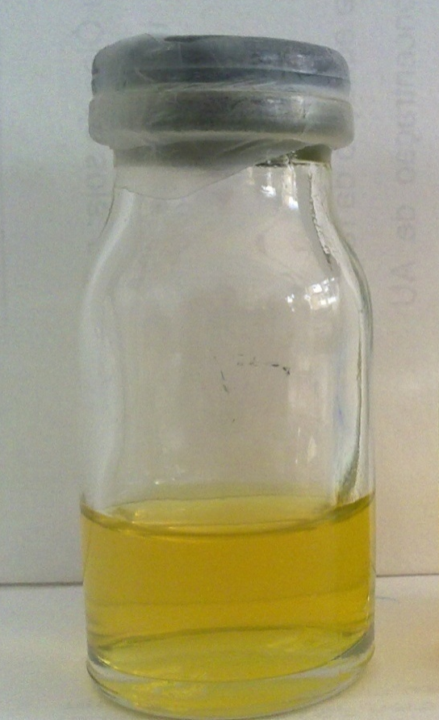
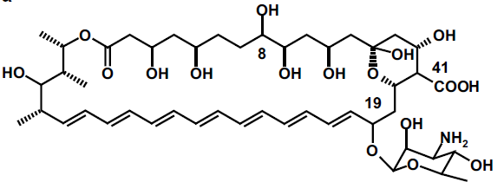
Incorporation of AmB in SbL8 nanoassemblies
Amphotericin B (AmB)
Low oral absorption and high toxicity
related to its aggregation state
SbL8-AmB 0.2%
AmB incorporation efficiency (HPLC)
SbL8 | SbL10
84% | 83%

Slide 14
UV absorption spectra of formulations SbL10-AmB
AmB aggregation state after dilutionof SbL10-AmB mixed composition

Slide 15
Circular dichroism spectra of formulations SbL10

Slide 16
Circular dichroism spectra of formulations SbL10

Slide 17
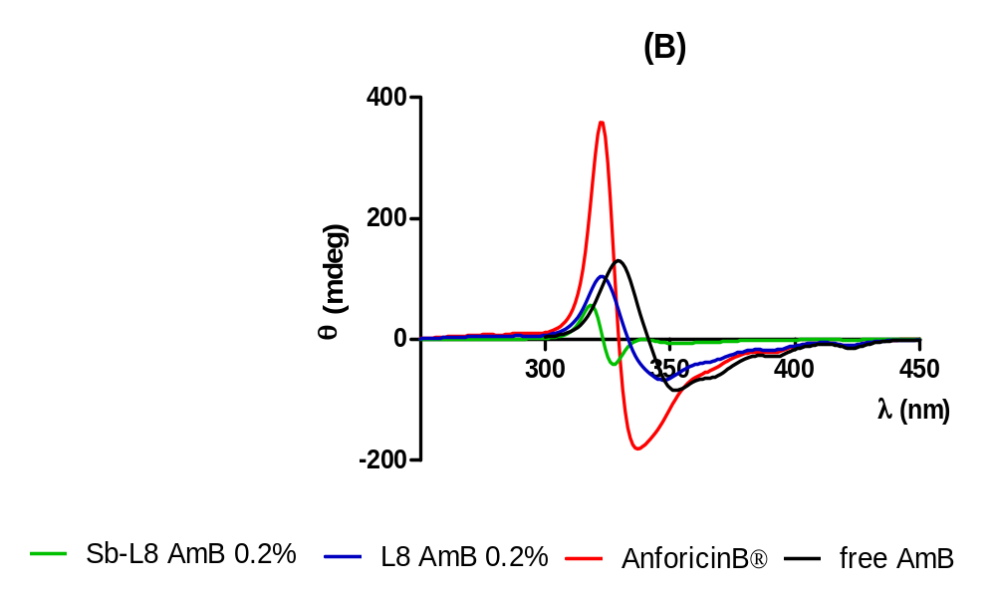
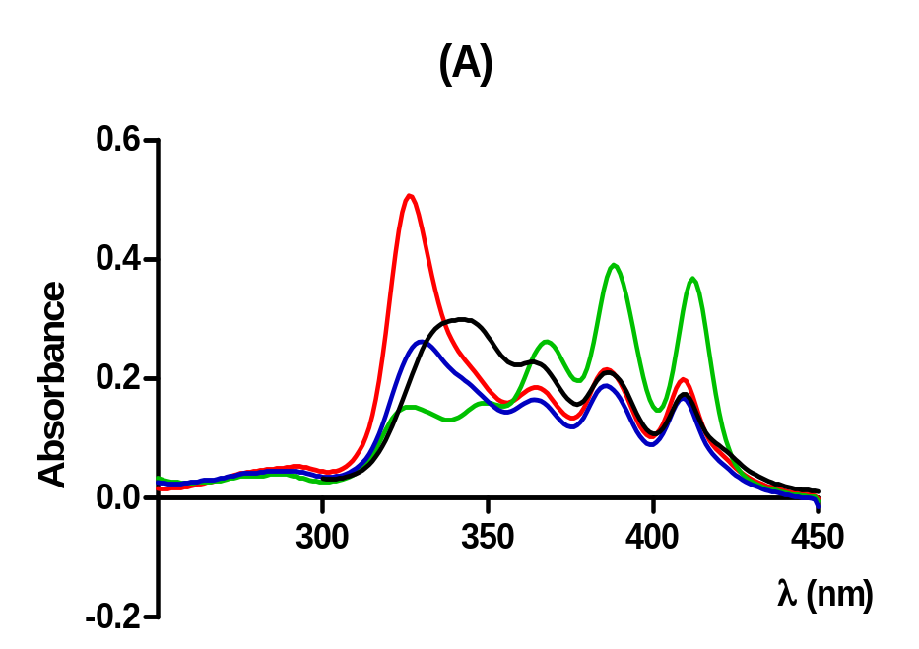
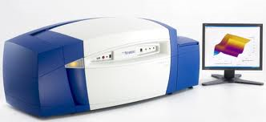
Results and Discussions
AmB aggregation state after dilution
of SbL8/AmB mixed composition
UV/Vis Absorption and Circular Dichroism Spectra

Slide 18
Kinetics studies/Stability in solution: Variation of flourescence intensity of DPH probe after interaction with nanosytems SbL8
Results and Discussion
References:

Slide 19
Kinetics studies/Stability in solution: Variation of flourescence intensity of DPH probe after interaction with nanosytems SbL10
Results and Discussion
References:

Slide 20
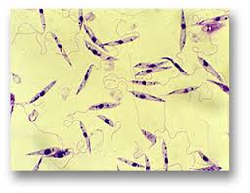
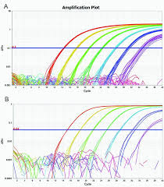
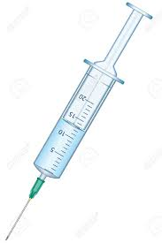
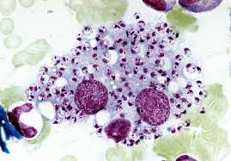
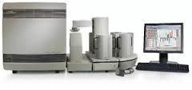
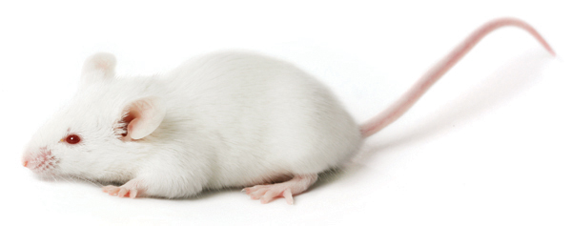
Infection and treatment protocol of mice infected with L. amazonensis and L. infantum
SbL8/SbL10 - 170 mg Sb/kg
AmB-Doc – 14 mg/kg Oral
AmB-Doc – 1 mg/kg IP (Control)
SbL8/SbL10 – Sb 170 mg/kg + AmB 14mg/kg
Day 7 or 35
Infection confirmation
(imprint)
Day 28 or 65–
Last day of
treatment
Day 1 – Infection:
intraperitoneal inoculum of
10⁷ metacyclic Leishmania infatum/amaz
promastigotes .
Beggining of
treatment
Day 38 –
Euthanasia
Analysis
of qPCR

Slide 21
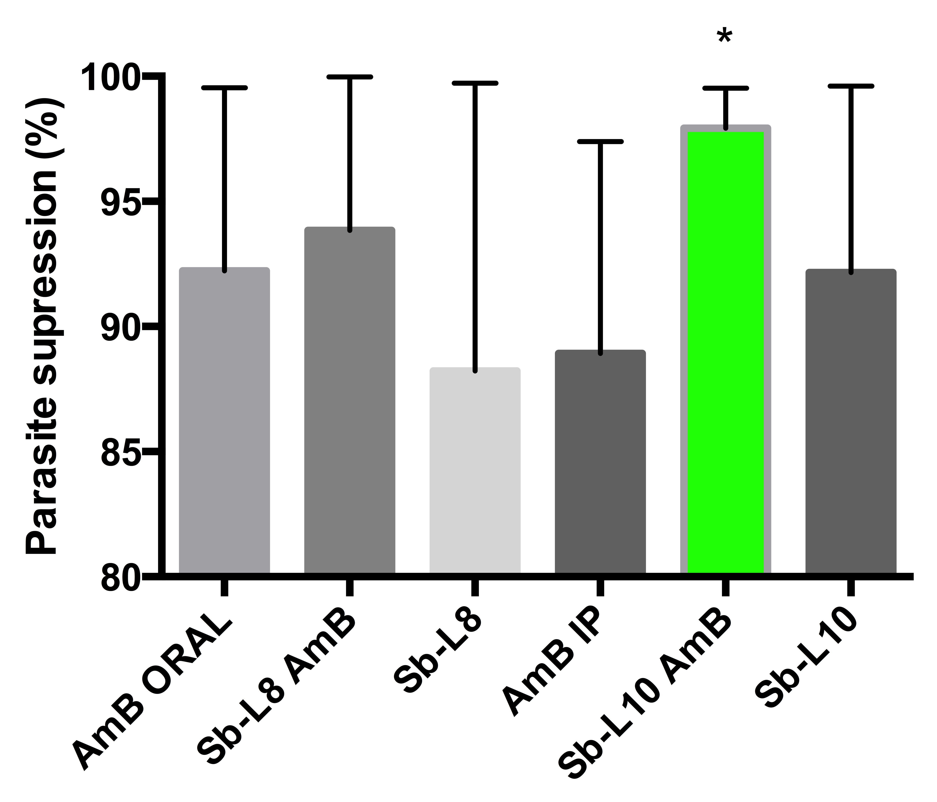
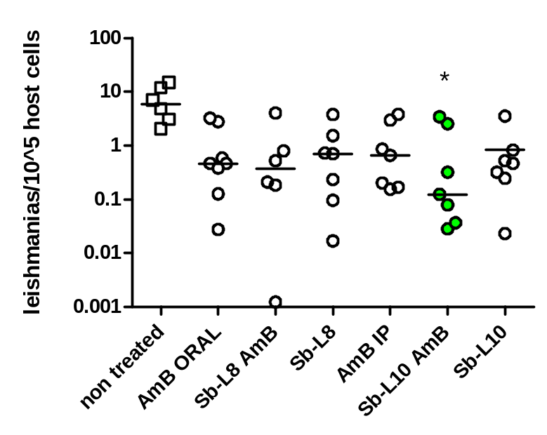
Antileishmanial activity of amphotericin B/SbL10 or AmB/SbL8 mixed composition by oral route in a murine model of VL (in vivo)
qPCR of Balb/c mice live parasite load infected with Leishmania chagasi and treated with following formulations: Anforicin® oral 13,6mg of AmB/kg/day; Sb-L8-Anfotericin oral, 170mg of Sb/kg/day and 13,6mg of AmB/kg/day; Sb-L8 oral 170mg of Sb/kg/day, AmB intreperitoneal 0,9mg/kg in each 4 days; Sb-L10-AmB oral 170mg of Sb/kg/day and 13,6mg of AmB/kg/day and Sb-L10 170mg of Sb/kg/day. One-way ANOVA with Bonferroni post test, *p<0,05.
Nanoparticle system of Sb-L10 AmB was the most effective treatment in reducing live parasite load in infected mice.
Summation or Synergism

Slide 22
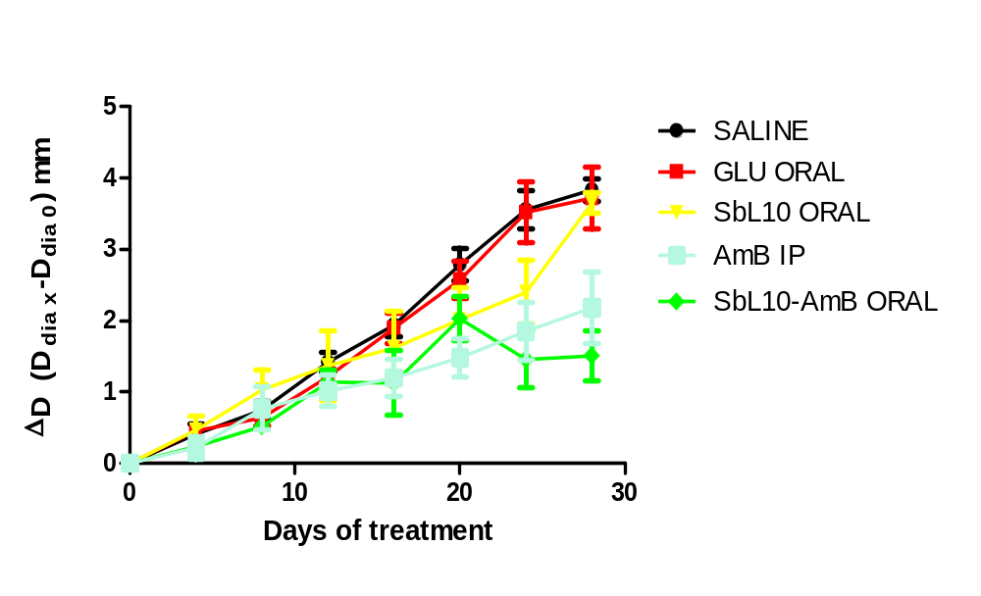
Antileishmanial activity of amphotericin B/SbL10 mixed composition by oral route in a murine model of CL
Oral: 170 mg Sb/kg/2d
14 mg AmB/kg/2d
IP: 1 mg AmB/kg/d
Islam Arshad, postdoc fellow, 2015

Slide 23
Conclusions
AmB is highly admissible in the monomeric form in the SbL8 and SbL10 dispersions
SbL8-AmB and SbL10-AmB formulations are stable in solution upon dilution at neutral pH as well at acid pH
SbL10-AmB is less cytotoxic than SbL8-AmB formulation in vivo
This study established for the first time the potential of mixed SbL10-AmB and SbL8-AmB formulations for the oral treatment of both cutaneous and visceral leishmaniasis, indicating their potential for further development and applications.

Slide 24
Thank you

