Slide 1


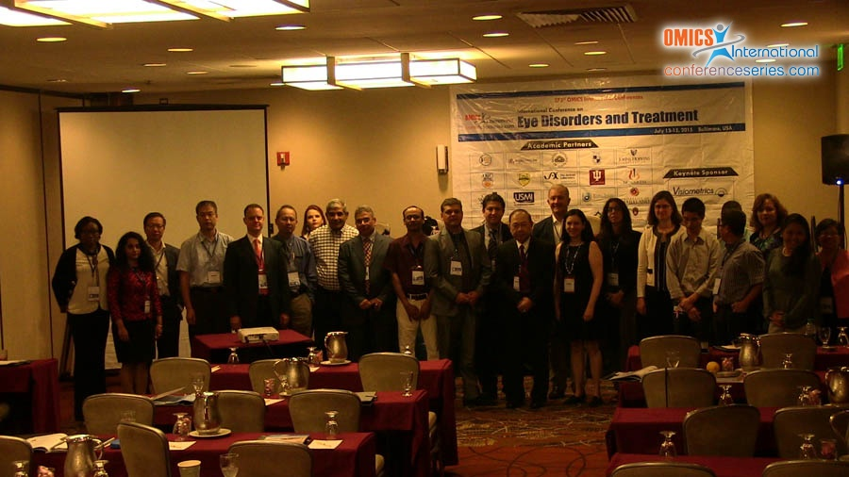
Eye-2015
Baltimore, USA
July13 - 15 2015
Arpitha Parthasarathy

Slide 2

Selective Ablation of Ocular Cancer Cells and Cancer Stem Cells with Cold Atmospheric Plasma
ISO 9001:2008
Arpitha Parthasarathy, PhD
Director Research- Translational and Molecular Biology
JCRI-ABTS/PMLS/US Medical Innovations, LLC
Maryland
International Conference on Eye Disorders and Treatment, July13-15th, 2015

Slide 3


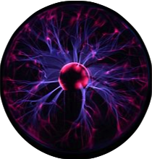

Plasma: 4th State of Matter
Most common form of matter in the universe
An ionized gas with freely moving charged particles of electrons and radicals
energy
even more energy
more energy
Solid
Liquid
Gas
Plasma

Slide 4
Introduction
Cold Plasma (CAP) - A new technology in the field of cancer biology
Application of the ionized gas in the form of CAP for anti-tumour therapy (Keidar et al., 2011)
CAP functions via redox efficiency on tumour cells (Guerrero-Preston, et al., 2014)
The mechanism of selective ablation of tumor cells without destroying the normal cells may involve various pathways (Arpitha P, 2015)

Slide 5
What are the Pathways involved ?
ROS medicated cell stress, Nf-Kb apoptotic pathway has been reported
However, what induces this down stream response at the cell surface and what receptors are involved?

Slide 6
A novel pathway identified with the treatment of CAP in tumor cells
TRAIL-R1 (tumour necrosis factor (TNF)-related apoptosis inducing ligand)
TRAIL (recombinant protein/ as drug) used as a chemotherapeutic to breast, colon cancer patients (Spencer et al., 2009)
CAN THE DOSE OF TRAIL/CHEMOTHERAPEUTIC BE REDUCED ALONG WITH CAP TREATMENTS ?

Slide 7
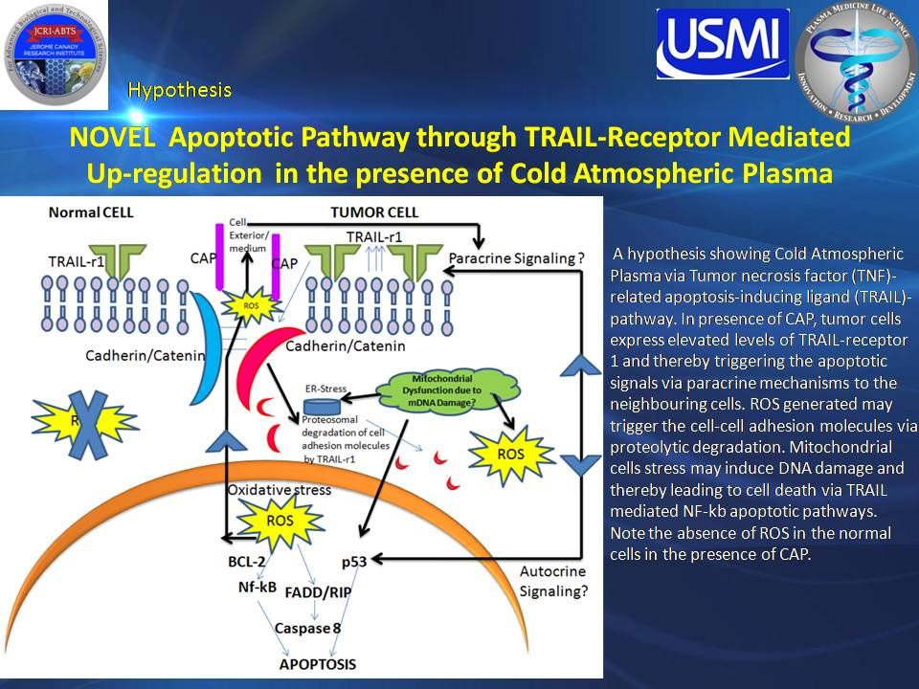
Arpitha P; Cell and Dev Biol, 2015

Slide 8
METHODS
Cold Plasma Set up
Confocal Microscopy
Trypan Blue Dye Exclusion Test
Immunoblot
mRNA expression
TUNEL Apoptosis Assay
Cell culture and expansion of primary (patients) tumor cells in vitro

Slide 9
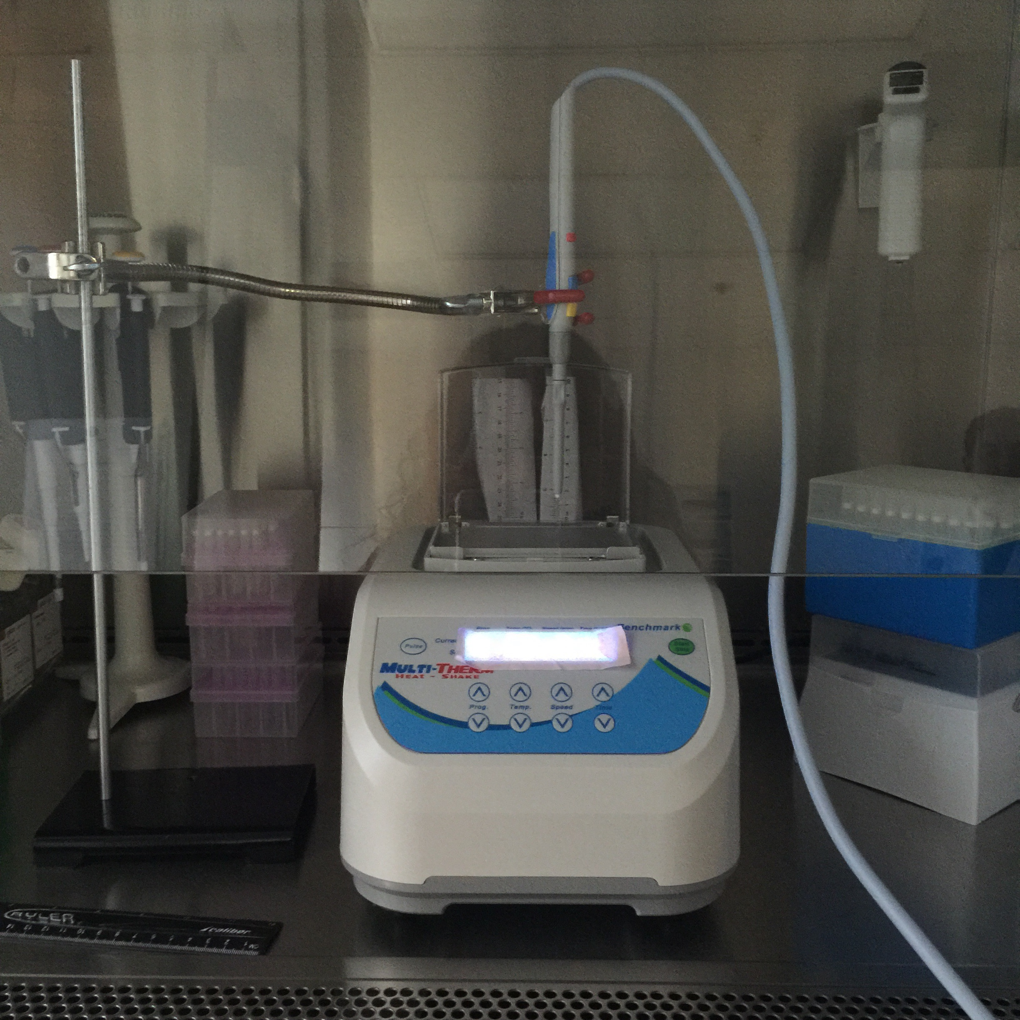
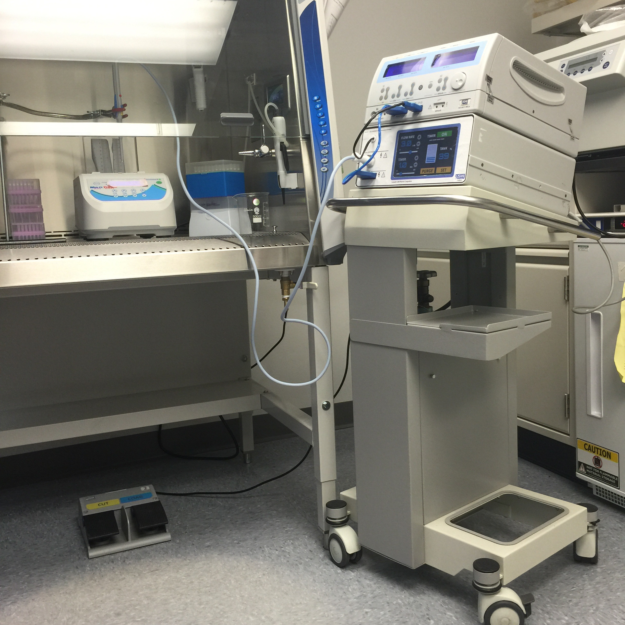
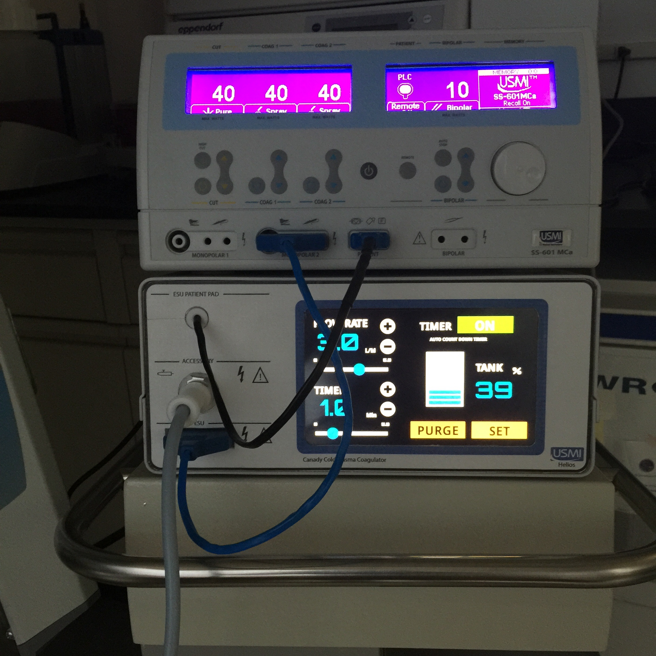
B
A
C
The experimental set up with Canady Helios Cold Plasma Scalpel. Note the 24 well-plate placed in a multi-thermal shaker to maintain 37⁰C in a biosafety hood during the course of the CAP treatment of epithelial cells (A, B). Arrow- Showing Hand piece of Canady HeliosTM Cold Plasma Scalpel (A,B) The entire set up with the SS-601MCa Canady Plasma Electrosurgical System and the converter box (arrowhead) for cold plasma connected to the experimental set up also showing the foot pad. Note the enlarged image of the SS-601MCa generator and the converter box in Figure C

Slide 10
COLD PLASMA SCALPEL
Technology and Device used on Colon Cancer patient (4th stage) for the first time in the world

Slide 11
% Cell Death/Viability-
Trypan Blue Dye Exclusion Test
Application of CAP on Tumor Stem cells
Primary Colon Cancer Cell Model- LT-97 (Gift of Dr. Brigette Marian)
Treated every 48 hrs- 6 treatments
 | Plasma length 2cm 1st Treatment |  | Plasma length 2cm 6th Treatment
Time in Sec | % cell Death CAP | % cell Death He | % cell Death CAP | % cell Death He
5 | 8.15±1.65 | 6.735±7.62
15 | 15.725±1.096 | 10.515±9.821
20 | 27.27±13.41 | 11.5±14.77
30 | 35.99±4.44 | 8.245±6.78
60 | 38.25±3.422 | 9.34±11.10 | 47.56±3.5
120 | 56.745±36.13 | 8.5±5.12 | 79.47±2.09
180 | 65.805±33.38 | 12.6±9.19 | 85.38±2.85 | 24.67±9.55
H2O2 | 88.83 ± 14.1 |  | 97.44±2.57
No Treatment | 6.4 ± 1.7 |  | 12.38±3.54

Slide 12
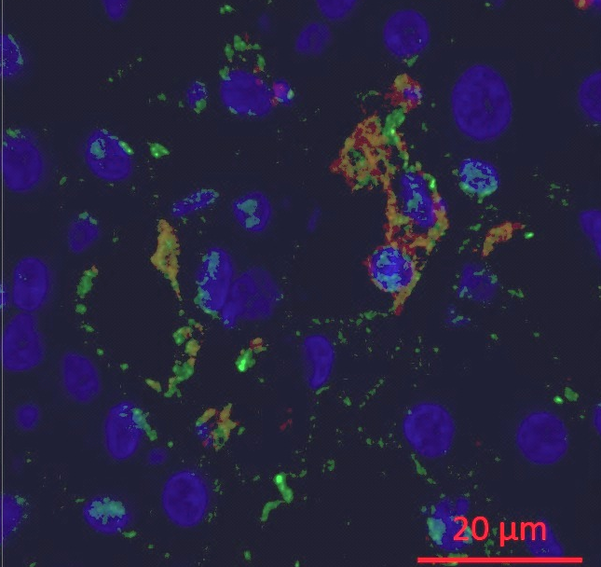
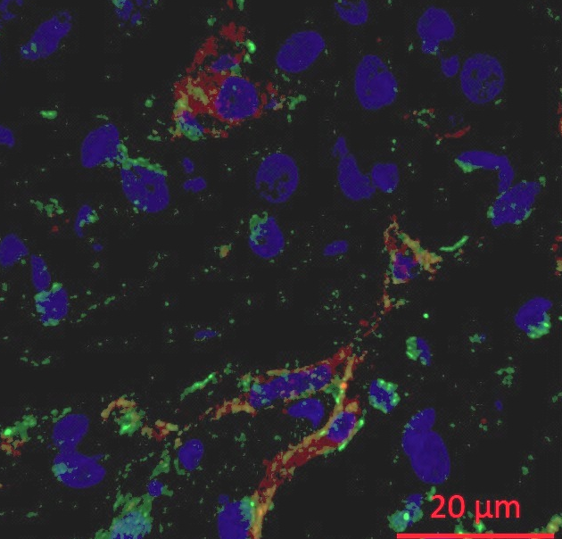
Immunofluorescence for CD44 and TRAIL-R1 showing Colon Cancer stem cells (arrow) in Liver
Immunofluorescence for CD44 (red) and TRAIL-R1 (green) showing Colon Cancer stem cells (arrow) in metastatic Liver
No CAP
No CAP
A
B
Human Liver No CAP
Images are 3D Reconstruction of Confocal Z--stack
TRAIL-R1- Green
CD44-Red
Nuclear counterstain DAPI- blue
Human colon cancer in liver
Patient- 4th stage of Metastatic colon cancer

Slide 13
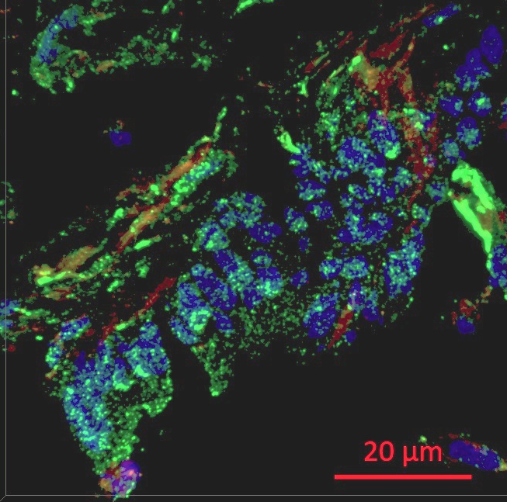
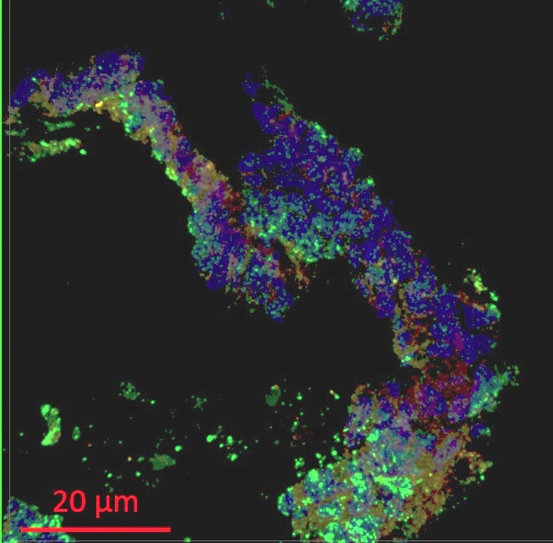
Immunofluorescence for CD44 and TRAIL-R1 showing Colon Cancer stem cells (arrow) in Liver
Immunofluorescence for CD44 (red) and TRAIL-R1 (green) showing Colon Cancer stem cells (arrow) in metastatic Liver
With CAP
With CAP
C
D
Human Liver With CAP
Images are 3D Reconstruction of Confocal Z—stack
Inserts showing Transmitted Light images
TRAIL-R1- Green
CD44-Red
Nuclear counterstain DAPI- blue

Slide 14
Primary Cultures from Human sample
Human tumor samples minced in to 2mm bits, washed in Penstrep
Explant cultures
Isolated Single Cell cultures
Outgrowth see after 11 days
Epithelial cells and Fibroblasts within 3 days
Characterize the cellular profile. Record the number of cells generated from CAP treated vs untreated samples

Slide 15
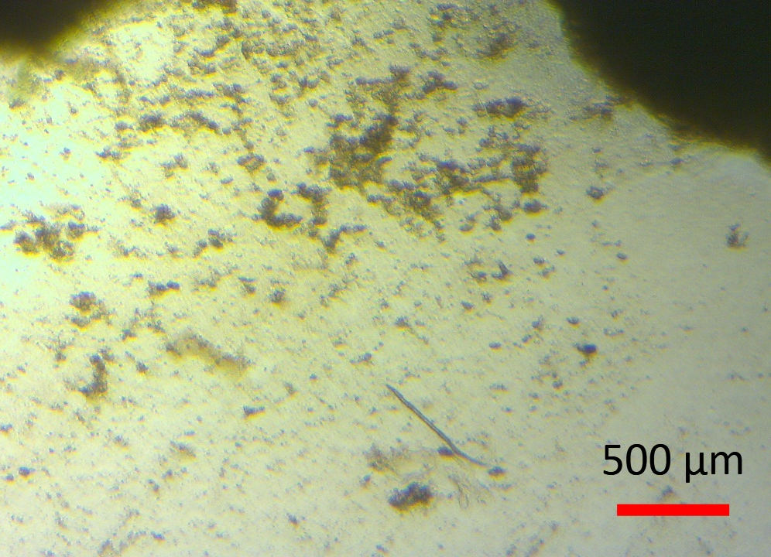
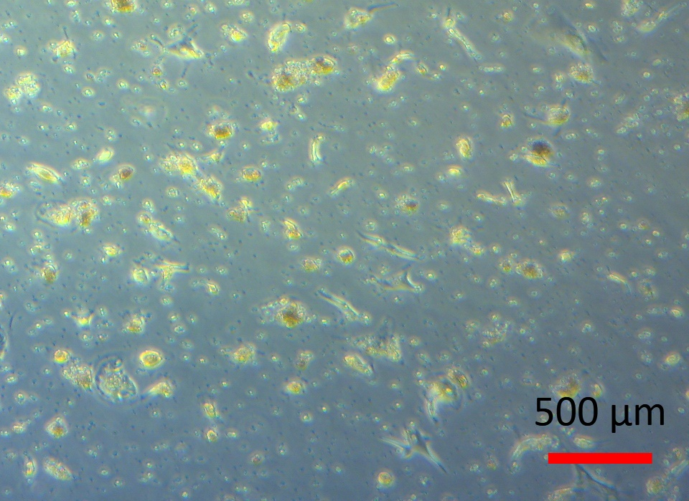
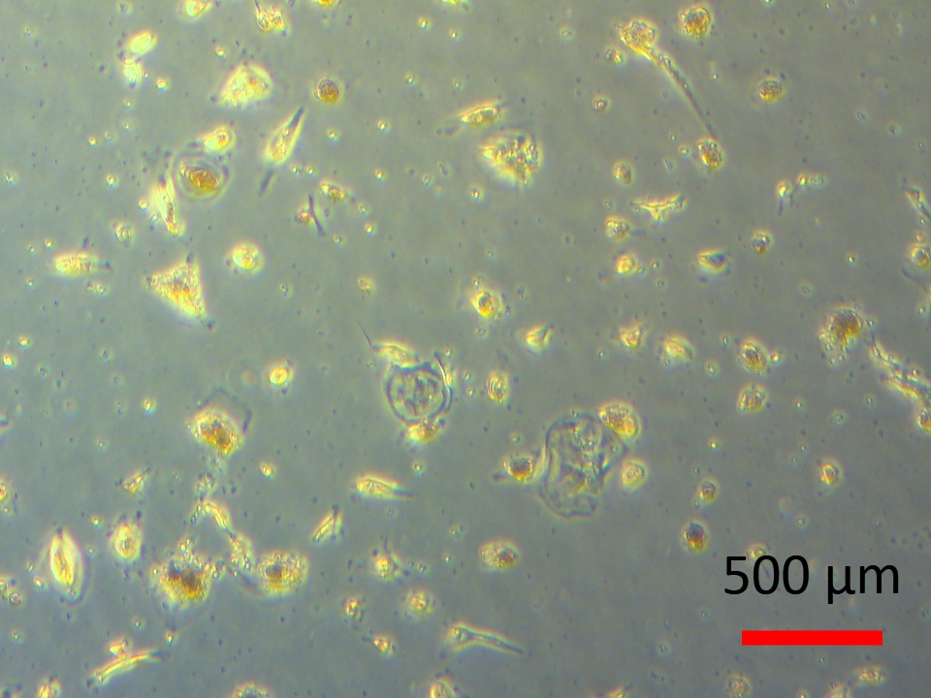
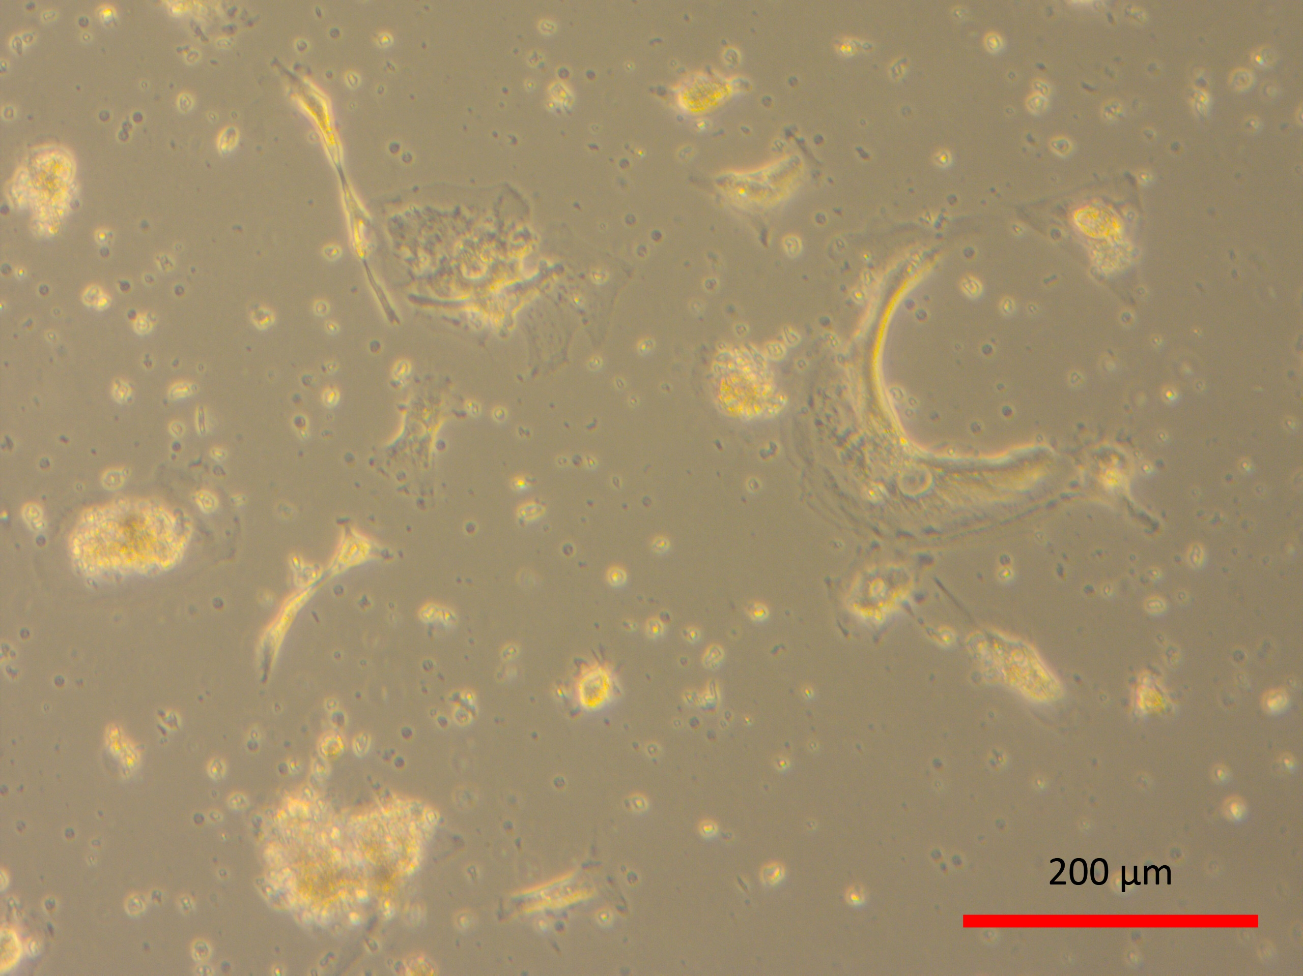
In vitro Expansion of Human Colon Cancer cells isolated from Liver after treatment with CAP
A
17 day-Explant culture
B
17 day-Isolated cell culture
C
20 Day-Isolated cell culture
D
27 Day-Isolated cell culture
20 day old cultures- Isolated cell cultures of epithelial cells showing
Cells differentiated cells going through apoptosis (arrow)

Slide 16
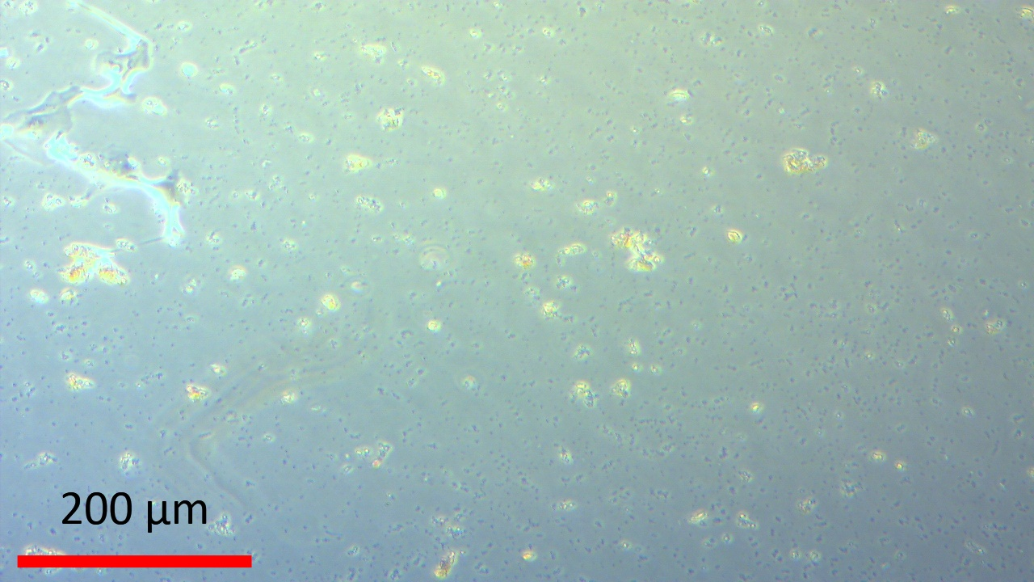
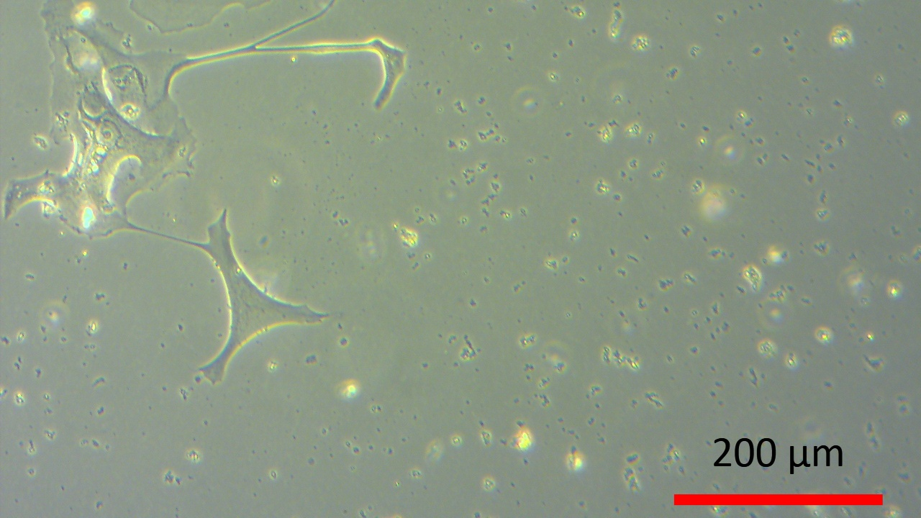
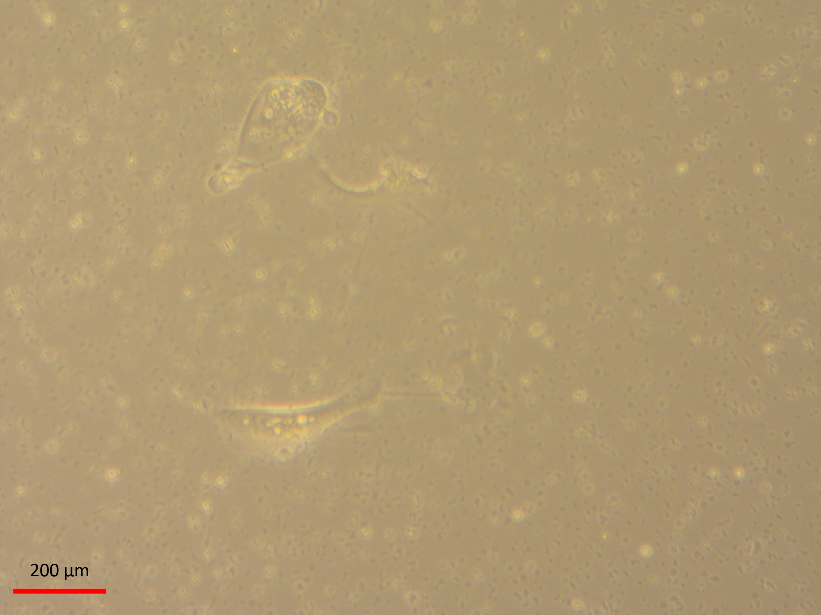
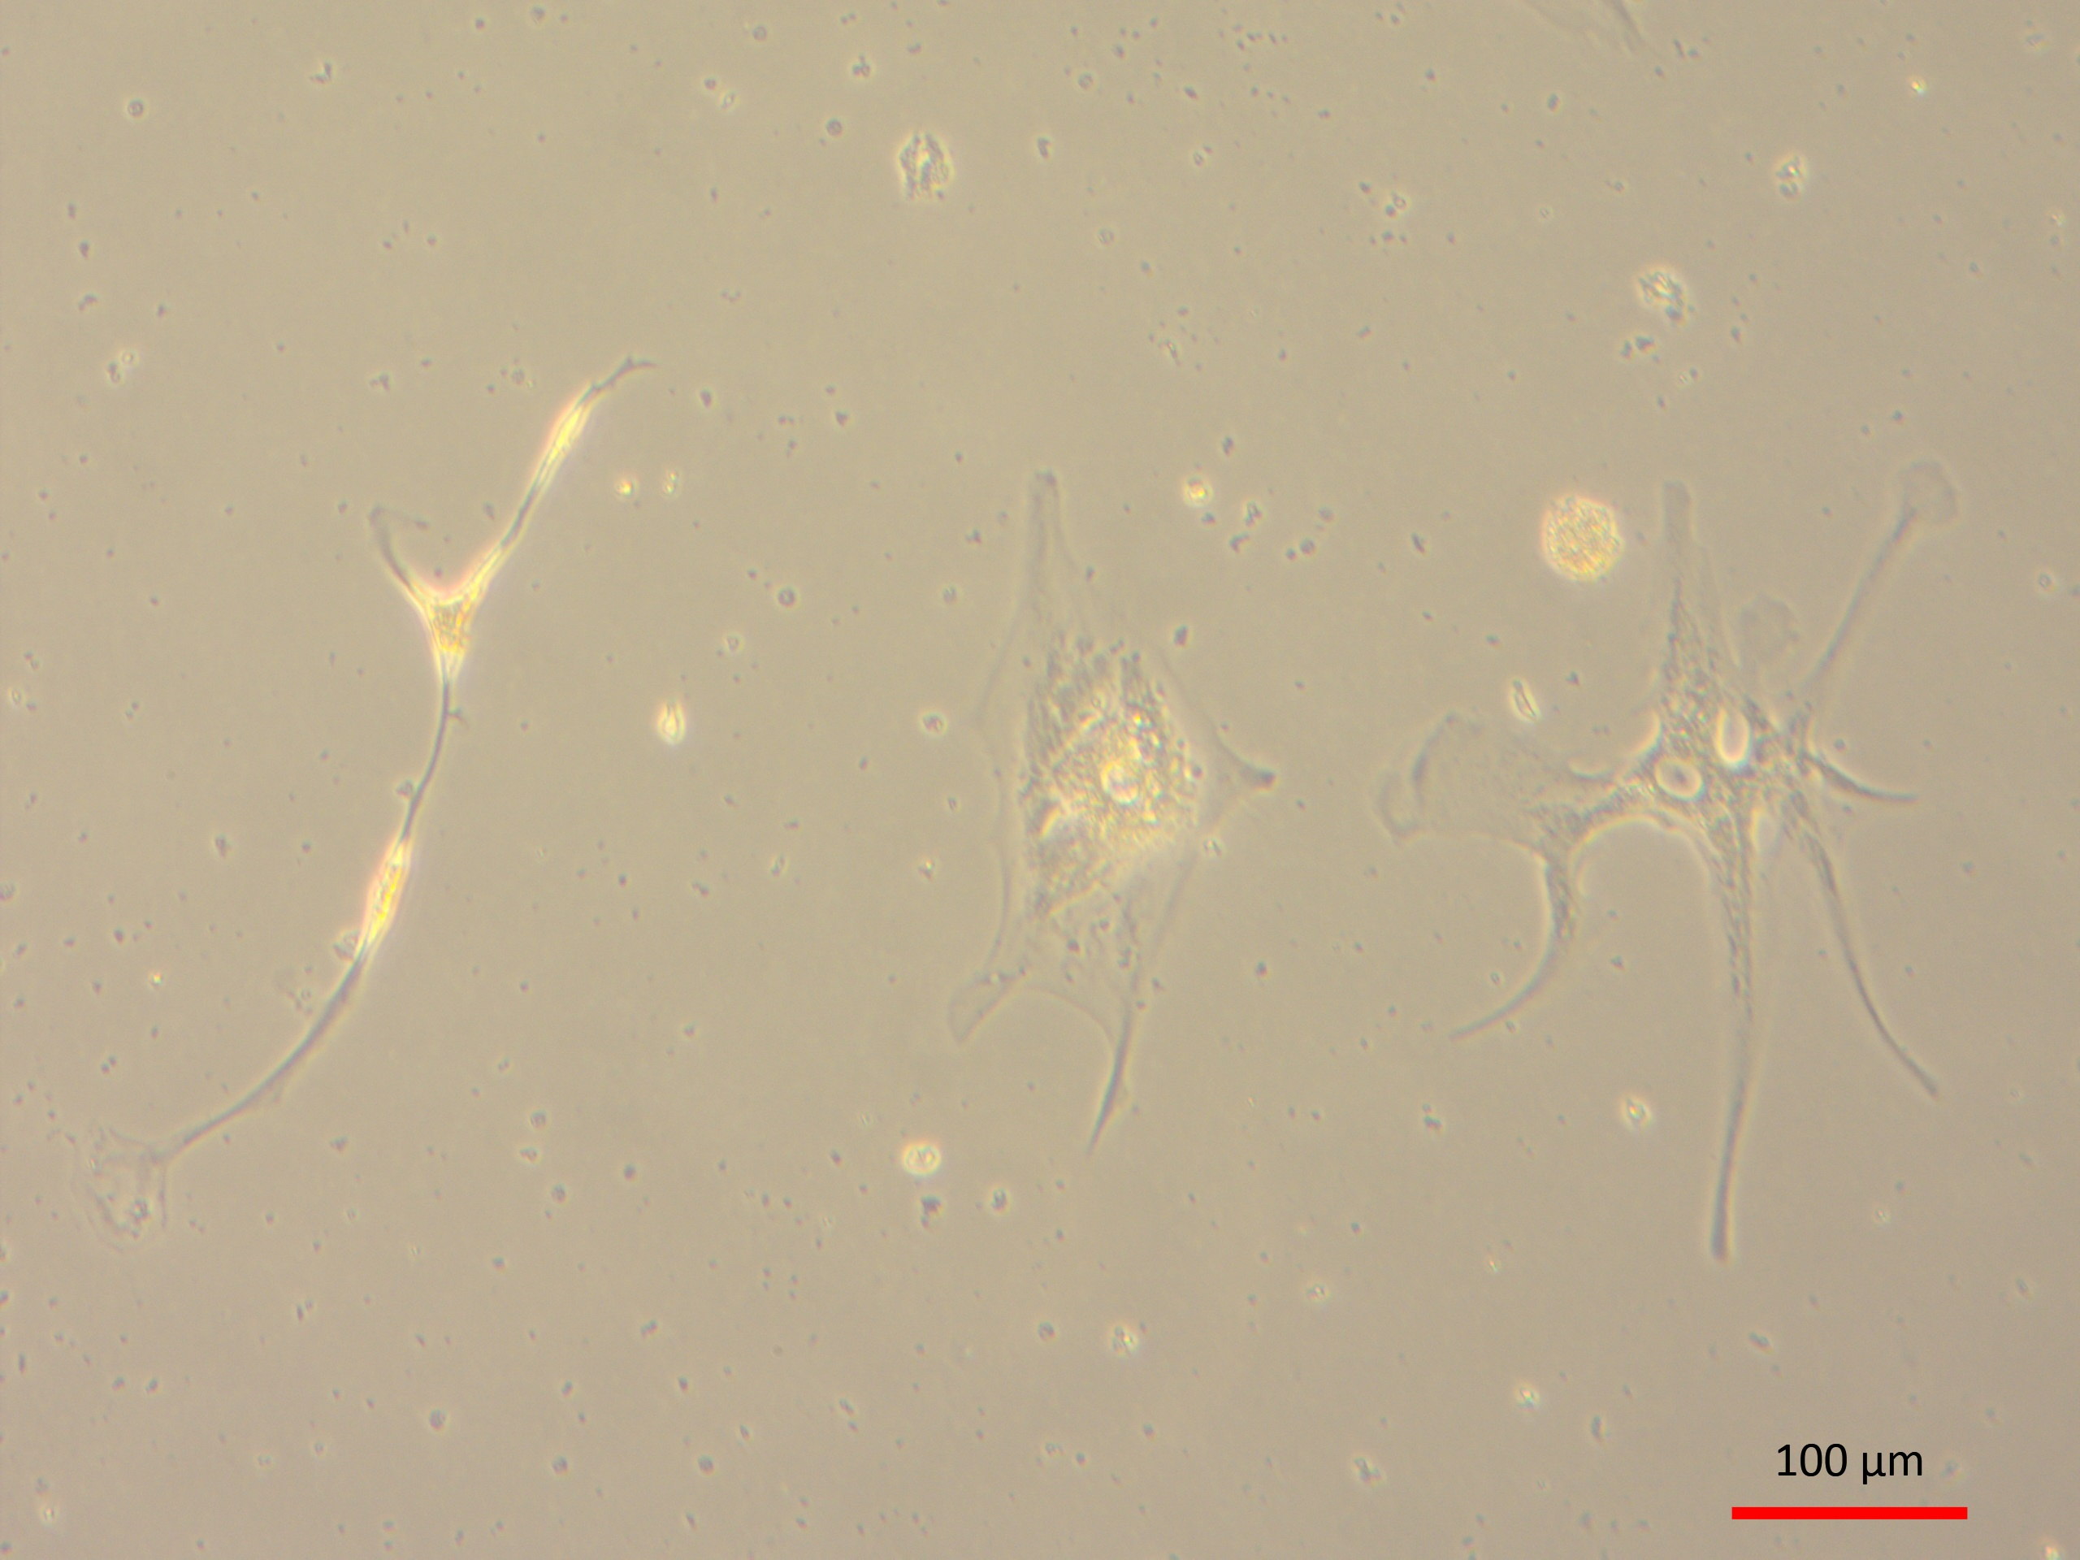
In vitro Expansion of Human Colon Cancer cells
isolated from Liver after treatment without CAP
17 day-Isolated cell culture
20 day-Isolated cell culture
A
B
27 day-Isolated cell culture
27 day-Isolated cell culture
C
D
Isolated cell cultures(20th day) showing colony of proliferating epithelial cells
Note the healthy proliferating colony of epithelial cells (arrow)

Slide 17
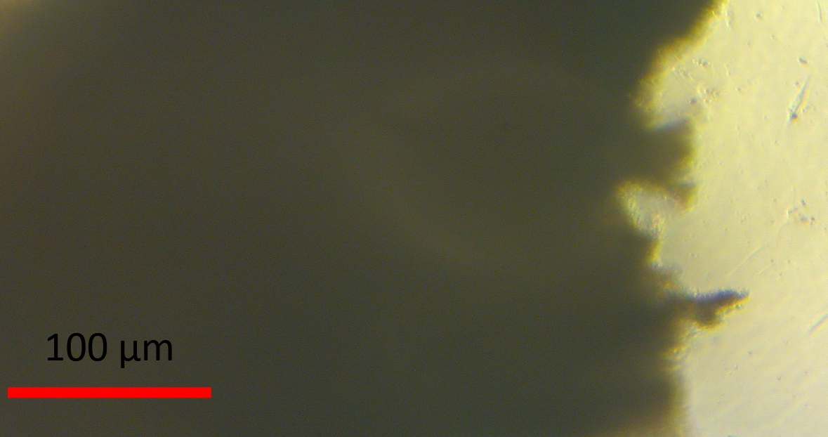
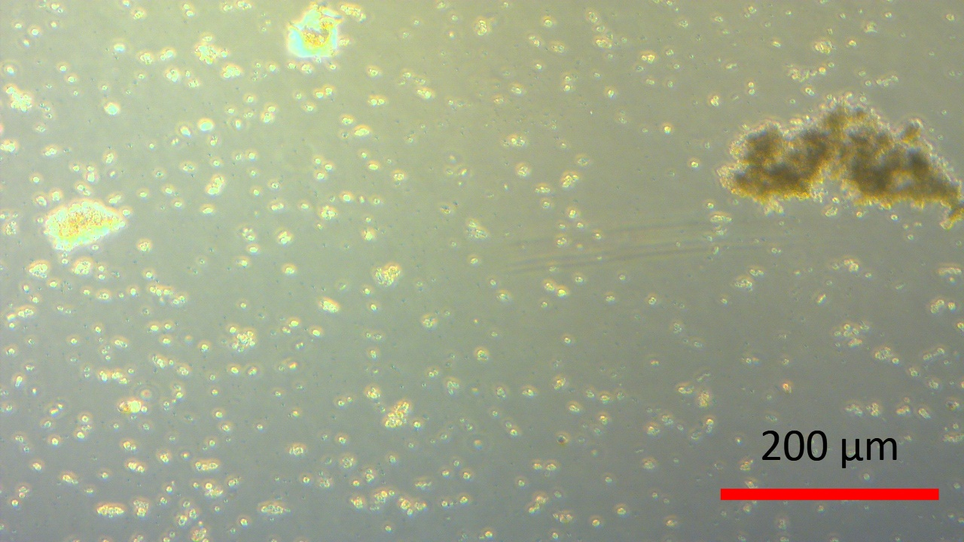
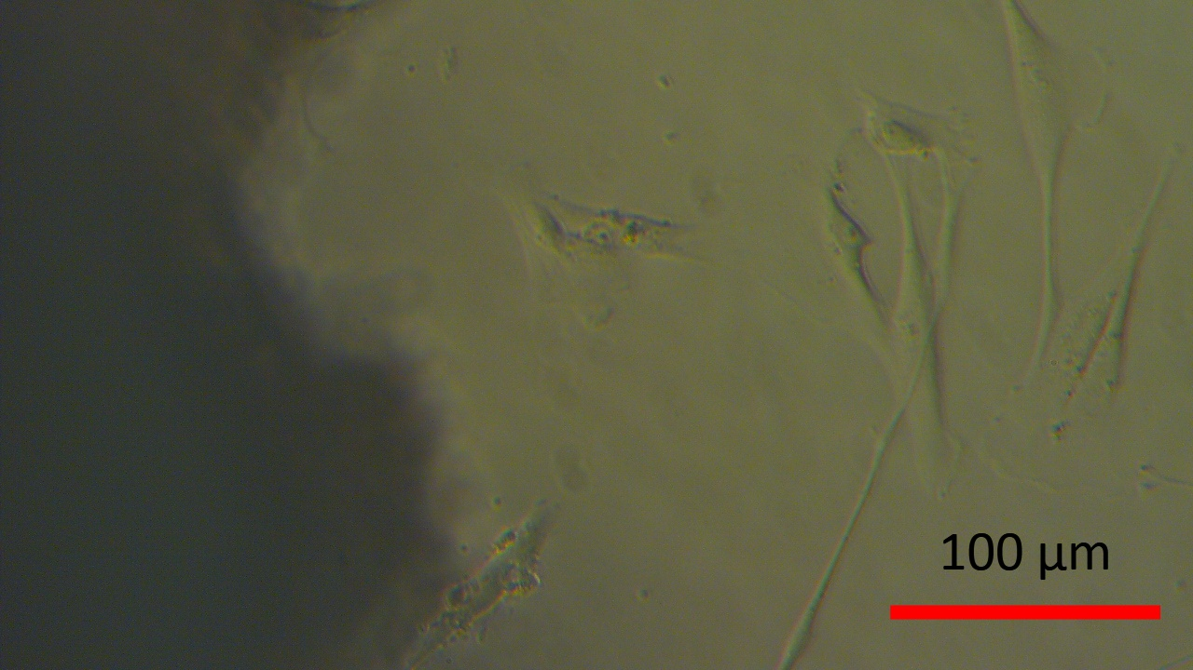
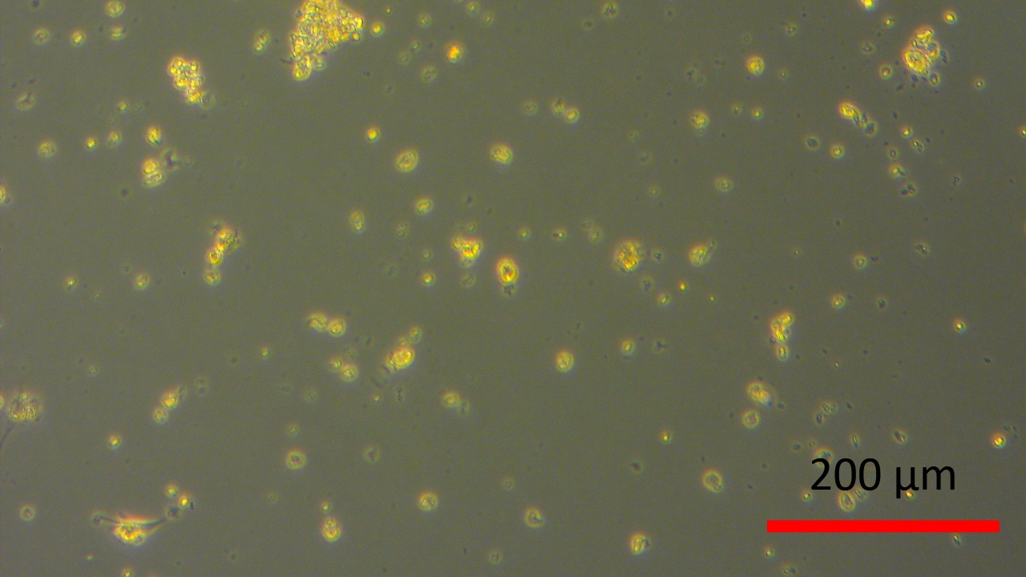
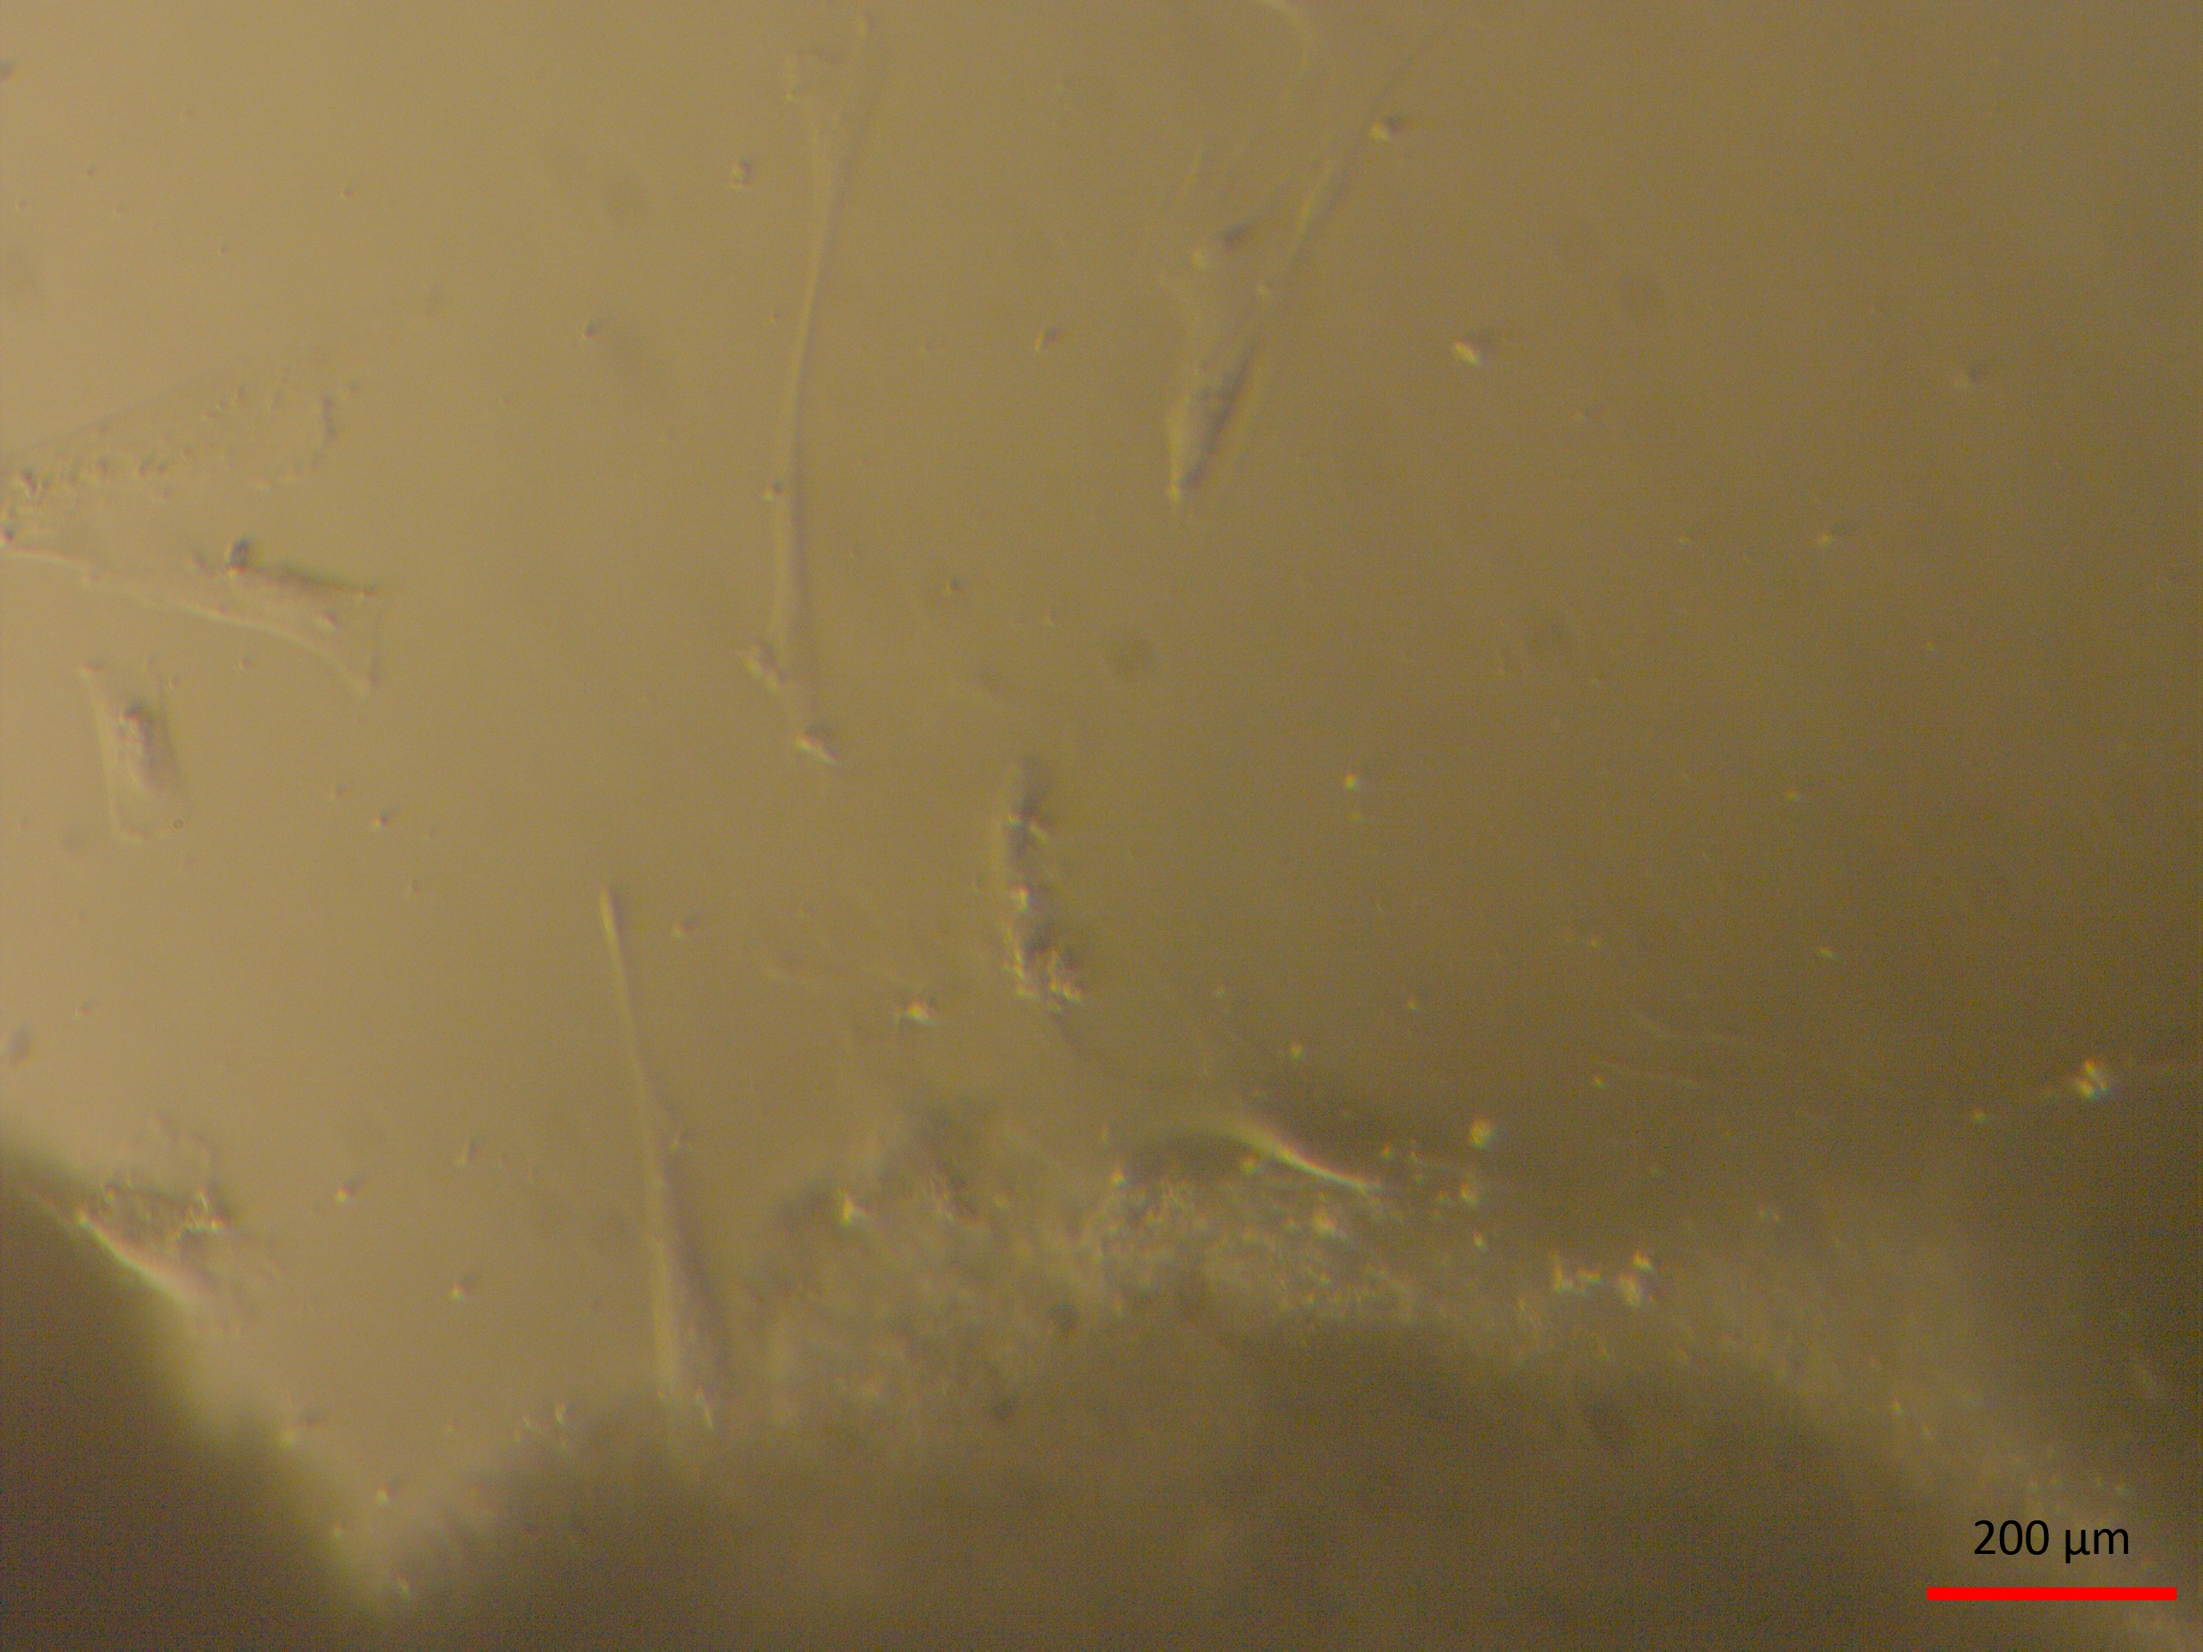
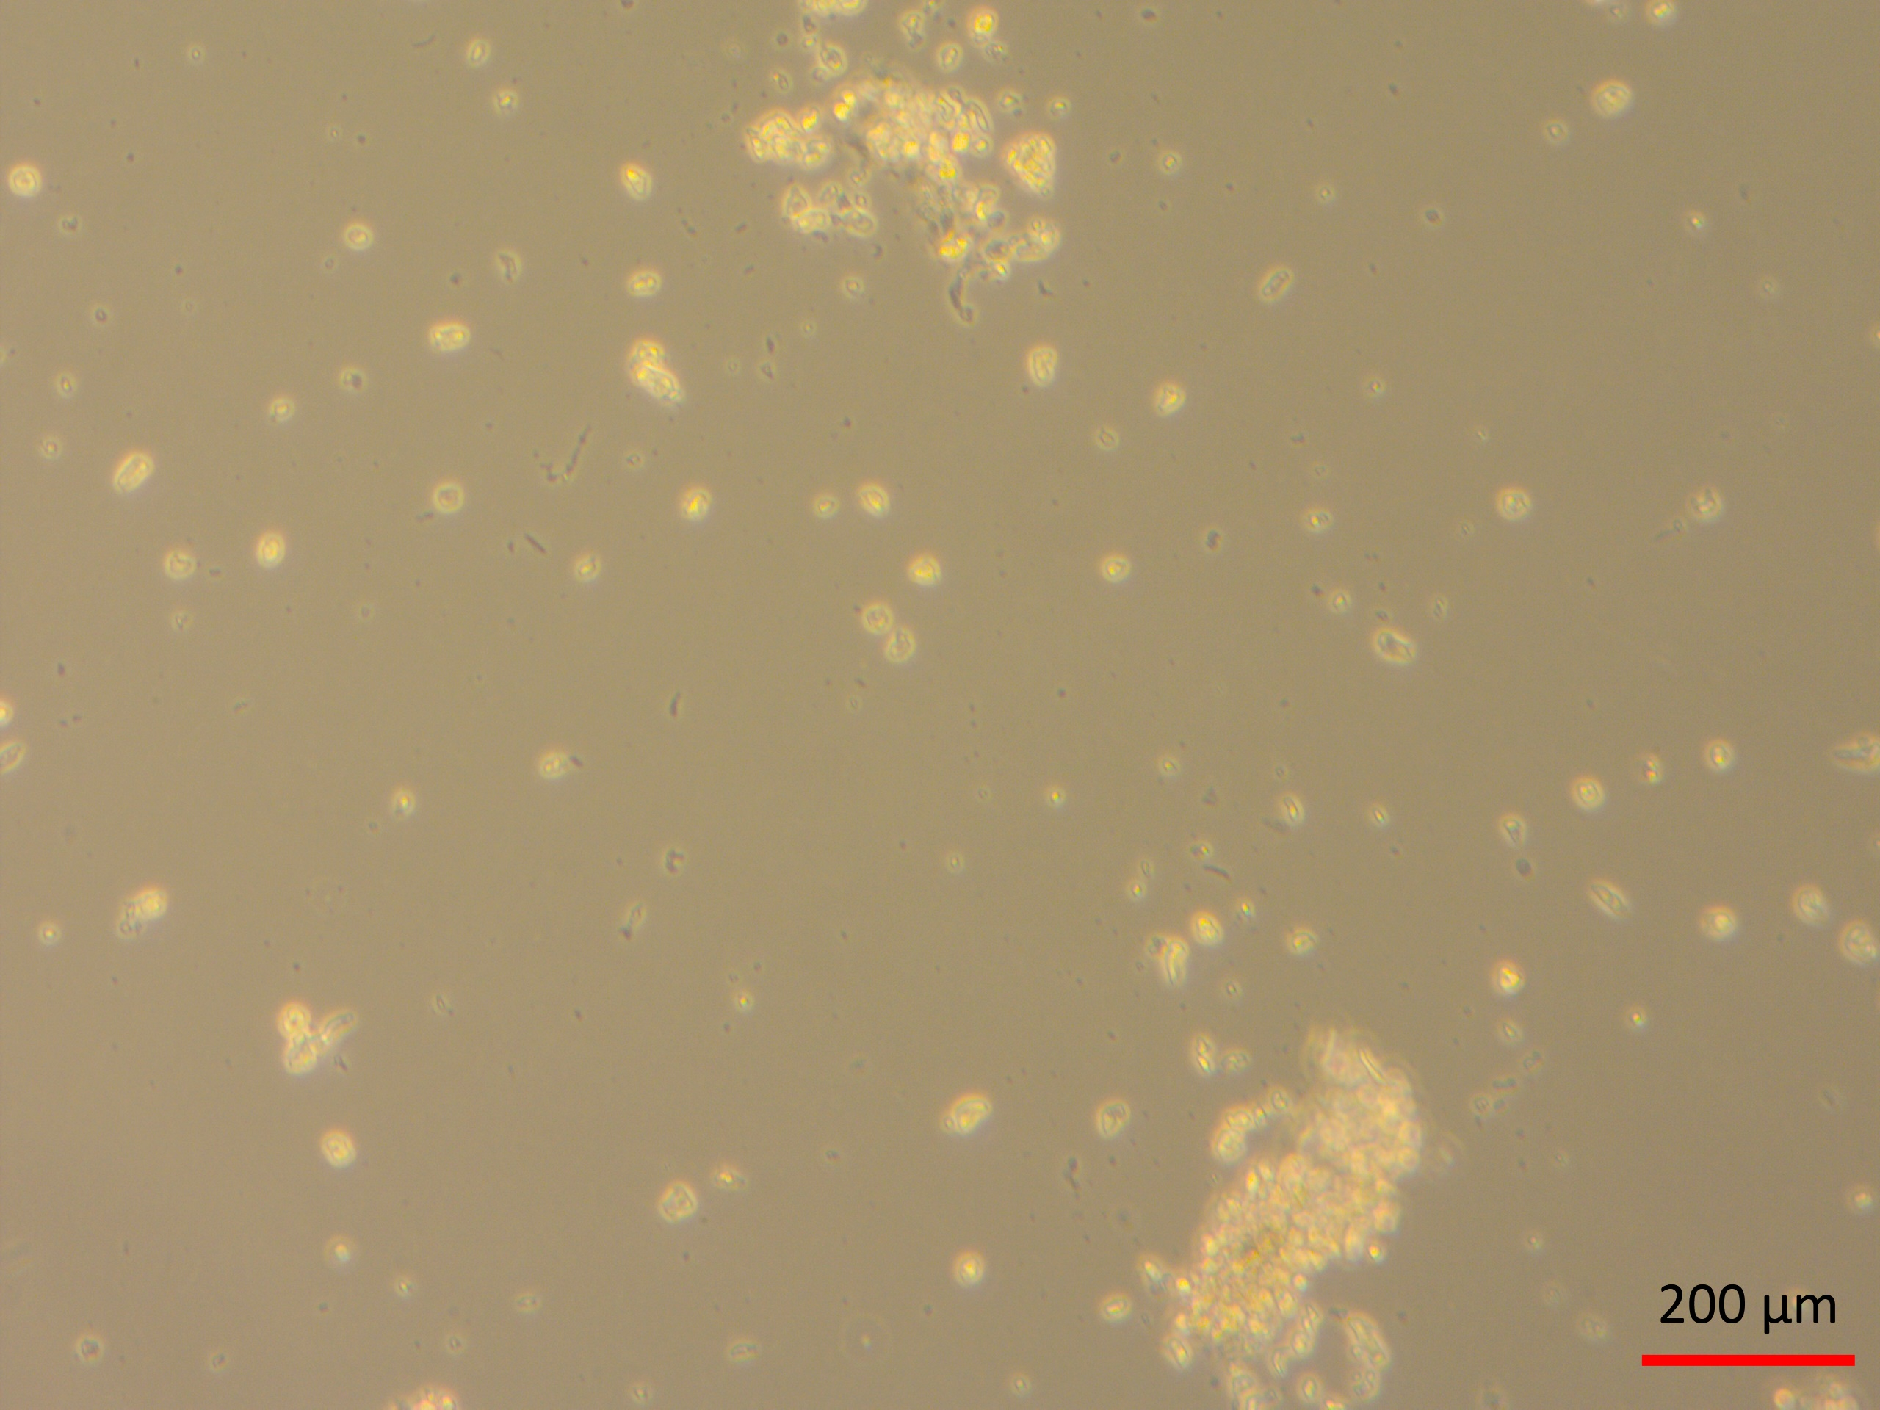
In vitro Expansion of Human Colon Cancer cells isolated
from Subphrenic Diaphragm after treatment with CAP
EXPLANT CULTURES
ISOLATED CELL CULTURES
A
B
17 day- Explant culture
17 day-Isolated cell culture
C
D
20 day- Explant culture
20 day-Isolated cell culture
E
F
27 day- Explant culture
20 day-Isolated cell culture

Slide 18
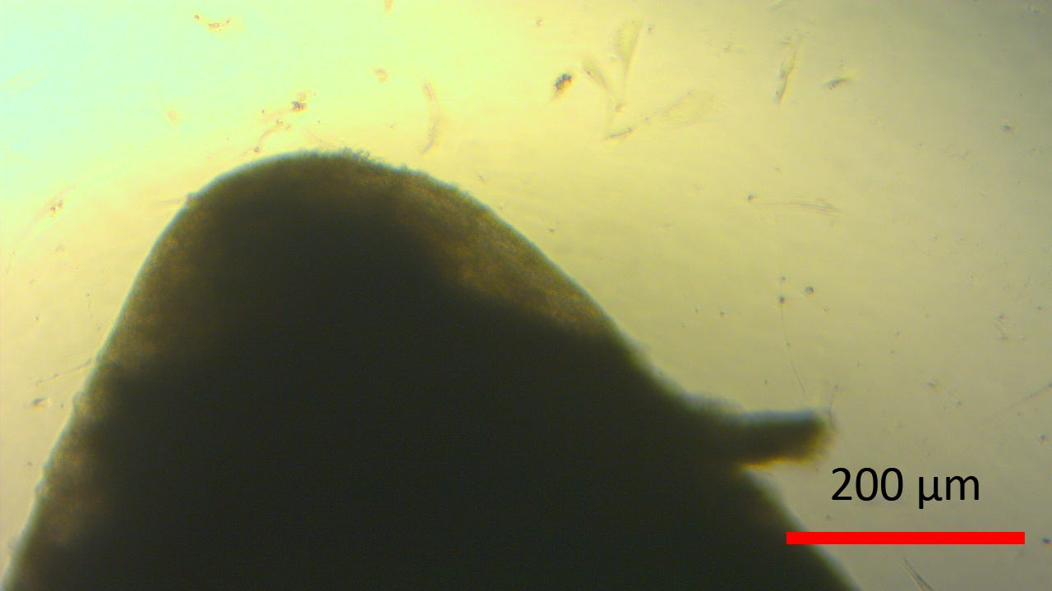
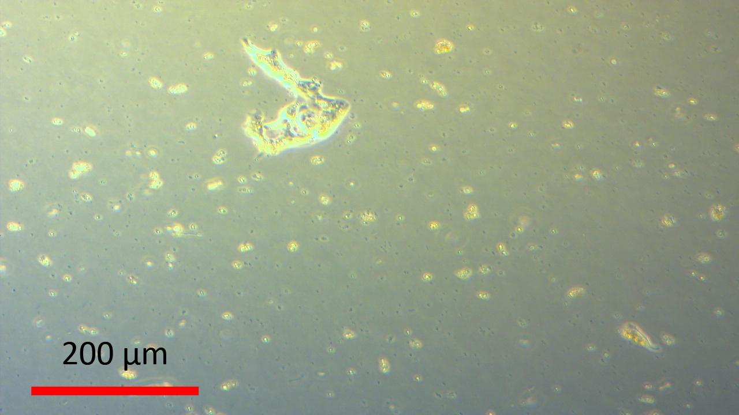
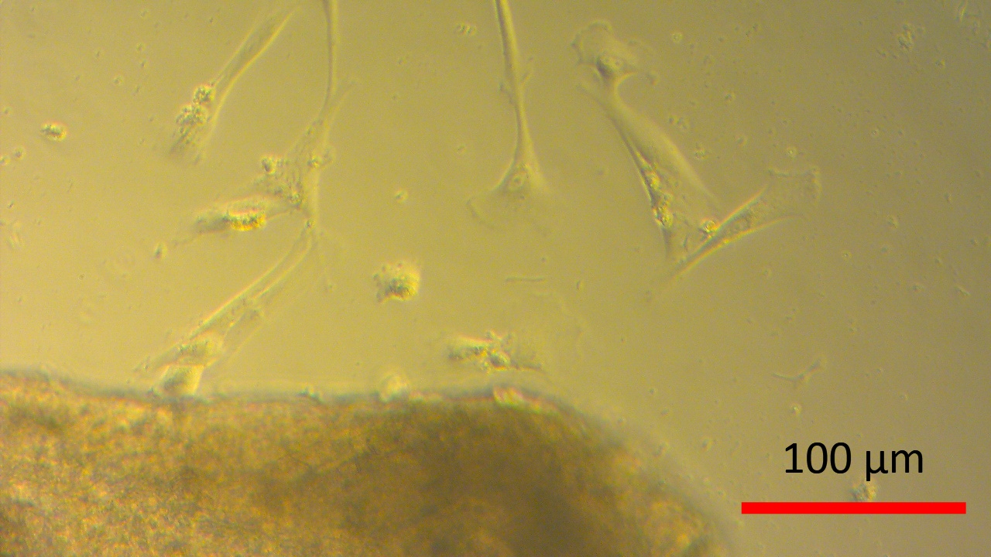
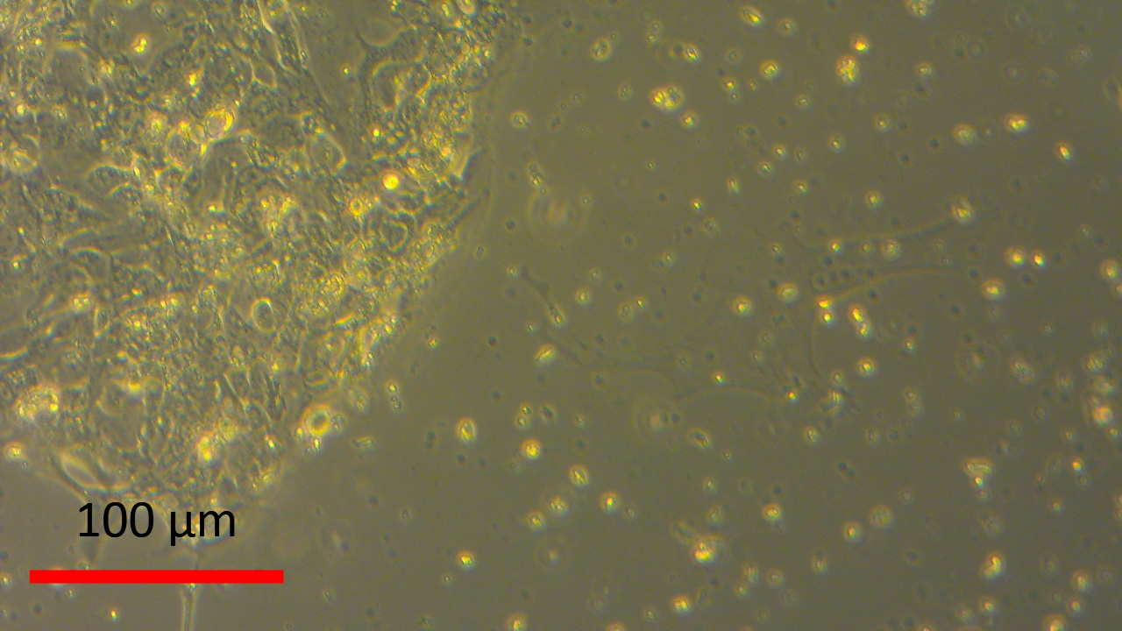
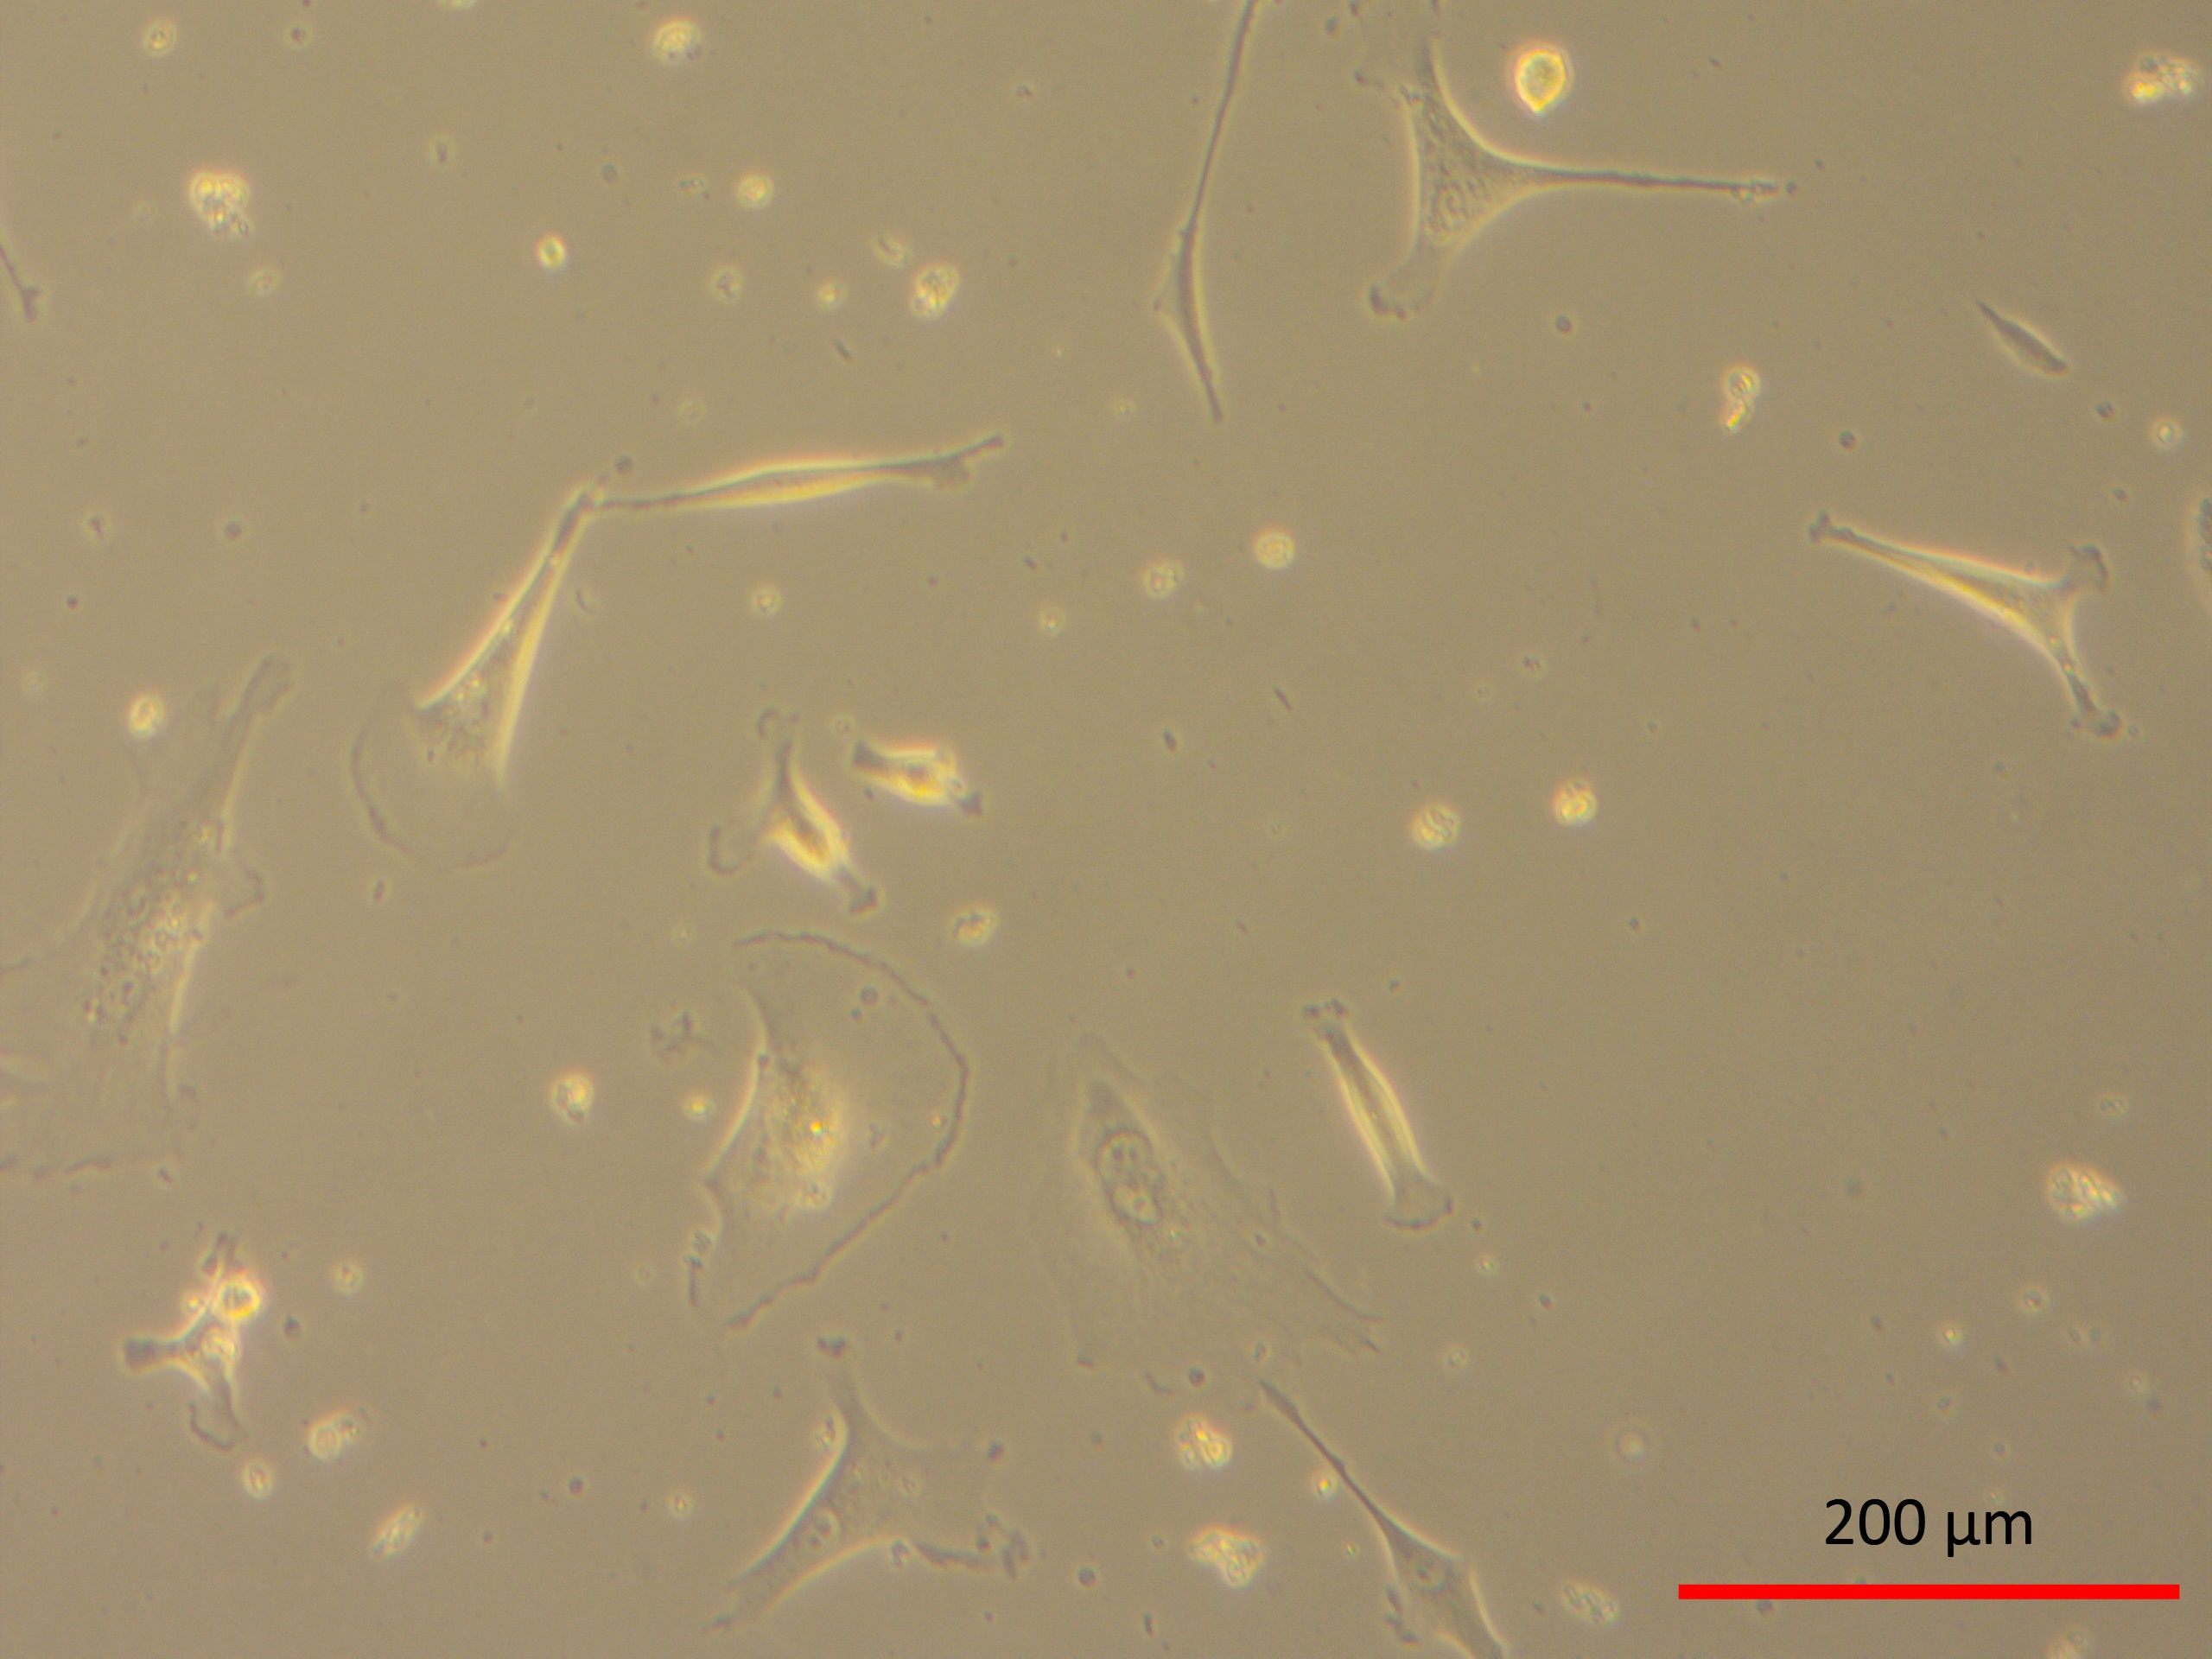
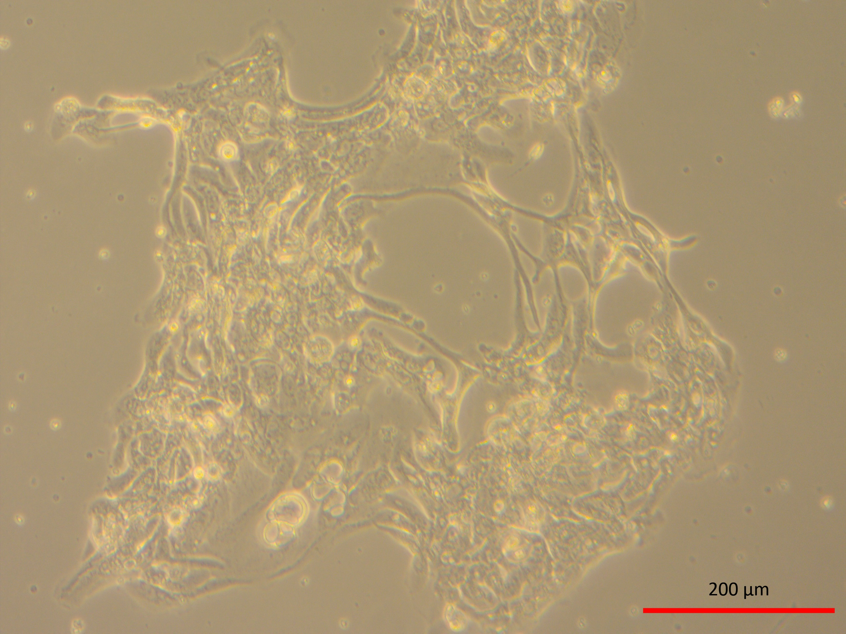
In vitro Expansion of Human Colon Cancer cells isolated from Subphrenic Diaphragm after treatment without CAP
EXPLANT CULTURES
ISOLATED CELL CULTURES
A
17 day- Explant culture
B
17 day-Isolated cell culture
C
20 day- Explant culture
D
20 day-Isolated cell culture
E
27 day- Explant culture
F
20 day-Isolated cell culture
27 day- Explant culture
20 day-Isolated cell culture

Slide 19
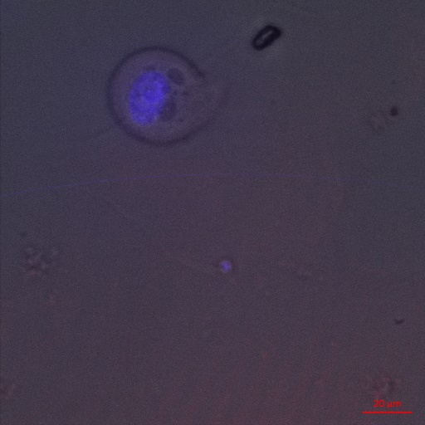
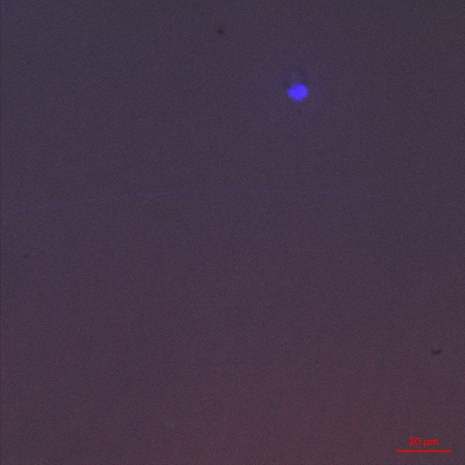
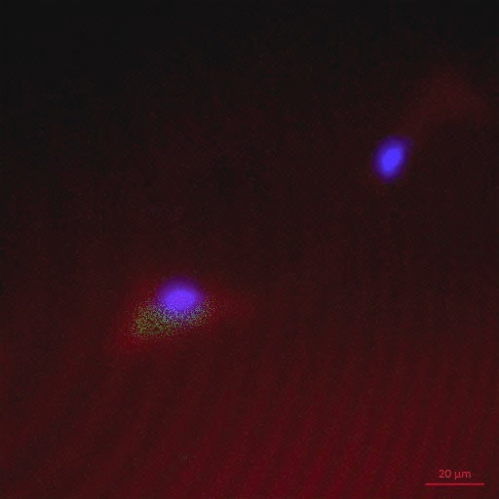
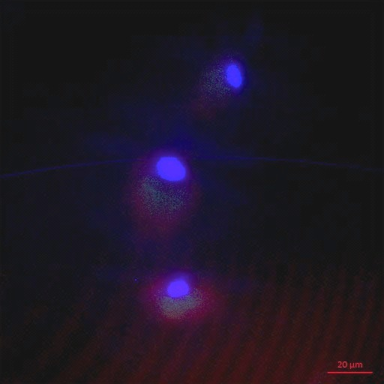
Cellular profile of cells after 27 days of ex vivo expansion
of human colon tumor cells in presence of CAP
CAP
CAP
20μm
20μm
A
B
No CAP
No CAP
No CAP
Arrow-
Double positive cells
for Ki67 (green) and
TRAIL-r1 (red)
CD44 red
Ki67 green
Ki67 green
CD44 red
C
20μm
D
20μm

Slide 20
Proportion of Proliferating cells expressing TRAIL-R1
 | %Double Positive cells | Ki67% Positive Cells | %Trail-r1 Positive Cells | %DAPI positive cells
Colon Tumor cells without CAP* | 24 | 16 | 32 | 28
Colon tumor cells with CAP | NIL | NIL | NIL | 24 Disintegrating cells

Slide 21
% Cell Death/Viability- Retinobalstoma Cells (Y-79)
Trypan Blue Dye Exclusion Test
Plasma length 2cm - ARPE Control Cells |  |  | Plasma length 2cm - Y79 Retinoblastoma cells
Time in Sec | % cell Death CAP | % cell Death He | % cell Death CAP | % cell Death He
5 | 0.39±0.675 | 0.1903±0.33 | 45.28±47.83 | 3.433±3.433
15 | 0.551±0.55 | 0.401±0.361 | 50.17±48.17 | 14.4±8.591
20 | 0.311±0.539 | 0.102±0.176 | 56.64±42.35 | 12.03±8.571
30 | 1.127±1.95 | 0.47±0.429 | 86.81±17.72 | 28.47±16.96
60 | 1.3±1.69* | 0±0 | 87.86±16.38* | 18.02±13.40
120 | 2.203±1.97 | 0.843±0.747 | 90.74±16.04 | 33.55±17.99
180 | 13.28±20.15 | 0.847±0.768 | 100±0 | 47.60±26.12
H2O2 | 94.18±2.07 |  | 94.075±5.55
No Treatment | 0.543±0.941 |  | 22.78±27.35
*p≤0.005; Retinoblastoma cells showed increased cell death at 1 &2 minute CAP- Most optimal

Slide 22
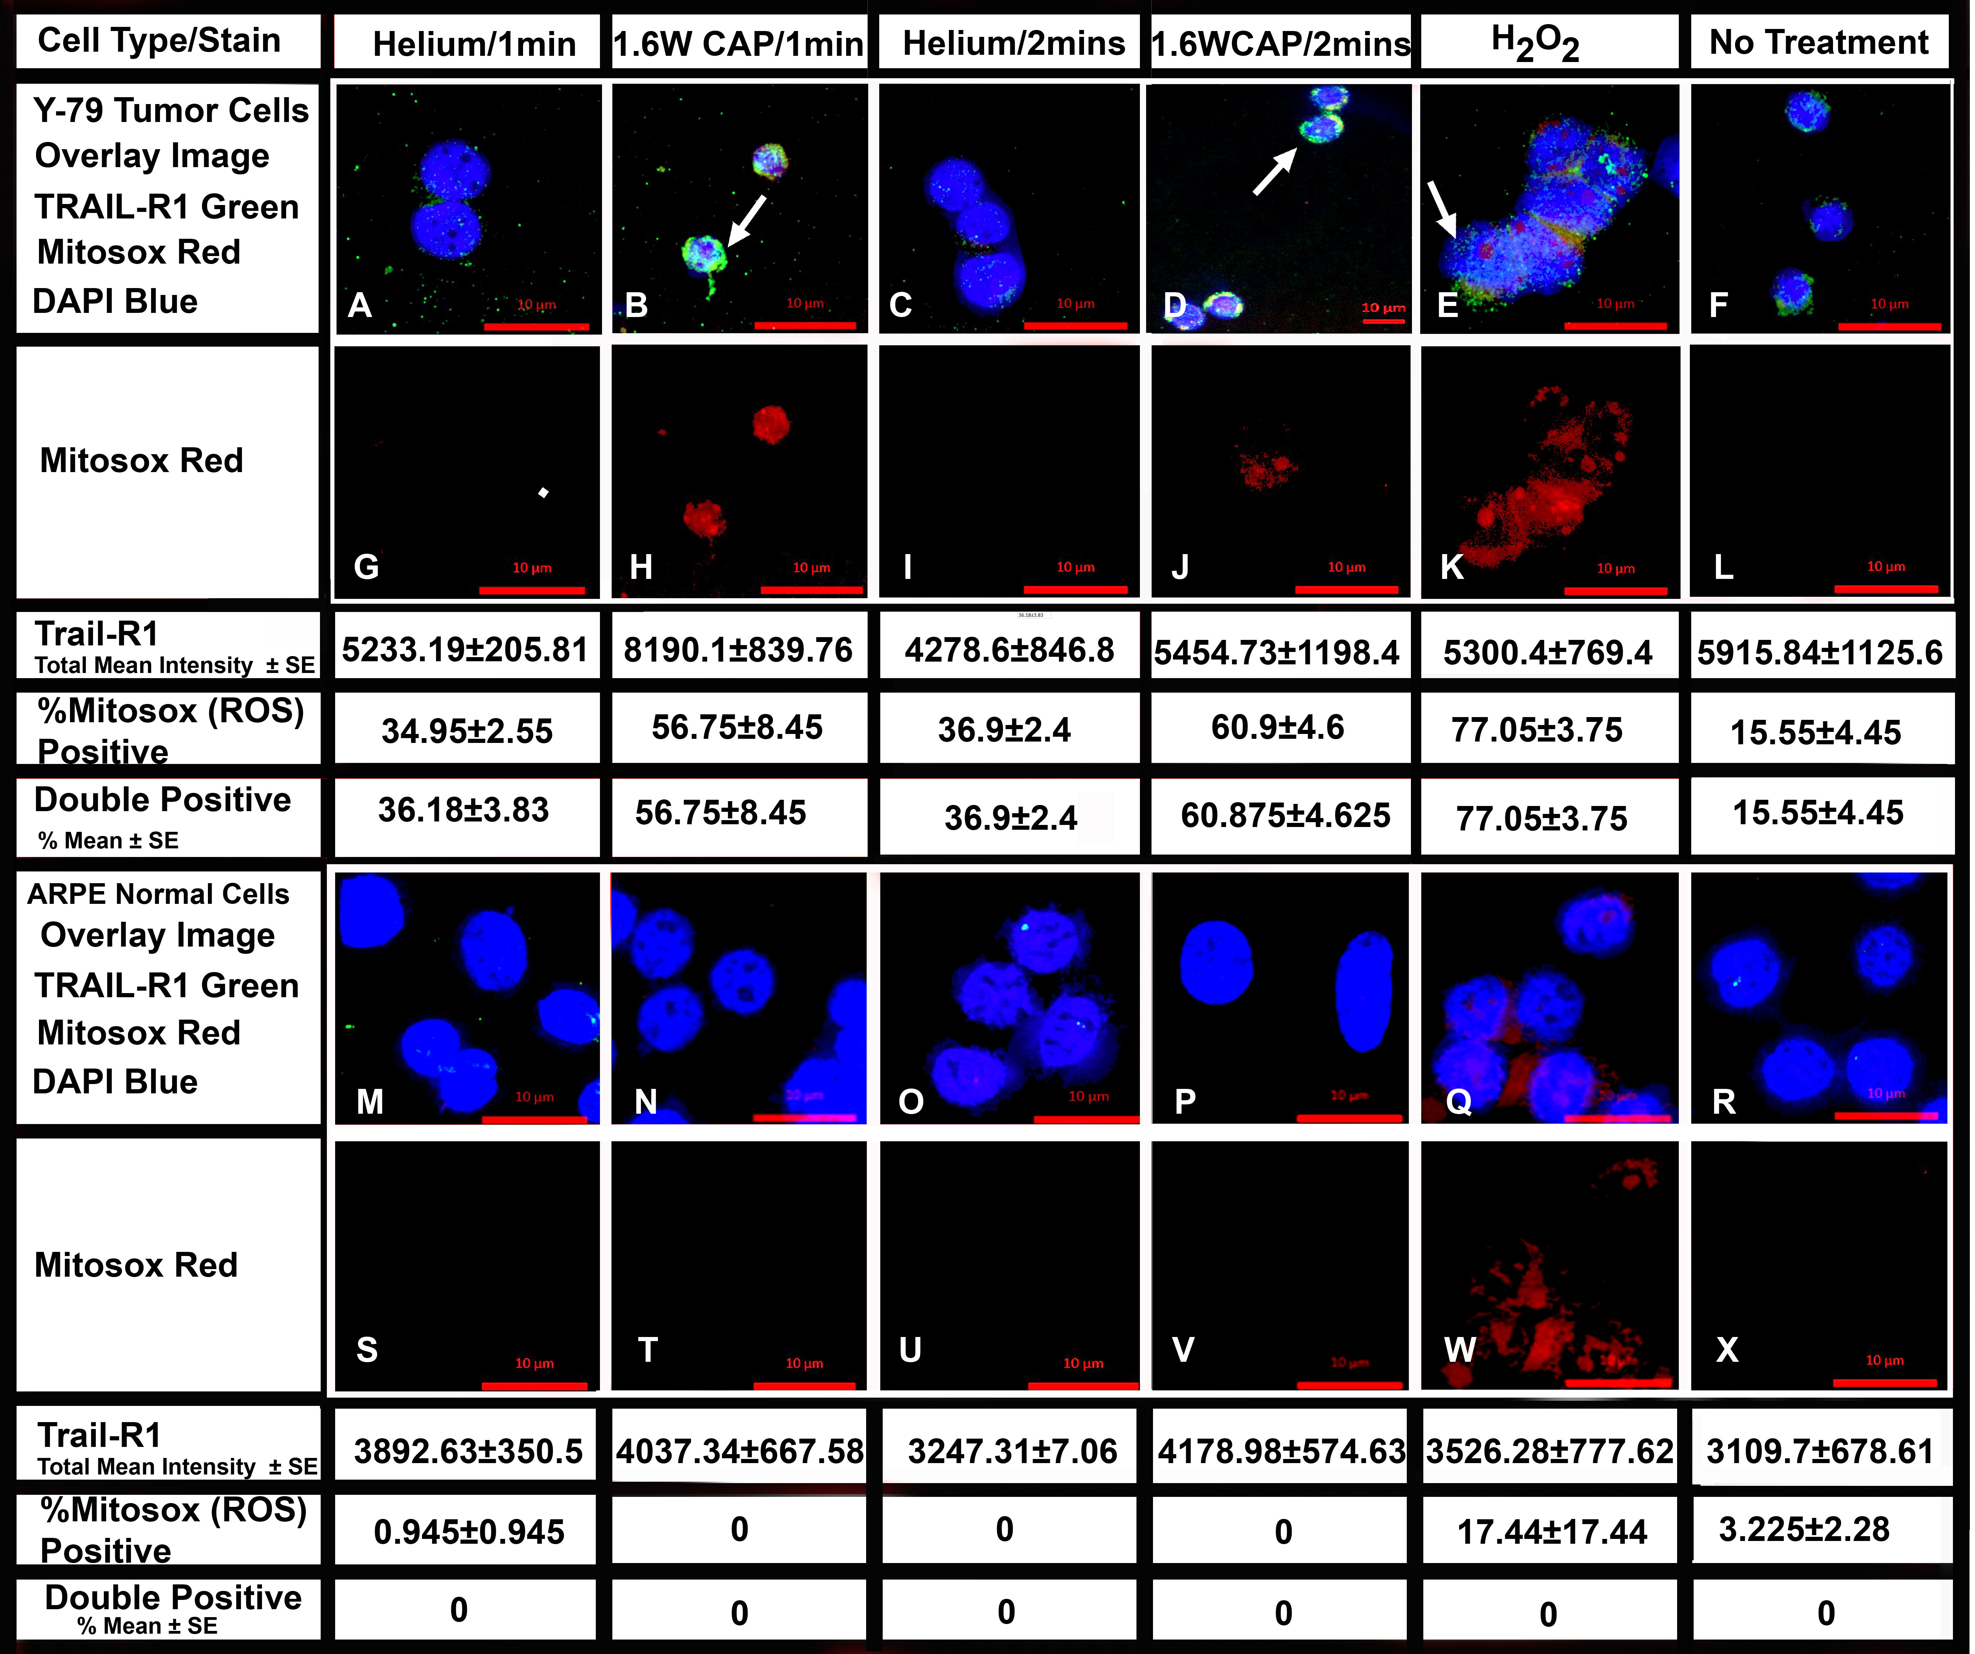
Total Mean Surface Expression of TRAIL-R1 and ROS Positive Tumor Cells
*
*
*
*

Slide 23
SUMMARY
CAP induced cell death of primary colon cancer stem cells isolated from patient sample
Tumor stem cells invitro more resistant to cell death in presence of CAP –require 6 treatements
Retinoblastoma cells responded to CAP inducing cell death at 1-2 minutes (1.4W)
Elevated levels of TRAIL-R1 expression in Rb
CAP serves as an alternative therapy for solid tumors

Slide 24
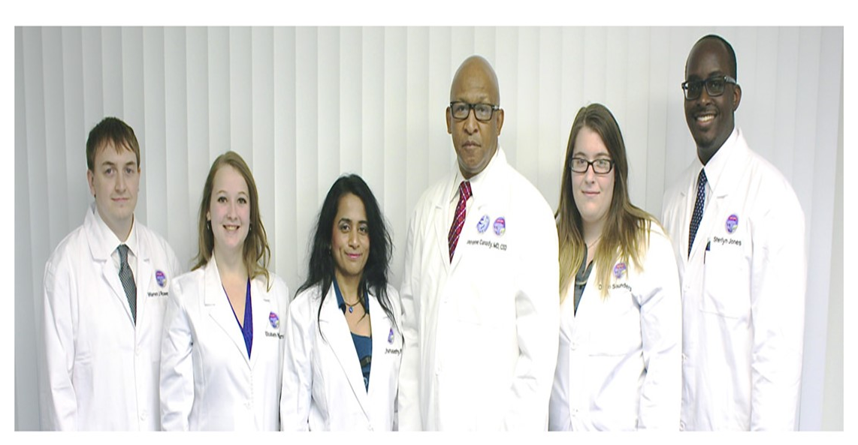
Translational Molecular Biology Group-
Dr. Jerome Canady, MD, CEO
Arpitha Parthasarathy, PhD(Director Research & Principal Investigator)
Warren Rowe III, PhD (Postdoctoral Scientist)
Elizabeth Williams, (Senior Research Assistant)
Sterlyn Jones and Devin Saunders (Research Assistants)

Slide 25

Meet the eminent gathering once again at
Eye-2016
Miami, USA
September 26-28, 2016
Eye– 2016
Website: eye.conferenceseries.com

