Slide 1
Use of the combined uncertainty of measurement result for testing compliance of food commodities with legal limits
Prof Dr. Árpád Ambrus
in cooperation with
Zsuzsa Farkas¹, Gabriella Suszter²

Slide 2

Objectives
Interpret the maximum limits from the prospectives of producers and official control.
Use of combined uncertainty for establishing action and decision limits by the producers and buyers, respectively.
Illustrate the principles with
practical examples.

Slide 3
Basic definitions – legal limits
Maximum level (ML)
For contaminants, naturally occurring toxicants and nutrients, the maximum concentration of a substance recommended by the Codex Alimentarius Commission to be legally permitted in a given commodity. It applies to the avearge concentration of the chemical in samples meeting the minimum mass and sample size requirements
Maximum residue limit (MRL, ML) for pesticide residues
The maximum concentration of a pesticide residue (expressed as milligrams per kilogram) to be legally permitted in or on food commodities and animal feed. MRLs for meat and poultry apply to a bulk sample derived from a single primary sample, whereas MRLs for plant products, eggs and dairy products apply to the average residue in a specified portion of the composite bulk sample derived from 1-10 primary samples..

Slide 4
Control of the commodities
There are two distinctly different situations which needs different sampling plans:
it has to be certified that at least a specified proportion of the product in terms of the minimum size and mass of bulk/laboratory sample complies with the legal limit
the combined uncertainty including sampling uncertainty (CV_{R}) shall be taken into account
Control of commodities on the market
Premarketing self-control
a lot is considered non-compliant if the measured analyte concentration corrected for recovery, where specified, minus the expanded uncertainty of the results are above the legal limit.
the combined uncertainty of the measured concentration (CV_{L}) shall only be taken into account (excluding the sampling uncertainty)

Slide 5
Illustration of the consideration of combined uncertainty of the measurement result
1. Sampled lot does not comply with the legal limit
2. The product is compliant
3. Product may not comply with the specification.
4. Product complies with the specification.

Slide 6

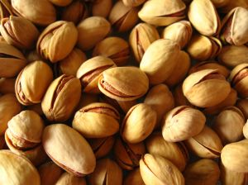
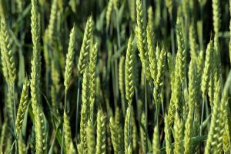
Distributions of contaminants in food
If the measured value is compared to the legal limit the chance of wrongly declaring a lot to be compliant depends on the distribution of the measurand in the tested food.
  if the tested commodity is homogenous in term of the contaminant (aflatoxin M1 in milk), then the uncertainty of the analytical measurement (e.g. 15% for ELISA-based detection of aflatoxin M1) need only to be considered ;
  the pesticide residues in fruits and vegetables, and ochratoxin in pistachio are distributed approximately following lognormal distribution; in case of pesticide residues the CV_{R} of 35-45% shall be taken into account.
  due to the very patchy distribution of aflatoxins in nuts, cereals, etc. their distribution can be best described with negative binominal function; the CV_{R} around 60-70% can be expected.

Slide 7
OBJECTIVE: Combined uncertainty of results (S_{Res}) should be as low as practically posible
Ring tests, proficiency tests and internal quality control provide information only for CV_{A}
What do we kow about the contribution of CV_{S}, CV_{SS}, CV_{Sp} ??

Slide 8
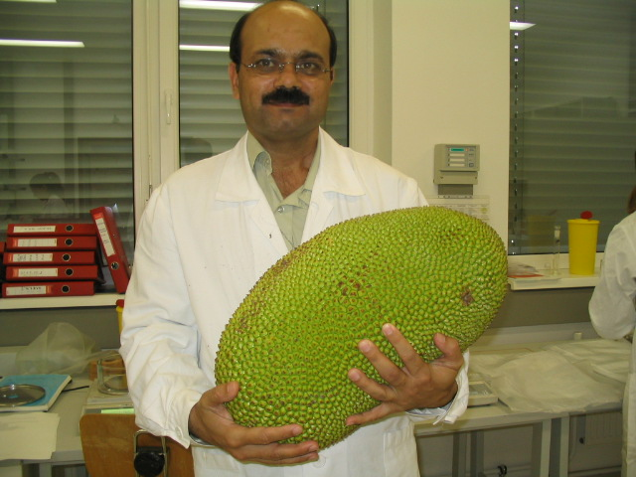
Sample size reduction CV_{SS}

Slide 9
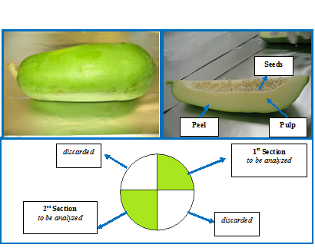
Sample size reduction
Notes:
In the present study, error from sample preparation was evaluated by calculating the differences between the distributions of benomyl pesticide in peel and in pulp. Evaluating of such a difference helps to understand the importance of sample preparation step.
Papaya samples harvested from a commercial farm of Malaysia were dipped into solution containing benomyl as a post harvest treatment.
After shipment of 11 papaya fruits to the laboratory, their stems were removed.
Then, they were cut in to 4 sections in longitudinal directions.
Two opposite sections were taken for processing and the other two were discarded.
Peel and pulp and the seeds of the selected sections were separated. Benomyl residue was analysed by HPLC_UV.

Slide 10
Internal quality control
Regularly re-analyse replicate test portions at different time intervals.
Select replicate results which are within the 95% critical range.
2 replicates:
3 replicates

Slide 11

Determination of CV_{L}
Calculate their relative standard deviations from the results of replicate test portions :
R_{Δi} = 2(R_{i1} –R_{i2})/(R_{i1}+R_{i2})
ν = n
(# : number of replicate test portions)
For 2 replicates

Slide 12

Effect of particle size
Gy’s sampling RSD=CV_{Sp}
C: shape factor,
d: upper 95% of particle size,
M_{Tp} : extracted test portion,
M_{As} : mass of homogenised portion of sample
M_{AS}=1000 g M_{Tp}: 25g (F=0.039); 10g (F=0.099); 5g (F=0.199); 2 g (F=0.499)
Ingamells’ sampling constant:

Slide 13



The effect of test portion size reduction
Gy’s equation
Test portion M_{Tp} [g] | Mass of laboratory sample (M_{Ls})
 | 1 kg | 2 kg | 5kg
 | Multiplying factor
1 | 15.2 | 15.1 | 15.0
2 | 7.6 | 7.5 | 7.5
5 | 3.0 | 3.0 | 3.0
10 | 1.5 | 1.5 | 1.5
15 | 1.0 | 1.0 | 1.0
25 | 0.6 | 0.6 | 0.6
50 | 0.3 | 0.3 | 0.3

Slide 15
Typical contribution of the steps of pesticide residues determination (CV_{R}=0.38) to the combined uncertainty
The CV_{A} is only 11%

Slide 16
Interpretation of measure values

Slide 17
Relationship of AL and ML in case of determination of AFM1 in milk.
Where the product to be tested can be considered homogeneous such as bulk milk, the sampling uncertainty is practically zero. In this case only the uncertainty of the analytical measurement (CV_{L}) should be taken into account .

Slide 18
Distribution of residues in apple composite samples.
Comparison of mesured value to the MRL/ML
If we compare contaminants/residues in composite samples to the ML/MRL we would make wrong decision in over 50-70% of the cases depending on the measurand and sample.

Slide 19
Relationship of the Action limit (AL) for testing and the decision limit (DL) for verifying compliance with an MRL of 1 mg/kg of an apple lot.
Premarket control: Action limit
Post-market control: Decision limit (expanded uncertainty =2x SD, CV = 0.25 )

Slide 20
Examples of estimated action limits for selected pesticide residues
 | MRL mg/kg | AL mg/kg
acephate | 0.02* | LD≤0.008
azoxystrobin | 3 | 1.2
chlorpyrifos | 0.05* | LD≤0.02
cyfluthrin | 0.1 | 0.04
difenoconazole | 1 | 0.4
indoxacarb | 0.3 | 0.12
tetradifon | 0.01* | LD≤0.004

Slide 21
Calculation of compliance of mycotoxin contamination taking into account the AL or targeted complinace level
Input data
Commodity - mycotoxin combination
Variability of measurand in composite samples.
Mass and number of laboratory sample
CV_{L} of the laboratory analysis
Test portion size
Web based tool has been developed:
http://www.fstools.org/mycotoxins/.
Notes:
We have a very smart template to calculate the action limit where you can give the
-sampling uncertainty for different type of crops
-uncertainty laboratory phase
And The AL can be easily calculated from the number of samples and analyzed test portions, which should not be exceeded in the replicate samples to assure targeted compliance level at the MRL.

Slide 22
Template for mycotoxins
Mycotoxin, Commodity | Aflatoxin, Corn , Shelled | Aflatoxin, Corn , Shelled | Aflatoxin, Corn , Shelled
Laboratory Sample Size - ns (kg) = | 10.00 | 10.00 | 10.00
Number Laboratory Samples - scnt (#) = | 2 | 3 | 4
Test Portion - nss (g) = | 50 | 50 | 50
Number of aliquots - na = | 1 | 1 | 1
Accept/Reject Limit (ng/g) = | 2 | 2 | 2
Regulatory Limit (ng/g) = | 5.0
The Mycotoxin Sampling Tool can be accessed at the following website address: http://www.fstools.org/mycotoxins/.
FAO encourages Codex members to use the tool. Feedback on the tool can be sent at food-quality@fao.org
Additional references on related topics can be found on the web at http://www.bae.ncsu.edu/usda/www/whitaker1.htm

Slide 23
Practical examples
AL
=2 mg/kg
ML
=5 mg/kg

Slide 24
Conclusions and recommendations
The concept of the action limit can be applied for the verification of the compliance of a particular lot, or can be used within an early warning control programme.
AL depends on CV_{R} (n, p, ap, CV_{L}) acceptable violation rate
The sample size (number of primary samples, total mass) should correspond to that specified in relevant legislation.
Producers should define suitable control points when appropriate action levels (Performance Criterion) can be applied.
The sampling programme should be based on the precise definition of the sampling frame, weighting the potential risk associated with the production of a given product and the random sampling of the products all over the production cycle.
Under such conditions the analytical results can be used to verify that the production is under control.

Slide 25

Thank you for your attention.
Close collaboration of all stakeholders is required for limiting rejection of lots and disputes in food trading

