Slide 1

May 09-11,2016 Chicago, Ilinois, USA
2nd International Conference on
Hepatology
Hepatitis C virus (HCV) genotype 1b as a risk factor
for Hepatocellular carcinoma development
in chronic HCV positive patients in Southern Italy
Dr. Arnolfo Petruzziello
PhD, Unit of Virology
IRCCS- Fondazione G. Pascale - Naples, Italy

Slide 2
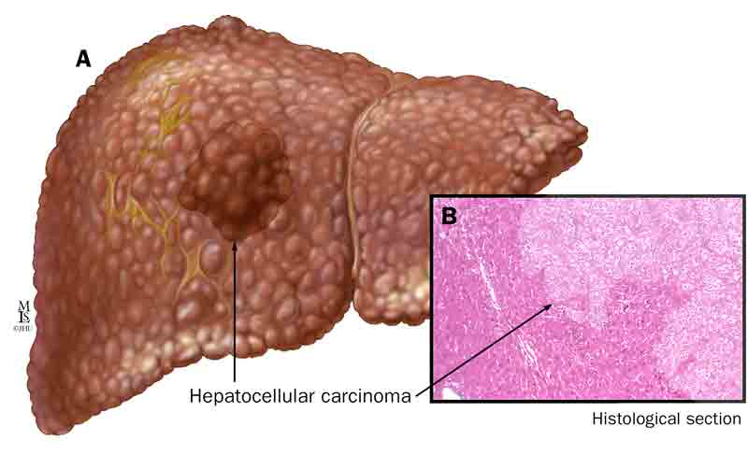
Epidemiology of HCC
Accounts for about 7% of all cancers in the world and 80-90% of primary liver cancer;
5th and 7th most common cancer in males and females, respectively;
Estimated to kill more than 600,000 people per years, especially in developing countries.

Slide 3
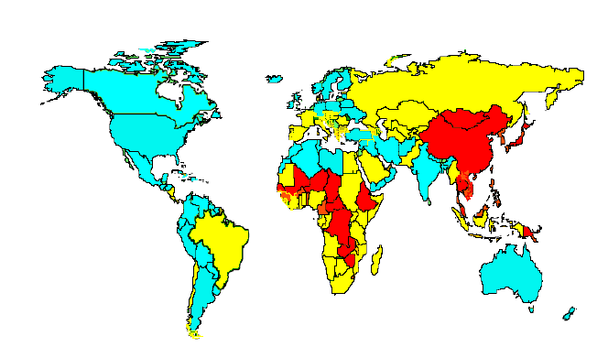
Worldwide incidence of HCC
Low (< 5: 100,000)
Intermediate ( 5-15: 100,000)
High (> 15: 100,000)
Kew MC: Hepatocellular carcinoma: epidemiology and risk factors .Journal of Hepatocellular carcinoma, 2014. 1: 115-125.

Slide 4
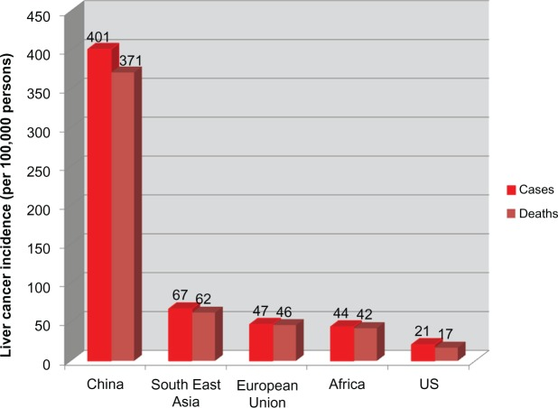
Age-standardized incidence rates of HCC
Dhanasekaran R, Limaye A and Cabrera R. : Hepatocellular carcinoma: current trends in worldwide epidemiology, risk factors, diagnosis, and therapeutics. Hepat Med. 2012; 4: 19–37.

Slide 5
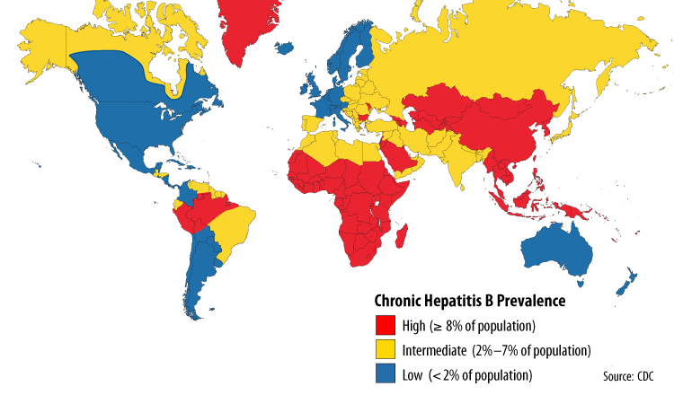
Prevalence of Chronic HBV infection
Te HS, Jensen DM : Epidemiology of Hepatitis B and C Viruses: a Global Overview. Clinic in Liver Disease, 2010. 14:1 ; 1-21.

Slide 6
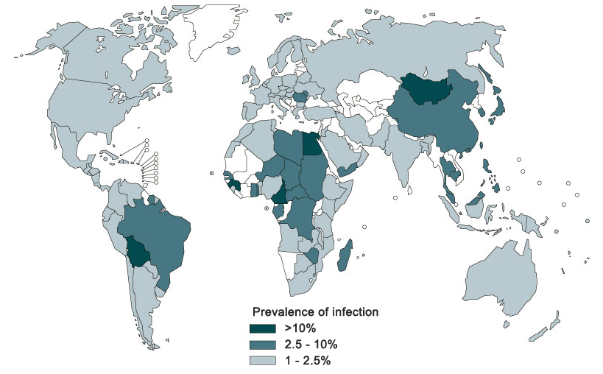
Prevalence of Chronic HCV infection
Petruzziello A, Marigliano S, Loquercio G et al: Hepatitis C Virus (HCV) infection: an epidemiology up-date of HCV genotypes distribution, 2016, World Journal of Gastroenterology (in press)

Slide 7
HCC risk factors and geographical variation
Europe and North America
Asia and Africa (excluding Japan)
2%
12%
18%
20%
18%
60%
20%
Japan
8%
12%
20%
70%
HBV
HCV
Alcohol
Others
Petruzziello A, Marigliano S, Loquercio G et al: Hepatocellular carcinoma: current trends in worldwide epidemiology and risk factors, 2016, J. Virology and Emerging Diseases (in press)

Slide 8
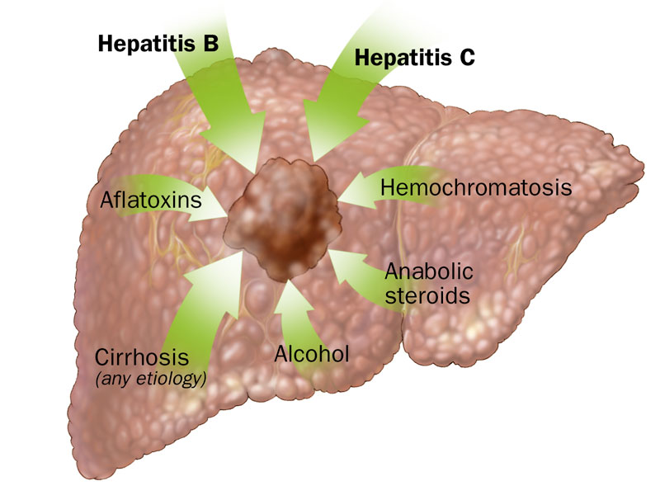
Predictors of progression to HCC
related to the host
longer duration of infection (progression to cirrhosis), older age, male
sex, NAFLD (diabetes and/or metabolic liver diseases),alcohol consumption)
related to environment
Aflatoxins exposure, HBV infection , HCV infection

Slide 9
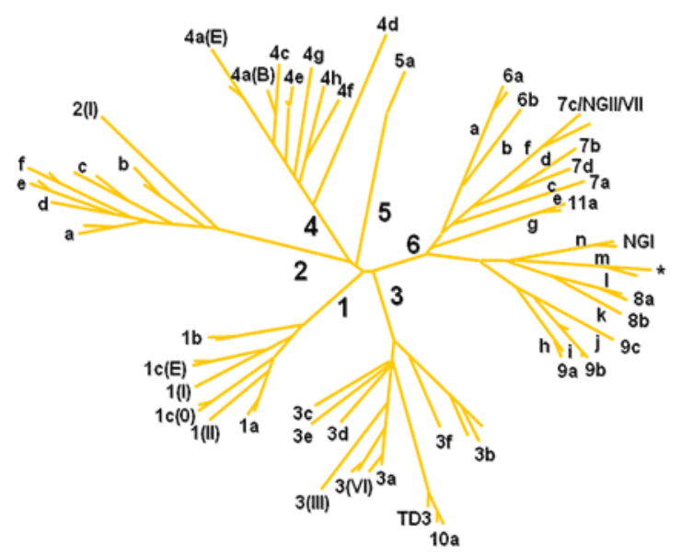
HCV GENOTYPES
HCV is characterized by a high degree of heterogeneity. Based on the sequence divergence rate, seven genotypes and more than 50 subtypes have been identified.
The contemporary global geographic distribution of HCV genotypes is complex
Geographic area | Genotype
North America | 1a
Europe | 1b
Eastern Asia | 2
Central Asia | 3
North Africa and Middle East | 4
South Africa | 5
South East Asia | 6

Slide 10
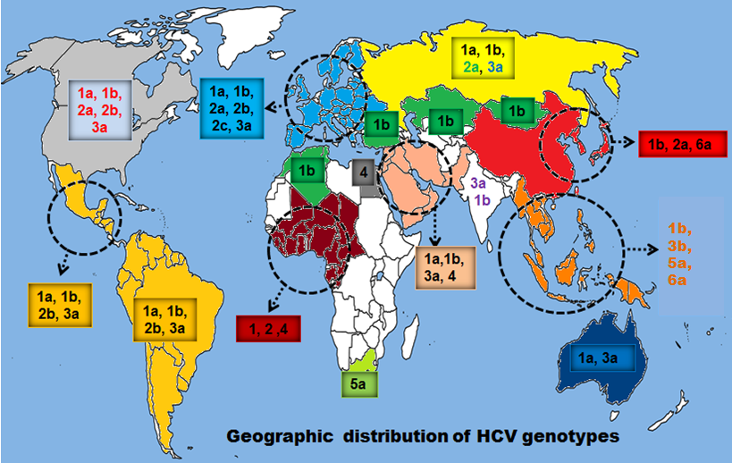
Worlwide geographic distribution of HCV genotypes
Messina JP, Humphreys I, Flaxman A, Brown A, Cooke GS, Pybus OG, Barnes E. Global distribution of Hepatitis C virus Genotypes. Hepatology 2015; 61 (1):77-87.

Slide 11
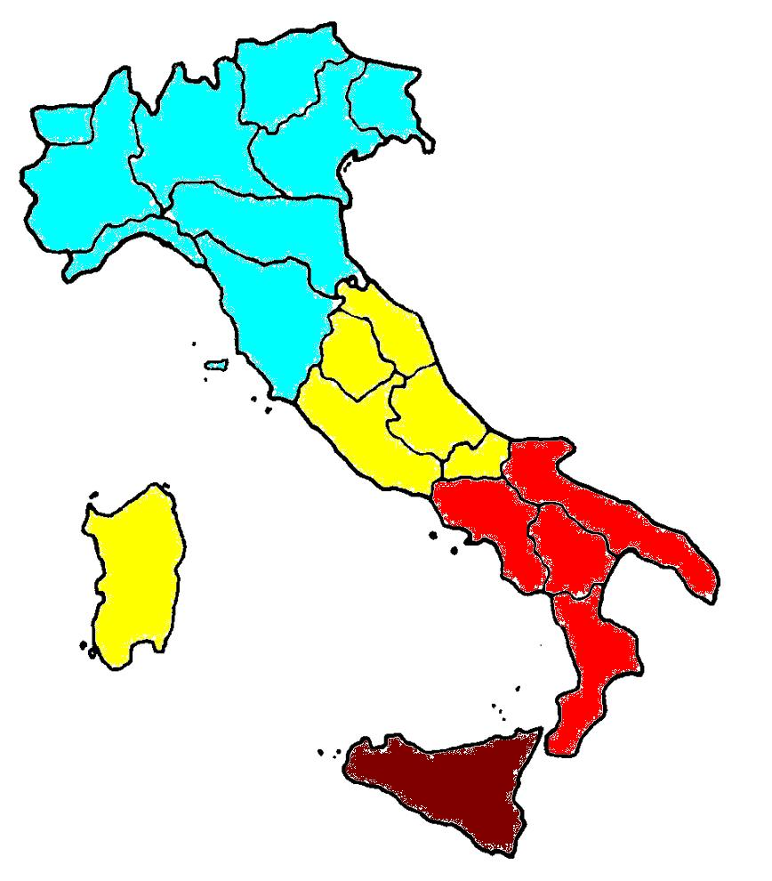
Anti- HCV prevalence in Italy
Nothern Italy
Central Italy
Southern Italy
2-4 %
4-6 %
6-12 %
> 12 %
Sicily
Petruzziello A, Marigliano S, Loquercio G et al: Hepatitis C Virus (HCV) infection: an epidemiology up-date of HCV genotypes distribution, 2016, World Journal of Gastroenterology (in press)

Slide 12
HCV genotype distribution
in Southern Italy (2009-2011)
Petruzziello A, Coppola N, Loquercio G, Marigliano S, et al : Distribution pattern of Hepatitis C Virus (HCV) genotypes and correlation with viral load and risk factors in chronic positive patients. Intervirology, 2014.

Slide 13
HCV genotype distribution
in Western Europe (2010-2015)
5.8%
29.0%
55.1%
8.9%
A. Petruzziello, S. Marigliano, G. Loquercio et al: Hepatitis C Virus (HCV) infection: an epidemiology up-date of HCV genotypes distribution, 2016, World Journal of Gastroenterology (in press)

Slide 14
HCV Genotype update in Southern Italy
Prevalence (%)
Petruzziello A, Loquercio G, Marigliano S. et al .: An epidemiology up-date of the circulation of HCV genotypes in Chronic Positive Patients in Southern Italy , World Journal of Gastroenterology ( in press)

Slide 15
Hcv Risk Factors In Southern Italy
Dental therapy
Prevalence (%)
Blood transfusion
Surgery
Tatooes and sexual exposure
Petruzziello A, Loquercio G, Marigliano S, et al .: An epidemiology up-date of the circulation of HCV genotypes in Southern Italy , World Journal of Gastroenterology ( in press)

Slide 16
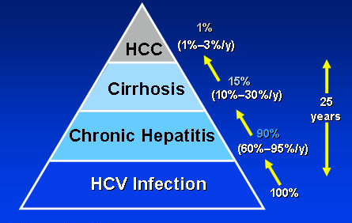
Hcv to Hcc pyramid

Slide 17
Despite several published studies show that patients infected with HCV genotype 1b may have a higher risk of developing HCC than those infected with other genotypes , other studies did not confirm this result.

Slide 18
The purpose of this study was to clarify whether the genotype 1b is associated with a higher risk of HCC than other genotypes.

Slide 19
MATERIALS AND METHODS
Population
1. HCC group: 120 HCC patients
97 males (80.8 %) and 23 females (19.2%)
M/F ratio: 3.06:1
Mean age: 71.8 years
Control Group: 125 patients
67 males (53.6 %) and 58 females (46.4 %)
M/F ratio: 2.71:1
Mean age: 64.7 years

Slide 20
METHODS
Anti-HCV : HCV CIA-Vitros;
RIBA III (Recombinant ImmunoBlot Assay);
PCR-Real Time (COBAS AmpliPrep/COBAS TaqMan 48);
VERSANT® HCV Genotype 2.0 LiPA.

Slide 21
Anti- HCV prevalence among HCC patients and Control Group
RESULTS
Prevalence %
OR: 8.04- p = 0.01

Slide 22
RESULTS
Gender distribution of anti-HCV among patients
with HCC and other malignancies (control group)
Prevalence %
male
female
OR: 2.45 - p < 0.05

Slide 23
RESULTS
Age distribution of anti-HCV among patients
with HCC and other malignancies (control group)
.
Prevalence %
< 59 years
60-69 years
> 70 years
(p=0,001)

Slide 24
HCV- RNA prevalence among HCC patients and Control Group
RESULTS
Prevalence %
OR: 3.1 - p = 0.01

Slide 25
RESULTS
HCV genotype distribution among HCC patients
and Control Group
Genotype | HCC |  | Control Group
 | n. | % | n. | %
1a | 4 | 5.8 | 0 | 0
1b | 41 | 59.4 ^{A} | 5 | 26.3 ^{B}
1* | 3 | 4.4 | 0 | 0
2a/2c | 15 | 21.7 ^{C} | 12 | 63.1 ^{D}
2* | 1 | 1.4 | 1 | 5.3
3a | 4 | 5.8 | 0 | 0
4* | 1 | 1.4 | 1 | 5.3
A vs B : p=0,05 for genotype 1b
C vs D : p=0,01 for genotype 2a/2c

Slide 26
Conclusions
Anti-HCV positivity is significantly higher among HCC patients than in the control group and HCC patients significantly have 8 times higher risk of exposure to HCV infection compared to the control group.

Slide 27
Conclusions
High percentage of our HCC patients demonstrates HCV RNA in their sera, whereas only 29.9% of them
is negative

Slide 28
Conclusions
Anti-HCV rate increases steadily with age,
supporting that HCC is age-related
and older age acts
as an independent factor associated
with HCC progression.

Slide 29
Conclusions
Our study confirms a male predominance in anti-HCV positive HCC
probably related to the fact that
HCC always exhibits androgen receptors and males usually have history of drinking alcohol and/or smoking

Slide 30
Conclusions
Genotype 1b is strictly correlated to the risk of developing HCC, probably due to the correlation between genotype 1b and liver damage
HCV genotype 1b is associated with almost two times the risk of developing HCC
than other genotypes

Slide 31
A special thanks to
Samantha Marigliano and Giovanna Loquercio
for their support in the realization
of this study
To Dr. Francesco Izzo for allowing me to conduct this study on his patients
and to
Dr. Carmela Cacciapuoti for her moral support

Slide 32

Thank you for your attention
Unity of Virology
Laboratory of Molecular Virology “V. Tridente”

