Slide 1

4th International Conference and Exhibition on
Food Processing & Technology – August 11th 2015
Matís
Multiple benefits of Food Technology collaboration in Fish Processing
Arnljótur Bjarki Bergsson arnljoturb@matis.is
Resources and Products
Matis, Iceland www.matis.is
Notes:
Ladies and gentlemen distingusihed audience
My name is
As Julie Gold wrote and Bette Midler later sang
From a distance the world looks blue and green,
and the snow-capped mountains white.
From a distance the ocean meets the stream,
and the eagle takes to flight.

Slide 2

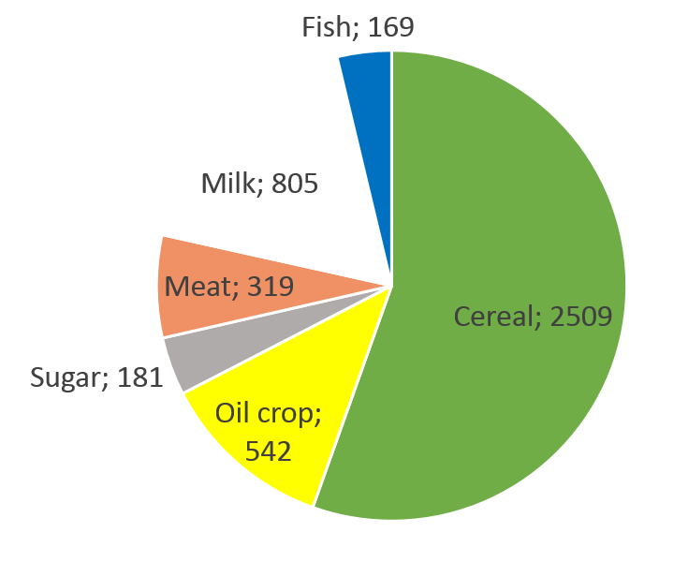
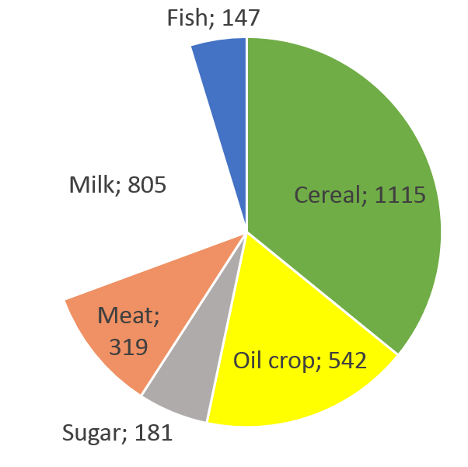
World food production
Forecast 2015
Total Production For food consumption
4.5 billion tons 3.1 billion tons
Notes:
Food out look mentions salmon, fish oil and fish meal

Slide 3
Growing world population
Need to feed the world population
Fierce competition between food products
Seafood minor part on the worlds dining table
91 million tons captured, 67 million tons cultivated in 2012
91 million tons captured, 78 million tons cultivated in 2015 - Forecast
169 million out of 4.5 billion tons
3 million of 4.3 million tons of Atlantic demersal catches, from North East Atlantic
Even more pressure to obtain high prices for what is harvested and produced
Precision and efficiency in high demand
Post harvest losses - food waste (up to 30% of produced foods)
Increase in aquatic products demand, anticipated
Notes:
As presented and discussed yesterday we need to feed the future world population
The challenge of making aquaculture sustainable
As Assistant Director-General, Fisheries and Aquaculture Department FAO Arni Matthiesen has stated the ocean can feed the world if Asia can make its aquaculture suastanable.

Slide 4

European Fish Market - FinFish Study 2014
Total market supply 14.2 million t up 1.7 %
Imported share slightly down to 63 % (8.9 million t)
Whitefish dependency unchanged at 89 % for wild capture species
EU catches for whitefish species have increased marginally (+1 %) but quota utilization continues to deteriorate
Exports slip back by 5 %
Tuna, salmon and cod are more or less equal in consumption at WFE of around 1.1 million t each
Supply for per capita consumption is up by 0.6 kg at WFE
Competition is intensifying from other countries and regions
EU fisheries account for 27% of consumption
Whole Fish Equivalent (WFE)
Mr. Guus Pastoor AIPCE-CEP

Slide 5
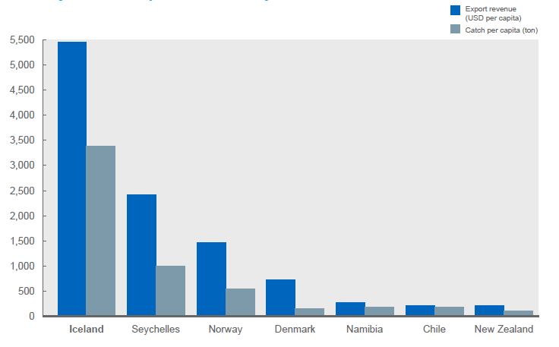
Supreme importance of fisheries to Iceland
Source FAO; McKinsey analysis. McKinsey Charting a Growth Path for Iceland
Notes:
Few countires where as Fisheries are as important as in Iceland
Note: Faroe Islands are much higher, but this data does give a indication of the supreme importance the industry as in Iceland. Could make a new version of this from scratch.

Slide 6
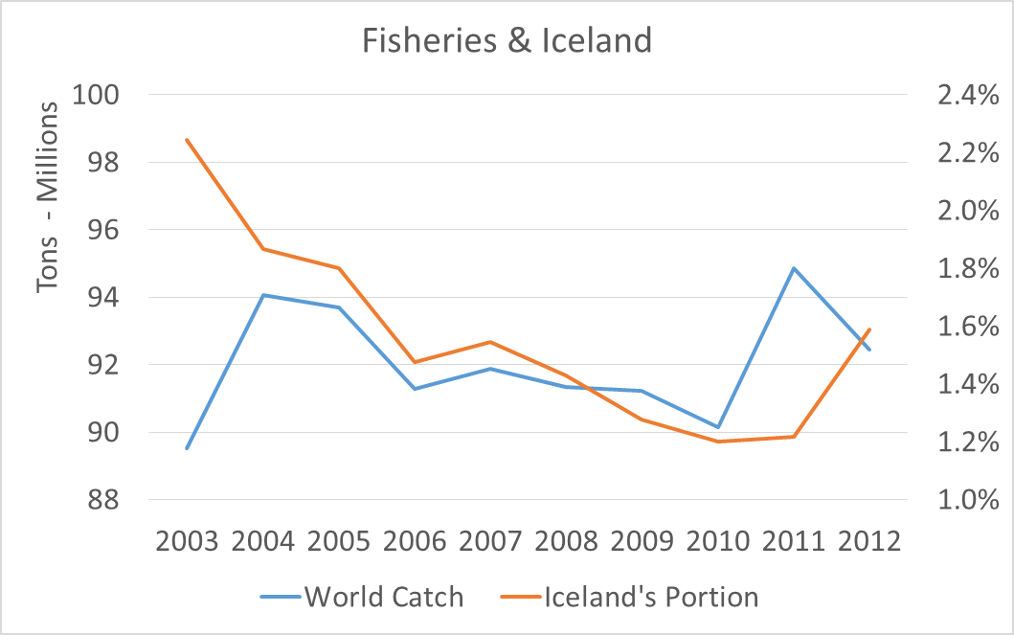
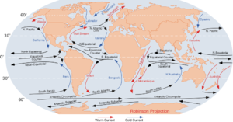
Iceland’s Fisheries
Iceland 103,000 km² landmass 753,000 km² EEZ (0.16%)
330,000 inhabitants
Harvest ≥ 1.1 million ton/year Export ≈660 thousand tons seafood products in 2014
Export Value of Icelandic Seafood Products 1.9 billion GBP 2014 42.5%
Ocean Currents
Source Wikipedia Source Statistics Iceland

Slide 7
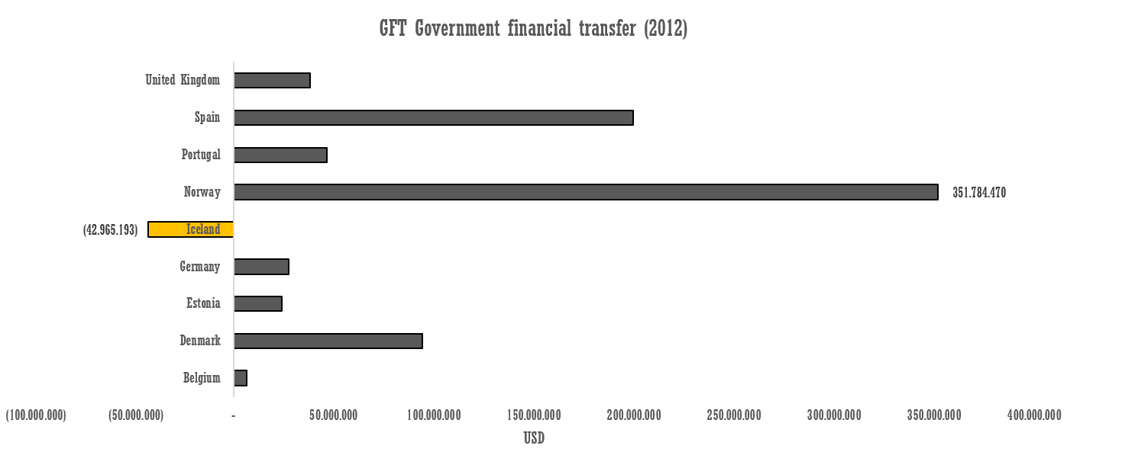
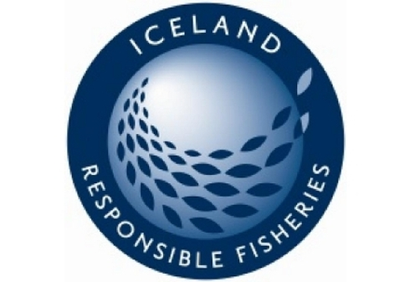
Economic independence
International comparison
Kolbeinn Árnason, CEO of Fisheries Iceland 2014
Source: OECD
Notes:
This we have done while selling our products on markets where we compete with subsidized competitors and to top it off here it is the mild version of the picture of international comparison as I excluded the Resource Taxes that the governments keep changing and charging.
IRF FAO based Responsible Fishery Management Certification
20 million meals a day

Slide 8
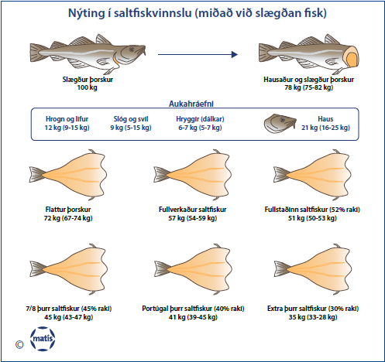
Processing Salted fish
Utilization in Salt Fish production based on gutted fish
By-products

Slide 9
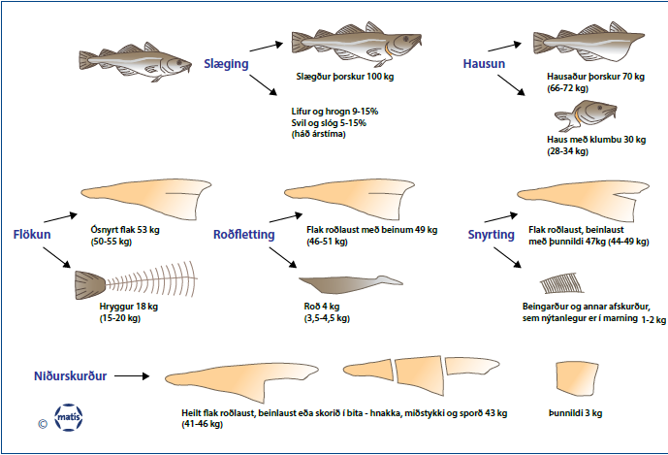
Processing Fish fillets, frozen or fresh
Gutting
Heading
Filleting
Skinning
Trimming
Portioning

Slide 10
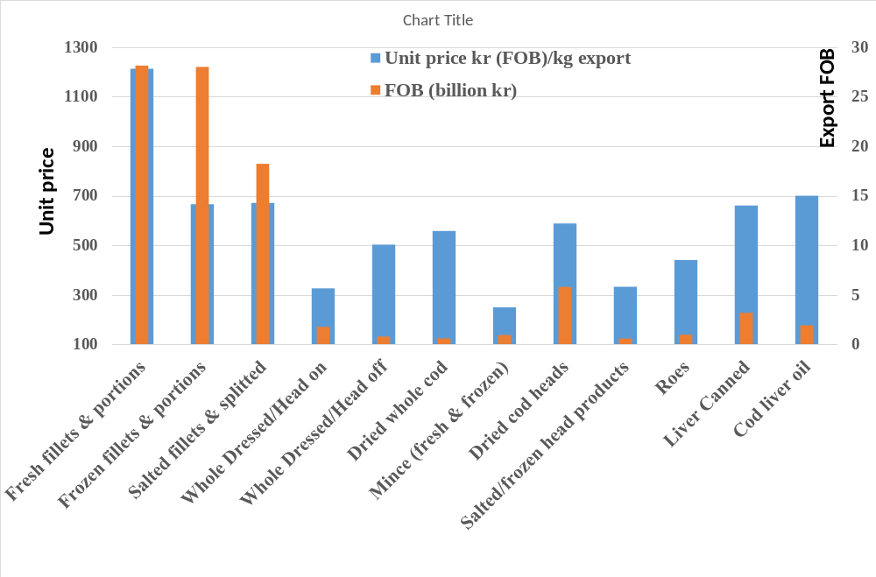
Value Creation of Cod 2013
Catch utilization: 78,5%
Roughly 80% of Valuables
(Statistics Iceland, 2014)

Slide 11
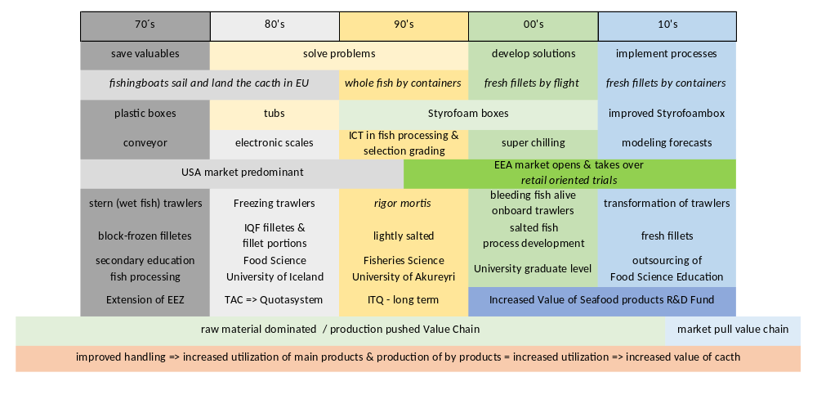
Ever-changing challenges in Icelandic Fisheries
Notes:
On sustainability we banned whaling due to high effort of whaling in 1915 resumed after WWII

Slide 12
Matis - youtu.be/8gWo_rhOiWE

Slide 13
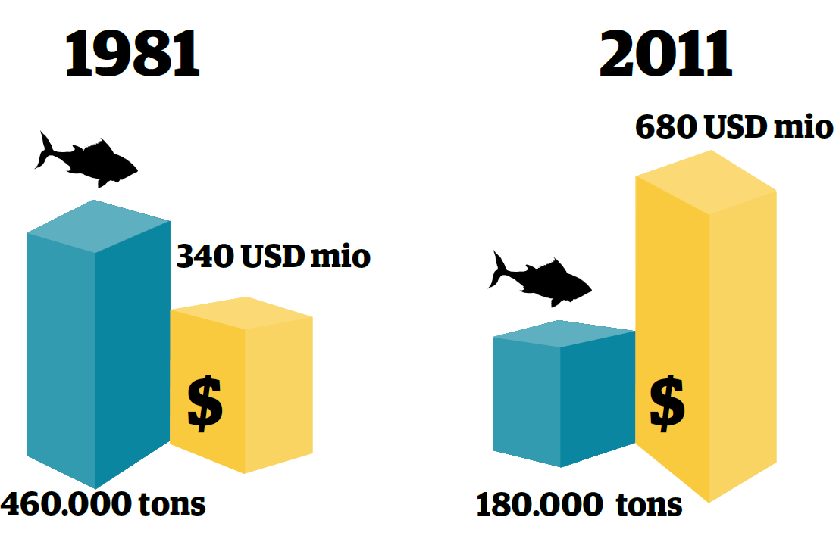
Value creation
Economical impact of cod
Kolbeinn Árnason, CEO of Fisheries Iceland 2014
Notes:
If we look further back the progress is more visual, Aiming to stay as occupation of first desire

Slide 14
Collaboration to sole the challenges
Notes:
IUU Illeageal, Unregulated and Unreported fishing
Collaboration is the prerequisite for funding

Slide 15







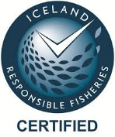

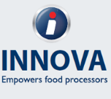









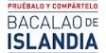









Collaboration to solve the challenges
Notes:
Innovation vouchers

Slide 16
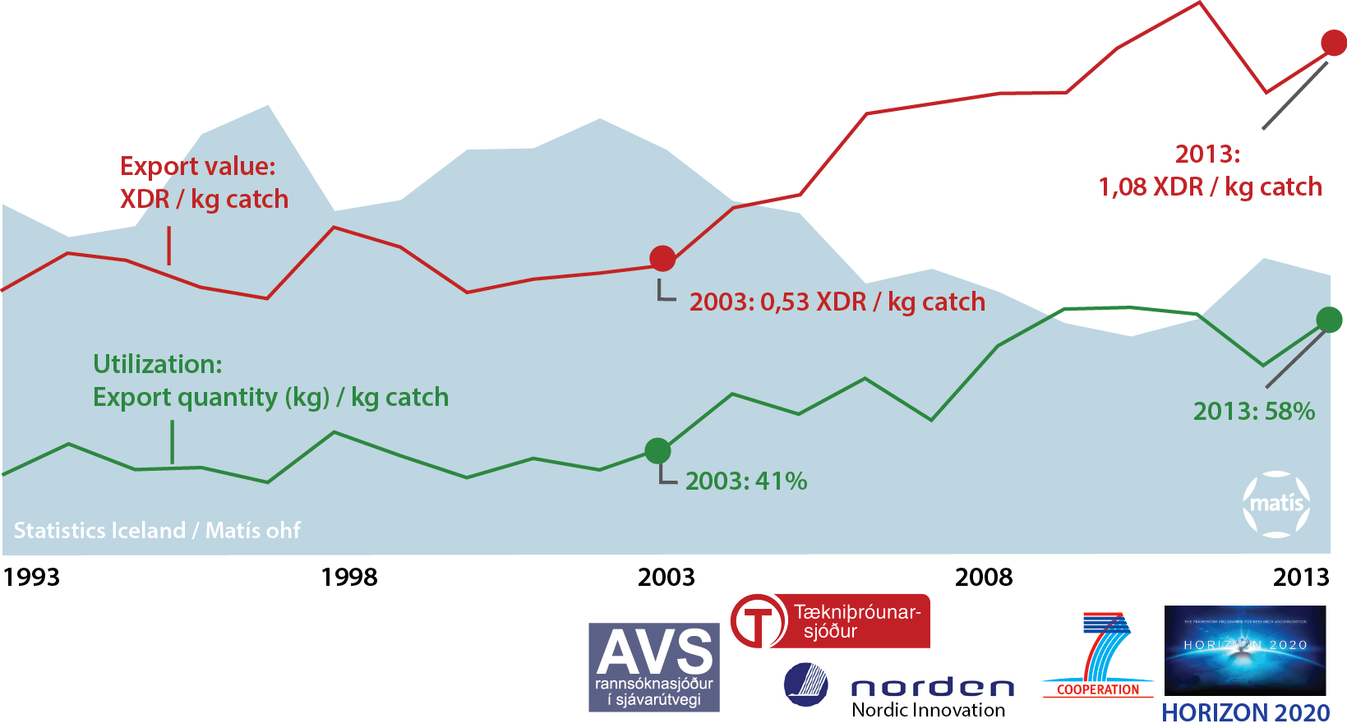
Value creation from catch through processing to markets
Notes:
Respect the raw material, each fish that is drawn from the sea by making the most out of it, in terms of products, utilization, and handling the catch in a way it full fill requirements that reward it with the highest price, and handling it in a way that does not abuse its good nature
Respect the environment by not taking more that is needed, harvesting the oceans sustainably and conveying the quality to the consumer
Respect the society by making the most valuables out of it, contribute to the economy, by creating valuables that need qualified hands to process
Respect Consumer by informing of the origin and the treatment
The green line is translation of respect for the environment and the raw material
The red thread is what drives the economy, the valuables created

Slide 17
Volatile Food
Best practices
=> Better material quality
=> More utilization
=> New processing possibilities
=> Value creation
Safe – Sustainable – Traceable – Nutritious – Responsible – Tasty

Slide 18
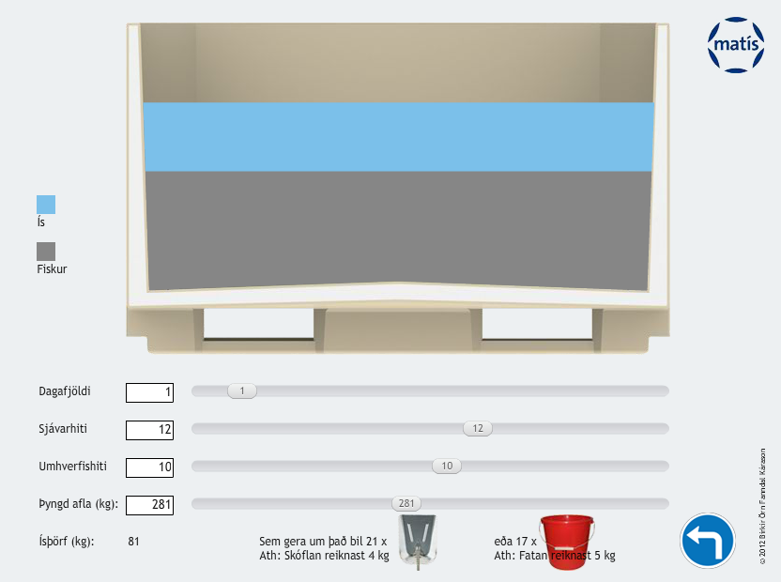
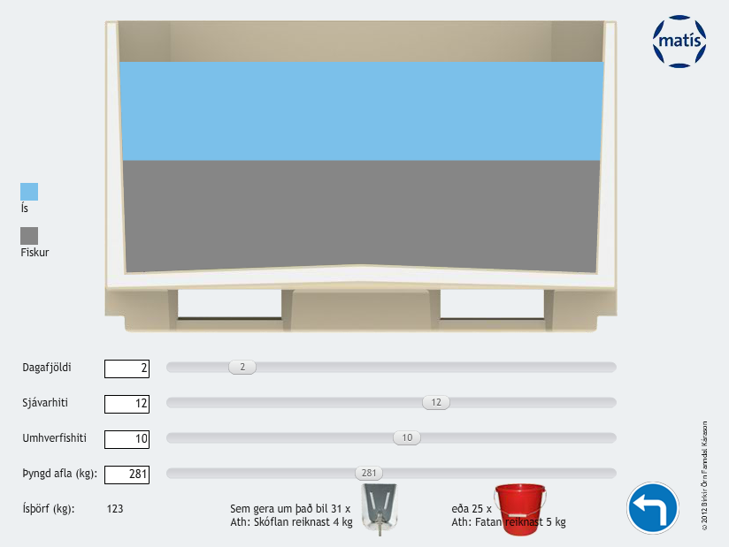
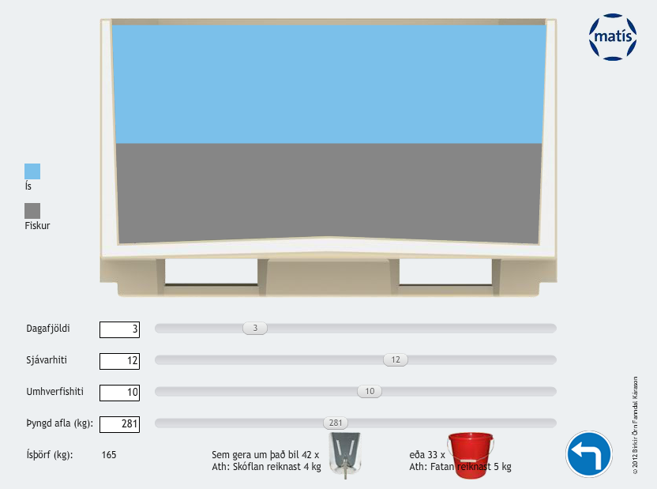
Requirements for cooling media too chill catch
Notes:
281kg of catch

Slide 19
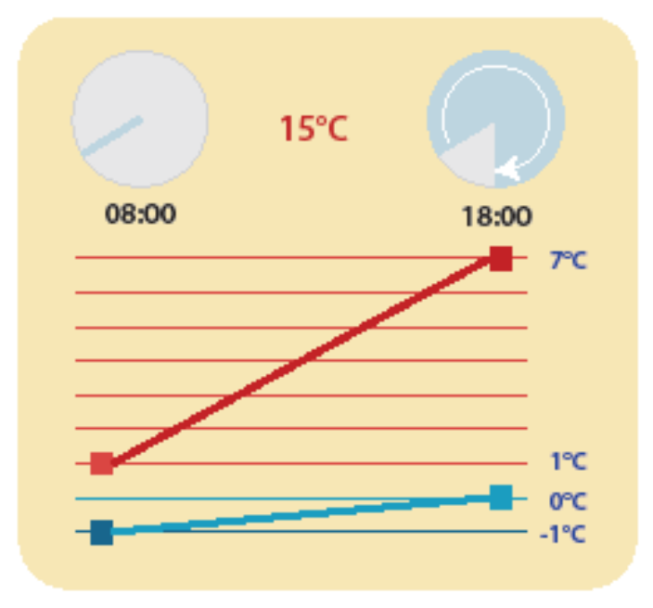
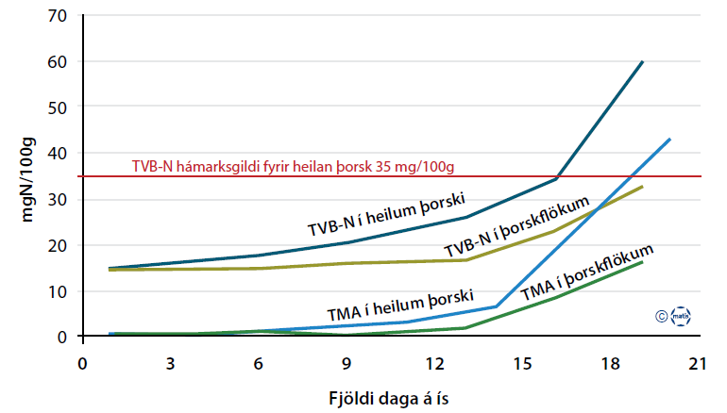
Shelf life
Temperature is crucial
Temperature at packaging matters
Better to pack cold fresh fish products than warm
TVB-N maximum for whole cod 35 mg/100g
Days on Ice
Notes:
• 25 mgN/100 g hamark fyrir karfategundir
• 30 mgN/100 g fyrir flatfisktegundir
• 35 mgN/100 g fyrir hvitan magran fisk
eins og torsk og ysu.

Slide 20
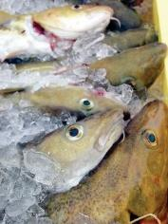
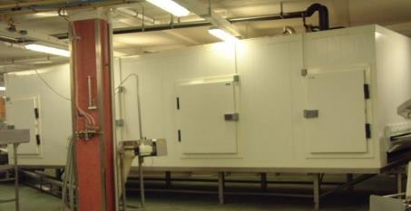
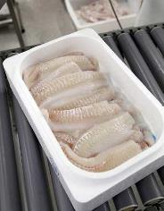
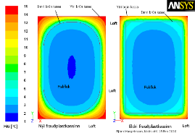

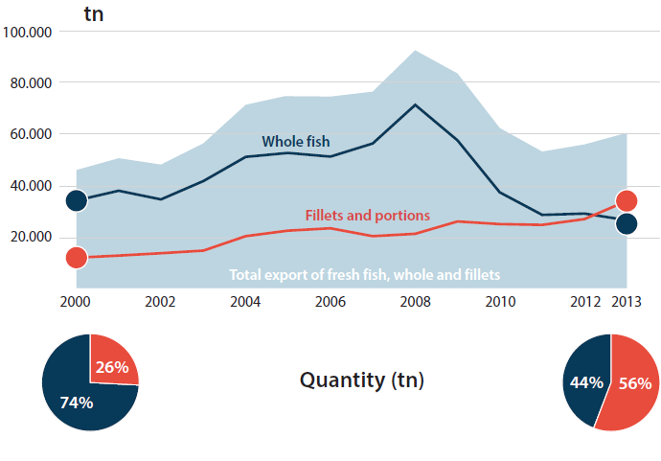


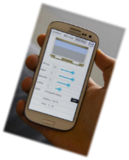
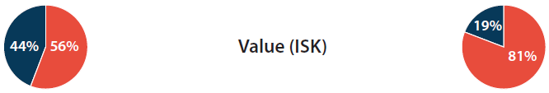
Seafood export from Iceland - Quantity
Notes:
Handling
Processing
Packing
Logistics

Slide 21
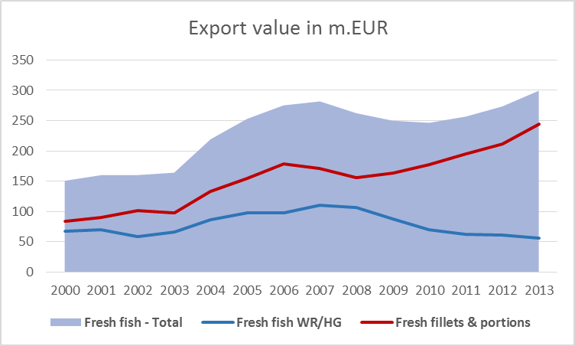
Value of fresh Icelandic Fish Products
Notes:
Due to heavy emphasis on research and development, improevments and innovation in handling processing and logistics value of fresh fillets and portions increased over 150% in one decade

Slide 22


Industrial PhDs
S Margeirsson Processing forecast of cod 2008
K Sveinsdottir Improved seafood sensory quality 2009
W Tao Preservation techniques & seaweed Algalpoluphenols as antioxidants 2009
T Brenner Aggreation behavior of cod muscle proteins 2009
E Reynisson Fresh view in fish microbiology 2010
GR Shaviklo Properties & applications of Fish proteins in value added convenience foods 2010
HL Lauzon Preventive Measures in Aquaculture: […] Probiotics on cod at Early Stages 2010
KA Thorarinsdottir Influence of salting procedures on the characteristics of heavy salted cod 2010 Lund
MTT Nga Enhancing quality management: fresh fish supply chains, logistics & traceability 2010
R Bjornsdottir Bacterial community during early production stages of intensively reared halibut 2010
S Bjornsdottir Genetical motification of Rhodothermus marinus bacteria 2010
M Gudjonsdottir Quality changes during seafood processing studied with NMR & NIR 2011 NTNU
MV Nguyen Effects of processes on physiochemical attributes of salted cod 2011
JSRE Jensen Bioactive compounds from Icelandic liverworts 2012
B Margeirsson Modeling temperature changes during transport of fresh fish products 2012
SM Halldorsdottir New & improved methods for production of hydrolyzed fish proteins 2013
E Sturludottir Statistical methods to identify changes in time series of monitoring data 2013
AH Petursdottir Inorganic and lipophilic arsenic in food commodities with emphasis on seafood 2014 Aberdeen
MG Karlsdottir Oxidation and stability of frozen seafood products 2014
VA Kale Bioactive sulfated polysaccharides from the sea cucumber 2014
Notes:
2 of 7 Icelandic Universities graduate PhDs Univeristy of Reykjavik and University of Iceland, we callobaroate with all 7 univeristies but mostly with university of Iceland founded in 1911
NMR & NIR spectroscopy

Slide 23














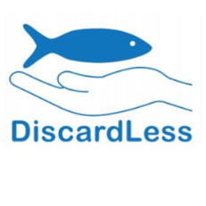

International Collaboration
Nordic Marine Innovation 2.0
CapMafi
ProffAqua
SuperChilling
Improved quality and value of Nordic mackerel products for the Global market
European Research and Development Collaboration

Slide 24
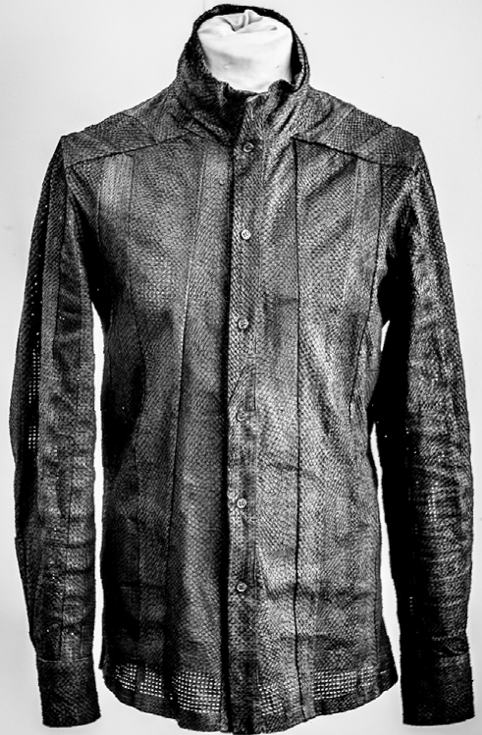
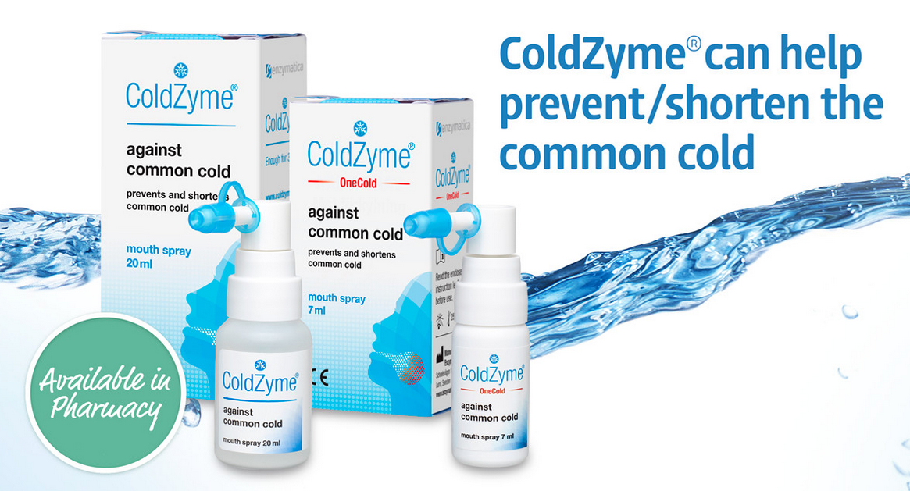
The way forward?
Struggling health care systems
Burden of Lifestyle diseases
Seafood might ease the pain as its consumption has been linked to health benefits
Intake through fortified portions or balanced diet
Utilization of marine compounds contribute to more than food
Fisheries - Important section of the BioEconomy

Slide 25
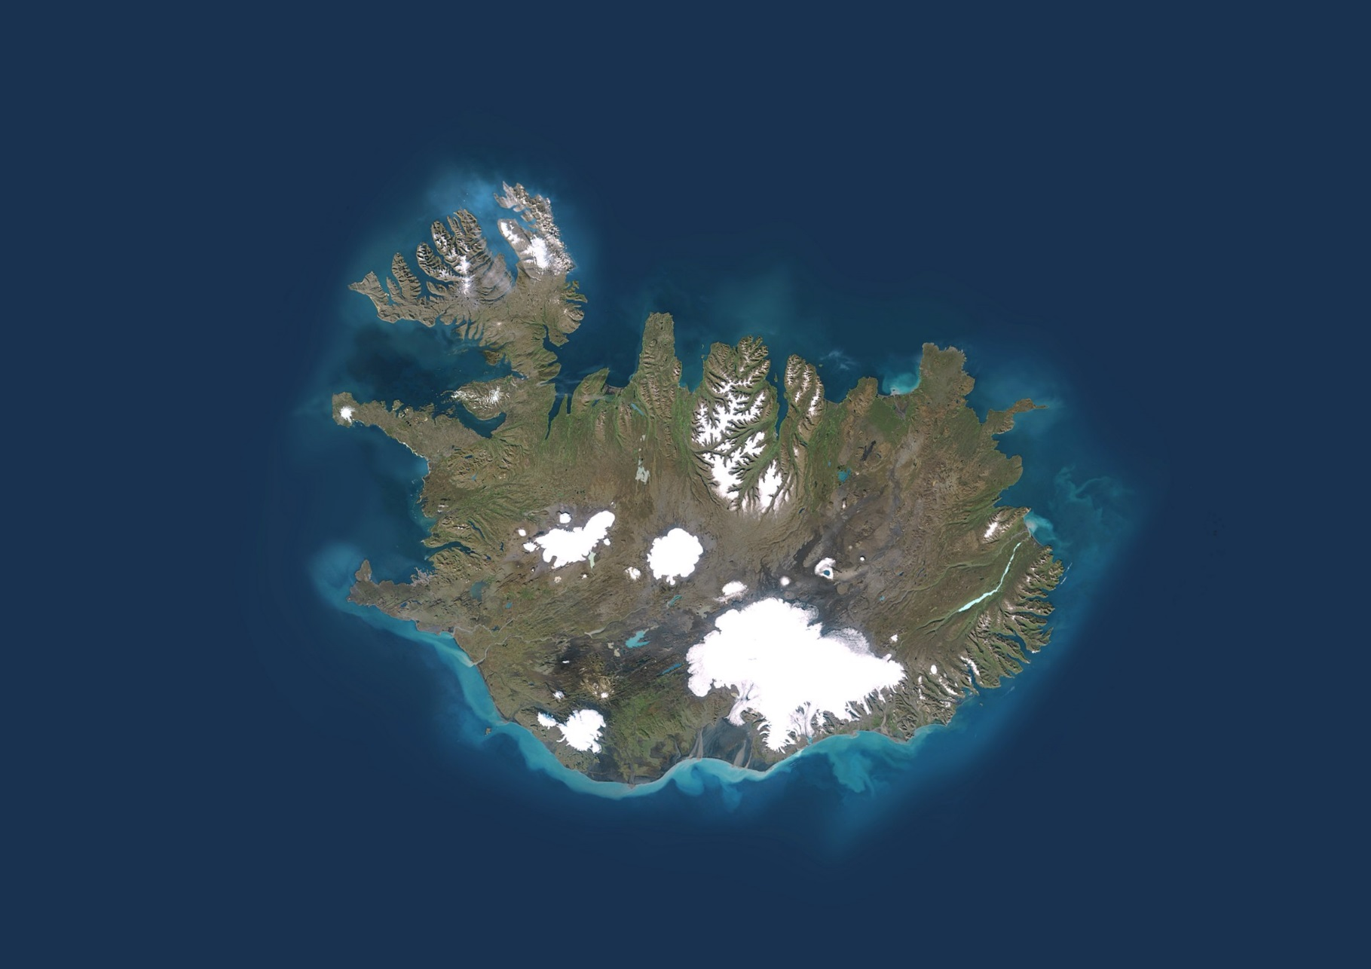

Our Goals
We are committed to sustainable value creation in the food and biotech industries, food safety and public health
Our mission
We provide research, consultancy and solutions to companies in the food industry with emphasis on marine opportunities
Our values
We value long term integrity above short term profit
We take initiative in turning good ideas into profitable solutions through science and innovation
We are intent on achieving the ambitious goals of our customers and employees
Notes:
Our values
We value long term integrity above short term profit
We take initiative in turning good ideas into profitable solutions through science and innovation
We are intent on achieving the ambitious goals of our customers and employees

