Slide 1







University of Crete Medical School
Department of Toxicology & Forensic Science
Challenges for Toxicology and Risk Analysis in 21st Century: Epidemiology Experimental and Computational Data in Real Life Exposures
8th World Congress on Toxicology and Pharmacology April 13-15, 2017 Dubai, UAE
Aristides M. Tsatsakis
Professor and Director, MSc, PhD, DSc, ERT
http://aristsatsakis.com

Slide 2

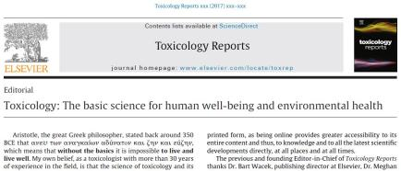
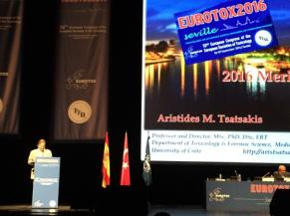
Aristotle, the great Greek philosopher ‘ ...... ανευ των αναγκαίων αδύνατον και ζην και εύζην, which means that ..... without the basics it is impossible to live and live well.
And I too, believe that the science of toxicology and its effect to the people and the environment .. is truly such a basic, both for our existence, as well for our well being
Aristotle

Slide 3
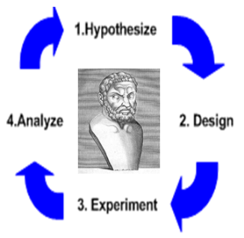
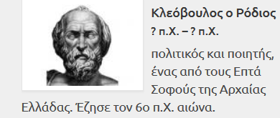

Trust the evidence…..but don’t generalise into conclusions ! …..Think of personlised causality and intergarted approaches ... AMT
Kleovoulos Rodios
Modern toxicology versus
ancient philosophy
«Αρχή σοφίας, η γνώση της άγνοιας.»
Μέτρον άριστον
Thales
Ippocrates

Slide 4
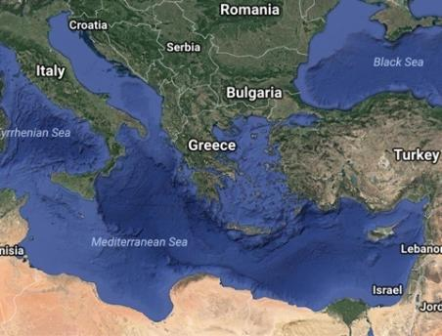
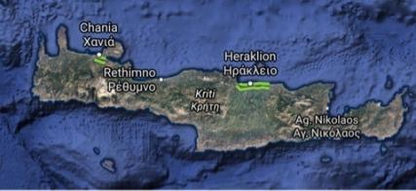

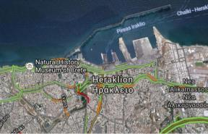

Slide 5
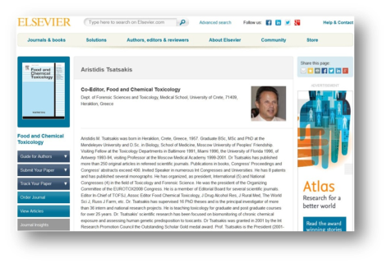

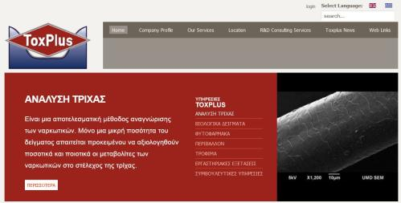

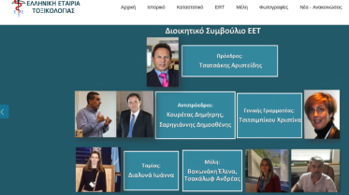
Related Web sites
aristsatsakis.com
ctoxres.med.uoc.gr
toxplus.gr

Slide 6
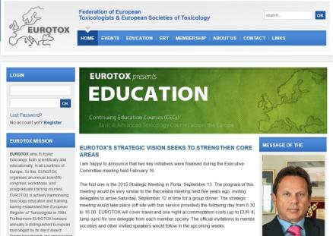
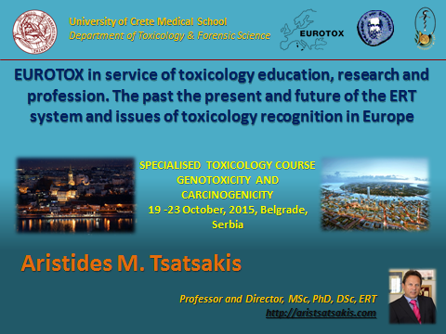

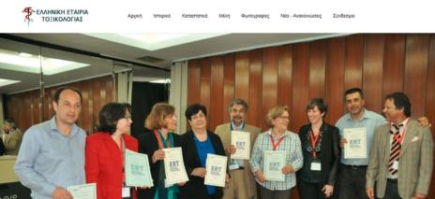


Slide 7


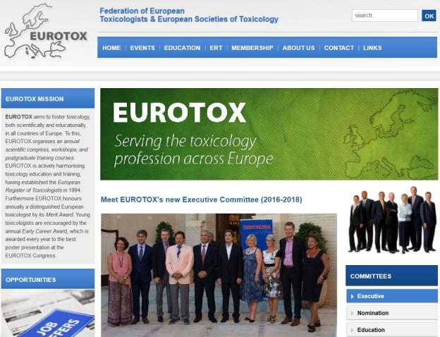


Slide 8
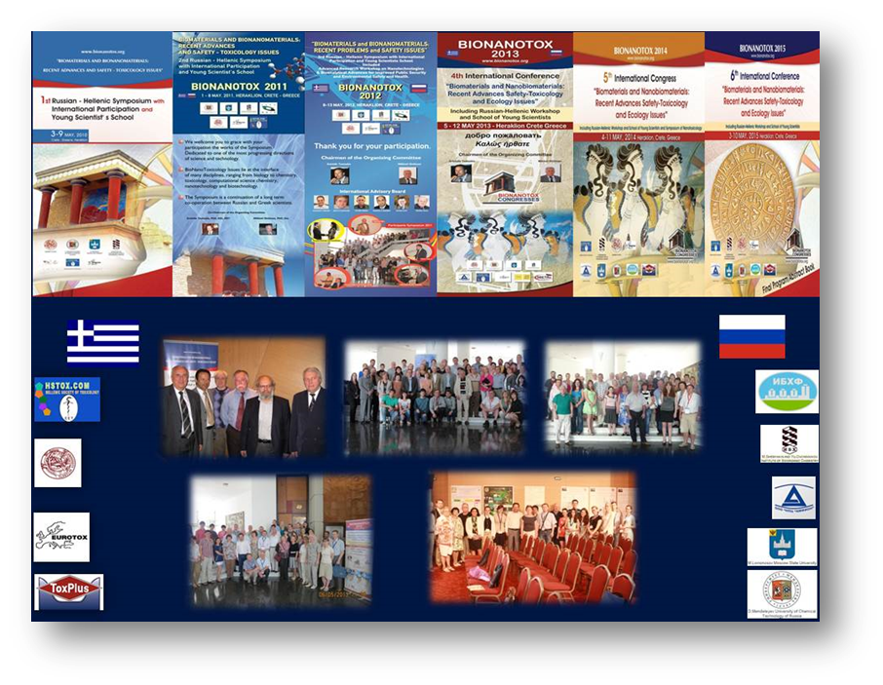

Slide 9
Changes in Causes of Morbidity and the concern of increase of chemical exposure
Why to study Long Term Low Dose Exposure to Chemicals
During the last 100 years changes in our planet and in life conditions and climate
have resulted in major changes in causes of morbidity and the burden of diseases
The Burden of Disease and the Changing Task of Medicine
N Engl J Med 2012; 366:2333-2338 June 21, 2012
Notes:
Κατά τη διάρκεια των τελευταίων 100 ετών αλλαγές στον πλανήτη μας και στις συνθήκες ζωής και το κλίμα
έχουν οδηγήσει σε σημαντικές αλλαγές στις αιτίες της νοσηρότητας και στους επιβαρυντικούς παράγοντες των ασθενειών

Slide 10
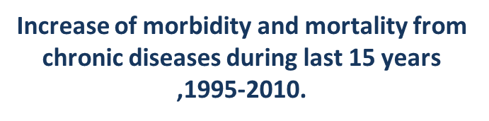
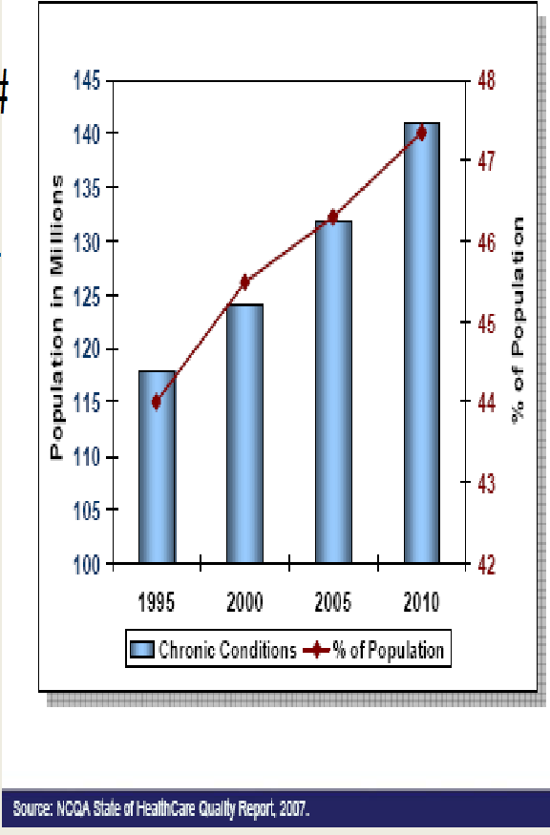
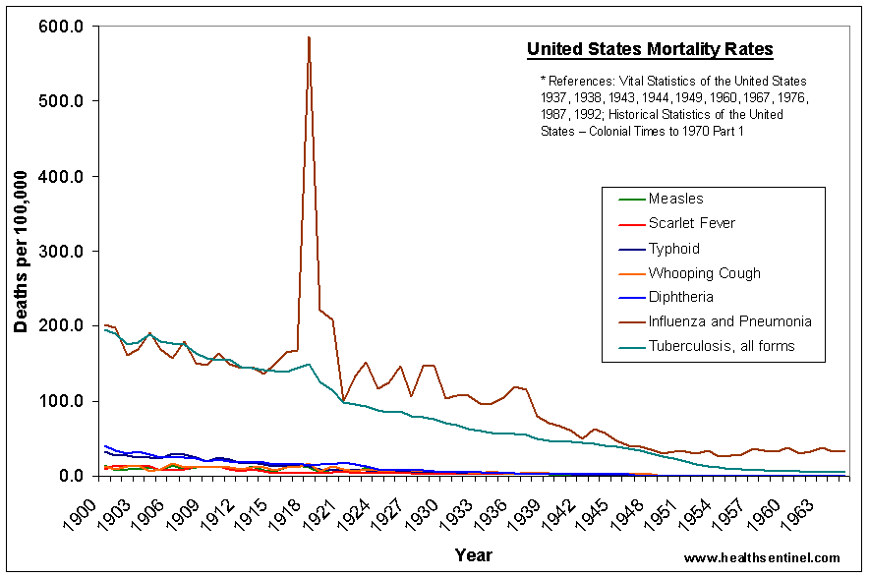
Decrease in mortality from infectious diseases during century
Notes:
Εικονα 1: Μείωση της θνησιμότητας από λοιμώδη νοσήματα κατά τη διάρκεια του αιώνα
Εικόνα 2: Αύξηση της θνησιμότητας από χρόνια νοσήματα κατά τη διάρκεια των τελευταίων 15 ετών (1995-2010)

Slide 11
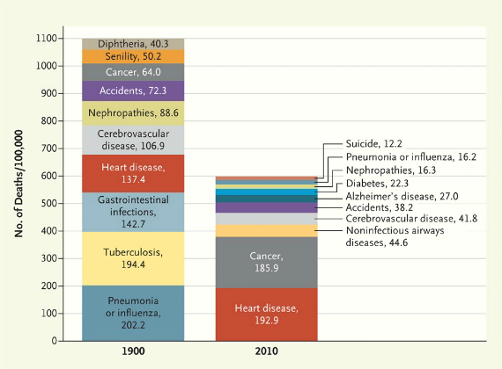
Main causes of morbidity in 1900 and 2010
60% acute and infectious diseases
40% chronic diseases
12% acute and infectious diseases
88% chronic diseases
The Burden of Disease and the Changing Task of Medicine: N Engl J Med 2012
Notes:
Κύριες αιτίες νοσηρότητας το 1900 και το 2010
1900: 60% οξείες και λοιμώδεις νόσοι
40% χρόνιες παθήσεις
2010: 12% οξείες και λοιμώδεις νόσοι
88% χρόνιες παθήσεις

Slide 12
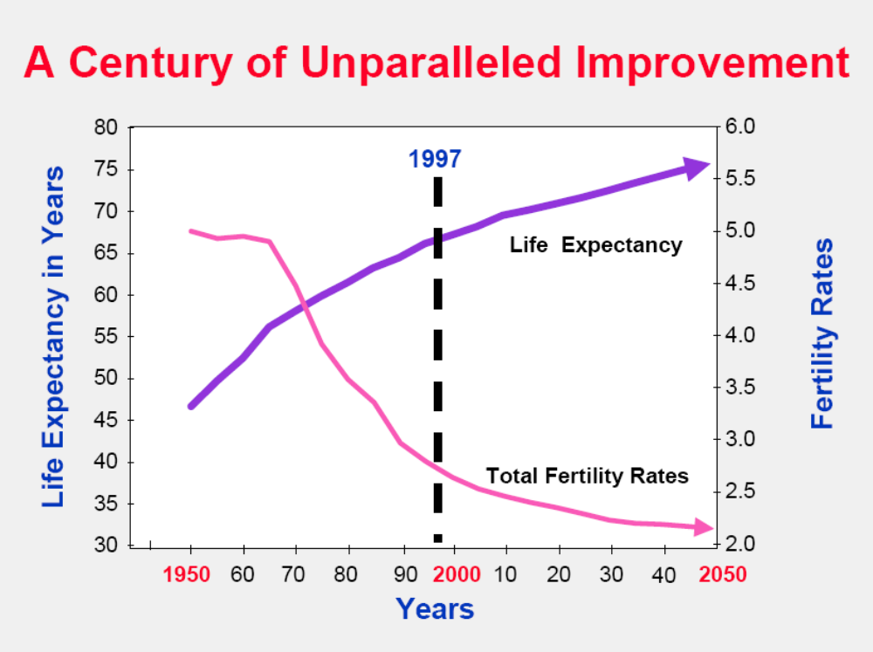
Preker: Int. Health Summit

Slide 13
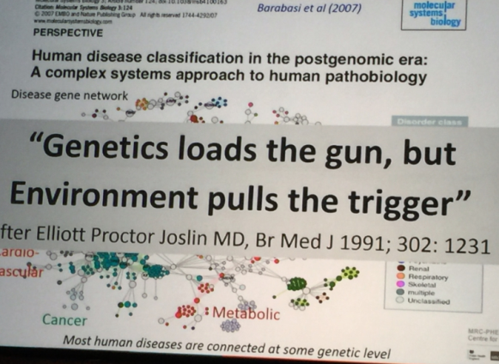
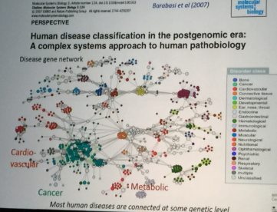
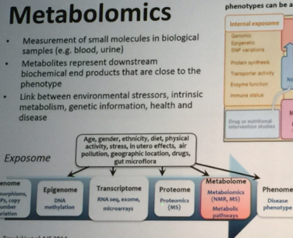
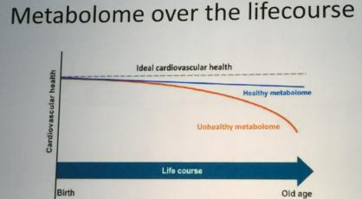

Slide 14
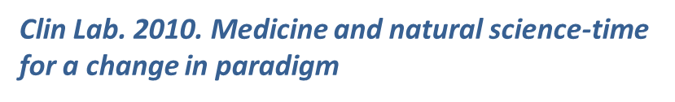
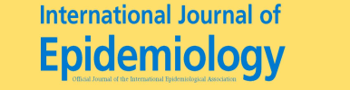

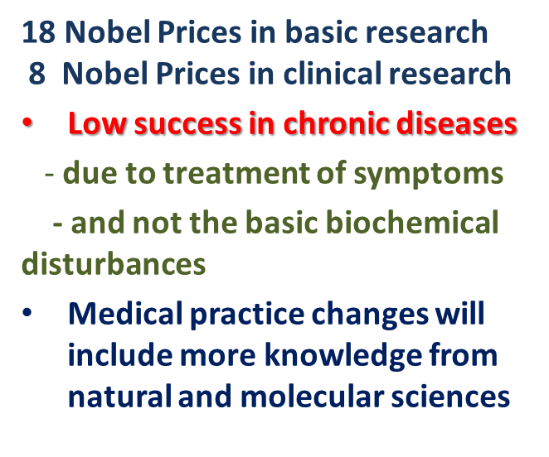
Contribution of medical therapies in mean life length is only : 5-10%
Contribution of hygiene in mean life length is major : 90-95%
Hygiene as ‘’prophylactic ‘’ preventive medicine based on public surveillance and exposure science, toxicology data and risk assessment and risk analysis
aims to improve and maintain public health
The role of medical care in contributing to health improvements within societies . Int. J. Epidemiol. (2001) 30 (6): 1260-1263.
Notes:
Η Συμβολή των ιατρικών θεραπειών στη μέση διάρκεια ζωής: 5-10%
Η Συμβολή της υγιεινής στο μέσο προσδόκιμο ζωής: 90-95% υγιεινή είναι η πρόληψη, η τοξικολογία, η αξιολόγηση των κινδύνων
Σίγουρα απαιτούνται αλλαγές του επιστημονικού μοντέλου που αφορά τις ιατρικές έρευνες και πρακτικές

Slide 15
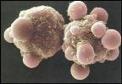
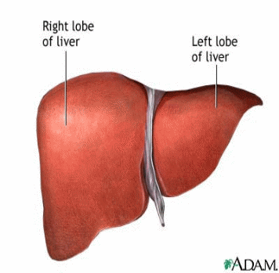

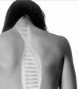

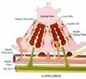
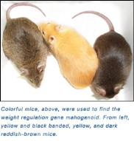
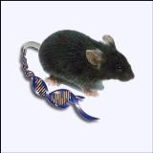
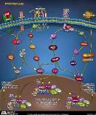
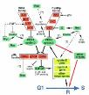
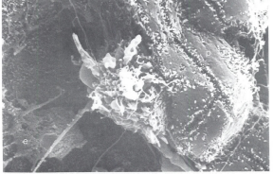
Qualitative and Quantitative Inferences Based on Mechanistic Understanding
Molecule → Cell → Tissue / Organ → Individual → Population
Parenchymal
--Diploid
--Polyploid
--Putative
stem cell
NPCs
--Kupffer
--Ito
-Endothelial
Lobular and regional
differences:
Ploidy
Maturation
Function
Pathway
Exposure dose/ window?
Tissue concordance across species?
Other outcomes?
Susceptible populations?
Shape/slope of population dose-response curve?
Notes:
Molecular/cellular to tissue
Tissue to individual
Individual to population(s)
Populations to ecosystem
Local to global

Slide 16
Purpose of Toxicology
To Provide
  Information to risk managers
    About nature & severity of effects on human health and environment as it relates to specific exposures
      Ecotoxicology often drives remediation site clean-ups
    ~6,000,000 known chemicals
      Approximately 100,000 currently in use worldwide, 500 new chemicals added annually
        limited information
      HPVC & REACH; 7th Amendment
    Via Risk Assessments
      Hazard identification
      Dose-response assessment
      Exposure assessment
      Risk characterization
  Human Health
    Workers
      Safe working environment (OEL)
    Consumers
      Products should be safe to use as specified and under foreseeable misuse
        ADI (food ingredients)
        RfD (pesticides)
        TDI (food contaminants)
  Environment (ecotoxicology)
    Air, water (surface and ground), soil, bedrock
    Aquatic (fresh and salt) & terrestrial organisms (flora and fauna)

Slide 17
ANIMAL-BASED TOXICOLOGICAL STUDIES
(quantification of adverse health effects)
HUMAN
variability
INDIVIDUALS
ANIMALS
:10
:10
intraspecies
interspecies
response
ADI/TDI
NOAEL/BMD
1.85
18.5
185
dose mg/kg bw

Slide 18
Cut-off and Approval criteria
(as., safeners, synergists)
CUT-OFF criteria
Human Health
Carcinogenic, Mutagenic, Reprotox (CMR)
Endocrine properties
Environment
POP
Persistent Organic Pollutant
vPvB
very Persistent,
very Bioccumulative
PBT
Persistent, Bioaccumulative Toxicants
Notes:
parameters that exclude the possibility to register an active substance and are related to the protection of human health and environmental protection

Slide 19
Health based guidance
FIELD EVALUATION
TOXICOLOGICAL EVALUATION
Acute
NOAEL
Short term NOAEL
Chronic
NOAEL
Safety Factor
Safety Factor
Safety Factor
Maximum Residue Levels (MRL)
ARfD
AOEL
ADI

Slide 20
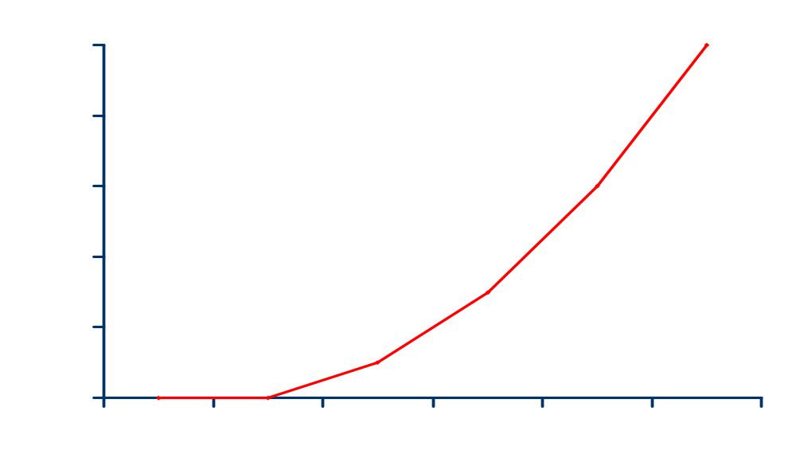
Toxicological assessment exposure
Poisoning
Unintentional
Suicide
Occupational
Producers
Operators
Mixing
Loading
Harvester
Biological Effect
Bystanders
Direct exposure
Indirect exposure
Population
Food,
Water,
Air
Dose (mg/kg body weight)

Slide 21
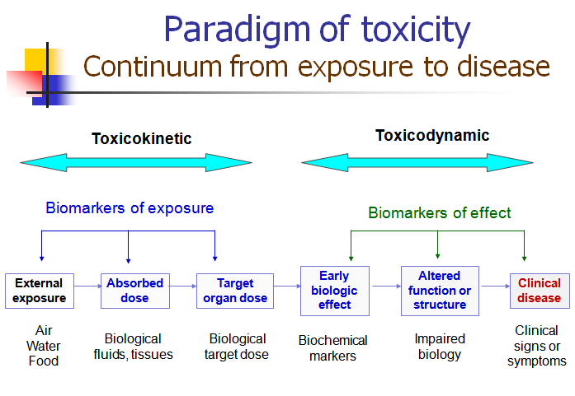

Slide 22
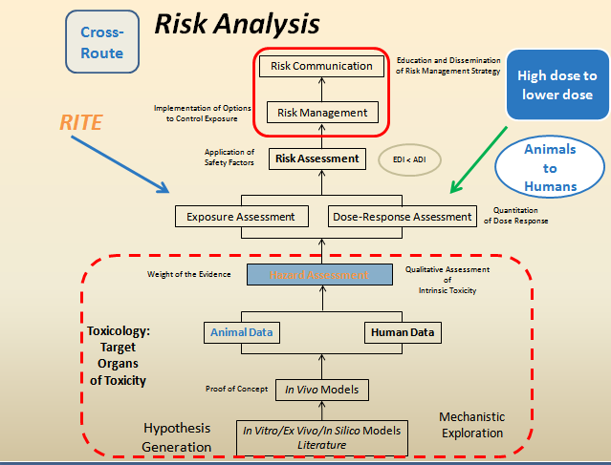

Slide 23






University of Crete Medical School
Department of Toxicology & Forensic Science
Prenatal long term pesticide exposure and its association with
pregnancy problems and birth defects
Aristides M. Tsatsakis
Professor and Director, MSc, PhD, DSc, ERT
Department of Toxicology & Forensic Science, Medical School, University of Crete
http://aristsatsakis.com

Slide 24
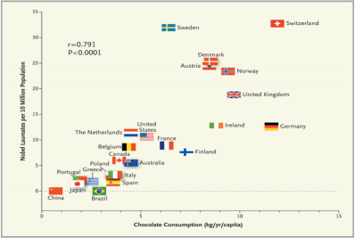
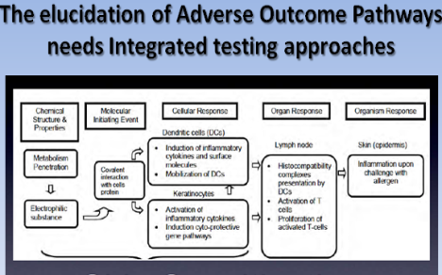
Associations related to exposures and health problems remain at the end only associations for certain cases and is not a prove for general conclusions.
Association is not Causality
These associations are more evident in cases with strong epidemiology support and objections and restrictions are apparent .
The case of paraquat and parkinson disease in recent EFSA studies
What is the value then ? Policy and Prevention and Regulatory issues, and increase of knowledge
Correlation ..Chocolate Consumption and the Number of Nobel Laureates .
Messerli (2012) New Engl J Med, 367, 1562

Slide 25
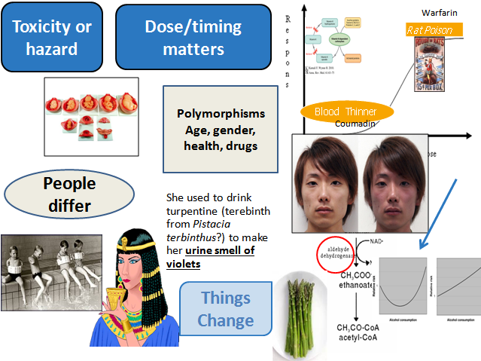

Slide 26
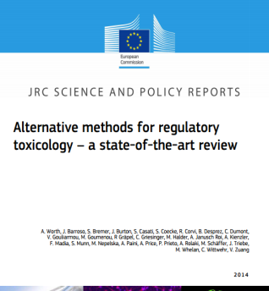
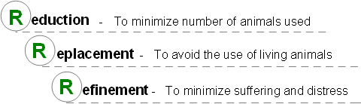
3R and the JRC Activity
New integrated methods based on in-depth biological knowledge are needed. Therefore the JRC is developing and testing new animal-free methods, alternatives to animal-based tests, to be applied in an integrated safety assessment of chemicals.
EURL ECVAM, the European Union Reference Laboratory for Alternatives to Animal Testing
3R!
Examples of EU legislation that require, or strongly encourage, the replacement of animal testing
Directive on the protection of animals used for scientific purposes (2010/63)
Regulation on cosmetic products (1223/2009)
REACH (2007/2006)
Classification, Labelling and Packaging (CLP) (1272/2008)

Slide 27
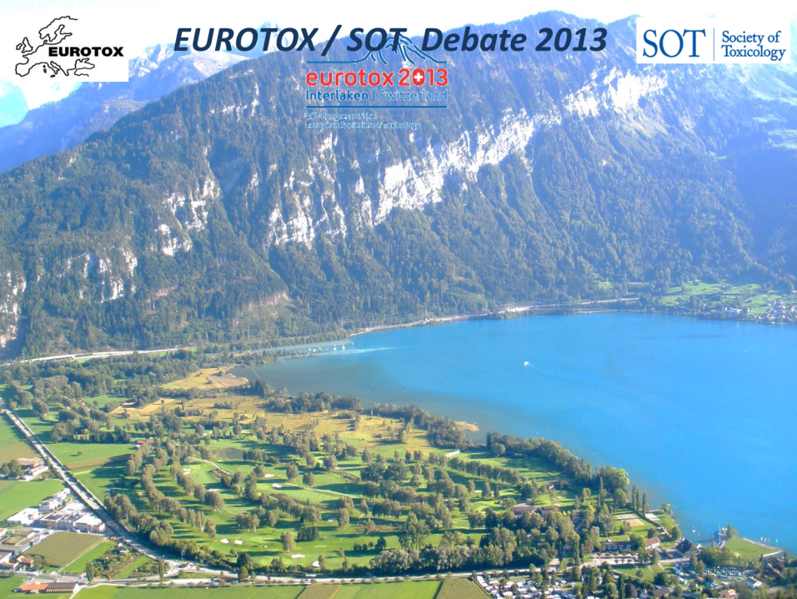
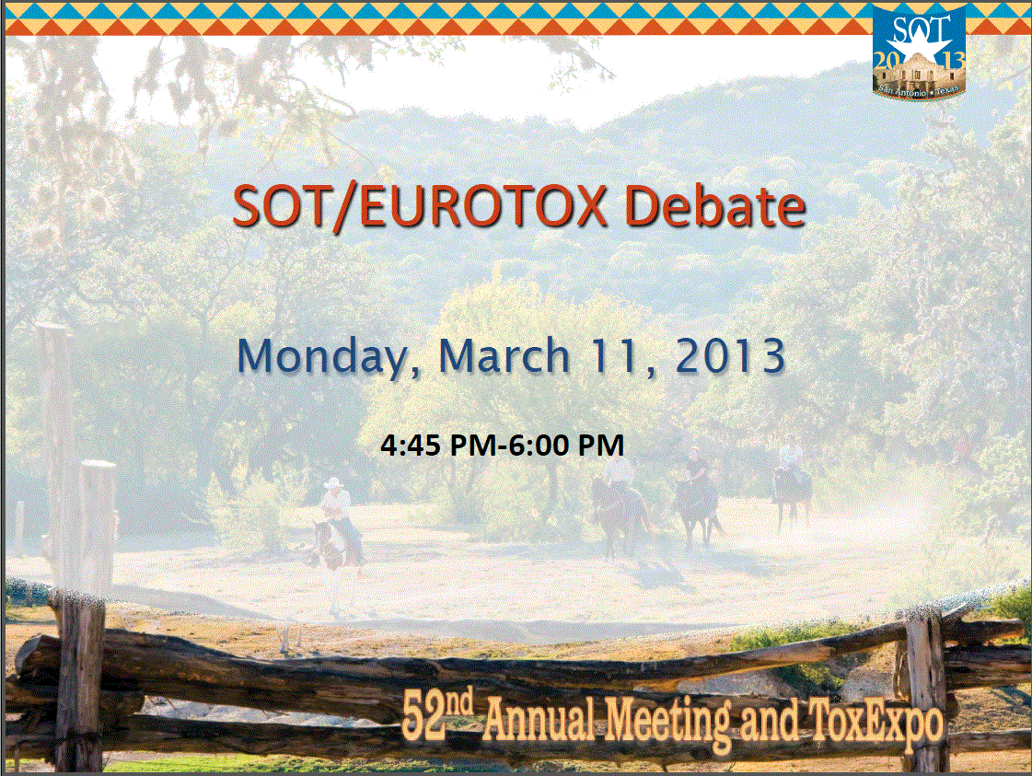

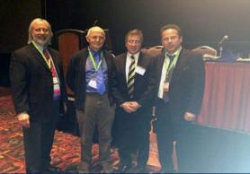
In the Near Foreseeable Future, Much of Toxicity Testing
Can Be Replaced by Computational Approaches

Slide 28
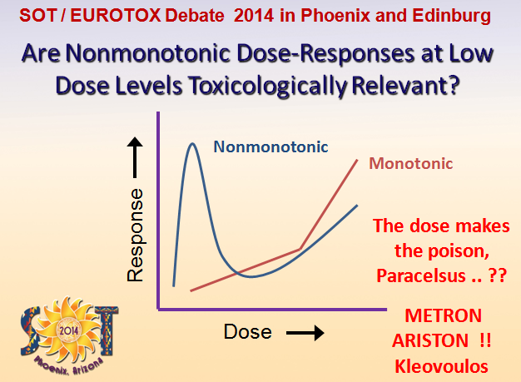
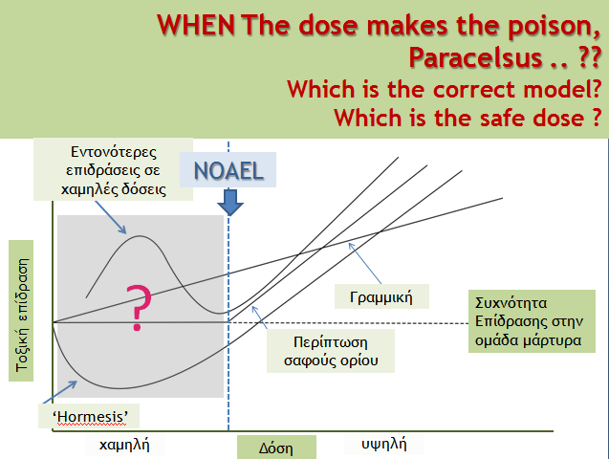

Slide 29
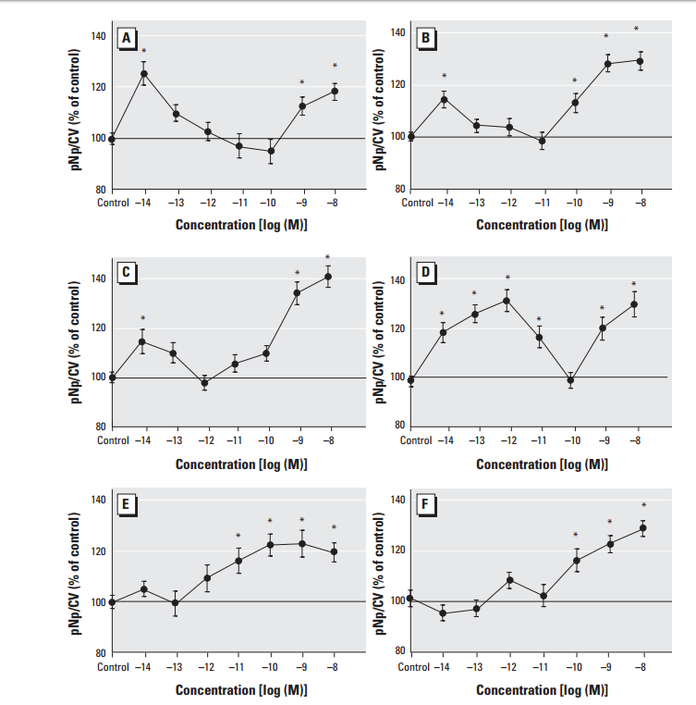
Examples of non-monotonic curves
Xenoestrogens in vitro cell lines
Estradiol
Coumestrol
p-nonylphenol
endosulfan
Concentration-dependent changes in the phosphorylation status of extracellular-regulated kinases (ERK)
Concentrations in log₁₀ scale
Bulayeva NN Watson CS (2004). Environmental Health Perspectives, 112(15): 1481-1487

Slide 30



Non linear (non monotonic) response at low? doses
Mortality vs. Cd accumulation
Mortality data: this study (Renieri E.), including recent literature
  S. Cambier et al., 2010
  L. Vergauwen et al. / Chemosphere (2013)
  LA. Arini et al., 2015
Accumulation data: this study (Renieri E.)

Slide 31


Slide 32

Issues under consideration include high variability in levels and sensitivity and of exposure duration of the toxicological studies

Slide 33

WHO , Oct. 26 2015 released review study performed by IARC
Intern Agency Research on Cancer WHO subsidiary
Processed meat as a Group 1 Carcinogen, meaning evidence that links to cancer
This based on meta-analysis studies evaluating 800 papers and conducted by team of 22 experts from 10 countries who voted on what findings to issue
FDA Food and Drug Administration response : Federal Government carries out its own research through the
National Toxicology Program
NTP on carcinogens will not look at processed meats as whole food items nominated for review as carcinogens
Contraversies
among regulators

Slide 34






Slide 35


SOT EUROTOX debate

Slide 36


Slide 37
Epidemiological studies
Advantages
Disadvantages
Human populations
True range of exposure
Vulnerable subgroups
Sensitive parts of lifespan
Gender-selective effects
Poor exposure information
No quantitative data
More than one chemical
Heterogeneity of data
Temporal concordance?
Confounders
No biological plausibility
Notes:
37

Slide 38


Slide 39
Application of epidemiological studies to pesticide risk assessment
Classical single hazard approach
(regulatory framework)
Multiple hazard
(integrated epi approach)
Evaluation of various
‘stressors’
Known (or emerging risk)
Evaluation of one pesticide
Various potential outcomes
Pesticides
Endpoint 1
Chemicals
↑ disease incidence
Single hazard
Endpoint 2
Biological agents
Endpoint 3

Slide 40


Slide 41
Activation of a toxicity pathway (NRC, 2007)
Exposure
Tissue Dose
Biologic Interaction
Perturbation
Low Dose
Higher Dose
Higher yet
Biologic
Inputs
Normal
Biologic
Function
Early Cellular
Changes
Adaptive Stress
Responses
Morbidity
and
Mortality
Cell
Injury
Notes:
NASがこのような発表を行うにあたり基本としたのは，全ての有害事象は物理的あるいは化学的作用因子と細胞パスウェイとの相互作用によって惹起されるという概念である．
つまり，そのような相互作用によって引き起こされた揺らぎが生理的な適応範囲を超えたときに，細胞障害や病的な状態，最終的には死がもたらされるのである．

Slide 42


Slide 43


Slide 44

AOP 1: Inhibition of the mitochondrial complex I of nigra-striatal neurons leads to parkinsonian motor deficits
AOP Wiki: https://aopwiki.org/wiki/index.php/Aop:3, accessed Oct 1, 2016
Studies on Adverse Outcome pathways for many years now resulted so far only in few AOPs not without contraversies also
See EFSA recent reports on Paraquat and Parskinson Disease

Slide 45





Mechanisms involved in long-term low dose exposure
Paradigm for pesticides
Inhibition or enhancement of enzymes, lipid peroxidation
Production of free radicals, oxidative sress
Reduction of antioxidant enzymes GHS, SOD, CAT, Gpx
Inhibition of the electron transport chain
Disturbances in transcription at the nucleus
Splitting chromatid DNA, Chromosomal damage
Apoptosis, oncogenesis, epigenetic damage, depletion of mitochondria, telomere shortening and ageing
Inhibition of protein synthesis
Disorders phosphorylation, methylation and intracellular signaling
Receptor and ion channels function’s modifications
Muscarinic (Rs) secondary
signaling Gps, PΚC,Ca+2
Ops, Pyrethroids and Carbamades
cause cholinergic crisis
Pesticides inhibit the mitochondrial energy production at mt complexes
Pesticides cause oxidative stress, ROS production,
apoptosis, necrosis, pimutations, ageing
Ops and Pyrethroids
inhibit Na+/K+ -ATPase

Slide 46

The challenge of linking diseases with exposure web of interactions
3 IMPORTANT ISSUES
The big number and categories of diseases and/or disorders that can be involved
The expanding number of measurable exposures to specific substances or categories of pollutants
The effect of various types of confounders on both exposure and disease manifestation
The complex issue of linking exposures to diseases/health effects can be summarized underthe term “web of interactions’’
Editorial in Toxicol Letters
Environmental contaminants and target organ toxicities – new insights into old problems
Tsatsakis and Wilks
Notes:
Need for application of integrated frameworks for testing such as the OECD’s adverse outcome pathway (AOP) approach.
In review papers of epidemiology authors call for harmonization in study methodologies and a better characterization of exposure.
Ερευνητικά άρθρα χρησιμοποιούν μη πρότυπες μεθόδους για τον προσδιορισμό του κινδύνου των χημικών ουσιών και οι αξιολογητές του κινδύνου έχουν δυσκολίες με τη χρήση αυτών των δεδομένων.
Το σύνθετο ζήτημα της σύνδεσης των ανοιγμάτων σε ασθένειες / επιδράσεις στην υγεία μπορούν να συνοψιστούν κάτω από τον όρο «πλέγμα αλληλεπιδράσεων"
Τρία σημαντικά ζητήματα συμβάλλουν σε αυτό το έργο
Ο μεγάλος αριθμός και οι κατηγορίες των ασθενειών ή / και διαταραχών που μπορούν να συμμετέχουν
Η αύξηση του αριθμού των μετρήσιμων εκθέσεων σε συγκεκριμένες ουσίες ή κατηγορίες ρύπων
Και η επίδραση των διαφόρων τύπων των συγχυτικών παραγόντων τόσο στην έκθεση όσο και στην εκδήλωση της νόσου.

Slide 47


Trust the evidence…..but don’t generalise into conclusions ! …..Think of personlised causality and intergarted approaches ... AMT
«Αρχή σοφίας, η γνώση της άγνοιας.»
Begin of Wisdom is acknowledgement of ignorance
Pan metron ariston
Be fond of hearing
rather than of talking
Be fond of learning
I grow old ever learning

Slide 48


Simulating real life exposures to uncover possible risks to human health: a proposed consensus for a methodological approach
Exposure scenarios simulating real life is a complex issue
since effects from multiply chemicals must be considered as a web of interactions that produce variety of mechanisms of effects and subsequently of health outcomes.
Linear –monomodal but also nonlinear effects can be seen in the range of low and/or high concentrations of exposures

Slide 49



PPPs or pesticides “any substance or mixture of substances used as insecticides, fungicides, herbicides, acaricides, rodenticides, nematicides, growth regulators, repellents, biocides to prevent, destroy or control a harmful organism (‘pest’) or disease, or to protect plants or plant products during production, storage and transport”
[http://ec.europa.eu/food/plant/pesticides/index_en.htm].
Food improvement agents = food additives, food enzymes and food flavouring. Additives are defined by the same EU legislation as any substance not normally consumed as a food in itself and not normally used as a characteristic ingredient of food, whether or not it has nutritive value [http://ec.europa.eu/food/safety/food_improvement_agents/additives/index_en.htm].
”Lifestyle additives” - other substances used as additives, preservatives, plasticisers, solvents, colorants that can be found in consumer related products as cosmetics, products of personal hygiene, detergents, food contact materials and medicines.

Slide 50


”Lifestyle additives” as bisphenol-A, phthalates, parabens, 1,4 dioxine, sodium laureth/sodium lauretsulfate, propylene glycol, PEG’s, phenoxyethanol, (PFOA) along with some pesticides and some food additives
may act as EDCs and cause a range of toxic effects
on humans as learning differences and behaviour problems, asthma, increased sensitivity to infections, testicular dysgenesis syndrome, altered puberty and obesity in early years, and infertility, breast cancer, fibroids, premature menopause, atherosclerosis, cardiovascular disease, diabetes/metabolic syndrome, prostate cancer, Alzheimer disease and Parkinson disease [
Most of the food additives regulated EU legislation have some concerns that though safe for the general population may cause health problems in children such as hyperactivity and immunological reactions
Briffa J. Aspartame and its effects on health: independently funded studies have found potential for adverse effects. BMJ. 2005 Feb 5;330(7486):309-10; Food additives and hyperactive behaviour in 3-year-old and 8/9-year-old children in the community: a randomised, double-blinded, placebo-controlled trial. Lancet. 2007 Nov 3;370 (9598):1560-7].

Slide 51



Simulating Real Life Exposures to Uncover Possible Risks to Human Health.
The present regulatory assessment disadvantage
Chronic toxicity evaluations for chemicals have been performed for a single chemical each time in order to set appropriate reference doses and regulatory limits,
Status now
such as the ADIs of additives in food and other consumer products,
the MRLs for pesticides residues in food, the OELs to different chemicals and the DNELs (derived no-effect levels) for chemical safety assessment of chemicals under the REACH Regulation.
BUT
In practise the general population is never exposed to one single chemical
but
experiences uncontrolled multi-chemicals exposure from many different sources, at doses around or well below the regulatory limits.

Slide 52


Limitation of toxicological studies investigating mixtures
The existing studies on mixtures disadvantages :
dosage schemes proposed from the internationally recognised experimental protocols that are too high to simulate real exposure scenarios
endpoints studied - limited to specific types of toxicity covered by the Regulations, allowing for a gap of knowledge for example on cardiotoxicity or neurotoxicity.
Long term studies are not performed to simulate time frames for neurodegenartive diseases

Slide 53
The need for a cumulative risk assessment
Nowadays, the international scientific community as well as the international regulatory authorities have started to realise the need for a cumulative risk assessment and new methodologies are being developed [https://www.efsa.europa.eu/en/efsajournal/pub/3313].
EFSA started to give special attention to cumulative risks from exposure to pesticides that produce common adverse outcomes on the same target organ/system [EFSA. Scientific opinion on the identification of pesticides to be included in cumulative assessment groups on the basis of their toxicological profile. EFSA J., 11 (2013), p. 3293].
The lack of data from toxicological studies investigating mixtures consists one of the biggest regulatory challenges.
The CLP Regulation [http://echa.europa.eu/web/guest/regulations/clp] gives the opportunity to Industry to perform animal testing in commercial mixtures as a last resort to prove a toxicological hazard.

Slide 54

Aim of the study
Our experimental methodology has the ambition to provide at one strike multi-answers to multi-questions:
long term toxicity study of non-commercial chemical mixtures, consisting of common everyday life chemicals (pesticides, food additives, life-style products components)
at low and realistic dose levels around the regulatory limits
with the simultaneous investigation of several key endpoints like genotoxicity, endocrine disruption, target organ toxicity and systemic mechanistic pathways, like oxidative stress.

Slide 55




The new methodology approach high lights
The need for a new experimental methodology for mixture testing intending to answer to multiple questions related to health concerns after exposure to low, realistic doses
raised the attention of research
in the field

Slide 56

New methodology approach
This experimental methodology has the ambition to provide at one strike multi-answers to multi-questions:
long term toxicity study of pesticide mixtures
at low and realistic dose levels around the regulatory limits – ADI doses
with the simultaneous investigation of several key endpoints like genotoxicity, endocrine disruption, target organ toxicity and systemic mechanistic pathways, like oxidative stress.

Slide 57



Slide 58

If the hypothesis of an increased hazard from cumulative exposure on chemicals in ADI levels were shown to be true, this will provide further information to public authorities and research community supporting the effort to pass from the single-compound risk assessment to the era of cumulative risk assessment.
Such transition would probably lead to serious reconsiderations regarding chemicals’ use and to the recalculation of related ADIs, hopefully reducing the incidences of different chronic diseases as well as the costs for their treatment.
The next step in cumulative risk assessment will be to take in consideration all type of interactions that can appear between the chemicals analysed and how this will influence the effect of final mixture even if the compounds have different adverse outcomes pathways and act on different target organ/system.

Slide 59


Slide 60



Slide 61

Gene flow
Gene flow creates reduction of differentiation between populations
Transgene x wild hybridization a possible and has been proven
Synergistic and antagonistic effects of stacked transgenes offer risks
Horizontal gene transfer can create fitness changes in the recipient organism
Weediness is potential effects of adoption of HR crops
Chemical toxicity
Natural/Novel toxins have target and/or non-target impacts on life
Herbicides have immediate or delayed adverse effects on the environment
Bt toxins has effects tri-trophic interactions among fauna and flora
Indirect impacts of GM
Implications
Excess of Glyphosate effects soil and water
GMOs effect biodiversity
Reduced efficiency of pest, disease and weed control
Evolution of insecticide and herbicide resistance
Regulation of GMOs
EU-Comparative assessment VS US-Substantial equivalence
Authorities should consider sci. evidences as well as legitimate reasons
Chronic and sub-chronic studies have limitations
Future prospects
Evidences are not enough, case-to-case studies, large scale investigations
Complex food webs, long term exposure/full-life span for many generations

Slide 62



I know nothing
except the fact of my ignorance
"The only good is knowledge and the only evil is ignorance“
As more we increase our knowledge about things as more we understand that we increase the boarders with our no knowledge
i.e. we increase the understanding the knowledge of our ignorance
"I know that
I know nothing"

Slide 63



Slide 64
















Thank You
http://ctoxres.med.uoc.gr/
http://toxplus.gr/en/

