Slide 1
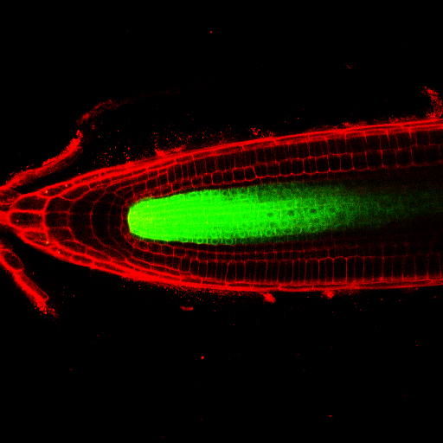


Arieh Moussaieff B.Pharm; PhD
Cell Specific Analysis:
a voyage from the Arabidopsis root
to human embryonic stem cells
Arieh Moussaieff
PhD
Notes:
Shalom,
I would like to thank Prof. Benita and the committee for the kind invitation.
Today I would like to talk on the role of metabolism in development. Specifically, I will describe the link between metabolism and cell identity.
I used two models to study two aspects this link.
The first metabolic mapping of a tissue was done using the Arabidopsis root for reasons that will be clearer soon.
I the second part of this talk I will discuss the interactions between metabolism, epigenetics, and cell identity during pluripotent stem cell differentiation.

Slide 2
Metabolic Phenotyping
Metabolism, from Greek metabolē, “change”: chemical transformations in living organisms
Metabolism is either directly or indirectly involved with every aspect of cell function
The metabolome - the set of small-molecule found within a biological sample provides a functional readout of cellular state
The term ‘metabolome’ (also ‘metabonome’) was first coined at late 1990s
Pioneer attempts for metabolic profiling were made by Linus Pauling (1971)
(Oliver et al, 1998; Tweeddale et al, 1998; Nicholson et al, 1999; Pauling et al, 1971)
Notes:
I would like to start by introducing a new and non-familiar concept: Chemical Phenotyping.
To understand this term, let us consider metabolism.
…
Pauling studied the metabolic profile of human urine long before the bioinformatic and statistical tools we now use for such a study were introduced to the field.

Slide 3
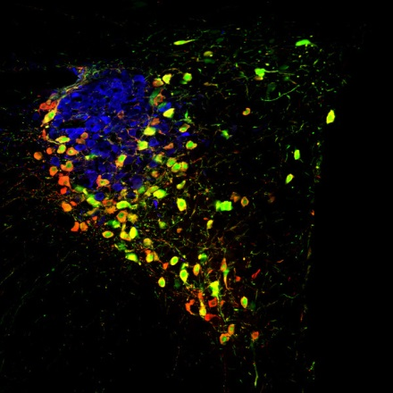
Metabolomics at a Cell Type Level
Metabolite accumulation in various cell-types is very different
Metabolites that accumulate in specific cell-types are overlooked
Metabolic zonation plays major roles in many fields e.g. liver metabolism, in cancerous tumors or in emotional modulation
Oxytocin distribution within hypothalamus has a role in the attenuation of fear response (Knobloch, 2012)
Notes:
Despite intensive use in the new tool of metabolomics during the last 15 years, to date, such studies have been performed almost exclusively either on tissues, or on cell cultures providing scarce information on the metabolome at a cell type level.
As suggested by a recent study, oxytocin, a neuropeptide, is released in hypothalamic neurons to form a structure critically involved in fear suppression (here in red).
Evoked Axonal Oxytocin Release in the Central Amygdala Attenuates Fear Response (Knobloch, 2012)
Oxytocin MW = 1007.19
The hypothalamic neuropeptide oxytocin (OT). Here we gained by recombinant viruses selective genetic access to hypothalamic OT neurons to study their connectivity and control their activity by optogenetic means. We found axons of hypothalamic OT neurons in the majority of forebrain regions, including the central amygdala (CeA), a structure critically involved in OT-mediated fear suppression. In vitro, exposure to blue light of channelrhodopsin-2-expressing OT axons activated a local GABAergic circuit that inhibited neurons in the output region of the CeA. Remarkably, in vivo, local blue-light-induced endogenous OT release robustly decreased freezing responses in fear-conditioned rats. Our results thus show widespread central projections of hypothalamic OT neurons and demonstrate that OT release from local axonal endings can specifically control region-associated behaviors.
Oxytocin (red)

Slide 4
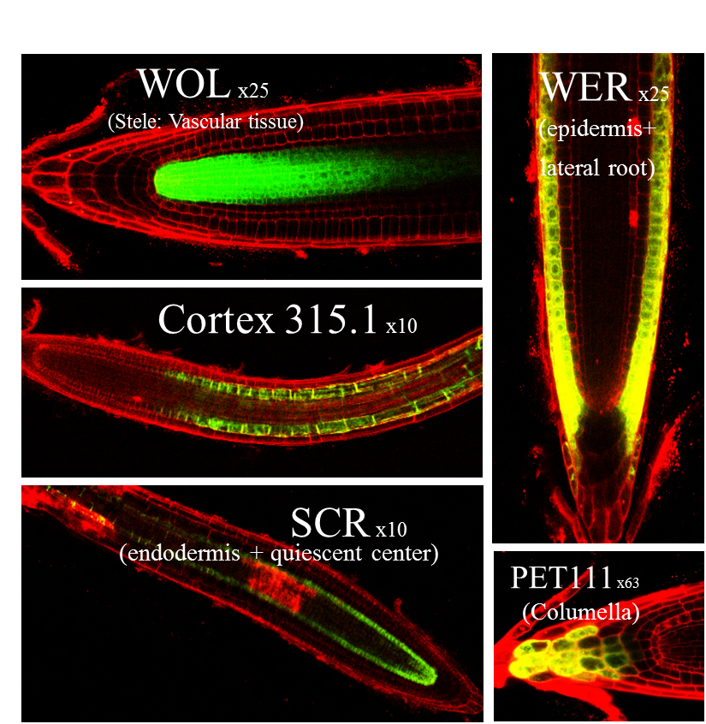
Cell Metabolic Heterogeneity in the Developing Tissue
Arabidopsis root has a relatively simple radial organization
Cell type analysis thus infers spatial and developmental implications
5 lines of Arabidopsis thaliana with GFP labeling for cell population with a distinct loci
Notes:
To address metabolic zonation in a tissue, we chose the Arabidopsis root as a model.

Slide 5
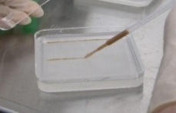
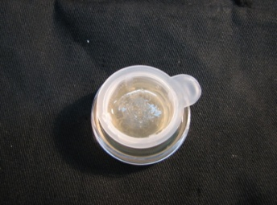
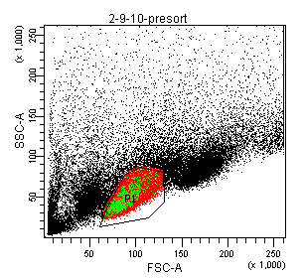
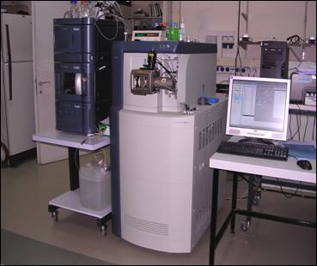

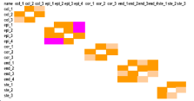
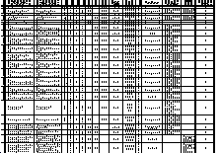
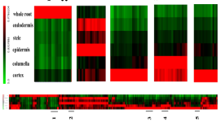
Biological samples
Enzymatic separation
Collection of GFP labeled cells
Concentration of samples 1000 fold
Cell-type Metabolomics Workflow
Chemical Analysis
Comparison of intact tissue to isolated cells
Peak picking
and peak alignment
Quality
control
Selection of samples derived masses
Robustness tests
Exclusion of masses resulting from enzymatic separation / sorting
Cell specific metabolic profiles
Moussaieff et al, PNAS, 2013; Brodsky, Moussaieff et al, Anal Chem, 2012
Notes:
For a metabolic profiling of cell types, I established the following work flow: a few steps were added to the typical sample preparation for metabolic profiling: enzymatic separation; cell isolation; concentration * 1000. Quite a few bioinformatic steps were taken to filter the data and get a comprehensive data set. A few of these were developed especially for this project: QC, Selection of samples derived masses, Exclusion of masses resulting from enzymatic separation / sorting.

Slide 6
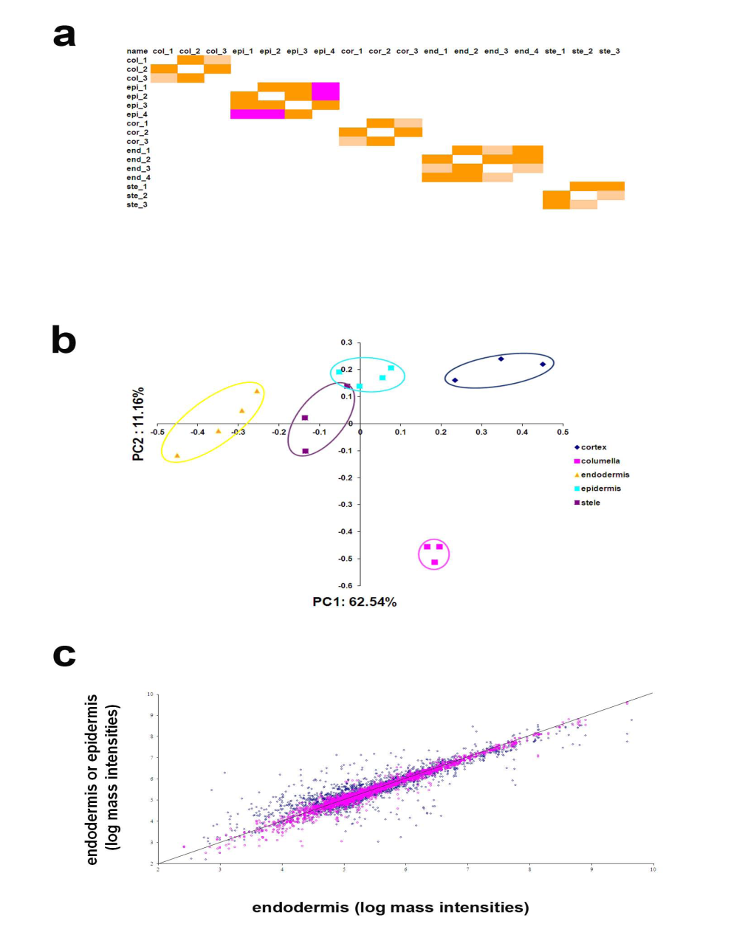
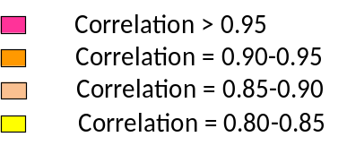
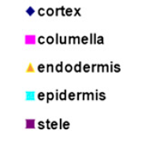
Reproducibility and Statistical Separation
col
epi
cor
end
ste
col
epi
cor
end
ste
Moussaieff et al, PNAS, 2013
Notes:
The results of the new work flow can be assessed from a Pearson correlation matrix in the upper panel, showing correlations of over 0.85 for all samples within the same cell type, and considerably lower correlations for samples from different cell populations.
PCA also suggested a separation of samples of the different groups, while clustering of samples of the same group.
Principal Component Analysis (PCA) analysis transforms the data to a new coordinate system such that the greatest variance comes to lie on the first coordinate (called the first principal component), the second greatest variance on the second coordinate, and so on. Principal Component Analysis is useful for reducing and interpreting large multivariate data sets with underlying linear structures, and for discovering previously unsuspected relationships.
Pearson correlation coefficient of robust masses of plant origin among replicates of all five cell-type populations is higher than 0.85 (pink, correlation >0.95; dark orange, correlation of 0.90–0.95; light orange, correlation of 0.85–0.90) (all
correlations are shown in Fig. S5)
Principal component analysis (PCA) is mathematically defined as an orthogonal linear transformation that transforms the data to a new coordinate system such that the greatest variance by any projection of the data comes to lie on the first coordinate (called the first principal component), the second greatest variance on the second coordinate, and so on. Partial Least Square Discriminant Analysis. Principal Component Analysis is useful for reducing and interpreting large multivariate data sets with underlying linear structures, and for discovering previously unsuspected relationships.

Slide 7
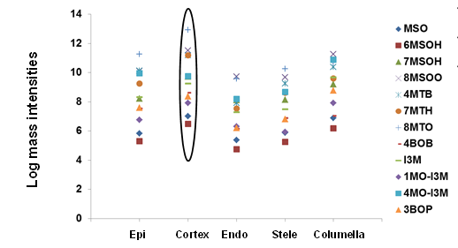
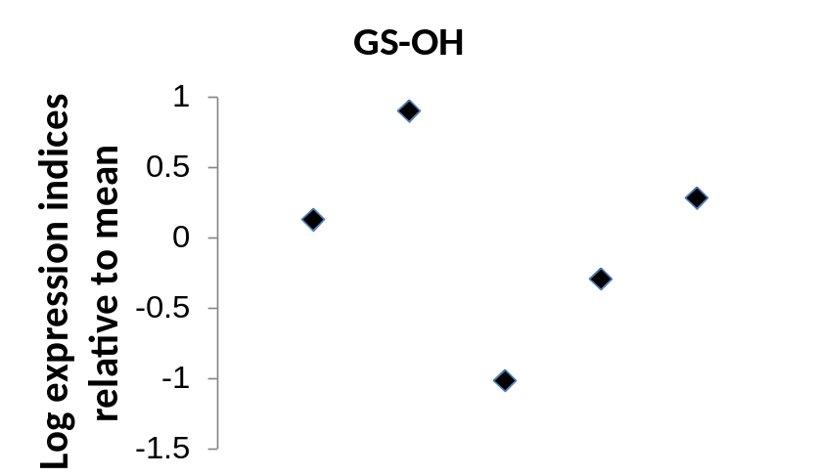
Correlating Metabolic and Transcriptome Profiles
Notes:
The tight regulation resulting in the striking correlation of the different profiles of abundance of GSL metabolites in the different cell types can be attributed to the rate limiting steps of the pathway. Under the assumption that metabolite abundance profile will be most correlative to the profile of the expression of the rate limiting step enzymes, the metabolic profile has been compared to the profiles of the expression of different enzymes of the pathway.
GS-OH: a side-chain modifying locus that is involved in hydroxylating alkenyl glucosinolates (Kliebenstein et al, 2005), and FMO-GSOX5, which catalyzes thiol oxidation, i.e. the conversion of methylthioalkyl GLIs into methylsulfinylalkyl GLIs (Sønderby et al, 2010).
Log10 of Normalized Expression relative to the mean.

Slide 8
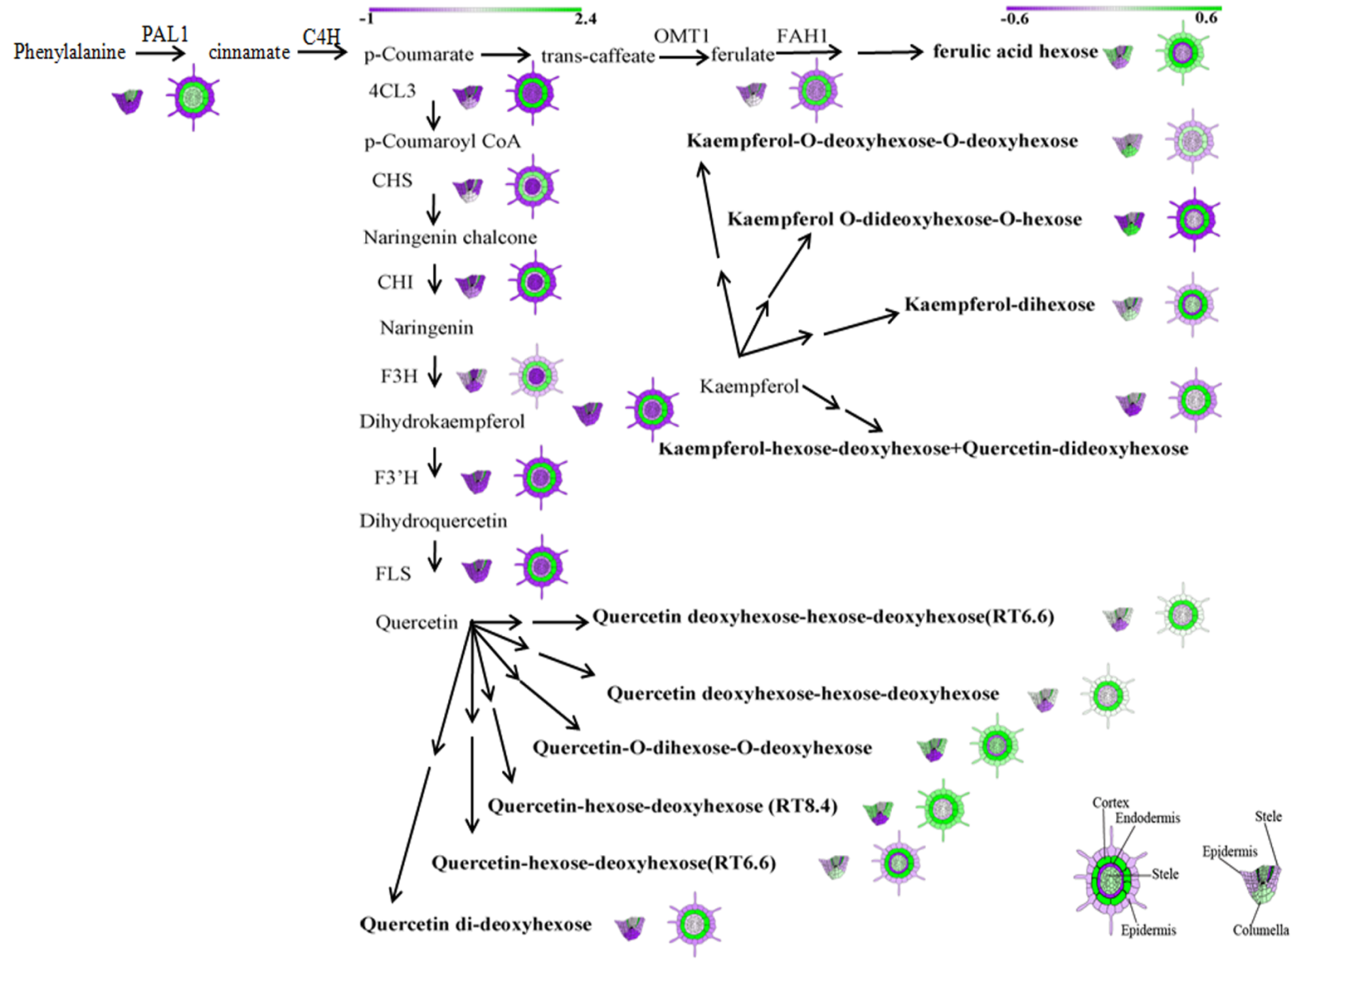
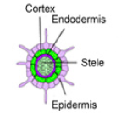
Secondary Metabolite accumulation in At Root
Moussaieff et al, PNAS, 2013
Notes:
Phenylpropanoid are also most abundant within the cortex. The majority of Phenylpropanoids show maximal abundance (log₁₀) in the cortex relative to other cell types, in accordance with the expression of Phenylpropanoid biosynthesis genes (log₂) enriched in the cortex relative to other cell types. Seeing the anatomy of the root, this makes biological sense. The plant would be best served by releasing defensive secondary metabolites when bacterial /fugi/insect infection reaches the inner layers. This way, while protecting the inner layers, energy is not wasted on every superficial scratch in the epidermis.

Slide 9
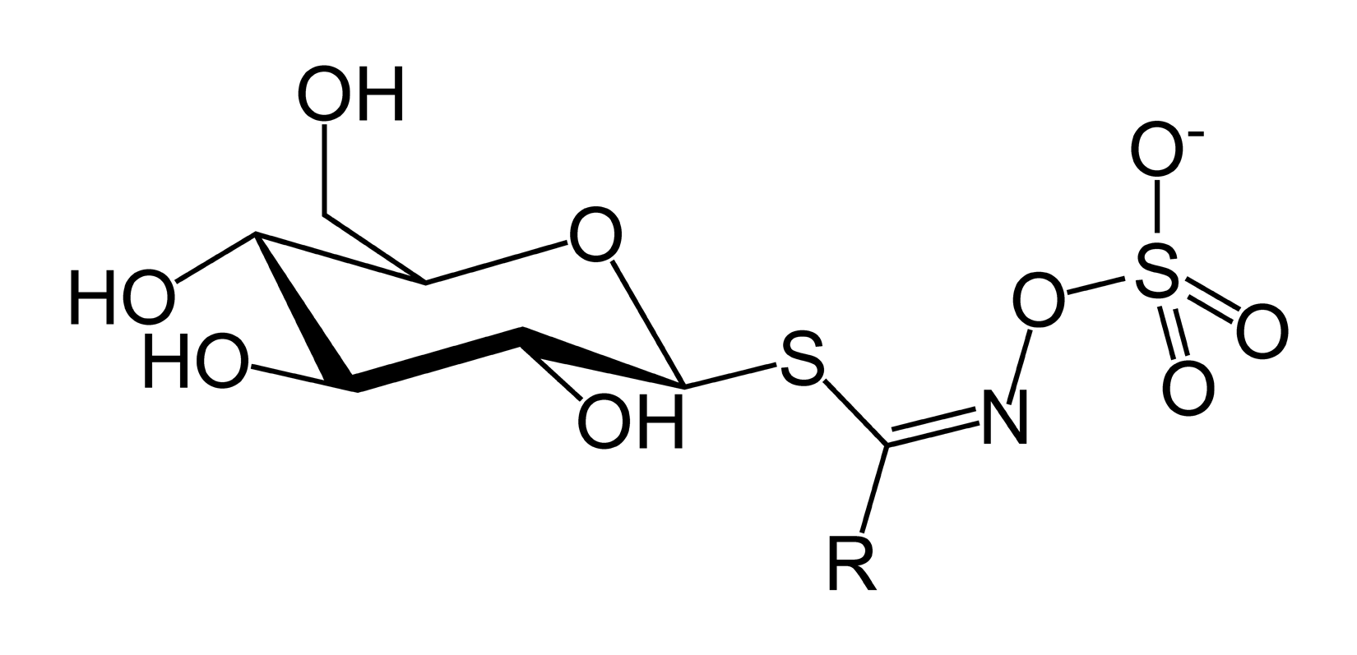
Integration of Metabolic and Transcriptomic Data: Rate Limiting Steps of the Glucosinolate Pathway
Glucone formation and core structure
Average Pearson correlation = -0.09±0.34
Elongation of side chain
Average Pearson correlation = 0.16 ±0.31
Oxidation of side chain
Average Pearson correlation = 0.68 ±0.15
Notes:
We studied the correlations of metabolite abundance and gene expression in several different ways. While Elongation of side chain and Glucone formation and core structure have poor Pearson correlations, Oxidation of side chain shows a much higher correlation between metabolite abundance and gene expression, suggesting that these are the rate limiting steps of the pathway.
Interestingly, these chemical modifications are considered to be responsible for the biological activity of these metabolites.
GS-OH: a side-chain modifying locus that is involved in hydroxylating alkenyl glucosinolates (Kliebenstein et al, 2005), and FMO-GSOX5, which catalyzes thiol oxidation, i.e. the conversion of methylthioalkyl GLIs into methylsulfinylalkyl GLIs (Sønderby et al, 2010).

Slide 10
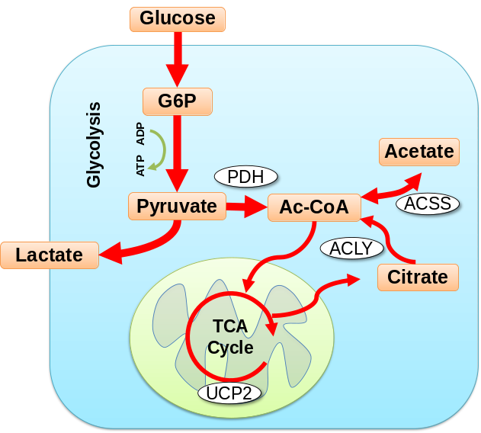
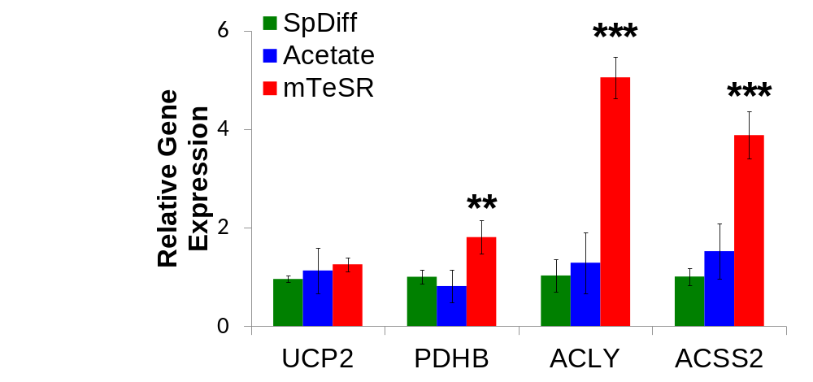
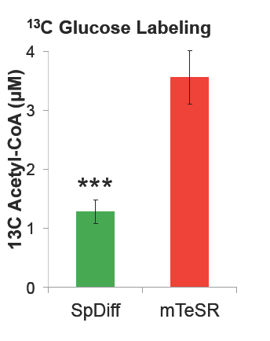
Acetyl CoA Formation in Early Differentiation
Moussaieff et al, Cell Metabolism, 2015
***
***
**
Notes:
Although the metabolism pf acetate in mammalian cells was overlooked for many years, it is known to be in equilibrium with acetyl CoA, a major metabolic junction of primary metabolic pathways.
I tested the expression of the genes responsible for the formation of acetyl CoA in mammalian cells.
These were all down-regulated in early differentiated cells, giving the notion that this metabolite may have some role in pluripotent cells.
Quantitative Reverse transcription polymerase chain reaction (RT-PCR) analysis shows 2 5 and 4, -fold lower expression of pyruvate dehydrogenase B (PDHB), ATP citrate lyase (ACLY) and acetyl-coenzyme A synthetase (ACCS2), after 48 hours of spontaneous differentiation, suggesting a glycolytic driven production of cytoplasmic acetyl-CoA .
Importantly, stimulation of differentiating cells with acetate increased acetyl-CoA (p≤0.05), but did not affect glycolysis or the expression of ACSS2, PDHB and ACLY, suggesting that acetate is converted to acetyl-CoA.
Mitochondrial uncoupling protein expression was not changed, although recently suggested to be involved in ESC differentiation

Slide 11
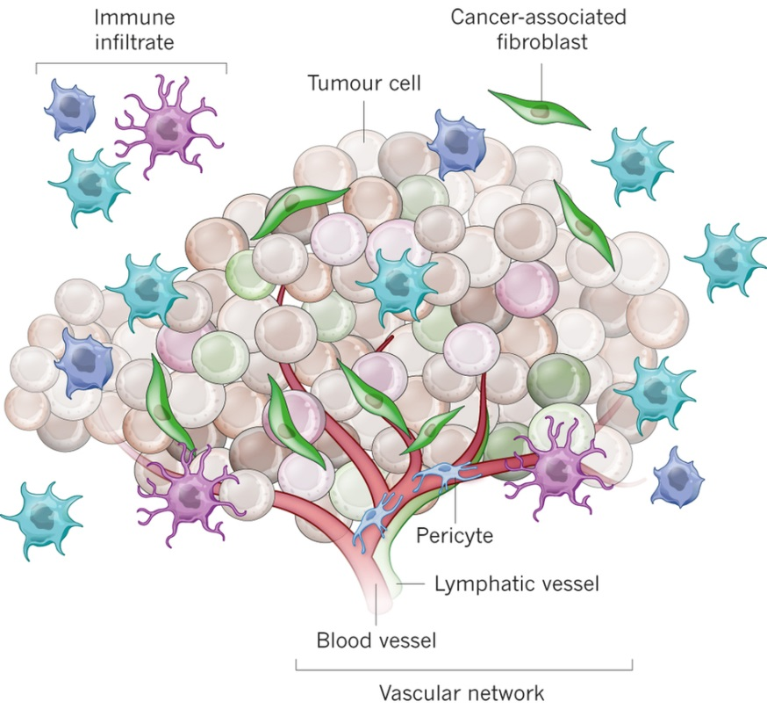
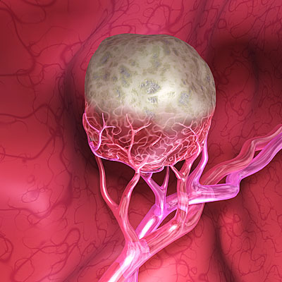
Using cell-type metabolic analysis, a metabolic map of tumors will be drawn, as a function of distance from blood vessels.
Junttila and de Sauvage; Nature, 2013
http://www.gcarlson.com/illustration.php?subcategory=immunological&ImageID=30

Slide 12
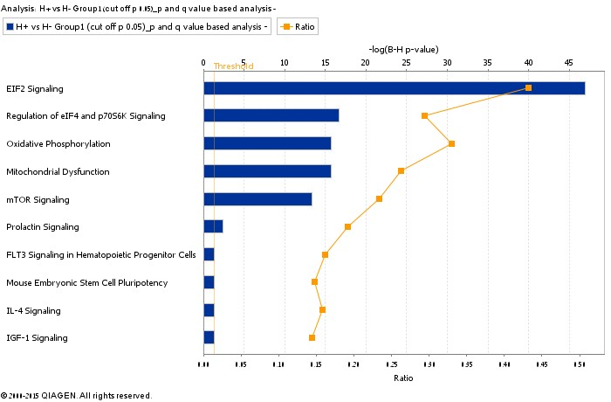
OxPhos Genes Upregulation

Slide 13
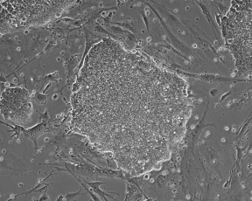
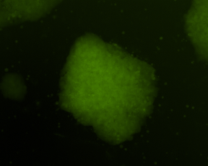
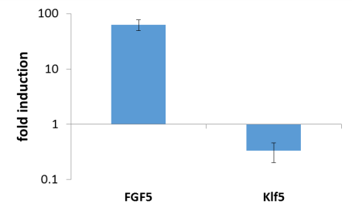
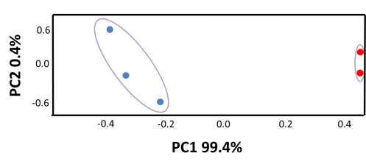
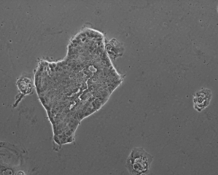
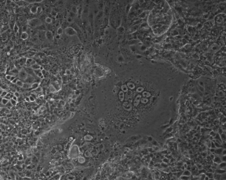
The Metabolic Maturation of Embryonic Cells
mESCs
EpiSCs

Slide 14
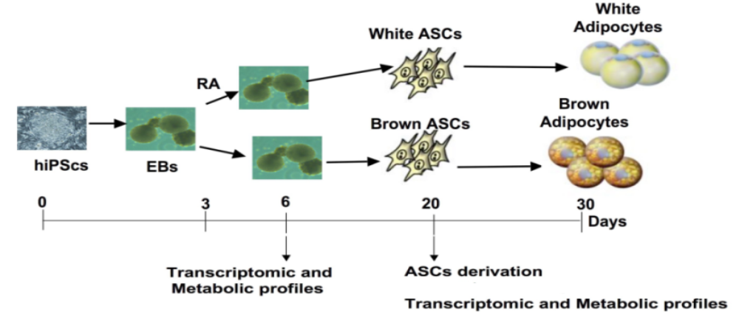
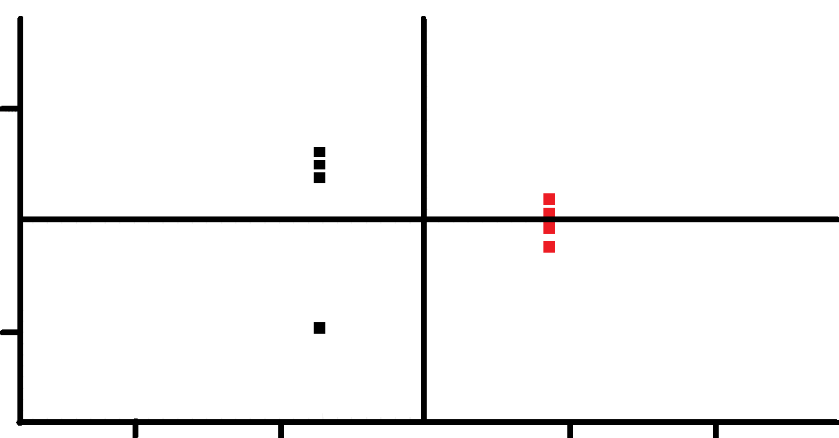
BAP WAP differentiation
1000
1000
-1000
99.87%
-2000
-1000
1000
2000

Slide 15
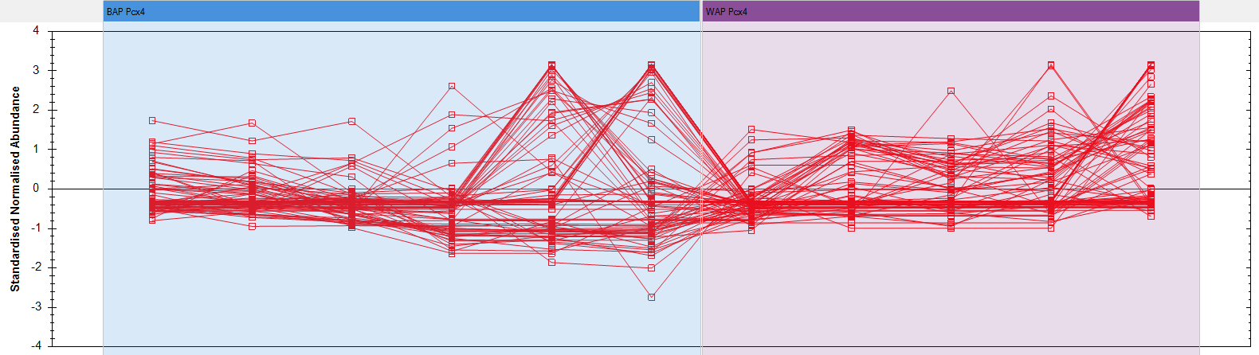
Clustering of Lipid Species
BAP Pcx4
WAP Pcx4
4.0
Standardized Normalized Abundance
0.0
-4.0
Notes:
Metabolite abundance normalization. Will be performed by using ratiometric data in log space, along with a median and mean absolute deviation outlier filtering approach, to calculate the scalar factor. One run is automatically selected as the normalization reference. The normalization reference is found by treating each sample as a putative normalization reference, and calculating the robust standard deviation estimate for every other run. This set of standard deviation estimates is then used to calculate a pooled variance for each potential normalization reference. The sample with the lowest pooled variance is used as the normalization reference.
Standardization procedure of metabolite abundance Normalized compound abundance will be used. The y-axis is then transformed - to show standard deviations from the mean. For any given run, the point plotted shows how far the normalized compound abundance in that run is above or below the mean normalized compound abundance over all runs, after being divided by the standard deviation of those data.
Multivariate data analysis. Progenesis (Nonlinear dynamics), EZinfo module (UMETRIX) and MetaboAnalyst 2.0 (TMIC) will be used for multivariate tests. Data will be filtered, and normalized. Following principal component analysis (PCA) and random forest outlier detection, outlier samples will be excluded from data sets. Partial least square (PLS) regression will be performed. Classification and cross validation will be performed. In order to assess if the class discrimination is statistically significant, permutation tests will be performed. Using loading plots we will unveil the discriminative metabolites in the data sets examined. Other multivariate tests will be performed according to need.

Slide 16
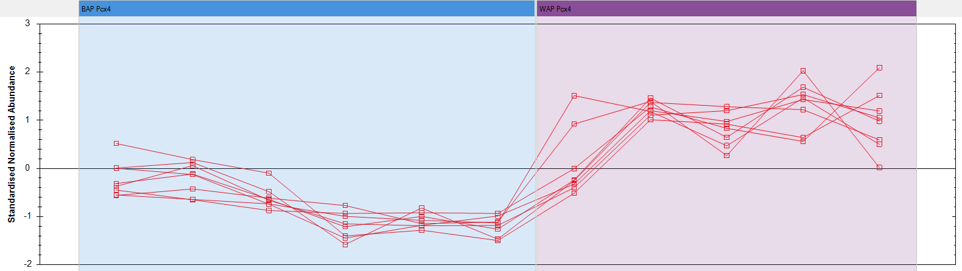
Clustering of a Lipid Sub-class
BAP Pcx4
WAP Pcx4
3.0
Standardized Normalized Abundance
0.0
-2.0

Slide 17



Acknowledgments
Dr. Natalya Kogan
Reut Bruck
Rotem Katz
Taghrid Hidmi
Dr. Tehila Hajaj
Yarden Lavi
Prof. Assaph Aharoni
Prof. Daniel Aberdam
Dr. Yaakov Nahmias
Prof. Joseph Itskovitz
Prof. Eran Meshorer
Dr. Yossi Buganim
Prof. Christian Dani
Prof. Eli Keshet

