Slide 1

Chondrogenic and possible pathologic effects of PRP on adipose derived MSCs.
Presented by: Arezou Pakfar
MSc , Cellular and Molecular Biology
International Congress Integrative Biology
18-20 July
Berlin-Germany
Notes:
Hello everyone, thank you for giving me this opportunity to present my project at this congress.

Slide 2
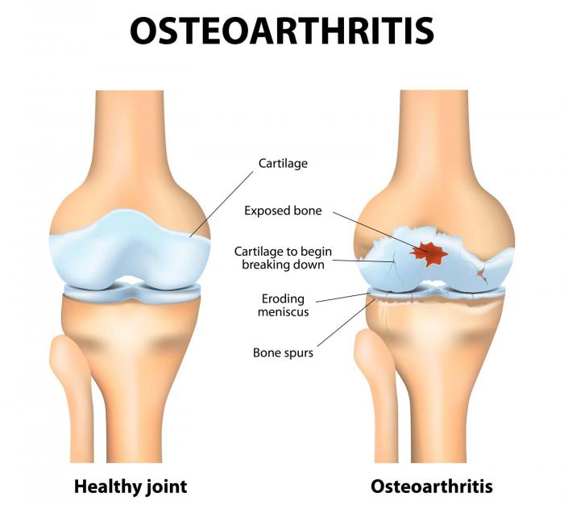
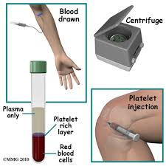
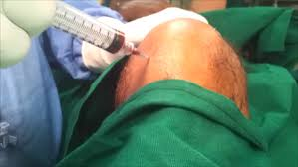
Introduction
www.medicalnewstoday.com
Notes:
Cartilage defects and most of the joint disease such as osteoarthritis are characterized by degeneration of the articular cartilage that ultimately leads to joint destructions.
Unfortunately, current treatments are inadequate. Cartilage tissue engineering with appropriate mesenchymal stem cells is currently being investigated to search for a new therapy. Platelet rich plasma (PRP) which is a portion plasma, having a high concentration of platelets in comparison with the baseline value. For culture of MSCs and cartilage cells, it could be substituted for fetal bovine serum (FBS) with efficiency and safety. It enhances the regeneration of cartilage cells when added to cartilage tissue engineering which result in repairing cartilage defects and as a therapy for Osteoarthritis.

Slide 3
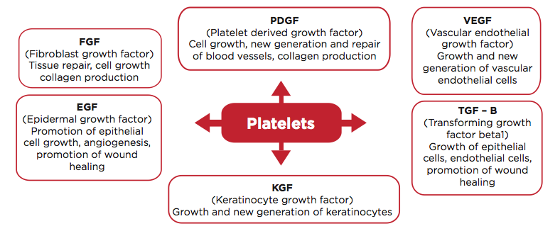
PRP Growth Factors
http://socalbodysculpt.com/
Notes:
But there are some key challenges about the negative effects of PRP. Some growth factors present in PRP and cause a negative effect on Osteoarthritis joint.
Here is a list of growth factors presented in PRP:
Platelet-derived growth factor (PDGF)
Transforming growth factor (TGF)
Platelet factor interlukin (IL)
Platelet drived angiogenesis factor (PDAF)
Vascular endothelial growth factor (VEGF)
Epidermal growth factor (EGF)
Insuline-like growth factor (IGF)
Fibronectin
Studies show that the overall effect of PRP is dependent on its composition, this is because of different preparation protocols suggested during the last 2 decades and they might lead to altering the content of its growth factors.

Slide 4
PRP Growth Factors
Factors have promotive effects on individual differentiation pathways.
Both physiologic and pathologic should be investigated.
Notes:
Also each factor or group of factors have inductive/promotive effects on individual differentiation pathways, therefore different results might be seen.
It should be added that: since under experimental conditions where not all required regulatory elements are present, the overall effects of the agent including both physiologic and pathologic should be investigated.
PRP has been introduced as a potential chondrogenic compound but due to presence of a wide range of factors which induce other differentiation pathways, monitoring the possible undesired effects is of the same importance as that of the physiologic ones.

Slide 5
Issue of this study…
The expression of Chondrogenic markers
Osteogenic markers.
Inflammatory markers.
Angiogenesis markers.
and synthesis of GAG
Notes:
Therefore, in this study, the expression of chondrogenic, inflammatory, osteogenic and angiogenic markers during chondrogenic differentiation of human adipose derived MSCs were measured.
And also the mount of Glycosaminoglycan was determined.

Slide 6
Methods
These techniques have be done:
1. Preparation of PRP
2. Mesenchymal Stem Sell extraction from human adipose
3. Flow cytometry
4. Analysis the efficiency of chondrogenesis
5. Analyses the efficiency of Osteogenesis and hypertrophy
6. Analysis the angiogenesis and inflammation
Notes:
In this study, First of all, human adipose tissue was obtained from three young women by liposuction. All procedures were carried out according to the previous experiments. Finally, MSCs were extracted from adipose and cultured in medium. After 4-5 passages, when reaching desired confluency, cells were used for the following experiments: flow-cytometry…..

Slide 7
Results and conclusion
Results are divided into five groups:
Chondrogenic markers express in PRP-based medium
Angiogenic potential of the differentiated cells
Inflammatory potential of the differentiated cells
Advent of osteogenic marker in the differentiated cells
GAG production
Notes:
Our finding are divided into five groups:
1.
2.
3.
4.
5.

Slide 8
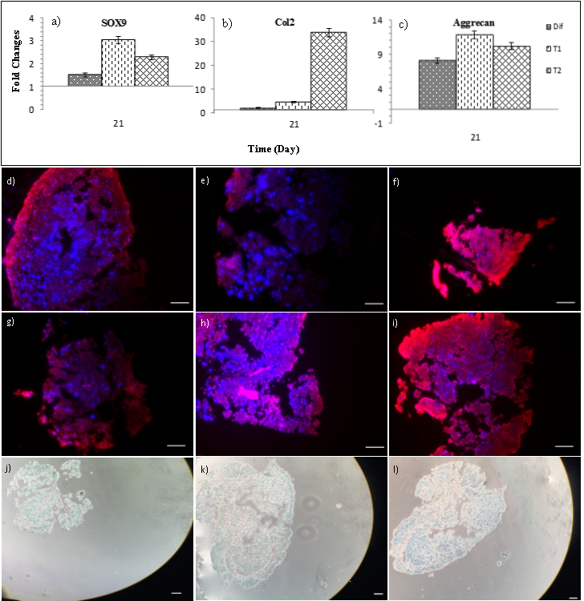

Chondrogenic markers expression
Col II
Col X
Notes:
Cartilage specific markers such as SOX9, aggrecan and collagen type II genes were expressed in all groups. As you see in these charts (a,b,c), PRP had stimulatory effect on these genes in comparison to that of TGFb treated group.
The ICC pictures (d,e,f,g,h and I ) show that Collagen type II and X were almost the same as presented in all groups.
These pictures (j,k and l) show Chondrogenic differentiation was also confirmed by production of GAG in all studied group (Fig.1j-l).

Slide 9
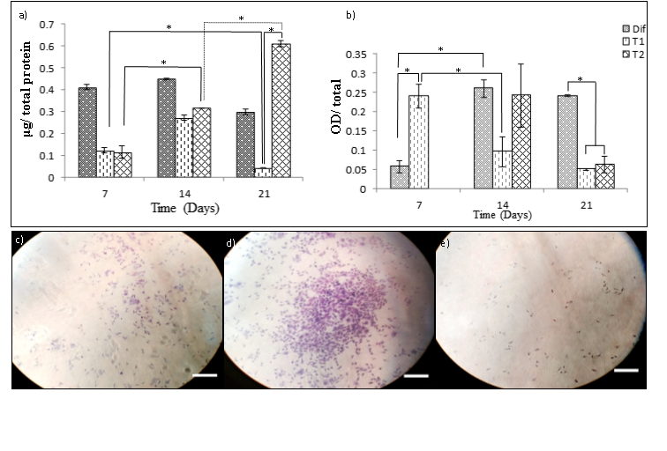
Angiogenic potential of PRP
HUVEC migration
Notes:
In the first figure (a), all the studied groups at each time point released VEGF, though at day 7 the TGFb group has the highest secretion in comparison to that of PRP treated groups.
Because this ELISA kit recognized all kind of VEGF isoforms, the angiogenic potential of each treatment is determined by monitoring the phosphorylation of VEGFR2.
So in the second chart, TGFb1 treated group showed the increasing trend for VEGFR2 activation, in opposition to PRP groups at day 21 had the lowest receptor activation rate.
Based on our results, inconsistency was observed between the VEGF production rate and VEGFR2 phosphorylation.
In addition, the chemotactic potential of differentiated cells was studied by HUVEC migration.
Studying the chemotactic
potential of differentiated cells revealed that, HUVECs migrated upon treating with
conditioned media (day 21) of each correspondence group and the conditioned medium of the
5% PRP treated group had the highest stimulatory potential on HUVECs migration (Fig.2ce).

Slide 10
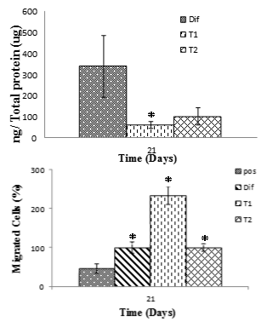
Inflammatory potential of PRP
U937
Notes:
The possible inflammatory potential of the differentiated cells was measured based on the amount of release TNFa.
In the first chart, the highest potential for evoking inflammatory was in the TGFb treated group. While the PRP groups have a lower secretion.
The second chart, The potential of the differentiated cell for evoking immune cell through secreting chemotactic factors was also determined by using migration assay on U937 cells. The 5% PRP treated group had the highest potential. The 10% FBS as a positive control had the same stimulatory potential on U937 migration as TGFb.

Slide 11
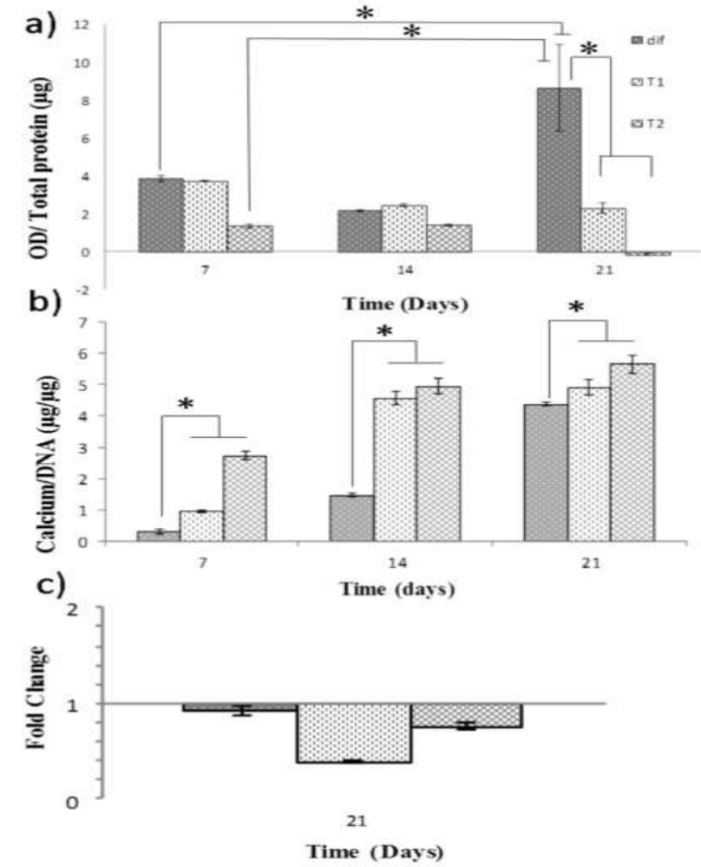
Osteogenic marker expression
ALP
activity
Calcium deposition
RUNX 2
Notes:
Under our experimental condition, ALP (Alkaline phosphatase) was expressed by all studied groups. Chondrogenic
differentiation with standard TGFβ based medium led to increasing trend on ALP activity;
while that was not observed for PRP based differentiation. On the other hand PRP
had dose dependent effect on ALP activities; the higher PRP concertation the lowest enzyme
activity (Fig.4a). Both PRP and TGFβ based differentiation led to deposition of calcium in
ECM and PRP had higher stimulatory on ECM mineralization (Fig.4b). At gene expression
level, in all studied group expressions of RUNX2 was down regulated, and 5% PRP had the
highest inhibitory effect.
So I can say that this protocol enhance ostechondral differentiation in comparison to cartilage Hyaline.

Slide 12
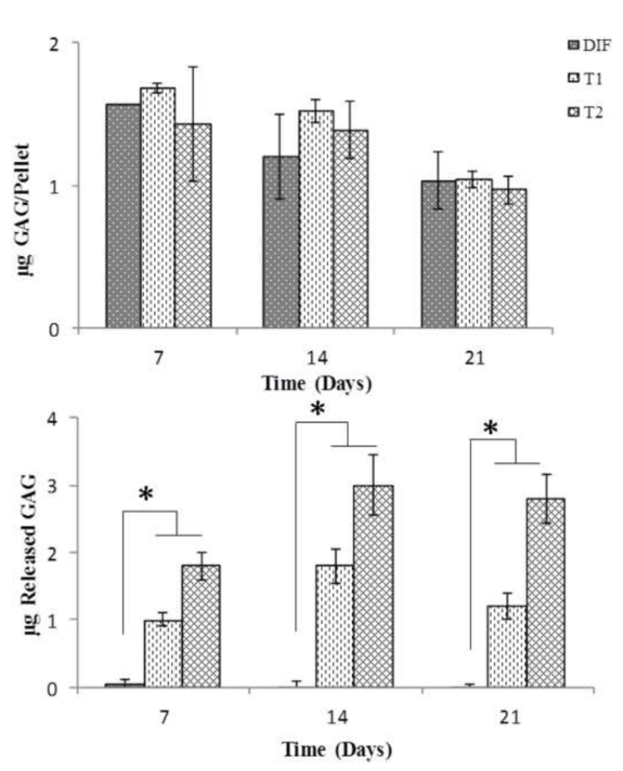
GAG Production
Notes:
The first chart, the overall gag production (the portion remained in pellets plus the fraction released in medium) in PRP based groups was higher than that of TGFβ based group (Fig.5),
But as you see in the second chart, the remarkable fraction of GAGs was released out from the pellets which treated with PRP
(Fig.5b).

Slide 13
Conclusion
PRP decrease angiogenic and inflammatory potential but did
not inhibit them.
enhanced mineralization in the matrix.
And most of GAG production released out
Notes:
It should be mentioned that although PRP significantly decreases the angiogenic and inflammatory potentials of the chondrogenically differentiated cells, but did not inhibit it completely.
On the other hand, PRP enhanced the mineralizatin in the matrix of the macro pellet neotissues.
In addition, while the GAG production was increased, the sigificant portion was released out.

Slide 14


