Slide 1
Laser Treated Metallic Probes for Cancer Treatment in MRI Systems
Thiwanka Wickramasooriya
Aravinda Kar
Raj Vaidyanathan
Advance Materials Processing and Analysis Center (AMPAC)
Department of Materials Science and Engineering
Laser-Advanced Manufacturing, Materials and Micro-Processing (LAMP) Laboratory
College of Optics and Photonics
Department of Mechanical and Aerospace Engineering
University of Central Florida
July 08, 2015

Slide 2
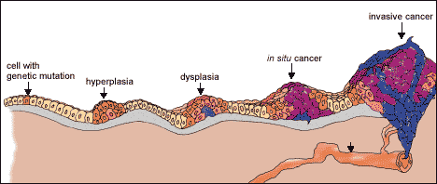
Motivation
http://science.education.nih.gov/supplements/nih1/Cancer/guide/understanding1.html
Cancer is an abnormal cell growth with potential to invade other tissues
Hyperthermia treatment is an effective mechanism to destroy cancer cells
Project goal is to develop a novel probe for hyperthermia treatment which works on radio frequency magnetic field heating

Slide 3
Hyperthermia Therapy
Hyperthermia therapy use thermal ablation to destroy cancer cells
This is a targeted cancer therapy
Needs efficient method to locate the cancer cells and an efficient and safe delivery mechanism of thermal energy
Typically involves MRI scanner and system to generate thermal energy with probes or electrodes to guide it
Available thermal systems are expensive

Slide 4
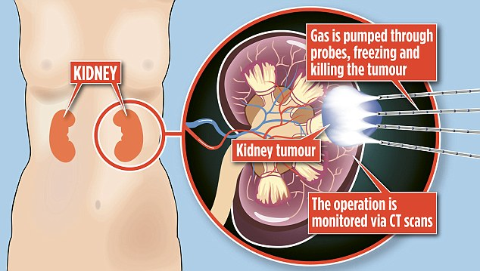
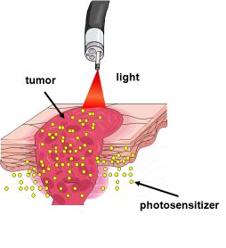
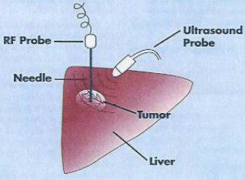
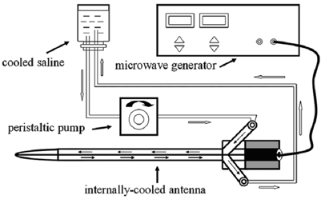
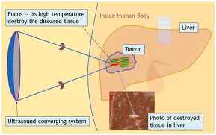
Existing methods
Currently available methods
  Cryoablation
  Laser ablation
  Microwave ablation
  High intensity focused ultrasound ablation
  Radio frequency ablation

Slide 5
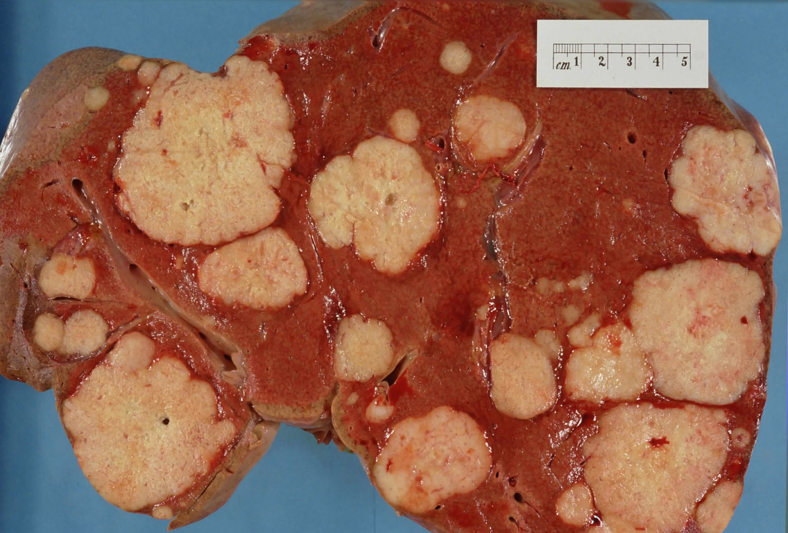
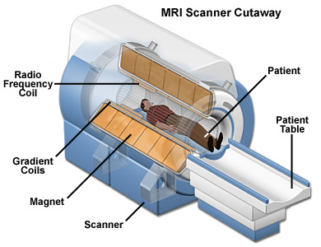
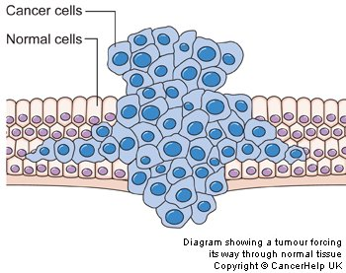
Approach
Treated wire
MRI’s RF magnetic field induces eddy currents in metallic implants
Eddy currents heats up the probe destroying cancer cells
Energy absorbed by the wire depends on its geometry
Project goal is to reduce heating of the probe in healthy tissues
Tumor
Untreated wire
Healthy tissue
RF Magnetic field from MRI scanner
Treated region for reduced magnetic heating
Heated region destroying cancer cells
Heated probe due to induced currents

Slide 6
Advantages
A metallic probe is developed using inexpensive existing medical grade MP35N wire
Thermal energy is generated by RF magnetic field from MRI scanner eliminating the separate thermal system
Adjacent tissue damage is minimized
The probe is inexpensive, customizable accordingly with patient requirement and simple in design

Slide 7
Technology (US Patent 8644951)
reflected field
incident field
modified surface for reduced RF interaction
surface eddy currents
conductor made of medical grade material
(MP35N)
Diffusing noble metals on the wire surface (Au, Pt, Ag) increases reflectivity thereby reducing amount of energy absorbed by conductor
Noble metals are biocompatible and their conductivity is much higher than MP35N

Slide 8
Wire Surface Modification Process
Electro Cleaning
  Precursor deposition
  Thin coating provides reservoir of dopant atoms
  Diffusion of impurities is minimal
Electro Plating
  Higher diffused atom concentration
  Fast and clean process
  Minimal change in bulk
Laser Heat Treatment

Slide 9
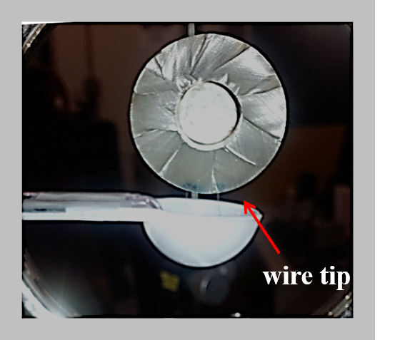
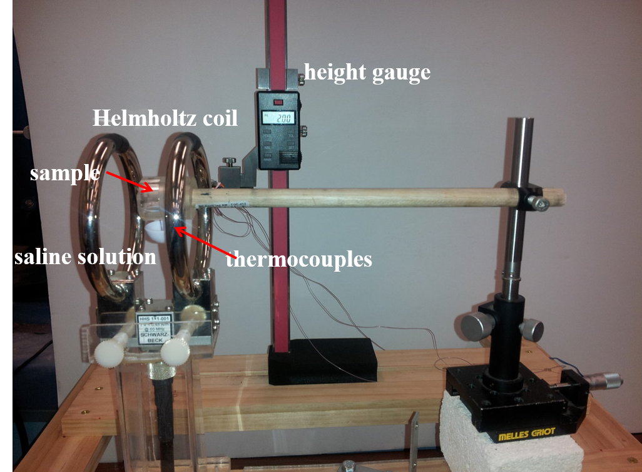
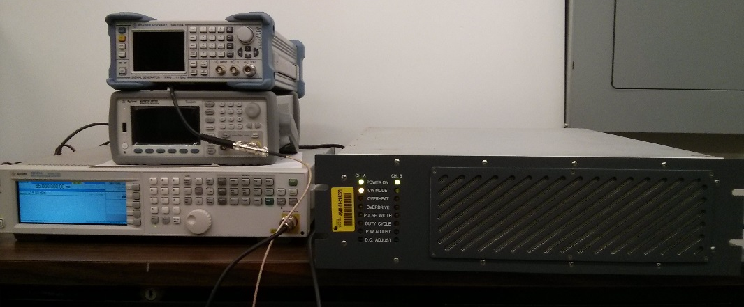
Helmholtz Coil Tests
Samples are tested at a frequency 65 MHz and 19.7 μT field strength
signal generator unit
RF Amplifier

Slide 10
Heating Reduction in Au Electroplated and Laser Treated Samples
Heating reduction (%)
-9.2
-8.7
-11.5
-14.3
-14.9
-14.9
-15.5
-14.1
Temperature rise (°C)

Slide 11
Heating Reduction in Pt Electroplated and Laser Treated Samples
Heating reduction (%)
-30.3
-29
-29.3
-32.4
-34.5
-45.8
-45.5
Temperature rise (°C)

Slide 12
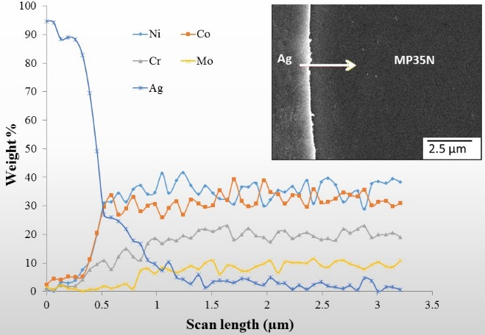
Current Density Distribution along wire Cross Section
electroplated region
Concentration of diffused Au is estimated as
$$C\left[\left(r_{w} −r\right), t\right]=1 −erf\left[\frac{(r_{w}−r)}{2\sqrt{Dt}}\right]$$
$$t= \frac{2r}{u}$$
$$r_{W}$$
Diffused region
$$r_{0}$$
Diffusion coefficient is estimated by curve fitting the EDS data
MP35 N
Magnetic field strength variation within the wire cross section
$$H={(1−γ)H}_{0}e^{−α\left(r_{0}−r\right)}$$
δ is the skin depth given as
$δ=\frac{1}{α}= \sqrt{\frac{2}{ωσμ}}$
Generated e.m.f at distance $r$
$$e_{r}=−A_{l}μ\frac{dH}{dt}$$
D = 5×10⁻¹³ (m²/s)
Current density at distance $r$
$$J_{r}= \frac{σ_{r}e_{r}}{l_{l}}=−A_{l}μ(1−γ)H_{0}ω \cos\left(ωt\right)e^{−α\left(r_{0}−r\right)}\frac{σ_{r}}{l_{l}}$$

Slide 13
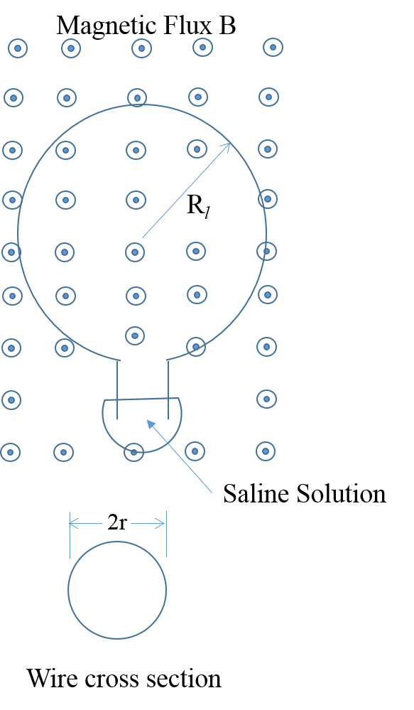
Model for Saline Heating in RF Magnetic Field
Now the conductivity of diffused region is
$$σ_{D}= ρ_{D}\left[\frac{C_{Au}σ_{Au}}{ρ_{Au}}+ \left(\frac{1}{ρ_{D}} − \frac{C_{Au}}{ρ_{Au}}\right)σ_{MP 35N}\right]$$
Au plated MP35N
Current density (A/m²)
Au plated laser treated MP35N
Radial distance from surface (µm)
Total current flow through saline solution
$$I=\int_{0}^{r_{0}}{A_{l}μ\left(1−γ\right)H_{0}ω \cos\left(ωt\right)e^{−α\left(r_{0}−r\right)}\frac{σ_{r}}{l_{l}}∙2πrdr}$$
Pt
Au
Temperature rise ΔT (°C)
Total heat generation
$$Q={\left(I_{rms}\right)}^{2}R_{eq}$$
Electroplate layer thickness (µm)

Slide 14
Comparison between Calculated and Experimental Values

Slide 15
Conclusions
Theory predicts reduced heating in RF magnetic fields in metals when noble metals such as Pt and Au present in surface layer
Laser assisted diffusion of Pt, Au electroplated samples effective way to fabricate such material without affecting baseline/bulk materials properties
Pt and Au doped MP35N shows reduced heating (up to 45%) in RF magnetic fields both in wire and lead forms
Reasonable agreement between theory and experiment

Slide 16
Thank You

