Slide 1
About Omics Group
OMICS Group International through its Open Access Initiative is committed to make genuine and reliable contributions to the scientific community. OMICS Group hosts over 400 leading-edge peer reviewed Open Access Journals and organize over 300 International Conferences annually all over the world. OMICS Publishing Group journals have over 3 million readers and the fame and success of the same can be attributed to the strong editorial board which contains over 30000 eminent personalities that ensure a rapid, quality and quick review process.

Slide 2
About Omics Group conferences
OMICS Group signed an agreement with more than 1000 International Societies to make healthcare information Open Access. OMICS Group Conferences make the perfect platform for global networking as it brings together renowned speakers and scientists across the globe to a most exciting and memorable scientific event filled with much enlightening interactive sessions, world class exhibitions and poster presentations
Omics group has organised 500 conferences, workshops and national symposium across the major cities including SanFrancisco,Omaha,Orlado,Rayleigh,SantaClara,Chicago,Philadelphia,Unitedkingdom,Baltimore,SanAntanio,Dubai,Hyderabad,Bangaluru and Mumbai.

Slide 3

Force Induced Regulation of Epigenetic State in Cancer Cells
Arash Tajik
University of Illinois at Urbana-Champaign
Notes:
Many thanks for attending my talk today.

Slide 4
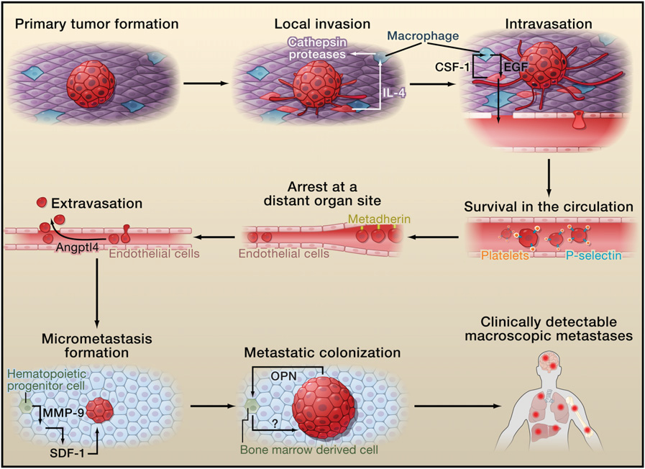
Metastatic colonization is a rare event: ~1 in 10,000
heterogeneous cancer cell population
Valastyan and Weinberg, Cell 2011
Notes:
When the tumor is formed after some time a sub-population of the cells will invade the surrounding tissue. They eventually find their way to enter the circulation, extravasate into a distant organ and form the metastatic colony. This process is a very rare event and only 1:10,000 circulating cancer cells can lead to the formation of metastatic colony and clinically detectable secondary tumor.

Slide 5
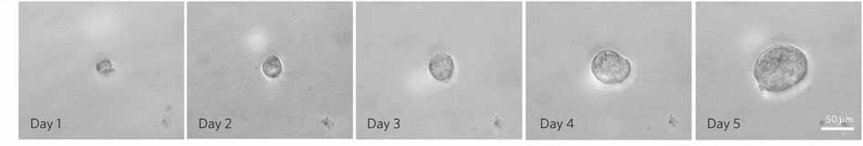
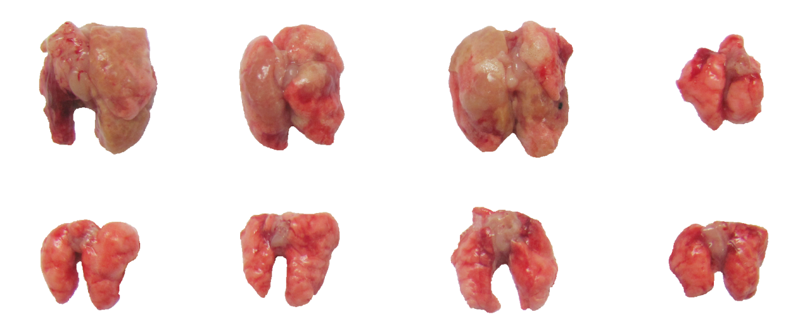
Soft Fibrin Matrix Promotes Growth of Tumorigenic Cells
3D Fibrin
Tumor Repopulating Cells (TRC)
3D Fibrin
(10-100 cells)
Control
(10,000-100,000 cells)
Liu & Tan et al, Nature Mat, 2012
Notes:
A couple of years ago our group showed that When we plated single B16 melanoma cells in soft fibrin matrices of about 90 Pa stiffness, 10% of the cells survive and lead to the formation of spheroid colonies. Now if we isolated these cells on day 5and injected them in tail vain of mouse, only 10 of these cells could generate metastatic tumor in lung. Whereas when control cells which are normally cultured on very stiff plastic culture dish were injected, at lease 10-100K cells were needed to form tumor. So we showed that by just changing the mechanical properties of the surrounding matrix we can change the tumorigenc properties of cancer cells and increased the chance of metastatic colony formation.
because only a few of such cells were needed to form a tumor we called them tumor repupulating cells orTRC in brief.

Slide 6
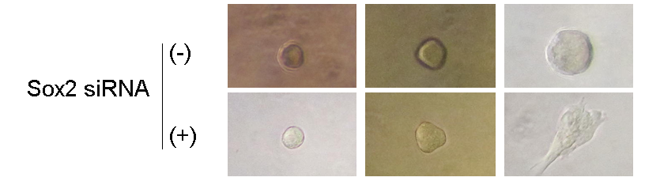
TRCs are progenitor of control melanoma cells
*
*
*
Sox2
Control
TRC
Relative expression
*
Relative expression
*
Sox2
Mitf
Control
TRC
1 day
3 days
5 days
7 days
Mitf: a melanin-related gene
Sox2: a self-renewal marker
Liu & Tan et al, Nature Mat, 2012
Notes:
When checked the gene experssion TRC, we realized that there is a self-renewal gene, Sox2 is over expressed in TRCs. Also, I should mention that if you plate TRCs back on plastic dish they will lose their tumorignic properties after about 7 days.

Slide 7
TRC & control melanoma cells are genetically identical
Control Melanoma Cells
No Sox2
High Mitf
2D Plastic
Matrix Stiffening
Matrix Softening
Tumor Repopulating Cells
High Sox2
Low Mitf
3D Fibrin
Notes:
Thank you Dr Wang
So, we asked the question that what the mechanism is and how does changing the mechanical properties of the microenvironemt affects gene expression. These are the same cells that are plated back and forth on plastic or in soft Fibrin matrix and they are essentially genetically identical.
So, we hypothesized that there might be epigenetic mechanisms that are regulating the gene expression

Slide 8
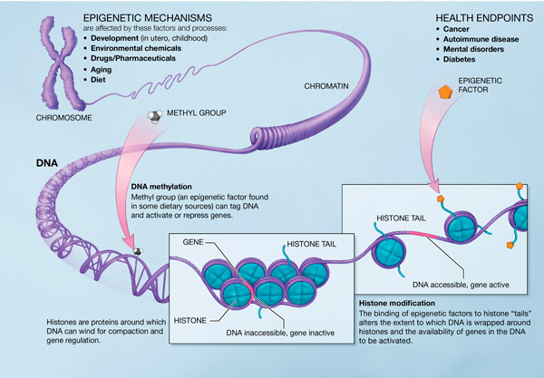
harvard.edu NIH Roadmap
Notes:
If you stretch the human DNA it is about 2 meters long, that’s about a few inches taller than I am. And yet it is compacted in the cell nucleus which is about 10um in diameter. The way that DNA is compacted inside the nucleus is tightly regulated by epigenetic mechanisms and in turn affects how genes are being expressed.
There area few mechanism of epigenetic regulation; but I am gonna focus on histone modifications….
As you can see here, the DNA is wrapped around protein complexes called histones to form a bead-on-string structure. The extent to which DNA is wrapped around histones regulated the gene expression.If the DNA is accessible then it can be expressed, and if it is tightly condensed then the gene is silences.

Slide 9

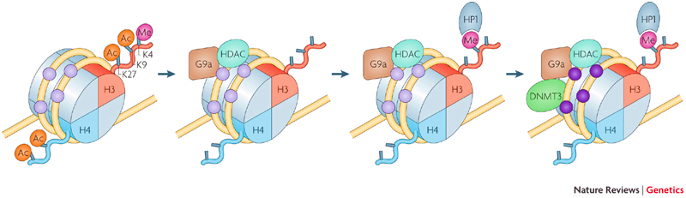
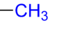
Histone Modification
Ac
Me
Modification | H3K4 | H3K9 | H3K27
mono-methylation | Activation | Activation | Activation
di-methylation |  | Repression | Repression
tri-methylation | Activation | Repression | Repression
acetylation |  | Activation
Modified from Cedar & Bergman, Nature Reviews Genetics, 2009
Notes:
There are different mechanisms of epigenetic modification like DNA methylation, histone modification, and chromatin organization. Here we focused on Histone modification.
DNA wraps around a protein complex called histones. Two of the histones in this complex have tails that is a few amino acids long. These residues can be modified by the addition of methyl or acetyl groups. And depending on the type of modification, that part of the genome can be made accesssible for expression or inaccessible.
For example when the lysine 9 on Histone H3 is mono-methylated the gene is activated. However, when two or three methyl groups are added the gene is silences and the same procedure is important for H3K27.

Slide 10
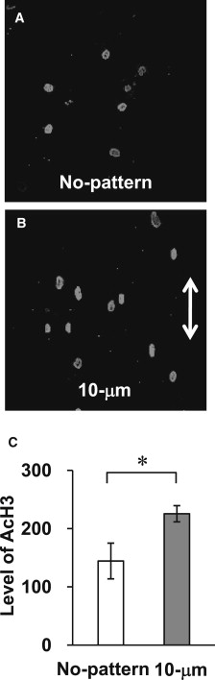
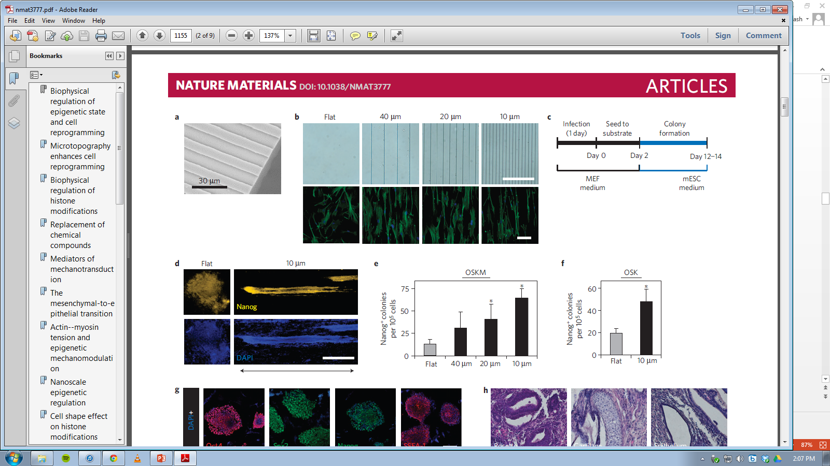
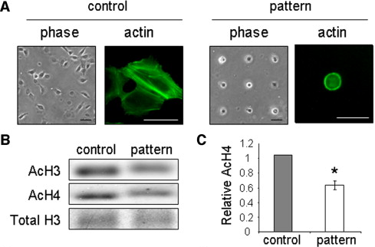
Mechanotransduction & Histone Acetylation
Le Beyec et al, Exp Cell Res, 2007
Li et al, Biophysical Journal, 2011
Downing et al, Nat Mat, 2013
Notes:
Two groups have previously shown the effect of mechanotransduction on histone acetylation. Mina Bissell’s group has shown that when cells are cultured on patterned islands, the global acetylaton of H4 is lowered as compared to cells cultured on plastic.
Song Li’s group has shown culting cells on micro grooves can increase the level of acetylation in H3 by stretching of the nucleus. They further showed that using these microgrroves the efficency of iPS formation can be increased through the modification of the histone acetylation level.
In our studies however we mainly focused on H3K9 mehtylation.

Slide 11

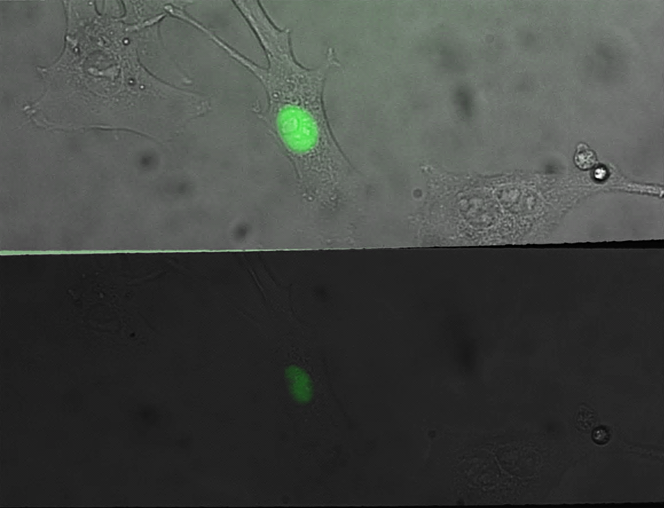
H3K9-me FRET Reporter
476 nm
Methylation
NLS
FRET
CFP
Demethylation
YPet
CFP
NLS
433 nm
433 nm
527 nm
K9
YPet
K9
Me
Cedar & Bergman, Nature Reviews Genetics, 2009
HP1 Methylysine-binding
domain
Adapted from Lin et al, JACS, 2004
Histone H3 Peptide
Overlay
YPet/CFP
2
1
0
Notes:
In order to measure H3K9 methylation in live cells we used a FRET probe that was originally developed in Alice Ting labs and we modified it for our application in collaboration Peter’s lab.
The probe contains a methylbinding domain of HP1 protein and the H3 tail domain that contains K9. When K9 is methylated, the HP1 domain will recognize and bind to it. When we excite CFP there will be energy transfer and Ypet emission nwill go up. And when it is demethylated the two fluorescent pairs are far away from each other and the ratio is gonna be low.
So as you an see here when we transfgect the cells with the probe the localize in the nucleus and we looked at the ratio of Ypet/CFP as an indicator of methylation level. The higher the ratio the higher theH3K9 methylation

Slide 12
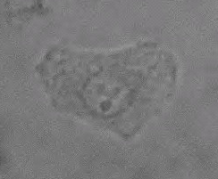
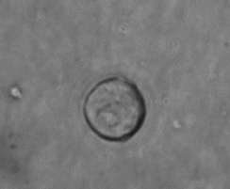
Cells in 3D Fibrin Gel have lower H3K9-me
*
2D Plastic
2D Plastic
3D Fibrin
ChIP assay at Sox2 Promoter
3D Fibrin (90 Pa)
*
Fold change in H3K9me
3D Fibrin
Notes:
So lets see how we used the probe to quanifiy the level of H3K9 methylation in response to mechanical stimuli.
If we transfect the cells with the FRET probe and plate them in soft fibrin matrix, as you can see, within three hours the methylation level is reduced and remains the same for the next 48 hours.
The H3K9 methylation was also validated by ChIP assay at Sox2 promoter, where we showed that demethylation of both di- and tri-methylation of H3K9 takes place in tumor repopulating cells.
Normally the plastic is coated with collagen or gelatin when we culture the cells. In order to see whether the changes in h3k9 methylation are due to matrix stiffness or the ECM molecule we plated the cells on different

Slide 13
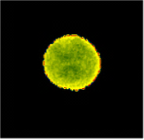


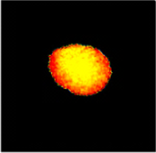




Substrate stiffness regulates H3K9-me in control melanoma cells
0.15 kPa
0.6 kPa
2 kPa
8 kPa
2
Fibrin(ogen)
0.15 kPa
1.6
0.6 kPa
18
8 kPa
360 Pa
Collagen
1
0
0
0
Fibrin(ogen)
Collagen
0.15 kPa
100
0.6 kPa
360
8 kPa
360 Pa
0
0
0
0
***
**
***
**
***
*
***
**
**
***
* **
Notes:
In order to see whether the changes in h3k9 methylation are due to matrix stiffness or the ECM molecule we plated the cells on different PA gels coated with either collagen or fibrinogen.
And as you can see here only cells plated on collagen respond to matrix stiffening.
As you can see here 8kPa collagen coated gel has the highest level of methylation compared to the softer substrates, which is also a good represnetain of the plastic plate culture that is normally coated with gelatin..however, ibrinogen coated gels, didn’t respond to substrate stiffening.
When we looked at how much traction forces cells are applying to the substrate, as you can see as we increase matrix stiffness, cells pull much harder on the collagen coated substrate as compared to fibrinogen coated substrates were the traction values wouldn’t increase as much….So endogenous forces can be a key factor in modifiation o histone H3K9 on collagen matrix.

Slide 14
TRCs do not respond to substrate stiffness
0.15 kPa
0.6 kPa
2 kPa
8 kPa
TRC
Collagen
2
1
Fibrin(ogen)
0
TRC
Liu & Tan et al, Nature Mat, 2012
Notes:
However, in the case of TRCs, cells don’t respond to substrate stiffness, regardless of matrix stiffness or the ECM molecule and methylation remains very low.
If we compare the tractions of control cells vs TRC on collagen coated gels, they roughly exert the same amount of force. But what is it that in TRCs these forces do not increase methylation of H3K9?
If you look at the cell stiffening response on differnet substrates, TRCs donot stiffen, meaning that the CSK which gives the cell their stiffness is remolded in TRCs. Also, our collaborators have recently shown that TRCs do not form actin bundles. therefore although there is forces generated, because there is no elements transfer the load, therefore, there is no changes in methylation takes place.
The drawback with substrate rigidity experiments is that while we change the matrix stiffness both traction forces and cystoskeleton organization is changed. They are coupled together.

Slide 15
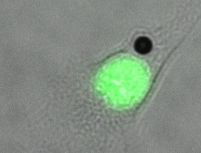
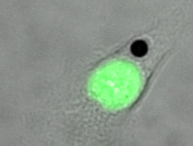
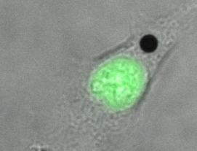
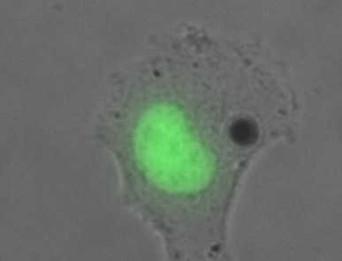
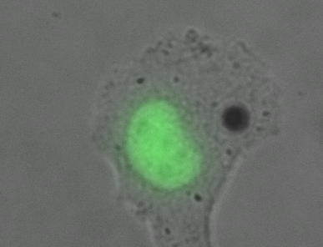
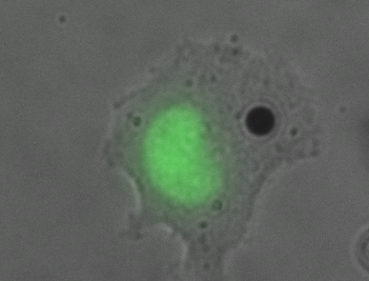
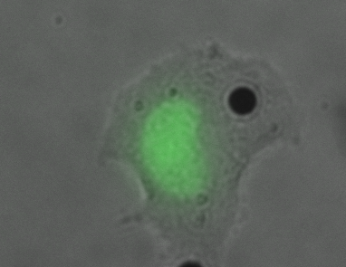
Exogenous forces regulate H3K9-me
+ Stress
0 min
10 min
30 min
60 min
Control
0 min
10 min
30 min
60 min
1.8
Fibrinogen Coated Glass
0
+ Stress
0 min
10 min
30 min
60 min
*
TRC
+24.5 Pa Stress
0 min
10 min
30 min
60 min
1.8
0
Notes:
In order to decouple the effect of the force from cytoskeleton organization, we used a MTC experiment.
Here we cultured the cells on a rigid substate coated with fibrinogen were we had already shown that the methylation level remains low. Then we bind a ferromagnetic bead to the apical surface of the cell and pulled on the cell surface to apply to forces. In this scenario, the cytoskeleton is intact and we only change the force.
So we applied sinosoidal forces to the cells for about an hour. As you can see here we have the cell, the black dot is the magnetic bead, and the green fluorescence is the FRET probe. When we applied the force to control melanoma cells, the methlation starts to increase after 30 minutes. Interestingly the increase in methylation is initiated at the nuclear perphery which is also consistant with the previous finding that the heterochormatin which is rich is H3K9 methylation resides in nuclear periphery.
If we do the same experiment on TRCs, again forces do not increase methylation because the elements to transfrer the load are not there.
And this is how we quantified these data. Where you can clearly see that the contorl cells do respond to exogenous forces.

Slide 16
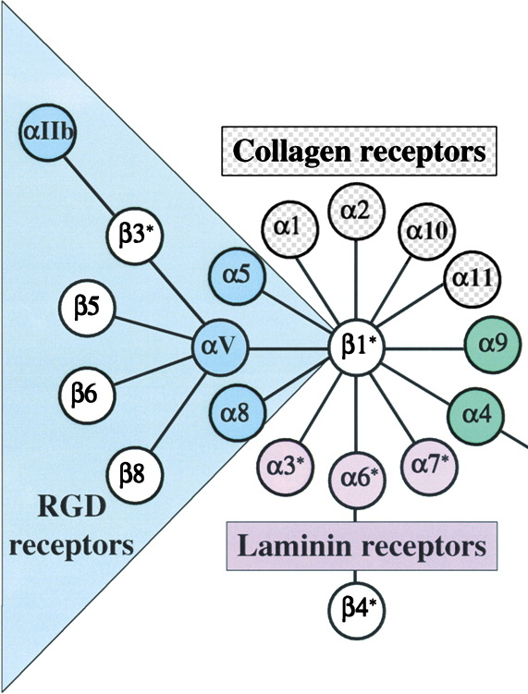
Blocking β1 integrin inhibits force induced H3K9-me in control melanoma cells
*
+24.5 Pa Stress
24.5 Pa
17.5 Pa
12.3 Pa
*
Hynes, Cell, 2002
Notes:
I need to mention that when we bind the beads to the cells, they are coated with RGD peptide that binds to specific integrins which are the receptors on the cell surface.
RGD, as you can see can bind to a variety of integrins. Some of them are shared with collagen and some are shared with fibrinogen. In order to decouple the effect of integrin subtypes, while we used RGD beads to apply to load, we blocked beta1 integrins. And as you can see here the force response was hindered. This is consistent with our previous finding on the fact that cells only when plated on collagen which interacts with beta 1 family of integrins respond to matrix stiffening. Were as fibrin matrix which mainly binds to alphaVbeta3 integrins has no effect on matrix induced histone methylation.
Also, when we used PLL coated beads which bind non-specifically to the cell surface, they induce no methylation.
In addition, the amplitude of force is also inportant and when we lower the force level, the force induced methylation is again abolished. Which means not only we need force, but the forces have to be above a certain threshold.

Slide 17
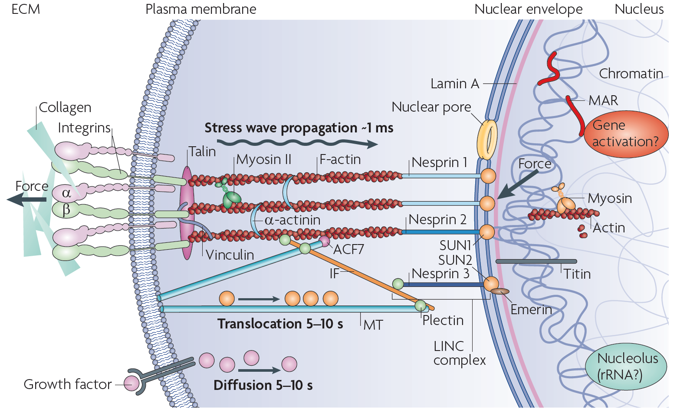
H3K9-me level depends on intact CSK
***
***
***
8kPa Collagen I
**
**
Wang et al, Nature Reviews Molecular Cell Biology, 2009
Notes:
As I mentioned before, we hypothesized that we need intact cytoskeleton to transfer loads to the nucleus.
When we disrupted cytoskeletal filaments like tubulin, myosin II and actin filaments using different pharmacological drugs, no load was transferred to the nucleus and histone methylation level was lowered within 20 minutes of drug incubation.

Slide 18



Force-induced H3K9-me depends on methyltransferases
Control Cells
TRC
SUV39h1
G9a
SUV39h1
GAPDH
Adapted from Cedar & Bergman, Nature Reviews Genetics, 2009
***
*
***
8kPa Collagen I
+24.5 Pa Stress
Notes:
There are some enzymes that induce methylation of histone H3K9, which are called methyltansferases. the most important ones are G9a and SUV39h1. G9a us reponsible for mono- and di-methylation and SUV39h1 is responsible for di- and tri-methylation. When we knockdown these methyltransferases through RNA interference, the force-induced methylation is prevented by both endogenous and exogenous forces.
With that I’d like to give the podium to dr wang for closing remarks.

Slide 19
Soft matrix-mediated H3K9 demethylation and Sox2 expression
Soft Fibrin Matrix
Fibrin Matrix
Integrins
CSK Softening
Plasma Membrane
CSK Elements
H3K9 demethylation
at Sox2 Promoter
Nuclear Membrane
Nuclear Lamina
Chromatin
Histone
Histones
Sox2 Expression
Nucleus
Tajik, Tan, Chen et al, Nature Comm, 4, 2014
Self-Renewal

Slide 20



Acknowledgment
Ning Wang’s Group (UIUC)
  Dr Youhua Tan
  Dr Jihye Seong
  Dr Farhan Chowdhury
  Dr YC Poh
  Rishi Singh
Peter Wang’s Group (UIUC, UCSD)
  Dr Li-Jung Lin
  Dr Jihye Seong
  Dr Jie Sun
Huazhong University of Science and Technology, China
  Junwei Chen
  Qiong Jia

Slide 21
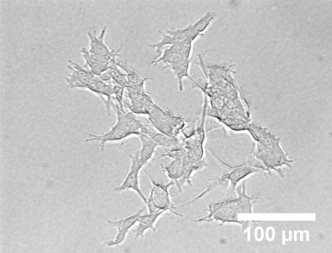
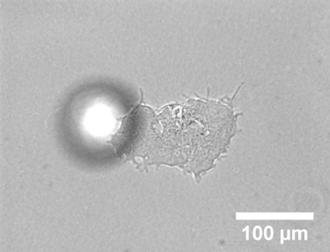
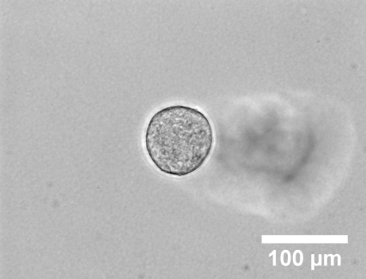
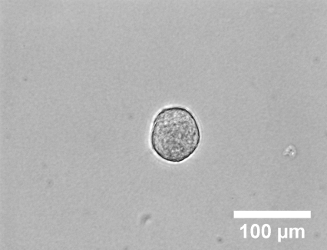
3D matrix stiffness not porosity dictates colony formation
Spread colony near rigid bottom
Round colony far away from rigid bottom
a
c
b
c
d
z=5 µm
z=22 µm
z=192 µm
z=486 µm
z: distance from the rigid bottom

Slide 22
Cytoskeleton-dependent H3K9 demethylation/methylation and Sox2 expression
Soft Fibrin Matrix
Soft Fibrin Matrix
Integrins
Plasma Membrane
CSK Softening
Mechanotransduction
CSK Elements
Nuclear Membrane
H3K9 demethylation
at Sox2 Promoter
Nuclear Lamina
Chromatin
Histone
Nucleus
Sox2 Expression
Self-Renewal

Slide 23
H3K9 demethylation mediates Sox2 dependent self-renewal of TRCs

Slide 24
H3K9 methylation of TRCs on rigid plastic takes 48 hrs
*
TRC
*

Slide 25
β-1 integrin mediated force-dependent H3K9 methylation
+Stress

Slide 26
Adding soluble fibrinogen does not change colony growth
Notes:
Fig. S23 Additional soluble fibrinogen does not affect colony growth in soft fibrin gels. Control melanoma cells were cultured in 90-Pa fibrin gels. After 1 day, appropriate amount of soluble fibrinogen was added into the culture medium to make the total amount of fibrinogen equivalent to that of 1050-Pa fibrin gels. Colony number was counted and colony size was monitored from day 1 through day 5. “Control” and “Control + fibrinogen” represent control melanoma cells cultured in 90-Pa fibrin gels in the absence and presence of soluble fibrinogen, respectively.

Slide 27
*
*
0 min
20 min
+25 µM ML7

Slide 28
Let Us Meet Again
We welcome all to our future group conferences of Omics group international
Please visit:
www.omicsgroup.com
www.Conferenceseries.com
http://optics.conferenceseries.com/

