Slide 1
Future telecomsats as a new paradigm for satellite industries and operators
Antonio G. Accettura, Ph.D.
OHB System, Germany
International Conference and Exhibition on Satellites
August 19, 2015 - Houston, TX, USA
Notes:
Cover Page
OHB System AG SmallGEO Product Line Presentation

Slide 2
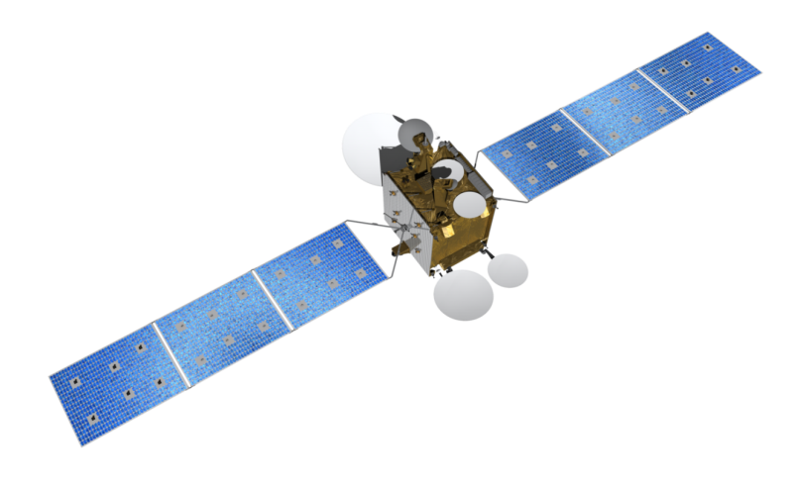
Content
Future telecomsats as a new paradigm for satellite industries and operators
  An overview of OHB
  The vision behind SmallGEO
  A brief history of the first steps
  The Electra new paradigm
  Current Missions
  Roadmap
  Conclusions
Notes:
Contents
Neues Bild mit MTG als Ergänzung (CB)

Slide 3
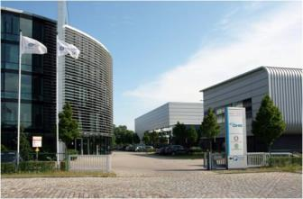
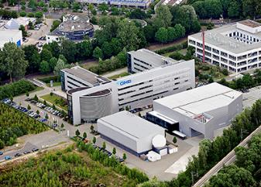
An overview of OHB
Visionary. European.
The European solution for small geostationary telecommunication satellites: SmallGEO
OHB System AG as European leader in small electric propulsion satellites
OHB SE is Germany‘s first listed technology and aerospace group
Approx 2,000 employees stationed around Europe
Two specified system branches deliver sophisticated, custom-made technology and systems to international customers
    Space Systems
    Design and development as well as implementation of space projects
    Aerospace + Industrial Products
    Product manufacturing for aerospace and telematics.
Notes:
The Vision
The starting point was the identification of a European capability and availability gap in relatively small geostationary satellite platforms.

Slide 4
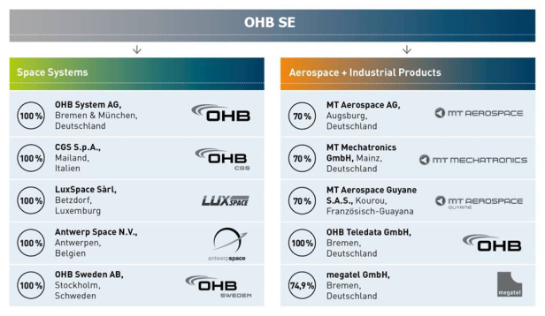
United under one roof
An overview of OHB
The value chain of the two specified system branches Space Systems and
Aerospace + Industrial Products of OHB AG includes:
Satellite design, construction
and operation
Data transmission and
processing
Design, development and
construction of scientific
payloads
Structures for aerospace
applications.
In Sept. 2014 we merged with Kayser-Threde GmbH
Notes:
The Vision
The starting point was the identification of a European capability and availability gap in relatively small geostationary satellite platforms.

Slide 5
OHB as a business model
OHB is one of the most interesting space industries operating in Europe, with many projects ongoing. Why this model could be considerate successful?
Several factors contributed:
1. Full capabilities to master all system activities associated to a satellite life: from development to design, from manufacturing to integration, from launch to operations.
2. Lean organization to achieve agility and react quickly.
3. System-oriented teams, because each satellite is a core business and the system mindset is a driver.
4. Strong Procurement Management organization: 75% activity subcontracted. Procurement is a strategic distinctive factor.
5. The most important asset are people: more than 25 Countries worldwide are represented supporting the international mindset we developed along the years.
The European solution for small geostationary telecommunication satellites: SmallGEO
OHB System AG as European leader in small electric propulsion satellites
Notes:
The Vision
The starting point was the identification of a European capability and availability gap in relatively small geostationary satellite platforms.

Slide 6
Current Projects
OHB-System design, manufacture, integrate, test and operate satellites (platform and payload).
Current Projects Overview
Since the SarLupe small constellation (6 sats), many objectives have been achieved and several projects are ongoing. Just if we consider OHB-System the following satellites are under development or under a manufacturing phase, as platform or satellite prime contractor:
  ExoMars 2016
  Hispasat AG1
  Galileo FOC (22 sats)
  EDRS-C
  MTG (6 sates)
  ExoMars 2018
  EnMap
  Heinrich Hertz
  SARah (3 sats)
  Electra
To the above list it should be added the huge amount of pre-development studies and ongoing bids.
The European solution for small geostationary telecommunication satellites: SmallGEO
OHB System AG as European leader in small electric propulsion satellites
Notes:
The Vision
The starting point was the identification of a European capability and availability gap in relatively small geostationary satellite platforms.

Slide 7

Progression of project portfolio (selection)
Current Projects
SARah 2013-2031
EDRS-C 2011-2016
MTG 2010-2028
The European solution for small geostationary telecommunication satellites: SmallGEO
OHB System AG as European leader in small electric propulsion satellites
Galileo 2010-2016
EnMAP 2008-2018
Hispasat AG 1 2008-2015
TET- 1 2008-2012
Columbus 2002-2008
SAR Lupe 2001-2017
ABRIXAS 1999-2009
PKE 1997 -2018
SOFIA 1996-2014 ff
MITA 1995 -2000
RUBIN 1-9 1994-1999
D2-Mission 92
MIR-Mission 92
SAFIR I & II
1988 -1993
D1-Mission 1985
Texus / Maxus Missions since 1977
1985
1990
1995
2000
2005
2010
2015
2020
Notes:
The Vision
The starting point was the identification of a European capability and availability gap in relatively small geostationary satellite platforms.

Slide 8
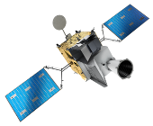


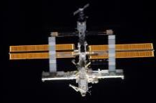
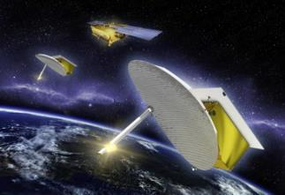
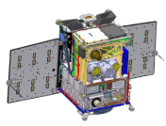

Current Projects
Scope of activities
Navigation
Tele-
communications
Galileo
Earth Observation
Exploration / Science
HISPASAT / Heinrich Herzt / Electra
CarbonSat / EnMAP / MTG
ExoMars / Euclid / JUICE /
PLATO / XMM-Newton /
Herschel-PACS / ROSETTA
Security
Manned
SAR Lupe / SARah / Athene
Spaceflight
Technology
International Space Station /
DC4EU
Robotics / TET /
Precision clocks /
Fibre optics
Notes:
The Vision
The starting point was the identification of a European capability and availability gap in relatively small geostationary satellite platforms.

Slide 9
The vision behind SmallGEO
The European solution for small geostationary telecommunication satellites: SmallGEO
OHB System AG as European leader in small electric propulsion satellites
Notes:
The Vision
The starting point was the identification of a European capability and availability gap in relatively small geostationary satellite platforms.

Slide 10
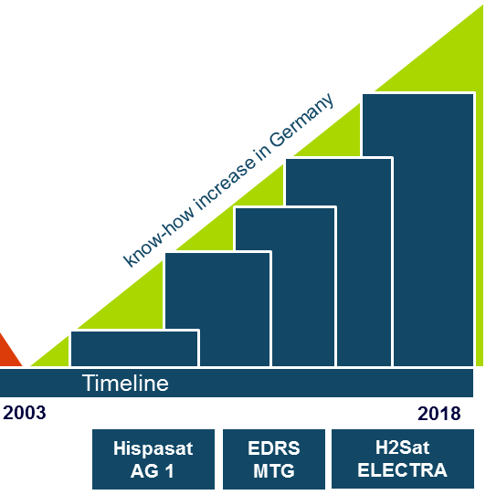
History of the first steps
A brief history of the first steps
The aims of the owner
  Revitalize the capability to build geostationary satellites in Germany
  Place OHB System AG in the market segment for small geostationary satellites
The initial steps
  Until 2006: Pre-development with company funding and support of DLR (German Space Agency)
  Since 2006: Start of the development of SmallGEO platform in ESA Artes 11 program
Use of SmallGEO for major European missions
  Telecommunication
  Earth observation
Notes:
In 1992 the last German geostationary satellite DFS Kopernikus was launched. Since then no further system and mission prime activities have been performed in Germany. OHB System AG is stepwise reactivating the relevant know-how in Germany.

Slide 11
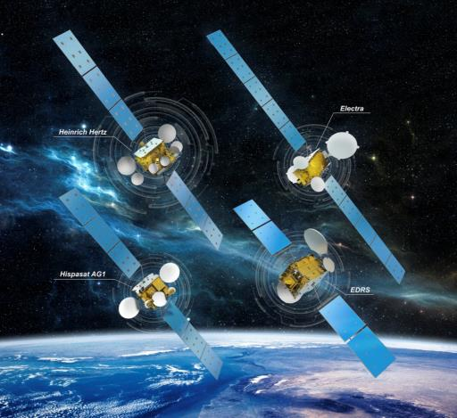
SmallGEO product line
The Electra new paradigm
OHB System AG geostationary satellite solution
  Designed for geostationary satellites with a launching mass of 2 to 4 tons
  Capability to provide end-to-end solutions for satellite telecommunications
Flexibility
  Different configurations to serve individual customer/mission demands
  SmallGEO platform adaptable for other applications (Earth observation, optical communications)
Status
  Ten satellites in preparation at OHB

Slide 12
SmallGEO configurations
The Electra new paradigm
Classical solution (SmallGEO Fast Classical)
  All maneuvers with chemical propulsion
    proven and simple system with long heritage
Hybrid solution (SmallGEO Fast Hybrid)
  Station keeping with electric propulsion
    Increase payload performance by adding additonal propulsion system
Full EP solution (SmallGEO Flex)
  All maneuvers (including transfer) with electric propulsion
    High propellant saving with transfer time of up to 200 days
Time is Money
Fast transfer
Performance is Money
Flexible transfer Min: Direct Injection Max: LEO

Slide 13
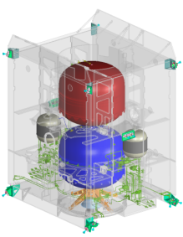
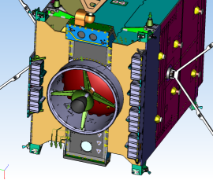
SmallGEO Fast - Classical -
The Electra new paradigm
Mission
Launchers | Ariane 5, Soyuz/Fregat (GSC), Falcon 9, Proton, Atlas V, Zenith (SL/SLB)
Dual launch | Upper position
Transfer | 10 d
  Based on chemical propulsion
  (“small” size payload configuration)
  Classical approach: Launcher delivers satellite in Geostationary Transfer Orbit (GTO)
  Satellite with apogee engine (chemical propulsion) to perform the transfer to GEO
  Station keeping based on chemical propulsion
Payload
TPE‘s | Up to 32
Mass | Up to 300 kg
Power EOL | Up to 4 kW (5,4 kW)
Satellite
Launch Mass | Up to 3400 kg
Propulsion System | Station keeping: chemical Transfer: chemical

Slide 14

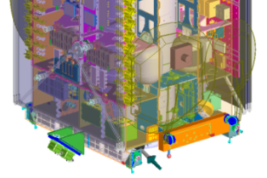
SmallGEO Fast - Hybrid -
The Electra new paradigm
Mission
Launchers | Ariane 5, Soyuz/Fregat (GSC), Falcon 9, Proton, Atlas V, Zenith (SL/SLB)
Dual launch | Upper position
Transfer | 10 d
Based on hybrid propulsion system
(“large” size payload configuration)
  Launcher delivers satellite in GTO
  Satellite with apogee engine (chemical propulsion) to perform the transfer to GEO
  E/W station keeping based on chemical propulsion
  Contingency & Desaturation based on chemical propulsion
  N/S Station-keeping based on electric propulsion
Payload
TPE‘s | Up to 40
Mass | Up to 400 kg
Power EOL | Up to 3,6 kW (5 kW)
Satellite
Launch Mass | Up to 3400 kg
Propulsion System | Station keeping: electric Transfer: chemical

Slide 15
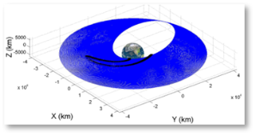
SmallGEO Flex
The Electra new paradigm
Mission
Launchers | Ariane 5, Soyuz/Fregat (GSC), Falcon 9, Proton, Atlas V, Zenith (SL/SLB)
Design Goal | Cyclone 4, GSLV – MKII, Soyuz Baikonur
Dual launch | Lower and upper position
Transfer | 10 d to 200 d
Performance
  Payload capacity of medium size classical satellite (would need 5 to 6 t launch mass) with 2 to 3 t launch mass
Flexibility for customer
  Trade of mass vs. transfer time and propellant lifetime
Higher mission margins
  Deal: higher launch mass vs. longer transfer time
    more robust to late changes, mass increase might be covered via transfer time
  E.g. launcher injection fault -> Artemis scenario
Launcher compatibility
  Compatible with wide range of todays GTO launchers
  Potential for future low cost launchers (e.g. GSLV or Cyclone)
Propellant lifetime opportunity
  Propellant lifetime of 20 years and beyond
Payload
TPE‘s | Up to 64 (72)
Mass | Up to 700 kg
Power EOL | Up to 7 kW
Satellite
Launch Mass | Up to 3200 kg
Propulsion System | Full electric

Slide 16

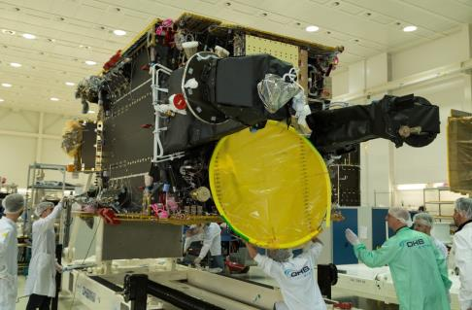
Hispasat AG 1 Mission
Current Missions
Customer
  Hispasat via ESA (Artes 11)
SmallGEO for TV broadcast and technology validation
  Platform qualification
  Coverage of Europe and South America
  Ku+Ka-band transparent repeater
  Advanced payload with phased array and on-board processor
Program Status
  OHB System AG is satellite prime
  Launch end 2015

Slide 17
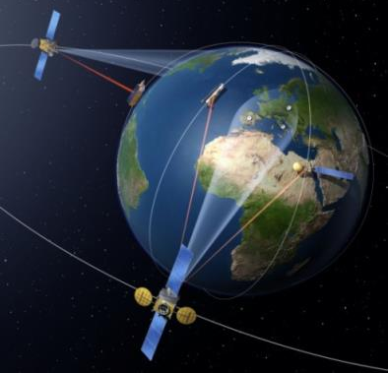
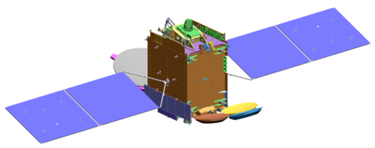
EDRS-C Mission
Current Missions
Customer
  European Union via ESA / Astrium Services
SmallGEO for Data Relay Applications
  ESA ARTES-7 program to serve the Copernicus Sentinel satellites
  Geostationary data-relay for earth observation satellites data downlink
      optical and microwave Inter-Satellite-Links up to 1,8 Gbps
      Ka-Band Downlink to ground segments
  SmallGeo satellite optimized for Data Relay Functions
Program Status
  OHB System AG is satellite prime
  Phase C/D ongoing
  Launch in 2017

Slide 18
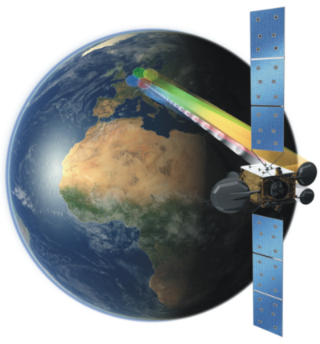
Heinrich Hertz Mission
Current Missions
Customer
  German Centre for Aerospace - DLR
  Use of excess capacity for hosted BMVg (German DOD) payload
SmallGEO for Technology Validation
  Multi-spotbeam coverage, 4(+1) spots over Germany
  Inter-satellite links LEOs: e.g. DEOS
  Experiments as single-hop communications, new waveforms, regenerative communications
  Mobile services, test bed for ground technologies
  (e.g. Santana, MoSaKa)
Program status
  OHB System AG is mission prime
  Phase B completed with PDR in Q1/2014
  Start C/D in 2015
  Launch in 2019

Slide 19

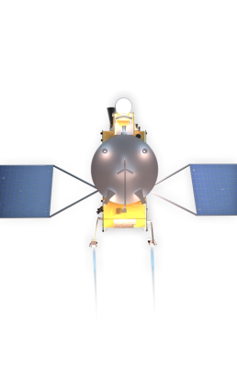
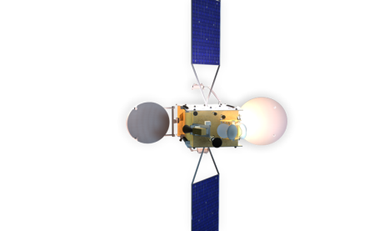
Electra Mission
Current Missions
Customer
  SES S.A. (ESA)
  Public Private Partnership between ESA, SES S.A. and OHB System AG
Development and qualification of SmallGEO Flex
  Part of ESA ARTES 33 programme
  SmallGEO satellite with electric propulsion for transfer and station keeping
  Satellite offers a payload capacity of medium-sized satellites and reduced launching cost of small-sized satellites
Program Status
  OHB System AG is satellite prime
  Phase B kick-off in October 2013
  Platform PDR performed on 2014

Slide 20
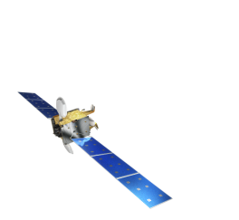
Telecommunications: a synthesis
Hispasat HAG 1 | EDRS-C | Heinrich Hertz | Electra program
Customer: Hispasat S.A./ ESA | Customer: Airbus Defence & Space Services | Customer: German Aerospace Center (DLR) | PPP between ESA, SES S.A. and OHB System AG
Realisation under the ARTES 11 programme | ESA ARTES 7 programme: European data relay satellite system for comple-menting the Sentinel earth observation satellites under the EU Copernicus pro-gramme (formerly GMES) | Economical/technical part of the payload for testing innovative communications and platform technologies in the Ku and Ka band in space and on the ground | Part of the ESA’s ARTES 33 programme
Ku and KA band TV transmission applications | Optical satellite links with data rates of up to 1.8 Gbps, downlink in Ka band |  | SmallGEO satellite with fully electrical propulsion system for transfer manoeuvers and attitude control
 | Additionally: hosted payload for Avanti Communications Group plc | Military payload part for the German federal armed forces | Increased payload capacity compared to the chemical propulsion version, resulting in optimized launch costs
Launch scheduled for 2015 | Launch scheduled for 2017 | Launch scheduled for 2019 | Launch scheduled for 2019

Slide 21
Roadmap
Roadmap
Qualification Flex
Electra mission
Electric Propulsion (Full EP)
SmallGEO Flex
Qualification Product Line
Hispasat mission
Chemical Propulsion
Hybrid Propulsion
SmallGEO Fast
Optimisation
EDRS-C mission
Optimisation
Heinrich Hertz mission
Payload-Mass
200 kg
300 kg
400 kg
600 kg
Payload-Power
3 kW
4 kW
5 kW
7 kW

Slide 22
Schedule
Roadmap
SmallGEO - Platform
Hispasat AG 1 – ESA Artes 11
EDRS-C – ESA Artes 7
Heinrich Hertz Satellite - DLR
Electra – ESA Artes 33
GEOBird
MeteoSat Third Generation
2011 2012 2013 2014 2015 2016 2017 2018 2019
Notes:
Back up slide

Slide 23
Conclusions
SmallGEO is a direct hit
  Four SmallGEO telecommunications missions
  Six SmallGEO platforms for Meteosat Third Generation
SmallGEO is well prepared for the commercial future
  Providing payload technology state-of-the-art and beyond
  Most advanced electric propulsion platform
  Sustainable European supplier network established
Electra new paradigm
  What is currently under development with Electra is a brand new concept, not paper based but exactly substantiated with a strong technical background.
  The telecomsats fleet currently under development and here presented, as well as the roadmap for a unified satellite platform, could perfectly match satellite capabilities and operator needs.
  This mutual growth will provide an exceptional added value to the market, including disclosing new opportunities for both governmental and commercial customers.

Slide 24
Conclusions
Objectives, vision and other targets
  OHB is focusing on the achievement of selected goals:
  System and platform integrator for national, European and international satellite programs
  Full gamut of satellite missions and applications: earth observation, exploration, telecommunications, science and navigation
  Commercial, civil and security-relevant services
  European systems specialist:
    Flat hierarchies and optimized cost structures
    Proactive and agile management for customers’ benefit
    Commitment to customer-centric activity and lessons-learnt processes
    Professional, project-oriented procurement management system
  Leadership in small Telecomsat through the development of Electra
    OHB is the third European industrial pole capable to build turn-key satellites and we are working to improve this rank…
Notes:
Back up slide

