Slide 1
SLEEP APNEA, STROKE and VASCULAR DEMENTIA
UNDER-RECOGNIZED CONVERGING STORMS
ANTONIO CULEBRAS, MD, FAAN, FAHA, FAASM
Professor of Neurology
SUNY Upstate Medical University
Syracuse, N.Y. USA
Valencia Convention Center
June 30, 2016

Slide 2
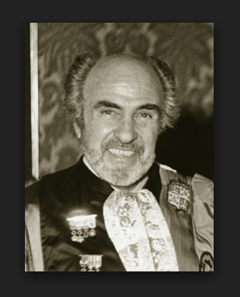
HENRI GASTAUT (1915-1995)

Slide 3
HENRI GASTAUT (1915-1995)
Gastaut H, Tassinari CA, Duron B.
Polygraphic study of diurnal and nocturnal (hypnic and respiratory) episodal manifestations of Pickwick syndrome.
Rev Neurol (Paris).
1965 Jun;112(6):568-79

Slide 4
ELIO LUGARESI (1925-2015)

Slide 5
ELIO LUGARESI (1925-2015)
Lugaresi E.
Snoring.
Electroencephalography and clinical neurophysiology.
1975;39:59-64.

Slide 6
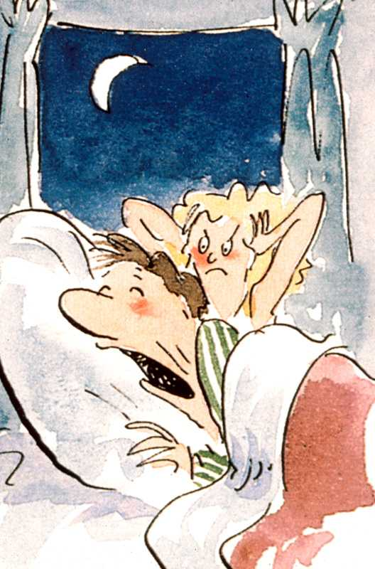

Slide 7
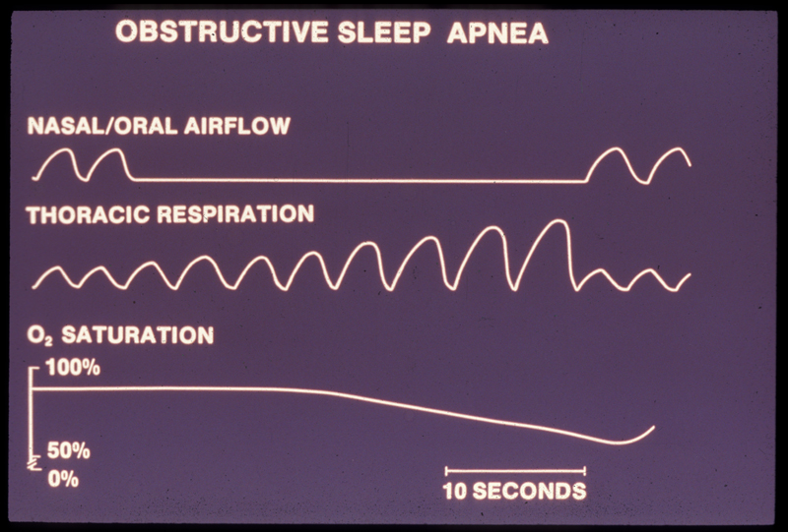

Slide 8
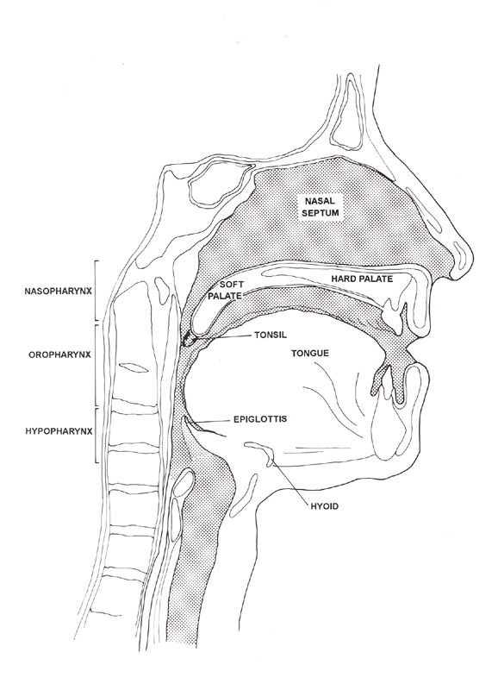
NASOPHARYNX
OROPHARYNX
TONGUE
HYPOPHARYNX

Slide 9
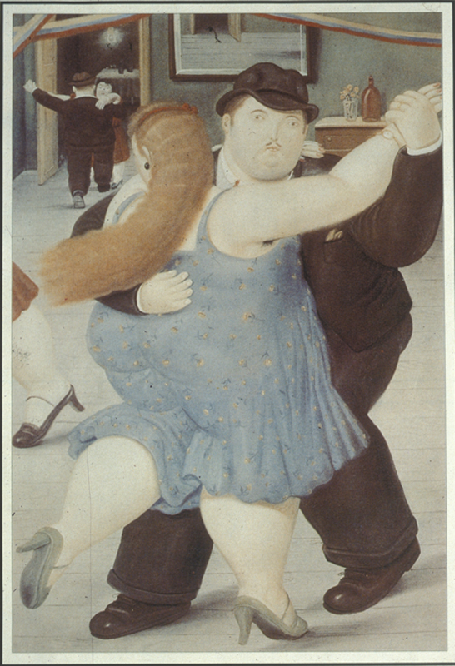

Slide 10
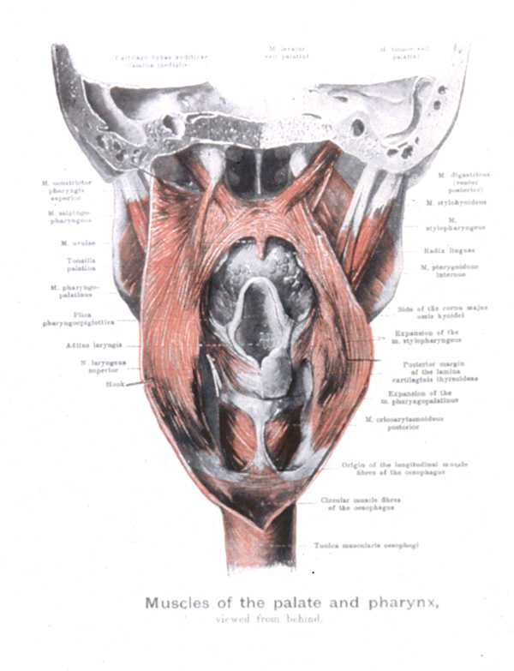

Slide 11
AROUSAL RESPONSE
Arousal response is associated with
  Sympathetic surges
    at termination of sleep apnea events
    more active in REM sleep
    decline in SWS

Slide 12
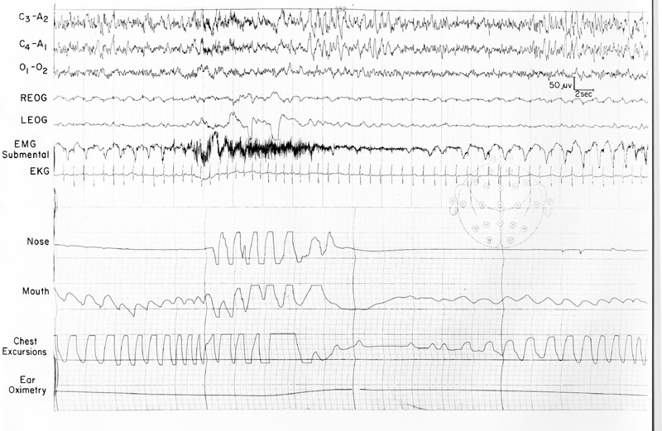

Slide 13
SLEEP APNEA PREVALENCE
Sleep apnea syndrome of moderate to severe intensity affects
  17% of 50-70 year-old men
  9% of 50-70 year-old women
    Peppard PE et al. Am J Epidemiol 2013

Slide 14
CLINICAL ASPECTS OF OBSTRUCTIVE SLEEP APNEA
Obstructive sleep apnea is a risk factor for cardiovascular disease and stroke.
    Culebras A. Overview of sleep and stroke. In: Culebras A, editor. Sleep, stroke and cardiovascular disease. Cambridge University Press, 2013, p 1.

Slide 15
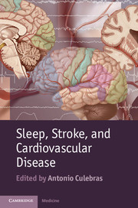

Slide 16
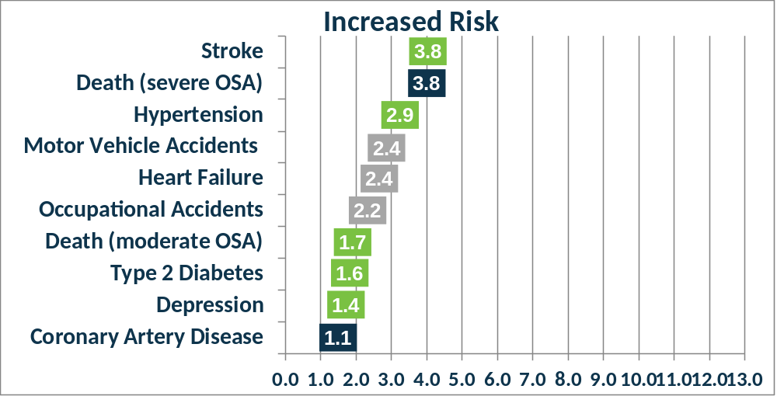
RISK OF STROKE AND OTHER CONDITIONS IN SLEEP APNEA

Slide 17

SLEEP APNEA AND STROKE
The obstructive sleep apnea syndrome significantly increases the risk of stroke or death from any cause, and the increase is independent of other risk factors, including hypertension
  Yaggi et al. N Engl J Med 2005;353:2034-2041

Slide 18
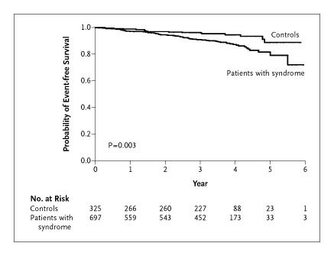
Kaplan-Meier Estimates of the Probability of Event-free Survival among Patients with the Obstructive Sleep Apnea Syndrome and Controls
Yaggi et al. 2005
Yaggi, H. et al. N Engl J Med 2005;353:2034-2041

Slide 19
SLEEP APNEA AND STROKE
Sleep Heart Health Study
5,422 participants without stroke at baseline, untreated for sleep apnea were followed for a median of 8.7 years.
193 ischemic strokes were observed.
Significant positive association between ischemic stroke and OA was observed in men (P value for linear trend: P = 0.016).
Men in the highest OA quartile (>19) had an adjusted hazard ratio of 2.86 (95% confidence interval, 1.1-7.4).
CONCLUSIONS: The strong adjusted association between ischemic stroke and OA in community-dwelling men with mild to moderate sleep apnea suggests that this is an appropriate target for future stroke prevention trials.
    Redline et al. Am J Respir Crit Care Med. 2010;182:269-77

Slide 20
YOUNG WOMEN WITH SLEEP APNEA HAVE MORE STROKES
29,961 Chinese patients with sleep apnea
the sleep apnea cohort had a higher stroke incidence compared with control subjects
52.4 per 10,000 person-years for men
61.7 per 10,000 person-years for women
adjusted hazard ratio
  men 1.21 (95% CI: 1.01−1.24; p < 0.05)
  women 1.44 (95% CI: 1.20−1.72; p < 0.05)
Chang CC et al. Sleep Medicine 2014; 15:410

Slide 21
YOUNG WOMEN WITH SLEEP APNEA HAVE MORE STROKES
Stratified by age the effects of sleep apnea on stroke risk in women decreased with age
adjusted HR: 4.90, 95% CI: 1.93-12.4 for subgroup aged 20-35 years
adjusted HR: 1.64, 95% CI: 1.01-2.65 for subgroup aged 36-50 years
adjusted HR: 1.38, 95% CI: 1.01-1.89 for subgroup aged 51-65 years
CONCLUSION young women with sleep apnea are at higher risk of stroke
Chang CC et al. Sleep Medicine 2014; 15:410

Slide 22
SLEEP APNEA AND PREGNANCY
EDITORIAL. Sleep apnea and stroke in young women: the many faces of the disorder
    Culebras A. Sleep Medicine 2014;15:377
In pregnant women with sleep apnea placental hypoxia may precipitate a cascade of active factors from the placenta that generate profound effects on the maternal cardiovascular system causing hypertension, endothelial dysfunction, and preeclampsia
Bourjeily G, et al. 2011 Mar;32:175

Slide 23
FACTORS CONTRIBUTING TO CEREBROVASCULAR DISEASE IN SLEEP APNEA
  Increased sympathetic drive and tone
  Surges in blood pressure
  Atrial fibrillation
  Patent foramen ovale
  Hemodynamic changes
  Autoregulation failure
  Hypoxia
  Systemic inflammation
  Endothelial dysfunction
  Hypercapnia
  Hypercoagulability

Slide 24
AROUSAL RESPONSE
Arousal response is associated with
  Sympathetic surges
    at termination of sleep apnea events
    more active in REM sleep
    decline in SWS

Slide 25
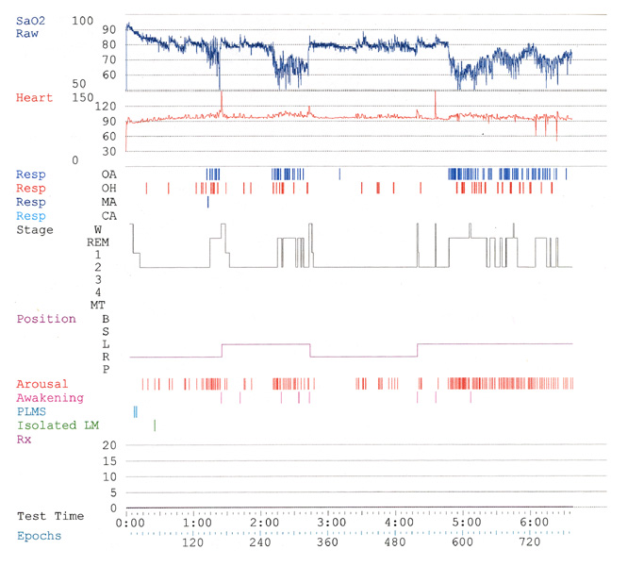

Slide 26
FACTORS CONTRIBUTING TO CEREBROVASCULAR DISEASE IN SLEEP APNEA
  Increased sympathetic drive and tone
  Surges in blood pressure
  Atrial fibrillation
  Patent foramen ovale
  Hemodynamic changes
  Autoregulation failure
  Hypoxia
  Systemic inflammation
  Endothelial dysfunction
  Hypercapnia
  Hypercoagulability

Slide 27
HYPERTENSION AT TERMINATION OF APNEA
  Transient BP elevations (>200 mm/Hg sys) have been recorded during the recovery phase from sleep apnea, particularly in REM sleep

Slide 28
APNEA AND SUSTAINED HYPERTENSION
    Sleep Heart Health Study
    Wisconsin study
    Toronto study
    …and more

Slide 29
SLEEP HEART HEALTH STUDY
    The Sleep Heart Health Study studied 6,132 subjects with home polysomnography
    The results showed a dose-response relationship between severity of SDB and HTN
        Nieto et al. JAMA 2000;283:1829

Slide 30
SLEEP HEART HEALTH STUDY
    Adjusted odds of HTN (>140/90) increased steadily with AHI >15
    For very high AHI values, odds ratios were 2 or higher
    A similar relation was obtained using desats <90% as the reference parameter
        Nieto et al. JAMA 2000;283:1829

Slide 31
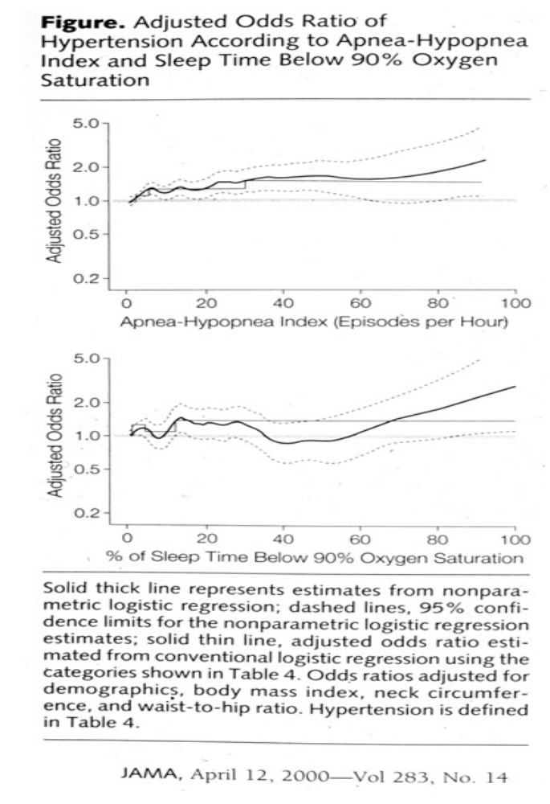

Slide 32
FACTORS CONTRIBUTING TO CEREBROVASCULAR DISEASE IN SLEEP APNEA
  Increased sympathetic drive and tone
  Surges in blood pressure
  Atrial fibrillation
  Patent foramen ovale
  Hypoxia
  Systemic inflammation
  Endothelial dysfunction
  Hemodynamic changes
  Hypercapnia
  Hypercoagulability

Slide 33
SLEEP APNEA AND ATRIAL FIBRILLATION
Obesity and the magnitude of nocturnal oxygen desaturation are independent risk factors for AF in individuals <65 years of age.
Gami AS. Sleep apnea and atrial fibrillation. In: Culebras A, editor. Sleep, stroke and cardiovascular disease. Cambridge University Press, 2013, p 81.
OSA is a univariate predictor of AF [hazard ratio 2.18, (95% CI, 1.34 to 3.54)]
    Gami AS. J Am Coll Cardiol. 2007;49:565

Slide 34
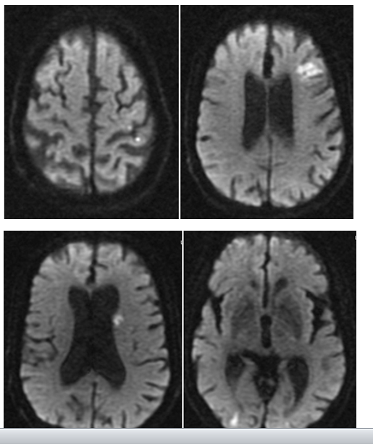

Slide 35
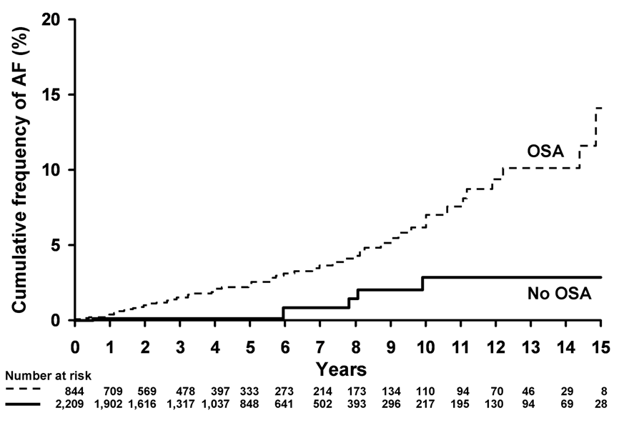
Gami AS et al. J Am Coll Cardiol. 2007;49:565-71.
Notes:
35

Slide 36
FACTORS CONTRIBUTING TO CEREBROVASCULAR DISEASE IN SLEEP APNEA
  Increased sympathetic drive and tone
  Surges in blood pressure
  Atrial fibrillation
  Patent foramen ovale
  Hypoxia
  Systemic inflammation
  Endothelial dysfunction
  Hemodynamic changes
  Hypercapnia
  Hypercoagulability

Slide 37
SLEEP APNEA AND PATENT FORAMEN OVALE
Long obstructive sleep apneas (LOSA) lasting 20 secs. or more were investigated in 335 patients with wake-up strokes/TIA
There were significantly more wake-up strokes/TIAs in subjects with LOSA plus RLSh than those without this association
(27/69 vs 70/266; OR 1.91, 95% CI 1.08 to 3.38; p=0.03)
The combination of LOSA and RLSh could be a new potentially treatable risk factor for cerebrovascular ischemic events
    Ciccone A et al. Stroke 2013;68:97

Slide 38
FACTORS CONTRIBUTING TO CEREBROVASCULAR DISEASE IN SLEEP APNEA
  Increased sympathetic drive and tone
  Surges in blood pressure
  Atrial fibrillation
  Patent foramen ovale
  Hemodynamic changes
  Autoregulation failure
  Hypoxia
  Systemic inflammation
  Endothelial dysfunction
  Hypercapnia
  Hypercoagulability

Slide 39
SLEEP APNEA AND CEREBRAL AUTOREGULATION
  Cerebral hemodynamic autoregulatory mechanisms (measured using cerebral infrared spectroscopy) fail with brain hypoxia in the presence of frequent apneas (AHI > 30) and obstructive events
      Pizza F et al. Sleep. 2010;33:205

Slide 40
FACTORS CONTRIBUTING TO CEREBROVASCULAR DISEASE IN SLEEP APNEA
  Increased sympathetic drive and tone
  Surges in blood pressure
  Atrial fibrillation
  Patent foramen ovale
  Hemodynamic changes
  Autoregulation
  Hypoxia
  Systemic inflammation
  Endothelial dysfunction
  Hypercapnia
  Hypercoagulability

Slide 41
HYPOXIA
Hypoxia and inflammation are intertwined at the molecular, cellular, and clinical levels
    Eltzschig HK et al. N Engl J Med. 2011:17;364:656.

Slide 42
HYPOXIA, PRO-INFLAMMATORY FACTORS AND ENDOTHELIAL DAMAGE
Repeated hypoxia may damage the endothelium and trigger the release of pro-inflammatory factors
  plasma cytokines
  tumor necrosis factor-alpha
  interleukin-6
    Berger S and Lavie L. Sleep apnea, oxidative stress, proinflammatory vascular risk factors and endothelial disease. In: Culebras A, editor. Sleep, stroke and cardiovascular disease. Cambridge University Press, 2013, p 11.

Slide 43
OSA AND SMALL VESSEL DISEASE
OSA >15 AHI is a risk factor for cerebral white matter changes in middle-aged and older patients
  OR:2.08 [95% (CI):1.05-4.13]
    Kim H et al. Sleep 2013;36:709

Slide 44
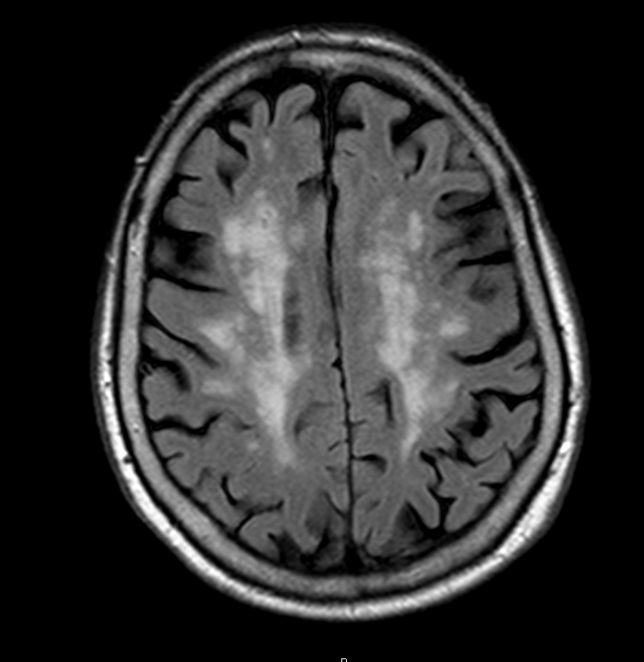

Slide 45
OSA AND VASCULAR COGNITIVE IMPAIRMENT
OSA is a risk factor for subcortical ischemic vascular dementia
    Román GC. In: Culebras A, editor. Sleep, stroke and cardiovascular disease. Cambridge University Press, 2013.

Slide 46
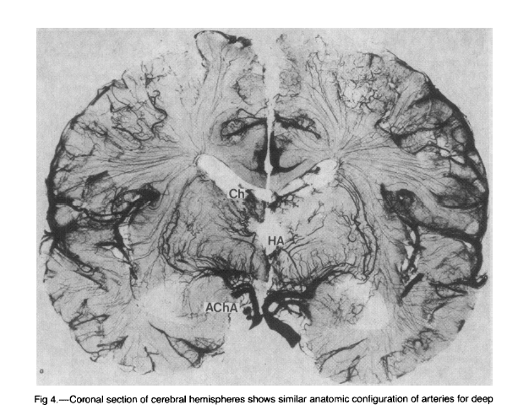
JAMA 1987;258:1782

Slide 47
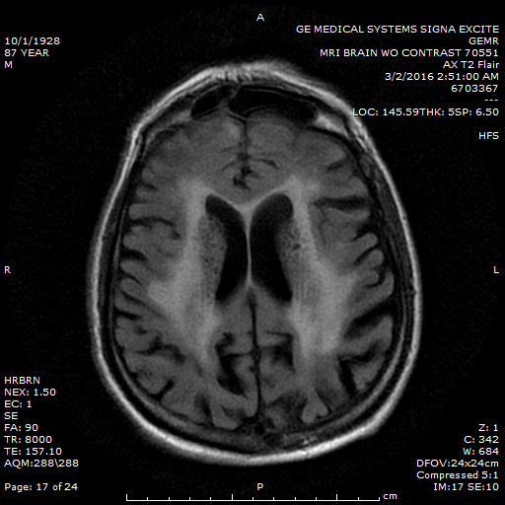

Slide 48
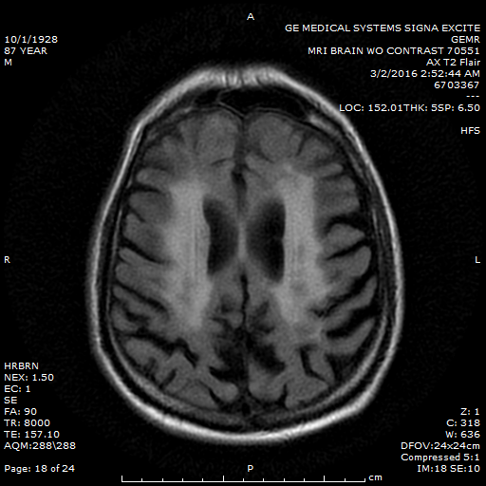

Slide 49
JAMA 1987;258:1782

Slide 50
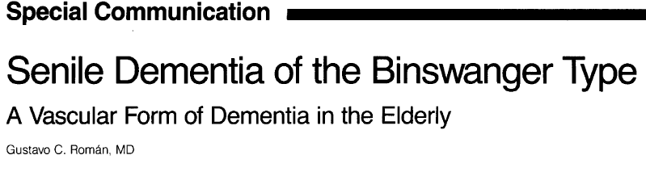
JAMA 1987;258:1782-1788

Slide 51
OSA AND COGNITIVE IMPAIRMENT
Old women (mean age: 82.3 yrs) with OSA >15 AHI were more likely to develop mild cognitive impairment or dementia
adjusted odds ratio [AOR], 1.85; [95% (CI), 1.11-3.08]
  Substudy of the Study of Osteoporotic Fractures
  Yaffe K et al. JAMA. 2011;306:613

Slide 52
OSA AND COGNITIVE IMPAIRMENT
In a home poligraphic study of 2,636 men 76.0 ± 5.3 years old
Results showed that nocturnal hypoxemia was related to decline in Modified Mini-Mental test scores
For every 5 points of increment in O2 desaturation there was an annual decline of 0.36 points in MMM (P=0.01)
  Blackwell t et al. J Am Geriatr Soc. 2015;63:453

Slide 53
TREATMENT
Does CPAP/Bilevel PAP prevent strokes?
Does CPAP/Bilevel PAP prevent vascular dementia?

Slide 54
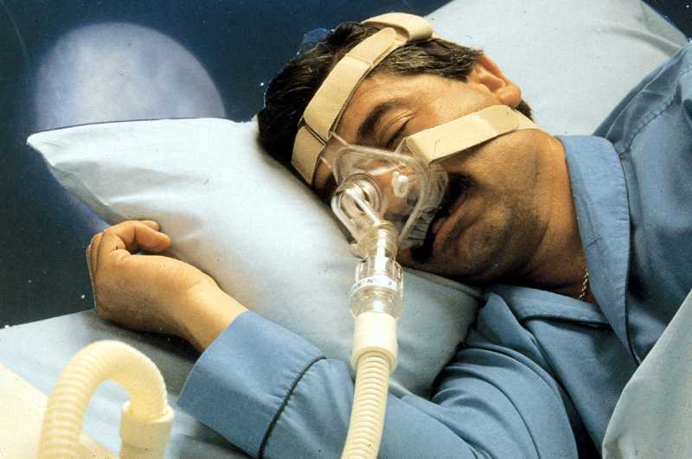

Slide 55
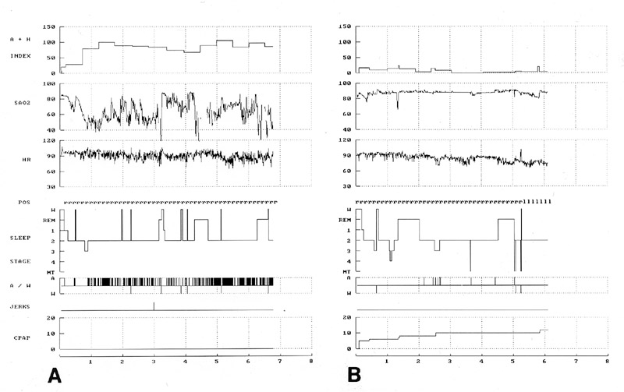

Slide 56
CPAP AND CEREBROVASCULAR DISEASE
Men with moderate-to-severe OSA were randomized to therapeutic or subtherapeutic CPAP treatment for 4 weeks
After 4 weeks of therapeutic CPAP significant reductions were seen
  24-h urinary catecholamine excretion
  arterial stiffness (augmentation index, pulse wave analysis)
  improved baroreflex sensitivity
  reduced mean 24-h ambulatory blood pressure by 2.6+/-5.4 mmHg
Treatment of obstructive sleep apnea with CPAP may lower cardiovascular risk
    Kohler M et al. Effect of CPAP on stroke risk factors and stroke. In: Culebras A, editor. Sleep, stroke and cardiovascular disease. Cambridge University Press, 2013, p 115.

Slide 57
CPAP AND CEREBROVASCULAR DISEASE
CPAP treatment significantly reduced systolic blood pressure (-7.3 mm Hg), particularly at night, and normalized nocturnal pressure patterns in patients with difficult-to-control hypertension and sleep apnea.
Martínez-García MA et al. Eur Respir J. 2007;29:951

Slide 58
CPAP and COGNITIVE IMPAIRMENT
In a study of patients with minimal cognitive impairment or with Alzheimer disease, patients with sleep apnea started cognitive decline at an earlier age
  (MC1: 72.63 vs 83.67; MC2: 72.15 vs 83.45; MC3: 77.40 vs 89.89; p < 0.01).
  (AC3: 83.46 vs 88.13; p < 0.05)
Treatment with CPAP delayed initiation or slowed progression of cognitive changes
  CMC1: 72.63 vs 82.10; CMC2: 72.11 vs 82.10; p < 0.01).
  Osorio RS et al. Neurology. 2015.12;84:1964

Slide 59
CPAP INTOLERANCE
CPAP use in patients with coexisting cardiovascular disease and moderate to severe OSA decreased significantly over 12 months
  Chai-Coetzer CL et al. Predictors of long-term adherence ....in the SAVE study. Sleep. 2013;36:1929.

Slide 60
CPAP ADHERENCE
General CPAP adherence is about 50%
  APPLES Study (2012) - CPAP adherence rate was 39% at 6-months
      Kushida et al, SLEEP 2012
  Home PAP Study (2012) – At 3-month follow-up: CPAP adherence was 39% for standard care; and 50% for home-based care
      Rosen et al, SLEEP 2012

Slide 61
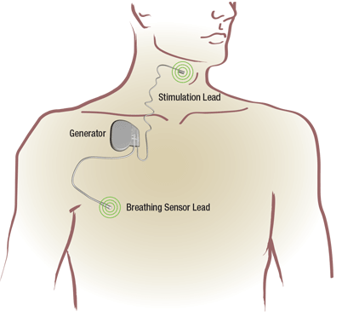
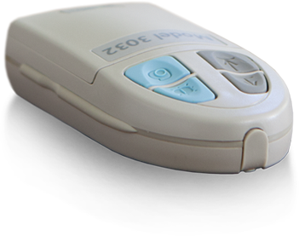
Neurostimulation Therapy Overview
Inspire therapy:
  Works inside the body - fully implanted
  Monitors breathing patterns during sleep
  Delivers mild stimulation to key airway muscles to keep airway open during sleep
  Turned on and off with a handheld
  sleep remote
Sleep Remote

Slide 62
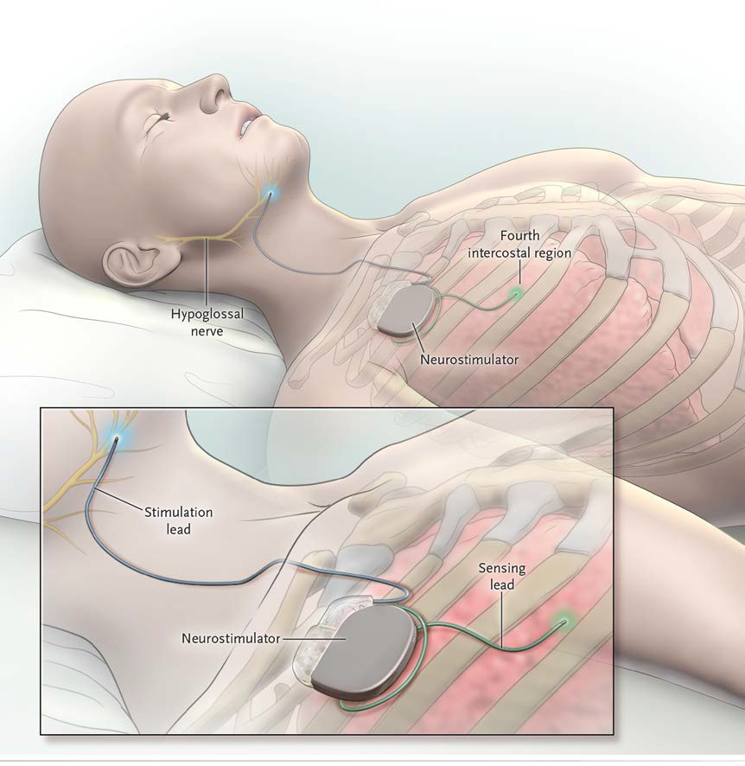
Standard Surgical Techniques
Implantable Pulse Generator: subcutaneous pocket common to pacemakers and neurostimulators
Stimulation lead: placed around the hypoglossal nerve
Sensor lead: inserted between intercostal muscle layers
Strollo et al, NEJM 2014

Slide 63
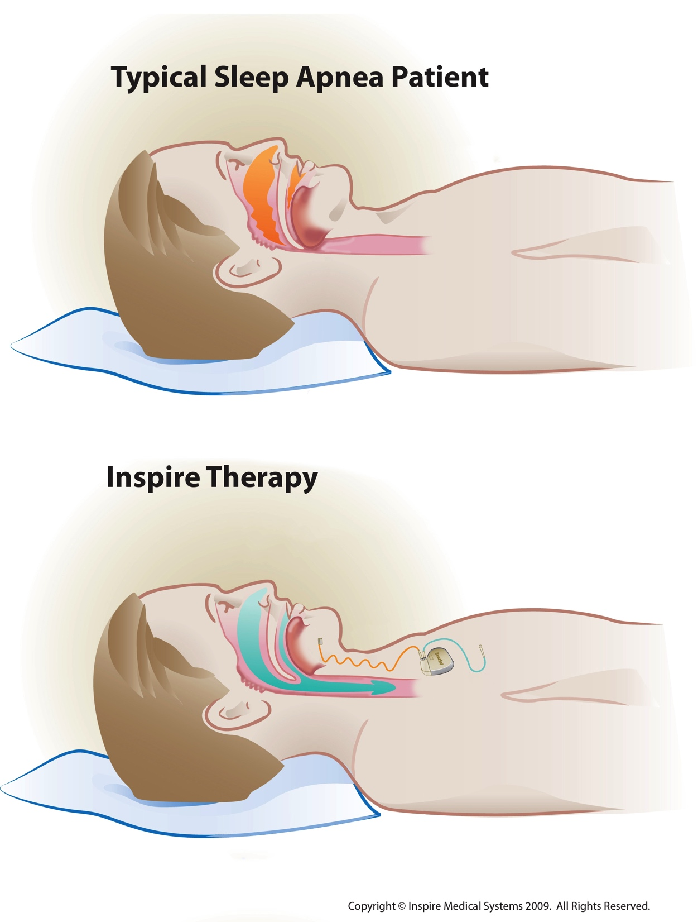
Airway Stimulation Effect
Untreated sleep apnea patient
Patient with neurostimulation therapy
Tongue and other soft tissues relax
and block the airway
Mild stimulation to key airway muscles maintains an open airway
Notes:
Ryan is very good at explaining this. Let us know if you have feedback on language on slide

Slide 64


Slide 65
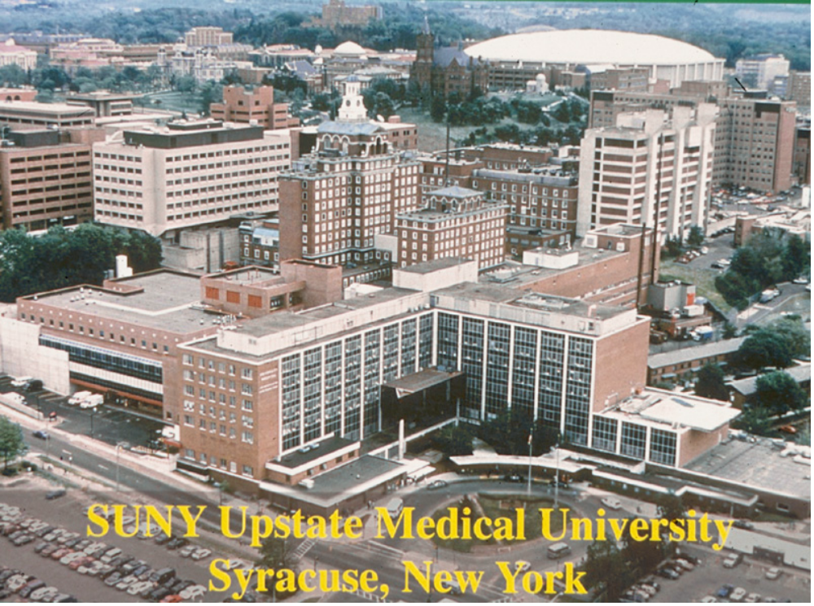
Notes:
THE END

