Slide 1



ANTICARCINOGENIC EFFECT OF PHYTOSTEROLS AND/OR BETA-CRYPTOXANTHIN IN COLON CANCER CELLS
I
Antonio Cilla Tatay PhD
Postdoctoral researcher
E-mail: antonio.cilla@uv.es
Nutrition and Food Science Area.
Faculty of Pharmacy. University of Valencia
Notes:
Good morning.
First of all, I want to express my gratitude to the organizing committe for allowing me to stay here in this symposium and also, for bringing me the opportunity to present this work that deals with “Anticarcinogenic effect of phytosterols and/or beta-cryptoxanthin in colon cancer cells”.

Slide 2
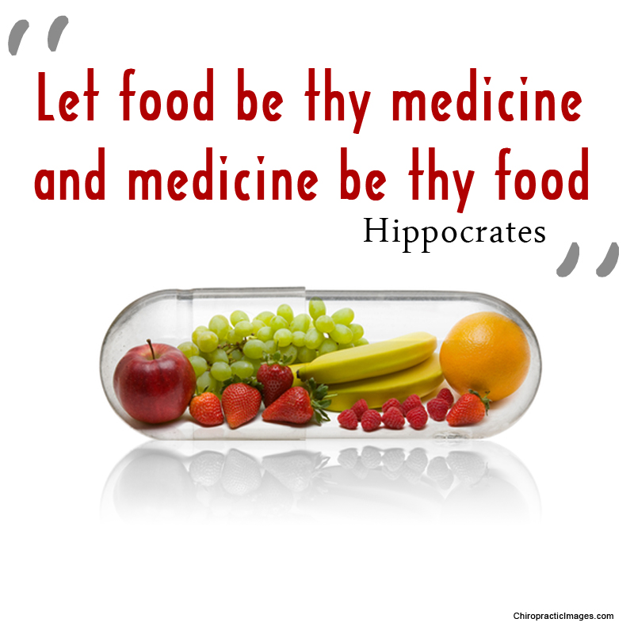
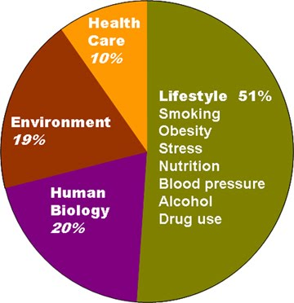
BACKGROUND
DETERMINANTS OF HEALTH
Lalonde (1974)
Notes:
“Let food be your medicine and medicine be your food” was the famous sentence said by Hippocrates already 25 centuries ago, indicating the importance and conditioning effect of food on health.
Nowadays, modernization and its resulting lifestyle trends have made the starting of a new era of chronic illness. Currently, it is also well-known that a balanced diet (with regular intake of fruits and vegetables), together with a healthy lifestyle, are essential factors to diminish the incidence of chronic-degenerative diseases, especially distinct types of cancer and particularly those of the digestive tract .
But this is not new. In fact, The World Health Organisation in 1974 published a report (led by the Canadian Ministry of Health, Marc Lalonde) in which it was stated that the factors determining health, illness and death were distributed not as the generally accepted view:
In this sense, more than 50% was attributed to lifestyle, (including diet, toxic habits, exercise, ways of relating, etc).
The report initiated the development of health promotion, recognising the need for people to take more responsibility in changing their behaviours to improve their own health.

Slide 3
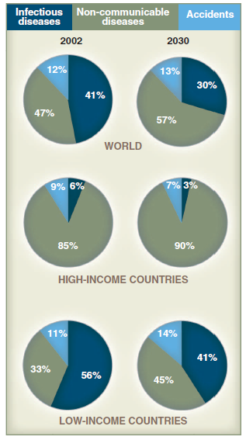
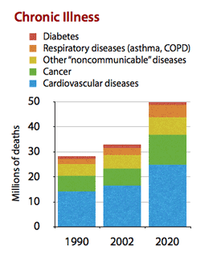
BACKGROUND
Bygbjerg, I.C. Science (2012) 337: 1499-1501
Yach et al. JAMA (2004) 291: 2616-2622
Notes:
Like individuals, societies have a “life cycle”:
In low-income countries, infectious diseases (in blue color) and nutritional deficiencies dominate; however, when societies “grow up,” chronic non-communicable diseases (NCDs) become more prevalent, particularly in urban populations. This trend observed in high-income countries and is expected to prevail in the future in the world.
Chronic diseases, as indicated, are the largest cause of death in the world, led by cardiovascular disease (17 million deaths in 2002) and followed by cancer (7 million deaths), chronic lung diseases (4 million), and diabetes mellitus (almost 1 million).
The global prevalence of all the leading chronic diseases is increasing, with the majority occurring in developing countries and projected to increase substantially over the next decades.

Slide 4
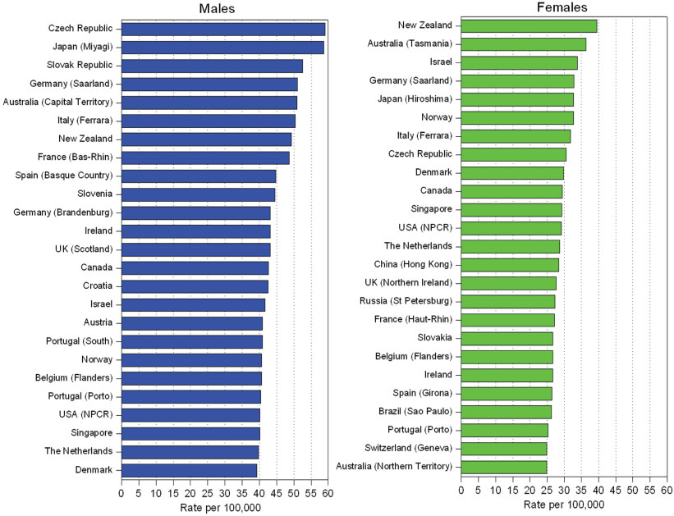
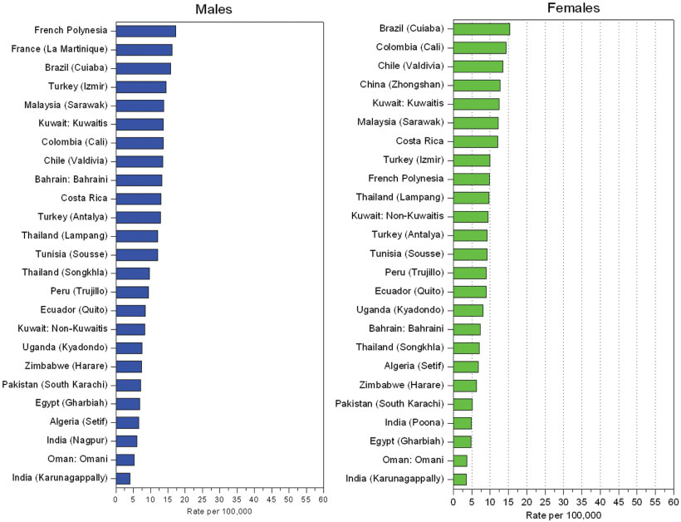
BACKGROUND
Colorectal cancer incidence rates by sex
Developed countries
Developing countries
Center et al. CA Cancer J Clin (2009)59:366–378
Notes:
Recent data about colorectal cancer incidence worldwide, indicate that this kind of cancer is the fourth most common cancer in men, and the third most common cancer in women.
As it can be observed on the slide, there are significant international variations in the distribution of colorectal cancer, typically higher in developed or “westernized” countries, although according to the so-called nutritional transition, most developing countries are changing their traditional pattern of high incidence of infectious diseases to this chronic disease scenario.
In the particular case of my country, Spain, males are situated in the 9th position of incidence while women are located in the 21st, indicating the high presence of this disease in our environment.

Slide 5
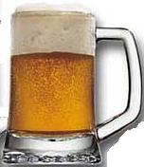


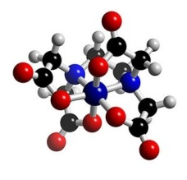
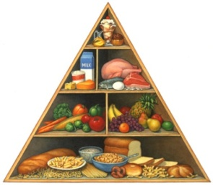

BACKGROUND
Aetiology of colon cancer
Heredity
Colorectal cancer is widely believed to be an enviromental disease
SMOKING
Culture
Social status
Lifestyle practices
ALCOHOL
Dietary habits
HYPERCALORIC FOODS
CHEMICALS
HEALTHY DIET
PHYSICAL ACTIVITY
Notes:
The main causes involved in the aetiology of this disease are:
On the one hand, the heredity factor, and on the other hand, enviromental factors including culture, social status and lifestyle practices.
Evidence from epidemiological and animal studies has suggested that dietary factors and related aspects of lifestyle are involved in the origin of colorectal cancer.
Typical risk factors for this disease are: tobacco and alcohol use, unhealthful diets (low intake of fruits and vegetables), and lack of physical activity.

Slide 6
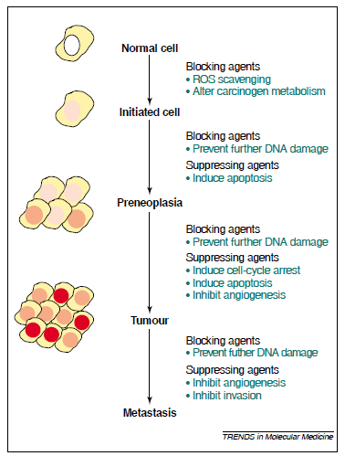
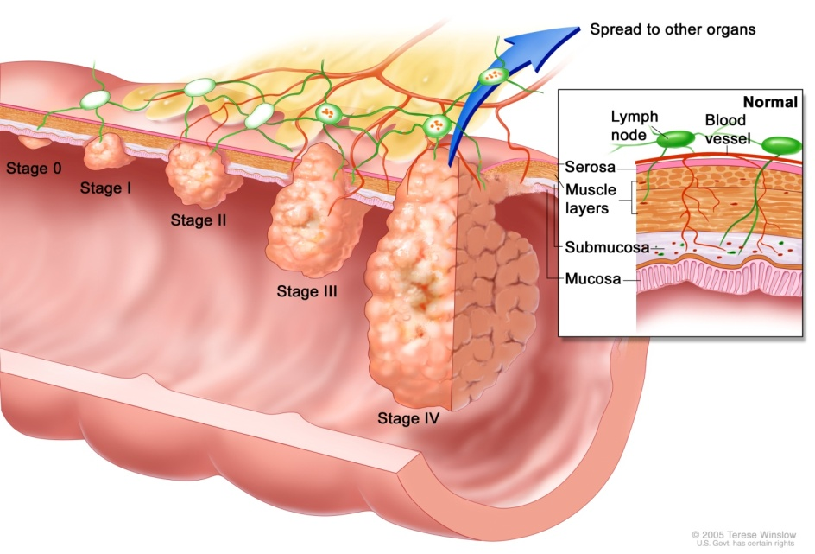
BACKGROUND
Steps and evolution of colon cancer
Chemoprevention by phytochemicals
Normal epithelium
Early adenoma
Intermediate adenoma
Transformation (initiation)
Late adenoma
Promotion (tumoral growing)
Carcinoma
Invasion
(distant metastasis)
Manson, M.M. Trends Mol. Med. (2003) 9: 11-18
Notes:
Among the main events in the flow of cancer evolution, deregulated cell proliferation and evasion of programmed cell death (formerly called apoptosis) provide the minimal environment necessary to support cancer progression.
The secuence of events involves the transition from normal epithelium, which is transformed into adenomas, to the final carcinoma form, leading to the invasion and dissemination to other organs.
Chemopreventive agents can exert blocking or suppressing effects on different stages of the carcinogenic process. Blocking mechanisms prevent damage to DNA, whereas suppression slows down or inhibits the growth of transformed cells or new blood vessels.

Slide 7

BACKGROUND
Functional food trends in 2014
http://www.foodmag.com.au/news/naturally-functional-foods-to-lead-the-way-in-2014
Notes:
In recent years the development of ingredients to elaborate functional foods has been espectacularly increased and now still continues in expansion.
In this sense, there is a wide array of functional ingredients in the market. According to the annual industry forecast, 12 Key Trends 2014, naturally functional foods will be the leader within food manufacturing throughout the next 12 months.

Slide 8

BACKGROUND
Functional foods
Classical
Fiber & carbohydrates
Bioactive
Vitamins
Minerals
Aminoacids
Probiotics
Cereals
β-glucans
Soy
Resistant starch
Inulin
Fruit fiber
Phytosterols
Carotenoids
Polyphenols
Antioxidant extracts (cocoa, grape seed)
ω-3 and ω-6
β-sitosterol , campesterol and stigmasterol
β-cryptoxanthin
Saura-Calixto et al., (2005)
Notes:
Functional foods have been classified in three groups:
First group corresponds to classical functional ingredients such as vitamins and minerals, which are used since various decades ago.
Another group is constituted by different types of fiber and carbohydrates such as inulin and β-glucans and…
Finally exists a third group including ingredients of bioactive compounds.
We are going to focus on the third group including bioactive compounds such as phytosterols (mainly beta-sitosterol, campesterol and stigmasterol) and carotenoids (such as beta-cryptoxanthin).

Slide 9


BACKGROUND
WHY THESE COMPOUNDS?
Gastrointestinal and systemic effects of a doubly modified functional beverage containing β-cryptoxanthin and phytosterols; unravelling potential mechanisms and mediators.
National Research Project (AGL2012-39503-C02-01)
β-cryptoxanthin
beneficial properties in different bone remodeling markers (formation and resorption)
Phytosterols
hypocholesterolemic effect
Combined action against colon cancer?
Notes:
Why these compounds?
Because they are being subject of research in a Spanish National Research Project performed by the Bionutest group of the University of Valencia and the Hospital Puerta de Hierro in Madrid.
These compounds have shown health benefits related to bone modelling markers (formation and resorption) and decrease in cardiovascular risk (hypocholesterolemic effect), but…
What about they combined action against colon cancer?

Slide 10
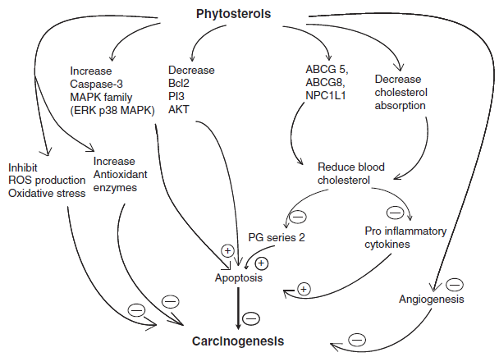
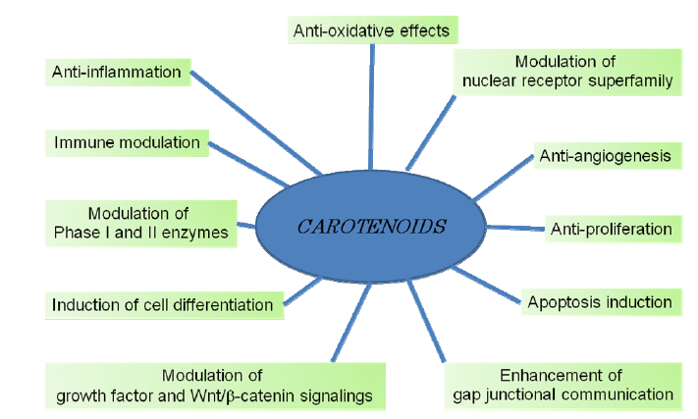
BACKGROUND
Proposed mechanisms of action of phytosterols and carotenoids on carcinogenesis
Woyengo, et al. Eur. J. Clin. Nutr. (2009) 63: 813-820
Tanaka et al. Molecules (2012) 17: 3202-3242
Notes:
The mechanisms underlying the anticancer and/or cancer chemopreventive activities of phytosterols and carotenoids may involve changes in pathways leading to cell growth or cell death. These mechanisms include, among others, regulatory mechanisms of cell cycle progression, cell differentiation and apoptosis; or even, increase in the activity of antioxidant enzymes and thereby reduction of oxidative stress.
However, their action in colon cancer cells are not fully elucidated and have received comparatively little attention than their known effects in bone health and cholesterol-lowering properties.

Slide 11
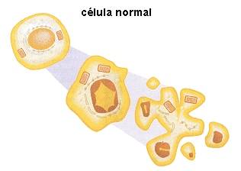
OBJECTIVES
1. Evaluate the antiproliferative activity of main dietary phytosterols and/or β-cryptoxanthin against a colon cancer cell line (Caco-2 cells).
2. Unravel the biochemical and molecular mechanisms involved in their possible antiproliferative activity.
Notes:
Based on the background presented, the main objectives of the present study were:
First, to evaluate the antiproliferative activity of main dietary phytosterols and/or β-cryptoxanthin (alone or in combination) against a colon cancer cell line.
And, second, to unravel the biochemical and molecular mechanisms involved in their possible antiproliferative activity.

Slide 12
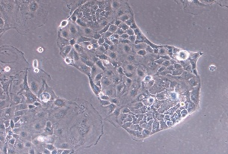
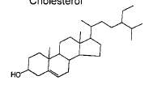
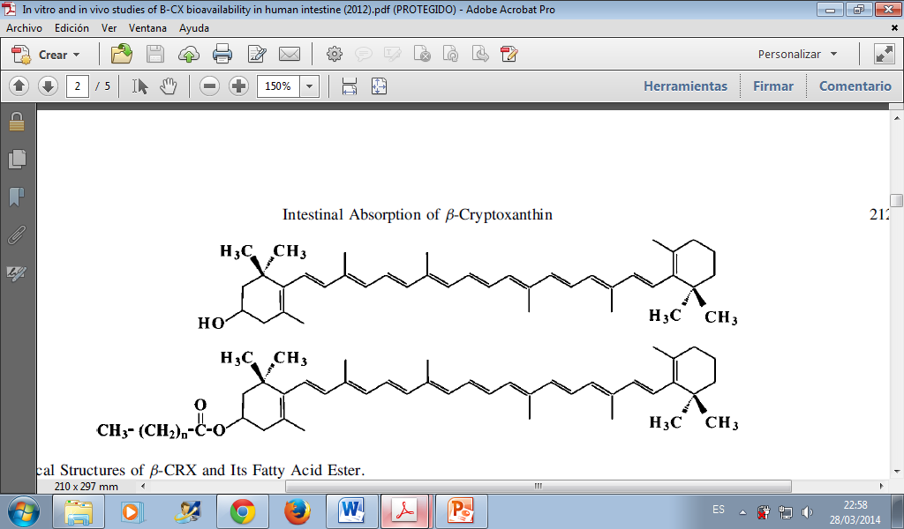
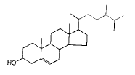

SAMPLES AND METHODS
SAMPLES
METHODS
Standards (alone or in combination) at phyisiological human serum concentrations according to:
Cilla et al., Ann Nutr. Metab. (2011) 58, suppl 3, 104
Granado-Lorencio et al., J. Agric. Food Chem. (2011) 59, 11819-24
Cell treatment
(continuous incubation 24 h with phytochemical standards)
Caco-2 cells
Cell viability - MTT test (Spectrophotometry)
Cell cycle (Flow cytometry)
Apoptosis Annexin V (Flow cytometry)
Mitochondrial membrane potential (Flow cytometry)
Intracellular Ca²⁺ (Flow cytometry)
Reactive oxygen species ROS (Flow cytometry)
Total thiols (Spectrophotometry)
Pro-apoptotic BAD protein (Western blot)
PARP-1 / caspase-3 susbtrate (Western blot)
β-cryptoxanthin
β-sitosterol
Campesterol
Stigmasterol
Notes:
Colon cancer Caco-2 cells were treated 24 h with beta-cryptoxanthin or main dietary phytosterols (beta-sitosterol, campesterol and stigmasterol) alone or in combination at concentrations compatible with physiological serum concentrations based on previous studies.
Different biochemical and molecular parameters were analyzed involving spectrophotometric, flow cytometry and Western blot analysis, to check the antiproliferative and apoptotic mechanisms of the compounds.

Slide 13
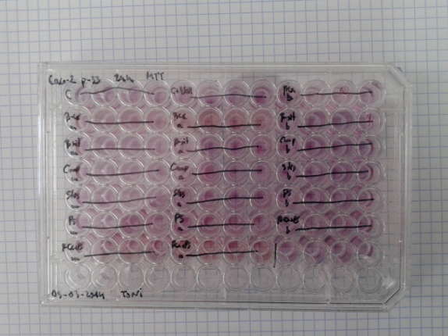
RESULTS
A) IMPACT ON VIABILITY AND APOPTOSIS
a
bc
bcd
cdef
cde
cdef
defg
cdefg
efg
cdefg
g
g
fg
Different letters denote statistical significant differences (p<0.05) using one-way ANOVA followed by LSD post-hoc test.
Notes:
As it can be observed in the graphic of cell viability, all the treatments displayed a significant decrease in cell viability compared with control cells, with the exception of beta-cryptoxanthin and campesterol at their lowest concentrations tested.
This decrease in cell viability ranged between 21 to 44%, without great differences among the different samples assayed (standards alone or mixtures of compounds, only phytosterols and beta-cryptoxanthin and phytosterols).
In addition, no additive or synergistic effects were observed in mixtures, but a trend, although not statistically significant, towards a lower antiproliferative activity with mixtures containing higher amounts of phytochemicals.

Slide 14
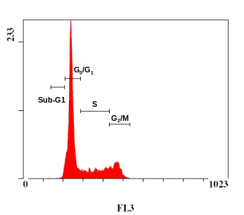
RESULTS
A) IMPACT ON VIABILITY AND APOPTOSIS
Cell cycle distribution
*
*
*
*
*
*
An asterisk indicates statistically significant diferences (p<0.05) versus control using one-way ANOVA followed by LSD post-hoc test
Notes:
Regarding cell cycle, all treatments exerted a significant effect on cell cycle progression compared with control cells. The presence of a significantly higher proportion of cells in sub-G1 phase (considered a marker of cell death by DNA fragmentation associated with apoptosis) was observed with all treatments, with the exception of beta-sitosterol. This compound exerted a significant 16% increase in G2/M phase, indicating a potential role in cell cycle arrest.
The induction of sub-G1 phase was highest in PS mix and stigmasterol, and lowest with beta-cryptoxanthin. These results indicate again the absence of synergistic effects of compounds in mixtures but an apparent predominant action of stigmasterol.

Slide 15
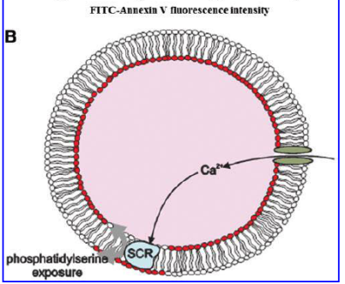
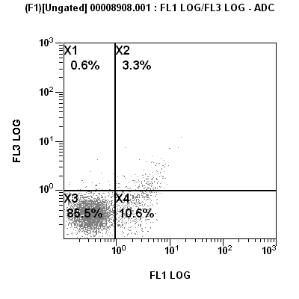



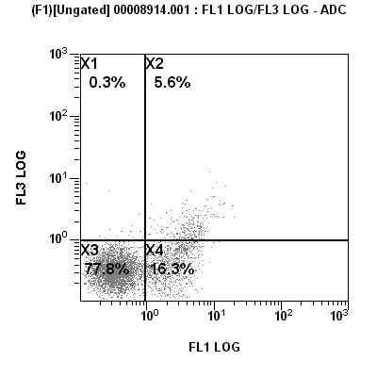
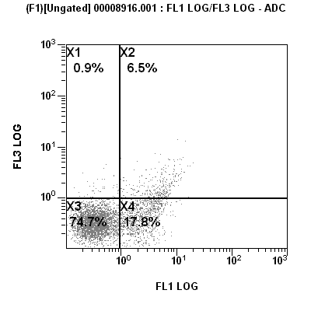
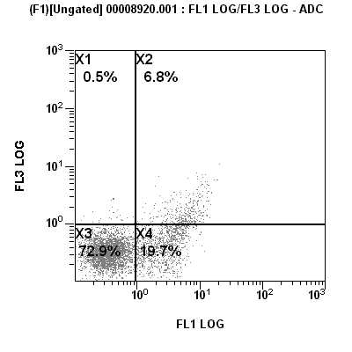
RESULTS
A) IMPACT ON VIABILITY AND APOPTOSIS
Apoptosis (Annexin V)
β-CX (3 µM)
β-sit (12µM)
PI
PI
Control
Annexin V
Annexin V
Camp (1 µM)
Stig (0.25 µM)
PI
PI
PI
Annexin V
Annexin V
Annexin V
PS mix
β-CX+PS mix
PI
PI
Annexin V
Annexin V
Notes:
As pro-apoptotic markers, it was determined: i) externalization of plasma membrane phisphatidylserine, ii) changes in mitochondrial transmembrane potential and iii) cleavage of poly(ADP-ribose)polymerase.
According to the Annexin V assay, all phytochemicals induced a 2- to 4- fold increase in early apoptosis. In addition, stigmasterols and both mixtures doubled the proportion of cells in late apoptosis, as compared with control.
Globally, the highest effects were found in mixtures and again with a marked effect of stigmasterol.

Slide 16
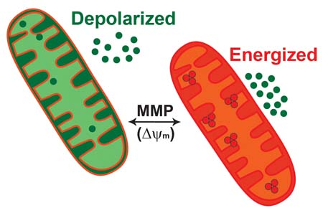
RESULTS
A) IMPACT ON VIABILITY AND APOPTOSIS
Changes in mitochondrial membrane potential (MMP)
*
*
*
*
*
An asterisk indicates statistically significant diferences (p<0.05) versus control using one-way ANOVA followed by LSD post-hoc test
Notes:
Loss of mitochondrial transmembrane potential is considered a feature of apoptosis in early stages.
All treatments caused a fall (not significant for beta-sitosterol) in mitochondrial membrane potential (between 31-36% versus control), but without differences among them.

Slide 17
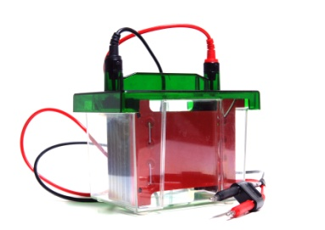

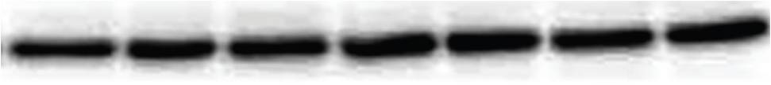
RESULTS
A) IMPACT ON VIABILITY AND APOPTOSIS
Poly(ADP-ribose)polymerase (PARP) cleavage
β-CX
(3 µM)
β-sit
(12 µM)
Stig
(0.25 µM)
Control
Camp
(1 µM)
PS mix
β-CX + PS mix
a
b
d
d
d
b
PARP (116KDa)
c
Cleaved product (89KDa)
Actin
Notes:
Cleavage of specific target proteins such as PARP-1 by activated caspase-3 was investigated.
In this case, treatment of cells with the phytochemicals caused a cleavage of PARP-1, with accumulation of the 89 kDa fragment and a concomitant decrease of the full-lenght protein of 116 kDa, compared to control.
The affect was higher for beta-sitosterol and lower with beta-cryptoxanthin and mixture of phytochemicals containing beta-cryptoxanthin.

Slide 18
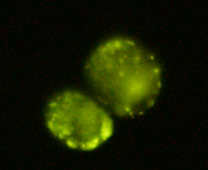
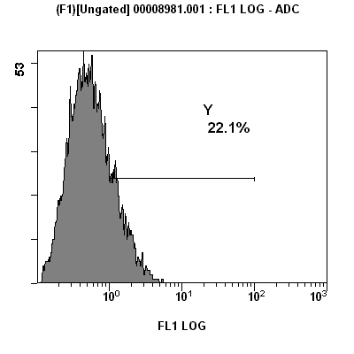
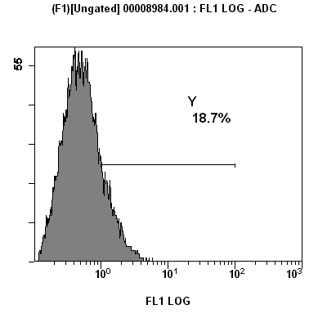
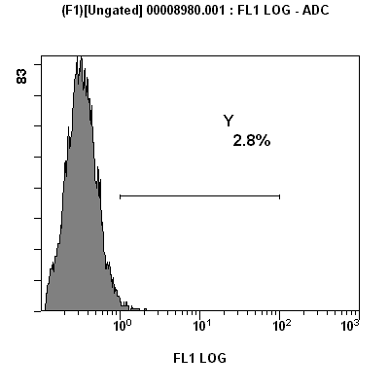

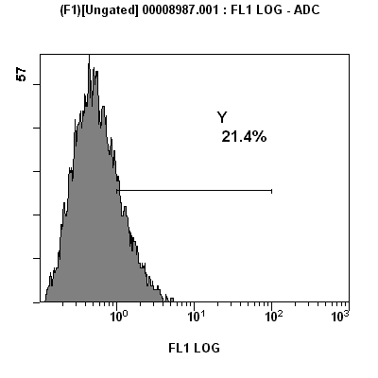
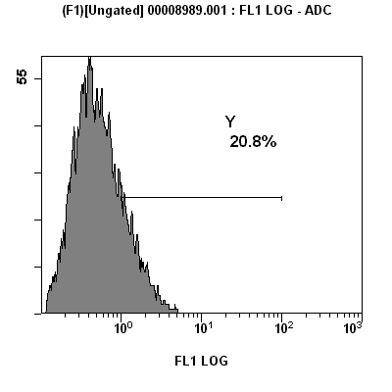
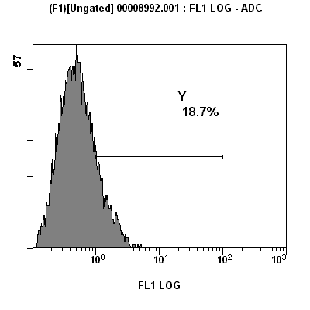
RESULTS
B) REDOX STATE
β-CX (3 µM)
β-sit (12µM)
Reactive oxygen species (ROS)
Control
Camp (1 µM)
Stig (0.25 µM)
PS mix
β-CX+PS mix
Notes:
Considering the redox state of the cells, it is known that ROS development in cancer cells may lead to cell death.
The flow cytometry determination of intracellular levels of ROS showed an approximately 10-fold increase with all treatments compared to controls, without appreciable differences among treatments.

Slide 19
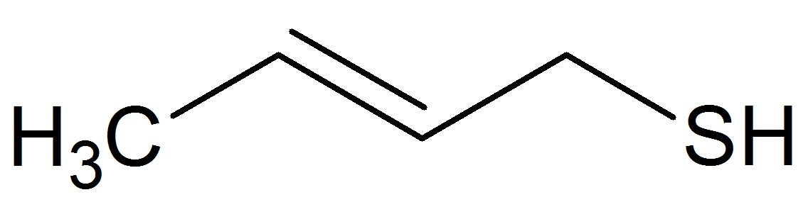
RESULTS
B) REDOX STATE
Total thiols (-SH)
e
de
cd
cd
bc
b
a
Different letters (a-e) denote statistical significant differences (p<0.05) using one-way ANOVA followed by LSD post-hoc test.
Notes:
Next step in the cell redox status, was the determination of total thiols (determination which include reduced glutahione (GSH) as the main non enzymatic intracellular antioxidant compound).
Surprisingly, and contrary to that expected, all treatments evoked an increase in total thiol levels compared with control, being higher with Ps (plant sterols) mix and lower with campesterol (without apparent additive or synergistic effects).
However, these results can be explained as an defensive or adaptative response of cancer cells trying to avoid oxidative stress, since it has been reported high levels of GSH in many human cancer cells. In line with this, it was observed an increase in total proteins after treatments, what partly could explain this phenomenon.

Slide 20

RESULTS
C) Ca²⁺ AND RELATED SIGNALLING PATHWAYS
Cytosolic calcium influx
e
d
bc
cd
bc
ab
a
Different letters (a-e) indicate statistically significant diferences (p<0.05) versus control using one-way ANOVA followed by LSD post-hoc test
Notes:
One of the initial triggers in the apoptotic events is the induction of intracellular calcium elevation, which precedes diferent steps in the apoptotic cascade.
Accordingly, it was determined calcium influx by flow cytometry. Results indicated a significant increase in cytosolic calcium with all treatments with the exception of campesterol (only showing a non-significant trend of rise).
Here, Ps mix displayed the highest value, with a very nearly additive effect, while the presence of beta-cryptoxanthin in the mixture decreased the effect.

Slide 21

RESULTS
C) Ca²⁺ AND RELATED SIGNALLING PATHWAYS
Pro-apoptotic BAD dephosphorilation
Control
β-CX
(3 µM)
β-sit
(12 µM)
Camp
(1 µM)
Stig
(0.25 µM)
β-CX + PS mix
a
PS mix
b
c
c
d
bc
d
p-BAD
(Ser 136)
Actin
Notes:
Finally, the activation of the pro-apoptotic protein BAD was determined.
It is known that dephosphorilation of BAD acts as a pro-apoptotic factor that interacts and inhibits the anti-apoptotic protein Bcl-2, a fact that is linked with intracellular Ca2+ elevation in early steps of apoptosis.
So, we observed a decrease in the levels of phosphorylated BAD protein in comparison with control, being higher for beta-sitosterol, campesterol and Ps-mix and lowest in stigmasterol and mixture with beta-cryptoxanthin.

Slide 22
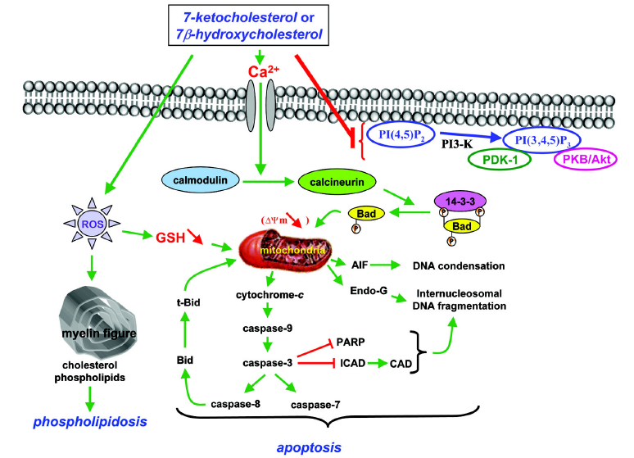
RESULTS
OVERVIEW
β-cryptoxanthin / β-sitosterol Campesterol / Stigmasterol
Rise in cell cycle sub-G1
Externalization of phosphatidylserine
Adapted from Vejux et al., Braz. J. Med. Biol. Res. (2008) 41, 545-556
Notes:
To summarize the molecular mechanisms involved in the anti-proliferative activity of the phytochemicals analyzed, the decrease in cell viability was linked with the induction of apoptosis due to a rise in sub-G1 population in cell cycle and externalization of phosphatidylserine. The initial triggers for this apoptotic cell death can be the influx of Ca2+ ions and increase of ROS levels, leading to mitochondrial depolarization and the activation of proapoptotic BAD protein and as a final step the cleavage of PARP by activated caspase-3.

Slide 23
CONCLUSIONS
β-cryptoxanthin and/or main dietary phytosterols (alone and in combination) reduced cell growth of colon cancer Caco-2 cells up to 44% due to apoptosis, possibly through the mitochondrial pathway
No clear dose-response was observed, neither additive nor synergistic effect for mixtures, but they retain the same antiproliferative activity as individual compounds indicating absence of antagonistic actions
The effects were obtained with concentrations compatible with physiological serum levels in humans and with reported bioavailability of these phytochemicals after regular consumption of a beverage containing a mix of all these molecules
Notes:
As a conclusion of this study, it can be indicated that…(leer conclusiones)

Slide 24
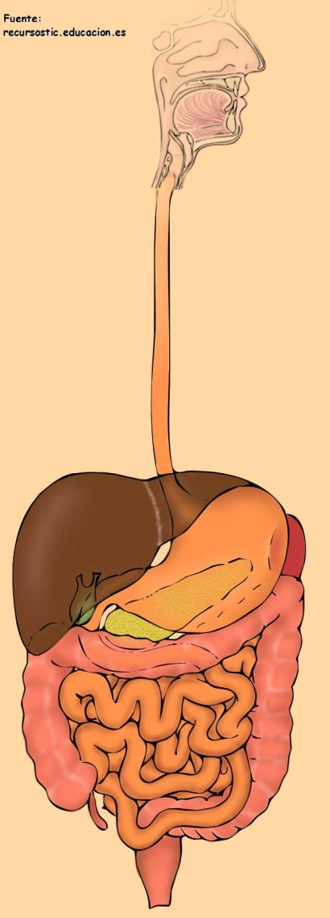
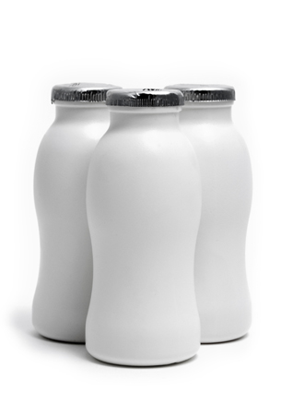
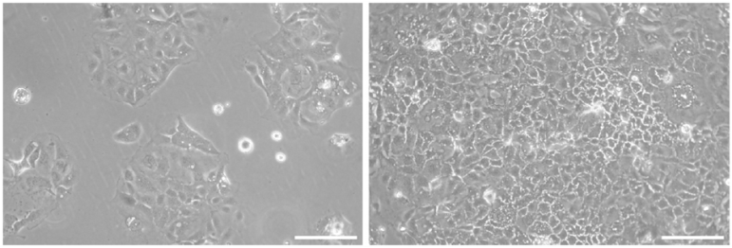
FUTURE RESEARCH
Functional beverages containing phytosterols and β-cryptoxanthin
In vitro gastrointestinal digestion
In vitro colonic fermentation
Anti-proliferative activity
Colon cancer (Caco-2 cells)
Notes:
The results of this study highlight the importance of conducting further assays of antiproliferative activity with whole foods.
In this sense, we are currently performing assays with functional beverages containing these phytochemicals and subjeted to an in vitro gastrointestinal digestion and to colonic fermentation to see the persistence or not of the antiproliferative activity of mixtures of phytosterols and beta-cryptoxanthin in colon cancer cells.

Slide 25
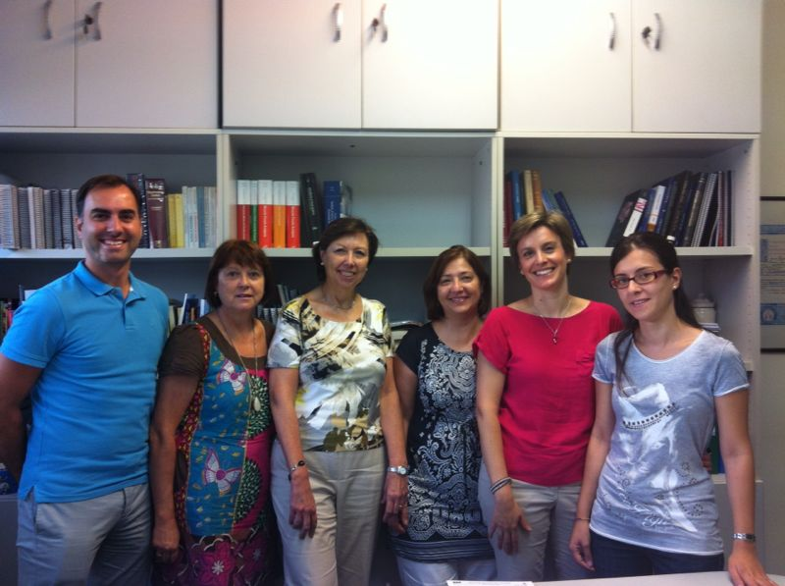

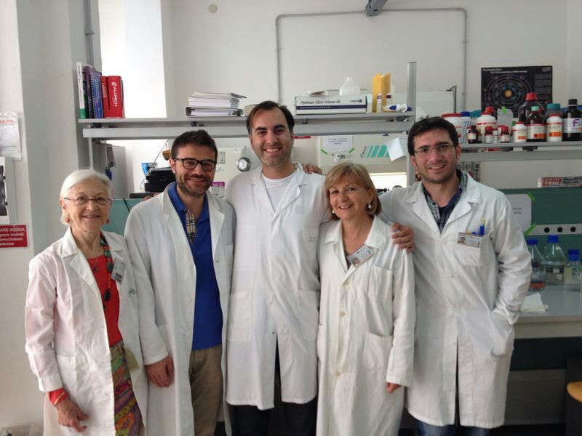
ACKNOWLEDGEMENTS
Laboratory of Biochemistry (STEBICEF).
University of Palermo
Dr. Maria Antonia Livrea
Dr. Luisa Tesoriere
Dr. Alessandro Attanzio
Dr. Mario Allegra
Bionutest research group. University of Valencia
Dr. Reyes Barberá
Dr. María Jesús Lagarda
Dr. Amparo Alegría
Dr. Guadalupe García- Llatas
Lorena Claumarchirant PhD student
Notes:
Before to end, I want to acknowledge all the people of my lab in Valencia for the kind day a day work, and specially the maravillous people of the Laboratory of Biochemistry at the University of Palermo, where I did a research stay and performed this study.

Slide 26
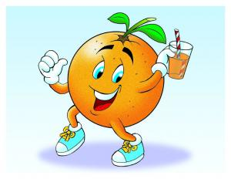
Thank you for your attention

