Slide 1
PD1-PDL1 AXIS IN LYMPHOPROLIPHERATIVE DISEASES:
THE PATHOLOGIST’S POINT OF VIEW.
Dr Antonella Bianchi
Pathology Unit of Campus Bio Medico University of Rome, Italy
7th World Hematologists Congress
May 08-09 2017
Barcelona, Spain

Slide 2
PhysiologicAL PD-1/PD-L1 checkpoint
Programmed death-1 (PD-1) receptors are inducibly expressed on activated T cells, and function to limit T-cell-mediated immune responses.
PD-1 ligands, PD-L1 (B7-H1 or CD274) and PD-L2 (B7H3 or CD273), are physiologically expressed respectively by a subset of cells of the hematopoietic lineage (B cells, T cells and macrophages) and by antigen-presenting cells and epithelial tissues.
They can be up-regulated in certain solid tumors and lymphomas.
PD-L1 upon binding to PD-1 receptors, leads to the reduction of T-cell receptor (TCR) signaling, which is essential in maintaining immune tolerance and balanced responses to eliminate pathogens and tumor cells.

Slide 3
PD-1/PD-L1 checkpoint: AN IMMUNE ESCAPE STRATEGY OF TUMORS
  There are two mechanisms of expression of immune checkpoint ligands on tumors cells:
    Constitutive expression of PD-L1 by tumors cells because of genetic alterations to the PD-L1 and PD-L2 locus of chromosome 9p24.1 (gains, amplifications or fusions).
    Activation of signaling pathways, independent of inflammatory signals (intrinsic immune resistance) or through an induced response to inflammatory signals produced by an active anti-tumor immune response (adaptive immune resistance).
  The adaptive immune resistance refers to the dynamic induction of PD-L1 expression on tumor cells in response to specific cytokines, in particular IFN-ɣ.
  Due to its role in suppressing T-cell function, one can see why the PD-1/PD-L1 pathway can be utilized by tumors to reduce or evade the host antitumor immune responses.

Slide 4
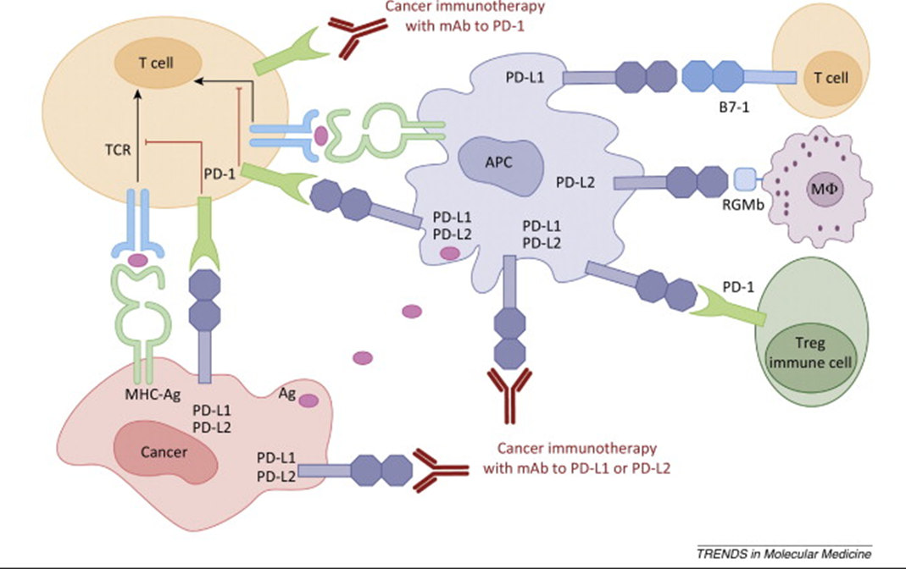
PD-1/PD-L1 checkpoint: AN IMMUNE ESCAPE STRATEGY OF TUMORS
Antitumor immunity is initiated by T cell priming and activation after tumor antigen presentation in the context of Major Histocompatibility Complex (MHC) molecules expressed by Antigen Presenting Cells (APC).
After activation, effector T cells start releasing several cytokines (GM-CSF, IL-4, IFNγ) inducing PD-L1 up-regulation.
The interaction of the up-regulated PD-L1 receptor in tumor cells with inhibitory receptor PD-1 expressed on activated T cells delivers inhibitory signals that cause apoptosis, anergy or functional exhaustion of the T cells.
The disruption of PD-1/PD-L1 interaction using antibodies directed against PD-1 or PD-L1 restores the T cell capability to exert cytolytic functions directed to neoplastic cells.

Slide 5
immunotherapy targeting PD-1 and PD-L1
Partial or complete response was seen in different trials on different types of advanced cancers as melanoma, renal cell carcinoma, and non-small-cell lung cancer (NSCLC) with durable treatment response with at least 1 year of follow-up, both with anti-PD-L1 antibody (Atezolizumab) and with anti-PD-1 antibody (Nivolumab and Pembrolizumab), which blocks the interaction of PD-1 with its ligands.
As most treatment-related adverse events were low grade, with some potential immune-related adverse events, immunotherapy targeting PD-1 and PD-L1 will be increasingly integrated into the treatment of selected tumors.

Slide 6
Assessment of PD-L1 expression by immunohistochemistry
In patients with solid tumors, a subset of patients (36%) who had PD-L1-positive tumors had objective response to the anti-PD-1 drug, while none of the patients who had PD-L1-negative tumors had objective response.
Therefore, the assessment of PD-L1 expression through immunohistochemical staining is advocated as a potential biomarker that allows better selection of patients who are likely to respond to targeted immunotherapy, to improve treatment efficacy and to manage cost of therapies.
Consequently, the success of checkpoint blockade therapy in the treatment of different solid tumors encourages the research for similar results in the wide spectrum of lymphoproliferative diseases.

Slide 7
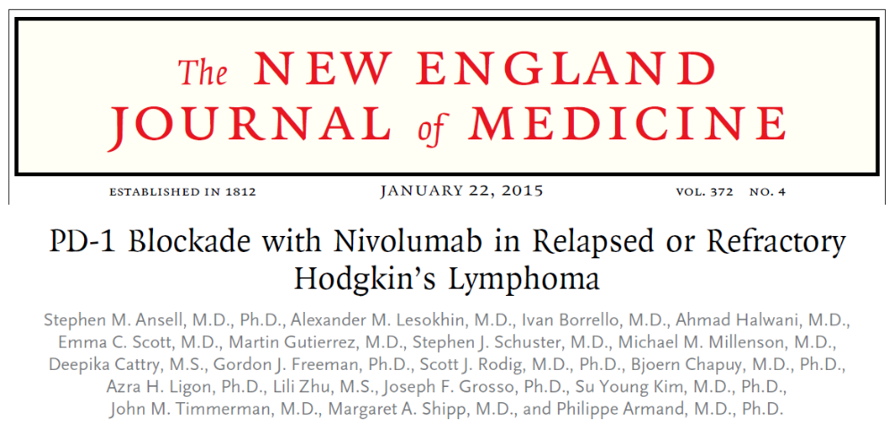
PD-1/PD-L1 IN HODGKIN’S LYMPHOMA
In the phase 1 study of Ansell et al., in 23 patients, with relapsed or refractory Hodgkin's Lymphoma, treated with Nivolumab, all Reed–Sternberg cells, which were identified by their characteristic morphologic features and staining for PAX5, expressed PD-L1 protein.
The response rate was 87%, with a complete response occurring in 4 patients (17%), a partial response in 16 patients (70%), and stable disease in 3 patients (13%).
Nivolumab-mediated PD-1 blockade was then recognized to be a promising targeted treatment, given the limited therapeutic options for patients with Hodgkin's Lymphoma, heavily pretreated, and whose disease progresses after autologous stem-cell transplantation.
Ansell, S.M., et al., PD-1 blockade with nivolumab in relapsed or refractory Hodgkin's lymphoma. N Engl J Med, 2015. 372(4): p. 311-9.

Slide 8
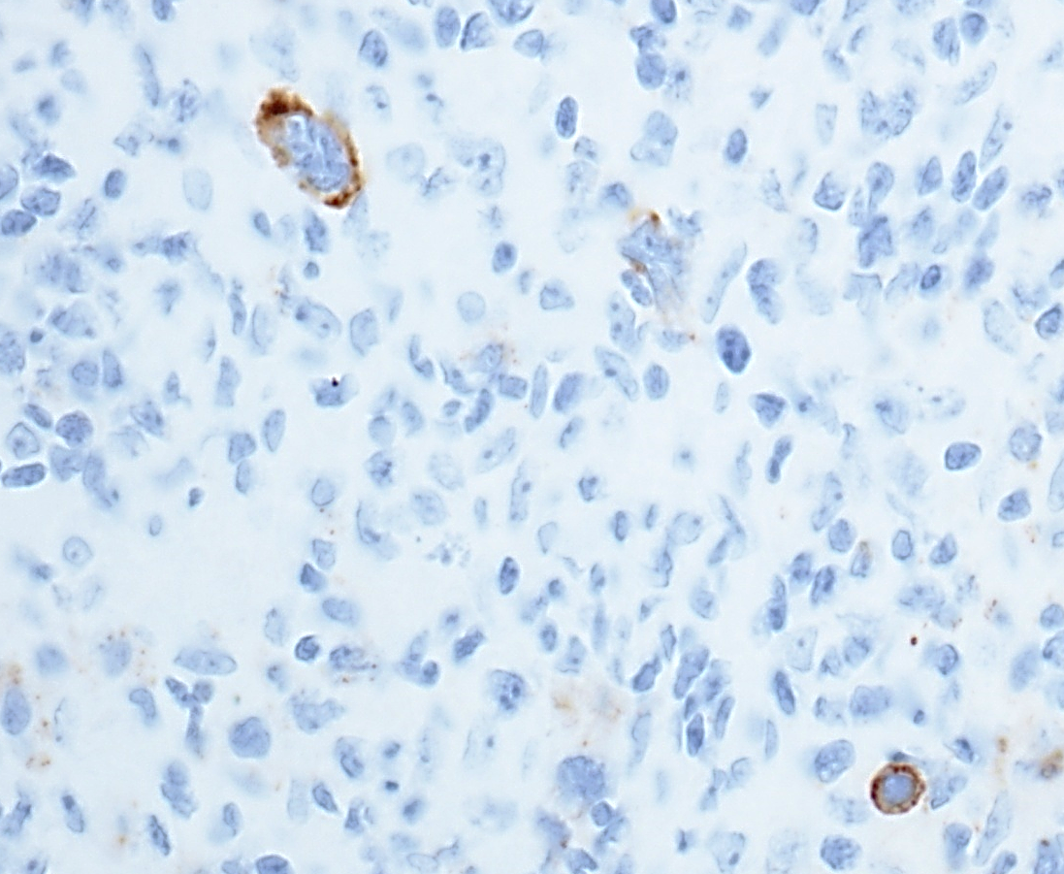
PD-L1+ Reed-Sternberg Cell
PD-L1+
Reed-Sternberg Cell
PD-L1+
Immune Cell
40X
CD274 BioSB, Santa Barbara, CA

Slide 9
PD-1/PD-L1 expression in Lymphomas: an overview of most recent immunohistochemical studies

Slide 10
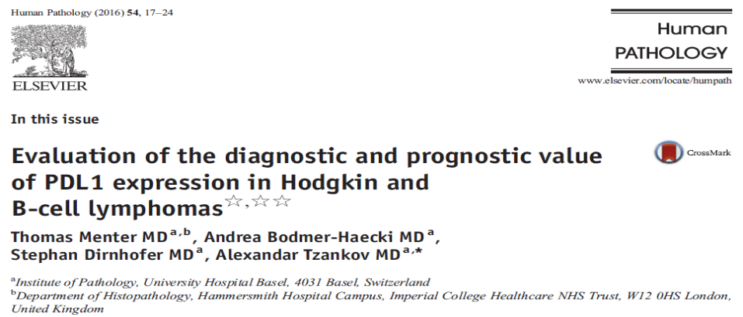
PD-1/PD-L1 in lymphoid malignancies
Menter et al. evaluated the diagnostic and prognostic value of PD-L1 on tissue microarrays and whole slides in a total number of 899 cases of Hodgkin’s Lymphoma and different B-cell lymphoma entities with two different antibodies: clone E1L3N [Cell Signaling, Danvers, MA] and clone SP142 [Roche/Ventana, Rotkreuz, Switzerland].
The staining pattern of both antibodies was membranous/submembranous with occasional dots. Sinus-lining cells and macrophages were considered as positive control.
For treatment purpose, only expression of PD-L1 on tumor cells was considered and PD-L1 positivity was defined as at least 5% positively staining tumor cells.
To be considered evaluable, cases, especially tissue microarray cases, had to exhibit at least 25% of tissue available for morphologic analysis and at least 1 positively staining tumor-infiltrating macrophage as positive internal control.
They had to contain unequivocal tumor cells, and, in cases of classic Hodgkin’s Lymphoma, at least 5 Hodgkin and Reed-Sternberg cells or, in cases of Nodular Lymphocyte-Predominant Hodgkin’s Lymphoma, 4 lymphocytic & histiocytic cells.
Menter, T., et al., Evaluation of the diagnostic and prognostic value of PDL1 expression in Hodgkin and B-cell lymphomas. Hum Pathol, 2016. 54: p. 17-24.

Slide 11
PD-1/PD-L1 in lymphoid malignancies (2)
In cases of Burkitt Lymphoma, classic Hodgkin’s Lymphoma, Diffuse Large B Cell Lymphoma, Marginal Zone Lymphoma with a high-grade component, Nodular Lymphocyte-Predominant Hodgkin Lymphoma, and Primary Mediastinal B Cell Lymphoma, tumor cells were morphologically easily identifiable for scoring.
In the so-called low-grade B cell Lymphomas, only tumor cell−rich areas, as assessed on consecutive slides stained with tumor cell typical markers such as Cyclin D1, CD20, or bcl6, were considered for PD-L1 evaluation.
PD-L1 expression was observed in:
  most cases in Hodgkin and Reed Sternberg cells of Hodgkin’s Lymphoma and on almost all tumor cells;
  31% of Diffuse Large B Cell Lymphoma cases on a considerable amount of tumor cells;
  35% of Primary Mediastinal B Cell Lymphoma;
  5% of Follicular Lymphoma only on a small proportion of tumor cells;
  10% of Marginal Zone Lymphoma with a high-grade component.
All cases of Lymphoplasmacytic Lymphoma, Mantle Cell Lymphoma, Burkitt Lymphoma and T-cell and histiocyte-rich B-cell Lymphoma were negative for PD-L1 on tumor cells, but the latter showed PD-L1 expression on infiltrating cells.
Menter, T., et al., Evaluation of the diagnostic and prognostic value of PDL1 expression in Hodgkin and B-cell lymphomas. Hum Pathol, 2016. 54: p. 17-24.

Slide 12
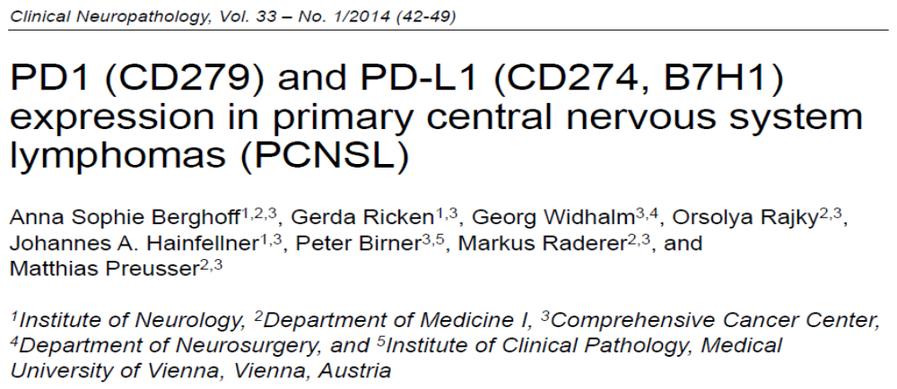
PD-1/PD-L1 in lymphoid malignancies
Berghoff et al. performed immunohistochemistry for PD-L1 with anti-human monoclonal mouse antibody (5H1, provided by Dr. Lieping Chen, Yale University, dilution 1 : 100) on tissue specimens of 20 immunocompetent patients with Primary Central Nervous System Lymphomas, treated with neurosurgical resection.
A specific, strong, and fully membranous immunoreactivity on more than ~5% of any cell type was considered positive.
They observed strong PD-L1 expression on tumor cells in 20% of cases with prominent membranous expression and on intra-tumoral histiocytes in 20% of tumors.
Berghoff, A.S., et al., PD1 (CD279) and PD-L1 (CD274, B7H1) expression in primary central nervous system lymphomas (PCNSL). Clin Neuropathol, 2014. 33(1): p. 42-9.

Slide 13

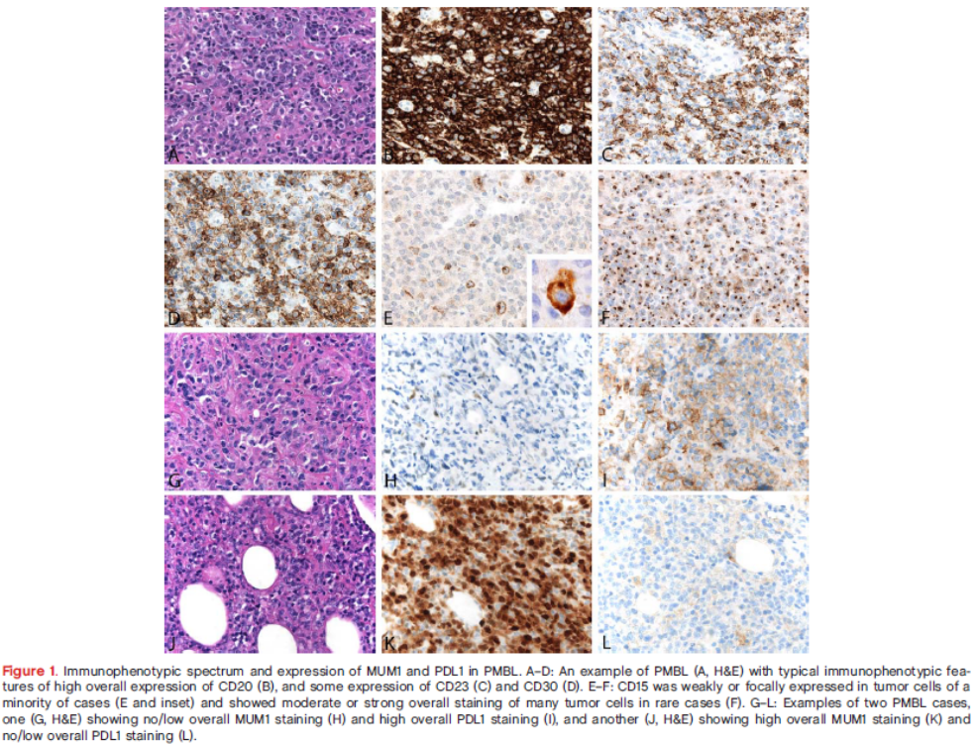
PD-1/PD-L1 in lymphoid malignancies
Bledsoe et al observed PD-L1 expression in 71% of Primary Mediastinal Large B-cell Lymphoma.
Bledsoe, J.R., et al., The immunophenotypic spectrum of primary mediastinal large B-cell lymphoma reveals prognostic biomarkers associated with outcome. Am J Hematol, 2016. 91(10):E436-41

Slide 14
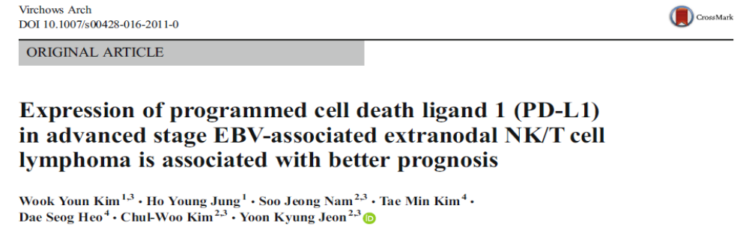
PD-1/PD-L1 in lymphoid malignancies
Expression of PD-L1 was also demonstrated in advanced stage EBV-associated Extranodal NK/T cell Lymphoma by Kim et al. Immunohistochemistry was performed by using a rabbit anti-PD-L1 (E1L3N) XP® monoclonal antibody (Cell Signaling Technology, Danvers, MA, USA).
Expression was semi-quantitatively evaluated in a representative area with >80% of tumor cells. Tumor areas with >20% of necrosis were excluded.
The proportion of total PD-L1+ cells including tumor cells and peri-tumoral reactive cells was also scored independently.
Immunohistochemical expression of PD-L1 was scored according to the proportion of stained cells and grouped into the following categories: 0, 1–9, 10–24, 25–50, and ≥50 %.
Staining intensity was assessed in a three-tiered approach: weak, moderate, or strong.
PD-L1 expression of tumor cells was deemed as positive when ≥10% of tumor cells showed moderate or strong immunoreactivity.
Tumor microenvironment was considered as positive for PD-L1 if ≥10% of total cells demonstrated moderate or strong staining intensity.
The Authors concluded that PD-L1 expression is a favorable prognostic indicator.
Kim, W.Y., et al., Expression of programmed cell death ligand 1 (PD-L1) in advanced stage EBV-associated extranodal NK/T cell lymphoma is associated with better prognosis. Virchows Arch, 2016. 469(5): p. 581-590.

Slide 15
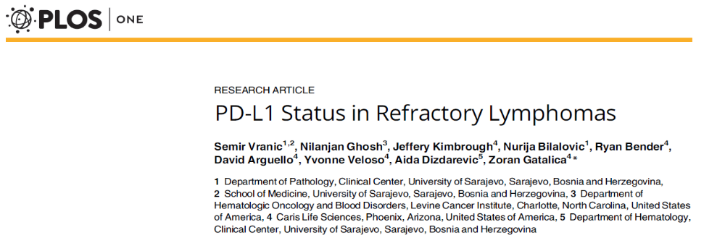
PD-1/PD-L1 in lymphoid malignancies
PD-L1 expression assessment was performed by Vranic et al. in refractory and/or resistant lymphomas of B-and T-cell lineages.
Fixed Formalin Paraffin Embedded sections were treated with PD-L1 (Clones:SP142 and SP263,Ventana MedicalSystems,Tucson, AZ) using automated immunohistochemical methods at a CLIA/CAP/ISO15189-certified lab (Caris Life Sciences, Phoenix ,AZ).
Cases were considered positive when 5% of the neoplastic cells exhibited membranous positivity with2+/3+intensity. PD-L1 expression was also evaluated in adjacent population of reactive/inflammatory cells.
Overall PD-L1 positivity (>5% positive cancer cells with 2+/3+ intensity) was 42% bySP142 and 46% by SP263 antibody.
The highest PD-L1 positivity was observed in classic Hodgkin’s Lymphoma (91%) and Primary Mediastinal B-cell Lymphoma (100%). Diffuse Large B-cell Lymphomas were frequently positive (50%) irrespective of subtype.
Follicular, Peripheral T-cell and Mantle cell Lymphomas were rarely positive, while Small Lymphocytic Lymphoma/CLL and Marginal Zone Lymphoma were consistently negative.
A single case of Diffuse Large B-cell Lymphoma arising in Follicular Lymphoma exhibited positivity exclusively in large cell component (~25% by 2–3+intensity by both antibodies) while low grade component was devoid of PD-L1 expression. The mean percentage of PD-L1 positivity in tumor cells was 21% (range, 5–100%).
The Authors also evaluated PD-L1 positivity in adjacent inflammatory (reactive) cell population; fifty-five out of 58 cases (95%) had PD-L1 positivity in reactive/inflammatory cells (ranging from single cells to abundant reactive population as typically seen in classic Hodgkin’s Lymphoma); only 3 cases had no visible PD-L1+ reactive cells by both clones.
Vranic, S., et al., PD-L1 Status in Refractory Lymphomas. PLoS One, 2016. 11(11): p. e0166266.

Slide 16
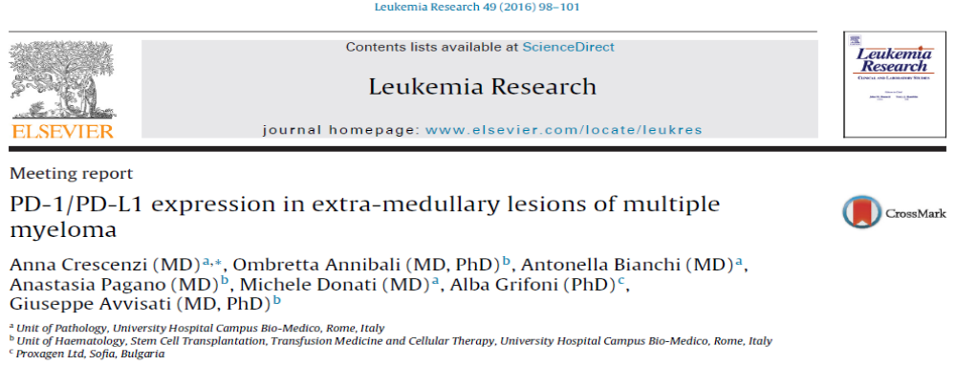
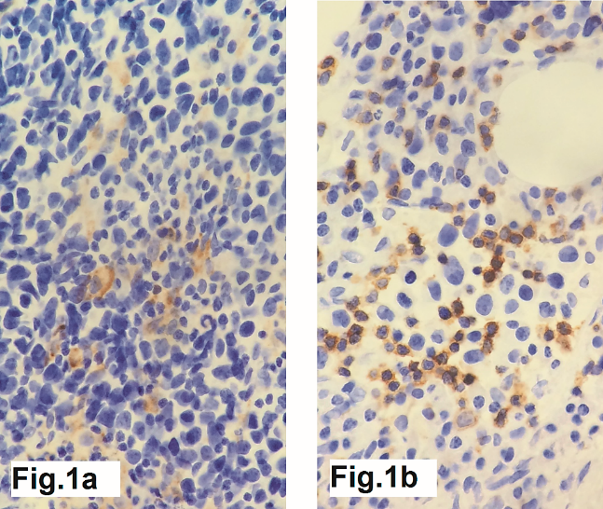
PD-1/PD-L1 in Multiple Myeloma
Multiple Myeloma is characterized by overexpression of PD-L1 due to bone marrow microenvironment.
We recently reported expression of PD-L1 also in the extra-medullary lesions of multiple myeloma supporting the fact that PD-L1 up-regulation occurs also outside the bone marrow location.
1a: PD-L1 immunohistochemistry (CD274 BioSB, Santa Barbara, CA) shows positive reaction on cell membrane of neoplastic plasma cells.
1b: PD-1+ (NAT-105 Dako) infiltrating lymphocytes are present within neoplastic cells.
Crescenzi et al. PD-1/PD-L1 expression in extra-medullary lesions of multiple myeloma. Leukemia Research 49 (2016) 98–101

Slide 17
Immunohistochemistry:
Problems and pitfalLs

Slide 18
Problems and pitfalLs
Immune checkpoint blockade with PD-1/PD-L1 has considerably changed the cancer treatment paradigm with remarkable results in several solid tumors as well as in classic Hodgkin’s Lymphoma.
However, predictive value of immunohistochemical biomarkers (thresholds, cellular distribution, methods of analysis) for the PD-1/PD-L1 axis inhibition need still be refined.

Slide 19
Antibodies CLONES
Immunohistochemistry testing is relatively inexpensive and easy to perform, but interpretation is complicated by the fact that different clones of monoclonal antibodies raised against the same protein are specific for different parts (epitopes) of the PD-L1 molecule.
Thus, different clones may give different staining results.
A number of PD-L1 antibodies clones are available as pre-packaged kits or as free antibodies, using different staining platforms and different staining protocols, with or without enhancement systems.
Standardization may be improved by using pre-packaged test kits of reagents running on company-specific staining platforms with an industry standard.
It is possible to produce very reliable and accurate ‘‘home brew’’ laboratory-developed tests, however, not every laboratory has the time or experience to validate laboratory-developed tests.

Slide 20
PREANALYTICAL/ANALYTICAL PHASES
Fixed Formalin Paraffin Embedded tissues are suitable for staining and allows morphologic evaluation of site of the predictive biomarker expression.
However, immunohistochemistry is sensitive to pre-analytical parameters (e.g. cold ischemia, type and duration of fixation, handing and processing, treatment of sections, antigen-retrival steps) that may influence the reproducibility and reliability of the results.
Recommendations
The recommended fixation time should be 24-48 hours in 10% neutral buffered formalin.
The paraffin temperature should not exceed 60°C.
Paraffin sections should be cut at 4-5 microns.
Negative and positive control slides should be included in each staining run.
Slide evaluation should be performed by a pathologist using a light microscope.
The scoring may be achieved using 10-20x objectives and confirmed at 40x if needed.
The staining need to be repeated if positive control fails to stain, negative control shows any grade of staining, or if staining background, limiting scoring interpretation, is present is the patient’s slide. Pathologists must distinguish what constitutes true staining or artifact for each particular assay.

Slide 21
TUMOR heterogeneity
In some lymphoma subtypes, the identification of PD-L1 positive tumor cells may be challenging due to the abundant reactive/inflammatory cells (e.g. peripheral T-cell Lymphoma and classic Hodgkin Lymphoma).
Several of the clinical studies report a dose-response relationship between PD-L1 expression and drug efficacy.
However, PD-L1 expression is:
  dynamic because it is a patho-physiologically inducible factor;
  a biological continuum from absent through low to intermediate to high levels of expression;
  heterogeneous among tumor cells, especially challenging if only biopsies are evaluated.
Nevertheless, even if identifying a cutoff point for expression above which the tumor is deemed positive, and below as negative, is an artificial creation, immunohistochemistry has been considered the most efficient method for patient selection.
Despite the fact that the cancer’s immune escape mechanisms are complex, as is the immune response itself, so far there are no other proven biomarkers with sufficient data available for clinical relevance.

Slide 22
INFILTRATING IMMUNE CELLS
Biomarker expression in lymphoid or other immune effector cells is a special challenge for pathologists. In solid tumors:
Herbst et al. showed that PD-L1 expression on tumour infiltrating immune cells predicts responses to Atezolizumab better than PD-L1 expression on tumour cells;
Teng et al. reported that combining immunohistochemical PD-L1 expression status of tumour-infiltrating lymphocytes and tumour cells might help to select patients for combination therapies.

Slide 23
CYTOLOGICAL SAMPLES
Biomarker tests proven in trials are rarely validated for cytological samples.
Cytological samples by Fine Needle Aspiration (FNA) are rarely employed in lymphoproliferative disease, but they may be the only available specimen in effusion lymphomas.
As for other pathological evaluations, immunohistochemistry on cytological samples require a cell block preparation to obtain consistent and reliable results.

Slide 24
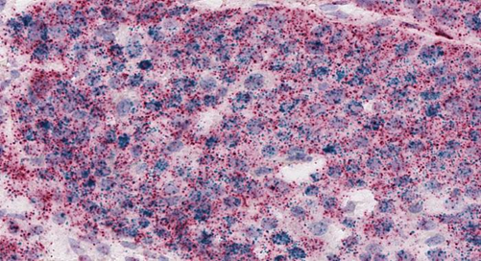
RNA PD-L1
Immune gene messenger RNA expression signatures of PD-L1 may provide interesting data in cytological samples as well as in histological specimens.
RNA In Situ Hybridization enable:
  detection of a specific RNA locus at single molecule detection sensitivity;
  sensitive and specific detection of any exon junction;
  detection of difficult targets like degraded RNA, transiently expressed RNA, and RNA in bone samples;
  analysis of broad sample types, including Formalin Fixed Paraffin Embedded tissues (including TMAs) and fresh frozen tissues.
CD274

Slide 25
PATHOLOGIC REPORT
In the report the pathologist has to indicate:
which biomarker test was used,
what the actual score assessment was,
the number of cells assessed neoplastic or inflammatory,
and then provide some comments regarding other relevant factors.

Slide 26
TAKE HOME MESSAGES
PD-L1 immunohistochemistry as a predictive assay for selecting patients for anti–PD-1 or anti–PD-L1 therapy is now a reality and is set to become a crucial step not only in solid tumors but also in lymphomas.
All pre-analytical issues (tissue fixation, handling, processing, treatment of sections) must be borne in mind when immunohistochemical tests are planned.
Morphologic evaluation is fundamental to correctly apply a scoring algorithm.
The pathologic report should be exhaustive.
A greater quantity of confirmed data is required for the validation of reporting criteria.
In the meantime, however, the pathology and hematology communities will have to wrestle with the deployment, delivery, and interpretation of the PD-L1 immunohistochemical assays for the patients being considered for these therapies.
Our patients and our health care systems can ill afford for that to happen!

Slide 27
Thank you for listening
To my presentation!

