Slide 1
Construction of cancer pathways for personalized medicine
Predictive, Preventive and Personalized Medicine & Molecular Diagnostics
Dr. Anton Yuryev
Nov 4, 2014

Slide 2
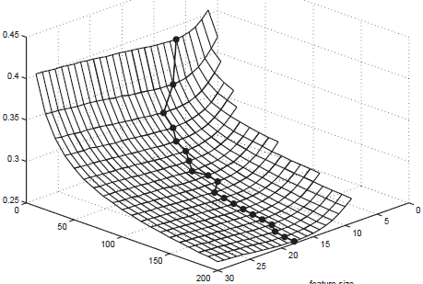
Curse of Dimensionality of OMICs data:
We will never have enough patient samples to calculate robust signatures from large scale molecular profiling data
Hua et al. Optimal number of features as a function of sample size for various classification rules. Bioinformatics. 2005
error rate
# patients
signature size
Fig.3 Optimal feature size versus sample size for Polynomial SVM classifier.
nonlinear model, correlated feature, G=1, ρ= 0.25. σ² is set to let Bayers error be 0.05

Slide 3
Mathematical requirements for short signature size vs. Biological reality
Mathematical requirement | Biological reality
Signature size must be 20-30 genes | Typical cancer transcriptomics profile has 500-2000 differentially expressed genes with p-value < 0.005
Increasing number of samples above 200 does not change optimal signature size | Typical cancer dataset has not more than 100 patients.
 | Increasing number of patients results in finding different cancer sub-types each having small number of samples
Error rate and robustness of signatures from uncorrelated feature is better than from correlated features | Most DE genes are correlated due to transcriptional linkage and different TFs regulated by only few biological pathways
 | We can use prior knowledge about transcriptional regulation to select most uncorrelated features, e.g. genes controlled by different TFs in different pathways

Slide 4
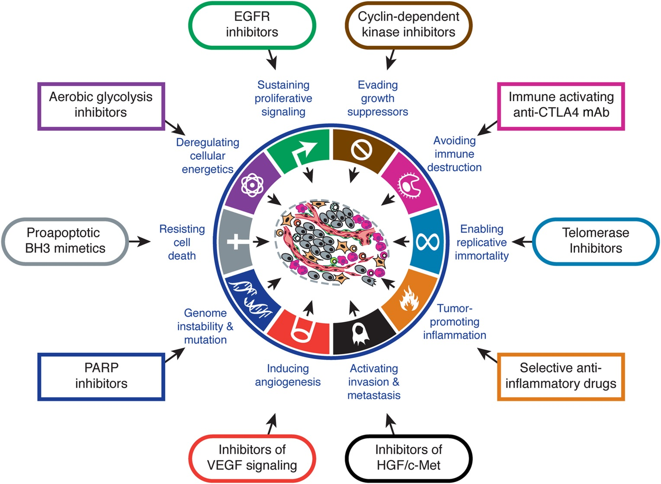
Our solution: Pathway Activity signature
SNEA (sub-network enrichment analysis) -> pathway analysis
Hanahan & Weinberg. Hallmarks of cancer: the next generation. Cell. 2011;144(5):646-74

Slide 5
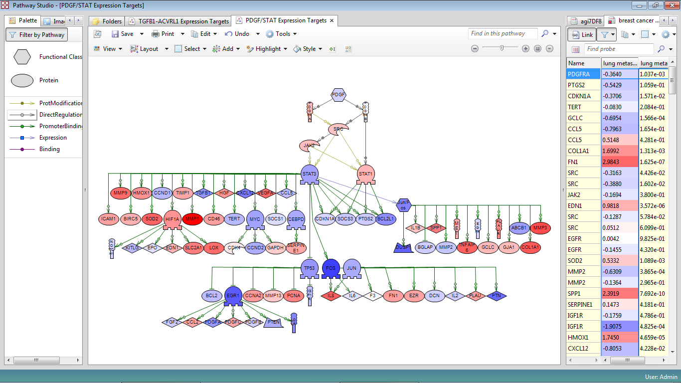
Common misconception
Pathway activity
Differential Expression of its expression targets
Pathway activity
Differential Expression of its components

Slide 6
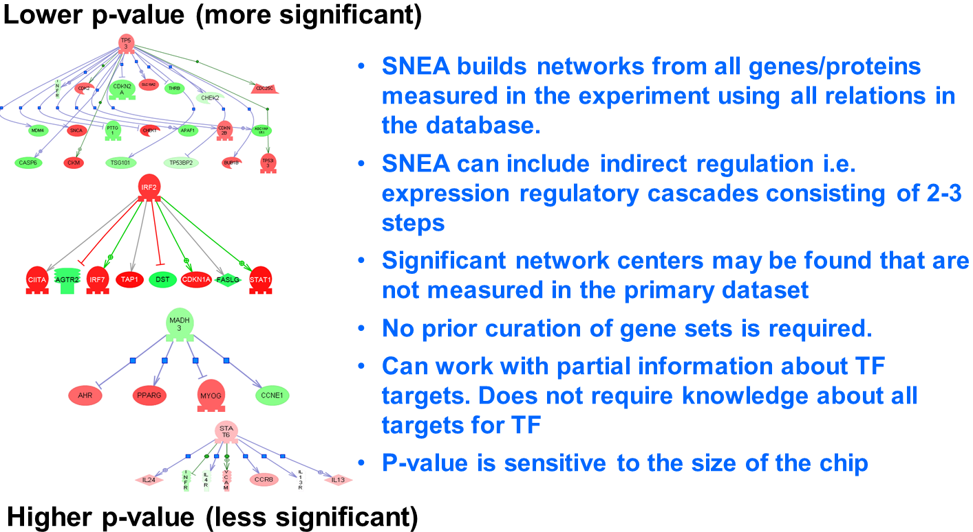
STEP1: SNEA calculating activity transcriptional activity of upstream regulators
Input: DE fold changes + prior knowledgebase of known expression regulation events
SNEA | Reverse Causal Reasoning
Mann-Whitney enrichment test | Fisher’s overlap test
Molecular networks in microarray analysis.
Sivachenko A, Yuryev A, Daraselia N, Mazo I. J Bioinform Comp. Biol. 2007

Slide 7

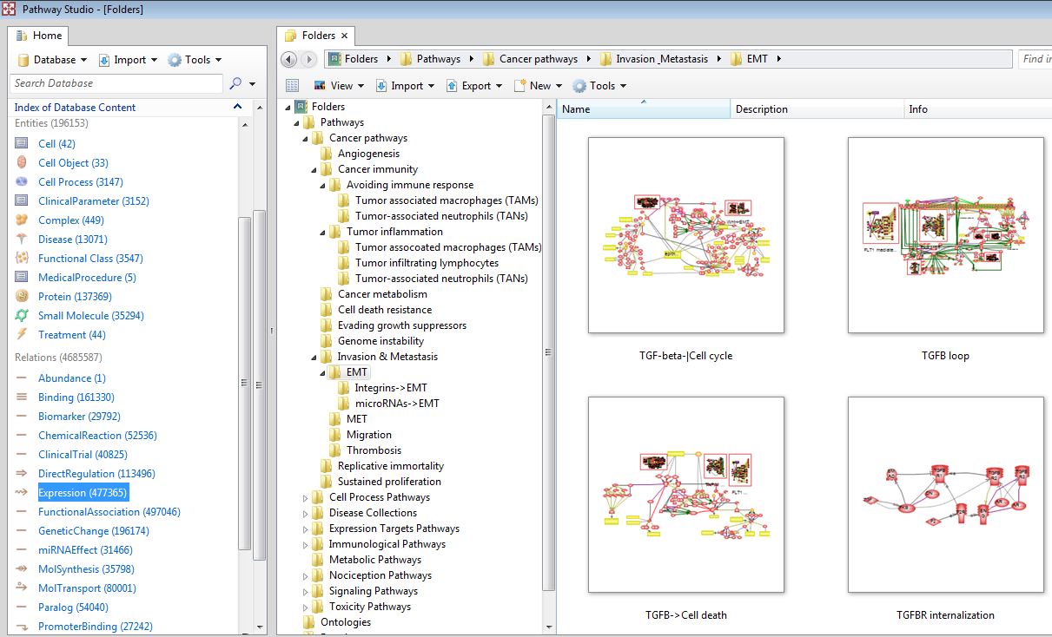










Pathway Studio Knowledgebase for SNEA powered by Elsevier NLP
>
23,641,270 Pubmed abstracts from >9,500 journals
613 Elsevier journals
884 non-Elsevier
journals
>3,500,000 full-text articles
Custom data can be imported into dedicated PS instance
27,243
Promoter Binding: Protein TF->Protein
Internal Documents
Subscribed Titles
Public databases
477,365
Expression: Protein->Protein

Slide 8
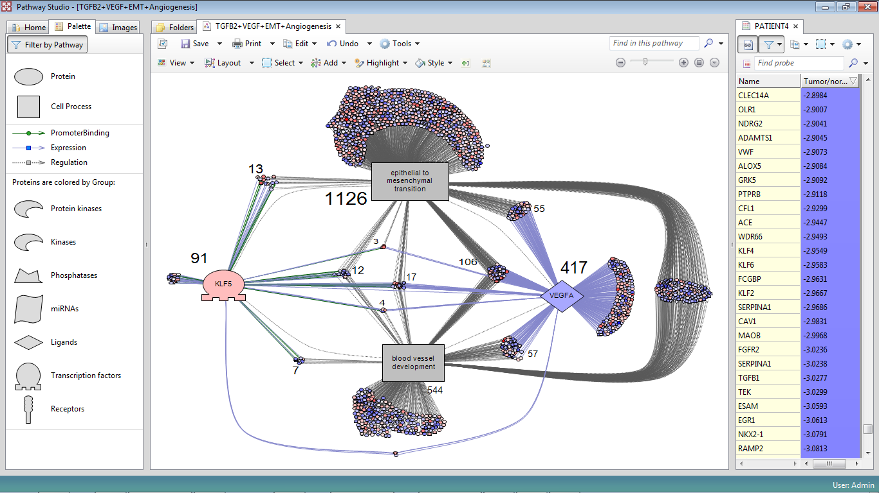
Example of expression regulators and Cell processes identified by SNEA
in lung cancer patient

Slide 9
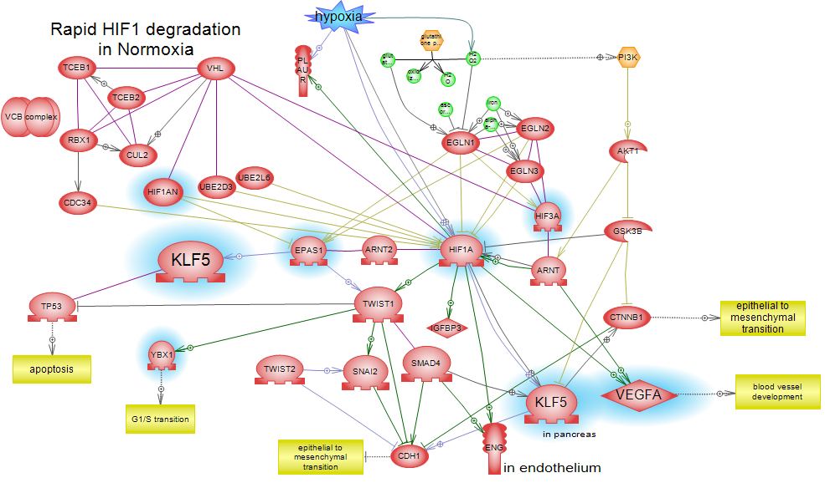
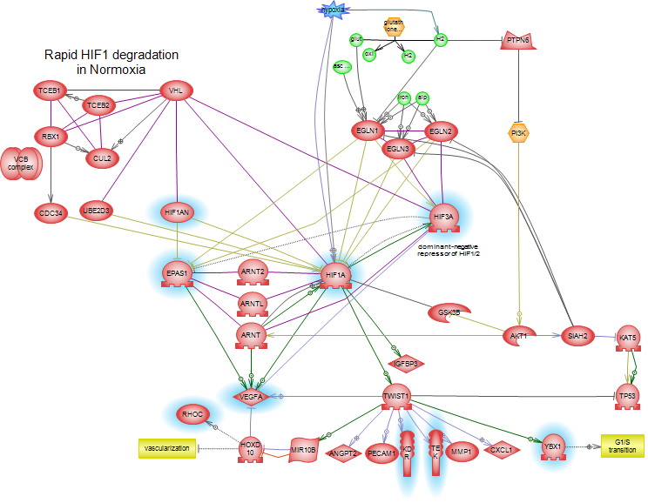
STEP2: Mapping expression regulators on pathways
Hypoxia->EMT
Blue highlight – expression regulators in
Lung cancer patient identified by SNEA
Hypoxia->Angiogenesis

Slide 10
Personalized Hematology-Oncology of Wake Forest
5 cancer patients
analyzed with SNEA to build cancer pathways
Gallbladder/Liver cancer
Lung cancer #1
Lung cancer #2
Breast cancer metastasis in lung
Colon cancer metastasis in liver

Slide 11
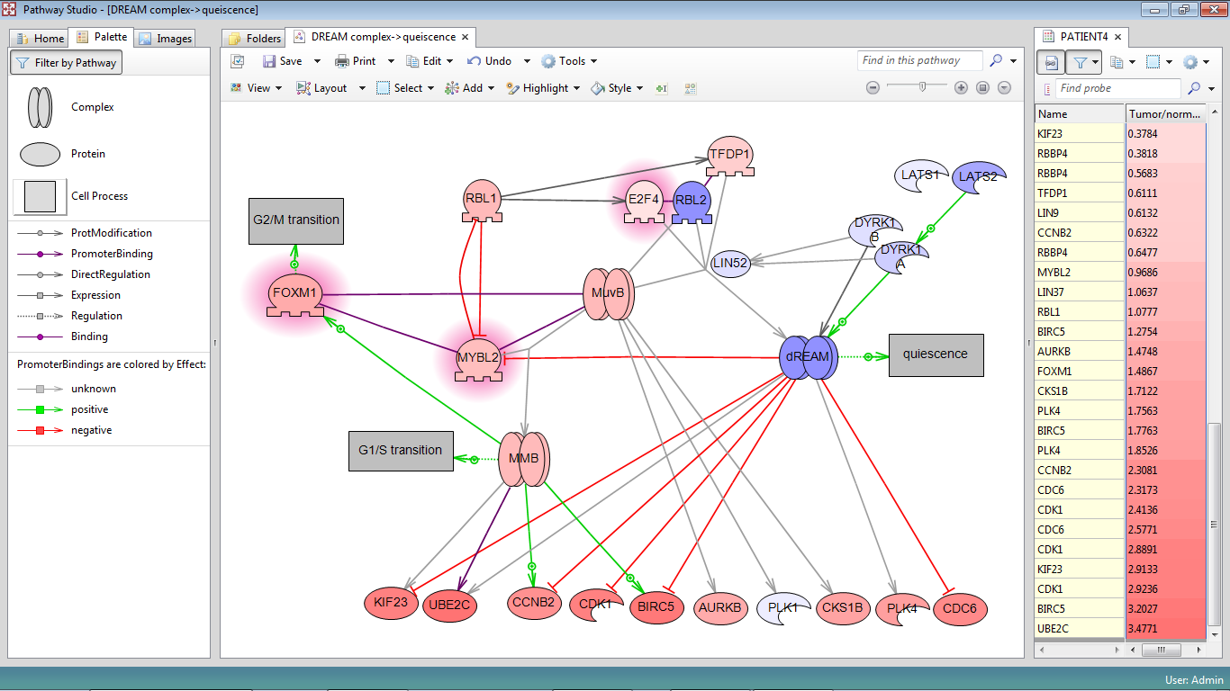
How many cancer pathways must be built?
Upper estimate: 10 hallmarks X 250 tissues = 2,500
In practice some pathways may be common for all tissues. Example: Cell cycle pathways
Red highlight –
Activated SNEA regulators

Slide 12
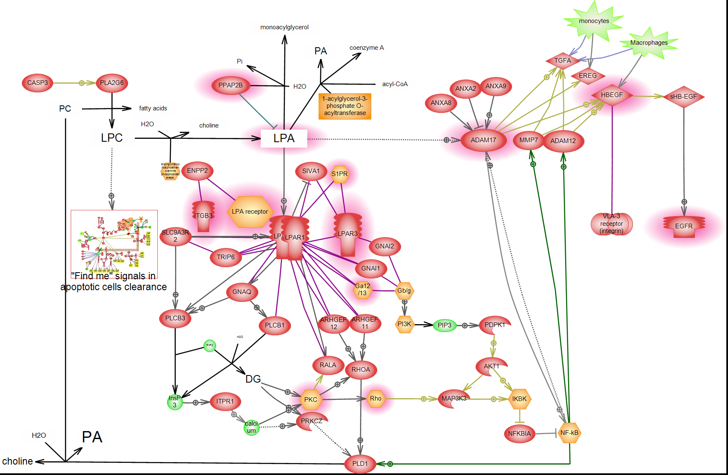
Cancer pathways: Insights to cancer biology
EGFR activation by apoptotic clearance (wound healing pathway)
Apoptotic debris
Red highlight –
Activated SNEA regulators

Slide 13
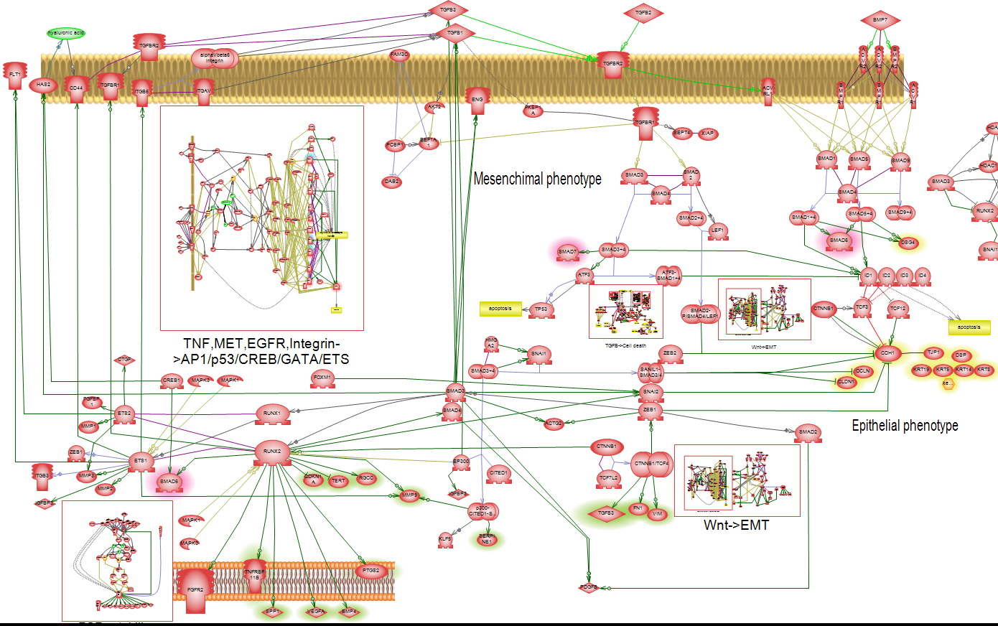
TGF-β autocrine loop sustains EMT

Slide 14
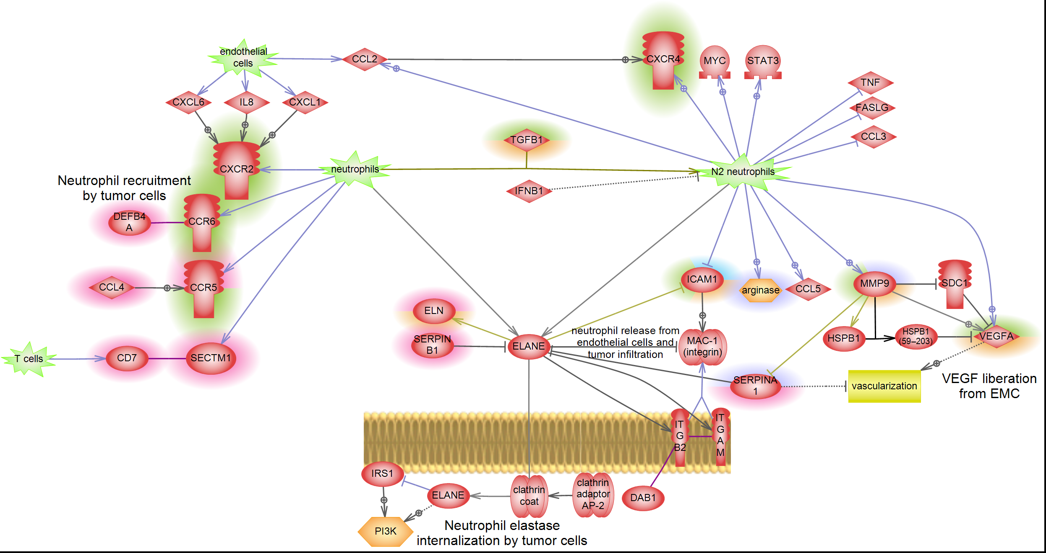
Avoiding immune response: N1->N2 polarization
Highlights – SNEA regulators from different patients

Slide 15
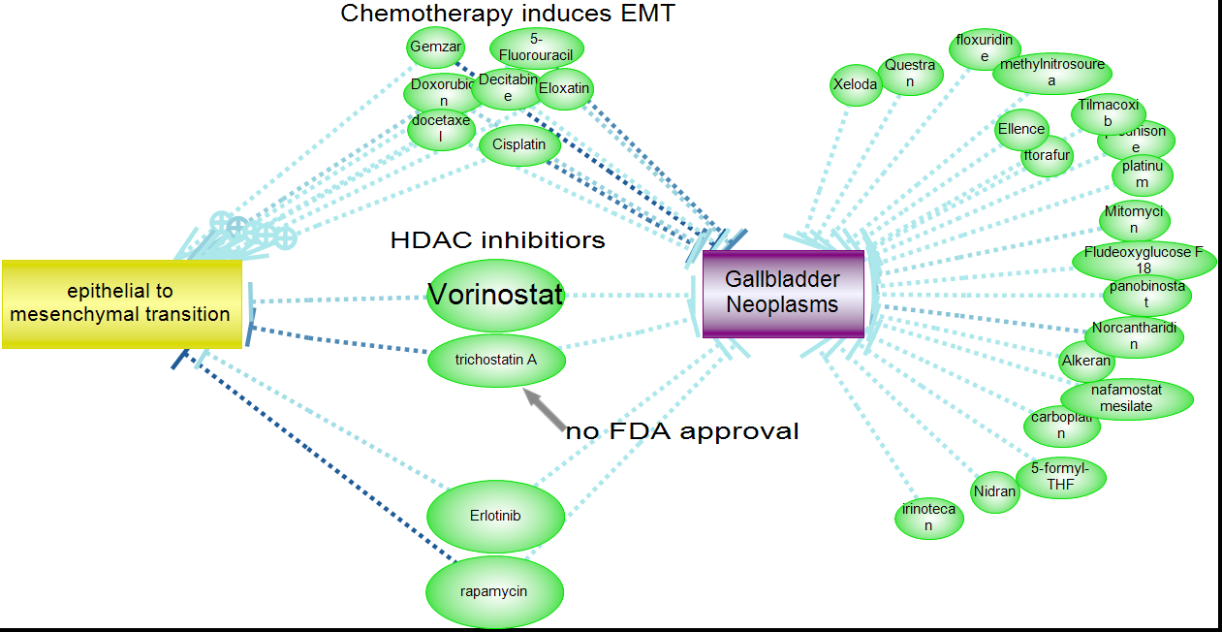
How to select anti-cancer drugs in Pathway Studio

Slide 16
Conclusions:
48 pathways containing 2,796 proteins provide mechanism for advanced cancer in 5 patients
Pathways explain about 50% (378) of all top 100 SNEA regulators indentified in five patients
Pathways are validated by:
  Scientific literature
  Patient microarray data
  Efficacy of personalized therapy

