Slide 1


IgG dose dictates outcome for passive immunization of macaques with polyclonal anti-SHIV IgG against challenge with heterologous tier 2 SHIV
Anton Sholukh
10-06-2014

Slide 2
Why do perform a passive immunization with polyclonal IgG again?
Polyclonal anti-virus IgG reflects the Ab repertoire which might be induced by a complex vaccine congaing Env, Gag and Tat proteins
Polyclonal anti-SHIV IgG should represent key features of HIVIG, human IgG raised upon HIV-1 infection
Earlier passive immunization studies suffered from using:
  human anti-HIV IgG in non-human primates
  easy-to-neutralize lab adapted tier 1 viruses
  challenge viruses were homologous to those used to raise Abs
  dual tropic (X4 and R5) SHIVs while all recently transmitted viruses are exclusively R5-tropic
  intravenous or single high-dose mucosal challenges instead of multiple low-dose mucosal challenges

Slide 3
Why do perform another passive immunization with polyclonal IgG?
Multiple-low dose challenges with tier 2 virus:
SHIV-2873Nip an R5-tropic SHIV carrying a HIV-1 clade C env isolated from a
Zambian infant who had rapid disease progression (Siddappa NB
at al. J Virol 2009, 83:1422-1432)
SHIV-2873Nip is a tier 2 virus and causes AIDS in RMs with clinical parameters and
disease progression rate similar to those in humans
Antibodies derived from the same specie:
SHIVIG polyclonal anti-SHIV IgG isolated from rhesus monkeys infected with
SHIVs
Antibodies heterologous to the challenge virus:
SHIVIG isolated from RMs infected with SHIV strains heterologous to the
challenge virus SHIV-2873Nip

Slide 4
SHIVIG preparation
Selection of RMs with high nAb
titers
Neutralization analysis of IgG preps
Isolation of total IgG on Protein A
RM passive immunization and SHIV challenge
SHIVIG characterization and testing
Pooling of IgG isolated from different RMs

Slide 5
SHIVIG binds cross-clade and competes with nmAbs
Sholukh et al. Retrovirology 2014, 11:8

Slide 6
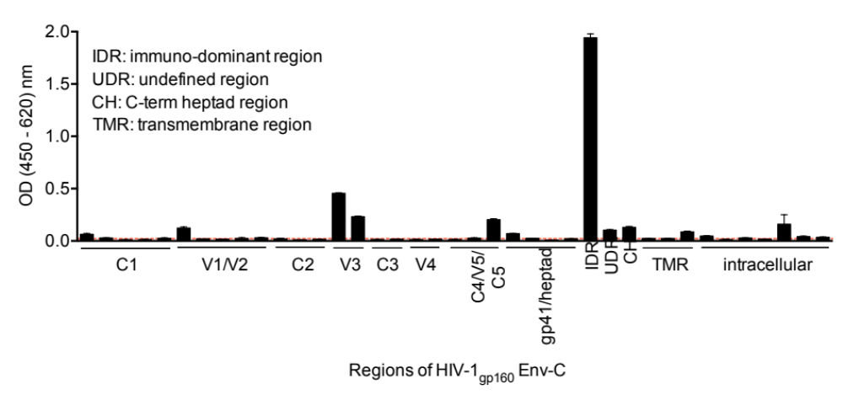
SHIVIG resembles binding pattern of HIVIG
Sholukh et al. Retrovirology 2014, 11:8

Slide 7
SHIVIG demonstrates cell-mediated anti-viral activity
Sholukh et al. Retrovirology 2014, 11:8

Slide 8
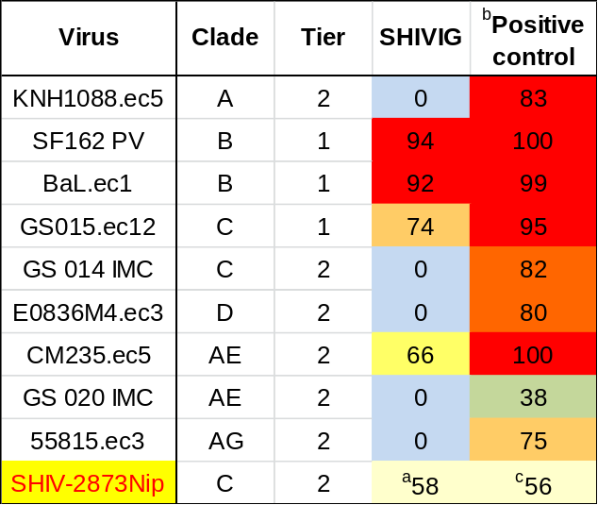
SHIVIG neutralizes tier 1 and tier 2 viruses
TZM-bl assay
PBMC assay IC₅₀ = 0.2 – 144 μg/ml (PBMC from different donors)
Sholukh et al. Retrovirology 2014, 11:8

Slide 9
Design and timeline of the passive immunization study
Sholukh et al. Retrovirology 2014, 11:8

Slide 10
All RMs were infected with SHIV-2873Nip despite the dose of SHIVIG
Sholukh et al. Retrovirology 2014, 11:8

Slide 11
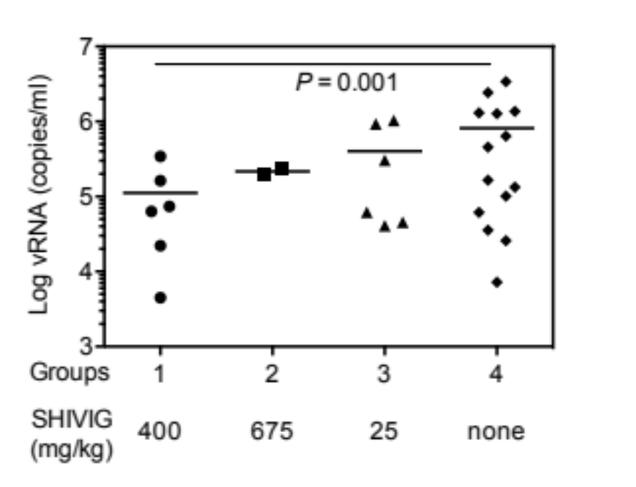
SHIVIG at 400 mg/kg significantly lowered peak of viremia
Sholukh et al. Retrovirology 2014, 11:8

Slide 12
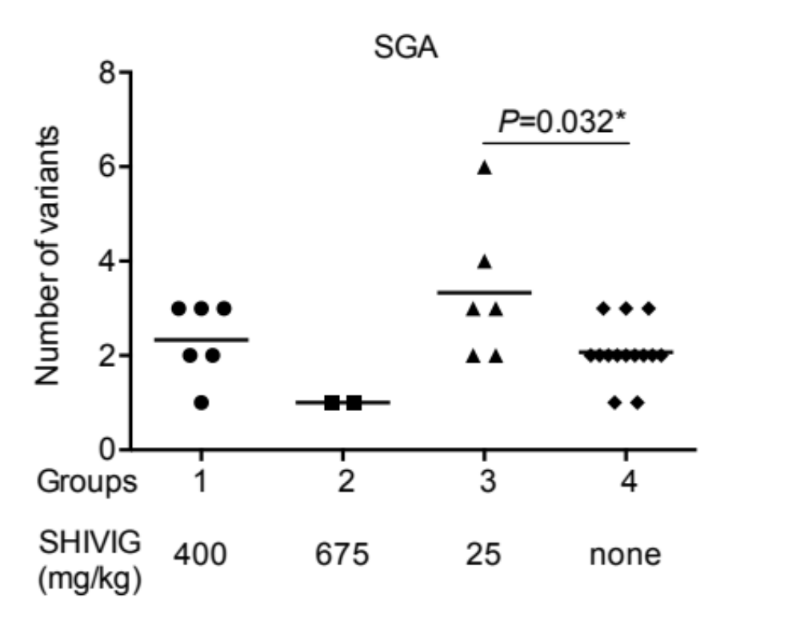
SHIVIG at low-dose (25 mg/kg) increased virus acquisition
Sholukh et al. Retrovirology 2014, 11:8

Slide 13
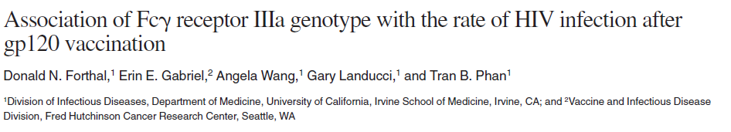
Possible mechanisms of the enhancement of the virus infection
Ab-mediated enhancement through Fcγ receptor

Slide 14

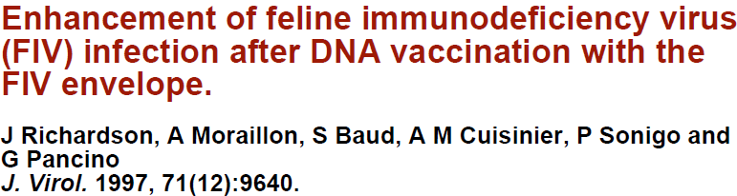
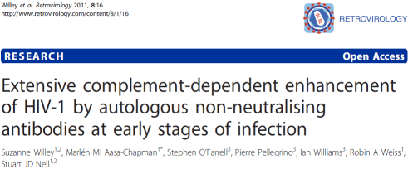
Possible mechanisms of the enhancement of virus infection
C’-ADE: complement-mediated antibody dependent enhancement

Slide 15
C’-ADE assay prerequisites
Viruses coding luciferase reporter gene:
SHIV-2873Ni parental virus used to obtain SHIV-2873Nip, the challenge virus, through
passaging in RMs
SHIV-2873Nipd late virus isolated from the RM developed AIDS
SHIV-1157ip tier 1 virus homologous to SHIVIG
SupT1.R5 cells:
Derived from T-cell lymphoblastic lymphoma
Naturally expressing CD4 and CD21 (Complement Receptor 2)
Engineered to express CCR5

Slide 16
SHIVIG enhances the SHIV infection through C’-ADE mechanism in vitro
Sholukh et al. Retrovirology 2014, 11:8

Slide 17
How relevant are in vitro C’-ADE to the increased virus acquisition in vivo?
Group 3 (25 mg/kg) SHIVIG concentration:
day 1 180 – 250 µg/ml
day 8 70 – 130 µg/ml
Maximum of C’-ADE:
NL-LucR.2873Ni 15.7 – 141 µg/ml
NL-LucR.2873Nipd 5.2 – 47 µg/ml

Slide 18
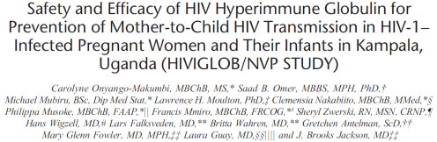
Our study paralleled the results of recent HIVIGLOB clinical trial
HIV-infected pregnant mothers and their infants were passively immunized with HIVIGLOB (anti-HIV human IgG) aiming to lower the risk of mother-to-child transmission
At birth, 9.1% of infants born from HIVIGLOB-treated mothers were HIV positive compared with 4.1% of controls infants
Passive immunization with HIVIGLOB did not prevent HIV-1 acquisition in any infant born to infected mothers, and may have enhanced in utero HIV-1 transmission

Slide 19
Challenges for AIDS vaccine development:
Can the Ab-mediated infection-enhancing activity be separated from protective functions, such as neutralization, ADCVI and ADCC?
Can immunogens be designed that will elicit protective but not infection-enhancing Abs?
Will it be possible to induce durable nAb responses at sufficiently high levels to counteract any potential Ab-mediated enhancement of infection?

Slide 20

Acknowledgments:
Ruth Ruprecht’s Lab at
DFCI, HMS and now at
the Texas Biomed:
Siddappa Byrareddy
Vivek Shanmuganathan
Girish Hemashettar
Samir Lakhashe
Bob Rasmussen
Jenny Watkins
Hemant Vyas
Swati Thorat
Tania Brandstoetter
Muhammad Mukhtar
John Yoon
Ruth Ruprecht
Yerkes National Primate Center:
F. Villinger
S. Ehnert
F. Novembre
Wistar Institute:
H. Ertl
S. Ratcliffe
UC Irvine:
D. Forthal
G. Landucci
Duke University:
D. Montefiori
M. Bilska
NCI:
M. Robert-Guroff
I. Tuero
Walter Reed Army Institute of Research:
V. Polonis
Boston College:
W. Johnson
UPenn:
J. Hoxie
DFCI:
W. Marasco
NIAID VRC:
J. Mascola
UAB:
C. Ochsenbauer
This work was supported by:
NIH:
P01 AI082282 , R37 AI034266 , P01 AI048240, R01 AI083118, HHSN27201100016C and P51OD11107
Henry M. Jackson Foundation:
W81XWH-07-2-0067

