Slide 1
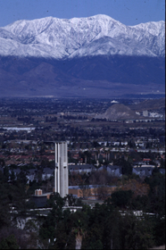

0mics GROUP CONFERENCES
2nd International Conference on ENDOCRINOLOGY
FROM VITAMIN D TO HORMONE D:
FUNDAMENTALS OF THE VITAMIN D
ENDOCRINE SYSTEM
[ October 20th, 2014]
Anthony W. Norman Ph.D.
Department of Biochemistry &
Division of Biomedical Sciences
University of California
Riverside, CA

Slide 2
OUTLINE
CONCEPT OF A VITAMIN
CONCEPT OF AN ENDOCRINE SYSTEM
INTRODUCTION TO VITAMIN D
VITAMIN D ENDOCRINE SYSTEM
VITAMIN D RECEPTOR
MODES OF ACTION OF 1α,25(OH)₂D₃
SUMMARY

Slide 3
OUTLINE
CONCEPT OF A VITAMIN
CONCEPT OF AN ENDOCRINE SYSTEM
INTRODUCTION TO VITAMIN D
VITAMIN D ENDOCRINE SYSTEM
VITAMIN D RECEPTOR
MODES OF ACTION OF 1α,25(OH)₂D₃
SUMMARY

Slide 4
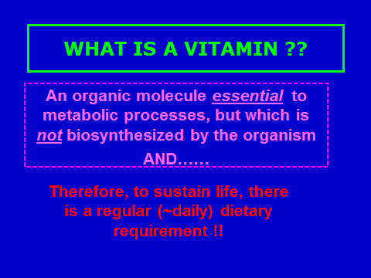

Slide 5
OUTLINE
CONCEPT OF A VITAMIN
CONCEPT OF AN ENDOCRINE SYSTEM
INTRODUCTION TO VITAMIN D
VITAMIN D ENDOCRINE SYSTEM
VITAMIN D RECEPTOR
MODES OF ACTION OF 1α,25(OH)₂D₃
SUMMARY

Slide 6
GENERAL MODEL OF HORMONE ACTION
Hormone binds to its personal
receptor in its target organ(s)
H
Hormone =
ENDOCRINE
GLAND
TARGET
TISSUE
Secretion of
HORMONE
Biological
Response !!
(-)
Feed Back
Loop

Slide 7
OUTLINE
CONCEPT OF A VITAMIN
CONCEPT OF AN ENDOCRINE SYSTEM
INTRODUCTION TO VITAMIN D
VITAMIN D ENDOCRINE SYSTEM
VITAMIN D RECEPTOR
MODES OF ACTION OF 1α,25(OH)₂D₃
SUMMARY

Slide 8
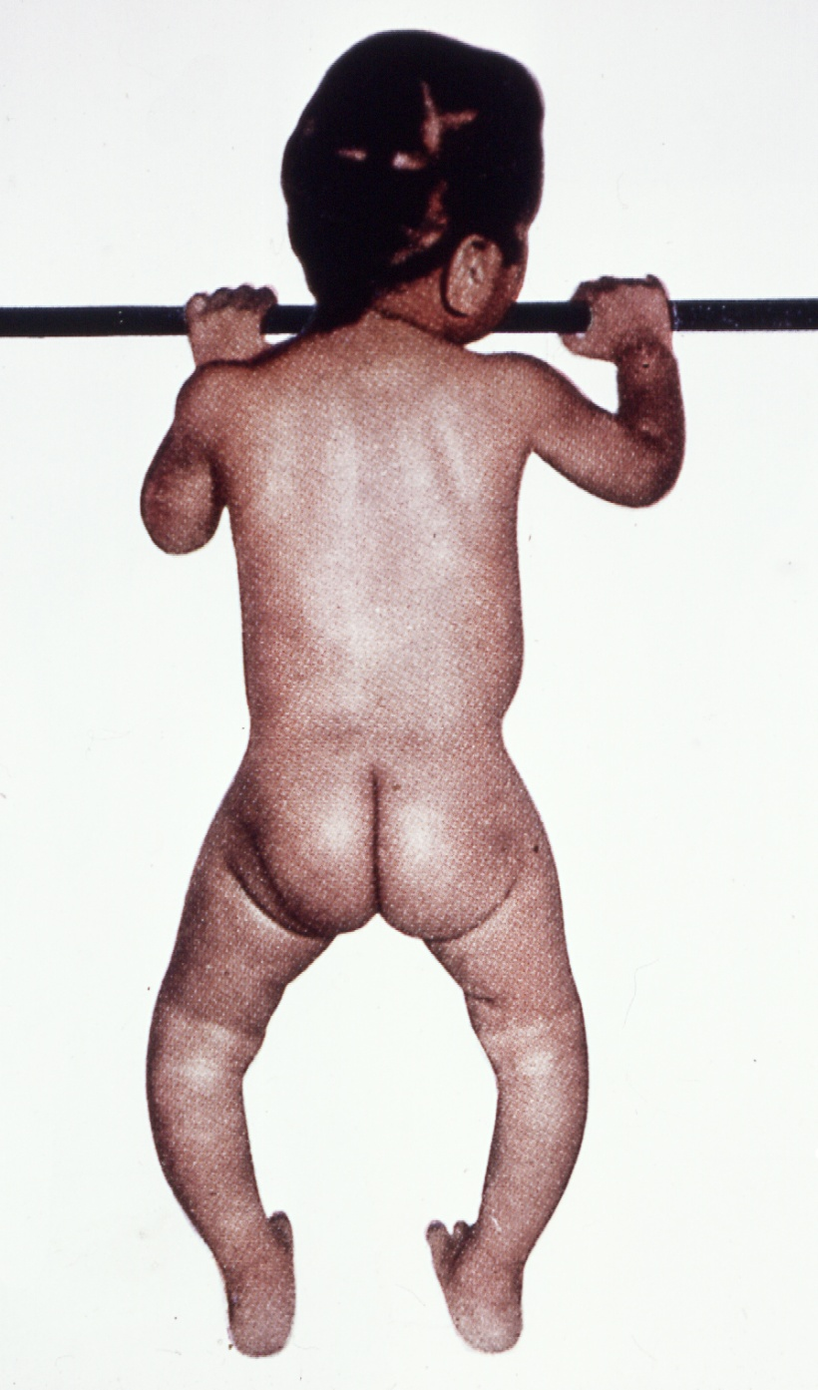
WHAT IS THE
HISTORICAL FUNCTION
OF VITAMIN D ? ?
WITHOUT VITAMIN D
POOR CALCIUM ABSORPTION
BY THE INTESTINE (from food)
POOR INCORPORATION OF
CALCIUM INTO THE BONES
BONE DISEASE
OF RICKETS

Slide 9
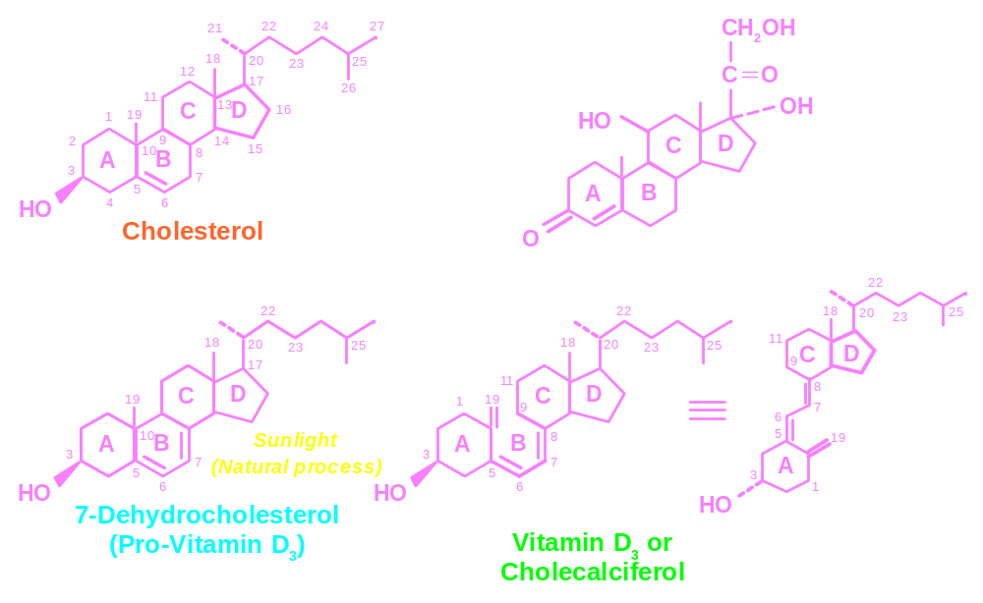

SO DOES VITAMIN D3
FUNCTION AS A
VITAMIN ? ?
or as a
STEROID HORMONE ??
In the
SKIN
An Important
Question for
VITAMIN D
IN THE ABSENCE OF SUNLIGHT, DIETARY
SUPPLEMENTATION WITH
VITAMIN D₃/ CHOLECALCIFEROL
PROMOTES IT TO A VITAMIN STATUS

Slide 10
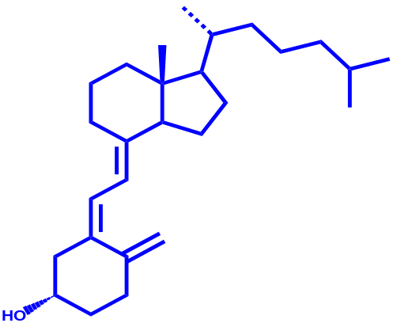
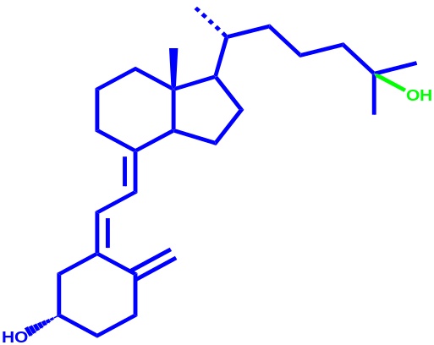
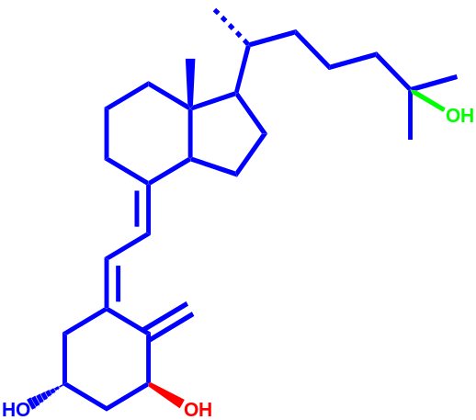
THE ANSWER
Vitamin D
is inert.
Thus the KIDNEY
is also an
ENDOCRINE GLAND
that produces a
STEROID HORMONE
Vitamin D₃
C
D
C
D
OH
.
LIVER
25(OH)D₃
A
A
(3β)
(3β)
OH
.
KIDNEY
C
D
1α,25(OH)₂-vitamin D₃
A
Target Tissues
BIOLOGICAL RESPONSES !!
(3β)
OH
.
1α,25(OH)₂D₃ is a STEROID HORMONE !!
A

Slide 11
  THE TISSUE DISTRIBUTION OF THE NUCLEAR
  1α,25(OH)₂D₃ RECEPTOR (VDR) DEFINES THE
  SCOPE OF THE VITAMIN D ENDOCRINE SYSTEM
Adipose Hair Follicle Pituitary
Adrenal Intestine Placenta
Bone Kidney This will be the first scholarly
function by our UCR Emeritus/a in an activity sponsored by our Emeritus/a Organization.Prostate
Bone Marrow Liver (fetal) Skin
Brain Lung Spermatazoa
Breast Muscle (cardiac) Stomach
Cancer Cells (many) Muscle (smooth) Testis
Cartilage Osteoblast Thymus
Colon Ovary Thyroid
Eggshell Gland Pancreas β Cell Uterus
Endothelium Parathyroid
Epididymis Parotid
Ganglion B & T Lymphocytes
Ganglion
(1969 – 2012)
Many Labs
Discovery of the VDR
in many new and
suprising tissues
(over 40 locations)
(1974 – 2020)
The orignal three
VDR containing
target organs where
1,25(OH)₂D₃
was known in 1971 to produce
biological effects were:
Intestine, Bone, Kidney
Some surprising new VDR target organs !!
Notes:
11

Slide 12

KEY DISCOVERIES ALL AT UCR
JBC 243:4055-4064 (1968)
The association of a metabolite of vitamin D₃ with intestinal mucosa chromatin in vivo.
Mark Haussler, Jim Myrtle, and Anthony W. Norman
Proc Natl Acad Sci U S A. 1969 January; 62(1): 155–162.
CHROMOSOMAL RECEPTOR (VDR) FOR A VITAMIN D METABOLITE*
Mark R. Haussler and Anthony W. Norman
DEPARTMENT OF BIOCHEMISTRY, UNIVERSITY OF CALIFORNIA (RIVERSIDE)
“A Nutrition Classic”: Nutrition Reviews 43: 181-183 (1985
  Science. 1971 Jul 2;173(991):51-4.
  1,25-dihydroxycholecalciferol: Identification of the proposed active form of vitamin D3 in the intestine.
  Norman AW, Myrtle JF, Midgett RJ, Nowicki HG, Williams V, Popjak G.

Slide 13
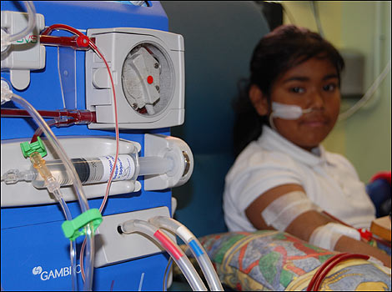
FIRST CLINICAL USE OF 1α,25(OH)₂-VITAMIN D₃
New England J. Medicine 287:891 -895 (1972)
Action of 1,25-dihydroxy cholecalciferol, a potent kidney-produced
metabolite of vitamin D₃ in uremic man.
A. S. Brickman, J. W. Coburn and A. W. Norman

Slide 14
OUTLINE
CONCEPT OF A VITAMIN
CONCEPT OF AN ENDOCRINE SYSTEM
INTRODUCTION TO VITAMIN D
VITAMIN D ENDOCRINE SYSTEM
VITAMIN D RECEPTOR
MODES OF ACTION OF 1α,25(OH)₂D₃
SUMMARY

Slide 15
KIDNEY 25(OH)D-1α-Hydroxylase PRODUCTION OF 1α,25(OH)₂D₃
is Regulated via a Feedback Loop
Parathyroid Gland
Kidney
(+)
PTH
1α-hydroxlase
PTH
(−)
Intestinal Calcium Absorption
1α,25(OH)₂D₃
Serum Ca²⁺
When the serum calcium is low, the parathyroid gland secretes PTH ! !

Slide 16
VITAMIN D ENDOCRINE SYSTEM
Calcium Homeostasis
LIVER
ENDOCRINE MODULATORS
25(OH)₂D₃
KIDNEY
(+)
Vitamin D₃
PARATHYROID GLAND (PTH)
1α,25(OH)₂D₃
24R,25(OH)₂D₃
(-)
CLASSIC TARGET ORGANS
Intestine
Bone
Kidney
BLOOD
Pi
Ca²⁺
Ca²⁺
A.W. Norman
(1971)
BIOLOGICAL RESPONSES

Slide 17
OUTLINE
CONCEPT OF A VITAMIN
CONCEPT OF AN ENDOCRINE SYSTEM
INTRODUCTION TO VITAMIN D
VITAMIN D ENDOCRINE SYSTEM
VITAMIN D RECEPTOR
MODES OF ACTION OF 1α,25(OH)₂D₃
SUMMARY

Slide 18
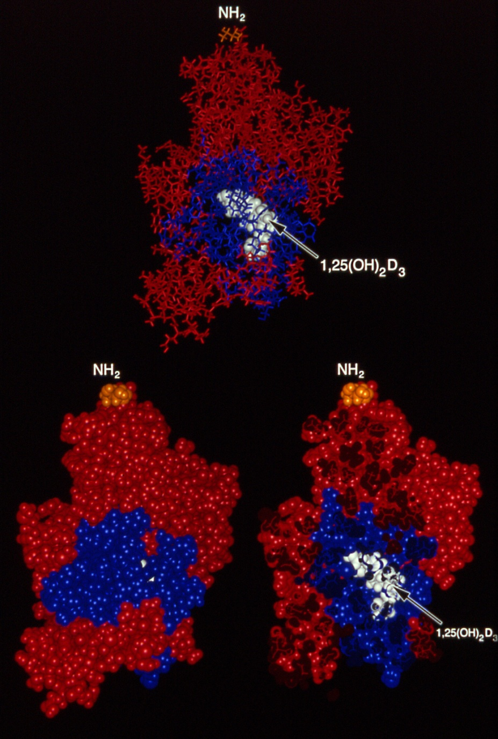
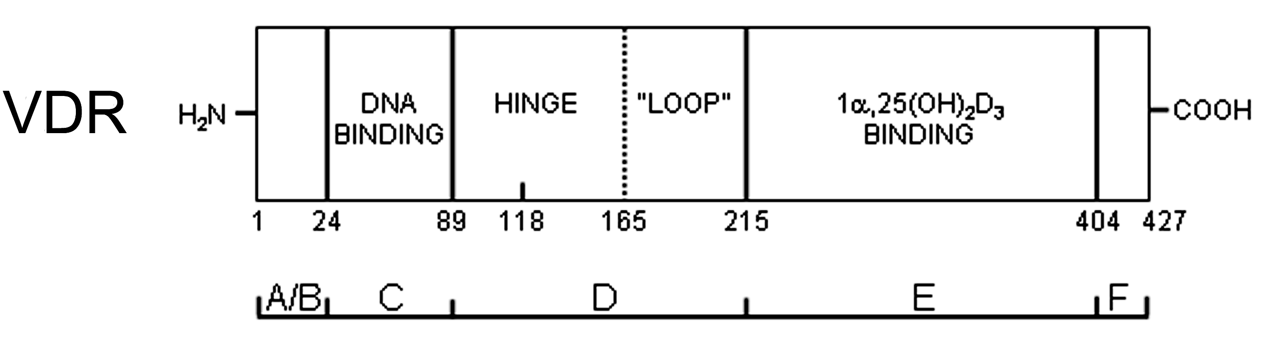
X-RAY STRUCTURE OF VITAMIN D RECEPTOR
Rochel et al. Molecular Cell 5:173 (2000)
VDR LBD
X-ray structure
has 259 amino
acids with approx.
5100 atoms.
Stick
structure
VDR
“nest”
Space
filling
VDR Crystal Structure
(aa 118-427; Δ165-215)

Slide 19
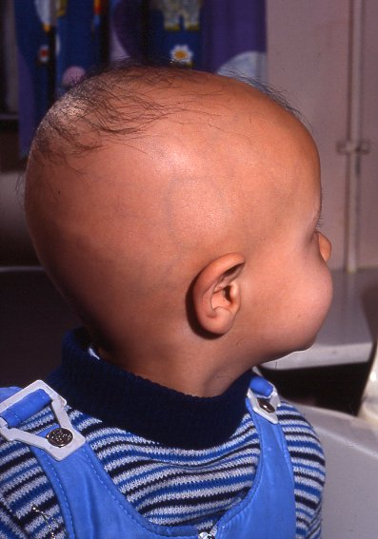
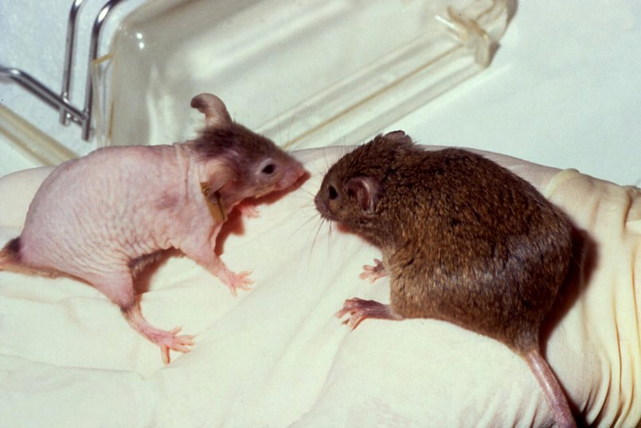
LOSS OF THE VDR RECEPTOR RESULTS IN ALOPECIA
Loss of
hair ! !
What is
alopecia ???
The VDR is in the hair follicle.
Hereditary Vitamin D-resistant
Rickets, type 2 [K45E]

Slide 20
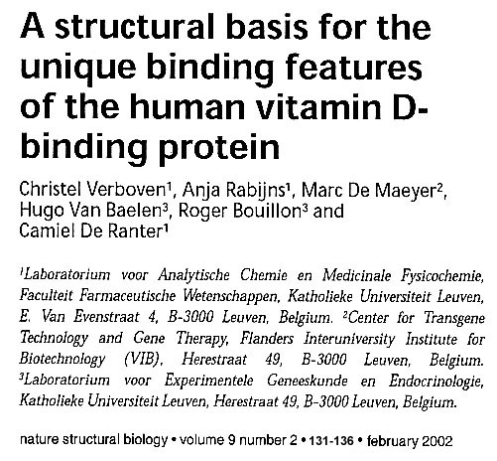
X-RAY STRCTURE OF THE VITAMIN D
BINDING PROTEIN (DBP)

Slide 21
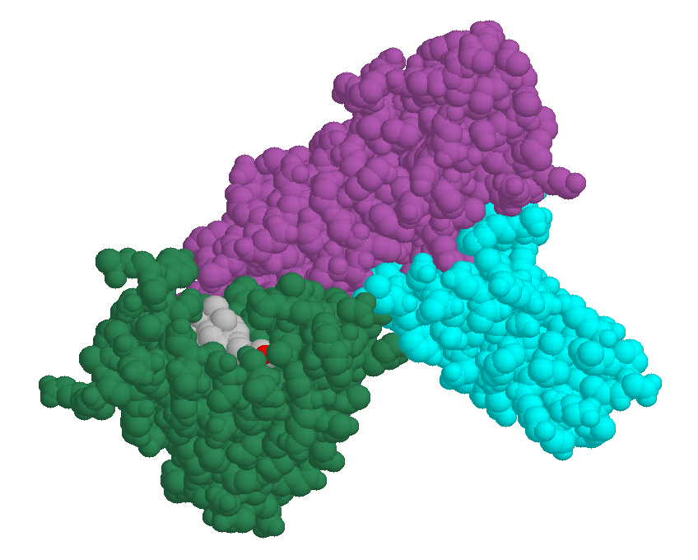
DBP Structure
Domains A, B, C
DBP LBD is not a ‘nest’ in the interior, but is a crevice on the surface !

Slide 22
OUTLINE
CONCEPT OF A VITAMIN
CONCEPT OF AN ENDOCRINE SYSTEM
INTRODUCTION TO VITAMIN D
VITAMIN D ENDOCRINE SYSTEM
VITAMIN D RECEPTOR
MODES OF ACTION OF 1α,25(OH)₂D₃
SUMMARY

Slide 23
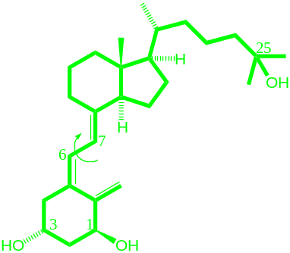
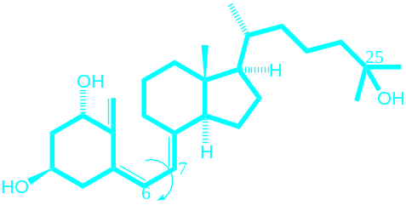
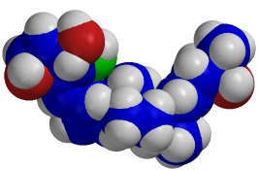
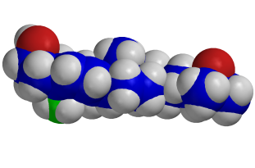
Modes of Action of 1α,25(OH)₂D₃
6-s-trans
1α,25(OH)₂D₃
6-s-cis
VDR_{Nuc}
VDR_{CavMem}
Ligand- nVDR complex
Ligand mVDR
Complex
DNA
Up regulation
Down regulation
Genomic responses
Rapid responses
Hours
to
Days
Seconds
To
Minutes
Biological Responses

Slide 24
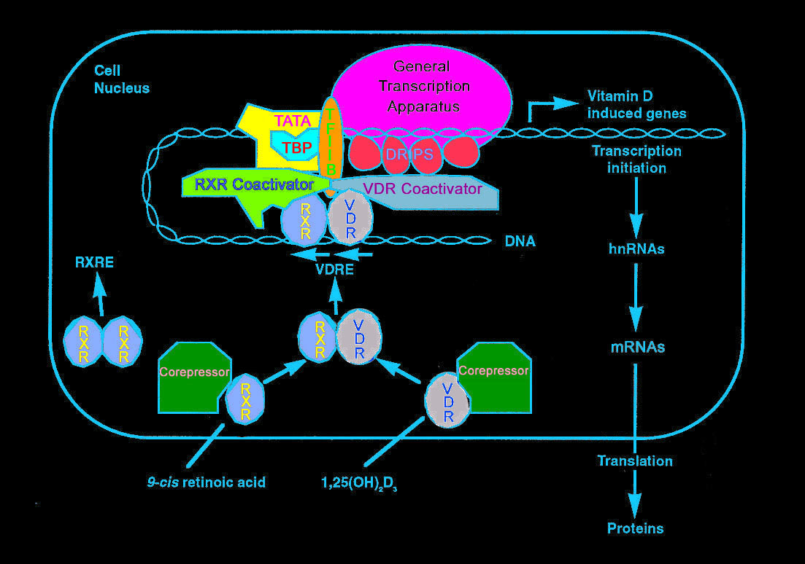
MODEL OF 1α,25(OH)₂D₃ TRANSCRIPTIONAL ACTIVATION OF THE GENE LIBRARY
There are ~3000/~22,000 human genes
modulated by the VDR+1,25D
GENE LIBRARY
VDR
BIOLOGICAL
RESPONSES

Slide 25
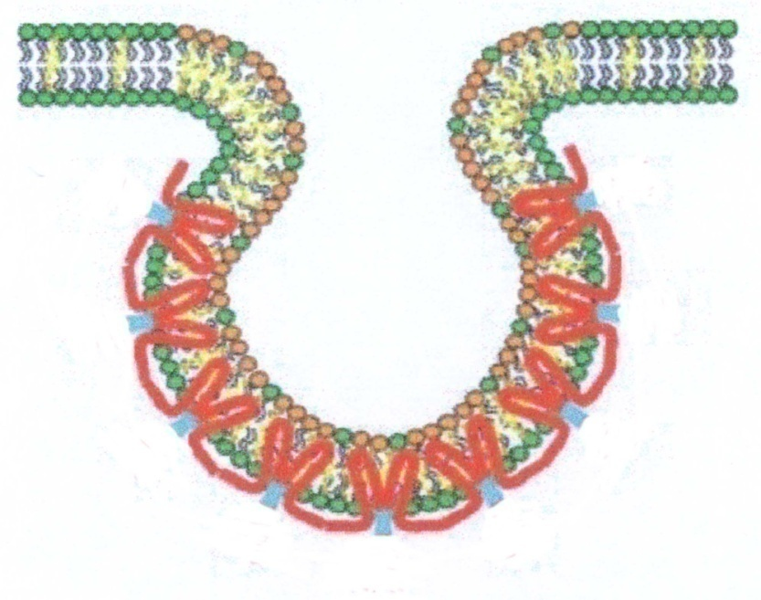
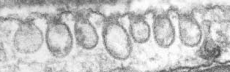
Isolation of
Caveolae Membrane Fractions
Is there a VDR_{mem} present?
Approach:
  Differential Centrifugation
  Absence of Detergents
Lipid raft-Caveolae (LR-C)
  Platforms
  Unique buoyant density
  Detergent-resistant
100 nm flask-shape invaginations or vesicles of the plasma membrane
http://www.rzuser.uni-heidelberg.de/~t73/plasmal/endoct.html
Cholesterol and sphingolipids, and caveolin-1/2/3 scaffolding proteins
Smart et al. PNAS 92:10104 (1995)
Notes:
Platforms in membrane trafficking and signaling
Associated with proteins that specifically interact with these rafts that can be identified by mass spec and other biochemical methods

Slide 26
Modes of Action of 1α,25(OH)₂D₃
6-s-trans
1α,25(OH)₂D₃
6-s-cis
VDR_{Nuc}
VDR_{CavMem}
Ligand- nVDR complex
Ligand mVDR
Complex
DNA
Up regulation
Down regulation
Genomic responses
Rapid responses
Hours
to
Days
Seconds
To
Minutes
Biological Responses

Slide 27
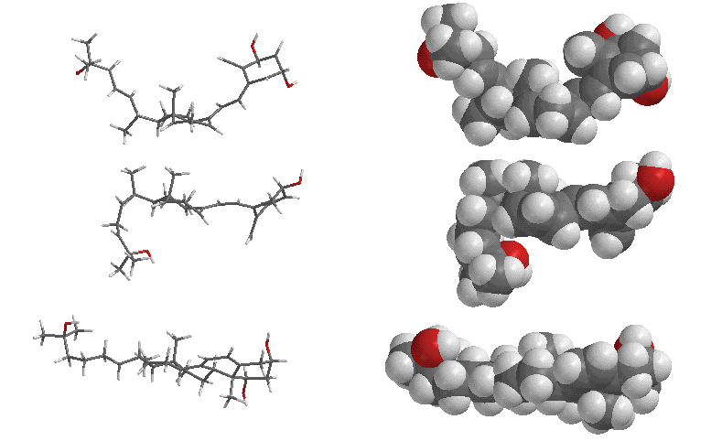
SUMMARY OF OPTIMAL LIGAND SHAPES
VDR-nuc
Genomic
DBP
Plasma
Transport
VDR-mem
Rapid

Slide 28
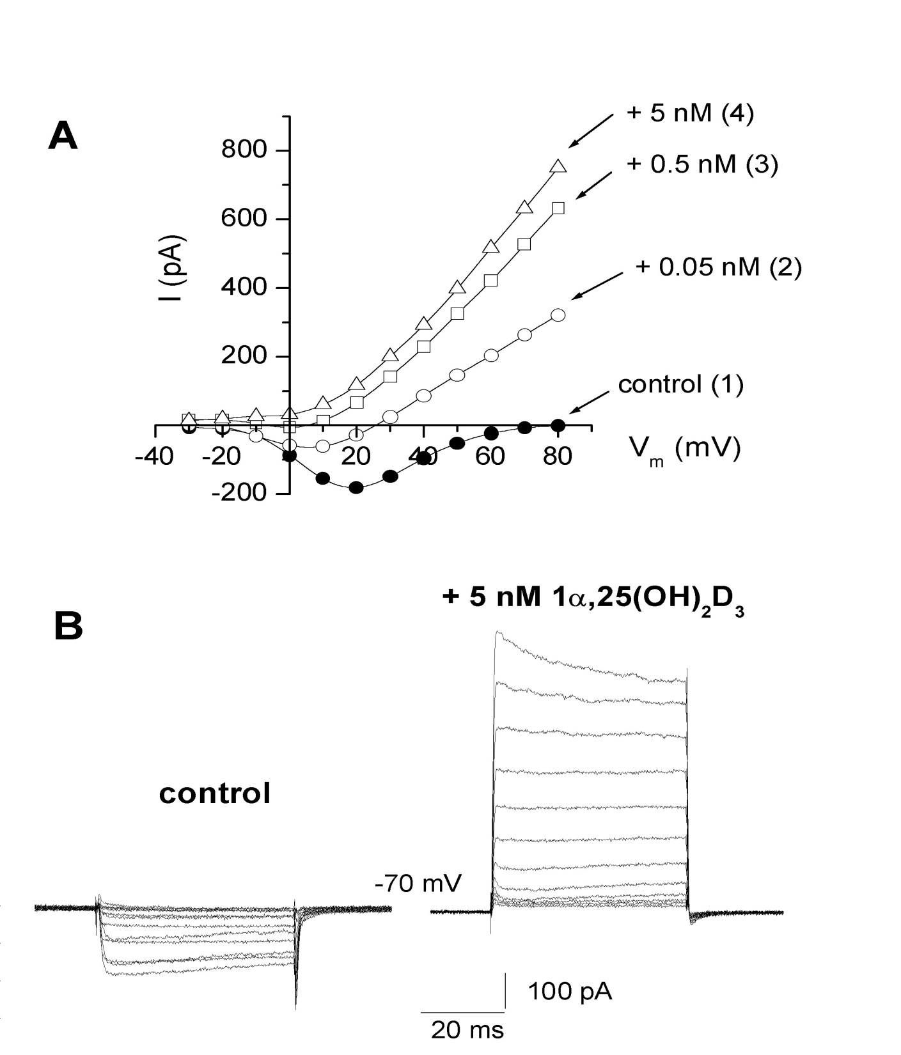
POTENTIATION OF ION CURRENTS BY 1,25D₃ IN OSTEOBLASTS
Whole-cell patch-clamp recordings
RAPID RESPONSES
Cl⁻
+
-
Cl⁻
Ba²⁺
OSTEOBLAST
Cl⁻
Ba²⁺
Ba²⁺
Zanello and Norman, JBC, 1997
Notes:
Zanello and Norman, Molec. Biol. Cell 13, 2003
Inward calcium currents and outward chloride currents potentiated by increasing concentrations of the steroid hormone.

Slide 29
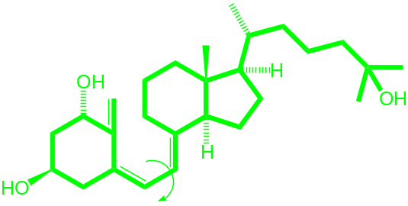
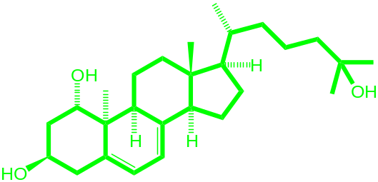
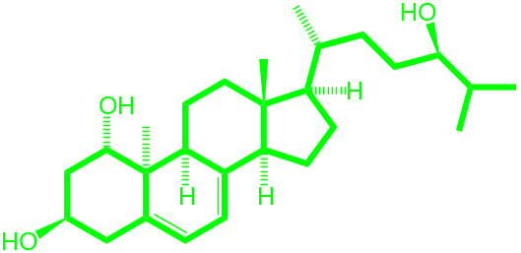
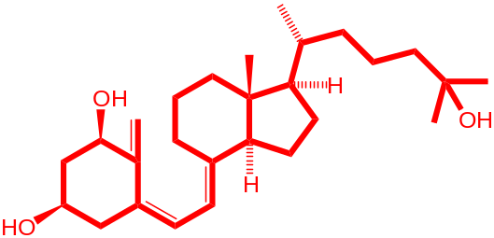
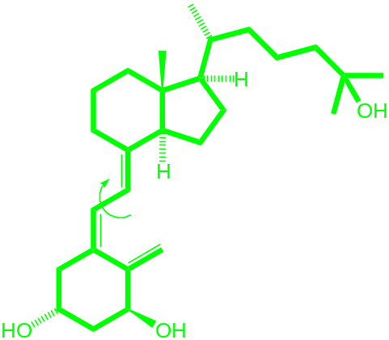
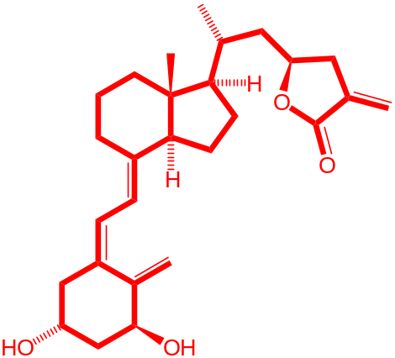
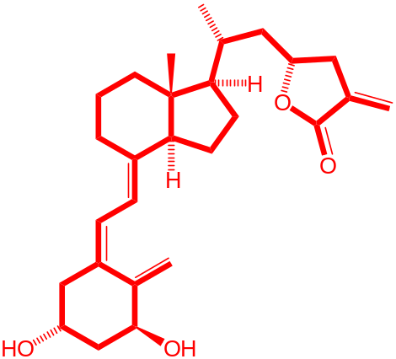
MOLECULAR TOOLS
RAPID RESPONSES VDR_{Mem}
ANTAGONIST
1α,25(OH)₂D₃
1α,25(OH)₂-Lumisterol₃
JN
1α,24R(OH)₂-Lumisterol₃
MZ
1β,25(OH)₂D₃
HL
GENOMIC RESPONSES VDR_{Nuc}
TEI-9647
MK
ANTAGONISTS
TEI-9648
ML
1α,25(OH)₂D₃

Slide 30

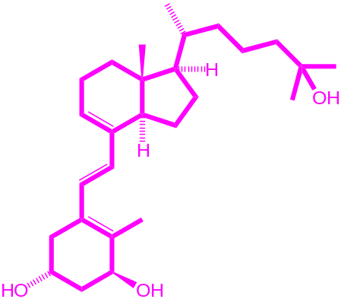
STRUCTURE FUNCTION STUDIES CONCERNING 1α,25(OH)₂D₃ STIMULATED CHLORIDE CHANNELS
5
4
* *
1α,25(OH)₂-Lumisterol₃
JN
Fold Increase of the Currents
3
1α,25(OH)₂-Tachysterol₃
JB
2
*
1
* *
*
*
0
1
α
,25(OH)
2
D
3
HL
1
α
,25
D
+HL
JN
JB
cholesterol
17β-
estradiol
1
β
,25D

Slide 31
1α,25(OH)₂D₃ STRUCTURE-FUNCTION ANALYSIS OF RAPID RESPONSES
Response  Agonist  | Cell/Organ
 | Chick Intestine | Pancreatic β-cells | Endothelial cells | Osteoblasts
 | Transcaltachia (rapid Ca²⁺ absorption) | Insulin secretion | Smooth muscle cell migration | Opening CI⁻ channels & secretion
1α,25(OH)₂D₃ Conformationally Flexible | Yes | Yes | Yes | Yes
(JN) 6-s-cis locked | Yes | Yes | Yes | Yes
(JB) 6-s-trans restricted | No | … | … | No
(HL) 1β,25(OH)₂D₃ | Antagonism | Antagonism | Antagonism | Antagonism
Reference | Norman, Bouillon, Farach-Carson Mol. Endocrin. 11:1518 (1997) | Ishida, Norman Endocrin. 140: 4706 (1999) | Liao, Norman Circ. Res. 91:17 (2002) | Zanello, Norman JBC 272:22617 (1997, 2004)

Slide 32
OUTLINE
CONCEPT OF A VITAMIN
CONCEPT OF AN ENDOCRINE SYSTEM
INTRODUCTION TO VITAMIN D
VITAMIN D ENDOCRINE SYSTEM
VITAMIN D RECEPTOR
MODES OF ACTION OF 1α,25(OH)₂D₃
SUMMARY

Slide 33
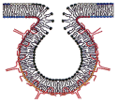
1α,25(OH)₂D₃ + VDR = RAPID RESPONSES
Ligand Shape Matters Affects Target Cell Biology
1α,25(OH)₂D₃
PLASMA MEMBRANE
Ca
2+
Cell
Nucleus
Ca
2+
Caveolae
Altered Genomic Responses
Osteocalcin promoter
24-OHase promoter
Alkaline Phosphatase
NB4 cell differentiation
3% of human genes
Signal Transduction
PI3K
GENE
EXPRESSION
Examples
Pancreas B cell
Adipocytes
Vascular smooth muscle
Intestine
Monocytes
Osteoblasts
G
PROTEIN
PKC
Systems → → → Second Messengers
PKC Phosphoproteins
RAS/MAP Kinase RAF/MAP Kinase
PI3’Kinase PtdIns-3,4,5-P₃
Phospholipase C
“cross-talk”

Slide 34
GROWTH OF VITAMIN D RESEARCH
OVER THE PAST 54 YEARS
[‘Vitamin D’ in the Title or Abstract @ PubMed]
3700 Papers/YR
Vitamin D is a HOT
Topic !!
*
54 year total ~ 39,500 papers
Number of Publications Per Year
2014
YEAR

Slide 35

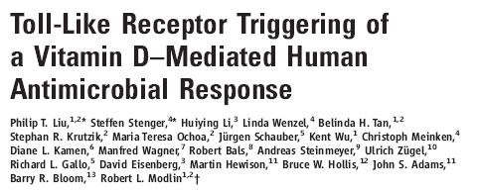
1α,25(OH)₂D₃ ACTIVATES THE INNATE IMMUNE SYSTEM
J. IMMUNOLOGY 173: 2909 (2004)
“The innate immune system provides front-line protection against…..
..infectious agents such as tuberculosis and
antibiotic-resistant pathogens such as Pseudomonas aeruginosa,
the agent responsible for long term infection in many
cystic fibrosis patients”.
SCIENCE 311: 1770 (2006)

Slide 36
Norman, A.W. History of the discovery of vitamin D and its daughter steroid hormone. See Annals Nutrition & Metabolism 61:199 (2012).
CONTRIBUTIONS OF VITAMIN D TO GOOD HEALTH
A. W. Norman 2014
PHYSIOLOGICAL
SYSTEMS
BIOLOGICAL
RESPONSES
VITAMIN D DEFICIENCY RELATED DISEASES
Cell cycle regulation
Cell proliferation inhibition
Cancer
Prostate, breast, colon cancer (prevention)
Leukemia(s) (treatment)
ALL CELLS
SKIN + UV LIGHT
KIDNEY
25(OH)D-1α-hydroxylase
Intestinal calcium absorption &
Bone remodeling
CALCIUM HOMEOSTASIS
Rickets, Osteomalacia, Osteoporosis
Vitamin D₃
LIVER
25(OH)D₃
1,25(OH)₂D₃
Increased prevalence of infection e.g. tuberculosis
Increased autoimmune diseases; e.g. type 1 diabetes, multiple sclerosis, inflammatory bowel disease, psoriasis
25(OH)D-1α-hydroxylase
IMMUNE SYSTEM
INNATE
ADAPTIVE
Stimulate synthesis of
antimicrobial peptides
Dendritic and T-cell function
DIET
PARACRINE
(at least 10 cell types)
COMMENTS
Vitamin D itself is biologically inactive. It is a precursor of 1α,25(OH)₂D_{3.}
Serum 25(OH)D₃ is a marker of vitamin D nutritional status.
Its serum level should be
40 – 80 ng/ml
1α,25(OH)₂D₃ is a steroid hormone that produces biological responses via binding to its receptor (VDR) in at least 37 tissues.
PANCREAS β Cells
Facilitate insulin secretion
Impaired glucose tolerance and
type-II diabetes
HEART &
CARDIOVASCULAR
Renin-angiotensin regulation,
Coagulation, fibrinolysis, heart muscle function
High renin hypertension, increased cardiovascular risk factor, increased thrombogenesis
Serum 25(OH)D |  | Nutritional Descriptor
ng/ml | nmoles/L
< 5 | <12 | Severe D deficiency
< 10 | < 25 | Vit. D deficiency
10 - 20 | 25 – 50 | Vit D. insufficiency
> 40 | >100 | Vit D. sufficiency
>100 | >250 | Risk for toxicity
Promote normal skeletal muscle development; improve muscle strength
MUSCLE
Muscle myopathy; increased falls
BRAIN
In progress
Brain has VDR &
1α-Hydroxylase
Vitamin D deficiency in utero alters adult behavior
New evidence indicates that vitamin D3 intake should be about 2000-5000 IU/day. Everyone should have their physician order a serum 25(OH)D level determined at least once yearly. Vitamin D3 soft gel capsules (1000 or 5000 IU)
.can be ordered from Bio-Tech Pharmacal on-line; their URL is http://www.biotechpharrmacal on-line. More health information is available at Grassroots Health More health information is available at their home page URL =
http://www.grassrootshealth.org/index.php [Email > anthony.norman@ucr.edu ]
…………………………………………………………………

Slide 37

D₃
D₃
I
I

I
I


D₃
D₃
I
D₃
I


I
D₃
D₃
Thank You !!
I


I
D₃
D₃
I


I
D₃
D₃
I


D₃
D₃
I
I
D₃


D₃
I
I


Slide 38
X-RAY STRUCTURE OF VITAMIN D RECEPTOR
Rochel et al. Molecular Cell 5:173 (2000)
VDR LBD
X-ray structure
has 259 amino
acids with approx.
5100 atoms.
VDR
“nest”
Space
filling
VDR Crystal Structure
(aa 118-427; Δ165-215)

Slide 39
OUTLINE
CONCEPT OF A VITAMIN
CONCEPT OF AN ENDOCRINE SYSTEM
INTRODUCTION TO VITAMIN D
VITAMIN D ENDOCRINE SYSTEM
VITAMIN D RECEPTOR
MODES OF ACTION OF 1α,25(OH)₂D₃
SUMMARY

Slide 40
OUTLINE
WHAT IS A ‘VITAMIN’ ?
VITAMIN D ENDOCRINE SYSTEM
GENERAL MODEL OF HORMONE ACTION
DISCOVERY OF VITAMIN D RECEPTOR & DBP
MODES OF ACTION OF 1α,25(OH)₂D₃
SUMMARY

