Slide 1
About Omics Group
OMICS Group International through its Open Access Initiative is committed to make genuine and reliable contributions to the scientific community. OMICS Group hosts over 400 leading-edge peer reviewed Open Access Journals and organize over 300 International Conferences annually all over the world. OMICS Publishing Group journals have over 3 million readers and the fame and success of the same can be attributed to the strong editorial board which contains over 30000 eminent personalities that ensure a rapid, quality and quick review process.

Slide 2
About Omics Group conferences
OMICS Group signed an agreement with more than 1000 International Societies to make healthcare information Open Access. OMICS Group Conferences make the perfect platform for global networking as it brings together renowned speakers and scientists across the globe to a most exciting and memorable scientific event filled with much enlightening interactive sessions, world class exhibitions and poster presentations
Omics group has organised 500 conferences, workshops and national symposium across the major cities including SanFrancisco,Omaha,Orlado,Rayleigh,SantaClara,Chicago,Philadelphia,Unitedkingdom,Baltimore,SanAntanio,Dubai,Hyderabad,Bangaluru and Mumbai.

Slide 3
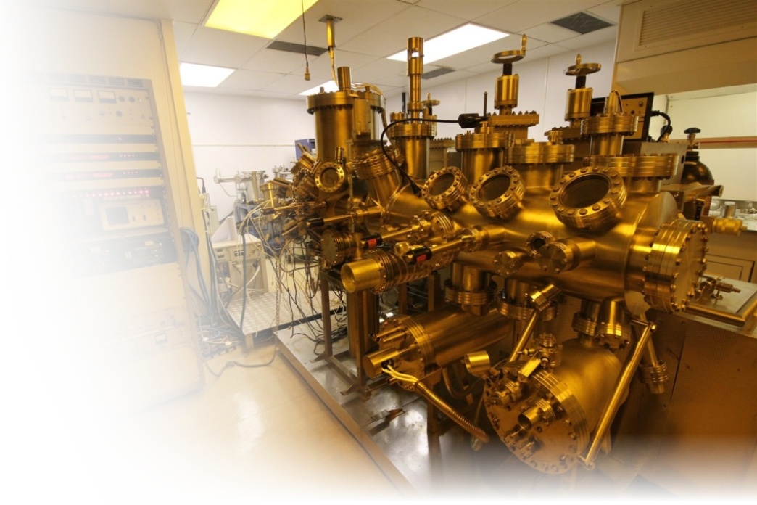

Dilute Nitrides – growth, characterisation and mid-infrared applications
A. Krier, M. de la Mare, P. Carrington, Q. Zhuang, M. Kesaria, M. Thompson
Physics Department, Lancaster University, UK
Optics 2014

Slide 4
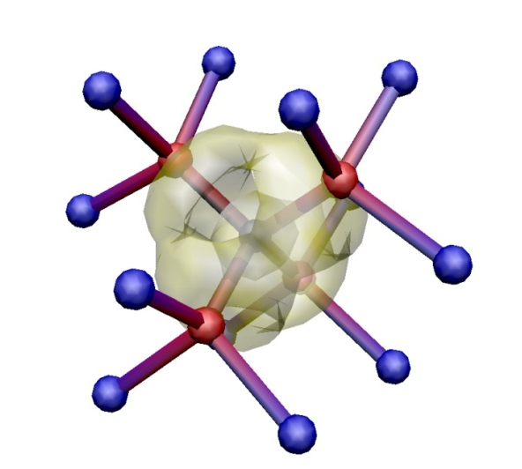
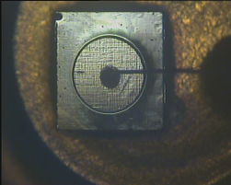

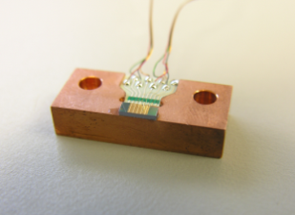
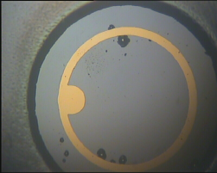
Outline
Dilute Nitrides
  MBE growth on InAs and GaAs
  Structural and transport properties
  PL and EL
  Addition of Sb
  Devices
Summary
N

Slide 5
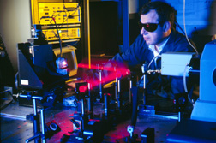
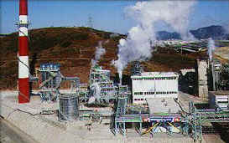

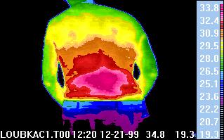
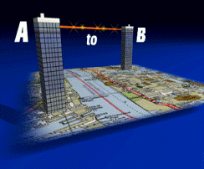
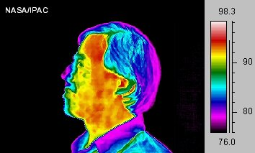
Motivation
Gas sensors - optical absorption;
CH₄, CO₂, CO
Industrial process control
Spectroscopy
Thermal imaging
Bio-medical diagnostics
Military - infrared countermeasures
Principal gas absorptions in the mid-infrared
For these applications we need LEDs, lasers and detectors operating at Room Temperature

Slide 6
Dilute nitrides and the Mid-infrared
Problems :- imbalance in the DOS of InAs
Auger recombination (CHSH)
Inter-valence band absorption (IVBA)
Inadequate electrical confinement
small band offsets
No SI substrates
Addition of N : Band anti-crossing effect
- flexible wavelength tailoring
without complex growth
Higher effective mass
than in InAs or InSb and equalises DOS
Superior bond strengths and material stability
Compared to CdHgTe
CB
1
1’
2’
E_{g}
HH
Δ₀
2
LH
InAsN dilute nitride alloys offer some possibilities for improvement

Slide 7
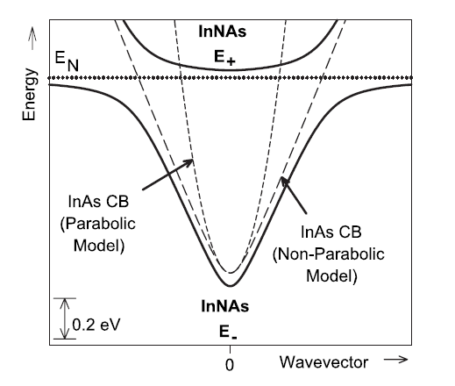
Band anti-crossing
Extended-localized state interaction
An empirical model
Anticrossing/repulsion between conduction-band edge and localized states
decreases the band gap
introduces minigap(s) at low k-value in the CB
GaAsN
E₊
E_{N}
E_{CB}
E₋
W. Shan et al., Phys. Rev. Lett. 82, 1221 (1999)

Slide 8
Band structure
CB
The band structure of III-V-Ns is determined by the distribution of energy levels due to N-impurities and N-clusters and their hybridization with the extended CB states
N levels
N-N pairs & clusters
N related
defects
VB
GaAsN InPN InAsN
N-level
CBE
0.2 eV
0.4 eV
N-pairs and clusters
ΔE = 1 eV
E.P. O’Reilly et al., SST 24 033001 (2009)
E. P. O‘Reilly, A. Lindsay, and S. Fahy, J. Phys. Cond. Matt., 16, S3257 (2004)

Slide 9
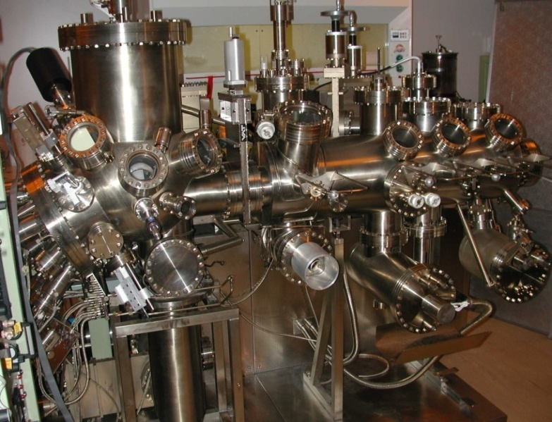
MBE Growth on InAs and on GaAs
V80 Molecular Beam Epitaxy (VG)
with RF Plasma Nitrogen source, As and Sb valved cracker cells (EPI)
Ga, In, Al and dopants GaTe and Be
Sample | T_{G} | Flux - As | Flux - N₂ | Plasma Power | N Content %
A0276 | 485 | 6.6x10-6 | n/a | n/a | n/a
A0282 | 420 | 2.2x10-6 | 6.12x10-7 | 160 | 0.6
A0285 | 442 | 2.2x10-6 | 6.12x10-7 | 160 | 0.2
A0299 | 376 | 2.2x10-6 | 6.3x10-7 | 160 | 1.0
A0300 | 450 | 2.8x10-6 | 5.0x10-7 | 160 | 0.4
Large parameter space for InAsN
InAsN successfully grown on InAs with N < 2% and PL observed out to 4.5 µm
For growth on GaAs
Optimum growth at substrate temperatures between 400⁰C- 440⁰C
Nitrogen plasma setting fixed at 160 W with flux of 5x10⁻⁷ mbar
Growth rate of ~1µm per hour
InAs control sample was grown under the same conditions

Slide 10
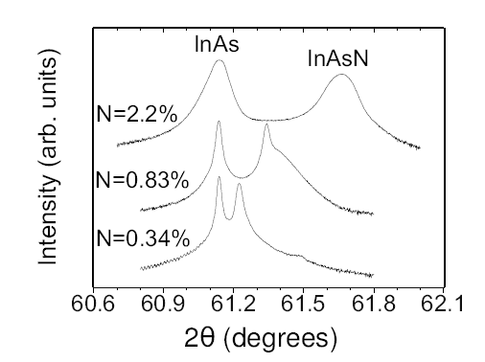
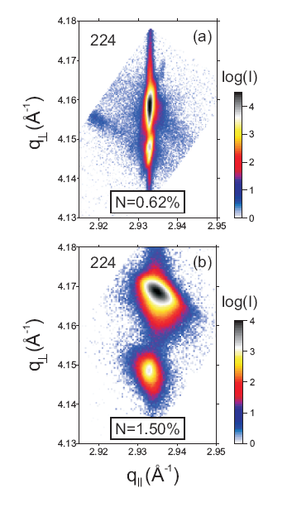

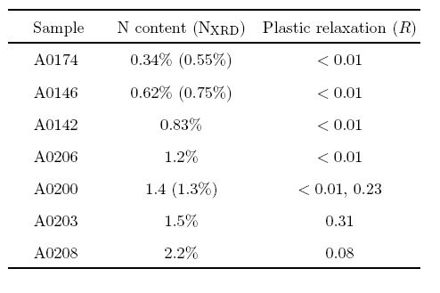
X-ray diffraction
2 different layer peaks obtained - 2 dominant N compositions
Plastic relaxation
Vertical and horizontal lattice deformations obtained
Gives relaxed lattice const.
and plastic deformation R
Layers with N< 1.2% are pseudomorphic
Bragg maps narrow in q_{II}
N > 1.2% more diffuse scattering from misfit dislocations & defects
Onset of plastic relaxation at N~ 1.4%
N=0.83% - tail indicates vertical N composition gradient
N=0.34% - thickness fringes – good interface quality
Growth rate decreases with increasing N
asymmetrical (224) reflections measured for all samples

Slide 11
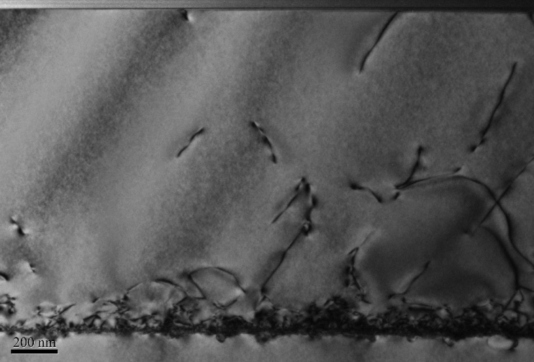
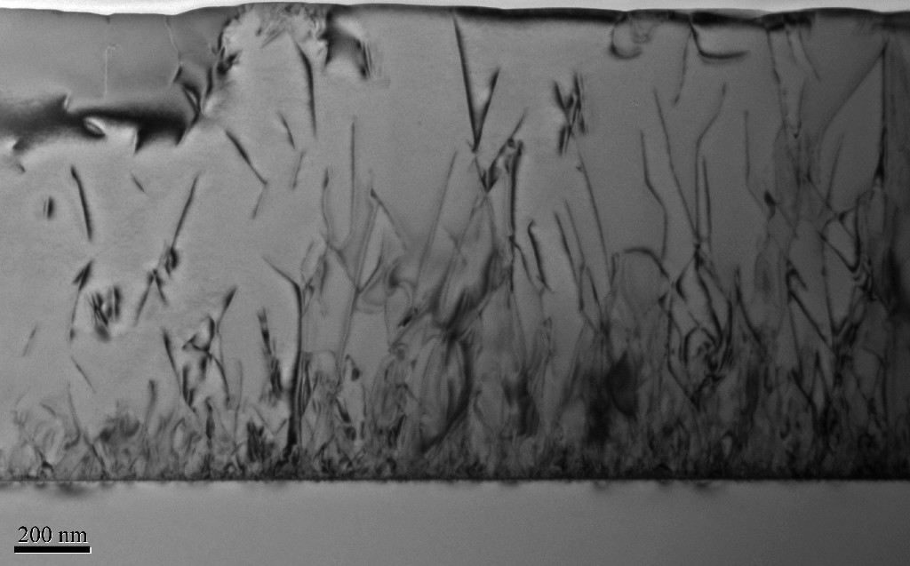
SIMS and TEM analysis
Ga
As
InAs/GaAs
In
200 nm
N
InAsN(1%) /GaAs
200 nm
N is uniform
No evidence of unintentional impurities (C, O etc.) as-grown InAsN is of high purity
Analysis of secondary ion peaks from CsAsN⁺ enables accurate N determination
-comparison with XRD data – N content is ~5% larger than determined from XRD
Significant incorporation of non-substitutional N
Higher dislocation density in InAsN – but obtain increase in PL
Localisation, non-uniform PL emission from regions around dislocations?

Slide 12
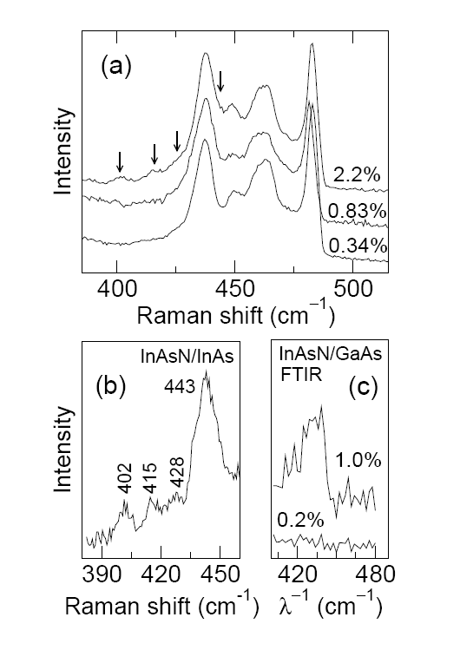
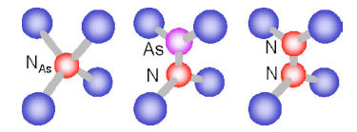
Raman spectroscopy
Weak InAs modes at 405 and 425 cm⁻¹ and
2nd order InAs optical modes at 435, 450, 460 and 480cm⁻¹
Additional N related features at 402, 415, 428 and 443 cm⁻¹
(previously observed by Wagner et al. N ~ 1.2 %)
N related features
2nd order InAs modes
N_{AS}
As -N
N-N
difference spectrum of highest N – lowest N content
443 cm⁻¹ feature - also detected in FTIR
NAs LVM from substitutional ¹⁴N_{As}
402 cm⁻¹ and 415 cm⁻¹ peaks from non-substitutional N-N or As-N split interstitials, (N antisites or interstitial N) rather than N-In-N complexes
and As -N produce deviations from Vegard’s law
(Calculations predict N-N split interstitial at 419 cm⁻¹
but also predict that the As-N split interstitial lies well above the LVM in GaAsN)
Ibanez et al, JAP (2010)

Slide 13
Electrical properties InAsN on GaAs
Phonon scattering
impurity scattering
1000 nm n-type InAs(N)
Semi-insulating GaAs substrate
N reduces electron mobility
µ is limited by electron scattering by N-atoms, -pairs and clusters
Model for GaAsN predicts a strong reduction of the mobility and electron mean free path due to the N-levels
Weak dependence of µ on N-content compared to GaAsN due to the proximity of the N-related states to the CBE
Impurity scattering dominant at high N
Residual carrier conc. increases for N >0.4%
N incorporation introduces native donor states
A. Patanè et al Appl. Phys Lett. 93, 25106 (2008)

Slide 14
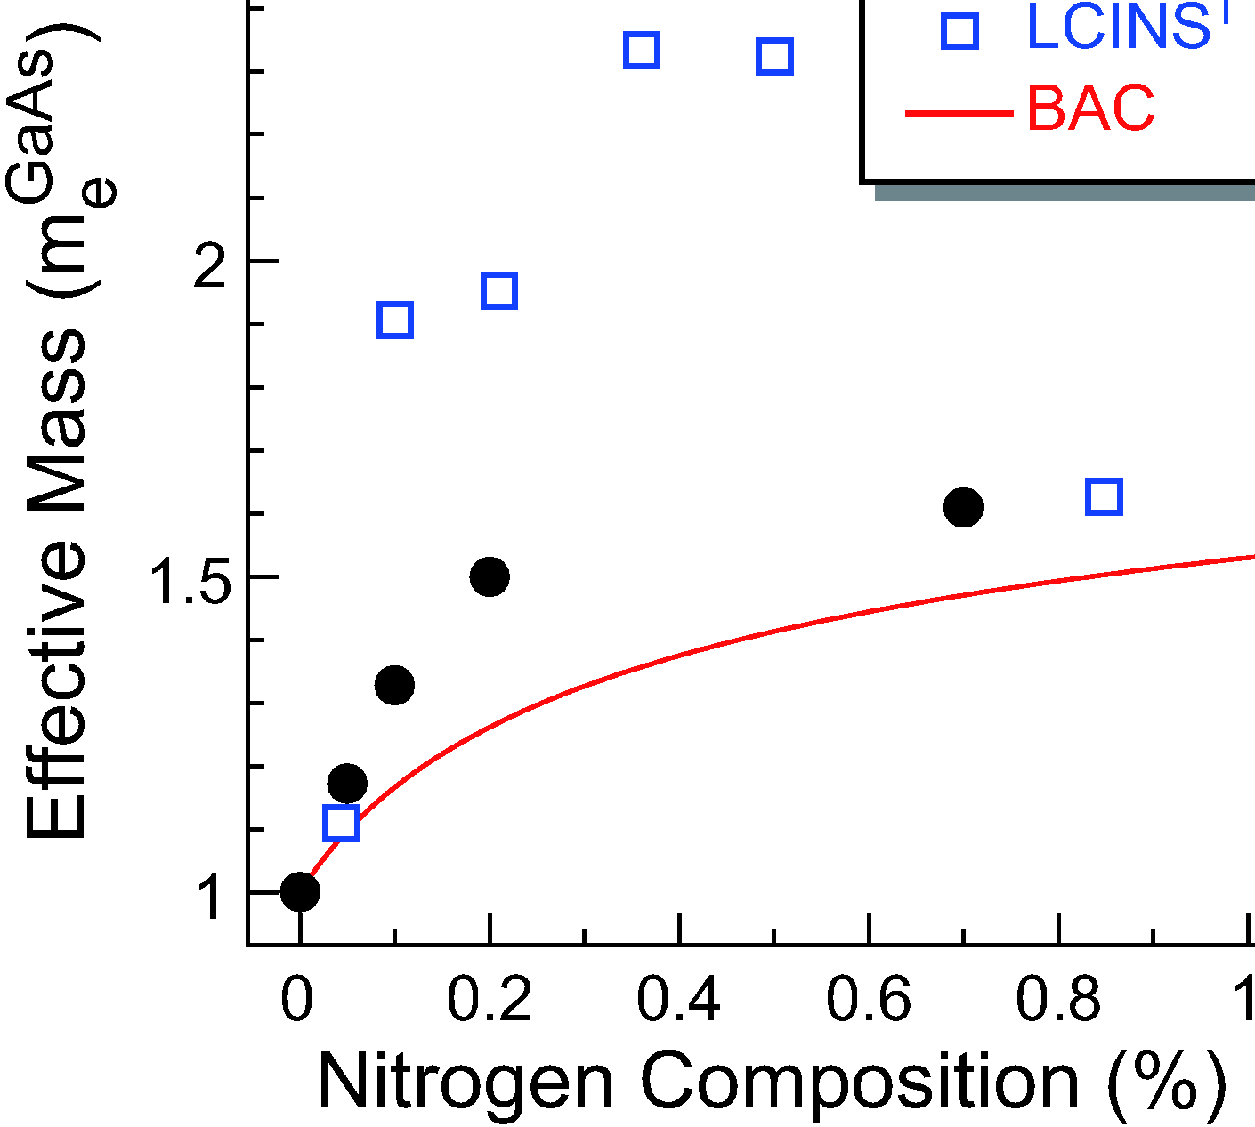
Electron Cyclotron Mass
The cyclotron mass increases with increasing x
Comparing the N-induced change of the mass in InAsN and GaAsN
GaAsN LCINS, O’Reilly
(m_{e})
CR/PR GaAsN
CR InAsN
The electron mass and its dependence on the excitation energy are weakly affected by the nitrogen
O. Drachenko et al. APL 98, 162109 (2011)

Slide 15
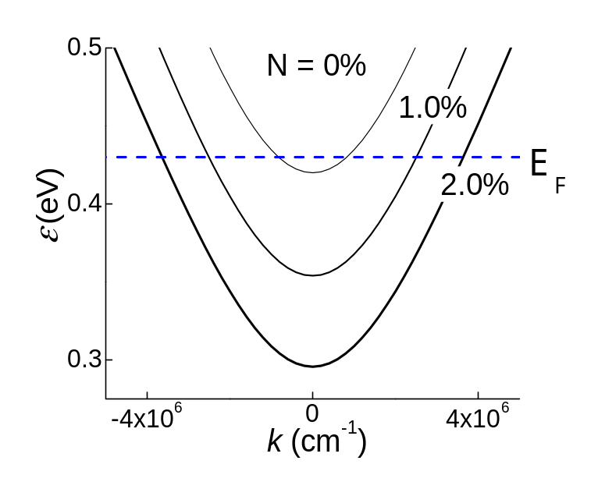
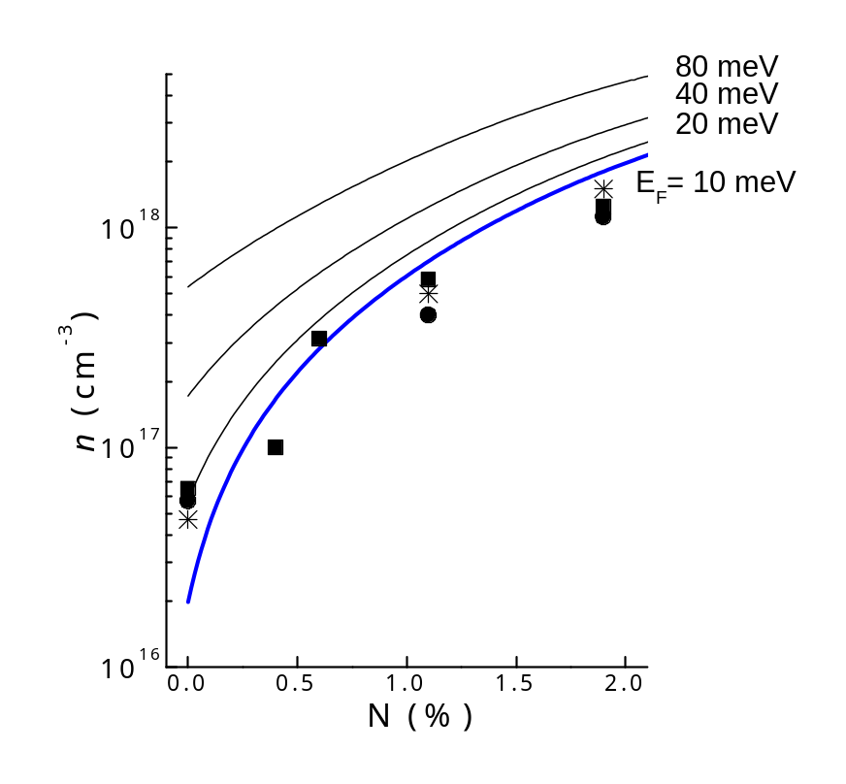
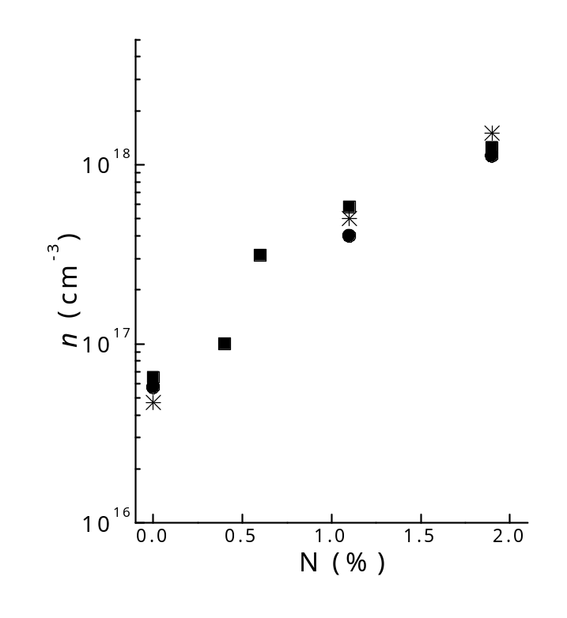
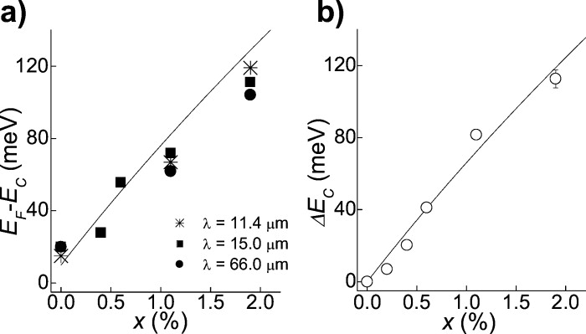
InAsN - Cyclotron Resonance
Pinning of the Fermi level
The increase of electron density with increasing N indicates a pinning of the Fermi level and implies a substantial density of native donor states
O. Drachenko et al. APL 98, 162109 (2011)

Slide 16
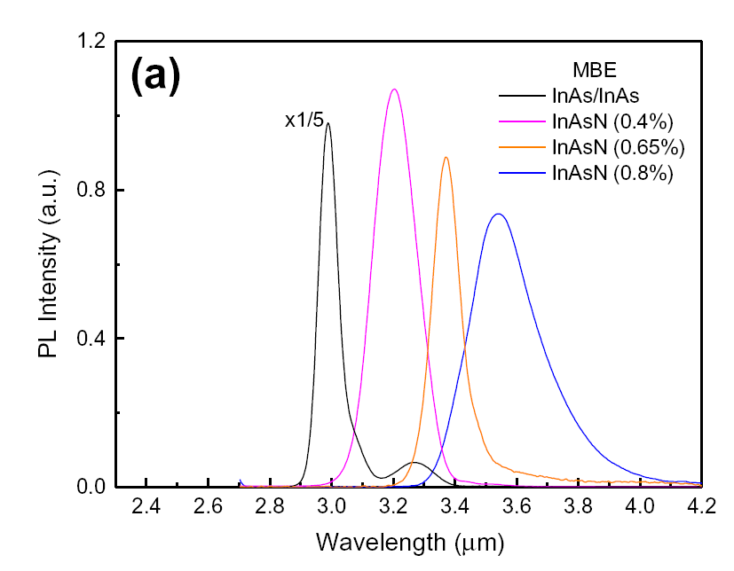

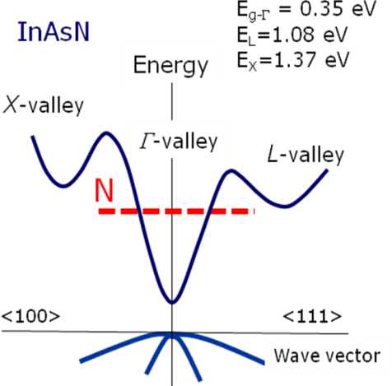
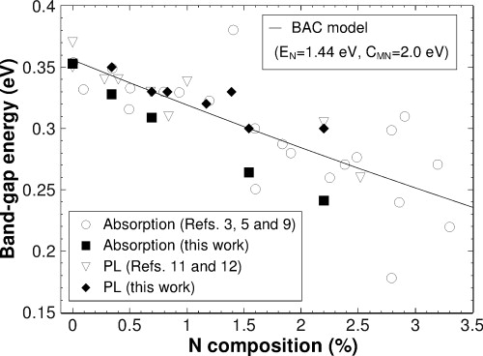
Photoluminescence InAsN on InAs
Incorporation of small amounts of N into III-V’s causes conduction band anti-crossing leading to reduction in band gap
Good agreement with band anti-crossing model
(60 meV per 1%N)
Long low energy tail appears - localisation
C_{MN} = 2.5 eV at 4 K
caused by uneven nitrogen distribution- composition fluctuations or point defects

Slide 17
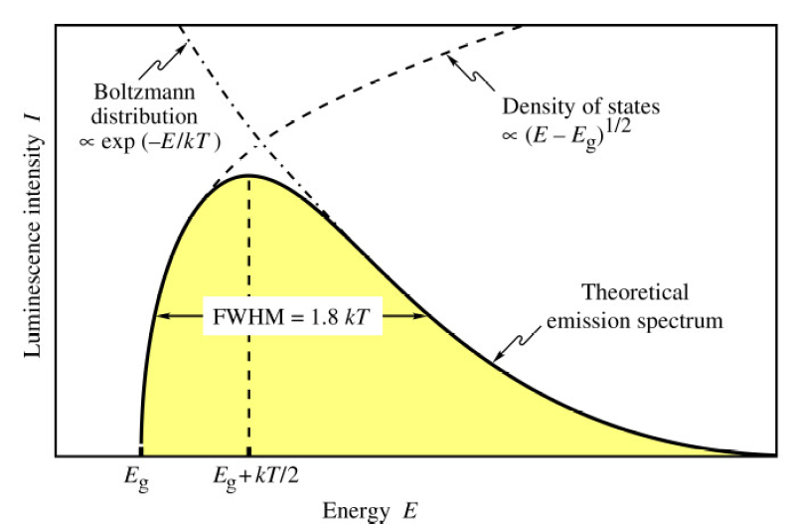
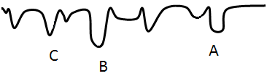
Photoluminescence Lineshape
PL is Gaussian at low T
As T increases becomes asymmetric with high energy tail
extends well above E_{g}
Lineshape - 2 effects
Localization at low T
Free carrier emission at high T
Conduction Band
Valence Band
J. Appl. Phys. 108, 103504 (2010)

Slide 18
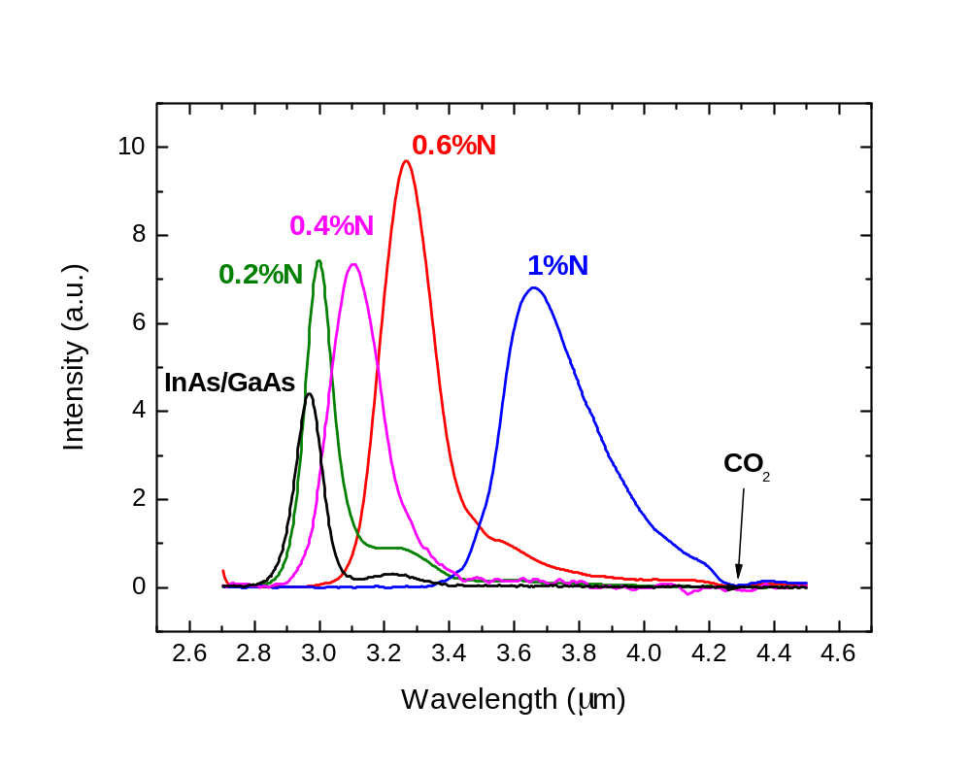
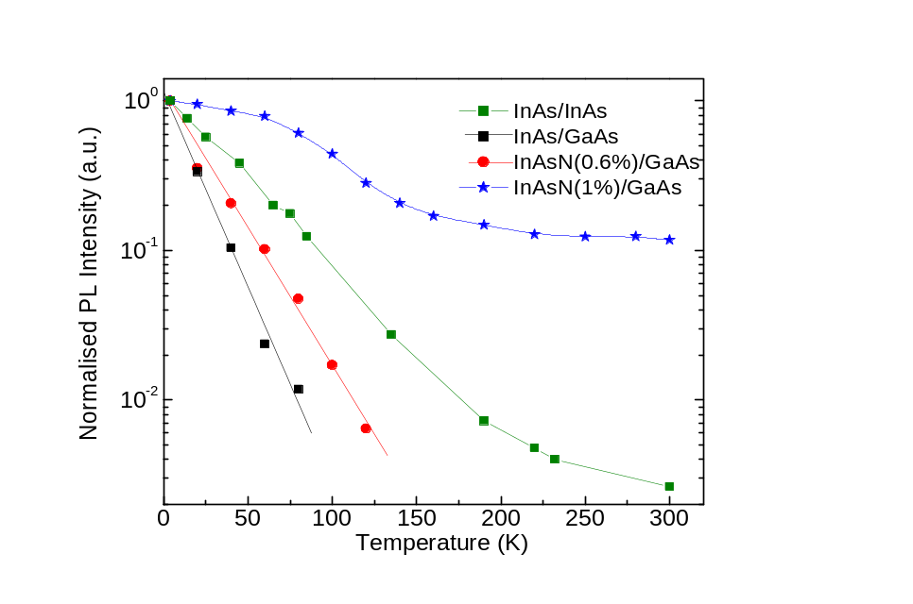
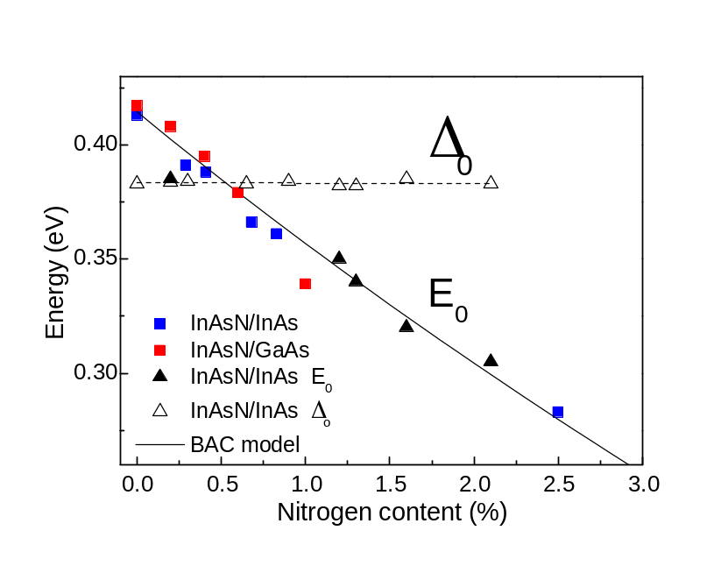
InAsN on GaAs
4K PL
PL obtained from InAsN on GaAs across the mid-IR spectral range with addition of small quantities (~ 1%) of nitrogen
Good agreement with band anti-crossing model
Inclusion of nitrogen improves the peak intensity InAsN > InAs on GaAs
Photoreflectance shows Δ₀ is constant with increasing N
Activation energy increases with increasing N content – CHSH Auger detuning
improved PL

Slide 19
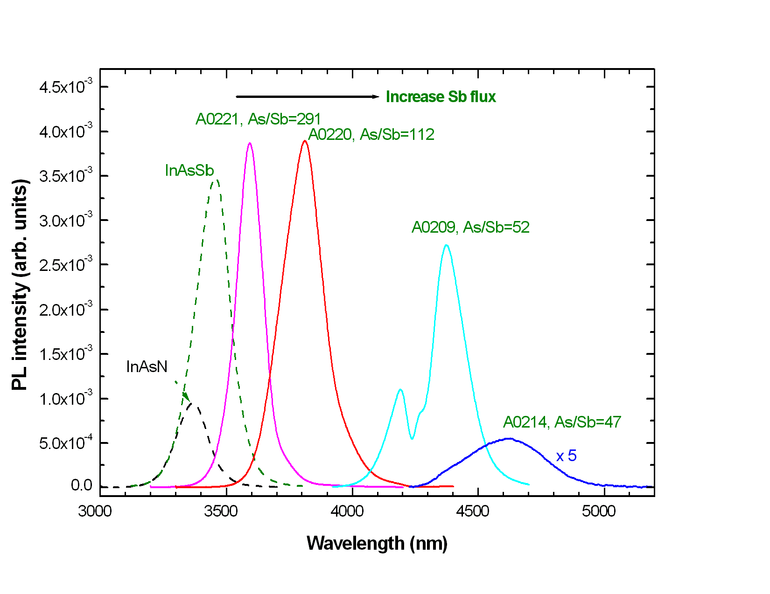
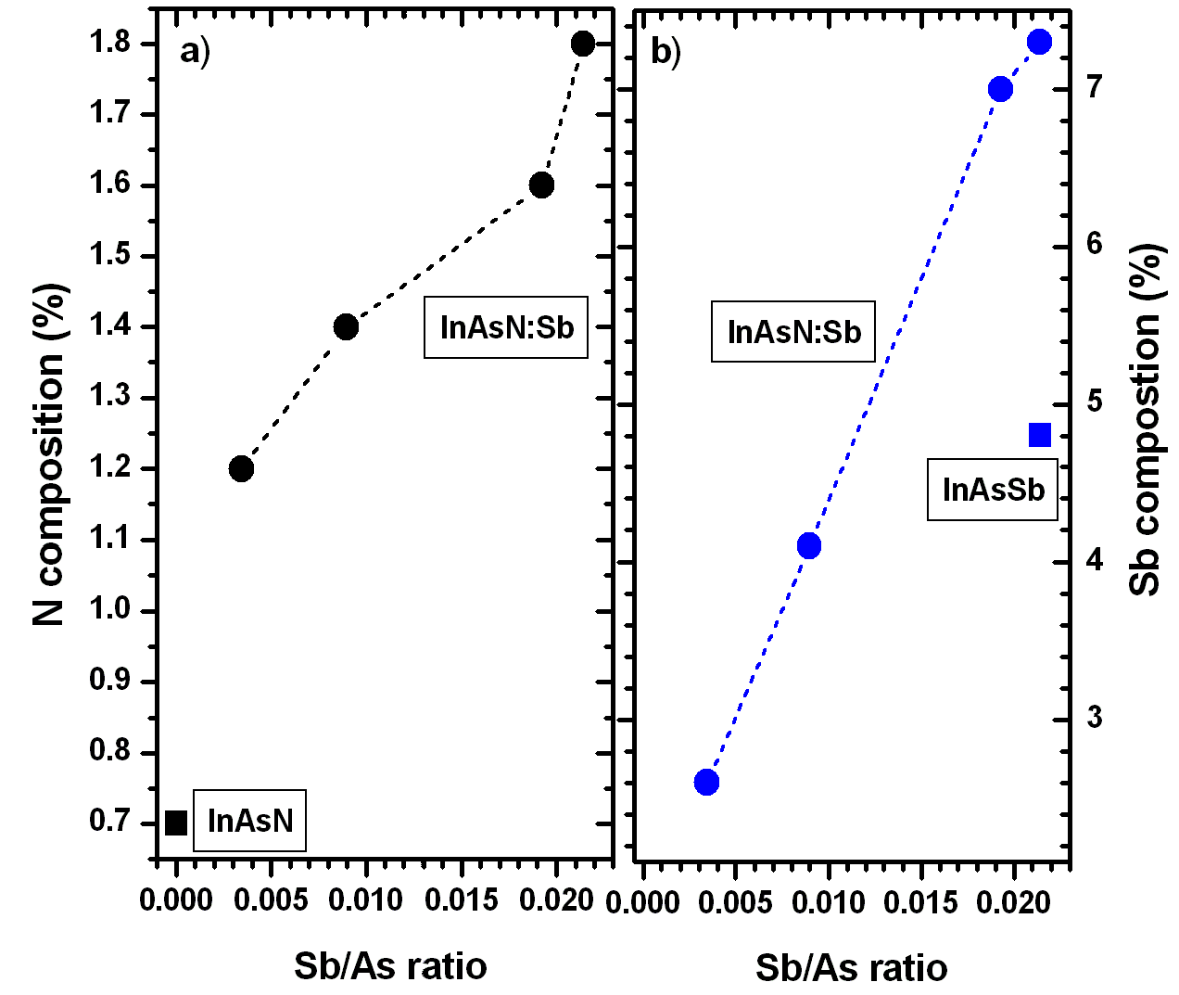
Adding Sb - MBE growth of InAsSbN
InAs
Conduction band
Adding N to InAs
Adding Sb to InAs
E_{g}
Valence band
Increasing N
Tensile strain
Increasing Sb
Compressive strain
N is hard to incorporate
Use Sb to reduce lattice mismatch increase N incorporation improve quality
Sb acts as surfactant to maintain 2D growth and reduces point defects - improves PL
Red-shift of emission wavelength
– need less N to reach longer wavelengths
Sb reduces N surface diffusion length - increases N incorporation ~ 2.5x
Reduction of Sb segregation induced by N - increases Sb incorporation ~1.5x

Slide 20
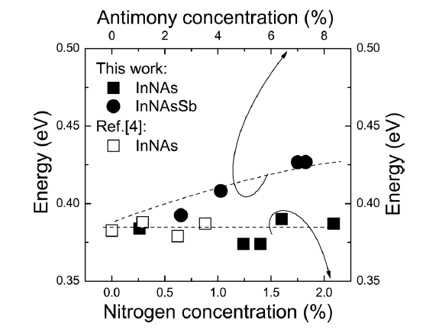
Photoreflectance
Δ_{so} > E₀ Auger suppression
Advantage of InAsNSb over InAsN
In-plane strain for layers grown on InAs
can be tuned from tensile to compressive
- Tailor polarization in QW to be either TE or TM
Sb increases confinement in valence band
- dominant polarisation is TE (e₁-hh₁)
Spin orbit splitting In InNAs & InAsNSb
Incorporation of Sb increases Δ_{so} and decreases E₀
N does not change Δ_{so}
Both Sb and N reduce E₀
~ 5 meV per 1% of Sb
~ 60 meV per 1% N
InNAs
InNAsSb
Kudrawiec et al. APL 99, 011904 (2011)

Slide 21
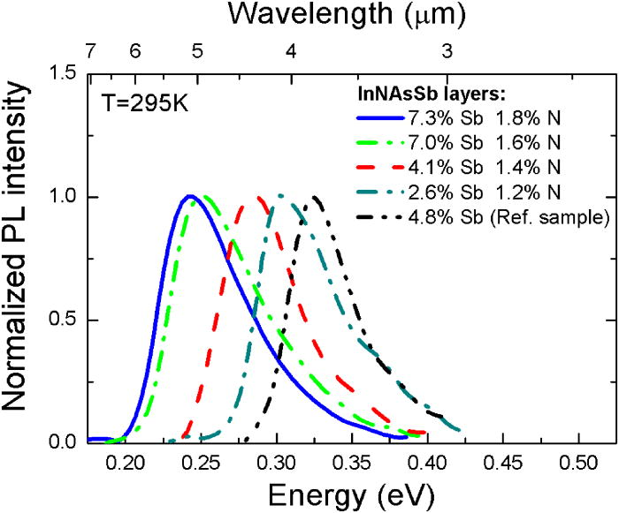
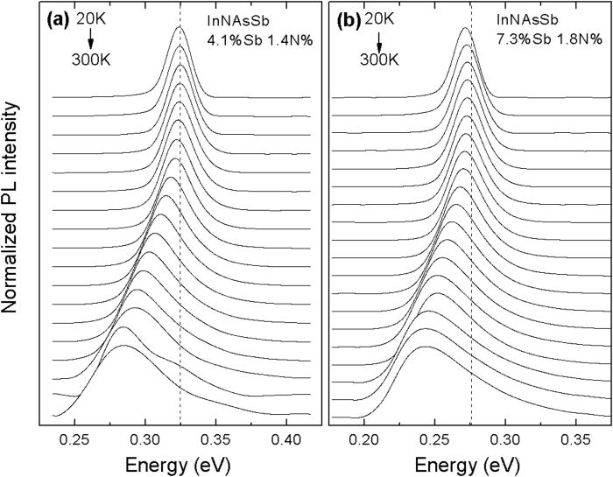
InAsSbN Photoluminescence
Strong PL at room temperature
- good optical quality
Asymmetric shape
Narrow energy gap – free carrier emission is important
Especially > 100 K
High energy tail extends well above E_{g}
Gaussian at low T
PL peak lower than E_{g} determined from PR
Characteristic S-shape but with weak carrier localisation
Stokes shift <10 meV
smaller than for InAsN
Composition fluctuations or point defects reduced due to surfactant effect of Sb
Latwoska et al, Appl. Phys. Lett 102, 122109 (2013)

Slide 22
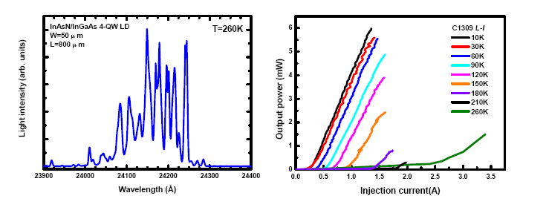
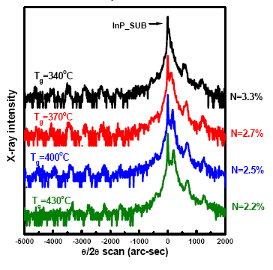
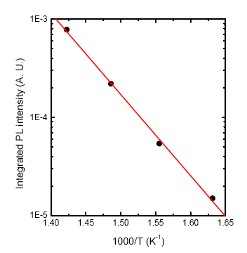
InAsN QW lasers on InP
InAsN ridge lasers operating up to 2.6 µm have been demonstrated – grown by gas source MBE
limited by N incorporation and critical thickness
4 QW InAsN/InGaAs on InP (5μs pulse width, 500 Hz repetition rate)
Max. operating temperature 260 K with T₀ = 110 K
Decreasing growth temp incorporates more N
….but reduces QW quality
D. K. Shih, H, H. Lin, and Y. H. Lin, IEE Proc. Optoelectronics 150, 253 (2003)

Slide 23
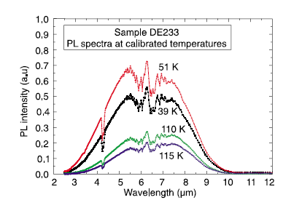
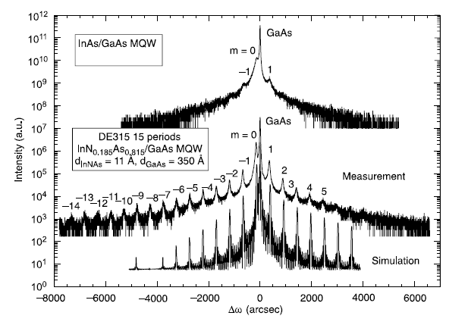
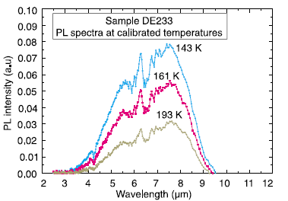
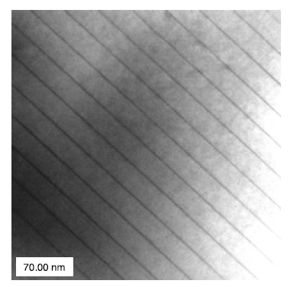
InAsN MQW grown by MOVPE
MQW containing 18% N
on GaAs (UNM)
longest wavelength PL obtained from dilute N
growth temperature 500 ⁰C
Osinski , Optoelectronics Review 11(4) 321-6 (2003)

Slide 24
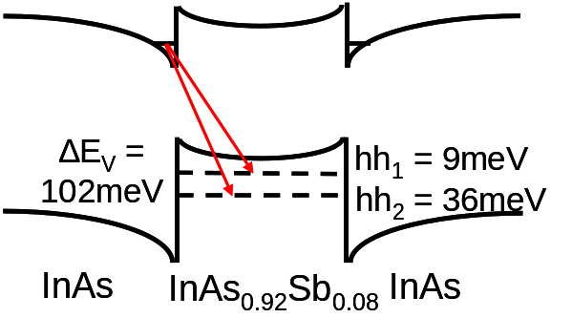
InAsSbN / InAs MQWs
100 nm InAs Capping Layer
10x InAsNSb /InAs QW
(12x24 nm)
Growth of the MQWs calibrated using the same growth method of previously grown InAsNSb bulk layers
200 nm InAs Buffer Layer
InAs substrate
200 nm InAs Buffer layer grown at 480°C
10x InAsSbN/InAs QW grown at 420°C
  Growth rate of 0.5µm per hour
  Nitrogen plasma setting fixed at 160 W with flux of 6×10⁻⁶ mbar
100 nm InAs Capping Layer grown at 480°C
As flux kept at minimum for growth of InAs layers

Slide 25

InAsSbN/InAs MQW 4K photoluminescence
N =1%, Sb 6%
Band alignment determined by modification of InAsSb - Type II alignment with conduction and valence band offsets of 39 & 82 meV
ADDITION OF N :
  Reduction in overall strain Reduction of
  band gap
  Conduction band further reduced by BAC model
  Reduction of 63 meV
No blue-shift with excitation power - Type I QW
3.48 µm
3.62 µm (expt.)

Slide 26
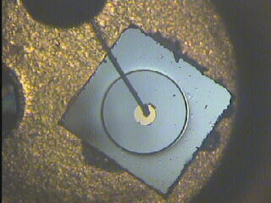
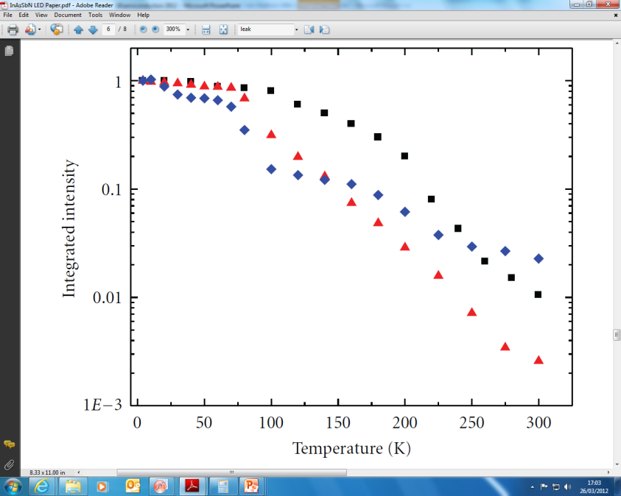
InAsSbN MQW LED
300 K EL
p-i-n diode containing 10x
InAsSbN QW in active region N =1%, Sb 6%
Longest wavelength dilute nitride
light emitting device to date
C-H
absorption
p InAs
InAsNSb MQW
n InAs
InAs (100) substrate
p⁺-InAs
n⁺-InAs
4 K EL
InAsSbN e-hh1
InAsSb e-hh1
InAsSb e-hh2
LED output power : 6 µW at 100 mA drive current and internal RT efficiency ~ 1%

Slide 27
InAsSbN MQW p-i-n photodetector
R₀A ~1/n
R₀A ~1/n²
Cut-off λ ~ 4 μm
Ideality factor = 1.6
R₀A
T<120 K generation-recombination dominates
T>220K diffusion limited recombination is dominant
Capacitance at 0V =2.54 nF
Built in potential = 0.19 V
Carrier concentration = 8.3x10¹⁷ cm⁻³

Slide 28
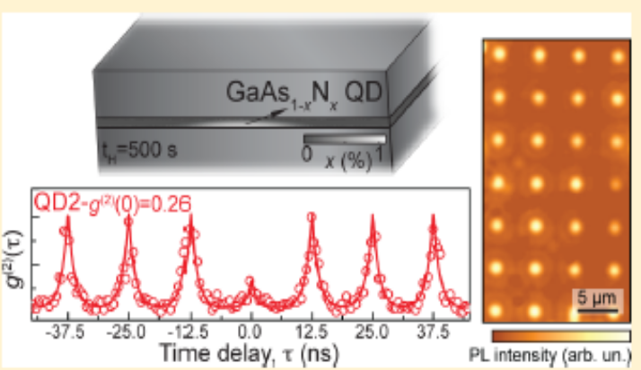
New prospects
Recent results on rapid thermal annealing (RTA) show a large x20 increase in PL intensity of InAsN
-no increase in residual carrier concentration
H irradiation also increases PL intensity
In InAsN
GaAsN +H results in passivation of N which restores the bandgap (reversibly)
Can create GaAsN quantum dots
hydrogen
titanium
GaAsN
GaAs
Change to GaInAsN - single photon sources
Micro – LED arrays

Slide 29
Summary
The successful MBE growth of InAsN directly onto InAs and GaAs substrates
has been obtained with N up to ~ 2%
Behaviour of N in InAs different to N in GaAs
Mobility is reduced but shows weak dependence on N content
Fermi level pinning and native donor states
PL was obtained which covers the mid-infrared (2-5 μm) spectral range in good
agreement with the BAC model
Localisation and free carrier effects are important in interpretation of PL spectra
N reduces band gap but has little effect on T sensitivity
Photoreflectance shows N has no effect on Δ_{o}
Auger CHSH de-tuning is possible
Addition of Sb increases N incorporation –structural and optical properties
- improved and bright PL obtained from Type I InAsSbN/InAs MQWs
First long wavelength dilute N LED operating at 300 K
good prospects for device applications if electron concentration can be controlled

Slide 30

Acknowledgements
  A. Patane Nottingham University Transport measurements
  R. Beanland & A. Sanchez University of Warwick TEM
  J. Ibanez University of Madrid Raman spectroscopy
  R. Kudrawiec Institute of Physics, Wroclaw Photoreflectance
M. Latkowska
O. Drachenko Helmholtz-Zentrum Cyclotron resonance
M. Helm Dresden-Rossendorf
M. Schmidbauer Leibniz-Institute, Berlin X-ray diffraction
  Financial support from EPSRC (EP/G000190/01) and also for providing a studentship for M. de la Mare

Slide 31
Comparison with InAsSb
InAsSbN MQW LED
N =1%, Sb 6%
InAsSbN e-hh1
InAsSb e-hh1
InAsSb e-hh2
Comparison of the temperature dependence of the EL with that of type II InAsSb/InAs reveals more intense emission at low temperature
Improved temperature quenching up to T~200 K where thermally activated carrier leakage becomes important and further increase in the QW band offsets is needed
Increasing the nitrogen content above 0.5% reduces the band gap sufficiently such that the energy gap E_{o} becomes less than Δ_{so} effectively detuning the CHSH Auger recombination mechanism

Slide 32
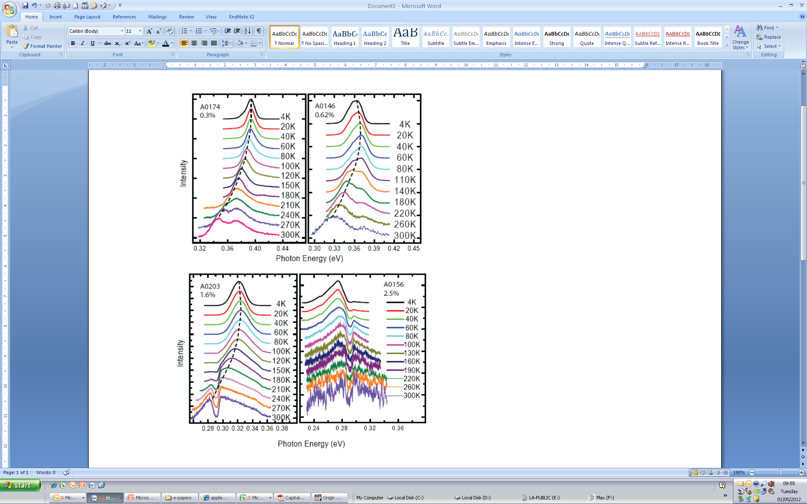
PL analysis temperature dependence
InAsN(1%) exhibits very weak temperature quenching ~ 8x
PL emission obtained up to room temperature without annealing
Peak wavelength near 4 µm – appropriate for CO₂ detection

Slide 33
Comparing III-N-Vs
InAsN
GaAsN
E_{g-Γ} = 1.42 eV E_{L}~0.3 eV E_{X}~0.3 eV
E_{g-Γ} = 0.35 eV
E_{L}=1.08 eV
E_{X}=1.37 eV
Energy
Energy
X-valley
X-valley
Γ-valley
L-valley
Γ-valley
L-valley
N
N
<100>
<111>
<100>
<111>
Wave vector
The energy of the N-level (E_{N}~ 1eV) is larger than the threshold energy for impact ionization (~ E_{g-Γ}).
The energy of the N-level (E_{N}~ 0.2eV) is smaller than the threshold energy for impact ionization (~ E_{g-Γ}).

Slide 34
InAsN - Cyclotron Resonance
Magneto-transmission in pulsed magnetic field B up to 60T and monochromatic excitation by QCL
Minimum at the resonance field B_{c} gives m_{e}* = eB_{C}λ/(2πc)
InAs_{1-x}N_{x}
CR quenches in GaAsN (0.1%) due to low μ
T =100 K
υ= 2.9THz
x=0%
N = 0%
0.4%
0.6%
N = 1.1%
1.0%
Area of the CR minimum gives electron density n
Patanè et al. PRB 80 115207 (2009)

Slide 35
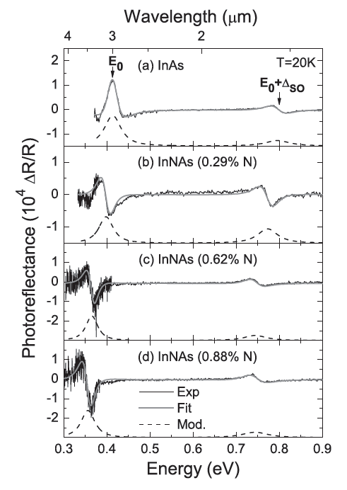




Photoreflectance Spectroscopy
PR spectra can be fitted using
where C and θ are amplitude and phase
m=2.5 for b-b
InAsN on InAs

Slide 36
Avalanche photodiodes
InAsN
GaAsN
E_{g-Γ} = 1.42 eV E_{L}~0.3 eV E_{X}~0.3 eV
E_{g-Γ} = 0.35 eV
E_{L}=1.08 eV
E_{X}=1.37 eV
Energy
Energy
X-valley
X-valley
Γ-valley
L-valley
Γ-valley
L-valley
N
N
<100>
<111>
<100>
<111>
Wave vector
The energy of the N-level (E_{N}~ 1eV) is larger than the threshold energy for impact ionization (~ E_{g-Γ}).
The energy of the N-level (E_{N}~ 0.2eV) is smaller than the threshold energy for impact ionization (~ E_{g-Γ}).

Slide 37


InAsN: Impact Ionization
Rapid increase of current at large electric fields (>1kV/cm) due to impact ionization (IO).
I
2μm
At x~1%, electric fields for impact ionisation are larger than those measured in InAs, although the threshold energy is smaller
The reduction of the band gap energy by the N-atoms combined with impact ionization is of interest for IR-Avalanche Photodiodes
Makarovsky et al., APL 96, 052115 (2010)

Slide 38



Dilute nitrides
D. Sentosa, X. Tang,a, and S.J. Chua, Eur. Phys. J. Appl. Phys. 40, 247–251 (2007)
InAs
InN
N introduces tensile strain (on InAs or GaAs)
disorder and strong bowing
N
Harris, J. S. Semiconductor Science and Technology 17, 880 (2002)

Slide 39




InAsN Photoreflectance
Solid lines are fits to
Where, x is the N content
N does not change Δ_{so}

Slide 40



Photoluminescence curve fitting
Fit using
Includes localized and band-band transitions
A = scaling factor
E_{cr} = energy of crossover between equations
K = smoothing parameter
σ relates to slope of DOS
Set K = k_{B}T/σ and E_{cr} = Eg + k_{B}T/σ
n= 0.5 to 2 for momentum conserving non-conserving transitions
Best fit when n=1
Black arrows – E_{g} determined from PL fitting
Red arrows – PL peak
Note the difference which increases with T
Latwoska et al, Appl. Phys. Lett 102, 122109 (2013)

Slide 41


Temperature dependence
E_{g} obtained from PL
spectral fitting
deviates from PL peak value especially at
T> 80K
Free carrier emission must be taken into account
Bose-Einstein formula
fitting gives: e-phonon coupling constant, α_{B} ~ 20 meV and average phonon temperature, θ_{B} ~ 140 K
N incorporation significantly reduces E_{g} in InNAsSb but has almost no effect on temperature dependence

Slide 42


Temperature dependence of bandgap
Comparison of change in energy gap with T
InNAsSb 65 meV
InAs 66 meV
InSb 62 meV
whereas 1% N in GaAs reduces T dependence of E_{g} by 40%
BAC model gives good agreement
T dependence of Eg in InNAsSb is not
sensitive to N due to large separation between E_{N} and E_{M} (~ 1 eV)

Slide 43
Let Us Meet Again
We welcome all to our future group conferences of Omics group international
Please visit:
www.omicsgroup.com
www.Conferenceseries.com
http://optics.conferenceseries.com/

