Slide 1

Anthony Jones
Understanding the mechanisms in the development of fibromyalgia
Human Pain Research Group
www.hop.man.ac.uk/painresearch

Slide 2

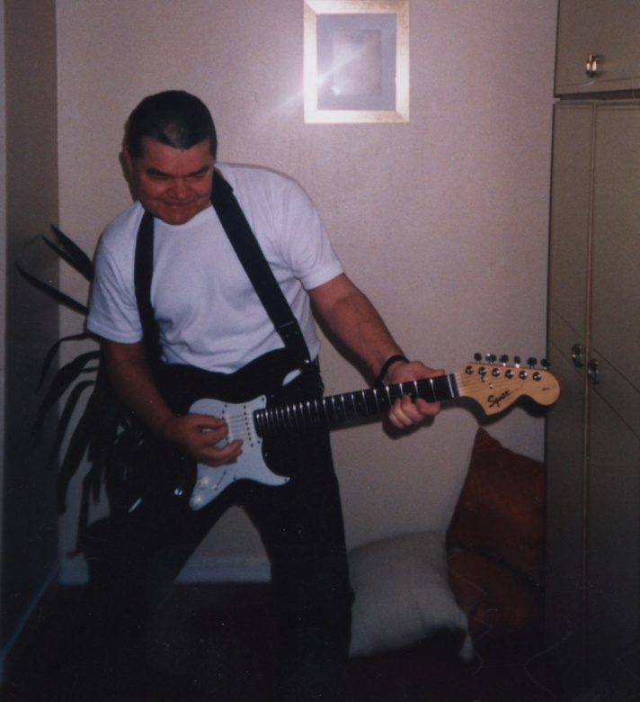
How can we explain arthritic pain and fibromyalgic pain in a common framework ?
Pain is not clearly correlated with tissue damage.
Disability is correlated with extent of pain and psychological distress. Natvig 2000.
Fibromyalgia
Arthritis
Notes:
Slide 2. Questions.
Je vais répondre aux trois questions :
Quels sont les mécanismes de la douleur ?
Qu’est ce qui change notre perception de la douleur ?
Pourquoi est-ce important ?
Pour moi, comme je suis rhumatologue les questions les plus importantes sont : « comment est-il possible qu’une personne souffrant d’arthrite ressente le même niveau de douleur que celle perçue par une personne atteinte de fibromyalgie, processus qui ne produit pas de dommage tissulaire ? » et « Quels sont les mécanismes de la douleur et comment la traiter avec plus d’efficacité ? »
PET provides the possibility of measuring and localising specific molecular events in tissue over time.
Will do this in relation to the indirect measurement of synaptic events and changes in opioid receptor binding during chronic pain.

Slide 3




Funding Acknowledgements
MRC – Medical Research Council
ARUK – Arthritis Research UK
Marie Curie
Dr Hadwen Trust
EU

Slide 4














Human Pain Research Consortium www.hop.man.ac.uk/painresearch
WATSON
TRUJILLO-BARRETO
BROWN C
TALMI
LOVELL
PROFESSOR AKP JONES
LLOYD
MORTON
POWER
KULKARNI
EL-DEREDY
BROWN R
MCCABE
LENTON

Slide 5
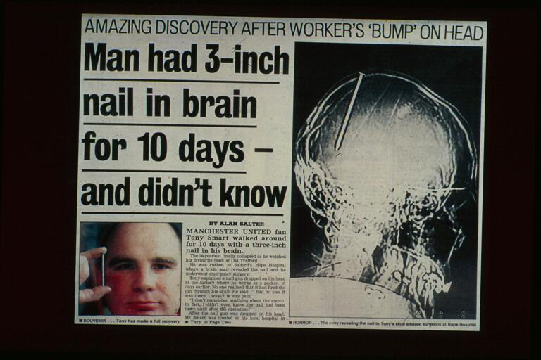

Slide 6
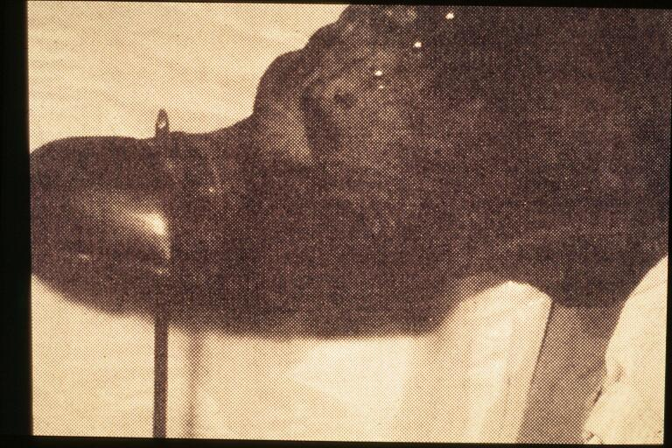

Slide 7
Types of pain
Nociceptive
stimulation of pain receptors
e.g. pin prick, arthritic pain
Non-nociceptive
no stimulation of pain receptors
Peripheral neuropathic pain
Central Pain:
Central deafferentation pain.
Psychogenic pain

Slide 8
TYPES OF PAIN PROCESSING
Emotional / Motivational
Evaluative
Sensory – discriminative – where is it ?
Reflex – automatic responses
Brain – cognitive
complex
1
23
4
simple

Slide 9
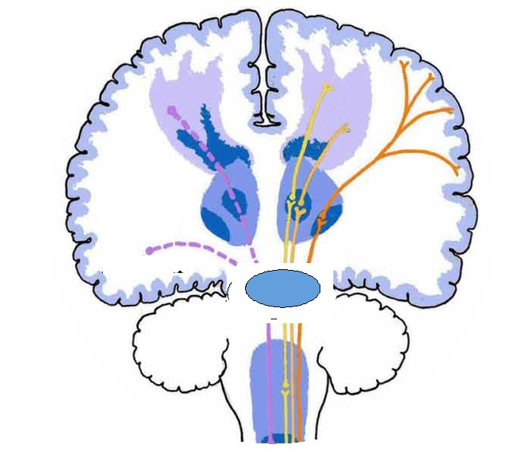
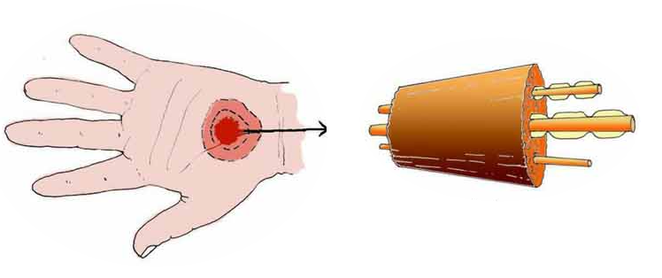
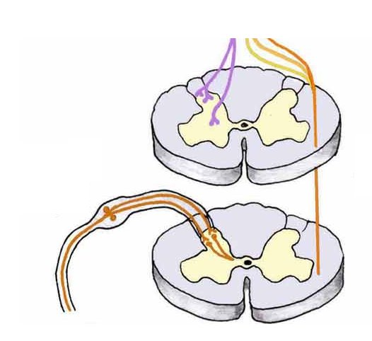
Medial pain
system
Lateral pain
  system
Pain pathways
Sensory
cortex
Limbic system
Thalamus
Tissue injury
Peripheral nerve
A-δ & C nociceptors
Spinothalamictracts
Dorsal horn
Notes:
Way back in the 16th century, it was believed that following injury pain messages are transmitted through specific nerve fibres to a single pain centre in the brain. In other words, it was assumed that the intensity of the pain is directly proportional to the extent of the injury
However, it is now very well established that pain is just not a linear response to the tissue injury, but has several factors influencing the experience of pain and in the brain pain signals are processed in an integrated network of structures called the pain matrix. This is a very simplified illustration of pain pathway. Following the tissue injury the peripheral receptors fro pain called a-delta and c nociceptors are activated that carry pain signals through the peripheral nerve spinothalamic tracts and thalamus. From thalamus this information is then relayed to various cortical areas. A further division of function has been proposed. Atleast 2 systems are known to function in parallel, 1 the medial pain system comprising the medial thalamus and its projections to medial structutres of brain are known to subserve emotional motivational components and the the lateral pain system comprising lateral thalamus and its projections to somatosensory areas. Medial is slow, non-somatotopic and lateral pain system is known to subserve sensory-discriminative aspects of pain. Most of the evidence for this division of function came from indirect evidences such as single unit recordings and clinical case reports.

Slide 10
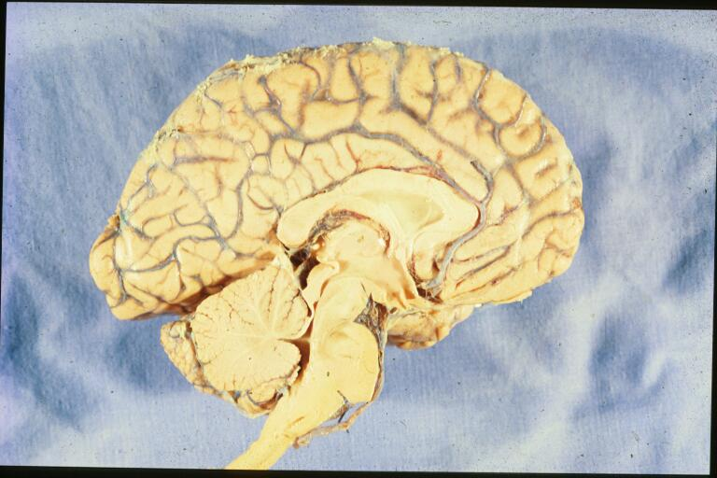
Medial surface of the brain

Slide 11
Medial nociceptive system Lateral nociceptive system
Pre-frontal Cortex
Cingulate Cortex
SI & SII
Basal Ganglia
Amygdala Hippocampus
Insula
Thalamus
Contralateral spino-thalamic tract
Brainstem PAG
A-delta afferents
C-fibre afferents
Spinal Cord

Slide 12
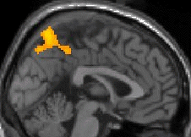
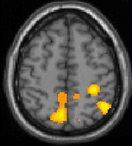
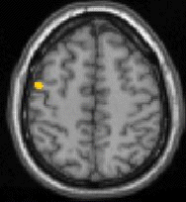
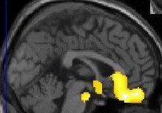
What do the medial and lateral pain pathways do?
Attend to Unpleasantness
Attend to Localisation
MEDIAL PAIN SYSTEM
activation with attention
to UNPLEASANTNESS
but not Localisation
LATERAL PAIN SYSTEM
activation with attention to
LOCALISATION
but not Unpleasantness
Kulkarni et al., Eur J Neurosci 2005

Slide 13
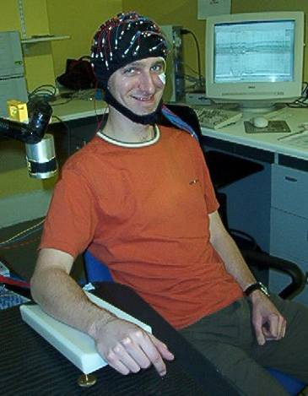

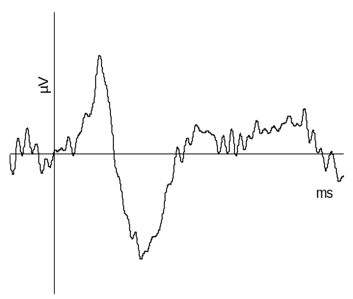
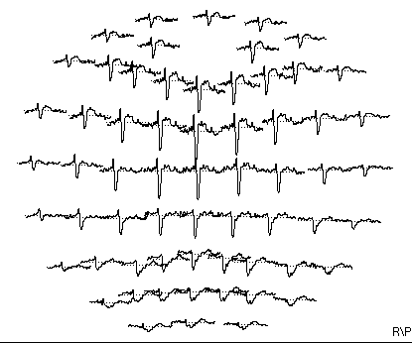
Laser evoked potentials (LEPs)
this is fun!
this is fun!
Laser pulse : 100 - 150 ms
ISI : 10 s
-µV
Zap!
Zap!
Zap!
Time ms
+µV
LEP
Zap!
N300
P450

Slide 14
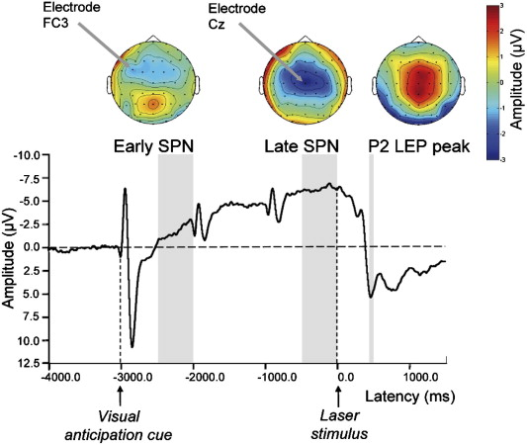
Pain Perception is shaped by anticipation
Brown et al, 2008 Pain

Slide 15
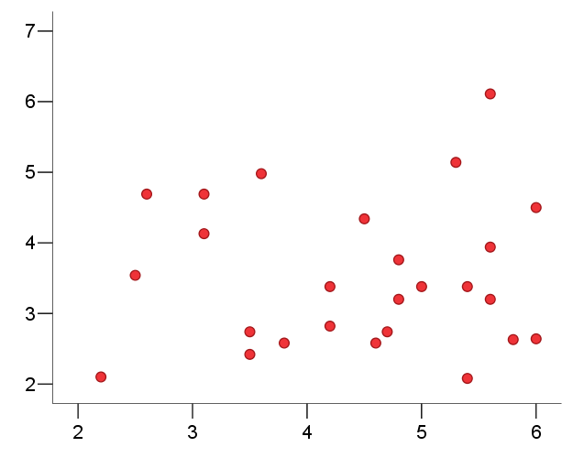
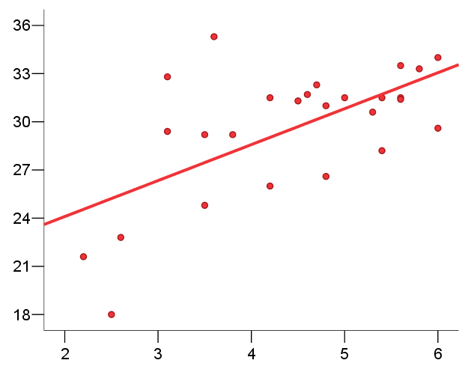
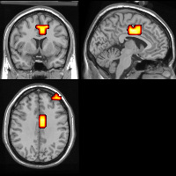
Top down effects are more powerful than bottom up effects
No correlation of unpleasantness ratings with applied laser energy
Intensity
Laser energy (J cm⁻²)
Unpleasantness rating
Correlation of unpleasantness ratings with anticipatory response in midcingulate cortex
Anticipation
Current density
Unpleasantness rating

Slide 16
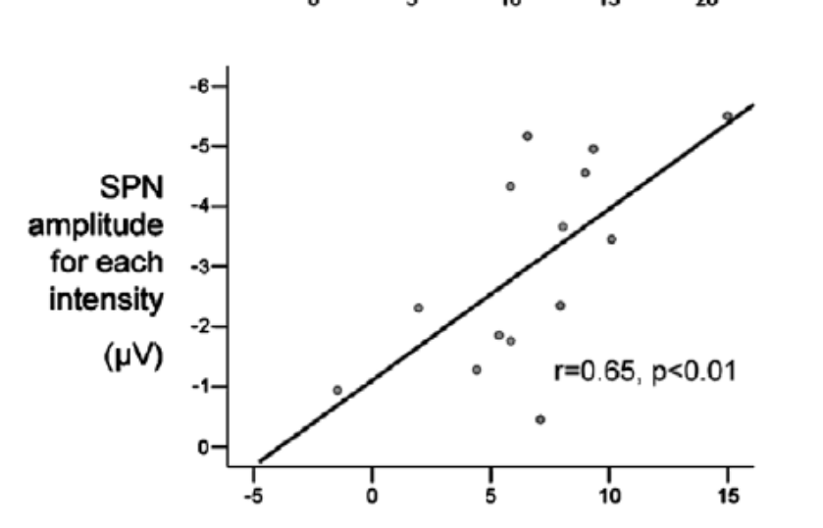
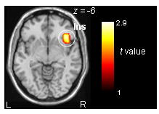
Pain Perception is shaped by anticipation
Experience is shaped by confidence in expectation
Brown et al, 2008 Pain

Slide 17
Placebo analgesia:
A Bayesian view of information processing
Placebo is a special case of a general cognitive system where
the brain resolves perceptual ambiguity by anticipating the forthcoming sensory environment; and generates a template against which to match observed sensory evidence
Prior knowledge / top-down
Confidence in prior information determines to what extent they are used

Slide 18
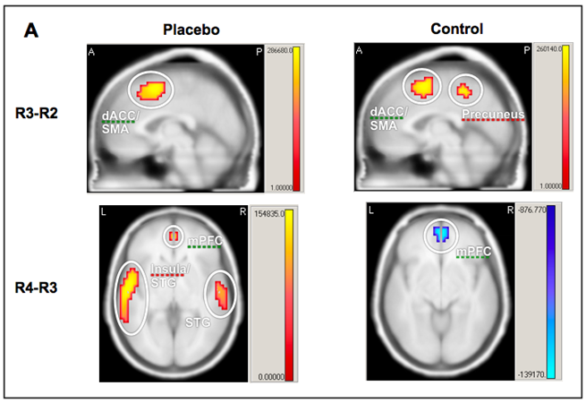
Alpha frequency and placebo
Significant sources of alpha activity in the contrast R3-R2 (top) and R4-R3 (bottom) in the healthy placebo (left) and healthy control groups (right).

Slide 19
Chronic Pain and Fibromyalgia:
What is different ?

Slide 20
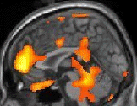
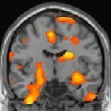
Chronic arthritic pain vs acute experimental pain
6
Greater responses in arthritis
4
2
0
¹⁸FDG PET Study
Kulkarni et al. Arthritis and Rheumatism: 2007

Slide 21
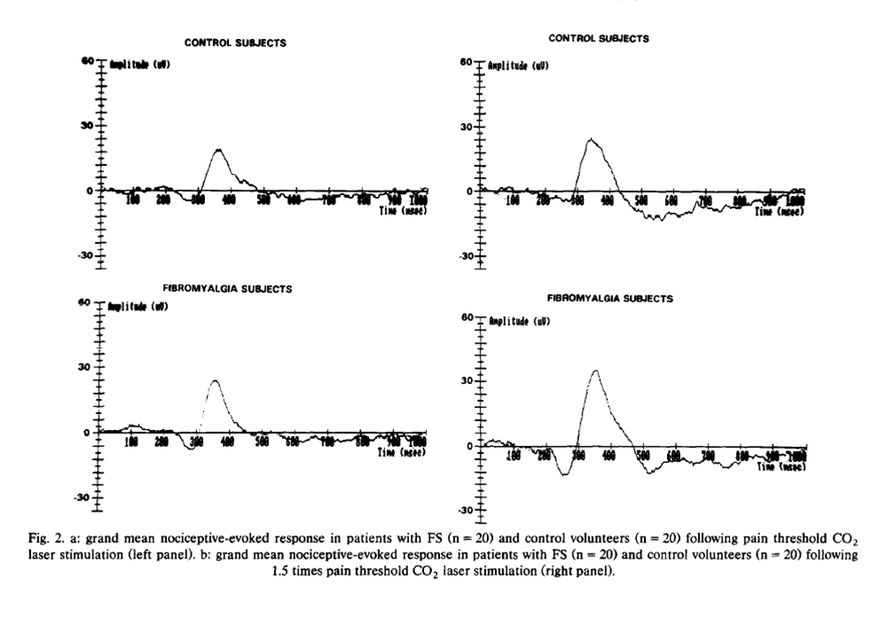
Pain-evoked potentials in fibromyalgia compared to age and sex-matched controls (N=20)
Gibson SJ, Pain 1994; 58: 185-193

Slide 22
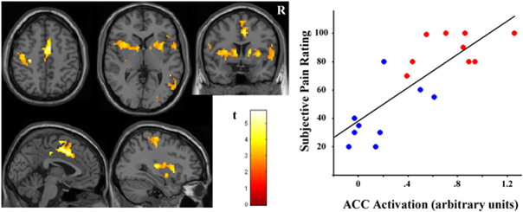
Correlation between pain scores and brain activations
Pujol et al, 2009 Plos One

Slide 23
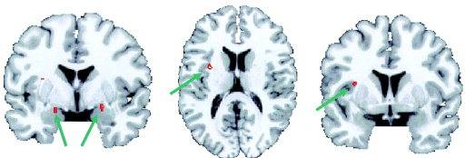
Increased activation of the amygdalae and insula cortex in fibromyalgia correlated with depression
Giesecke T, Arthritis & Rhematism 2005; 52:1577-1584

Slide 24
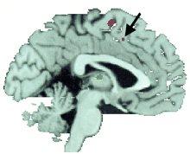
Increased cortical activity in FM associated with catastrophising
Gracely RH et al, Brain 2004

Slide 25
When the brain expects pain: common neural responses to pain anticipation are related to clinical pain and distress in fibromyalgia and osteoarthritis
Brown CA, El-Deredy W, Jones AKP
Eur J Neurosci 2014 Feb;39(4):663-72

Slide 26
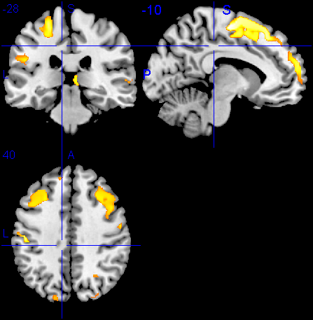
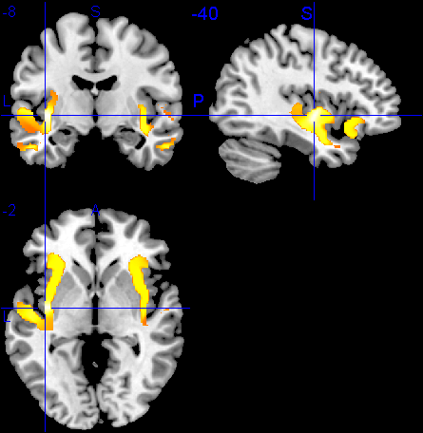
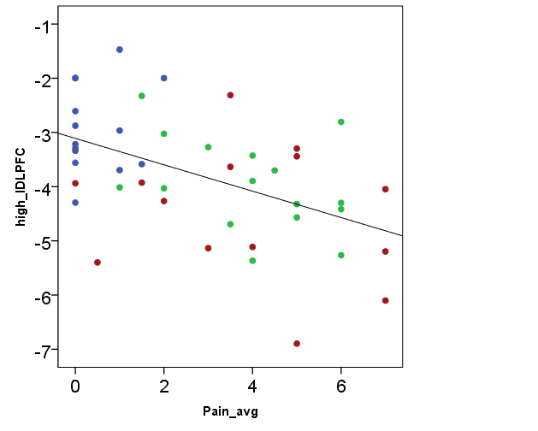
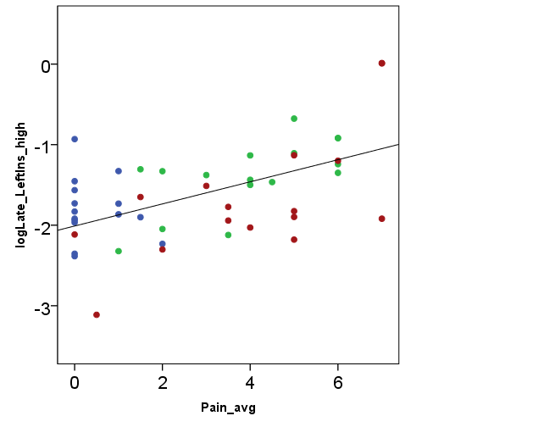
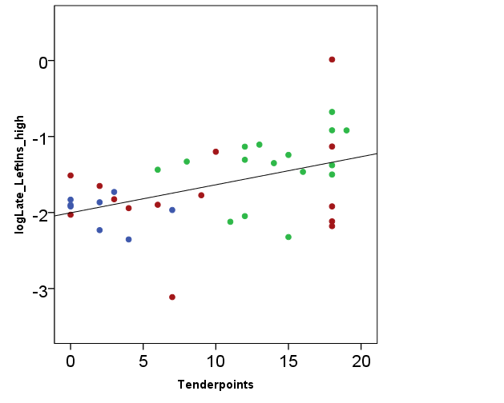
Abnormal anticipation of pain in fibromyalgia and osteoarthritis anticipatory brain activity in fibromyalgia and arthritis
Reduced activity in FM and OA groups relative to HP group
Greater activity in FM group relative to OA and HP groups
6.0
6.0
t value
t value
0
0
X = -10, Y = -28, Z = 40
X = -40, Y = -8, Z = 2
Left DLPFC
Left insula
Left insula
Clinical pain scores
Clinical pain scores
No. of tender points
Osteoarthritis patients
Healthy participants
Fibromyalgia patients
Eur J Neurosci

Slide 27
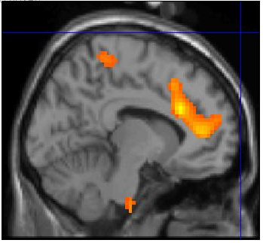
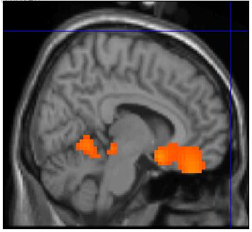
Altered brain activity in Fibromyalgia
Attention to unpleasantness
Attention to localisation
Kulkarni et al., Under review

Slide 28
Outcomes from an 8 week mindfulness intervention: changes in self-report measures
Self-management of pain
Perceived control over pain
20
Short-term training improves pain self-management, perceived control, and helplessness. Reduction in emotional experience of pain but non-significant.
10
15
8
6
10
4
2
5
0
-2
0
-4
-5
-6
Intervention group
Control group
Intervention group
Control group
Helplessness
Affective clinical pain
2
5
1
0
0
-1
-2
-5
-3
-4
-10
-5
-6
-15
-7
Intervention group
Control group
Intervention group
Control group

Slide 29
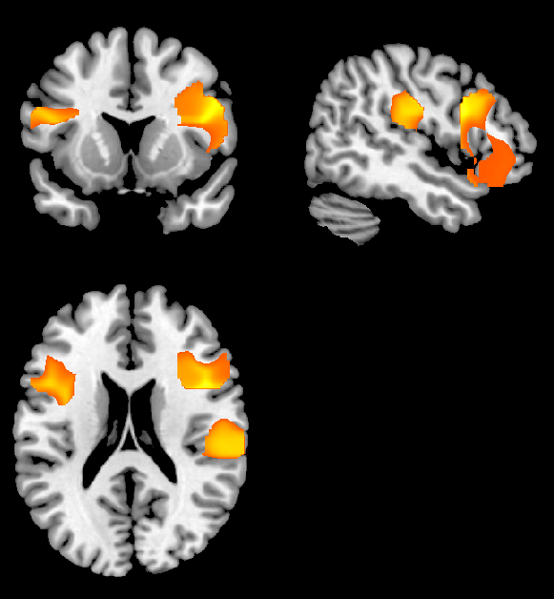
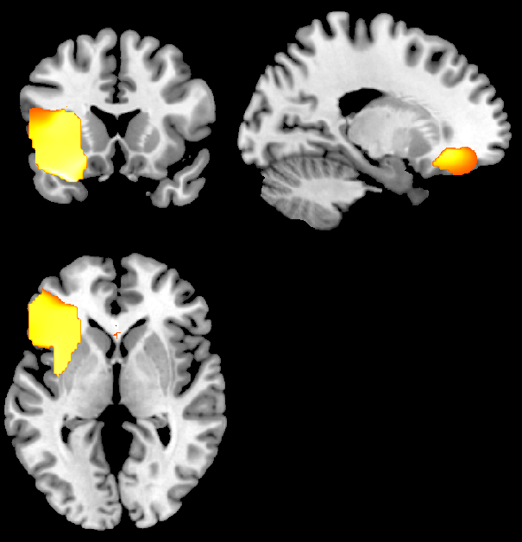
Outcomes from an 8 week mindfulness intervention: changes in the neural processing of pain
Figure 5
Mindfulness increases executive processing during early anticipation
Mindfulness decreases emotional responses during pain
12
R = 0.51
p = 0.003
10
8
6
* *
4
Anterior Insula
Perceived control over pain
Left DLPFC
Right DLPFC
2
4.0
4.0
0
* *
t value
t value
-2
-4
-6
0
0
-8
-0.4
-0.2
0
0.2
0.4
0.6
0.8
1
Left DLPFC
X = 48, Y = 13, Z = 20
X = -19, Y = 18, Z = 0
Mindfulness group
Control group
The evidence suggests that improvements in pain self-management and perceived control precede improvements in pain
Short-term effects correlate with greater neural processing in executive networks - dorsolateral prefrontal cortex (DLPFC) – which precede reductions in emotional processing during pain.
Brown et al., J Pain 2013

Slide 30
Neurochemical differences in Fibromyalgia compared to controls
5HT metabolites decreased in CSF Russell 1992
Mu-receptor binding decreased in brain Harris 2007
Glutamate Increased in posterior- Harris 2008
insula cortexH
Increased in Feraco 2011
pre-frontal cortex
Abnormal stress response
McBeth & Power, 2012,
From Acute to Chronic Back Pain, Oxford Press

Slide 31
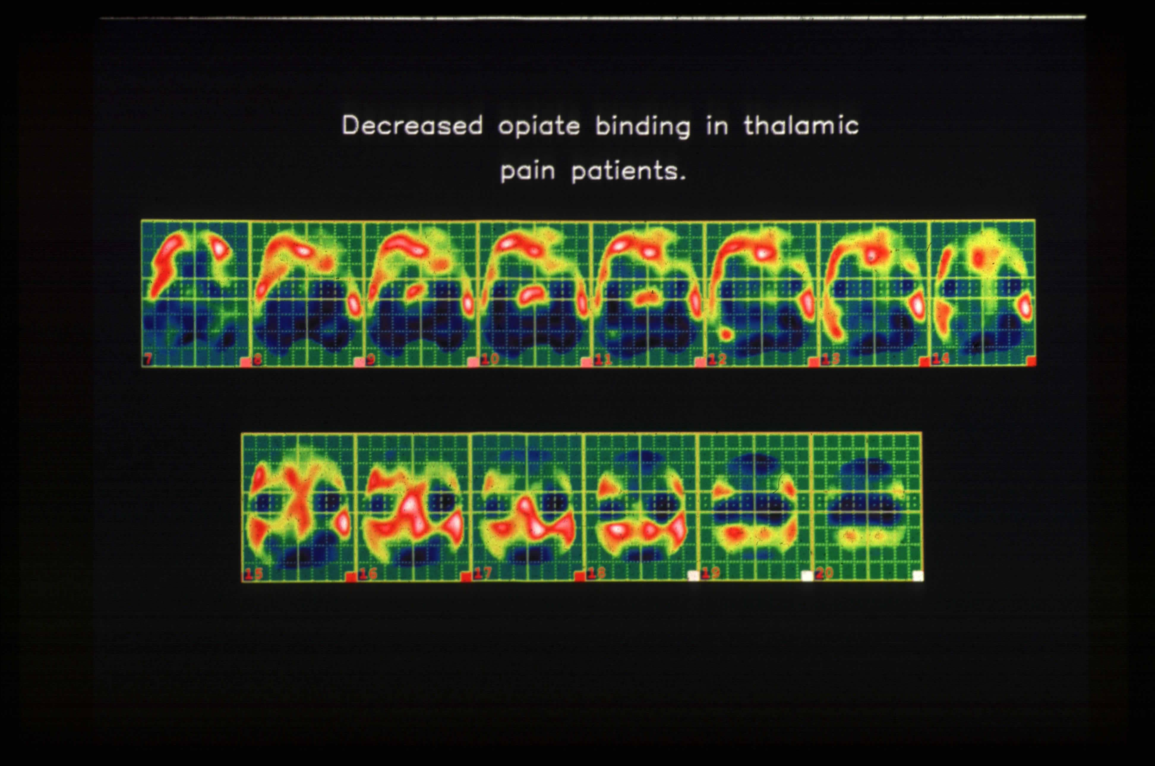
Eur J Pain 2004

Slide 32
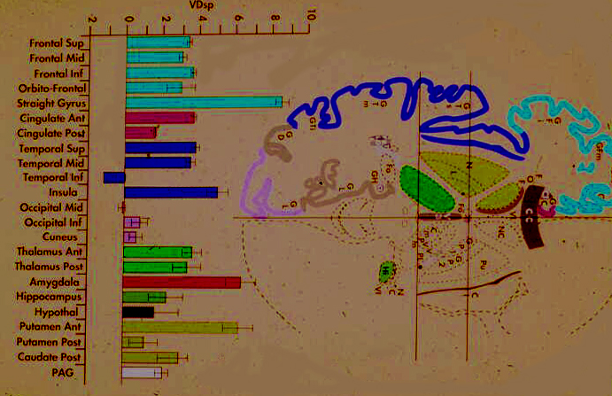
Increases in ¹¹C diprenorphine binding due to
pain relief in RA pain
*
*
*
*
*
*
*

Slide 33
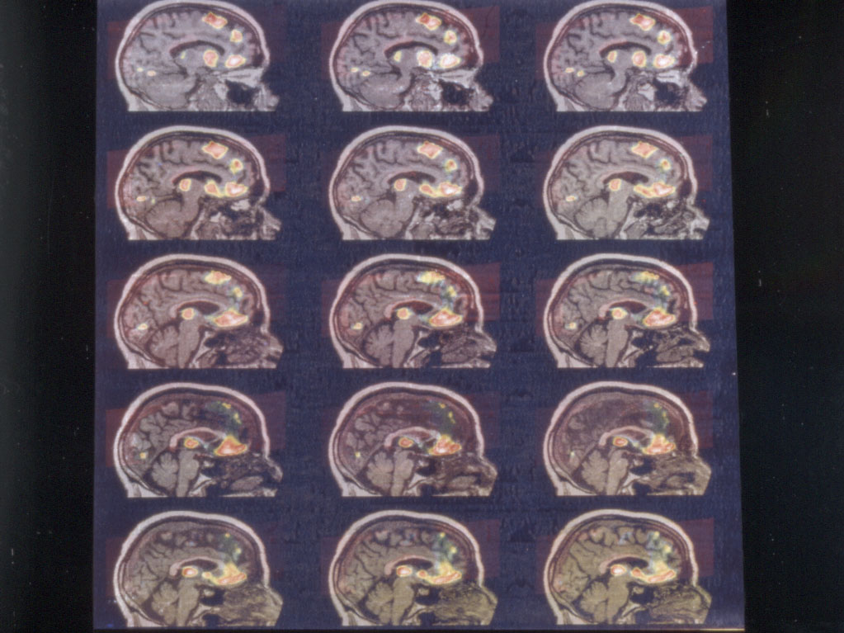
Reduced available opioid receptor binding during chronic TGN pain

Slide 34
Upregulation of OR binding in response chronic pain
Brown et al. Pain 2015

Slide 35

WELL BEING
Social interactions
Social worth
Sexual Dysfunction
Fatigue
Sexual dysfunction
Fatigue
Self Management
PPP
Pharmacological
Physical/Physiological
Psychological
Pain
Pain
Motivation
Patient
Patients Relatives
Motivation
Sleep
Sleep
Co-morbidities
Co-Morbidities
Mobility
Mobility
Mood
Neuro-Endocrine Dysfunction
Neuro-Endocrine Dysfunction
MEDICAL
THERAPUTIC
INTERVENTIONS
Work/economy
Economic Empowerment
PPP

Slide 36
Summary
As far as the brain is concerned pain is pain is pain.
Main differences in processing are related to the psychological context of pain.
Candidate mechanisms for fibromyalgia, OA and post-stroke pain.
It is possible to begin to characterise the brain correlates of pain vulnerability and resilience and the positive effects of pain therapies including placebo.
Potential to use this information to design more efficient clinical trials and new personalised therapies.

Slide 37
Reduced available opioid receptor binding during chronic TGN pain

Slide 38
Eur J Pain 2004

Slide 39
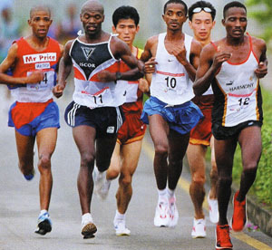

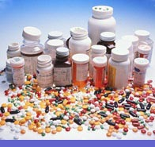

Endogenous opioids

Slide 40
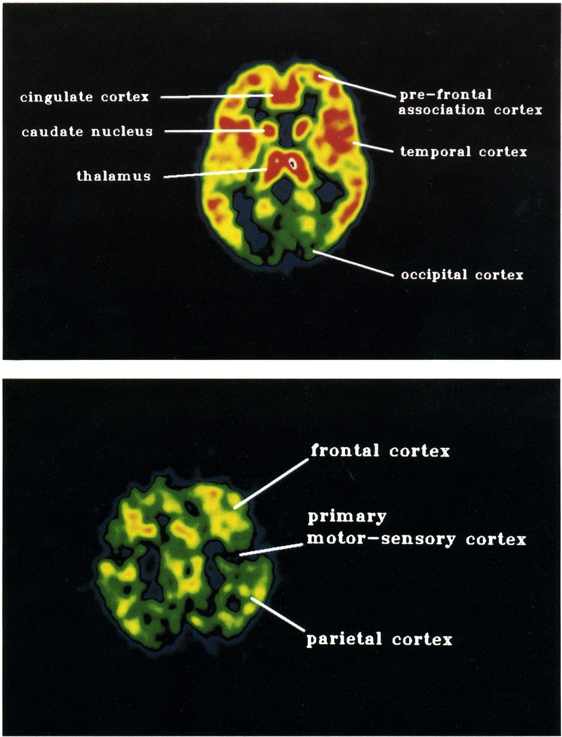
PET images of opioid receptor binding in the brain
[11C]diprenorphine.

Slide 41
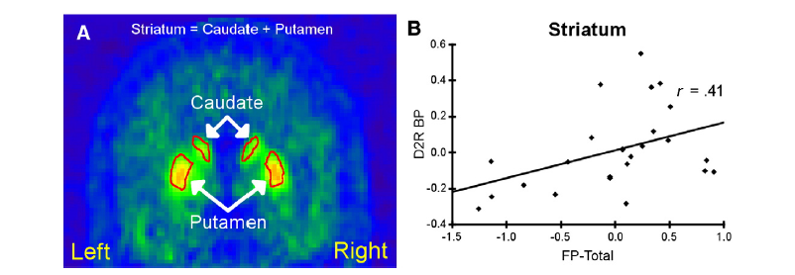
Correlations between side effects and receptor occupancy of D2 receptors
Farde L et al, 2013

Slide 42
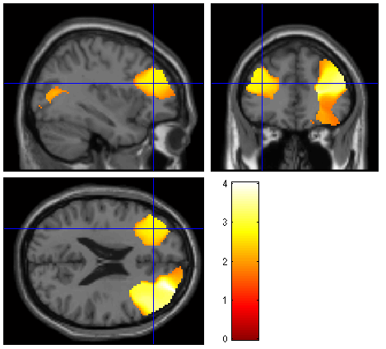
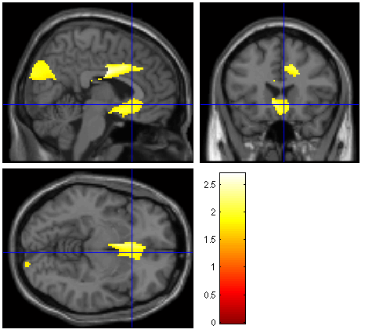
Less activity in executive / attention networks during anticipation in FM
Less activation of prefrontal cortex
Greater activation of cingulate cortex
Early anticipation
Late anticipation
The evidence is in favour of greater emotional anticipation of pain and reduced cognitive control

Slide 43
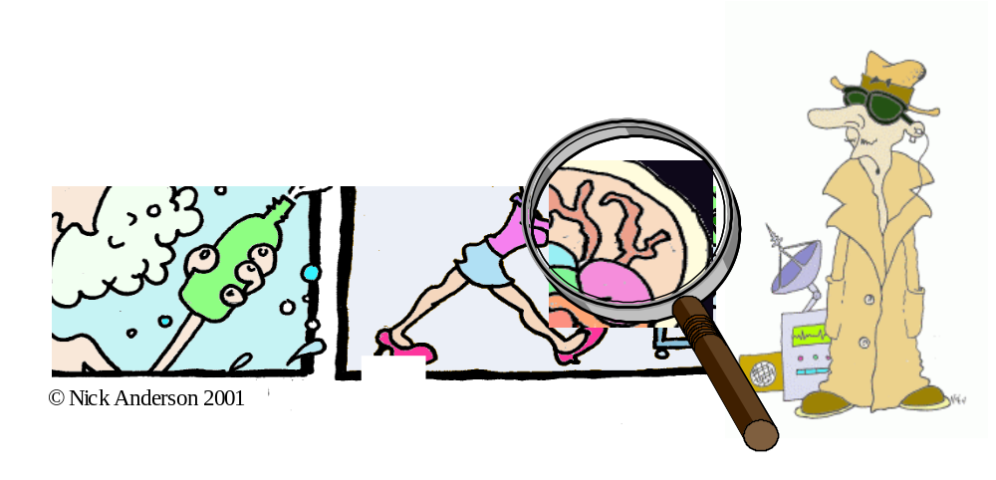
Thank you….

Slide 44
Summary
As far as the brain is concerned pain is pain is pain.
The brain rules
All pain processed in the pain matrix
Main differences in processing are related to the psychological context of pain.
Candidate mechanisms for fibromyalgia and post-stroke pain.
It is possible to begin to characterise the brain correlates of the positive effects of pain therapies including placebo effects.
We should be able to begin to use this information to design more efficient clinical trials, new therapies and systems of health care delivery.
Notes:
Much of the cognitive content of pain experience is identified or implied from this definition, in terms of anticipation, sensory discrimination, intensity coding, affect, attention and memory.

Slide 45
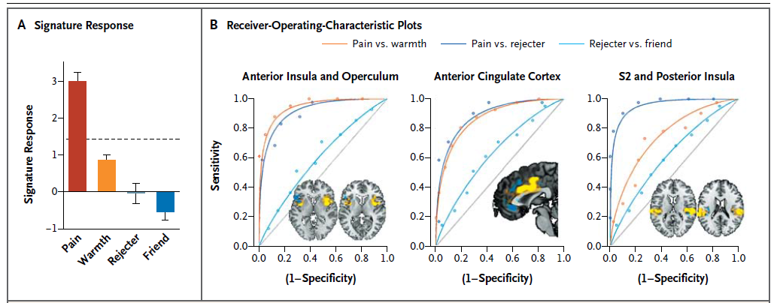
Specificity of pain matrix responses
Wager et al, 2013

Slide 46
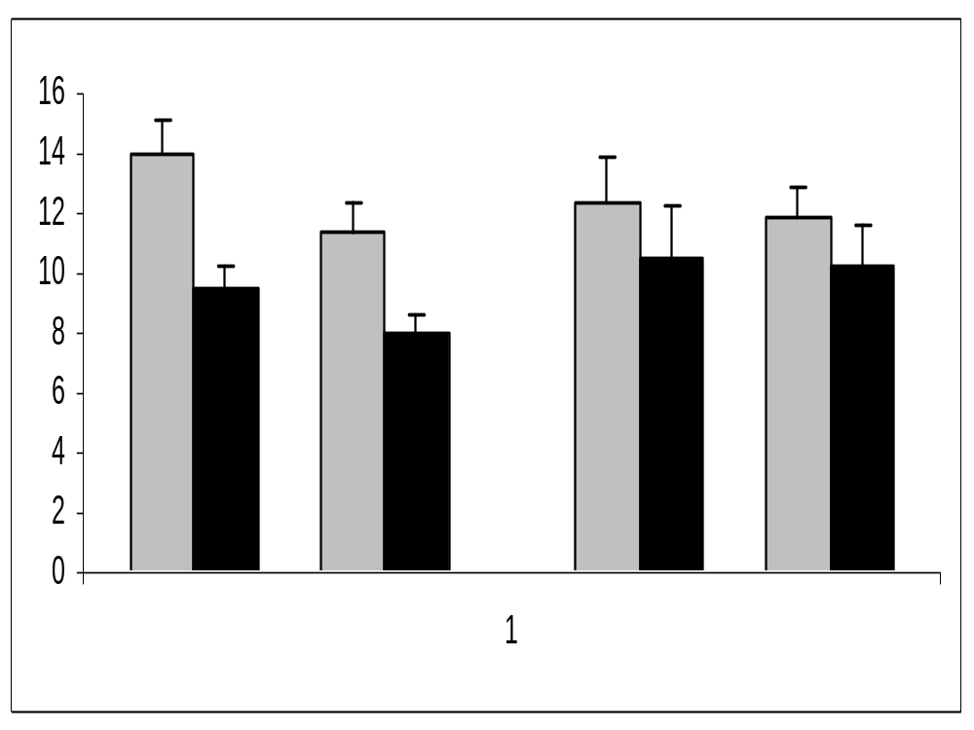
Reproducibility of the placebo response
Figure 5
Pre-treatment
Post-treatment
* *
* *
Amplitude (μV)
First treatment
Repeat treatment
First
control
Repeat control
Morton et al, 2009, Pain
Morton et al, 2009, Neuropsychologia

Slide 47
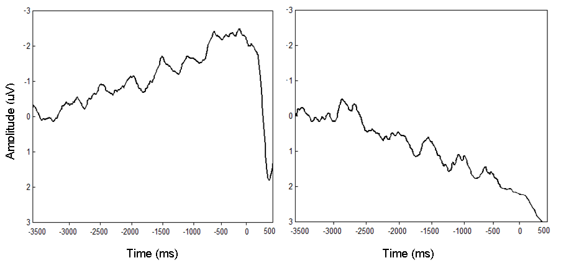
Reproducibility of the placebo response
Anticipation
1st treatment session
Repeat treatment session
Morton et al, 2009, Pain
Morton et al, 2009, Neuropsychologia

Slide 48
Forward translation; human experimental pain to chronic pain
Phasic experimental nociceptive pain and arthritic pain activate similar areas of the pain matrix
Peripherally driven experimental allodynia and neuropathic pain also activate similar areas of the pain matrix .

Slide 49
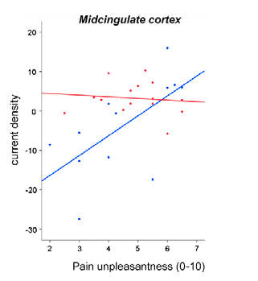

Long-term mindfulness training reduces the emotional anticipation response in midcingulate cortex.
Anticipation of pain
Midcingulate cortex vs. pain unpleasantness
[Control group > Mindfulness group]
Mindfulness group
1st treatment session
Repeat treatment session
Control group
X = 1, Y = -3, Z = 29
Only long-term mindfulness meditators (> 6 years) showed reduced perception of pain unpleasantness
Are much shorter (8 week) mindfulness-based CBT programmes effective in chronic pain?
Pain 2010

Slide 50




Relationships between opioid receptor availability and physiological responses to pain
(a) Painful laser-evoked potentials, averaged over 12 healthy participants:
Waveform at electrode Cz
Topography of P2 peak over scalp
Amplitude
(µV)
Electrode Cz
P2 peak
Time (ms)
(b) Correlation of P2 peak with diprenorphine binding in the posterior cingulate cortex across 12 participants (p < 0.001 uncorrected):
Whole-brain statistical map showing regions of correlation
Plot of correlated brain activity in posterior cingulate cortex
Posterior cingulate cortex
P2 peak amplitude
(µV)
Diprenorphine binding (Volume of Distribution)

Slide 51
Final word…
Bayesian view of information processing
Placebo is a special case of a general cognitive system
Brain resolves perceptual ambiguity by anticipating the forthcoming sensory environment
Generates a template against which to match observed sensory evidence
Prior knowledge / top-down

Slide 52
Placebo response:
Perception or cognition ?
Prior information about the treatment changes the approach to the evaluation of the pain stimulus (allocation of attention?)
Ambiguous instruction: response not site specific
Anticipation is reduced in line with reduction in anxiety (repeat session two weeks later)
Medial pain system activation during anticipation of treatment
No modulation of lateral pain system
Placebo responders do not use sensory information to make decisions

Slide 53

Experimental Placebo set up
Ambiguous
Perceptual decisions α Prior information X Sensory data

Slide 54
The association between functional status and the number of areas in the body with musculoskeletal symptoms
Natvig B, Rutle O, Brussgaard R, Eriksen WB
Int J Rehab Res, 2000 Mar; 23(1) 49-53

Slide 55
Placebo Analgesia
Watson et al. Pain 2006
Placebo Group
Control Group
8
P<0.001
8
6
6
Mean & Std Dev Pain Rating
4
4
2
2
0
0
Pre-Cream
Post-Cream
Pre-Cream
Post-Cream
Placebo
Control
-6
-6
-4
-4
-2
-2
LEP Amplitude µV
0
0
2
2
4
**
4
6
P<0.001
6
8
8
-500
0
500
1000
1500
-500
0
500
1000
1500
Time (ms)
Time (ms)
Pre-cream
Post-cream

Slide 56




Placebo Analgesia
left BA 8,
left BA 8,
left BA 8,
left BA 8,
left
left
aMCC
aMCC
,
left
,
left
aMCC
aMCC
,
,
A.
A.
Parasagittal
A.
Parasagittal
A.
Parasagittal
Parasagittal
R
R
R
R
left DLPFC
BA 11
BA 11
B. Transverse
B. Transverse
B. Transverse
B. Transverse
Areas of activation during anticipation of reduced pain
Common areas of activation during anticipation of reduced pain during placebo conditioning and placebo analgesia
Watson et al, Pain 2009

