Slide 1
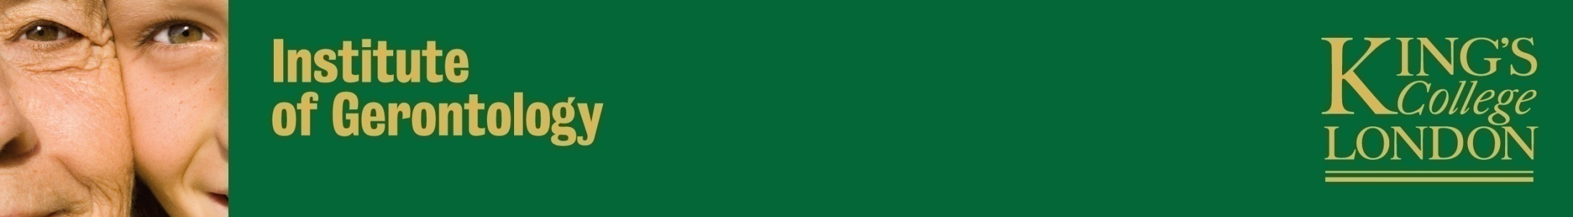
Should medical students study Social Gerontology?
Geriatrics and Gerontological Nursing conference 4.10.16
Anthea Tinker, Labib Hussain, Jack Lilly d’Cruz, William Tai Yee Seng, Sebastian Zaidman,
King’s College London

Slide 2
Outline
1. Origins of this presentation and reactions to the findings
2. Background
3. Teaching on Gerontology in Medical Schools
  3a. Clinical Geriatrics
  3b. Social Gerontology
4. Why Social Gerontology?
5. What subjects are most relevant to Social Gerontology?
  5a. Demography
  5b. Sociology of Ageing
  5c. Psychology of Ageing
  5d. Social Policy
6. Our conclusion
7. The response to our paper

Slide 3
1. Origins of this presentation
Professor Anthea Tinker is Professor of Social Gerontology at King’s College London and is personal tutor to the Intercalated medical students taking the BSc Gerontology. Each year she works with the students to give a conference presentation and a publication. The 2014 – 2015 were enthusiastic about this and they all collaborated in their own time (this is not an official part of the course) to produce a presentation to the British Society of Gerontology conference in Newcastle in 2015. They had a good response to this and wrote an article. This was published by Age and Ageing in 2016 (vol. 45, pp. 190 – 192).

Slide 4
1. Reactions to the findings
The response to the article was an Editorial and this was published by Age and Ageing in 2016 (vol. 45, pp. 188 – 189).
This was by Professor Adam Gordon, Professor Adrian Blundell, Professor John Gladman and Professor Tahir Masud.
Our article was considered by the authors of the Editorial to be ‘impassioned and well-argued’. The response of these commentators to our article is discussed at the end of our presentation

Slide 5
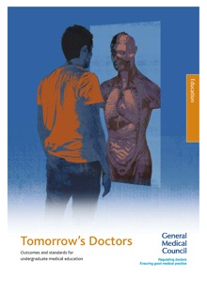
2. Background on Medical School Curricula
General Medical School (GMC) Guidance
  Tomorrow’s Doctors (2009)
    Generic Guidance
    Lack of individual specialties
    Scope for variability
Notes:
GMC Tomorrow’s Doctors:
This guidance sets out the knowledge, skills and behaviours that new UK medical graduates must be able to show. It also sets standards for teaching, assessment and learning for medical students and medical schools.
Picture Source:
http://www.ehu.eus/SEMDE/docum.html

Slide 6
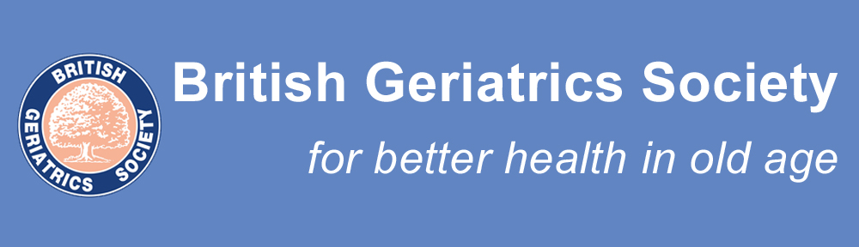
2. Background on Medical School Curricula
British Geriatrics Society (BGS)
  11 Learning Outcomes mapped to ‘Tomorrow’s Doctors’
    Attitudes / Skills / Core Competencies
    Ageing and Health
Notes:
Picture source:
https://britishgeriatricssociety.wordpress.com/

Slide 7
3. Teaching on Gerontology in Medical Schools – a. Clinical Geriatrics
British Geriatrics Society: Learning Outcomes
  3a. describe the contributions of the following professions allied to medicine: Occupational therapy, Physiotherapy, Nurses, Dieticians, Speech & language therapists, Social workers
  3f. Describe/define the diagnosis, pathophysiology, management and preventative strategies for specific disease processes: dementia, delirium, depression, continence, osteoporosis, falls, parkinsonism & movement disorders, pressure ulcers, cerebrovascular disease and stroke
  8c. describe the process of Comprehensive Geriatric Assessment, including initial assessment, establishment of a problem list, management plan, goals and iteration. Describe the role of the multidisciplinary team in this process.
Notes:
It is important that all new medical graduates are prepared for life-long learning. The core undergraduate curriculum in Geriatric Medicine can be regarded as a basis upon which Foundation Year (FY1 and FY2) and Specialist Training (ST) doctors can build their educational objectives. However it cannot be assumed that doctors will have further education in Geriatric Medicine and the undergraduate curriculum is designed to ensure that all graduates have the essential knowledge and abilities to manage older people.
BGS have developed Clinical Guidelines through a rigorous procedure of audit, literature search and peer review to improve the standards of diagnosis, treatment and management of specific diseases and conditions.

Slide 8
3. Teaching on Gerontology in Medical Schools – a. Clinical Geriatrics
Comprehensive Geriatric Assessment (CGA)
  Evidence Based Medicine
    Older People with Frailty
  Multidisciplinary & Iterative Approach
Provision of Care
  Many Aspects
    E.g. Heterogeneity of Older People

Slide 9
3. Teaching on Gerontology in Medical Schools – b. Social Gerontology
BGS Guidelines 2013
  Learning Outcome 1 : recognising the ‘myths and stereotypes related to older people’ and the ‘heterogeneity of older persons’.
  Learning Outcome 9 : demography, the relationship between health and social care provision for older people and the psychosocial theories of ageing.
European curriculum (Masud et al 2014)
Notes:
The mainstay of the 11 BGS learning outcomes focus on clinical care of older people and the biomedical components of ageing. However, a thread of social gerontology runs throughout.
The BSG guidelines were used to form a EU curricula in collaboration with similar guidelines from the Australia and New Zealand Society of Geriatric Medicine (ANZSGM), the American Geriatric Society (AGS) and the International, Association of Gerontology and Geriatrics (IAGG) (Masud et al 2014).

Slide 10
3.Teaching on Gerontology in Medical Schools – b. Social Gerontology
Taught throughout medical school as per BGS guidelines
Pre-clinical lectures covering the subtopics discussed
4 week Geriatric clinical placement to reinforce pre-clinical teaching
Variety of assessment formats
Notes:
The BGS guidelines recommend that teaching of Gerontology and Geriatric Medicine is incorporated longitudinally into all years of Medical School Curricula (British Geriatric Society 2013). It is our belief that Social Gerontology merits a minimum of two stand-alone lectures in pre-clinical years of the Medical Degree. Transgender older people).
This early exposure to Social Gerontology is important for a number of reasons. First, it would provide an understanding of the issues facing older patients that students witness in subsequent primary and secondary care placements. The ability to empathise is widely cited as an important attribute of good doctors (ref), relying on an understanding of both the health and social issues of older patients. Second, early exposure to social gerontology may influence attitudes both towards older people and decision to embark on future studies in the fields of Geriatrics or Gerontology.

Slide 11
3. Teaching on Gerontology in Medical Schools: Summary
Need for combination
  Geriatric Physician
  Social Gerontologist

Slide 12
4. Why Social Gerontology?
26% of UK medical students not exposed
Gordon et al. 2014
Reasons embedded within the sub-topics of:
  Demography
  Sociology of Ageing
  Psychology of Ageing
  Social Policy
Notes:
References:
Gordon, A.L., Blundell, A., Dhesi, J.K., Forrester-Paton, C., Forrester-Paton, J., Mitchell, H.K., Bracewell, N., Mjojo, J., Masud, T., Gladman, J.R.F 2014, ‘UK medical teaching about ageing is improving but there is still work to be done: the Second National Survey of Undergraduate Teaching in Ageing and Geriatric Medicine’, Age and Ageing, vol. 43(2), pp. 293-297.

Slide 13
5. What subjects are most relevant in Social Gerontology?
Probably all but we now identify 4 as being crucial

Slide 14
5a. Demography
Valuable introduction and reminder of population ageing
AND
…its impact on the doctors of tomorrow
Notes:
Provisional Notes
Promote appreciation for growing number of older patients
Promote appreciation for growing importance of Geriatric Medicine

Slide 15
5b. Sociology of Ageing
Highlight heterogeneity among older people
Challenge negative stereotypes and ageist attitudes
Life course perspective – a reminder for:
- Thorough medical history
- Temporal consideration – appreciate worth
Notes:
Provisional Notes:
Stereotypes tend to homogenise

Slide 16
5c. Psychology of Ageing
Differentiate normal vs. pathological ageing – cognition, intellect and personality
First-hand lived experiences e.g. dementia
Coping strategies and resilience
Health-seeking behaviours

Slide 17
5d. Social Policy
Clinician involvement in policies
Better aware of best practice measures
Better aware of financial and political state of working environment
Adds to life-long learning mantra: policies

Slide 18
6. Our conclusion
Increased knowledge base
Challenge ageist attitudes and any pre-existing stereotypes
  Philp 2006 – National Service Framework
Improved attitudes towards older patients
  Tullo et al. 2010
Better empathy, relationship, communication and person-centred approach in practice
  Burley 1981
Notes:
Provisional Notes:
Challenge ageist attitudes and any pre-existing stereotypes – reminder of worth and value of older people
References:
Philp 2006, A New Ambition for Old Age: Next Steps in Implementing the National Service Framework for Older People [pdf] London, available from: http://library.nhsggc.org.uk/mediaAssets/dementiasp/A_new_ambition_for_old_age_12-Nov-07.pdf [Accessed: 17th June 2015].
Tullo, E., Spencer, J., Allan, L 2010, ‘Helping the young to understand the old. Teaching Interventions in Geriatrics to improve the knowledge, skills and attitudes of undergraduate medical students’, Journal of the American Geriatrics Society, 58(2010, pp. 1987-1993.
Burley, D. 1981, ‘What every medical student should know about Social Gerontology’, Gerontology & Geriatrics Education, 2.1(1981), pp. 15-18.

Slide 19
6. Our conclusion
British Geriatrics Society guidance should be closely followed
Need for better universal pre-clinical coverage of Social Gerontology
  Ensured presence in clinical blocks
More programmes such as the Intercalated BSc Gerontology at King’s College London

Slide 20
7. The response to our paper
It said that our arguments must take into account:
- ‘not enough space’ – it is impossible to accommodate all desirable information in the medical curriculum. The response to this must be to work out a way in via numerous means such as multidisciplinary teaching

Slide 21
7. The response to our paper
It said that our arguments must take into account:
- ‘not enough evidence’ – ‘there is need for more evidence that more and better teaching about older people and ageing can substantially and positively influence attitudes and behaviours of the medical profession in a meaningful way’

Slide 22
7. The response to our paper
It said that our arguments must take into account:
- ‘disciplinary territorialism’. For example psychology may or not be considered as part of Social Gerontology. In addition there are other disciplines which it could equally be argued should be part of the syllabus such as architecture and design

Slide 23
7. The response to our paper
There were 4 key points in the article:
‘Training in the full breadth of gerontological disciplines is important to appropriately equip doctors for practice’
‘The amount of teaching currently delivered to medical undergraduates in these areas is inadequate’

Slide 24
7. The response to our paper
There were 4 key points in the article:
3. ‘Gerontologists must be aware of the time pressures on modern medical education in making innovative cases for inclusion’.
4. ‘It is important to conduct research alongside innovative teaching in gerontology to evaluate its impact on doctors’ knowledge, behaviours and attitudes’.

Slide 25
References
British Geriatrics Society. 2013. British Geriatrics Society Recommended Curriculum in Geriatric Medicine for Medical Undergraduates, 2013. Available At: www.bgs.org.uk/index.php/general-information-171/306-undergraduatecurriculum. [Accessed: 17th June 2015].
Burley, D. 1981, ‘What every medical student should know about Social Gerontology’, Gerontology & Geriatrics Education, 2.1(1981), pp. 15-18.
Gordon, A.L., Blundell, A., Dhesi, J.K., Forrester-Paton, C., Forrester-Paton, J., Mitchell, H.K., Bracewell, N., Mjojo, J., Masud, T., Gladman, J.R.F 2014, ‘UK medical teaching about ageing is improving but there is still work to be done: the Second National Survey of Undergraduate Teaching in Ageing and Geriatric Medicine’, Age and Ageing, vol. 43(2), pp. 293-297.
Masud, T. A., Blundell, A. L., Gordon, Mulpeter, K., Roller, R., Singler, K., Goeldlin, A., Stuck, A. 2014, "European undergraduate curriculum in geriatric medicine developed using an international modified Delphi technique." Age and ageing (2014): afu019.
Philp 2006, A New Ambition for Old Age: Next Steps in Implementing the National Service Framework for Older People [pdf] London. Available At: http://library.nhsggc.org.uk/mediaAssets/dementiasp/A_new_ambition_for_old_age_12-Nov-07.pdf. [Accessed: 17th June 2015].
Tullo, E., Spencer, J., Allan, L 2010, ‘Helping the young to understand the old. Teaching Interventions in Geriatrics to improve the knowledge, skills and attitudes of undergraduate medical students’, Journal of the American Geriatrics Society, 58(2010, pp. 1987-1993.
Notes:
http://www.bgs.org.uk/index.php/general-information-171/306-undergraduatecurriculum
Unsure of how to reference above

Slide 26
Questions and comments welcome
Thank you for listening

