Slide 1


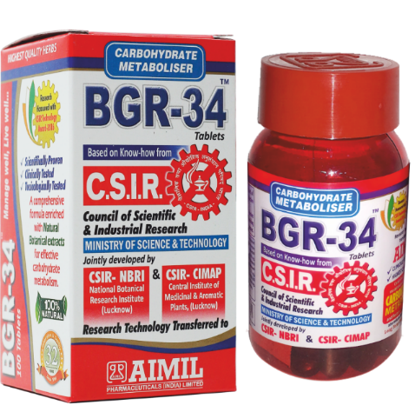


A NATURAL, AYURVEDIC BREAKTHROUGH FOR THE MANAGEMENT OF TYPE- 2 DIABETES
Dr. ANSHU RATHI
(Research officer)
Aimil Pharmaceuticals India ltd.
Notes:
I thank u vry much 4 introducing me to the learned audience gathered here from different corners of globe.
I will be talking about of course type 2 diabetes and a breakthrough anti- diabetic herbal medicine bgr 34 invented in India which is gaining global success steadily.

Slide 2



INTERNATIONAL DIABETES FEDERATION
Number of people (20 -79 yrs. age) with diabetes 2010-2030
COUNTRY/TERRITORY |  | 2010 MILLION | COUNTRY/TERRITORY | 2030 MILLION
1 | INDIA | 50.8 | INDIA | 87.0
2 | CHINA | 43.2 | CHINA | 62.6
3 | UNITED STATES OF AMERICA | 26.8 | UNITED STATES OF AMERICA | 36.8
4 | RUSSIAN FEDERATION | 9.6 | RUSSIAN FEDERATION | 13.8
5 | BRAZIL | 7.6 | BRAZIL | 12.7
6 | GERMANY | 7.5 | GERMANY | 12.0
7 | PAKISTAN | 7.1 | PAKISTAN | 11.9
8 | JAPAN | 7.1 | JAPAN | 10.4
9 | INDONASIA | 7.0 | INDONASIA | 10.3
10 | MEXICO | 6.8 | MEXICO | 8.6
Notes:
This slide shows why diabetes is so talked about in india. According to international diabetes federation, I
india along with china contribute more 90 million diabetes patients in global data. They are the major stakeholder. And this is a major concern for us.

Slide 3
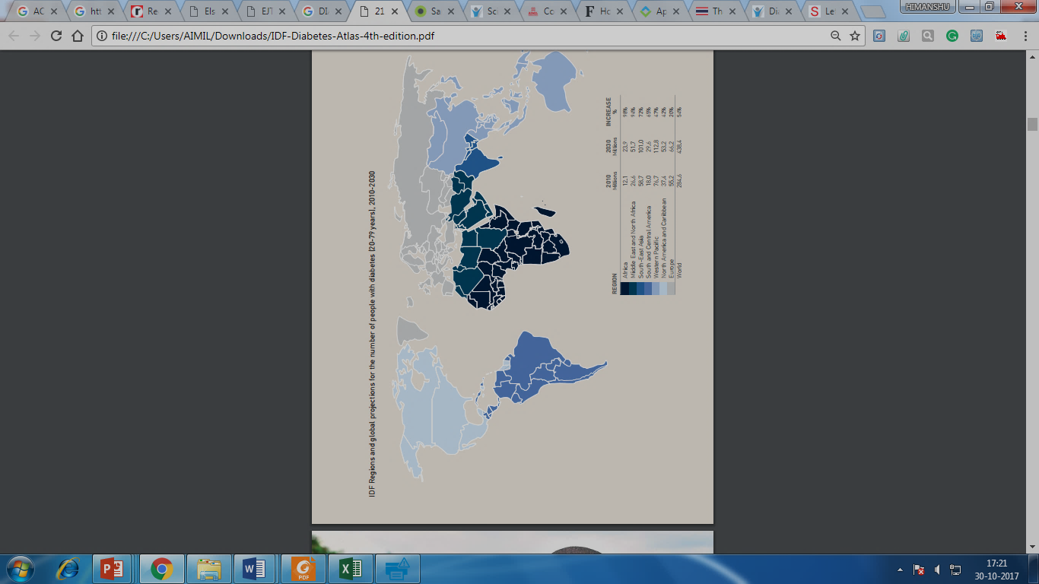
INTERNATIONAL DIABETES FEDERATION
REGIONS AND GLOBAL PROJECTIONS
Number of people (20 -79 yrs. age) with diabetes 2010-2030
Notes:
This color code based projection is very important as after African continent and middle east The darkest or u can say the highest percent in patients are coming from india. So by above three slides I hv presented it is clear that how important is diabetes for india.

Slide 4
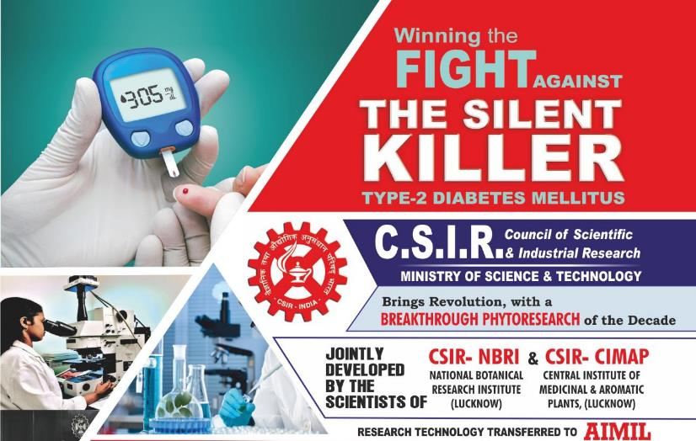
BGR 34- AN APPROACH FOR TYPE 2 DIABETES BY INFUSION OF ANCIENT HERBAL KNOWLEDGE AND MODERN MOLECULAR BIOLOGY
Notes:
THE SCIENCE AND TECHNOLOGY POLICY MAKERS IN INDIA ADVOCATED FOR UTILISATION OF AN ANCIENT INDIAN HERBAL KNOWLEDGE BASE I.E. AYURVEDA FOR EFFECTIVE MANAGEMENT OF TYPE 2 DIABETES NOT ONLY IN INDIA BUT ROUND THE GLOBE. AND THE CHALLENGE WAS ACCEPTED BY WORLDS 8TH RANKED SCIENTIFIC ORGANISATION THE COUNCIL OF SCIENTIFIC AND INDUSTRIAL RESEARCH INDIA. AND THIS LED TO THE DEVELOPMENT OF BGR 34.

Slide 5

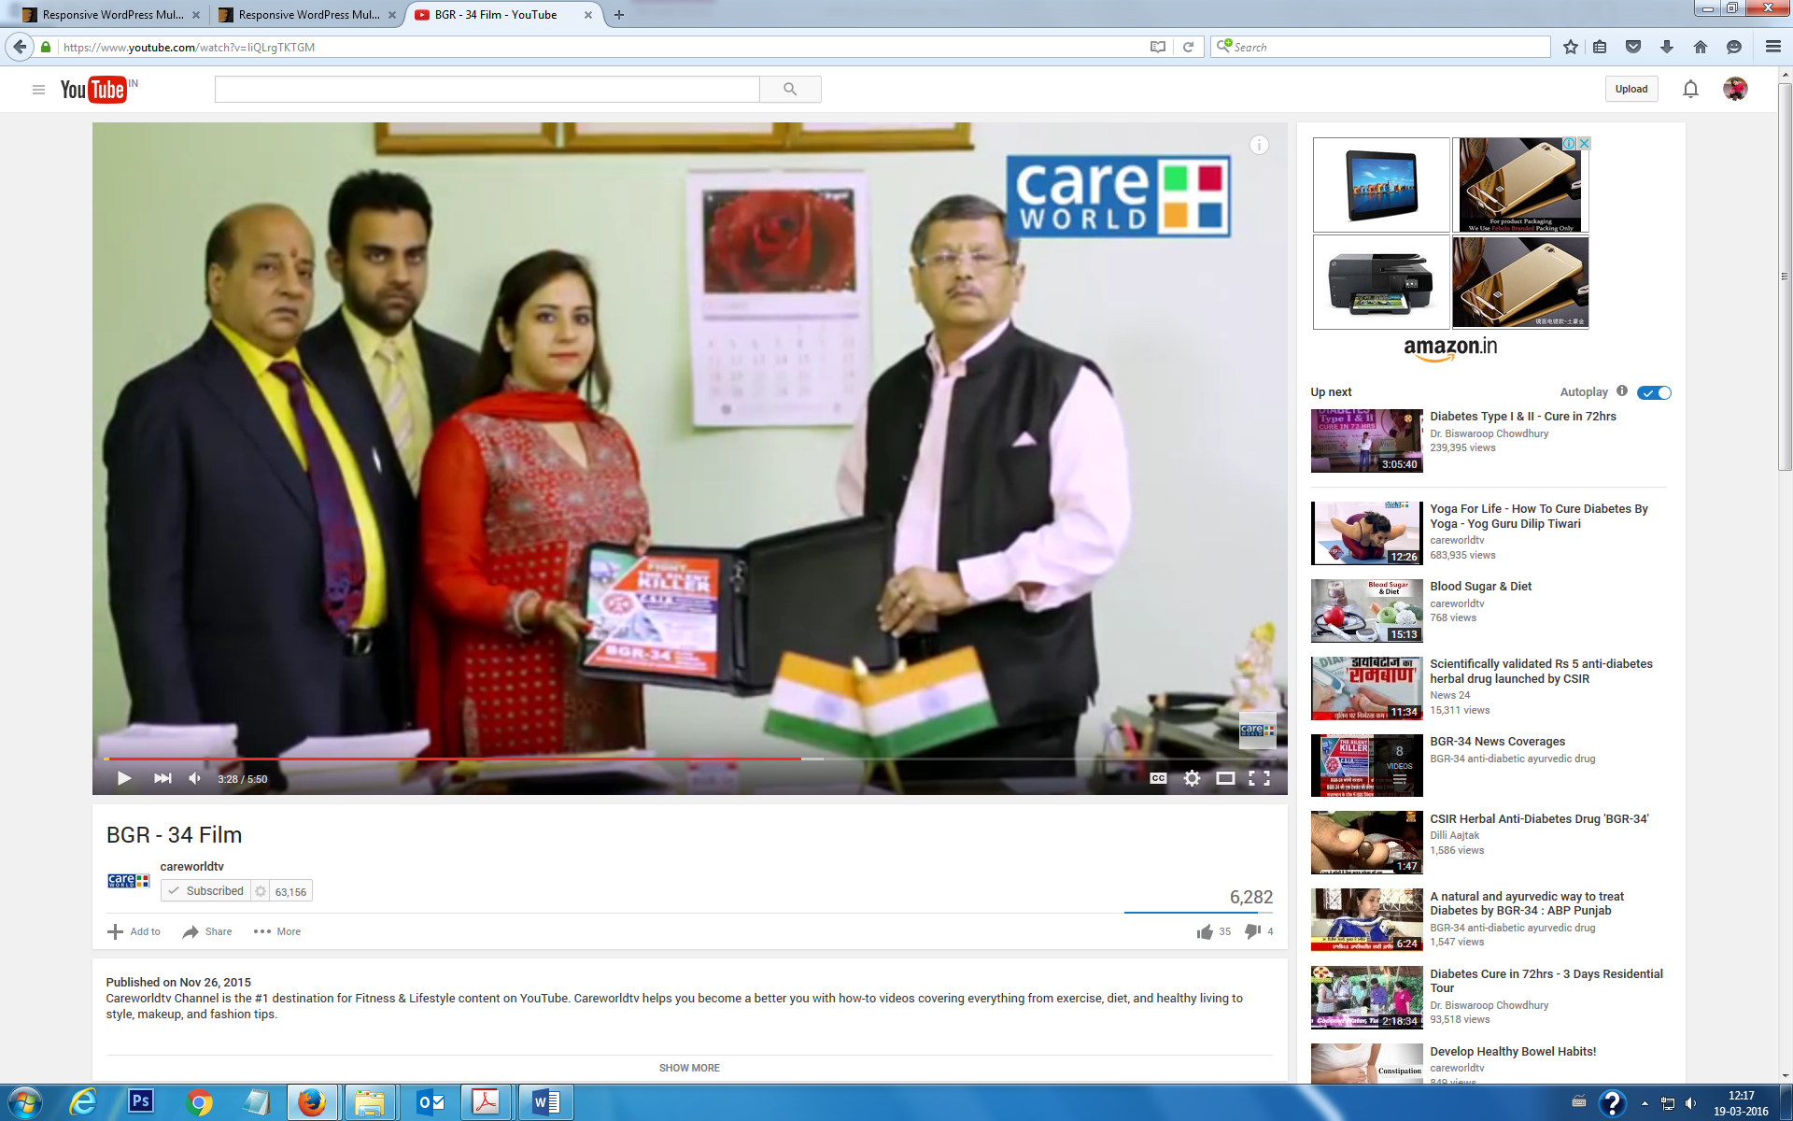
TECHNOLOGY TRANSFER
CSIR-INDIA
AIMIL-INDIA
Notes:
WE THE AIMIL PHARMACEUTICAL INDIA LIMITED ARE FORTUNATE TO FETCH COMMERCIAL MANUFACTURING AND MARKETING OF BGR 34 A MIRACLE ANTIDIABETIC HERBAL MEDICINE FROM CSIR INDIA.

Slide 6
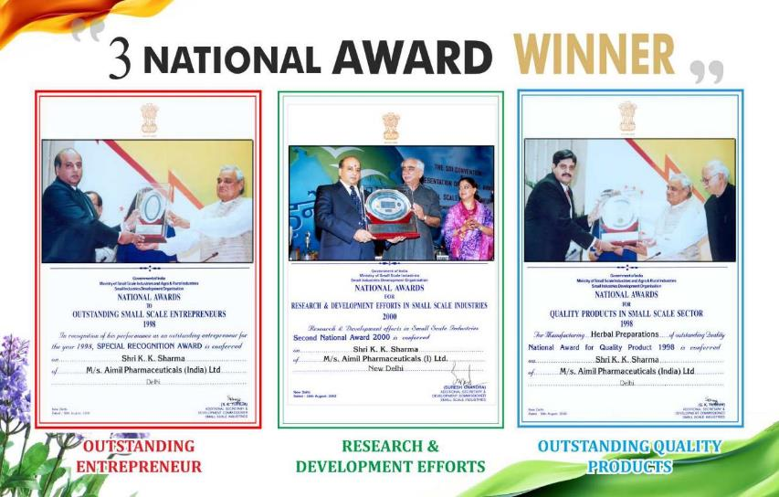
Notes:
AIMIL PHARMACEUTICALS HAS WON THREE NATIONAL AWARDS FOR ITS OUTSTANDING ENTERPRENEUR AND HIS R & D EFFORTS TOWARDS MANUFACTURING AND MARKETING OF QUQLITY PRODUCTS.

Slide 7

ABOUT BGR-34
BLOOD
GLUCOSE
REGULATOR
With 34 Vital Phytoconstituents from 6 botanical herbs to manage diabetes
Notes:
WHAT IS BGR 34? IT IS A BLOOD GLUCOSE REGULATOR AND 34 STANDS FOR 34 VITAL PHYTOCONTITUENTS AVAILABLE FROM 6 BOTANICAL HERBS.

Slide 8
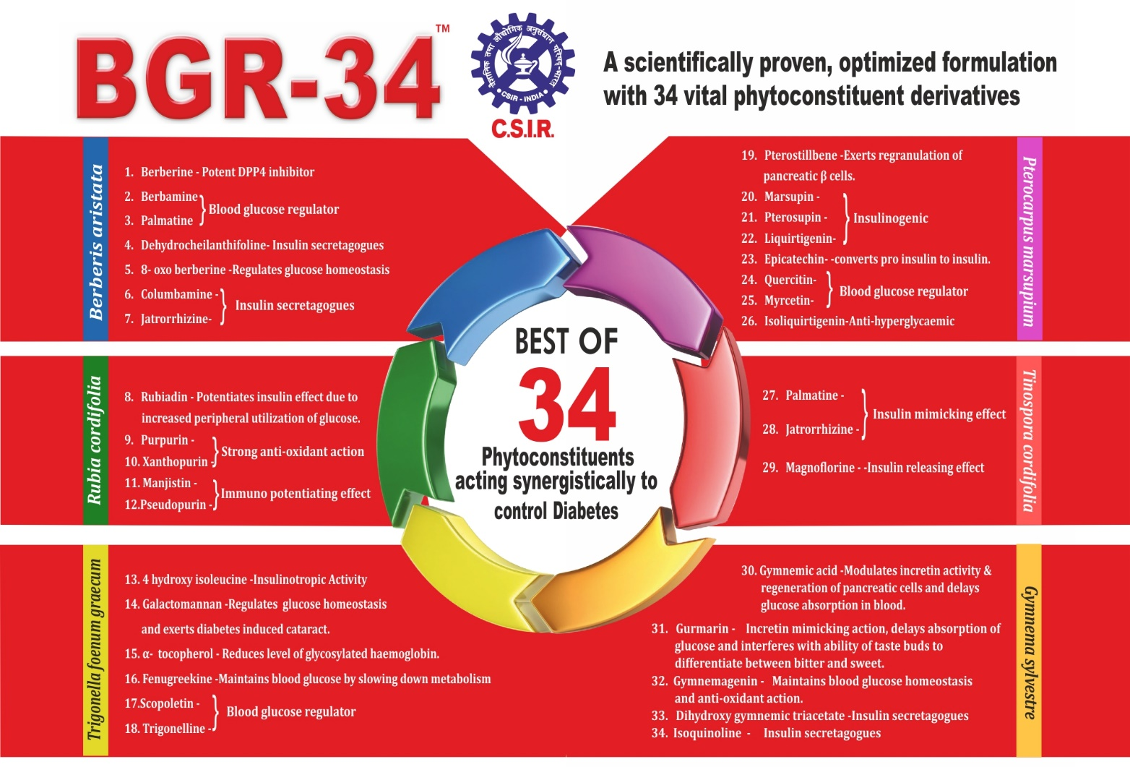
LIST OF 34 PHYTOCONSTITUENTS
Notes:
AND THESE 34 INGRIDIENTS ARE PRESENTED IN THIS SLIDE. A FEW OF THEM I READ AS……….

Slide 9
THERAPEUTIC EFFICACY OF BGR-34
HERBS | ACTION
Berberis aristata | ACTS AS DPP-4 INHIBITOR
Gymnema sylvestre | STRENGTHENS ß-CELL FUNCTIONAL CAPACITY
Tinospora cordifolia | EXERTS CARDIOPROTECTIVE ACTION
Trigonella foenum-graecum | DELAYS ABSORPTION OF GLUCOSE FROM GIT
Rubia cordifolia | NOURISHES & STRENGTHENS VITAL ORGANS
Pterocarpus marsupium | CONVERTS PRO-INSULIN TO INSULIN
Notes:
I BRIEFLY DESCRIBE BGR 34 COMPOSITION IN THIS SLIDE. THE SIX COMPONRNTS ARE………An optimized concentration of synergistically acting extracts derived from herbs mentioned above makes BGR-34 highly efficacious in management of Diabetes through following claims based on literature review.

Slide 10

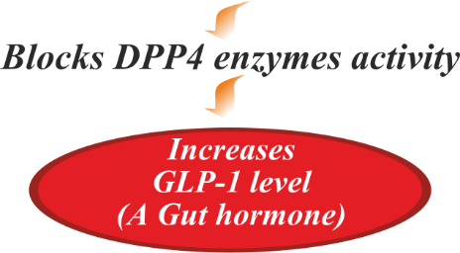
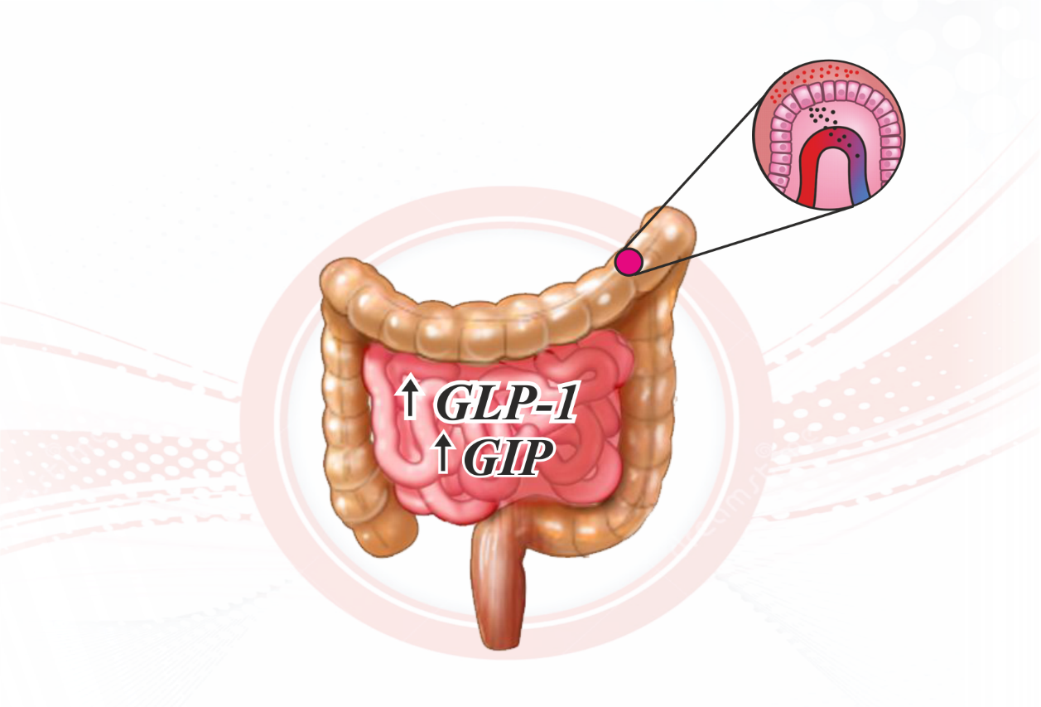
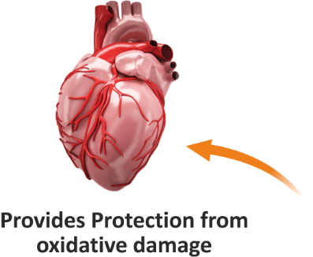
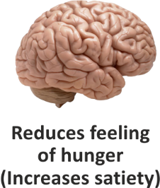
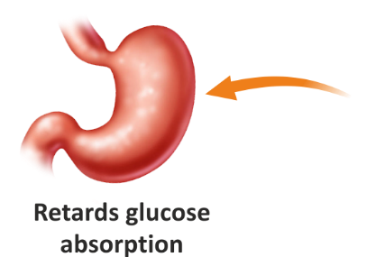
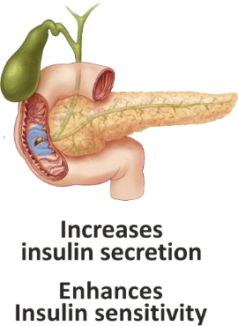

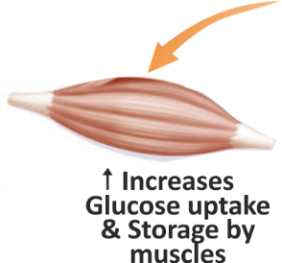
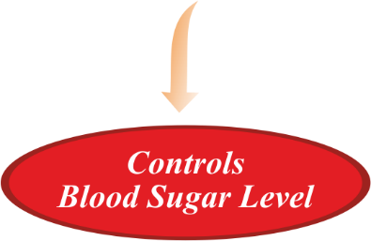

A unique mechanism of action Benefiting patients
Multi-dimensionally
MODE OF ACTION
Notes:
The unique blend of phytoconstituents from diverse herbs act simultaneously at multiple sites and induce multiple therapeutic pathways finally providing maximum benefit to patients.

Slide 11
STRENGTH OF PRODUCT
CSIR technological awards 2016 : Prime Minister Shri. Narendra Modi applauds Scientists at CSIR Technological Awards, 2016 ‘CSIR has developed the first Ayurvedic medicine of the country for diabetic patients.’and
BGR-34: Ist Scientifically Validated poly-herbal Ayurveda Drug, formulated after in-depth screening on 500 anti-diabetic medicinal plants.
BGR-34 and Safety Profile : Found safe in acute and sub acute toxicity studies.
BGR-34: The trial has been registered in CTRI having registration number as- CTRI/2016/11/007476.
BGR-34 is India's ranked Ist amongst all newly launched drugs in the Indian Pharmaceutical market as per data shown by IMS health (2015-16).
BGR-34 is the first and only Ayurvedic drug which has got into top 20 brands of best launches in last 2 years as per data of AIOCD.
Notes:
THE MAJOR STRENGTH OF BGR 34 IS THAT IT IS SCIENTIFICALLY TESTED AND FOUND SAFE IN ACUTE AND SUB ACUTE TOXICITY STUDY. And also our clinical trials have been registered in CTRI India. THE IMS HEALTH 2016 ALSO PROJECTS BGR 34 AT RANK NO. 1 IN THE CATEGORY OF NEWLY INTRODUCED MEDICINES.

Slide 12
A BRIEF REVIEW OF LITERATURE ON ACTIVES USED IN
BGR 34

Slide 13
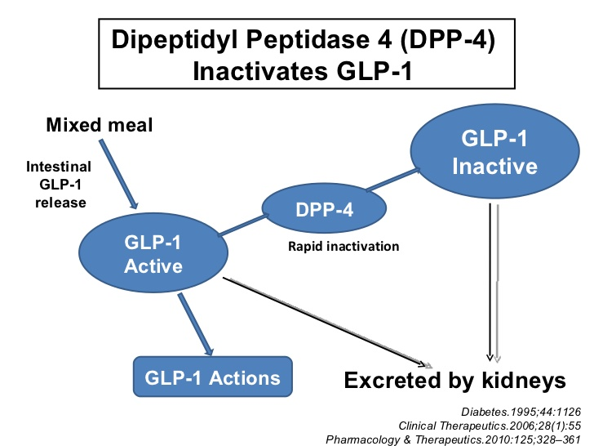
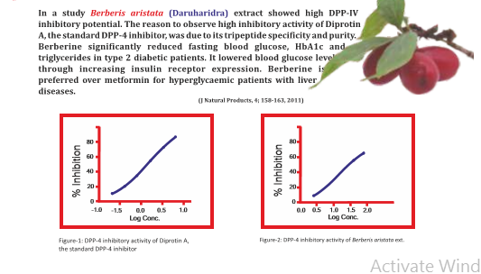
ACTS AS DPP-4 INHIBITOR

Slide 14
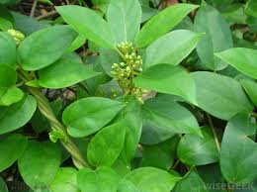
STRENGTHENS β-CELLS CAPACITY
BGR-34 have enough concentration of Gymnema sylvstre (Gurmar), which Strengthens β-cells capacity
Promotes reparative regeneration of islet cells which increase secretion of insulin and causes inhibition of glucose absorption from intestine.
It normalises post prandial glucose level and increases the utilization of glucose
Decreases in gluconeogenic enzymes, thereby decreasing gluconeogenesis.

Slide 15
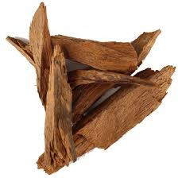
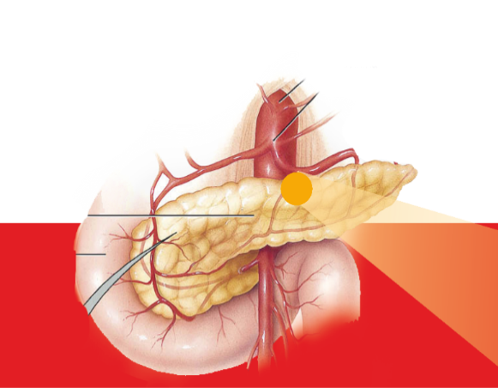
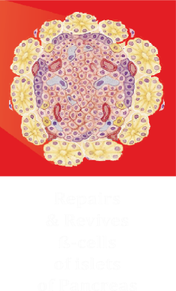
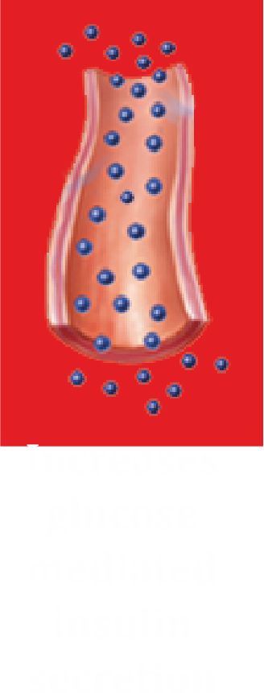

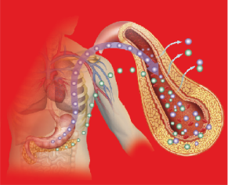
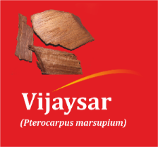



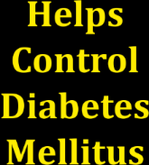

EXERTS INSULINOGENIC EFFECT
Enriched with- Pterocarpus marsupium (Vijaysaar)
Repairs & Revives β-cells & enhances Insulin Release.
The flavonoid fraction from it exerts pancreatic β cell regranulation.
It converts Pro-insulin to Insulin.

Slide 16
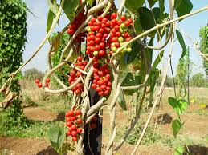
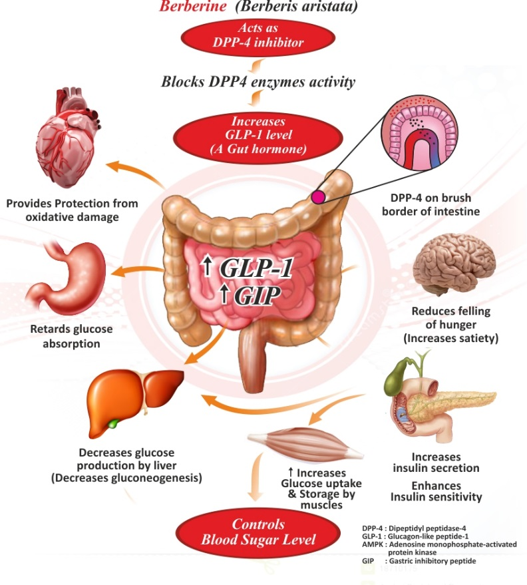
ACTS AS CARDIO PROTECTIVE
Tinospora Cordifolia (Giloe) exerts cardio protective action
Boosts body defence system, and antioxidant mechanism to protect the cardiovascular system.

Slide 17
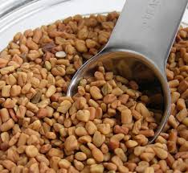
MANAGES GLUCOSE ABSORPTION & UPTAKE
Trigonella foenum-graceum (Methi) which very effectively Manages glucose absorption and uptake
Delays gastric emptying, slows down carbohydrate absorption and inhibits glucose transport.
Rich source of polysaccharide- Galactomanan
Normalises Post-Prandial Hyperglycemia (PPHG).
Also stimulates pancreas to release Insulin due to its Amino-acid content- 4-hydroxyisoleucine

Slide 18
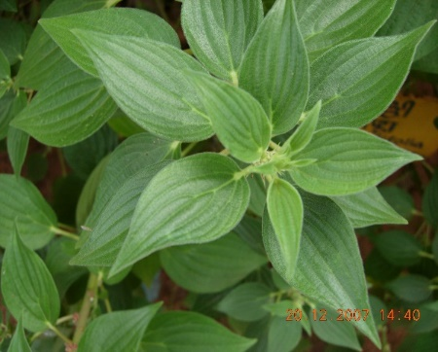
ACTS AS AN ANTI-OXIDANT
Rubia Cordifolia (Majeeth) is proven to be a strong antioxidant.
It nourishes & strengthens vital organs
Potentiates insulin effect due to increased peripheral utilization of glucose
Provides Immuno potentiating effect

Slide 19
OPTIMIZATION AND EFFICACY
STUDIES OF
BGR- 34
COURTESY BY CSIR
Notes:
LETS STRAIGHT AWAY COME TO MAIN THEME OF MY PRESENTATION I.E CLINICAL STUDIES OF BGR 34 DURING ITS INITIAL YEARS OF LAUNCH

Slide 20
PRE-CLINICAL STUDIES OF
BGR-34
Approved by institutional animal ethics committee (IAEC) in accordance with OECD test guidelines 425

Slide 21
ACUTE TOXICITY STUDY
SINGLE DOSE ORAL ACUTE TOXICITY STUDY OF “BGR 34” (protocol number- SDPARC/AFC/TOX/14/06)
EXPERIMENTAL SUBJECT | DOSE | OBSERVATION
Wistar Rats (5/sex/dose) | SINGLE 2000 mg/kg | 15 day (body wt., food consumption, clinical observations)
Notes:
This is single dose oral ………….., on experimental subject,…………..at dose ………….., and observation were taken upto two weeks for parameter…….

Slide 22
ACUTE LD₅₀ VALUES VS TOXICITY OUTCOME
Day | Dose (mg/kg bw) | Outcome
1 | 250 | There were no changes in normal behaviour pattern and no signs and symptoms of toxicity and mortality were observed.
3 | 500
5 | 1000
7 | 2000
9 | 2000
11 | 2000
13 | 2000
15 | 2000
*2000 mg/kg bw is the limit test dose

Slide 23
SUB ACUTE TOXICITY STUDY
28-DAYS REPEATED DOSE SUB-ACUTE ORAL TOXICITY STUDY OF “BGR 34” IN WISTAR RAT (SDPARC/AFC/TOX/16/15)
EXPERIMENTAL SUBJECT | DOSE | OBSERVATION
50 animals (25 male + 25 female) | High dose 1500 mg/kg | 28 day (body wt., food consumption, clinical observations)

Slide 24
HEMATOLOGICAL PARAMETERS IN FEMALE RATS
Group ↓ Days→ | G1- Control | G2- High dose | G3- Intermediate dose | G4- Low dose | G5- Satellite
WBC | 6240±588.72 | 6220±572.19 | 6820±376.03 | 6740±1585.43 | 7820±1098.81
HGB | 13.78±0.63 | 13.50±0.39 | 13.80±0.70 | 12.12±1.22 | 13.04±0.64
NEUT | 7.00±0.45 | 6.20±1.02 | 8.60±1.57 | 8.90±1.63 | 8.20±0.86
LYMPH | 81.40±0.86 | 82.80±1.24 | 79.20±3.31 | 82±2.51 | 78.6±3.61
MONOCYTES | 11.00±1.10 | 11.60±1.1 | 12.40±1.44 | 11.2±1.44 | 12±0.71
EOSINOPHIL | 1.40±0.25 | 1.60±0.25 | 1.20±0.20 | 1±0.32 | 1.6±0.25
BASOPHIL | 0±0 | 0±0 | 0±0 | 0±0 | 0±0
Data has been expressed as Mean ± SEM
Notes:
STANDARD ERROR AROUND MEAN

Slide 25
HEMATOLOGICAL PARAMETERS IN MALE RATS
Group ↓ Days→ | G1- Control | G2- High dose | G3- Intermediate dose | G4- Low dose | G5- Satellite
WBC | 8440±559.10 | 7920±609.43 | 9080±868.60 | 8160±1523.67 | 9460±1523.67
HGB | 14.62±0.42 | 12.44±0.98 | 12.16±0.38 | 13.94±0.39 | 14.08±0.36
NEUT | 7.60±1.12 | 7.00±0.32 | 6.20±0.37 | 7.40±1.69 | 7.20±1.77
LYMPH | 80.40±1.99 | 80.40±0.68 | 82.20±1.02 | 78.60±2.38 | 76.40±2.38
MONOCYTES | 10.00±2.38 | 10.60±0.75 | 10.40±0.51 | 12.00±0.51 | 12.00±1.14
EOSINOPHIL | 2.00±0.63 | 2.00±0.32 | 1.40±0.32 | 2.00±0.45 | 1.80±0.37
BASOPHIL | 0±0 | 0±0 | 0±0 | 0±0 | 0±0
Data has been expressed as Mean ± SEM

Slide 26
BIOCHEMICAL PARAMETERS IN FEMALE RATS

Slide 27
BIOCHEMICAL PARAMETERS IN FEMALE RATS

Slide 28
BIOCHEMICAL PARAMETERS IN MALE RATS

Slide 29
BIOCHEMICAL PARAMETERS IN MALE RATS

Slide 30
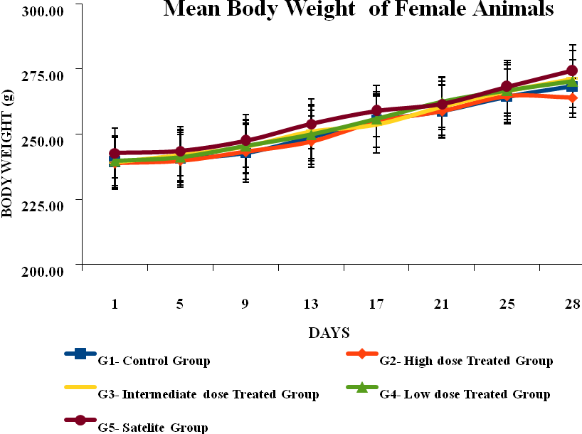
MEAN BODY WEIGHT OF FEMALE RATS
DURING THE TREATMENT PERIOD

Slide 31
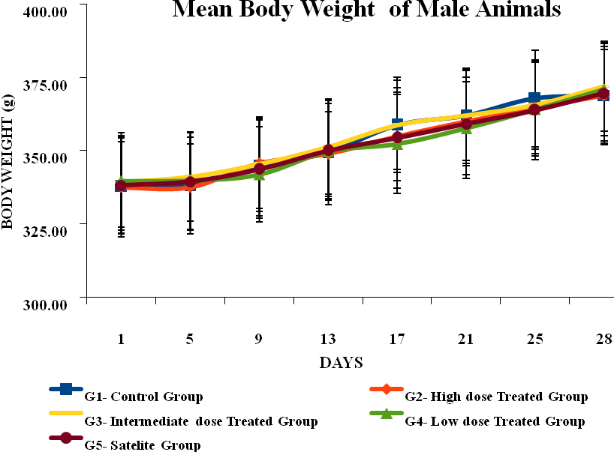
MEAN BODY WEIGHT OF MALE RATS
DURING THE TREATMENT PERIOD

Slide 32
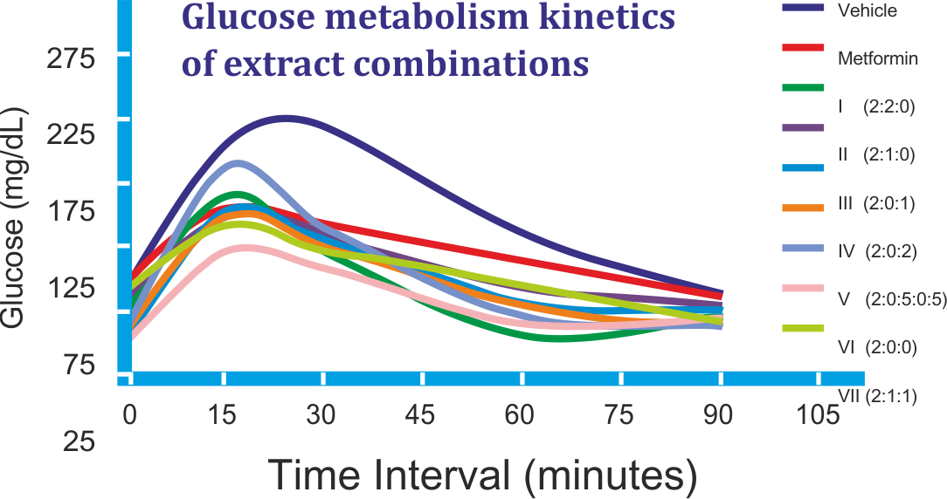
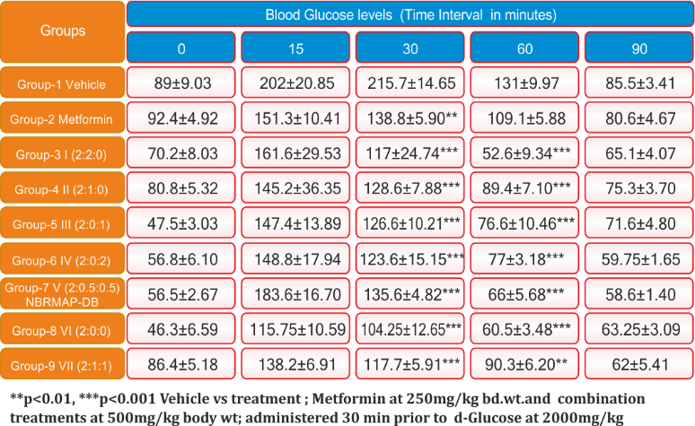
EFFICACY STUDY OF BGR 34 COMPONENTS FOR SYNERGISTIC ACTION
Primary screening of anti-diabetic potential of the herbal combinations in different proportions was undertaken by conducting Oral Glucose Tolerance Test (OGTT) as per the selected parameters.
BGR-34 maintained the glucose levels significantly when compared to control.
COURTESY BY CSIR
Notes:
THIS PARTICULAR SLIDE SHOW THE PRECLINICAL DATA ABOUT SYNERGISTIC ROLE OF 6 HERBAL COMPONTS OF BGR 34 IN REGULATIONG BLOOD GLUCOSE LEVELS PERFORMED AT CSIR INDIA. TRAIT SECRETE OF CSIR.

Slide 33
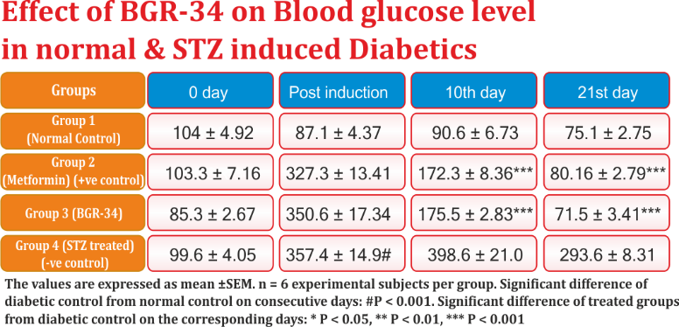
ANTIHYPERGLYCEMIC ACTIVITY
BGR-34 maintains glucose homeostasis in Diabetics
Anti-hyperglycaemic potential of BGR-34 was studied in streptozotocin induced diabetic experimental subjects with fasting blood glucose (FBG) observed in 0,2nd, 10th & 21st day. BGR-34 was found to significantly maintain glucose homeostasis quite comparable to that with normal control (Vehicle group) and Metformin treated group and significantly different as compared to negative control streptozotocin only treated group with p<0.001.
COURTESY BY CSIR
Notes:
IN ANTIHYPERGLYCEMIC ACTIVITY BGR-34 was found to significantly maintain glucose homeostasis quite comparable to that with normal control (Vehicle group) and Metformin treated group

Slide 34
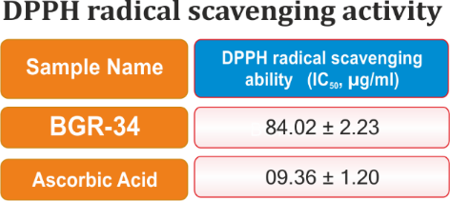
ANTIOXIDANT ACTIVITY
Provides pronounced Antioxidant activity
The Antioxidant protective activity of BGR-34 was determined using DPPH radical scavenging ability (IC50, µg/ml) model.
BGR-34 showed nine times higher anti-oxidant
activity than that of standard anti-oxidant Ascorbic acid.
COURTESY BY CSIR

Slide 35
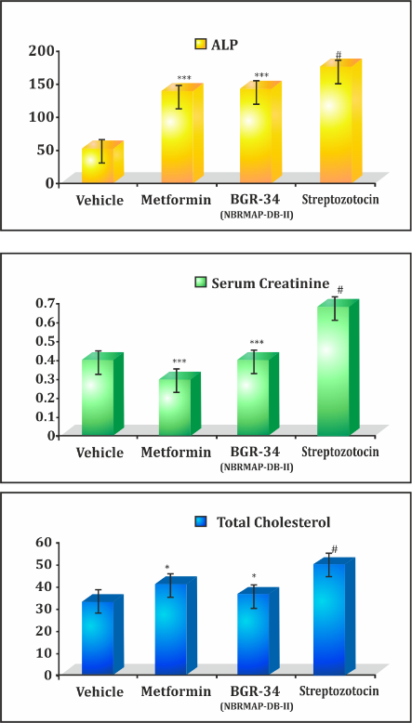
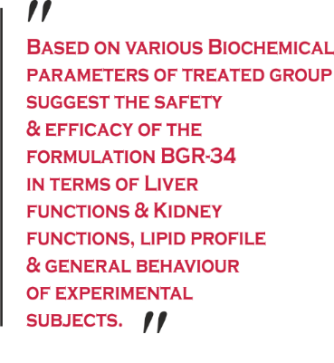
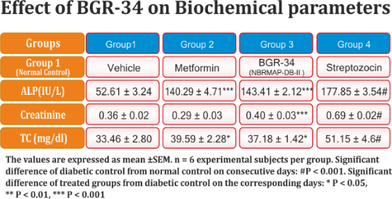
STUDY ON BIOCHEMICAL PARAMETERS
SHOWING ITS SAFETY
BGR-34 prevents disturbances in the
bio-chemical parameters due to diabetes
The bio-chemical parameters in diabetic experimental subjects receiving BGR-34 as well, remain significantly different than the diabetic control with p<0.001 in Serum alkaline phosphatase (ALP) and serum creatinine and P<0.05 in Total cholesterol over the study period after induction of diabetes.
COURTESY BY CSIR

Slide 36
CLINICAL STUDIES OF
BGR-34
Study was designed, run, and analysed by
P.I- DR. B.P. Gupta at Aggarwal Hospital New Delhi.
The study was conducted as per ethical guidelines for biochemical research on human participants (ICMR) and was approved by Hospitals Institutes Ethical Committee (IEC)

Slide 37
CLINICAL STUDY DESIGN
BGR-34 was clinically studied based on the study design followed at All India Institute of Medical Sciences (AIIMS) for the study of an herbal anti-diabetic preparation.
Patients were randomized into placebo and drug arms for 16 weeks (after 4 weeks of run in period). Patients were provided with medicine, either drug/placebo coded with particular number and advised to take 2 tablets of the drug/placebo twice a day as adjuvant ALONG WITH PRESCRIBED ANTI DIABETIC DRUGS.
The patients were investigated after every 4 weeks for fasting and PP blood glucose.
Further, the patients were advised to seek medical advice and report immediately in case of development of any complications or any untoward events at any stage during the course of the study.
At study completion (after 16 weeks of the treatment), blood glucose-fasting and PP, glycosylated haemoglobin (HbA1c), were repeated.

Slide 38
DESIGN OF CLINICAL STUDY
A double blind placebo controlled clinical study of BGR-34
Targeted population | Treatment |  | Evaluation
 | GROUP I BGR-34 | GROUP 2 PLACEBO | Effectiveness | Safety | Quality of life (w.r.t. symptoms like-)
Patients with mild to moderate type 2 diabetes mellitus | 2 tablets twice a day as adjuvant along with (anti diabetic drugs) | 2 tablets twice a day as adjuvant along with routine management (anti diabetic drugs) | FBG PPBG HBA1c | No untoward effects were observed in any of the patients on BGR-34 | Polyuria Polyphagia Polydipsia General Fatigue Pain In Calf Muscles Burning Sensation Of Soles And Palms Dryness Of Mouth Itching Genitals Decreased Libido Blurred Vision Delayed healing of wounds etc.

Slide 39
CLINICAL STUDY
INCLUSION CRITERIA:
Age: 25 to 60 years
Patients with type 2 Diabetes mellitus
Fasting blood glucose >126 mg/dL
Absence of any other significant disease or clinically significant medical history on physical examination during screening in the view of the investigator.
Subjects willing to provide written informed consent to participate in the study.
EXCLUSION CRITERIA:
Patients on Insulin.
Patients with acute infections or chronic debilitating diseases, tuberculosis, malignancy, HIV infection etc.
Any life threatening serious disorder of the liver, kidneys, heart, lungs or other organs.
Pregnancy and lactation
Patients diagnosed with severe end organ damage
Unwillingness to give written informed consent for participation in the study.

Slide 40
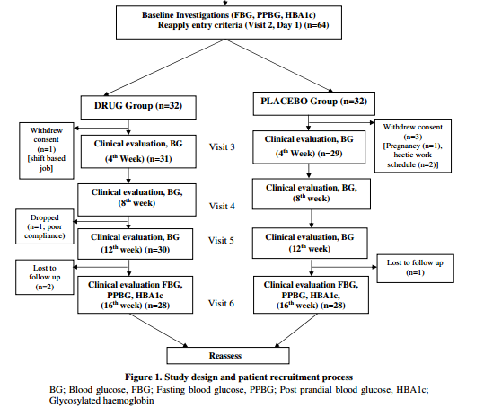
SCREENING OF PATIENTS
140 patients from the OPD at Aggarwal Hospital were screened, out of which 64 patients were selected after applying inclusion and exclusion criteria.

Slide 41
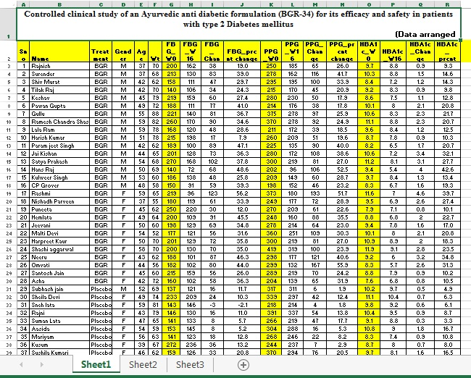
DATA MANAGEMENT OF CLINICAL TRIAL
Data was arranged in MS Excel. Student’s t test was used to compare difference in mean values between the two groups. Chi-square test was used for categorical variables. Paired t-test has been used for within group analysis. For every outcome variable, results are presented as mean ± sd (standard deviation), p value <0.05 was considered statistically significant. STATA 12.0 (STATA Corp, Houston, TX, USA) statistical software has been used for data analysis.

Slide 42
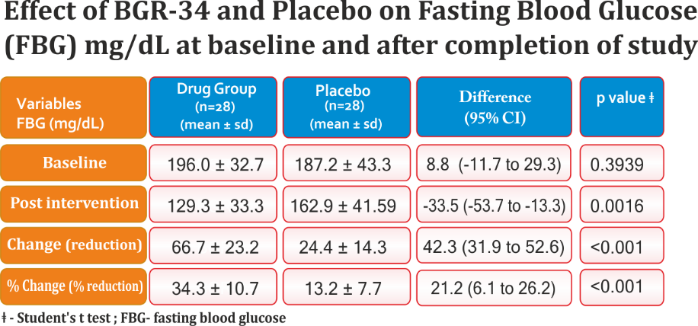
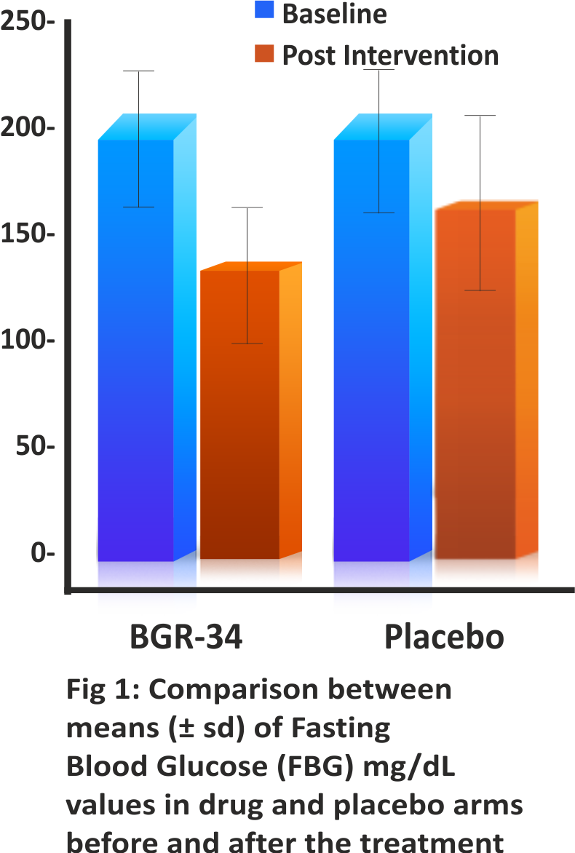
RESULTS & OBSERVATIONS
Effect On FBS

Slide 43
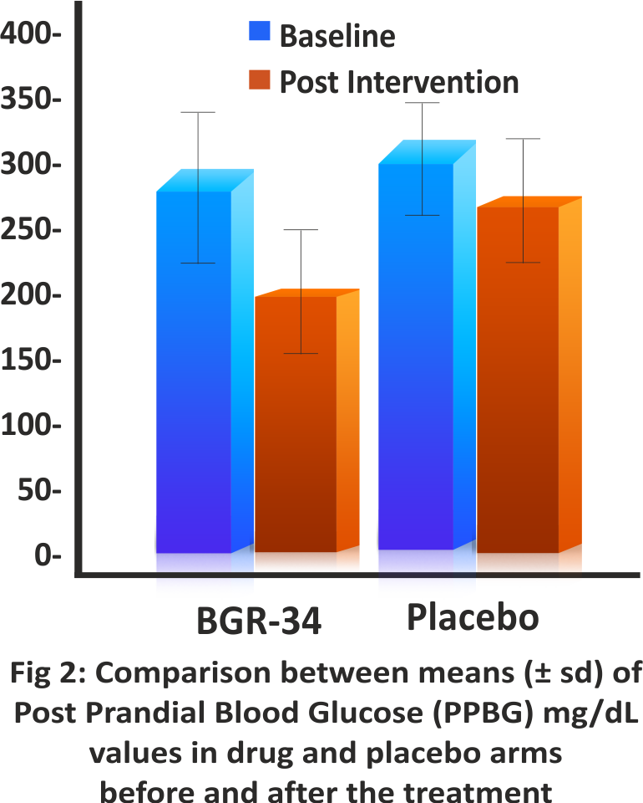
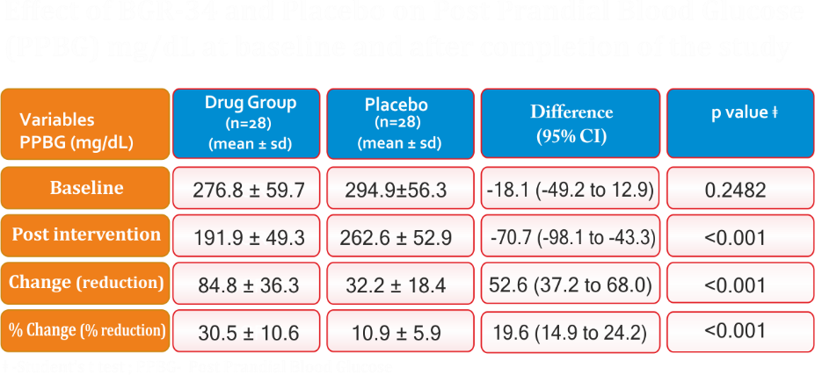
RESULTS & OBSERVATIONS
Effect On PPBS
Effect of BGR -34 and placebo on Post Prandial Blood Glucose (PPBS) mg /dl at baseline and after completion of the study

Slide 44
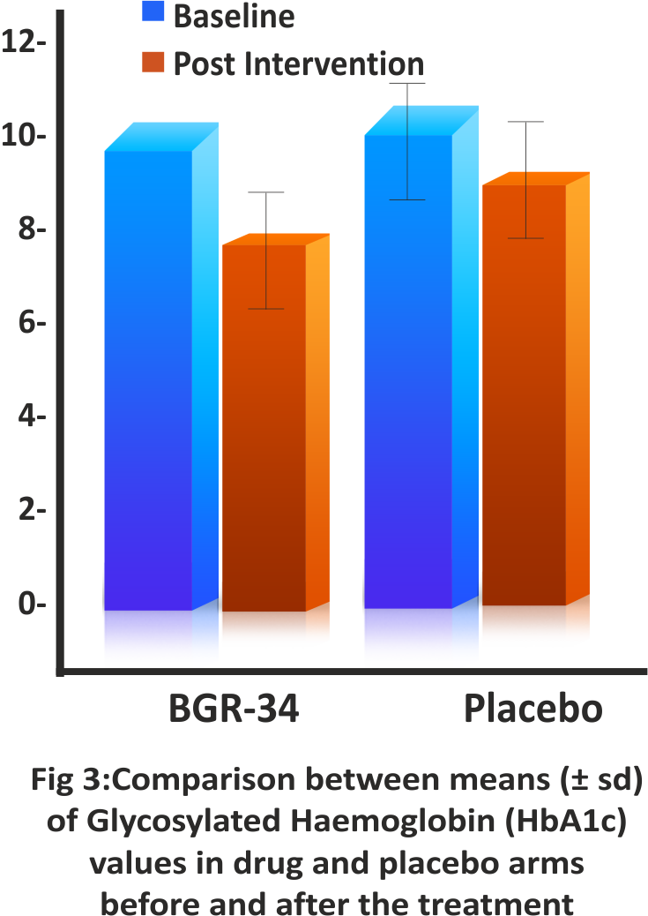
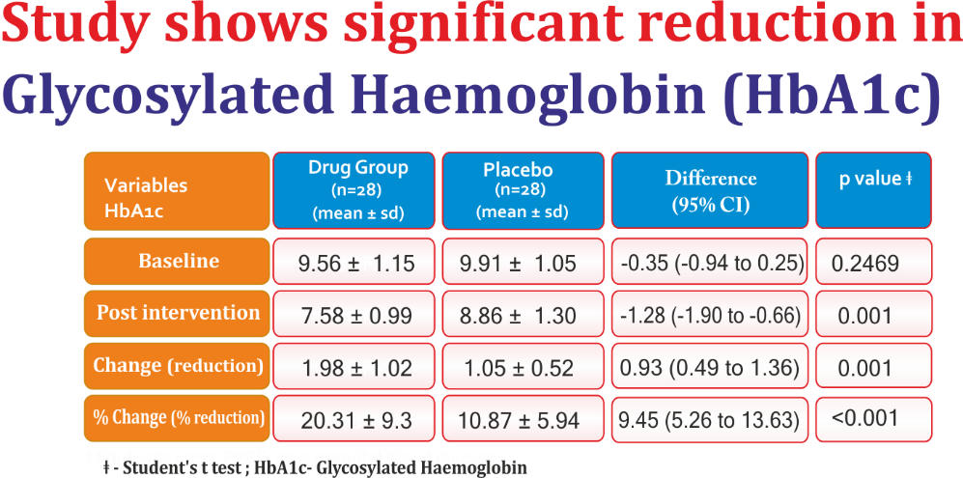
RESULTS & OBSERVATIONS
Effect On HbA1c

Slide 45
OBSERVATIONS & RESULTS
The difference in Age, body weight & number of patients in the drug and placebo group was not found to be significant. Both the groups showed reduction in blood sugar parameters. However, in BGR-34 treated group reduction in blood sugar parameters was significantly higher.
Fasting Blood Glucose (FBG)
The percent reduction in the BGR-34 treated group was significant (p<0.001) as compared to the placebo group.
Post Prandial Blood Glucose (PPBG)
The percentage reduction in the BGR-34 treated group was significant (p<0.001) as compared to the placebo group.
Glycosylated haemoglobin
The percentage reduction in the BGR-34 treated group was significant (p<0.001) as compared to the placebo group.
Untoward effects
No untoward effects were observed in any of the patients on BGR-34. Rather patients reported improvement in quality of life along with relief in symptoms like polyuria, polyphagia, polydipsia, general fatigue, pain in calf muscles, burning sensation of soles and palms, dryness of mouth etc. Improvement in appetite and digestion with no gastric discomforts were also reported in BGR-34 group.

Slide 46
CONCLUSION
BGR-34 showed very promising results with respect to glycemic parameters in patients with type 2 diabetes mellitus. There was a significant improvement in the feeling of wellbeing due to better control of hyperglycemia. The various mechanism through which the drug showed these results may be attributed to:
i) delays in absorption of glucose from GIT,
ii) inhibition of Advanced glycation end products (AGEs) accumulation and
iii) enhancing insulin release and conversion of pro-insulin to insulin. It is further suggested that BGR-34 should be further extensively used as a mono therapy/adjunctive therapy for the regulation/ management / control of blood glucose level.

Slide 47
CONCLUSION ABOUT BGR-34
A breakthrough phyto-research of the decade
Enriched with scientifically validated natural botanical extracts extracted from highest quality herbs to maintain normal blood glucose metabolism.
Scientifically Proven
Clinically Tested
Toxicologically Tested
Notes:
Therefore we can say at conclusion about bgr 34 as a wonderful drug for diabetes patients not only restricted to India but also round the globe. And at the I would also like to share some emerging marketing data about bgr 34……

Slide 48
PHYSICAL AND CHEMICAL
CHARACTERIZATION
BGR 34
FOLLOWING A.P.I AND INTERNATIONAL
STANDARD GUIDLINE (E.U)
AIMIL PHARMACEUTICAL
Notes:
WE AT AIMIL PHARMACEUTICAL CHARACTERIZED PHYSICAL AND CHEMICAL ATRIBUTES OF BGR 34 FOLLOWING……………

Slide 49
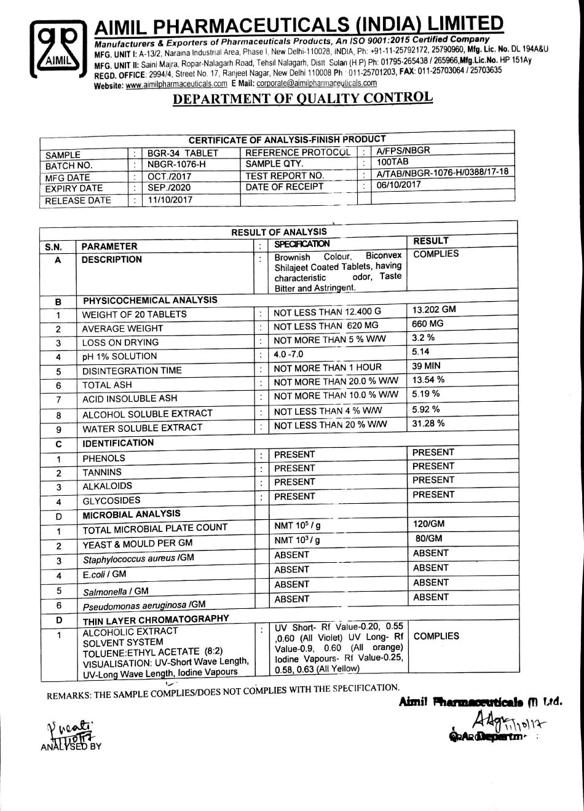
IN-HOUSE PARAMETERS : BGR 34- COA
Notes:
PHYSICAL AND CHEMICAL DATA FOR BGR 34 ARE ………………………..

Slide 50
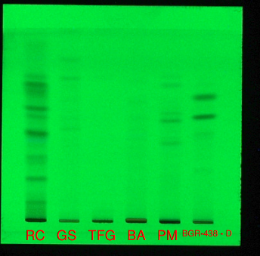
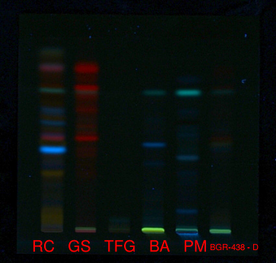
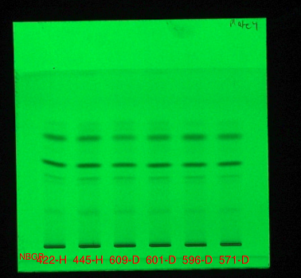
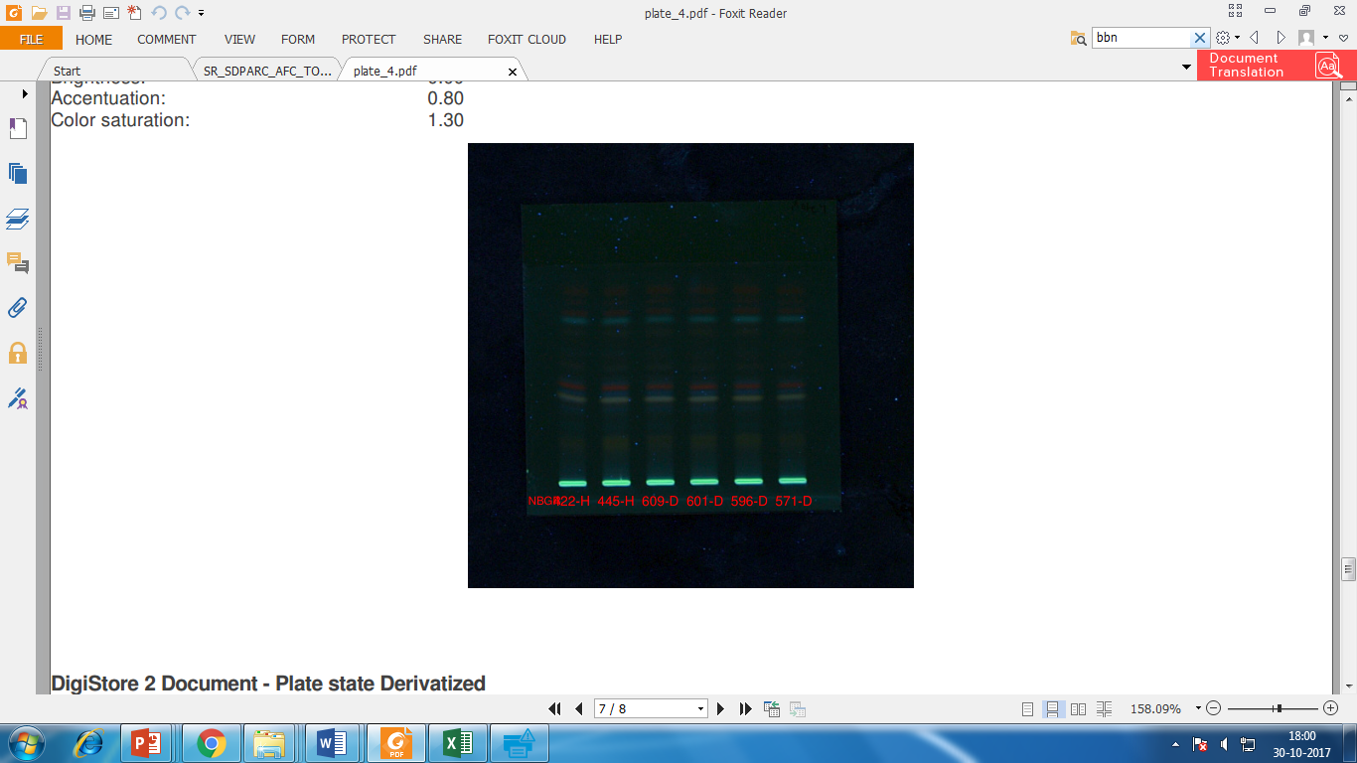
HPTLC FINGER PRINTING
HPTLC finger printing
BGR 34 WITH INGRIDIENTS
BGR 34 WITH INGRIDIENTS
DIFFERENT BATHCHES BGR 34
DIFFERENT BATHCHES BGR 34
PHYTO-CHEMICAL PROPERTIES OF DRUG: BGR 34
Notes:
HPTLC FINGER PRINT PROFILE OG BGR 34 UNDER RUNNING CONDITIONS………………….

Slide 51
STABILITY STUDIES –BGR 34
STUDY | STORAGE CONDITION |  | MINIMUM TIME PERIOD (IN MONTHS)
 | Temperature | humidity
Real time | 30⁰ ±2 | 65% ±5% | 36
Accelerated | 40⁰ ±2 | 75% ±5% | 6
Stability specification
Physical properties | NO CHANGES OBSERVED AFTER 36 MONTHS
Chemical properties | NO CHANGES OBSERVED AFTER 36 MONTHS NO CHANGES OBSERVED AFTER 36 MONTHS
Microbial properties
Notes:
BGR 34 REMAINED STABLE OVER 36 MONTH UNDER AMBIENT CONDITIONS.

Slide 52

COMPLIES TO MICROBIAL LOAD NORMS: BGR 34
MICROBIAL LOAD | METHODS |  | RESULT UNIT | LIMIT
Total microbial plate count | : | ISO 4833-1:2013 | 150 cfu/ GM | 10⁴ / g
Yeast & moulds count | : | ISO 21527-2:2008 | < 10 cfu/ GM | 10³ / g
Coliforms |  | ISO 4832:2006 | < 10 cfu/ GM | < 1 cfu/ml
E.coli |  | ISO 16649-2:2001 | Absent /GM | < 10/ml
Staphylo-coccus aureus | : | ISO 6888-1:1999 | Absent /GM | < 10/ml
Salmonella | : | ISO 6579:2002 | Absent /10 GM | Absent
Pseudomonas-aeruginosa | : | European Pharmacopeea | Absent / 25 GM | Absent
Shigella | : | ISO 21567:2004 | Absent /25 GM | Absent
Listeria monocytogenes | : | ISO 11290-1:1997 | Absent / 25 GM | Absent
Notes:
THE DRUG SATISFIES MICROBIAL LOAD OF INTERNATIONAL……

Slide 53

COMPLIES TO HEAVY METALS NORMS: BGR 34
HEAVY METALS |  | Method | Result unit | Limit
LEAD | : | AOAC 2015.01 by ICP-MS | <.05 mg/kg | 1ppm
ARSENIC | : | AOAC 2015.01 by ICP-MS | <.05 mg/kg | 3ppm
CADMIUM | : | AOAC 2015.01 by ICP-MS | <.02 mg/kg | 0.3ppm
MERCURY | : | AOAC 2015.01 by ICP-MS | <.01 mg/kg | 0.1ppm
Notes:
THE DRUG SATISFIES MICROBIAL LOAD OF INTERNATIONAL

Slide 54
COMPLIES TO MYCOTOXINS NORMS : BGR 34
MYCOTOXINS | METHODS |  | RESULT UNIT | LIMIT
AFLATOXINS | : | EASI-CHE-SOP-19, LC-FLD | < 0.5ug/kg
B1 | : | EASI-CHE-SOP-19, LC-FLD | < 0.5ug/kg | 5ug/kg
B2 | : | EASI-CHE-SOP-19, LC-FLD | < 0.5ug/kg | -
G1 | : | EASI-CHE-SOP-19, LC-FLD | < 0.5ug/kg | -
G2 | : | EASI-CHE-SOP-19, LC-FLD | < 0.5ug/kg | -
B1+B2+G1+G2 |  | - | - | 10ug/kg
Ochratoxin A |  | EASI-CHE-SOP-19, LC-FLD | < 0.5ug/kg | 15ug/kg
Notes:
THE DRUG SATISFIES MICROBIAL LOAD OF INTERNATIONAL

Slide 55
COMPLIES TO PESTICIDES NORMS : BGR 34
PESTICIDES | METHODS |  | RESULT UNIT
IR408 IR Screened | : | EASI-CHE-SOP-21 | Not Detected
IR409 IR Screened |  | EASI-CHE-SOP-21 | Not Detected
Notes:
THE DRUG SATISFIES MICROBIAL LOAD OF INTERNATIONAL

Slide 56

POST MARKETING FEEDBACK
AIM- To have the feedback from Doctors having introduced BGR-34 & repeatedly called upon with respect to Efficacy, Safety & Additional benefits from BGR-34 (Study ongoing)
Target Sample size- >10,000 Doctors
Demographic representation-
All 5 zones of country viz. North, West, Central, East & South
All metros of country, 2nd tier,3rd tier towns.
Market feedback taken by Product executive team
Received formats till date- More than 5000

Slide 57

FORMAT OF FEEDBACK FROM DOCTORS

Slide 58
TABULATON OF THE RECEIVED FORMATS
ZONE: REST OF MAHARASHTARA
S.NO. | CITY | DOCTOR'S PARTICULAR |  |  | PATIENTS ON BGR-34 | MO*/CO*-THERAPY | INDICATION PD*/Mi*/Mo*/S* | SATISFACTORY %AGE | ADVERSITIES (IF ANY) | ADVANTAGES & O.I. | CASUALITY MANANGEMENT
 |  | NAME (Dr.) | QUAL* | CONTACT No.
1 | Pune | Archana S Kharge | BAMS | 9689933770 | 2 | MO | PD | 60-75% | No | No
2 | Pune | Prashant R Panhalkar | DHMS | 9422032636 | 3 | MO | Mo | 60-75% | No | Glucose level normal | No Casuality
3 | Pune | Savana A Deshpande | BAMS | 9422608485 | 4 | MO | Mo | 60-75% | No | Insulin utilization increases | No Casuality
4 | Pune | Abhijit M Deshpande | BAMS | 9422608485 | 6 | MO | Mo | 60-75% | No | Digestive system improved | No Casuality
5 | Pune | Sushma P Panhalkar | BAMS | 9011240799 | 5 | MO | Mo | 60-75% | No | Helps in metabolism function | No Casuality
6 | Pune | Madhu Pawar | BMMI | 9763383242 | 5 | MO | Mo | 60-75% | No | Antioxidant & improves metabolism rate | No Casuality
7 | Pune | Sangita Sadgune | BAMS | 9146510850 | 5 | MO | Mo | 60-75% | No |  | No Casuality
8 | Pune | Atul S Pharde | BHMS | 9920111818 | 4 | CO | Mi/Mo | 60-75% | No |  | No Casuality
9 | Pune | Sandeep Bhingardive | BHMS | 7385607104 | 2 | CO | Mi | >75% | No |  | No Casuality
10 | Pune | Yogesh Lakade | BHMA | 9660331037 | 2 | CO | Mi | 40-60% | No |  | No Casuality
11 | Pune | Bharti Vidyapeeth | BAMS |  | 5 | CO | Mo | 60-75% | No |  | No Casuality
12 | Pune | Harshada Kulkarni | BHMS/CCH/CGO | 9422317191 | 2 | CO | Mi | 60-75% | No |  | No Casuality
13 | Pune | Sharvari Avalaskar | BAMS |  | 2 | CO | Mo | 40-60% | No |  | No Casuality
14 | Pune | Swati Jagtap | BAMS | 9850798486 | 3 | CO | Mi | 40-60% | No |  | No Casuality
15 | Pune | Jagdish O | BAMS |  | 1 | CO | Mi | 60-75% | No |  | No Casuality
16 | Pune | Sagar Mande | BHMS | 9822261033 | 2 | MO | Mi | 60-75% | No |  | No Casuality
17 | Pune | Faiyaz Shikalgar | BAMS | 9823323193 | 4 | MO | Mo | 60-75% | No | Digestive system improved | No Casuality
18 | Pune | Avinash Bedkar | BAMS |  | 5 | MO | Mo | 60-75% | No | Improves Beta cells & maintain blood sugar | No Casuality
19 | Pune | Mahesh Ratnakar | BAMS |  | 7 | MO | Mo | 60-75% | No | Improves Immunity | No Casuality
20 | Pune | Dhananjay Ghaitade | BAMS | 9890222106 | 5 | MO | Mo | 60-75% | No | Improves Digestive System | No Casuality

Slide 59
QUALITATIVE ASSESSMENT OF FEEDBACK
Doctors from all over India comprising of Allopathic & Ayurvedic Dr’s practising in market/hospitals/medical colleges etc; numbering over 5000 have given acceptance of BGR-34 in the management of Diabetes.
Most of the Dr’s Prescribe BGR-34 as CO-THERAPY with other OHG’s.
The efficacy has been generalised in between 60-75% with Very good results.
No adversities/casualities except skin rash in 3 cases have been reported. Gastric upset has been reported in 15 cases which is less than 0.5% of total reports received.
About 60% of Dr’s reported benefits in Improving Quality of Life of patients also including improvement in LFT./KFT parameters and checking fatigue in such patients.
Overall, Dr’s are satisfied with results of BGR-34 and are using the drug in their day-to-day practice.

Slide 60


An indigenous DISCOVERY
At present diabetic treatment involves a lot of imported molecules (DPP-IV inhibitors, insulin, etc.) which increases burden on the patients and economy.
BGR-34, gives A RAY OF HOPE to the diabetic patients of the country to manage their diabetes well which is
Economical
Natural & Safe
Made in India

Slide 61
Thank You !
“Believe with all of your heart that you will do what you were made to do.”
-Orison Swett Marden

