Slide 1



Interactions of a novel class of beta-lactam antibiotics with their targets penicillin-binding proteins from different sources studied by covalent docking approach
Anna Marabotti
Dept. Chemistry and Biology «A. Zambelli»
University of Salerno, Italy

Slide 2
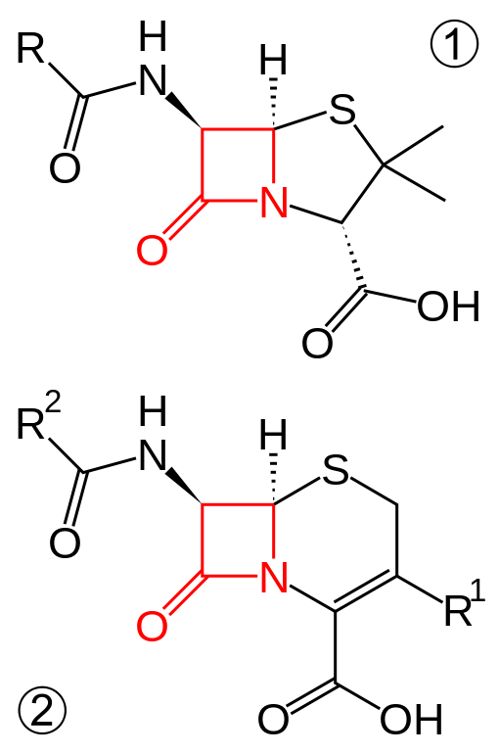
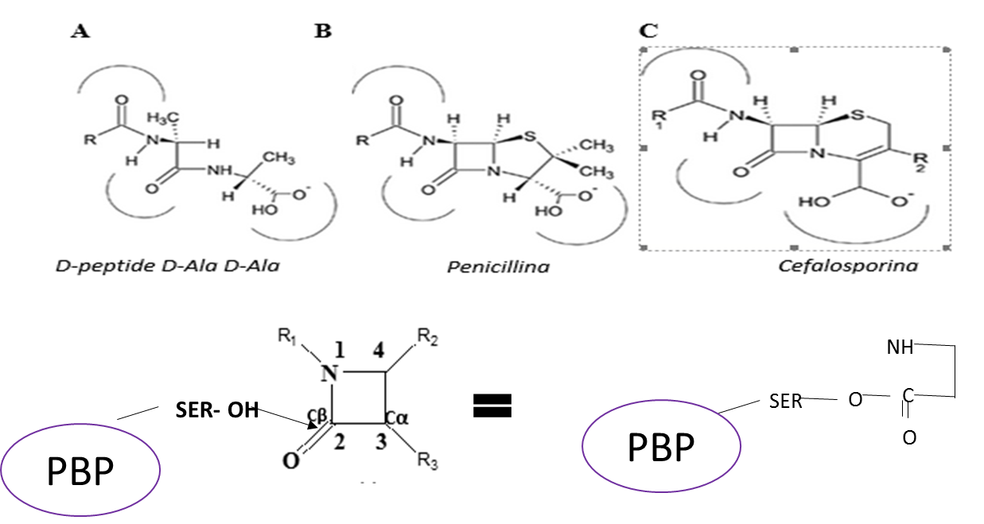
BETA-LACTAM ANTIBIOTICS
The first (and still most widely used) antibiotics
Penicillin
D-Ala-D-Ala
Penicillin
Cephalosporin
These compounds interfere with the synthesis of the peptidoglycan, an essential component of the cell wall in bacteria. The structure of beta-lactam antibiotics mimics the one of the dipeptide D-Ala-D-Ala.
These compounds bind covalently to the reactive Ser in the active site of PBPs, inactivating permanently the enzyme
Cephalosporin
Notes:
To briefly introduce the study, I would like to remember you that beta lactams were the first antibiotics discovered, in particular penicillin was serendipitously discovered by Sir Alexandre Fleming in 1928 and published in 1929, whereas cephalosporin was discovered by an Italian researcher, Giuseppe Brotzu, in 1945 and published in 1948. The two molecules are called beta lactams because the share in their chemical structures the presence of a beta lactam ring (in red) fused to a 5-member ring in penicillin, to a 6-member ring in cephalosporin, with different substituents (indicated with R) giving rise to a vast family of natural of synthetic compounds.

Slide 3
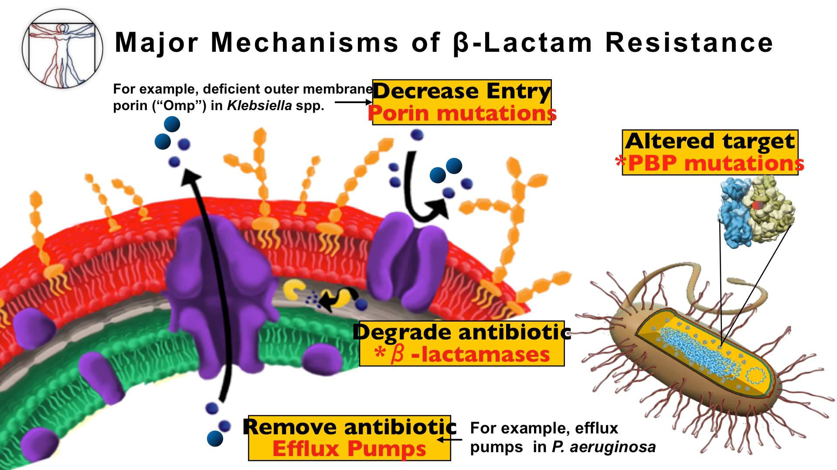
POSSIBLE CAUSES FOR
ANTIMICROBIAL RESISTANCE
Notes:
…and in particular, for beta lactam antibiotics, the main causes, apart from those systems that impair the introduction of the antibiotic into the cell, are two: mutations of the PBPs targets for the antibiotics, and the development of beta lactamases, enzymes able to disrupt the beta lactam ring, opening it and inactivating the molecule

Slide 4

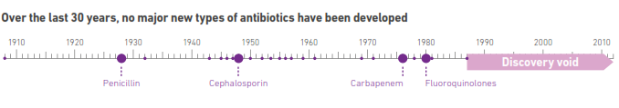

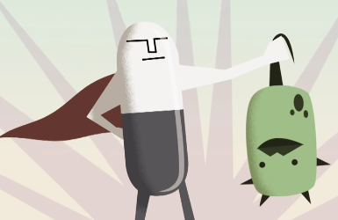

ANTIMICROBIAL RESISTANCE:
A GLOBAL ALARM
?
Past
Present
Notes:
Moreover, the same report highlights the lack of new molecules with antibiotic activity discovered during the last 30 years. Therefore, if in the past the antibiotics were able to guarantee an effective protection against microbial pathogens, nowadays the development of bacteria resistant to many antibiotics has become a real threat for the human beings.

Slide 5
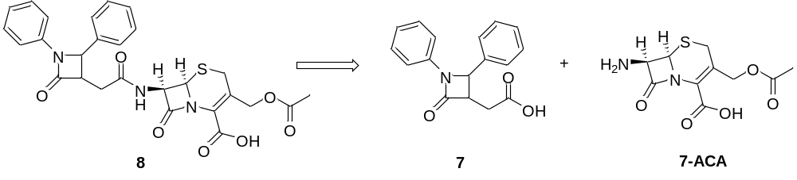
POSSIBLE SOLUTIONS FOR ANTIMICROBIAL RESISTANCE
To develop new antibiotics with:
Increased resistance to beta lactamases
Increased ability to bind to PBPs
A new class of cephalosporin analogues:
Additional beta lactam ring
AMA10
Notes:
In our Department of Chemistry and Biology at the University of Salerno there is an active line of research in order to synthesize new molecules that, starting from the original nucleus of penicillin and/or cephalosporin, carry on modifications in order to render them more resistant to beta lactamases and/or to widen their spectrum of activity. Recently, a new class of cephalosporin analogues has been developed, whose representative is AMA10, shown here. These molecules is formed by the condensation of the 7-aminocephalosporanic nucleus with a 2-azetidinone ring that can carry several substituents: in the case of AMA10 there are two phenyl rings attached to the isolated beta lactam. This molecule therefore possesses 2 beta lactam rings, and has been developed with the idea of provinding an active ring to block PBPs and a «suicide ring» to bind and inactivate beta lactamases; in this way this bifunctional molecule can protect itself from the hydrolysis of the active center.

Slide 6
POSSIBLE SOLUTIONS FOR ANTIMICROBIAL RESISTANCE
To develop new antibiotics with:
Increased resistance to beta lactamases
Increased ability to bind to PBPs
A new class of cephalosporin analogues:
AMA10
(3R,4S)
+
Additional beta lactam ring
AMA10
(3S,4R)
Notes:
In our Department of Chemistry and Biology at the University of Salerno there is an active line of research in order to synthesize new molecules that, starting from the original nucleus of penicillin and/or cephalosporin, carry on modifications in order to render them more resistant to beta lactamases and/or to widen their spectrum of activity. Recently, a new class of cephalosporin analogues has been developed, whose representative is AMA10, shown here. These molecules is formed by the condensation of the 7-aminocephalosporanic nucleus with a 2-azetidinone ring that can carry several substituents: in the case of AMA10 there are two phenyl rings attached to the isolated beta lactam. This molecule therefore possesses 2 beta lactam rings, and has been developed with the idea of provinding an active ring to block PBPs and a «suicide ring» to bind and inactivate beta lactamases; in this way this bifunctional molecule can protect itself from the hydrolysis of the active center.

Slide 7
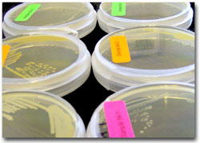
POSSIBLE SOLUTIONS FOR ANTIMICROBIAL RESISTANCE
To develop new antibiotics with:
Increased resistance to beta lactamases
Increased ability to bind to PBPs
A new class of cephalosporin analogues:
AMA10
(3R,4S)
+
Gram+: sensitive
Gram-: not sensitive
AMA10
(3S,4R)
Notes:
The synthesis of this compounds is quite easy and produces the formation of a mixture of diastereoisomers of AMA10, due to the presence of two chiral centers on the molecule of the 2-azetidinone ring (the 7-ACA is commercially available in the pure enantiomeric compound). This racemic mixture has been tested for its activity against either Gram+ and Gram- bacteria, and it has been shown to be active against Gram+ (S. aureus and Bacillus spp.) with a MIC slightly better than the one of ceftriaxone (a commercial third generation cephalosporin), but to be inactive against Gram- (E. coli and Salmonella spp.), whereas ceftriaxone is still active.
Starting from appropriate reagents, it is possible to insert different substituents, or to prolonge the chain between the two beta lactam rings, but to date this molecule has not been developed with a rational approach. Therefore, the aim of the present work has been to study the interactions of this prototype molecule, AMA10, and its potential targets (PBPs and beta lactamases) in order to rationalize the interactions, to understand if there is a difference between the two diastereoisomers in terms of activity and/or specificity, and of the affinity of the compounds towards Gram+ or Gram- molecules. Moreover, the study of the interactions between the PBPs and AMA10 could suggest the selection of substituents in order to improve the potency and/or the specificity of the derived molecules.

Slide 8
AIM OF THE WORK
Study of the interactions of AMA10 with its putative targets PBPs in order to understand:
Are there differences in the interactions with the PBPs coming from either Gram+ or Gram- organisms?
Are there differences in activity between the two diastereoisomers?
Rationalize the interactions with the enzymes to project modifications to the molecule
AMA10
(3R,4S)
AMA10
≠
AMA10
(3S,4R)

Slide 9

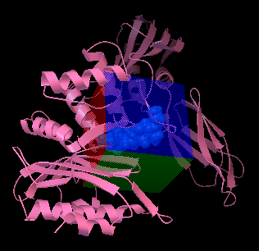
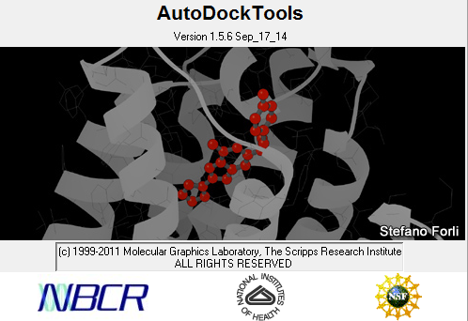
DOCKING
COVALENT
COMPLEX!
NON COVALENT
COMPLEX
ALTERNATIVE TECHNIQUE:
COVALENT DOCKING
Notes:
Docking is a well known classic computational technique in which it is possible to study the interactions between two molecules (typically a protein with its ligand. In general, to reduce the computational complexity, the protein is kept rigid or partially flexible in the zone of interaction with the ligand, whereas the small molecule binding the protein is always kept conformationally flexible. In all cases, however, traditionally docking is applied when the two interactors form a non-covalent complex. In this case, however, the problem is that the beta lactam antibiotics interact with the PBPs forming a covalent bond which is essential for their activity. Therefore, in order to obtain correct information, it is absolutely necessary to use an alternative technique which allows to simulate the formation of the covalent complex between AMA10 and PBPs.

Slide 10
COVALENT DOCKING
Bianco G, Forli S, Goodsell DS, Olson AJ. Covalent docking using autodock: Two-point attractor and flexible side chain methods. Protein Sci 2016 Jan;25(1):295-301
PBP
SER
N
CH₂-OH
C O
LIGAND
SER-C-O-
LIGAND
C
II
O
C
II
O
SUPERPOSITION
DOCKING
PBP
SER-C-O-
LIGAND
C
II
O
Notes:
There are only very few examples of covalent docking in literature. We tested several approaches, some of which are also available online via web servers, but the vast majority gave us unreliable results. The best approach we found has been developed only recently, it is based on a modification of the popular docking tool AutoDock and it is still not released; it claims a reliability of 75%. The approach uses a «trick» in order to create the covalent complex. We start from the PBP (or the beta lactamase) in which the reactive Ser residue has been identified, and from the ligand. First, the ligand is modified in order to open the beta lactam ring and to add a C=O group to simulate the acylation. Then, the Ser is extracted from the protein, superimposed to the acyl group added to the ligand, and a covalent adduct is then created. Then, the Ser residue with the ligand covalently bound is reinserted into the protein and the docking is performed treating this modified residue as the flexible one. A «ghost» molecule is used to simulate the presence of the interactor.

Slide 11
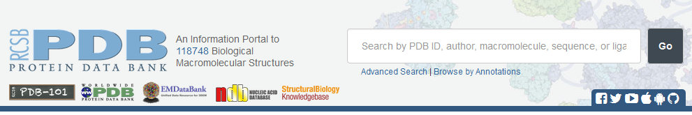
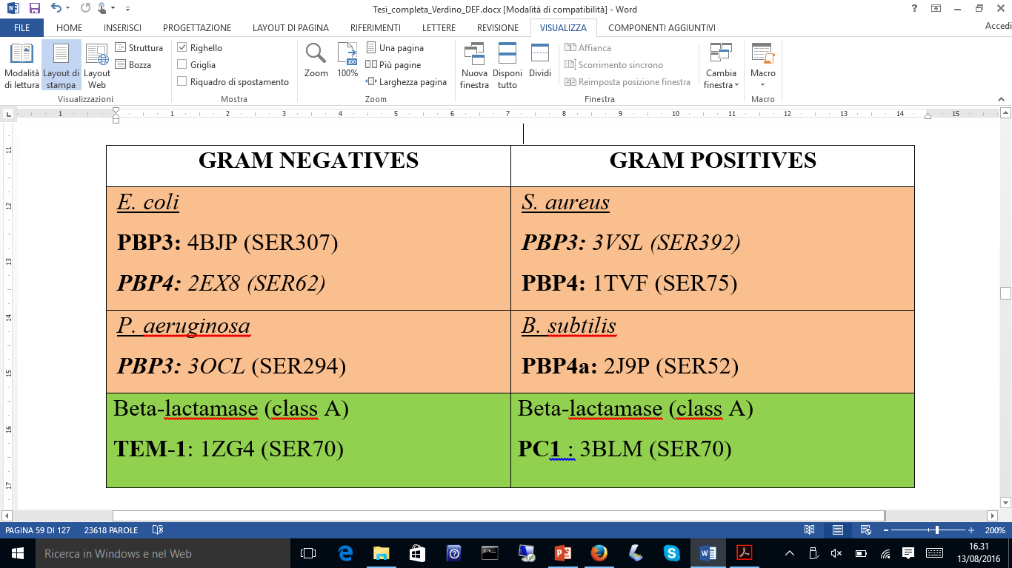
SELECTION OF THE PROTEINS
67 PBPs
67 PBPs
6 PBPs
2 BL
Notes:
We searched for the structures of PBPs in the Protein Data Bank and found 67 proteins, from different sources. However, many of them were redundant structures of the same PBP with different ligands, so we had to apply several criteria to select at last 6 representative proteins. We selected PBP3 and 4 because they are the most important PBPs from a clinical point of view, and we selected two Gram+ bacteria (corresponding to the ones tested experimentally for AMA10) and two Gram- bacteria. Moreover, in order to check preliminarly for the interactions of AMA10 with beta lactamases, we selected two enzymes representing the most important beta lactamases. The list of the proteins tested is shown in the table, and the corresponding active Ser residue is cited for each enzyme. Those enzymes in italics are the ones for which a covalent complex with a molecule is available as a structure in PDB. We used these complexes in our preliminary test to verify the reliability of the results of covalent docking.

Slide 12
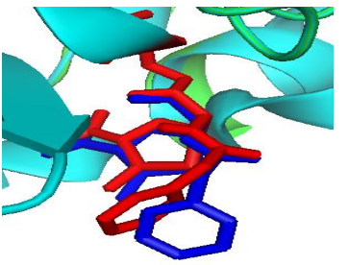
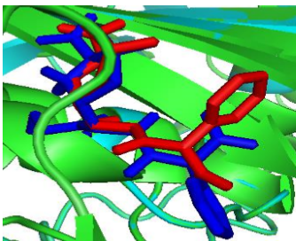
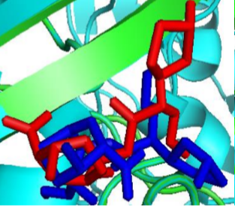
SELF-DOCKING RESULTS
PDB CODE | REPRESENTATIVE SOLUTION AND NUMBER OF POSES IN THE SELECTED CLUSTER | TOTAL NUMBER OF CLUSTERS | PREDICTED ΔG (kcal/mol) | PREDICTED K_{i} (nM)
2EX8 + Penicillin G (E. COLI, PBP4) | Run 18 (99 poses) | 2 | -9.20 | 181.57
3OCL + Carbenicillin (P. AERUGINOSA, PBP3) | Run 91 (63 poses) | 7 | -10.02 | 44.94
3VSL + Cefotaxime (S. AUREUS, PBP3) | Run 91 (58 poses) Run 62 (31 poses) | 5 | -12.54 -12.32 | 0.64 0.94
PENICILLIN G
CARBENICILLIN
CEFOTAXIME
Notes:
In order to check the correctness of the procedure, first of all we performed several self-docking tests. In the first case, we used the complexes available from PDB between PBPs and some beta lactam antibiotics: we simply separated the antibiotic from the PBP, and then we re-docked them into the protein. In this case the antibiotic is already modified with the beta lactam ring open. In the table you can see the results we obtained. For those who are not familiar with docking, each docking has been set up in order to give 100 solutions. When several solutions are similar to each others (RMSD less than 2 A), they are clustered together and a single solution is selected as the representative one for that cluster. This solution is characterized by a predicted binding energy (in kcal/mol) and a Ki is calculated directly from this binding energy. A negative binding energy indicates a potential binding, the lower is the energy, the better is the predicted affinity. An ideal docking result should consist in a single cluster with the lowest possible DeltaG. When two or more clusters are identified, this means that the molecule can have multiple possible binding modes, and this incertitude generally means a lower affinity with respect to the macromolecule.
Our self-docking results indicate that for each complex the docking procedure identified a good complex with a negative (favourable) DeltaG. We also superimposed the result of the docking with the crystallographic complex. In the case of 2EX8, we see that the two results are practically fully superimposed. In the case of 3OCL, there is a good superposition with the crystallographic complex, only the external part of the carbenicillin is rotated with respect to the crystal, but it is also worth noting that this part protrudes towards the exterior of the protein, with no main interactions. In the third case, the superposition with the crystal is less satisfactory and the results are also more scattered, however the main part of the molecule can take the same interactions with the protein, therefore we judged positively all these three results.
The self-docking were repeated also by using the three molecules downloaded from two different databases of chemical compounds. In this case, we must first open the beta lactam ring, then add the C=O group, the hydrogens, the charges. Also in this case, however, the results we had are consistent with these ones, and indicate that the procedure we adopted is suitable for such type of molecules.

Slide 13
RESULTS OF COVALENT DOCKING
OF PBPs WITH AMA10
AMA10
(3R,4S)
AMA10
(3S,4R)
An example: 2J9P (PBP4a, B. subtilis)
LIGANDS | SELECTED RUN | NUMBER OF POSES PER CLUSTER | TOTAL NUMBER OF CLUSTERS | PREDICTED ΔG (kcal/mol) | PREDICTED K_{i} (nM)
AMA10_3R4S_A | 41 | 33 | 7 | -10.27 | 29.69
 | 15 | 37 |  | -9.48 | 111.74
AMA10_3R4S_B | 54 | 68 | 8 | -12.13 | 1.28
AMA10_3S4R_A | 64 | 18 | 9 | -10.68 | 14.85
 | 98 | 38 |  | -10.48 | 20.94
AMA10_3S4R_B | 45 | 34 | 15 | -12.00 | 1.61
 | 14 | 20 |  | -11.63 | 2.97
Notes:
This is a representative result shown in the table. The different diastereoisomers are shown in italics and normal, respectively, and the opening of the A or B ring is shown in blue and pink, respectively. As you can see from the results, the two rings have a different affinity with respect to the macromolecule. The higher affinity is the one of the B ring (the traditional beta lactam ring of cephalosporins). The A ring has a lower affinity, probably due to the steric impairment caused by the presence of the substituent phenyl rings. Instead, in this case the two diastereoisomers do not show significant differences in affinity. 4 proteins gave similar results, see later for the summary. Another interesting observation is the fact that the predicted affinity of AMA10 for these PBPs is in the same range of amplitude, even if the two enzymes come from a Gram+ organism or a Gram- organism.
Below you can see a representation of the interactions between AMA10 and the residues in the active site of 2J9P (run 41). These interactions has been calculated with Discovery Studio and represent the different kind of binding that concur in stabilizing this complex.

Slide 14
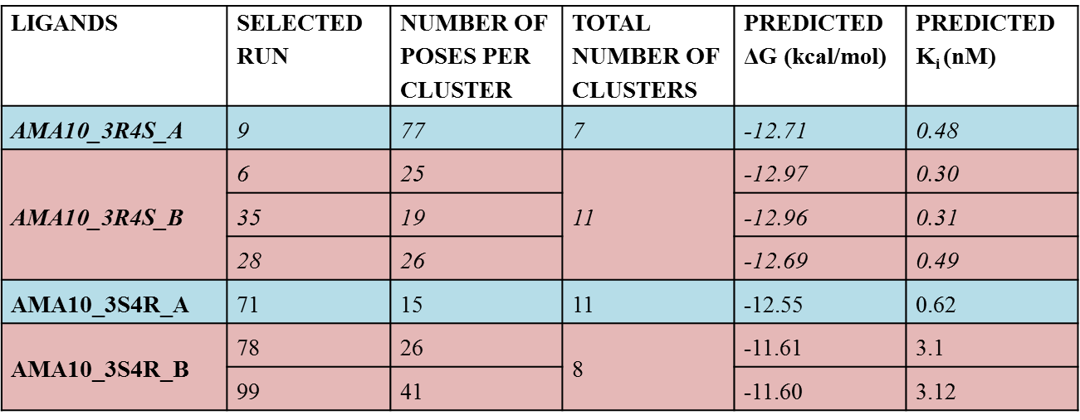
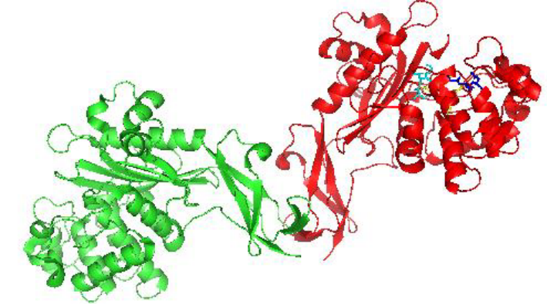
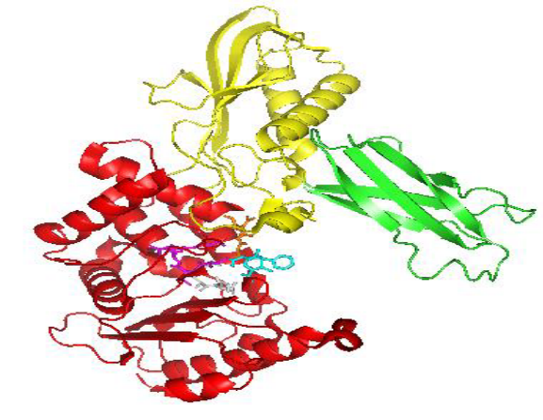
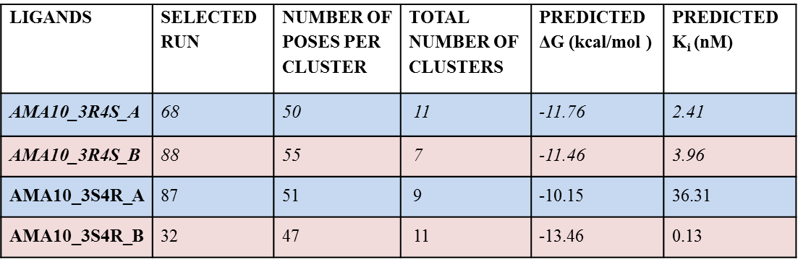
RESULTS OF COVALENT DOCKING
OF PBPs WITH AMA10
1TVF (PBP4, S. aureus)
2EX8 (PBP4, E. coli)
Notes:
For two PBPs, PBP4 from S. aureus and E. coli, the docking gave instead different results. In the first case, as you can see from the table, there is no significant difference either between ring A and B (although the results of ring B are more scattered with respect to those of ring A), and between diastereoisomers. In the second case, the main difference is between the two diastereoisomers, when the ring B is bound to the PBP.
It is interesting to note that these two PBP, in addition to their transpeptidase activities, have also an additional carboxipeptidase activity and, for 1TVF, also a slight beta lactamase activity. This could justify the presence of a different reactivity in the active site, with different results.
Finally, also in these cases, the predicted affinity of AMA10 for these PBPs is in the same range of amplitude, even if the two enzymes come from a Gram+ organism (S. aureus) and a Gram- organism (E. coli).

Slide 15
RESULTS OF COVALENT DOCKING
OF PBPs WITH AMA10
3OCL (PBP3, P. aeruginosa)
3VSL (PBP3, S. aureus)
4BJP (PBP3, E. coli)
2J9P (PBP4a, B. subtilis)
1TVF (PBP4, S. aureus)
NO DIFFERENCE IN AFFINITY NEITHER BETWEEN RING A OR B NOR BETWEEN DIASTEREOISOMERS
NO DIFFERENCE IN AFFINITY BETWEEN THE TWO DIASTEROISOMERS
HIGHER AFFINITY FOR AMA10 WITH RING B OPEN
2EX8 (PBP4, E.coli)
DIFFERENCE IN AFFINITY BETWEEN DIASTEREOISOMERS
ALL THE PREDICTED AFFINITIES ARE IN THE SAME RANGE OF AMPLITUDE IRRESPECTIVE FROM THE ORGANISM TO WHICH THE PBPs BELONG
Notes:
Here we summarize the results obtained for AMA10 with the selected PBPs. For 3OCL, 3VSL, 4BJP and 2J9P, which have only a transpeptidase activity, there are no differences in predicted affinity between the two diastereoisomers of AMA10, but there is a consistent higher affinity for the «canonical» B ring of AMA10, with respect to the additional ring.
In the two cases where the protein has additional activities, the results are different: in the case of 1TVF, there are practically no differences in affinity between the two rings, whereas in the case of 2EX8 the main difference is between the predicted activities of the two diastereoisomers.
Finally, for all the complexes, the predicted affinity is in the same range of amplitude irrespective of the fact that the organism to which the PBPs belong is Gram+ or a Gram-, indicating that the insensitivity of Gram- organisms towards these compounds derives probably from the different composition of the cell wall that impairs the entrance of the antibiotic into the bacteria, and not from a different structure of their PBPs.

Slide 16
RESULTS OF COVALENT DOCKING
OF PBPs WITH AMA10
72 complexes analysed
PBP | INTERACTING RESIDUES | INTERACTING ATOMS
4BJP | Lys310 Tyr514 Gly496 Thr497 | NH₃-OA, O1, OB, O2, aromatic ring OH-O1, O2 Cα-O1, OB, O2 NH-NA, OA, OB, O3
2EX8 | Ser420 Thr418 Asn308 | OH-O2, O1, S O-O2, O1, S NH-O2, O1, S, aromatic ring
2J9P | Asn301 Ser414 Thr412 Ser348 | NH₂,-O2, O1, S O-NH NH-OA, O1, O2 O-CB O-CB
1TVF | Thr260 Ser262 Lys78 Ser139 | OH-O2 Cβ-O2 NH-O1 O-NH OH-O2 O-C OH-aromatic ring NH₃-O1, O2 NH₃-OH OH-O1 Cβ-O1, O2
PBP | INTERACTING RESIDUES | INTERACTING ATOMS
3VSL | Thr621 Thr619 Pro660 Ser249 Asn450 | OH, O, NH-O1 Cβ-aromatic ring O-CB OH-S O-OH Aromatic ring- aromatic ring NH-OH O-NH NH2-aromatic ring
3OCL | Val333 Ser485 Thr487 Asn351 | Cβ-beta-lactam ring O-CB OH-O3, O4, O2 OH-aromatic ring O-NH NH-O1 OH-O3 NH-O1, OA
Notes:
The best 72 complexes derived from the covalent docking between AMA-10 and the selected PBPs were analysed in order to highlight the type of interactions involved and the residues promoting these interactions. Two different programs were used, in order to compare the results, and both gave consistent results. Here I show an example. As you can see in the representation on the left, many different forces concur in stabilizing the complex, in particular, apart from the covalent bond, there are many hydrogen bonds, several van der Waals contributions and other contributions involving the phenyl rings of the compound, such as the Pi interactions. The summary of the analysis is shown in the table on the right. We report the residues that are involved in the interactions in all complexes resulting from docking, and the two atoms interacting.

Slide 17
RESULTS OF COVALENT DOCKING
OF PBPs WITH AMA10
SERINE, THREONINE, ASPARAGINE, TYROSINE, ARGININE
H-BONDS
VAN DER WAALS INTERACTIONS
TYROSINE
π INTERACTIONS
LYSINE
INTERACTION WITH ACIDIC GROUPS OF THE LIGAND
Notes:
In this slide I summarize the general type of interactions found for all complex analysed between AMA10 and PBPs. What we found is that recurrent interactions between AMa10 are present with different residues. In particular, Ser, Thr, Asn, Tyr and Arg are mainly involved in H-bonds and van der Waals interactions, which represent the most important contribution to the affinity of the antibiotics with the enzyme, apart from the covalent bond. An interesting interaction has been found also with Tyr residues present in the active site, which are able to form a Pi interaction with the two phenyl rings in the structure of the antibiotic. This is interesting because these two rings can become the starting point for several modifications to the chemical structure of the compound, considering their ability to carry different substituents, and therefore it will be important to see in the future how this interaction will be affected by these substituents. Additionally, few salt bridges interactions are also present between the acidic moiety of AMA10 and the lysines present in the active site. Also the modulation of this moiety can result in the modulation of the affinity, activity and selectivity of the resulting compounds.

Slide 18
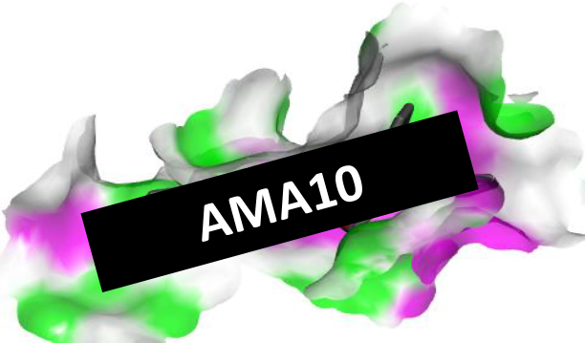
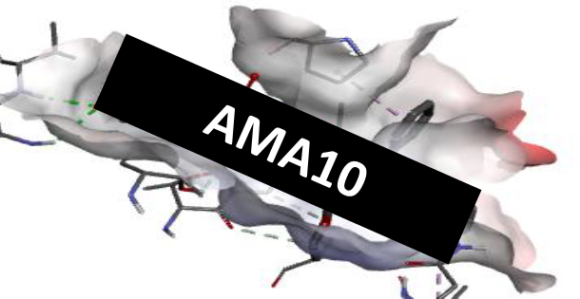
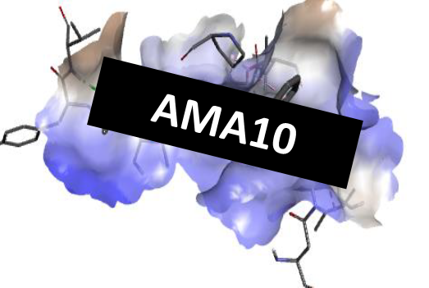
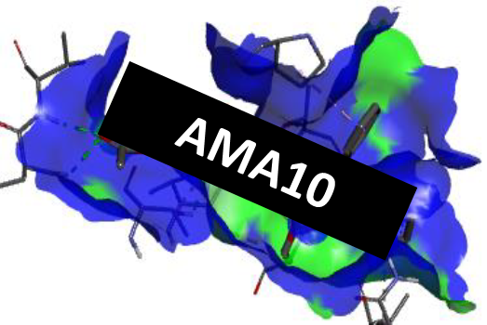
RESULTS OF COVALENT DOCKING
OF PBPs WITH AMA10
H-BONDS
ACIDITY /BASICITY
HYDROPHILIC/ HYDROPHOBIC
SOLVENT ACCESSIBILITY
Notes:
We have also studied how the different interactions are distributed into the active site of the different PBPs, and for each of them we obtained a representations of the areas in which the different interactions are more represented. In this slide I show an example of this analysis, showing the areas where there are h-bonds, in particular in green there are H-bonds acceptor residues, and in pink there are H-bond donors. Then, the areas where hydrophilic interactions are present are shown in blue, whereas the areas of hydrophobic interactions are represented in brown. As you can see, the active site is mainly hydrophilic with some hydrophobic areas that are clusterized near the pheny ring of AMA10, as discussed above. Then the areas with residues performing acid interactions are represented in red (no areas are present with basic residues).
Finally, we performed also an analysis of the solvent accessibility of the active site, in blue is represented the solvent accessible area which is consistently more pronounced than the area buried to solvent.

Slide 19
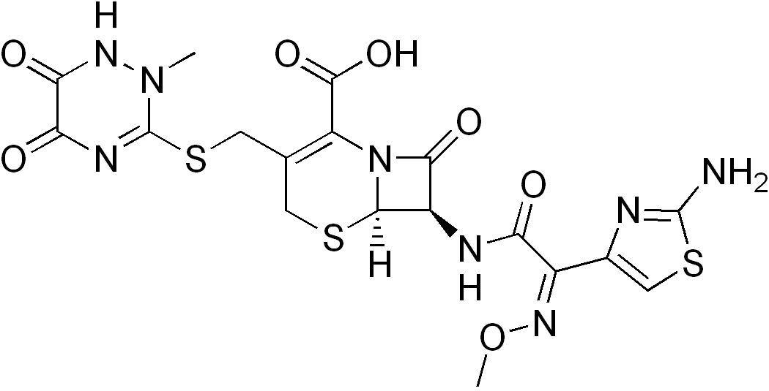
RESULTS OF COVALENT DOCKING
OF PBPs WITH CEFTRIAXONE
Third-generation cephalosporin, commonly used in clinics, active against Gram+ and Gram- selected organisms
PBP | SELECTED RUN | NUMBER OF POSES PER CLUSTER | TOTAL NUMBER OF CLUSTERS | PREDICTED ΔG (kcal/mol) | PREDICTED K_{i} (nM)
4BJP (PBP3, E. coli) | 12 27 | 5 12 | 31 | -12.55 -12.21 | 0.63 1.31
2EX8 (PBP4, E. coli) | 55 17 | 11 22 | 14 | -12.76 -11.77 | 0.44 2.36
2J9P (PBP4, B. subtilis) | 62 69 | 3 15 | 17 | -12.45 -10.85 | 0.74 11.08
1TVF (PBP4, S. aureus) | 45 98 | 17 20 | 22 | -12.22 -12.00 | 1.1 1.61
3VSL (PBP3, S. aureus) | 93 47 | 38 13 | 20 | -14.74 -14.38 | 0.015 0.028
3OCL (PBP3, P.aeruginosa) | 21 7 | 5 7 | 25 | -13.99 -13.30 | 0.05 0.17
Notes:
The same covalent docking procedure was applied also to simulate the interactions of ceftriaxone, the cephalosporin used during the experimental tests, selected as a reference because it is a third-generation compound diffused in clinics and with a wide spectrum of action against both Gram+ and Gram- organisms. The stereochemistry of this molecule is defined and there is only one beta lactam ring in its structure, therefore only 1 docking has been made for each protein (with the same settings selected for AMA10, obviously).
The results summarized in this table confirm that the predicted binding energy of ceftriaxone for the selected proteins is in the same range of amplitude as the one predicted for AMA10, and also in this case there are no significant differences between Gram+ and Gram- organisms, indicating that the insensitivity of Gram- organisms towards these compounds derives probably from the different composition of the cell wall that impairs the entrance of the antibiotic into the bacteria. Interestingly, the results are slightly more scattered, as indicated by the total number of clusters found for each protein and by the lower number of poses per cluster. This indicates that potentially AMA10 is superior to ceftriaxone in terms of stability of the complex formed with the target protein.

Slide 20
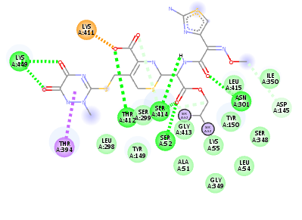

RESULTS OF COVALENT DOCKING
OF PBPs WITH CEFTRIAXONE
PBP | INTERACTING RESIDUES | INTERACTING ATOMS
4BJP | Lys310 Tyr514 Gly496 Thr497 | NH₃-OA, O4 OH-O1 Cα-O1 NH-NH1, O1
2EX8 | Ser420 Thr418 Asn308 | OH-O4 OH-O4 NH-O4
2J9P | Asn301 Ser414 Thr412 | NH₂,-O4 O-NH O-NH NH-O3 Cβ-beta-lactam ring
1TVF | Thr260 Lys70 | OH-O2 NH₃-O4, OH
3VSL | Thr621 Asn450 Thr619 Ser429 | OH, NH-O3 NH₂-O1 OH-S O-OD1 O-NH1
3OCL | Val333 Ser485 Thr487 Asn351 | Cβ-beta-lactam ring OH-O NH, OH-OD1 NH-OD1
Notes:
Also in the case of ceftriaxone, we performed a detailed investigation of the interactions between the antibiotic and the different PBPs. The result show that the interactions between the antibiotic and the active site of the enzymes are similar to those present in the complexes with AMA10, indicating that the latter is binding in a similar way with respect to known antibiotics, interacting more or less with the same residues. However, the number of interactions between ceftriaxone and active site residues is lower. In particular, the number of H-bonds between ceftriaxone and PBPs is less pronounced. Then, AMA10 is able to interact more specifically with PBPs considering that H-bonds are generally able to enhance the specificity of the interaction.

Slide 21
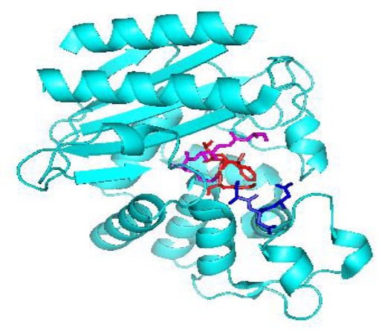
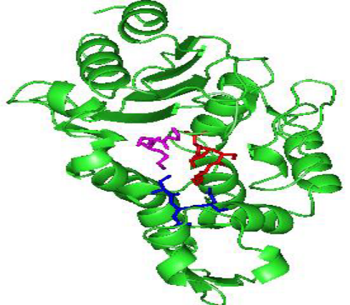
RESULTS OF COVALENT DOCKING
TOWARDS BETA LACTAMASES
LIGANDS | SELECTED RUN | NUMBER OF POSES PER CLUSTER | TOTAL NUMBER OF CLUSTERS | PREDICTED ΔG (kcal/mol) | PREDICTED K_{i} (n M)
AMA10_3R4S_A | 13 | 16 | 10 | -10.33 | 26.7
 | 60 | 36 |  | -9.75 | 71.89
AMA10_3R4S_B | 93 | 42 | 10 | -12.31 | 0.94
AMA10_3S4R_A | 100 | 55 | 10 | -10.64 | 15.98
AMA10_3S4R_B | 23 | 23 | 13 | -12.61 | 0.56
 | 66 | 31 |  | -12.60 | 0.57
CEF | 94 | 13 | 21 | -12.42 | 0.78
 | 16 | 30 |  | -12.33 | 0.92
3BLM: PC-1
1ZG4: TEM-1
LIGANDS | SELECTED RUN | NUMBER OF POSES PER CLUSTER | TOTAL NUMBER OF CLUSTERS | PREDICTED ΔG (kcal/mol) | PREDICTED K_{i} (n M)
AMA10_3R4S_A | 55 | 86 | 9 | -10.74 | 13.5
AMA10_3R4S_B | 42 | 65 | 6 | -12.11 | 1.32
AMA10_3S4R_A | 7 | 59 | 6 | -10.50 | 19.96
AMA10_3S4R_B | 77 | 51 | 9 | -13.50 | 0.126
CEF | 21 | 28 | 11 | -13.64 | 0.099
Notes:
In order to verify the interactions between AMA-10 and beta lactamases, two enzymes were selected, PC-1 which is a beta lactamase found in Gram+ bacteria, and TEM-1 which on the contrary is a beta lactamase typical of Gram- bacteria. Both selected lactamases belong to the class A, which means lactamases acting with a Ser-dependent mechanism of action analogous to the one of PBPs.
In this slide you can see first the results obtained for PC-1. Once again, 4 different simulations has been necessary for AMA10, because of the presence of its chiral centers and of the two different rings, whereas the last row refers to the results found for ceftriaxone which once again has been selected as a comparison. Once again it is possible to note that the B ring is more reactive than the ring A to the interaction with this enzyme, and that the order of magnitude for this molecule is more or less the same with respect to ceftriaxone.
The next results concerns the interaction with TEM-1. The result is very similar to the previous one, with a neat difference between the affinity of the two rings for the active site of the enzyme. On average however it is possible to note that the affinity of ceftriaxone towards the beta lactamases is slightly higher with respect to the one of AMA10, thus this molecule can become the lead compound of a new class of antibiotics more resistant to beta lactamases than the traditional ones.

Slide 22
CONCLUSIONS
AMA10 FORMS STABLE COMPLEXES WITH PBPs EITHER FROM GRAM + AND -
      POSSIBLE DIFFERENT ROLE OF THE TWO BETA LACTAM RINGS
AMA10
POSSIBLE DIFFERENT AFFINITY OF THE TWO DIASTEREOISOMERS 3R4S E 3S4R OF AMA10
IDENTIFICATION OF CRUCIAL INTERACTIONS BETWEEN AMA10 AND THE PBPs/BETA LACTAMASE ACTIVE SITE
STARTING POINT TO PLAN RATIONAL MODIFICATIONS IN ORDER TO CREATE A NEW CLASS OF ANTIBIOTICS MORE SPECIFIC AND/OR MORE EFFECTIVE TOWARDS DIFFERENT BACTERIA AND TO ENCOMPASS RESISTANCE
Notes:
In conclusion, I have presented here AMA10, a new antibiotic compound able to form stable complexes with either PBPs from Gram+ and Gram- bacteria, therefore the causes for its inactivity towards Gram- bacteria are probably due to its inhability to cross the external membrane of Gram- organisms and to interact with peptidoglycan. The additional ring of this compound has indeed a different affinity with respect to the traditional beta lactam ring of the 7-aminocephalosporanic acid, and the two phenyl rings present could be functionalized in order to modulate such activity. There are also differences between the predicted affinities of the two diastereoisomers, especially when the enzyme has different activities, and therefore also this should be taken into account to modulate, for example, the specificity towards a particular enzyme. Finally, we were able to identify crucial interactions between the PBPs active site and AMA10, and this would be the starting point to plan rational modifications in order to create a new class of antibiotics more specific and/or more effective towards different bacteria and to encompass resistance.

Slide 23

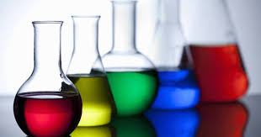
ACKNOWLEDGMENTS
Dr. Anna VERDINO
Prof. Annunziata SORIENTE
Dr. Margherita DE ROSA
Prof. Manuela HELMER-CITTERICH
Dr. Luciano MILANESI
Notes:
At the end of my talk I would like to thank my colleagues in the Department of Chemistry and Biology of the University of Salerno, in particular Dr. Anna Verdino who performed the computational work, and Prof. Soriente and De Rosa who synthesized AMA10. I would also like to thank Dr. Amit Dubey, which was a visiting Ph.D student in the Institute of Food Science in Avellino, an institution with which I have a long time collaboration: Dr. Dubey has assisted us in the use of the analysis tools of Discovery Studio. Last but not least, I would like to thank the Bioinformatics Italian Society, which also patrocinates this conference, and in particular the former president prof. Manuela Helmer Citterich for her support during last months, and the present President Dr Luciano Milanesi, for supporting my visit here…

Slide 24

Thank you for your attention!
Notes:
…and obviously thank you all for your kind attention.

