Slide 1
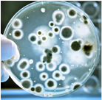
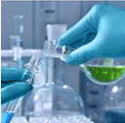
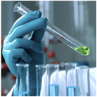
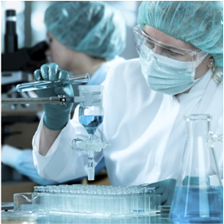
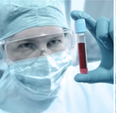


Lyme Disease
New Non-Synthetic Agent Challenging Active and Persistent Forms of Borrelia sp.
Anna Goc, Ph.D.
May 2016

Slide 2
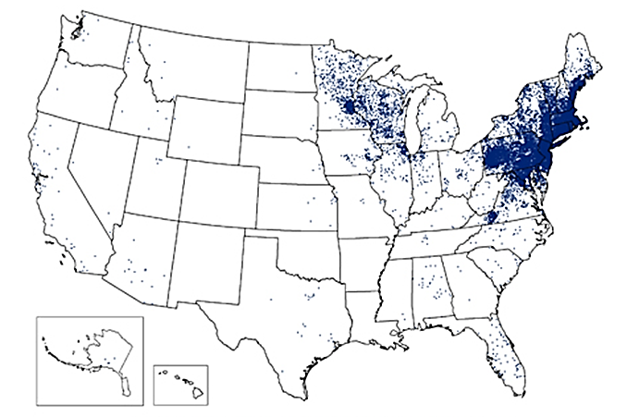
What is Lyme Disease
♦ Bacterial infection
♦ Systemic zoonosis
♦ Transmitted by ticks
♦ Limited treatment options

Slide 3
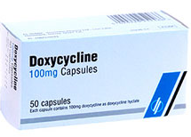
Therapy
CONVENTIONAL TREATMENTS
ALTERNATIVE TREATMENTS
♦ Oral and intravenous antibiotics
♦ Lack of sufficient efficacy when applied at later stages of LD and when administarted long-term
♦ Plant extracts, oils, enzymes, vitamins are applied to alleviate some symptoms of LD
♦ Largely used as individual components mimicking the pharmaceutical drugs approach
♦ Clinical efficacy varies

Slide 4
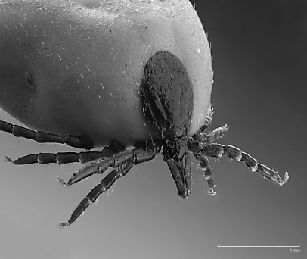
Borrelia sp. is a Causative Pathogen
♦ Borrelia burgdorferi sensu lato (14 species)
♦ Most common species causing this disease:
  ♦ Borrelia burgdorferi s.s (predominant in the USA) – arthritis
  ♦ Borrelia afzelii (predominant in Europe and Asia) – skin disorders
  ♦ Borrelia garinii (predominant in Europe and Asia) – neuroboreliosis
♦ All species are:
♦ host-dependent ♦ invasive ♦ non-toxicogenic
♦ micro-aerophilic ♦ slow-growing ♦ motile

Slide 5
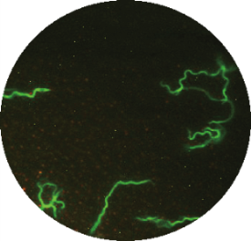
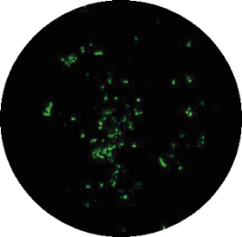
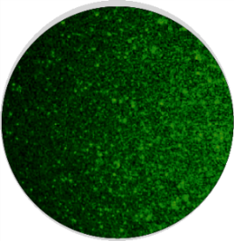
Morphological Diversity
All forms are capable of producing injury in the human host
♦ Active form (vegetative form) - very mobile, allows penetration into dense tissue and bone, capable of intracellular infection, rapidly converts to dormant forms
- Spirochetes
Spirochetes
♦ Dormant forms (latent forms) - survive antibiotics, starvation, pH changes, hydrogen peroxide, temperature variation, and most other adverse conditions
- Rounded forms
- Biofilm
Rounded forms
Biofilm

Slide 6



Methodology
Approach Taken in the Study
Research Platform
Selection
Screening
Testing
Interactions
♦ Natural sources
- Plants
- Herbs
- Spices
♦ Spirochetes
♦ RF
♦ Biofilm
♦ Efficacy
- Single
- Mix
♦ Reciprocity
♦ Side effects

Slide 7
Screened Compounds against Borrelia sp.
Polyphenols
Vitamins
Fatty acids
Plant extracts
Natural Agents
Enzymes
Others
Amino acids
Concentrations: 0.0005-1000 μg/ml; 1-50 x dilution

Slide 8
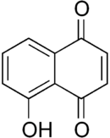
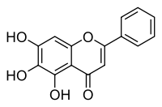
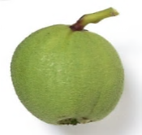
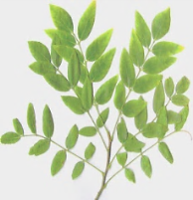
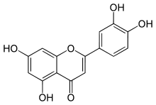
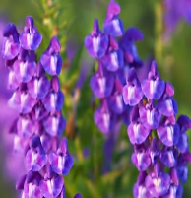
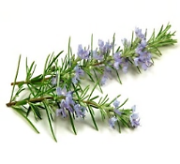

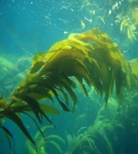

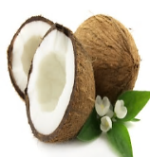
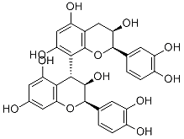
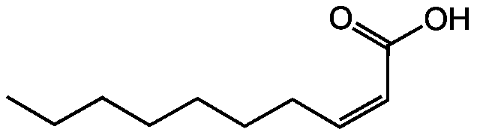
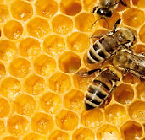
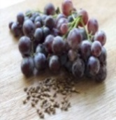
Most Effective Compounds against Borrelia sp.
Juglon
MIC= 100 μg/ml
MBC= 125 μg/ml
Luteolin
MIC= 125μg/ml
MBC= 250 μg/ml
Baicalein
MIC= 150 μg/ml
MBC= 250 μg/ml
Rosmarinic acid
MIC= 150 μg/ml
MBC= 250 μg/ml
Monolaurin
MIC= 100 μg/ml
MBC= 250 μg/ml
Proanthocyanidins
MIC= 100 μg/ml
MBC= 100 μg/ml
Iodine
(kelp)
MIC= 5 μg/ml
MBC= 15 μg/ml
10-HAD
MIC= 125 μg/ml
MBC= 250 μg/ml

Slide 9
Reciprocity with Doxycycline against Spirochetes
Tested combinations | Reciprocity with DOX
 | Spirochetes
 | FICI | FBCI
Baicalein+DOX | A | A
Luteolin+DOX | A | A
Monolaurin+DOX | I | I
10-HAD+DOX | I | I
RA+DOX | A | A
Iodine+DOX | A | A
Juglon+DOX | A | A
Grape seed+DOX | A | A
Control
Live spirochetes
(% of control)
DOX+PH
Dose of DOX:
MIC=12.5 µg/ml = 50%
MBC₉₀=100 µg/ml = 50%
Time (H)

Slide 10
Reciprocity with Doxycycline against Rounded Forms
Tested combinations | Reciprocity with DOX
 | Rounded forms
 | FBCI
Baicalein+DOX | A
Luteolin+DOX | A
Monolaurin+DOX | I
10-HAD+DOX | I
RA+DOX | I
Iodine+DOX | I
Juglon+DOX | A
Grape seed+DOX | A
Dead rounded forms
(% of control)
DOX+PH
5 x
DOX
Dose of DOX:
MBC₅₀=NS = 50 %
Control
Time (H)

Slide 11
Reciprocity with Doxycycline against Biofilm
Tested combinations | Reciprocity with DOX
 | Biofilm
 | FECI
Baicalein+DOX | A
Luteolin+DOX | A
Monolaurin+DOX | I
10-HAD+DOX | I
RA+DOX | I
Iodine+DOX | A
Juglon+DOX | I
Grape seed+DOX | I
DOX + Phytochemical
Remaining biofilm
(% of control)
DOX
RA
Control
Luteolin
Iodine
Juglon
Dose of DOX:
EC₅₀=125 µg/ml = 50%
Baicalein
Cis-2-decenoic
acid
Grape seed
Monolaurin

Slide 12
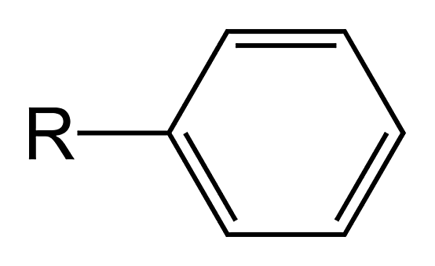
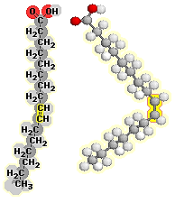
Conclusion
♦ Selected phytochemicals and micronutrients affect active and/or latent forms of the Borrelia sp.
♦ The presence of fatty acids and phenyl groups in the natural molecules appears to be important for the pleiotropic anti-borreliae efficacy
♦ All tested phytochemicals enhanced and extended anti-borreliea efficacy of doxycycline

Slide 13

Thank you

