Slide 1
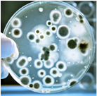
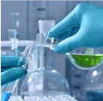
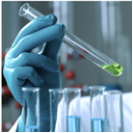
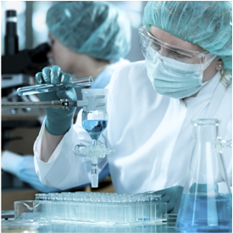
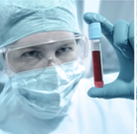


Lyme disease
Novel Composition of Phytochemicals as an Approach against Lyme Disease
Anna Goc Ph.D.
May 2016

Slide 2
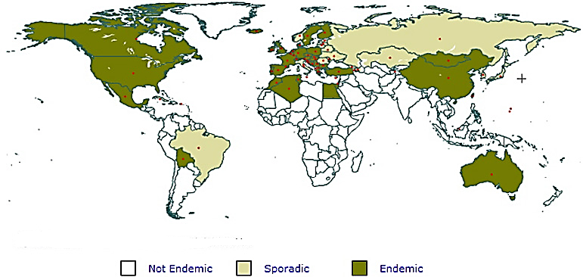
Lyme Disease
♦ Most-common vector born disease
♦ Infection transmitted by ticks
♦ Ticks transmit bacteria of genus Borrelia

Slide 3
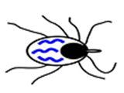


How Borrelia sp. are Transmitted
Uninfected with Borrelia sp. tick (or its life cycle form) feeds on an infectious vertebrate
Migration -> into tick
Replication -> midgut
Migration -> salivary glands
Biting and releasing -> blood
Colonization -> host’s skin
Moving -> other tissues/organs
Colonization -> other organs, ECM

Slide 4
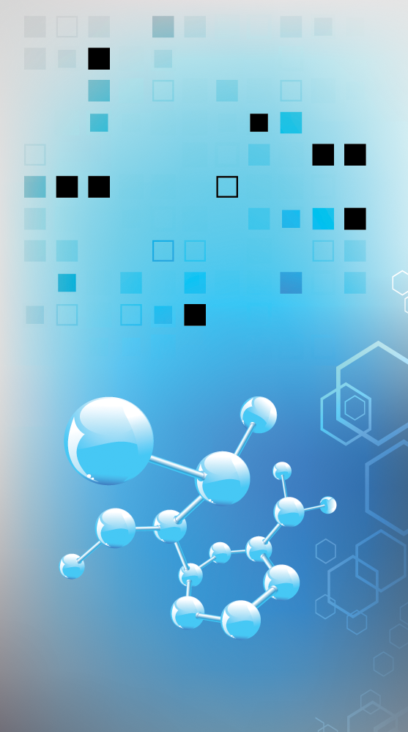
Methodology
Screening
in vitro
Testing
in vitro and in vivo
Studying of Cooperation
in vitro and in vivo

Slide 5
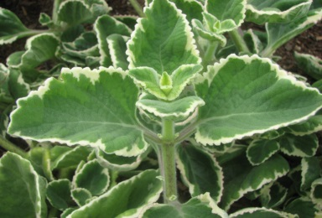
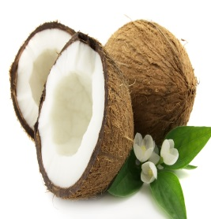
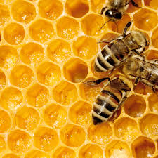
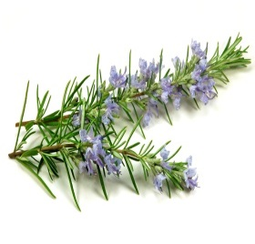
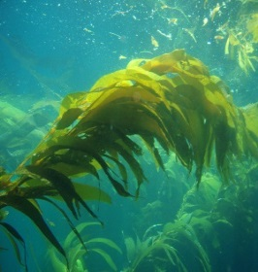
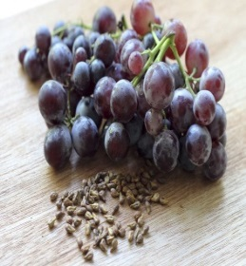
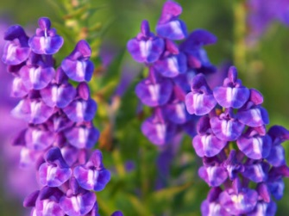
Selected Compounds against Borrelia sp.
10-Hydroxy-Cis-2-decenoic acid
Monolaurin
Iodine/Kelp
Baiclein
Luteolin
Juglone
Proanthocyanidins/Grape seed
Rosmarinic acid

Slide 6
Reciprocity of Phytochemicals against Borrelia sp.
Synergy:
spirochetes: 5 combinations
RF: 3 combinations
biofilm: none
Tested combinations | Reciprocity of Phytochemicals
 | Spirochetes |  | Rounded forms | Biofilm
 | FICI | FBCI | FBCI | FECI
Baicalein+Luteolin | S | S | A | A
Baicalein+RA | A | A | A | I
Luteolin+RA | A | A | A | I
Juglon+RA | A | A | A | I
Juglon+Iodine | S | S | S | I
Juglon+Grape seed | S | S | S | I
Iodine+Grape seed | S | S | S | I
10-HAD+Monolaurin | S | S | I | A
Additive effect:
spirochetes: 3 combinations
RF: 4 combinations
biofilm: 2 combinations
Indifference:
spirochetes: none
RF: 2 combinations
biofilm: 6 combinations
S – synergy, A – additive, I - indifference

Slide 7
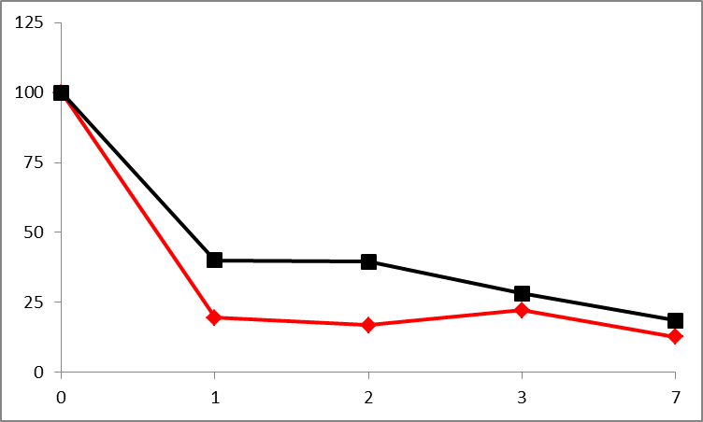
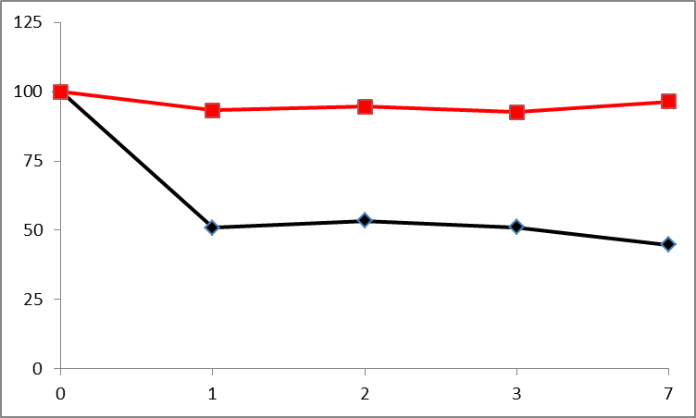
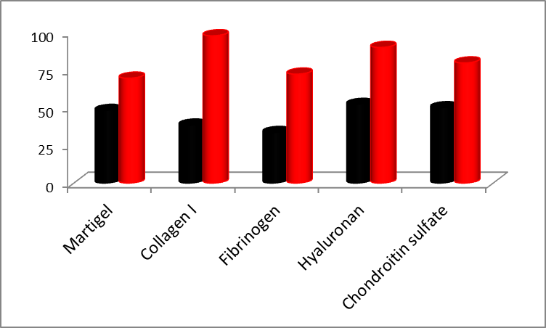
Effects of Defined Mix in vitro
MIX
Antibiotic
Remaining spirochetes
(% of Control)
Remaining rounded forms
(% of Control)
Remaining biofilm
(% of Control)
Time (Days)
Time (Days)
Defined Mix displays similar efficacy to doxycycline in eliminating spirochetes
Defined Mix is more effective (~5-8 X) than doxycycline in killing rounded forms
Defined Mix is more effective (~2-5 X) than doxycycline eliminating biofilm

Slide 8
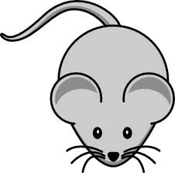
Tested of Defined Mix in Animal Model
0 2 weeks
1 month
Injection: pathogen
Injection: Mix O
Sampling
End points:
→ Efficacy
→ Toxicity
WT
LD
WT
+
Mix O
LD
→ WT = Control/Healthy not treated → WT+T = Control/Healthy treated
→ LD = Lyme Disease/Sick not treated → LD+T = Lyme Disease/Sick treated

Slide 9

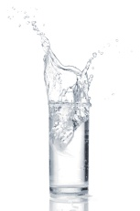
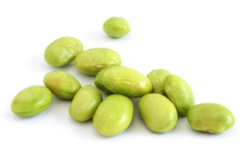
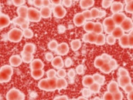
Clinical Parameters
Weight = No change
Food/Water = No change
Morphology
WBC Neutrophils | RBC Monocytes | HGB Eosinophils | HCT Basophils | MCV Lymphocytes | MCH/MVHC Platelets
→ WT, WT+T, LD+T = No change → LD = Elevated level of monocytes

Slide 10
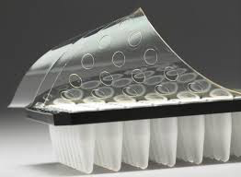
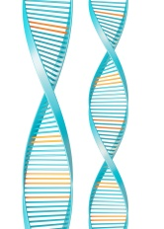
Pathogen Detection
Skin | Bladder | Kidney | Liver | Spleen | Joint | Heart
→ WT, WT+T = No presence → LD = Presence → LD+T = Presence reduced to 90%

Slide 11

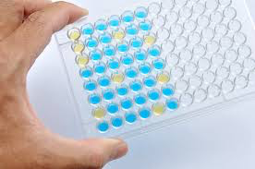
Toxicity
Clusterin | KIM-1 | RPA-1 | Haptoglobin
Fibrinogen | GGT | Creatine Kinase | SDH | Creatinine
→ WT, WT+T, LD+T = No change

Slide 12
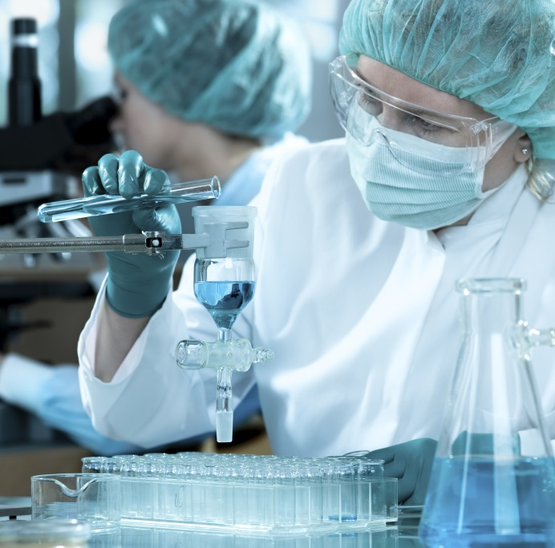
Conclusions
♦ Tested combinations of polyphenols and fatty acids revealed synergistic or additive effects against active and/or dormant forms Borrelia sp.
♦ Tested define mixture of polyphenols and fatty acids were effective anti-spirochetal agents in LD animal model
♦ Tested define mixture of polyphenols and
fatty acids did not display toxic effects in LD
animal model

Slide 13

Thank you

