Slide 1

Gastrointestinal Dysfunction in Postural Tachycardia Syndrome
Anna DePold Hohler, MD, AAN
Associate Professor of Neurology
Boston University School of Medicine

Slide 2
Objectives
Overview of Autonomic System
PoTS:
  History
  Pathophysiology
  BU survey data - symptoms
GI dysfunction in POTS
Treatment and Management

Slide 3
Overview of Autonomic System
Central autonomic nervous system
Peripheral autonomic nervous system
Sympathetic and parasympathetic innervation
  smooth muscle, cardiac muscle, and glands
Regulates heart rate, blood pressure, digestion, urination, sexual function

Slide 4
Normal Physiology
gravitational pooling of blood from the thorax into lower extremities
results in a decrease of blood return to the heart → decreased stroke volume and cardiac output
monitored by baroreceptors in carotid sinus and aortic arch
increases in HR, contractility, and peripheral resistance → maintain MAP and CBF
Iwase et al, Front Physiol., 2014

Slide 5
Normal Physiology
Arterial wall stretch → stimulation of baroreceptors → CN IX and X → nucleus tractus solitarius in medulla
Involvement of both glutamatergic and GABA-ergic neurons to transmit signals from caudal to rostral medulla
Exit spinal cord
NTS → Dorsal motor nucleus of vagus and nucleus ambiguus → CN X → heart, vessels
Iwase et al, Front Physiol., 2014

Slide 6
Sympathetic pathway
cardiac sympathetic activity and the activity of muscle sympathetic nerves
Innervation of skeletal muscles
When BP rises: vagus nerve (parasympathetics) is activated
When BP is low: suppresses vagus nerve activity
Notes:
From increase in HR etc → maintains arterial BP and cerebral blood flow

Slide 7
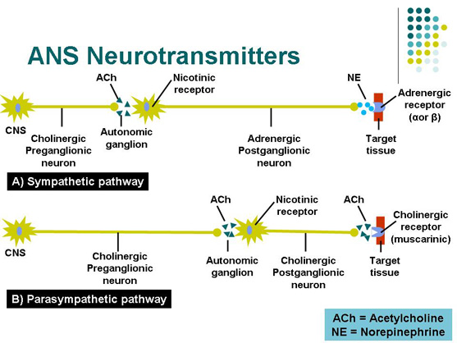
http://accessphysiotherapy.mhmedical.com/data/Multimedia/grandRounds/motorpathways/media/motorpathways_print.html

Slide 8
Sympathetic v. Parasympathetic
Sympathetic system:
  “Fight or flight:” emergencies, exercise
  Long post-ganglionic fibers
  Highly branched
  Multi-organ innervation
Parasympathetic system:
  “Rest and digest:” conserving energy
  Short post-ganglionic fibers
  Few branches
  Localized effect

Slide 9
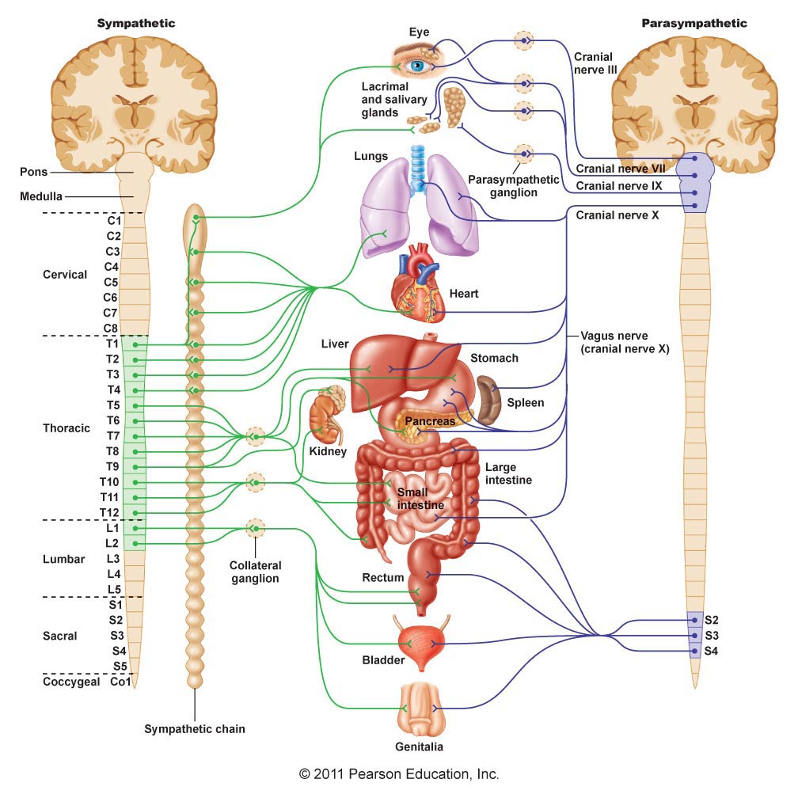
http://droualb.faculty.mjc.edu

Slide 10
Postural Orthostatic Tachycardia Syndrome (PoTS)
Typically young females ages 15-40
Adults: increase in heart rate of 30 beats per minute (bpm) or more within 10 minutes of head-up tilt or standing or HR >120 beats
Children: increase in heart rate of 40 beats or more within 10 minutes of standing
Orthostatic intolerance without orthostatic hypotension

Slide 11
History of PoTS
1871- described by Jacob Mendes Da Costa
  American Civil War- irritable heart syndrome
First World War- Sir Thomas Lewis
  “soldier’s heart”
1941- Paul Wood
  Da Costa Syndrome (anxiety neurosis)
  Implying non-organic component
Postural tachycardia syndrome” coined in 1982 by Rosen and Cryer. Patient with postural tachycardia without orthostatic hypotension
Estimated prevalence is 170/100,000
Mathias et al, Nat. Rev. Neurol., 2012

Slide 12
Autonomic Symptoms
Dizziness
Lightheadedness
Palpitations
Syncope
Fatigue, headaches, nausea, distention, abdominal pain, constipation or irritable bowel syndrome, urinary retention, skin changes, sleep changes

Slide 13
Triggers and exacerbating factors
Febrile illness, trauma or surgery
Food (large quantities)
Alcohol
Exercise
Heat
Menstrual period
Medications that cause vasodilation
Mathias et al, Nat. Rev. Neurol., 2012

Slide 14
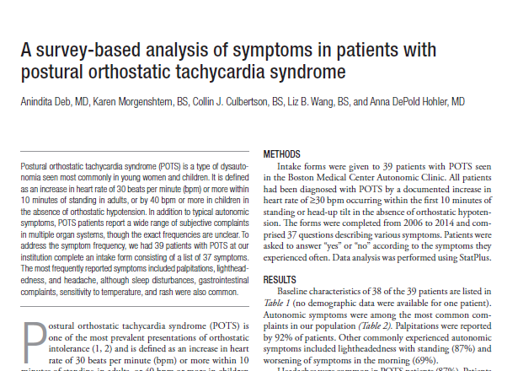

Slide 15
Postural Orthostatic Tachycardia Syndrome (PoTS) and its associated symptoms
Prospective qualitative survey with 37 questions
80 patients with autonomic dysfunction
40 patients with PoTS
diagnosed based on symptoms of orthostatic intolerance accompanied by a HR rise ≥30 beats per minute which occurred within the first 10 min of upright posture

Slide 16
Results
Autonomic symptoms:
87.2% lightheadedness with standing
69.2% worsening symptoms in the morning
Gastrointestinal dysfunction:
Irritable bowel symptoms 46%
Swallowing difficulty 41%

Slide 17
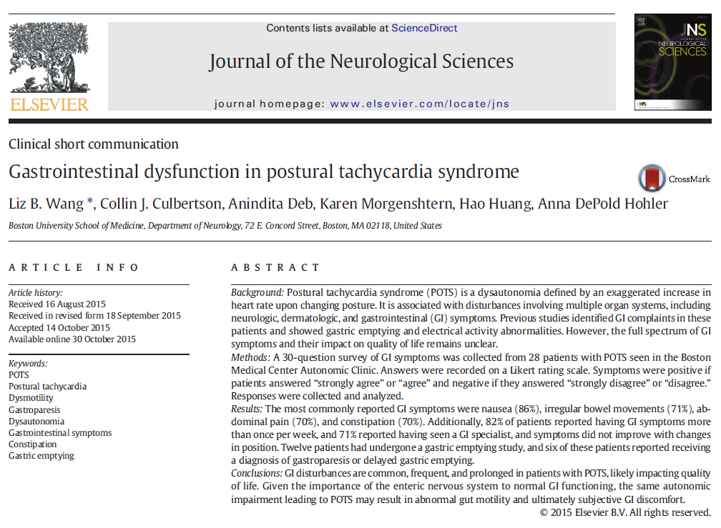

Slide 18
GI dysfunction in POTS
A 30-question survey of GI symptoms was collected from 28 patients with POTS seen in the Boston Medical Center Autonomic Clinic. Answers were recorded on a Likert rating scale. Symptoms were positive if patients answered “strongly agree” or “agree” and negative if they answered “strongly disagree” or “disagree.” Responses were collected and analyzed.
Results: The most commonly reported GI symptoms were nausea (86%), irregular bowel movements (71%), abdominal pain (70%), and constipation (70%). Additionally, 82% of patients reported having GI symptoms more than once per week, and 71% reported having seen a GI specialist, and symptoms did not improve with changes in position. Twelve patients had undergone a gastric emptying study, and six of these patients reported receiving a diagnosis of gastroparesis or delayed gastric emptying.
Conclusions: GI disturbances are common, frequent, and prolonged in patients with POTS, likely impacting quality of life. Given the importance of the enteric nervous system to normal GI functioning, the same autonomic impairment leading to POTS may result in abnormal gut motility and ultimately subjective GI discomfort.

Slide 19
GI symptoms
Nausea, bloating, constipation, abdominal pain
Change in electrical activity of the stomach in upright positioning
Increased and decreased gastric emptying has been noted as well
Irritable bowel syndrome and functional dyspepsia
Park et al, Clin. Auton. Res., 2013
Safder et al, Pediatr. Gastroenterol. Nutr., 2010
Seligman et al, Clin. Auton. Res., 2013

Slide 20
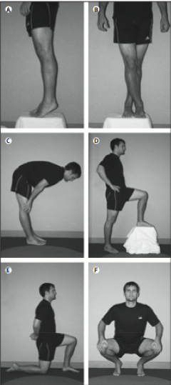
Conservative measures
Hydration: 80-100 oz/day
High salt diet (300 mEq/d)
Small, frequent meals
Tomato juice, salt tabs
HOB elevation
Regular exercise
Physical maneuvers
Compression stockings
Abdominal binder

Slide 21
Dietary Modifications
Small frequent meals
Easily digestible, no raw fruits and veggies unless juiced
Slow cooked vegetables and meats
Hydration with foods
Low lactose and low gluten diet
High B12, Iron, Vitamin D diet (multivitamin if needed)
For gut shut down- soft solids

Slide 22
GI dysfunction and autonomic instability
Ineffective motility appears to impact nutrient absorption.
In our patient population, individuals with lower gastric motility also had more frequent dehydration, vitamin deficiencies, and worse POTS symptoms.
Optimization of gut function is our priority in improving autonomic stability and optimizing absorption of medications.

Slide 23
Fludrocortisone (Florinef)
Mineralocorticoid, α-1 agonist
  expands intravascular volume, reduces salt loss
  Dose 0.1-0.5mg/d
Risk of:
  volume overload
  hypokalemia or hypomagnesemia
Additional side effects: headache, edema, weight gain, and supine hypertension
Robertson et al., Neurology,1995

Slide 24
Midodrine (ProAmatine)
Peripheral α-1 agonist
  Vasoconstriction
  Dose: 2.5-15mg (morning, noon, afternoon)
Common Side Effects: pupillary dilation, piloerection, paresthesias, and pruritus
Supine hypertension (avoid bedtime dosing)
Low et al., JAMA, 1997
Notes:
-Bisoprolol- B-2 receptor blocker, prevents vasodilation and tachycardia but can worsen OH
-octreotide- in small doses, peptide release inhibitor, somatostatin analog- prevents postprandial tachycardia
-ivabradine- selective sinus node blockade- reduces tachycardia
-clonidine- central sympatholytic- lowers BP if elevated and reduces tachy

Slide 25
Pyrodostigmine (Mestinon)
Acetylcholinesterase inhibitor
  Dose: 60mg TID
Significantly improves standing BP in patients with OH
Does NOT worsen supine hypertension
Effective alone or in combination with midodrine
Side effects: Diarrhea, salivation, nausea, vomiting, muscle cramps, fasciculations
Singer et al., J Neurol Neurosurg Psychiatry, 2003
Singer et al., Arch Neurol, 2006
Notes:
Non-FDA approved therapies:
Droxidopa (NE prodrug) Small randomized, double-blind, placebo-controlled study in pts w/ MSA & PAF showed attenuation of post-prandial blood pressure fall w/o HR response after administration of 1000mg (Freeman, 1996) **trend towards supine hypertension
Another randomized, double-blind, cross-over study of 10 patients (6 w/ MSA) treated w/1000mg droxidopa showed increased supine & tilted SBPs and **increased plasma NE levels (Freeman, 1999)
Phase III trial of 100-600mg TID droxidopa over 8 weeks showed improvement in orthostatic change in BP, symptoms of lightheadedness, and most notably 50% reduction in falls reported on the OHQ (Hauser, 2013)
Improvement in orthostatic tolerance has also been reported in a dose dependent manner in MSA (100-2000mg) (Mathias, 2001; Kaufman, 2003)
Yohimbine:
α-2 adrenoreceptor antagonist: raises plasma norepinephrine and blood pressure
Side effects: confusion, increase in heart rate, headache, or tremor

Slide 26
Droxidopa
Droxidopa (NE prodrug) Phase III trial of 100-600mg TID droxidopa over 8 weeks showed improvement in orthostatic change in BP, symptoms of lightheadedness, and most notably 50% reduction in falls reported on the OHQ (Hauser, 2013)
Improvement in orthostatic tolerance has also been reported in a dose dependent manner in MSA (100-2000mg) (Mathias, 2001; Kaufman, 2003)

Slide 27
Yohimbine
α-2 adrenoreceptor antagonist: raises plasma norepinephrine and blood pressure
Side effects: confusion, increase in heart rate, headache, or tremor

Slide 28

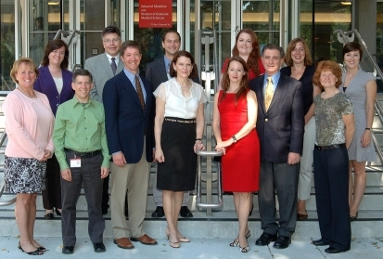
Boston University Movement Disorders Group

Slide 29
References
Iwase S, Nishimura N, Mano T. Role of sympathetic nerve activity in the process of fainting. Front Physiol. 2014; 5: 343.
Low PA, Gilden JL, Freeman R, Sheng KN, McElligott MA. Efficacy of midodrine vs placebo in neurogenic orthostatic hypotension. A randomized, double-blind multicenter study. Midodrine Study Group. JAMA 1997;277:1046-51.
Mathias C, Low D, Iodice V, Owens A, Kirbis M, Grahame R. Postural tachycardia syndrome- current experience and concepts. Nature Rev. Neurol., 2012; 8: 22-34.
Park KJ, Singer W, Sletten DM, Low PA, Bharucha AE. Gastric emptying in postural tachycardia syndrome: a preliminary report. ClinAuton Res. 2013;23(4):163-167.
Robertson D, Davis TL. Recent advances in the treatment of orthostatic hypotension. Neurology 1995;45(5):S26-32.
Safder S, Chelimsky TC, O’Riordan MA, Chelimsky G. Gastric electrical activity becomes abnormal in the upright position in patients with postural tachycardia syndrome. J PediatrGastroenterolNutr. 2010;51(3):314-318.
Seligman WH, Low DA, Asahina M, Mathias CJ. Abnormal gastric myoelectrical activity in postural tachycardia syndrome. ClinAuton Res. 2013;23(2):73-80.
Singer W, Opfer-Gehrking TL, McPhee BR, Hilz MJ, Bharucha AE, Low PA. Acetylcholinesterase inhibition: a novel approach in the treatment of neurogenic orthostatic hypotension. J Neurol Neurosurg Psychiatry 2003; 74: 1294–98.
Singer W, Sandroni P, Tonette L, et al. Pyridostigmine Treatment Trial in Neurogenic Orthostatic Hypotension. Arch Neurol 2006;63:513-518.

Slide 30
Thank you!!

