Slide 1


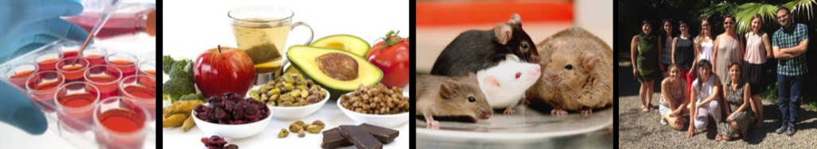
The effects of flavanols on the enteroendocrine system: Proanthocyanidins on food intake
Montserrat Pinent, Joan Serrano, Àngela Casanova-Martí, Katherine Gil-Cardoso, M Teresa Blay, Ximena Terra, and Anna Ardévol ( anna.ardevol@urv.cat)
MoBioFood Research Group. Departament de Bioquímica i Biotecnologia, Universitat Rovira i Virgili.
Tarragona, Spain.

Slide 2

The problem addressed is:

Slide 3
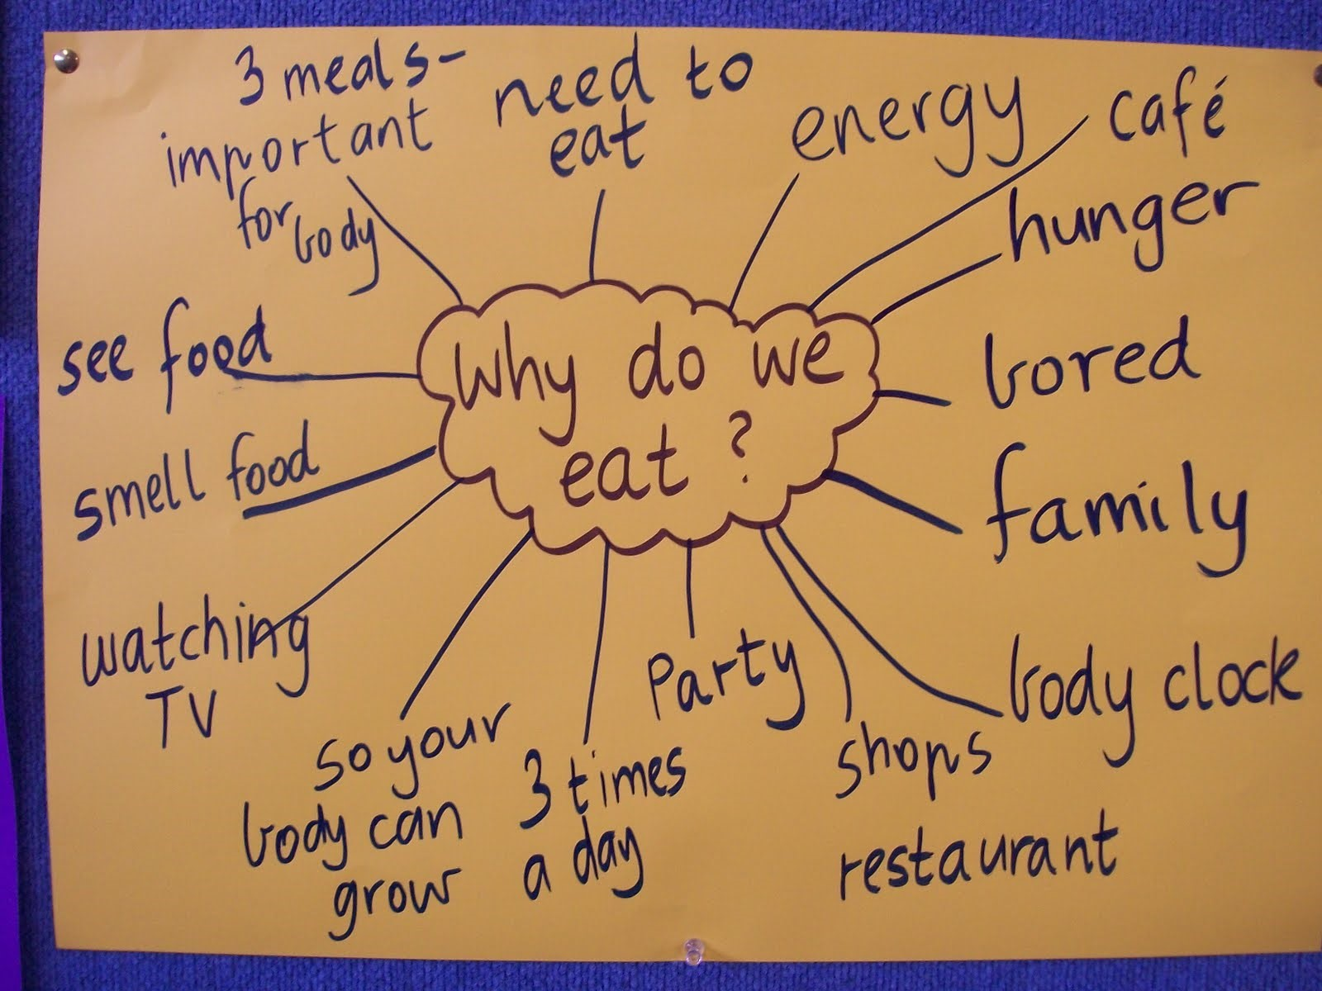

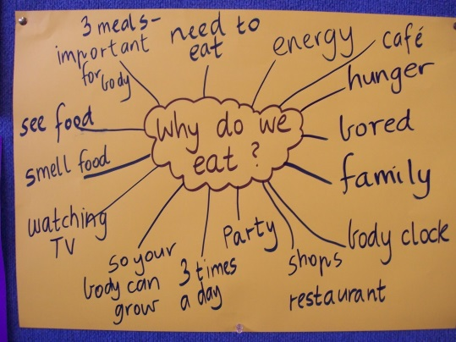

Notes:
AQUÍ RECORDAR QUE NO TENIM UN EXCÉS O MASSA ABUNDANCIA DE OFERTA, SINÓ UNA OFERTA EXTENSA I ATRACTIVA (DE FET, FETA PER IMPULSAR LA COMPRA)

Slide 4
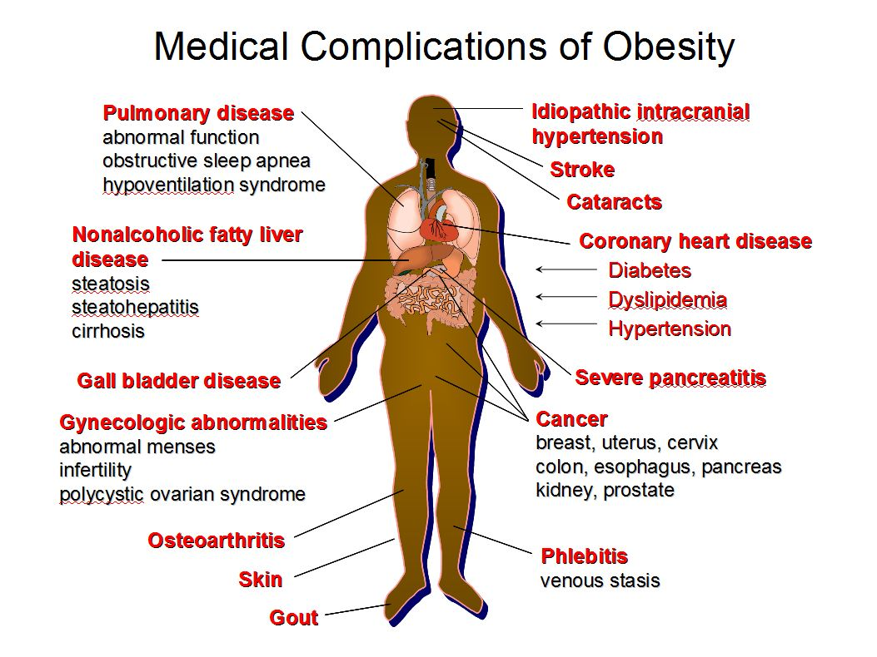
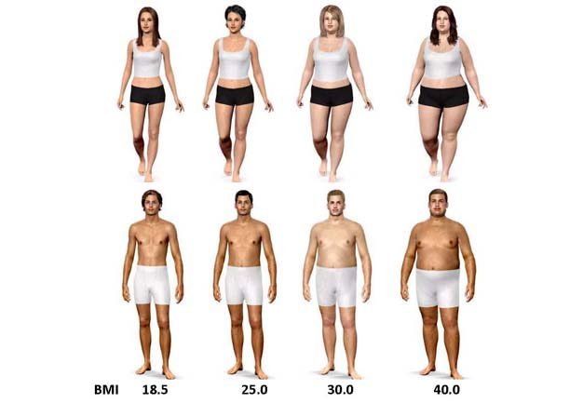
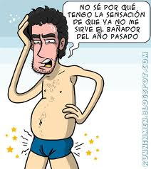

Slide 5
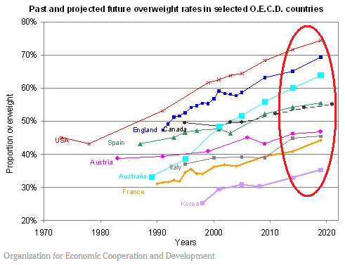
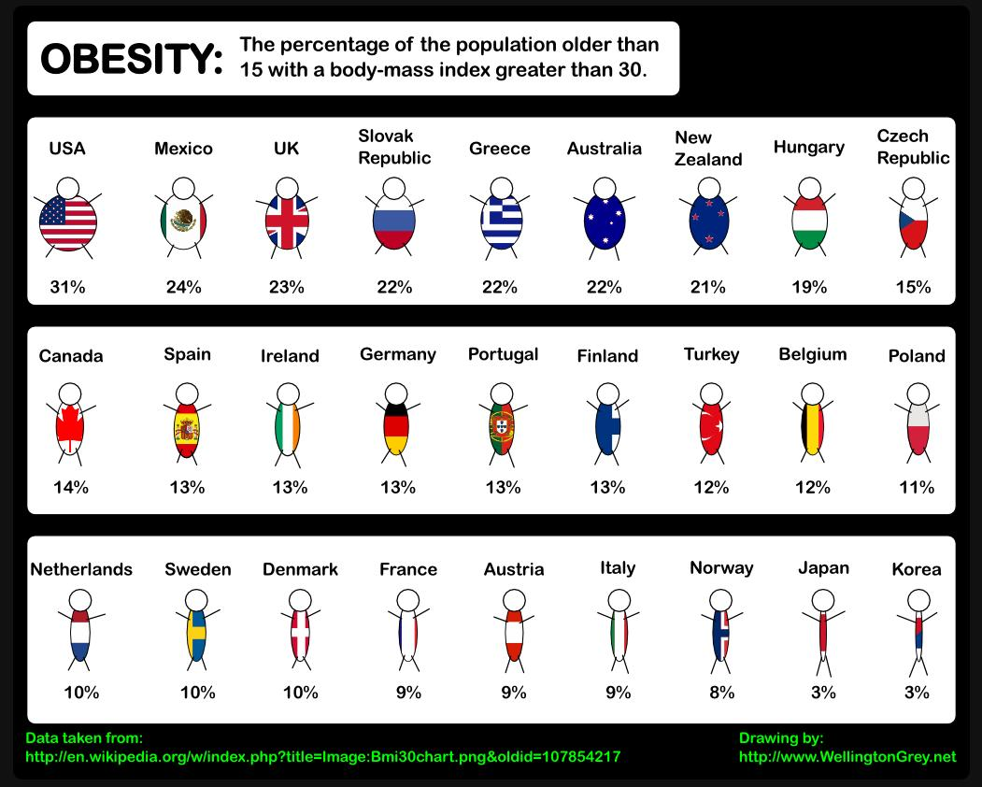

Slide 6

The USA and UK estimate that 40-50% of pets “exceed their ideal body condition.”

Slide 7
Our proposal is:
Decreasing energy intake to help control body weight
Approaching a market interested in maintaining the feeling of satiety to help curb energy intake

Slide 8
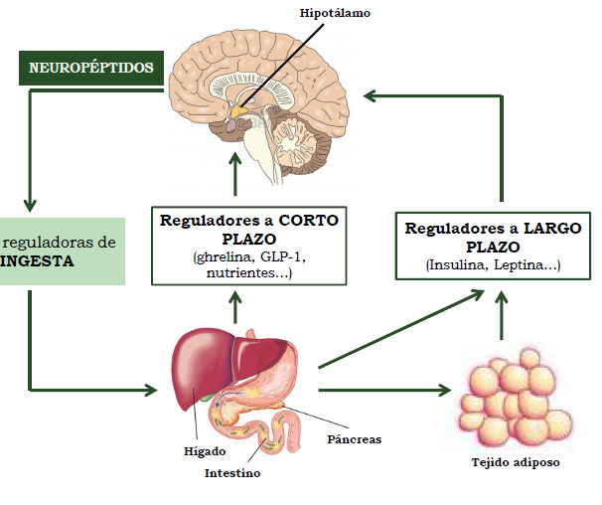
Food intake control
hypothalamus
NEUROPEPTIDES
FOOD INTAKE signalling
SHORT-TERM control
(ghrelin, GLP-1, nutrients, etc.)
LONG-TERM control
(insulin, leptin, etc.)
liver
pancreas
intestine
Adipose tissue

Slide 9
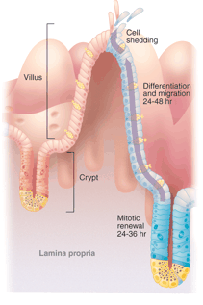

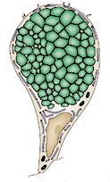
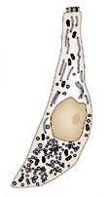
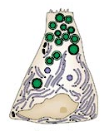
Enteroendocrine cells
Enterocyte
Goblet cell
Enteroendocrine
cell
Largest endocrine organ
Paneth cell
Notes:
Incretins are mainly released by the intestinal endocrine cells or enteroendocrine cells.
To give you a general idea, the intestine has a unique architecture that consists in villus and crypt structures. Within the villus reside several epithelial cell types: the enterocytes, the Goblet cells and the enteroendocrine cells, and in the crypts we can found stem cells and the Paneth cells.
Specifically, the enteroendocrine cells are scattered along the intestine as individuals, and, although they comprise only the 1% of the total intestinal epithelium, they are considered as the largest endocrine organ in the body.

Slide 10
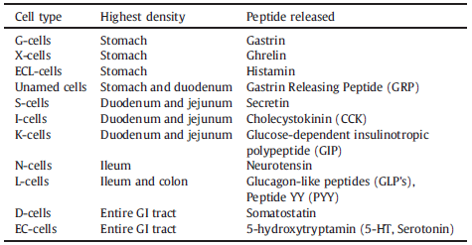
Enteroendocrine cells
CLOSED
Epithelial localization
OPEN
Morphology, hormone product(s), distribution
Steinert R.E. and Beglinger C. (2011) Physiol Behav
Notes:
These enteroendocrine cells could be classified, in one hand, according to their epithelial localization, finding the closed and the open types. On the other hand, they could be also classified according to their morphology, hormone products and distribution along de intestine, finding , at least, 10 types and being the most studied the I-, K-, and L-cells.
Regarding to the L-cells, they are open type enteroendocrine cells and, although they are present along all the intestinal epithelium, they are predominantly found in ileum and colon, and their main hormone products are glucagon-like peptides such as GLP-1 and peptide YY (PYY).

Slide 11
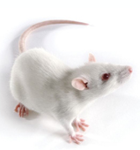
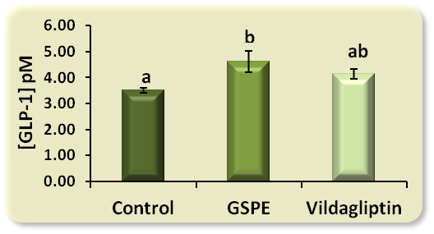
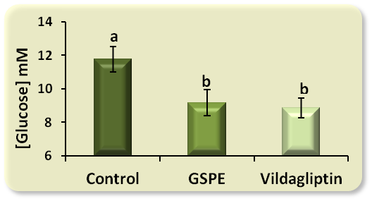
GSPE or vildagliptin
2 g glucose/kg bw
40 min
20 min
Active GLP-1
Glucose
Tail blood
Blood
Notes:
Our second approach was to analyze whether GSPE increases active GLP-1 levels. To do so, healthy wistar rats were orally treated with 1 g of GSPE/kg bw or water (that was de vehicle). Vildagliptin is commercial DPP4 inhibitor that is well reported to improve GLP-1 levels, so we treated a third group with 1 mg of vildaglilptin/kg bw as a positive control.
Because glucose is a potential GLP-1 secretagogue (as I explained in the introduction), after 40 minutes of treatment, 2 g of glucose/kg bw were orally administered to induce GLP-1 secretion. After 20 minutes, rats were sacrificed. Blood samples were collected at the beginning and the end of the experiment and active GLP-1, glucose and insulin levels were determined in plasma.
As shown in this figure, GSPE enhanced glucose-triggered GLP-1 levels in plasma, effect that was accompanied by decreased glucose levels and improved insulin/glucose ratio. In all these cases, the effect provoked by GSPE follows the same pattern as the commercial DPP4 inhibitor. With this results we concluded that the higher levels of active GLP-1 might be the responsible of the improvement on glycemia produced by GSPE treatment.
This improvement on active GLP-1 levels could be due to the action of GSPE on GLP-1 production, secretion and/or cleavage, so our second objective was…

Slide 12
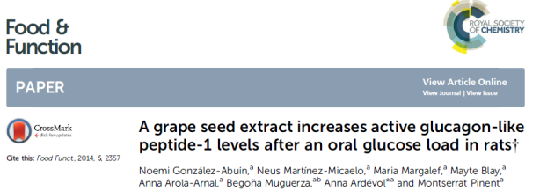
Notes:
Our second approach was to analyze whether GSPE increases active GLP-1 levels. To do so, healthy wistar rats were orally treated with 1 g of GSPE/kg bw or water (that was de vehicle). Vildagliptin is commercial DPP4 inhibitor that is well reported to improve GLP-1 levels, so we treated a third group with 1 mg of vildaglilptin/kg bw as a positive control.
Because glucose is a potential GLP-1 secretagogue (as I explained in the introduction), after 40 minutes of treatment, 2 g of glucose/kg bw were orally administered to induce GLP-1 secretion. After 20 minutes, rats were sacrificed. Blood samples were collected at the beginning and the end of the experiment and active GLP-1, glucose and insulin levels were determined in plasma.
As shown in this figure, GSPE enhanced glucose-triggered GLP-1 levels in plasma, effect that was accompanied by decreased glucose levels and improved insulin/glucose ratio. In all these cases, the effect provoked by GSPE follows the same pattern as the commercial DPP4 inhibitor. With this results we concluded that the higher levels of active GLP-1 might be the responsible of the improvement on glycemia produced by GSPE treatment.
This improvement on active GLP-1 levels could be due to the action of GSPE on GLP-1 production, secretion and/or cleavage, so our second objective was…

Slide 13
Could grape-seed derived proanthocyanidin extract be useful in limiting food intake?

Slide 14
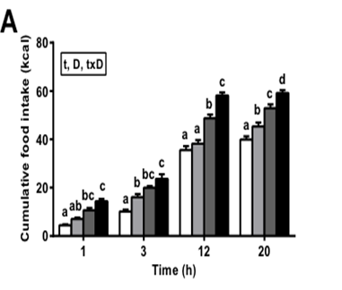
Rat model for food intake measurement:
Chow
Tasty diet

Slide 15


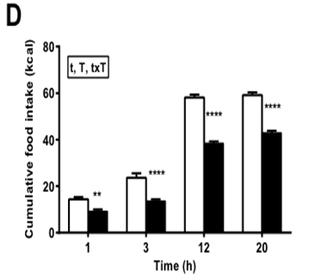
16.00 19.00 20.00 22. 00 8.00 15.00
Food removal GSPE Food Intake Food Intake Food Intake Food Intake
Tasty diet
+ GSPE

Slide 16
Food intake inhibitory activity of proanthocyanidin extracts under different conditions
Sex | BW (g) | Diet | H dose | Extract | Dose | 12h food intake inhibition (%)
♀ | 207 | Chow | -1 | GSPE | A | 22.2 ± 3.8 **
♀ | 223 | Chow | -1 | GSPE | A/2 | 18.7 ± 3.4***
♀ | 217 | Chow + 11ml HS | -1 | GSPE | A/2 | 15.9 ± 3.1*
♀ | 219 | Chow + 11ml HS | -1 | GSPE | A/10 | 1.4 ± 5.0
♀ | 204 | Chow | 0 | GSPE | A | 27.7 ± 9.0*
♂ | 542 | Chow | -1 | GSPE | A | 25.0 ± 4.5**
♂ | 543 | Chow | 1 | GSPE | A | 16.2 ± 7.1

Slide 17
Treatment:
one dose/day for 8 days

Slide 18
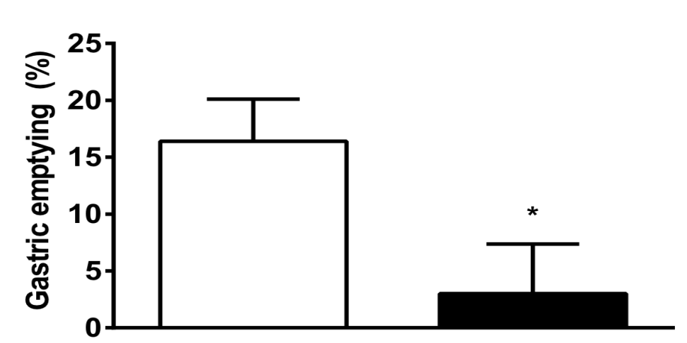
How it works?
* p<0.05
CONTROL GSPE
Portal levels of GLP-1 and insulin
Hormone | Treatment | 80min
GLP-1 | Control | 3.84 ± 0.35
 | GSPE | 8.64 ± 1.00***
Insulin | Control | 1.76 ± 0.31
 | GSPE | 3.29 ± 0.72*

Slide 19
What we know:
How much GSPE is needed to limit food intake and how to administer it to produce this effect
To a certain extent, how it works
That it is a safe product for human health
That the extract can be repeatedly obtained

Slide 20
Is this an innovative approach?
There are several products derived from grape seed extracts on the market.
  Most of them emphasize the antioxidant properties of these extracts.
  In some cases they are also offered as an immune stimulator and/or a product with anticancer properties.
  The suggested doses for these properties are a maximum of 20 g/ dose.
  Their antioxidant effect is scientifically proved; there is also overwhelming evidence of their anti-inflammatory activity and anticancer effect.
  There are no products on the market that propose using this extract as a satiating agent because, prior to our work, there was no evidence of it.
Some products offer a satiating effect, mainly based on fibre composition.
  There is scarce scientific support for this effect. Additionally, EFSA is not approving applications for it due to the lack of effect and the difficulty in determining the composition of the product.
We propose using the satiating effects of a by-product of the huge winery industry: grape seed extract
  It could be easily developed from a natural extract that is already available on the market.
  To date, we have found compelling evidence in animal studies, with a statistically significant effect (20% reduction in energy ingested).
  We need to run a human trial to adjust the best dose, to reproduce the optimal effects we have achieved in rats.

Slide 21
What we need before going to market:

Slide 22
Before going to market as a nutraceutical | Expected time | Expected €
Safety and reproducibility of production | 0 | √
Clinical trial | 10 months | 40 000
Better understanding of the effect | 10 months | AGL2014-55347-R
Intellectual property and legal aspects | Patent application on October 2014 | 10 000
Technological aspects for industrial development | 6 months | 50 000
Market and marketing analysis | 3 months | 10 000
Total amount | ≈ 2 years | ≈ 200 000

Slide 23
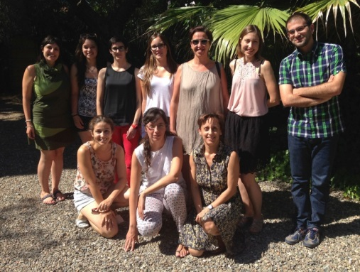
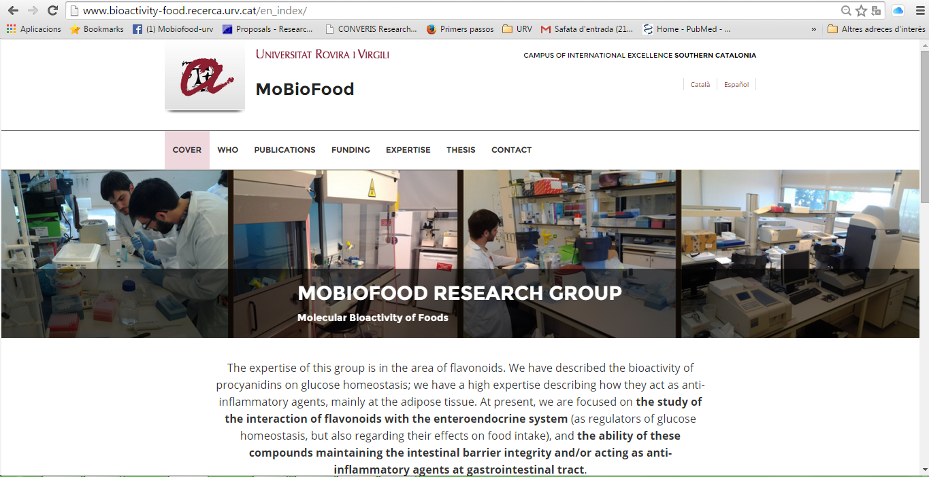
Thank you very much!
Supported by
MINECO AGL2011-23879; AGL2014-55347-R
GENCAT FI predoctoral; Emprenedoria Corporativa; Eval Xarta
URV FPI predoctoral
CTNS Technology transfer support

Slide 25
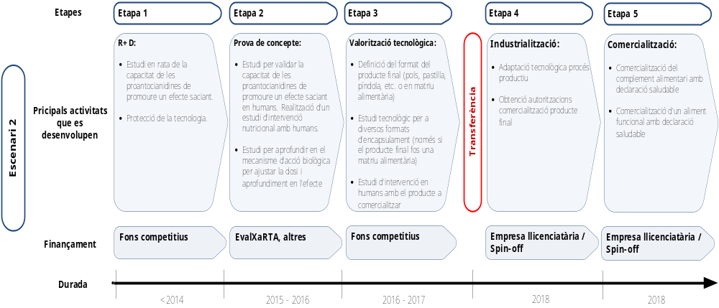
As a nutraceutical (one of the possibilities):

