Slide 1
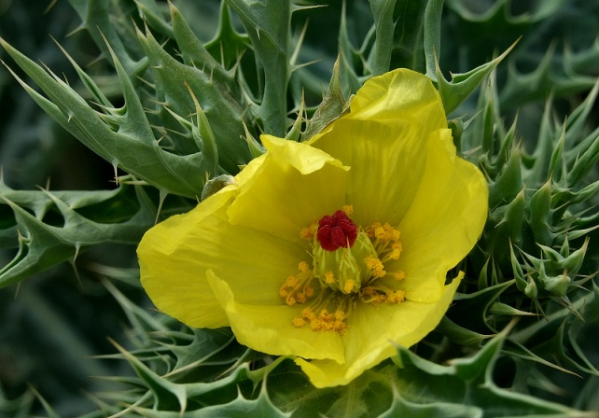
Immunomodulating potential of Argemone mexicana through cytokine regulation
Dr. Anjana Goel
Associate Professor
Dept. of Biotechnology,
GLA University, Mathura, INDIA

Slide 2

Happy Teachers Day

Slide 3

5th September

Slide 4
Argemone mexicana
Also known as Mexican poppy, Bhatkateya or Satyanashi
A variety of medicinal uses have been attributed to different parts.
Mechanism of action for therapeutic value is yet to be explored.

Slide 5

Activities reported
The decoction of leaves is used for the treatment of malaria, ulcers and chronic skin diseases.
Urinary infections can be treated with the decoction of plant extract.
It is a folk remedy of fever, headache, inflammation, itching, scabies etc.

Slide 6
Toxicity of A. mexicana
The outbreak of epidemic dropsy in the Indian capital, New Delhi, during the rainy season of 1998, results from ingestion of edible oil adulterated with Argemone mexicana seeds.
Some 2552 cases were reported and 65 deaths occurred between 5th August to 12th October, 1998.

Slide 7
Sanguinarine and dihydrosanguinarine are two
major toxic alkaloids of Argemone oil, which cause widespread capillary dilation, proliferation and increased capillary permeability.
Leakage of the protein-rich plasma component into the extracellular compartment leads to the formation of oedema specially in legs.
Produces interstitial pulmonary oedema.
Resultant pulmonary hypertension leads to a rise in right ventricular systolic pressure as well as dilation of right-sided cardiac chambers and right-sided heart failure

Slide 8

In the present study, before
conducting the experiment, the leaves of Argemone mexicana were analyzed for the presence of these toxic compounds with HPTLC and GC-MS analysis and found negative for these compounds.
These toxic compounds are probably present in seeds and flowers.

Slide 9
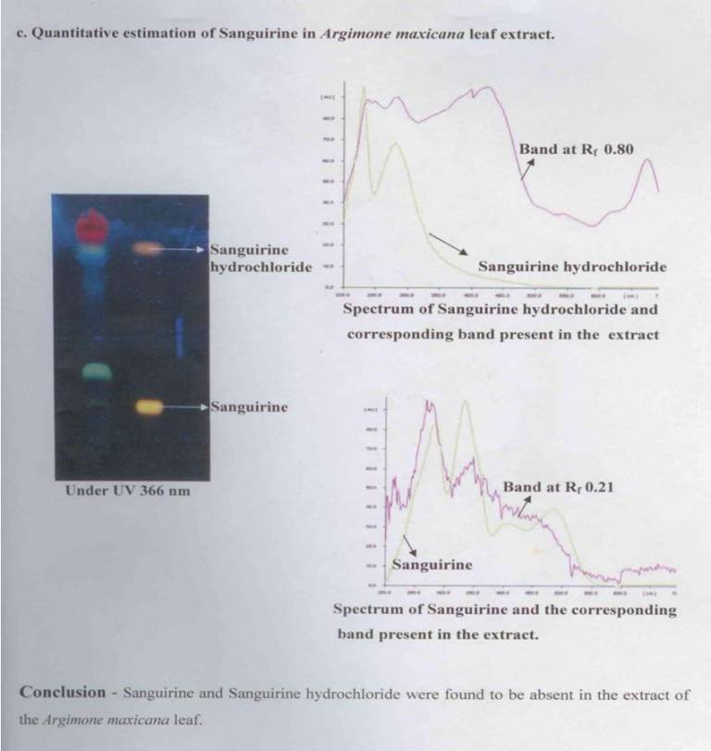
Certified from National Botanical Research Institute, Lucknow, INDIA

Slide 10

Brief Account
A holistic approach has been taken to
access the immuno modulating potential
of this plant by the modulation of cytokine expression.
Cytokines are the molecule which play a regulatory role in the immune responses.
Modulation of cytokine secretion offer a novel approaches in the treatment of a variety of diseases.
Inflammatory and allergic responses are regulated by the balance of pro- and anti-inflammatory cytokines in tissues.

Slide 11

Objectives
To determine the effect of A. mexicana for modulating T_{H}1 (IL-2 and IFN-γ) and T_{H}2 (IL-10) cytokine expression and its effect on the proliferation pattern of murine splenic T-lymphocytes
The correlation patterns of the cytokine expressions and cell proliferation.

Slide 12

Materials
All the cell culture reagents including RPMI-1640, Concanavalin A (Con A), foetal bovine serum (FBS), 3-(4,5-dimethylthiazol-2-yl)-2,5-diphenyltetrazolium bromide (MTT), TRI reagent were procured from Sigma Aldrich, (USA).
Rat IL-2, IFN-γ, and IL-10 ELISA kits were procured from BD Biosciences, USA and R&D System USA

Slide 13

Methods
A. mexicana leaves were collected from Mathura district, India and authenticated by Centre of Medicinal and Aromatic Plants, Lucknow.
Aqueous extract of leaves of A. mexicana was prepared and nontoxic dose was calculated.

Slide 14

Albino rats were fed orally with A. mexicana extract 100, 250 & 500mg/kg body weight for consecutive 20 days.
Hematological and biochemical parameters were measured in blood.
250mg/kg body weight dose was found suitable without any toxic symptoms and used in studies.
The experimental protocol was approved by Institutional Animal Ethics Committee.

Slide 15
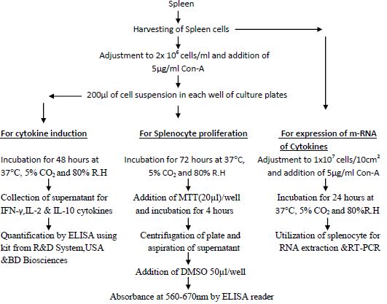
Splenocyte proliferation, cytokines induction & expression at molecular level

Slide 16
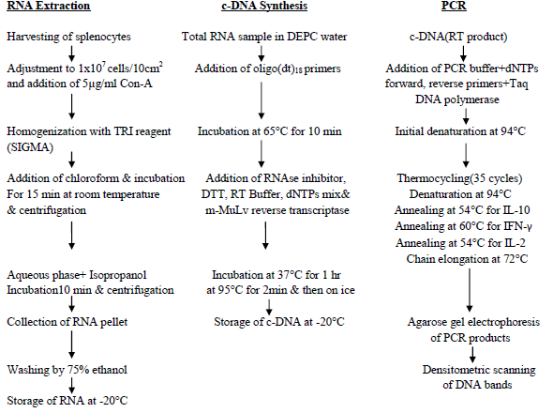
RNA extraction, c-DNA synthesis& PCR

Slide 17
RESULTS

Slide 18
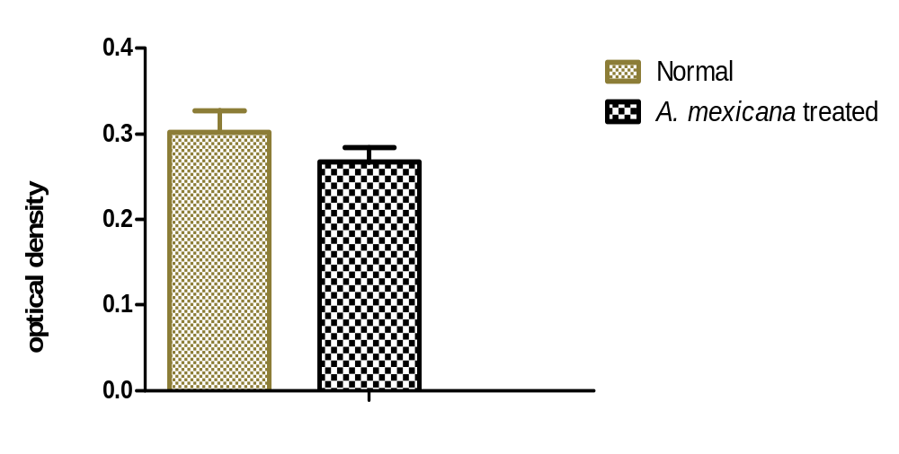
1.(a) Ex vivo effect of A. mexicana extract on splenocyte proliferation
In Argemone mexicana extract fed animals 11.58%decrease was noticed as compared to control animals.

Slide 19
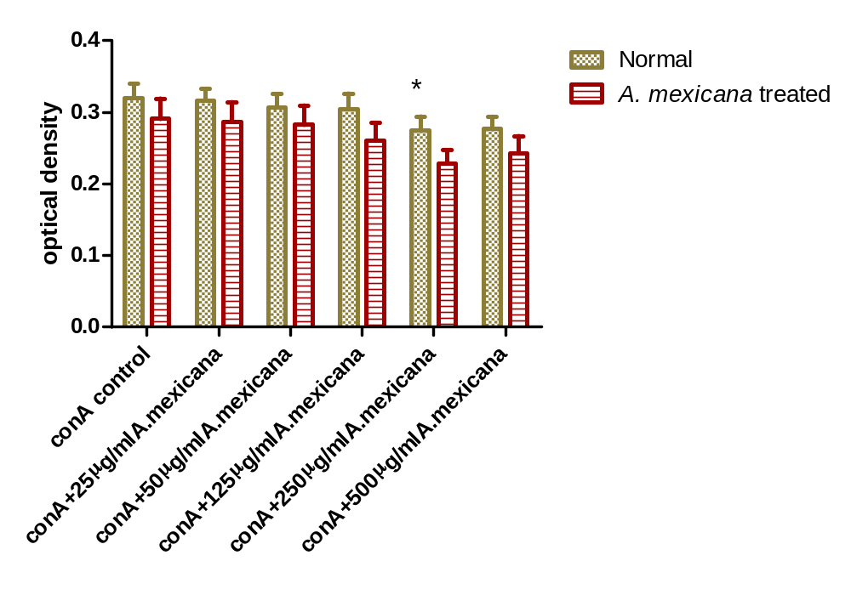
1.(b)In vitro effect of A. mexicana extract on splenocyte proliferation
Five different concentrations: 25, 50,125,250 and 500µg/ml of A.mexicana extract
showed a dose dependent inhibition of splenocytes proliferation. But in the in vitro experiments the decrease was significant(p<0.05) in A. mexicana fed animals (21.43%) compared to control (14.3%).

Slide 20
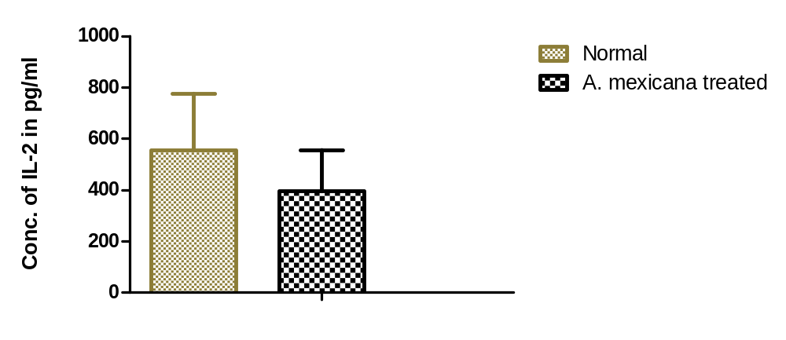
2. (a) Ex vivo effect of A. mexicana extracts on IL-2 production
A.mexicana treatment reduced the IL-2
secretion from splenocytes by 28.8%

Slide 21
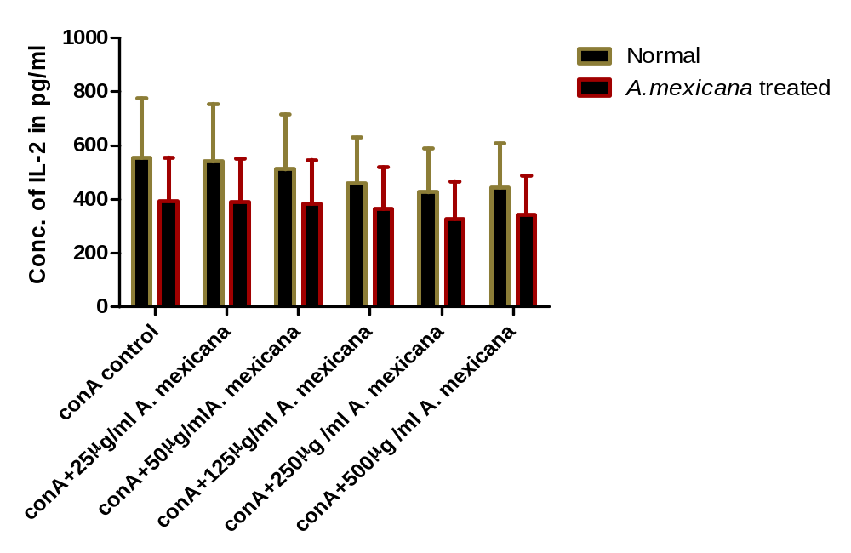
2. (b) In vitro effect of A. mexicana extract on IL-2 production
.
The A. mexicana extract decreased the IL-2 expression in ex vivo as well as
in vitro experiments.

Slide 22
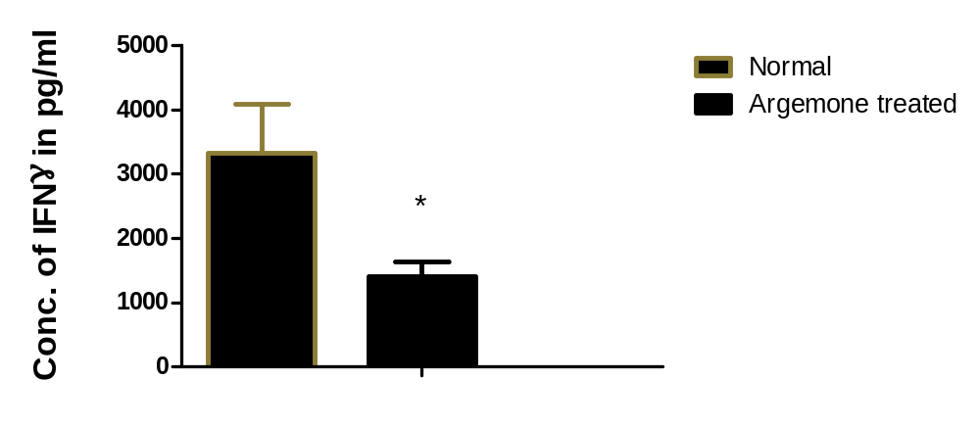
3.(a) Ex vivo effect of A. mexicana extract on IFN-γ production
A significant (p<0.05)decrease in IFN γ production (57.8%) by Argemone mexicana extract was noticed.

Slide 23
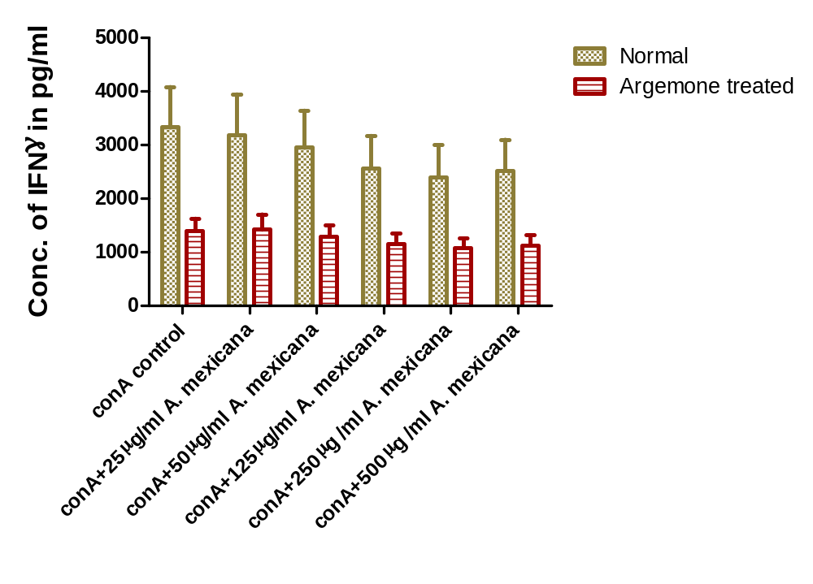
3.(b)In vitro effect of A. mexicana extract on IFN-γ production
A maximum decrease of 27.8% was recorded with 250µg/ml concentration of A. mexicana in in vitro studies.

Slide 24
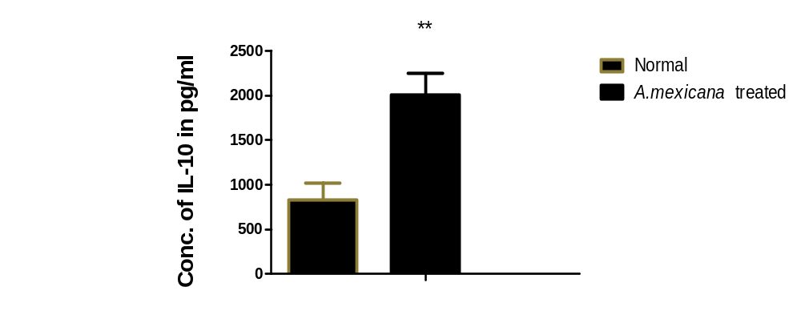
4.(a)Ex vivo Effect of A. mexicana extracts on IL-10 production
Elevation in secretion of IL-10 from splenocytes culture was noticed in Argemone mexicana fed rats with highly significant (p<0.01) increase of 140.53% in ex vivo experiment.

Slide 25
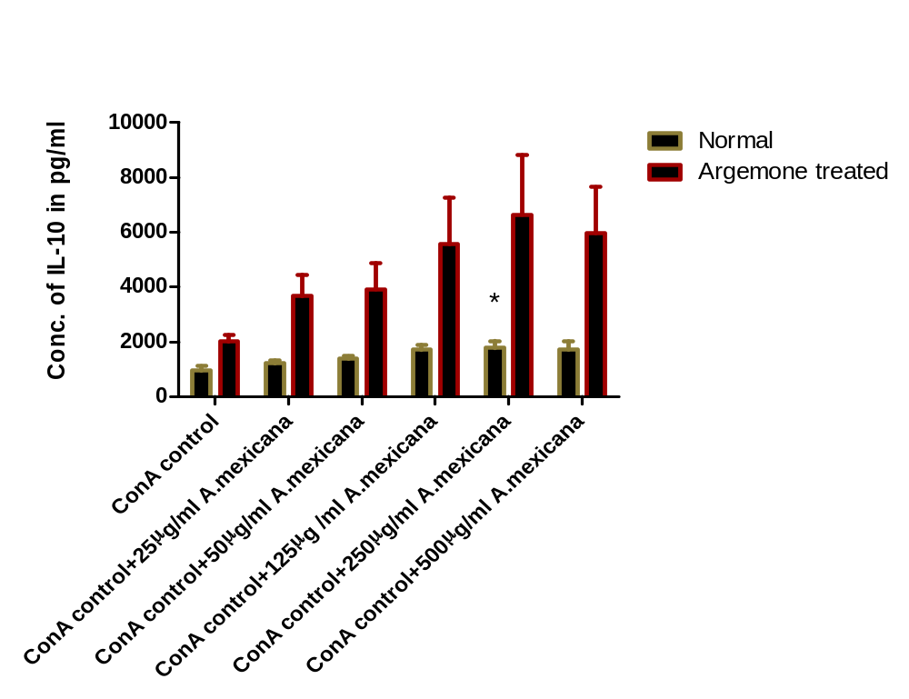
4.(b) In vitro effect of A. mexicana extract on IL-10 production
In in vitro studies at 250 µg/ml A.mexicana concentration showed significant(p<0.05) increase in IL-10 production with 87.7% change.

Slide 26
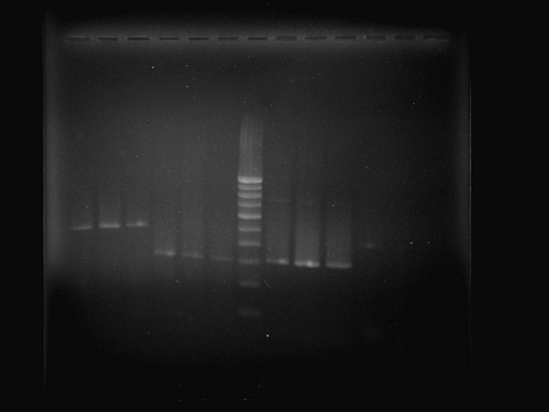
Expression of cytokines from splenocytes
Semi quantitative Rev. Trans-PCR analysis
489bp
460bp
307bp
315bp
IL-10 IL-2 IFN-γ β-actin
100bp Ladder
(489bp) (307bp) (460bp) (315bp)
C Am C Am C Am C Am
IL-10 IL-2 100bp IFN-γ β-actin
Ladder
(489bp) (307bp) (460bp) (315bp)
C Am C Am C Am C Am

Slide 27
Discussion & Conclusion
Immune system modulation by medicinal plants and their products can provide an alternate approach to chemotherapy.
The present study highlighted the effect of A. mexicana on IFN-γ, IL-2 and IL-10 cytokines.
IFN- γ is the key cytokine of T_{H}-1 and play a key role in cell mediated responses by activating macrophages and MHC-II expression.
IL-2 & IFN- γ promote the fully cytotoxic T-cells from CD8+ precursors.
Both these cytokines are down regulated by A. mexicana extract suggesting the down regulation of cell mediated immunity.

Slide 28
IL-10, ,secreted by T_{H}-2 cells, is a suppressive cytokine which suppress the expansion of T_{H}-1 cell population thus cell mediated responses.
It along with IL-4 & IL-5 induces the production of IgE.
IL-10 is greatly augmented in A. mexicana fed animals suggesting its role to cure allergic diseases (Type IV DTH) and auto immune diseases like multiple sclerosis.
Increased IL-10 but decreased IFN- γ& IL-2 expression is further proved by RT-PCR analysis.

Slide 29
It may have a wide application in minimizing the allograph graft rejection during transplantation.
IL-2 and IFN- γ are the important mediators of graft rejection. IL-2 promote cell proliferation and generation of CTLs while IFN- γ is central to the development of DTH responses.
A. mexicana stimulates the IL-10 production, inhibit the expansion of TH-1 cells and thus may prevent the graft to be rejected after transplantation.

Slide 30
Immunosuppressive drugs are nonspecific , resulting in generalized suppression to all antigens thus increased risk of infections and cancer.
mAb’s against CD3, rapidly deletes T-cells from circulation. Their animal origin again poses a problelm
In cytokine therapy, repeated administration is required and local concentration cannot be attained.
Thus A. mexicana can be a promising candidate for the hyper cell mediated immunity disorders by decreasing the Th-1 cytokines and augmenting the Th-2 cytokines.

Slide 31

THANK YOU

