Slide 1

ROLE OF CCR5 LEVELS IN HIV-1 EVOLUTION AND PATHOGENESIS
ANJALI JOSHI
Assistant Professor
Center of Emphasis in Infectious Diseases
Department of Biomedical Science
Texas Tech University Health Sciences Center
El Paso

Slide 2
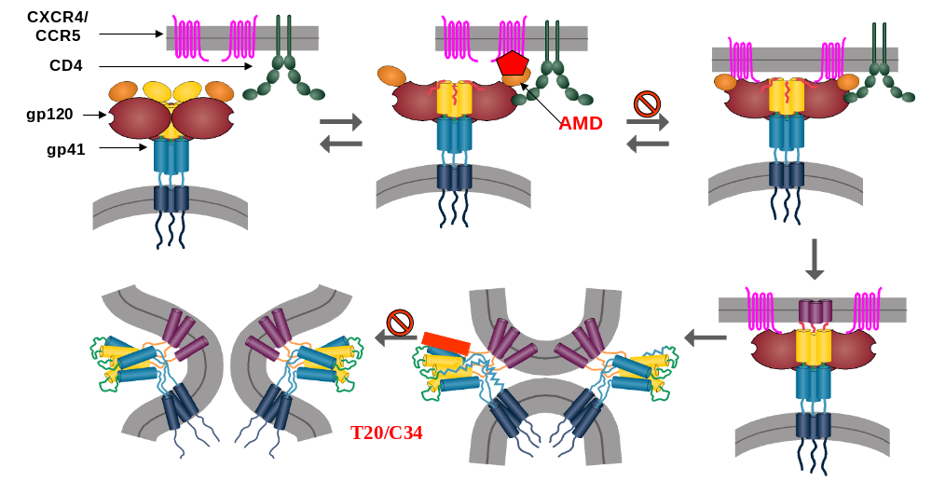
CCR5 ACTS AS A CO-RECEPTOR FOR HIV ENTRY
Garg and Blumenthal, Cell Mol Life Sci. 2008.

Slide 3
CCR5 LEVELS VARY IN THE HUMAN POPULATION
58755 A/G
58934 G/T
59029 A/G
59402 A/G
59353 T/C
59356 C/T
59653 C/T
CCR5 delta 32
562
594
CCR5 Promoter
3’
5’
CCR5 WT
CCR5 delta 32 decreases CCR5 levels on the surface.
2) Promoter polymorphisms.
CCR5 delta 32

Slide 4
ROLE OF CO-RECEPTOR LEVELS IN HIV DISEASE PROGRESSION
CCR5 delta 32 (CCR5 Δ32-/- or +/-) mutations have been shown to be associated with disease susceptibility and progression rate.
Individuals homozygous for CCR5 Δ32-/- are resistant to HIV infection.
Individuals heterozygous CCR5 Δ32+/- show slower progression to AIDS via unknown mechanism.

Slide 5
HOW DO VARIED CCR5 LEVELS IN THE HUMAN POPULATION AFFECT:
HIV evolution
Drug resistance
Disease progression

Slide 6
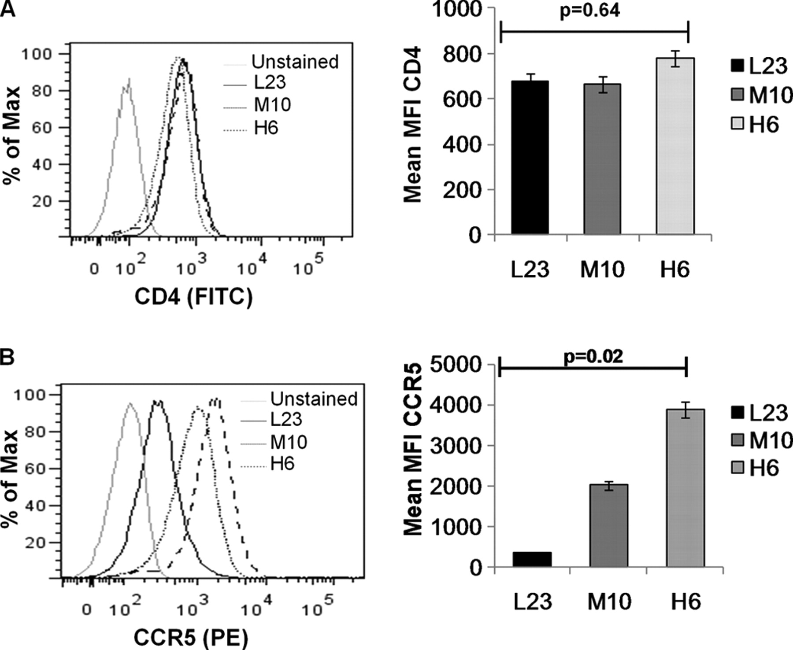
HOW DO VARIED CCR5 LEVELS AFFECT HIV
EVOLUTION
CD4
CCR5
Anjali Joshi et al. J. Biol. Chem. 2011;286:36404-36413

Slide 7
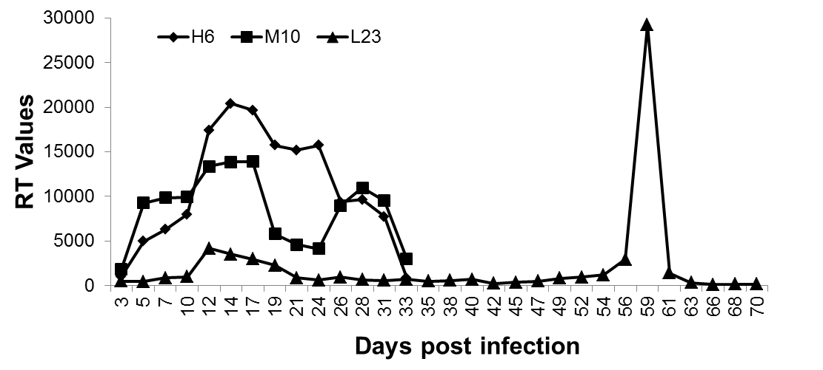
CCR5 TROPIC HIV YU-2 ADAPTS TO REPLICATE IN CELLS EXPRESSING LOW LEVELS OF CCR5
Emergence of adapted virus

Slide 8
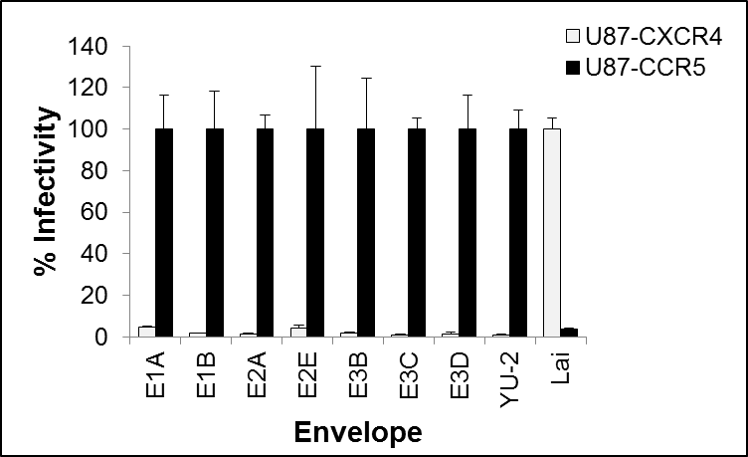
LOW CCR5 ADAPTED VIRUS MAINTAINS R5 TROPISM
Clone | YU2 #
E1A | E170K
 | A423V
E1B | E170K
 | N298Y
 | A423V
E2A | E170K
 | N298Y
 | D623E
E2E | E170K
 | N298Y
 | D623E
E3B | N298Y
 | E334K
E3C | A136T
 | N298Y
E3D | N298Y
 | T449M
 | P714L
 | G724D
N298Y MUTATION CONFERS ADAPTATION TO LOW CCR5

Slide 9
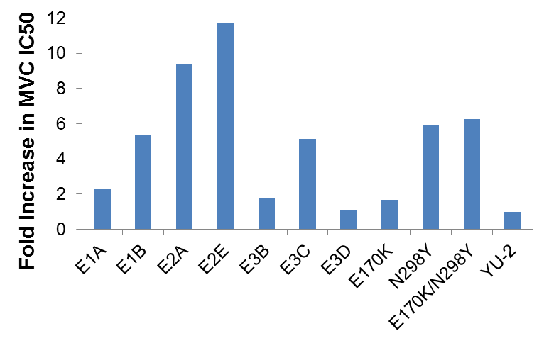
LOW CCR5 ADAPTED VIRUS SHOWS INCREASED RESISTANCE TO CCR5 ANTAGONISTS

Slide 10
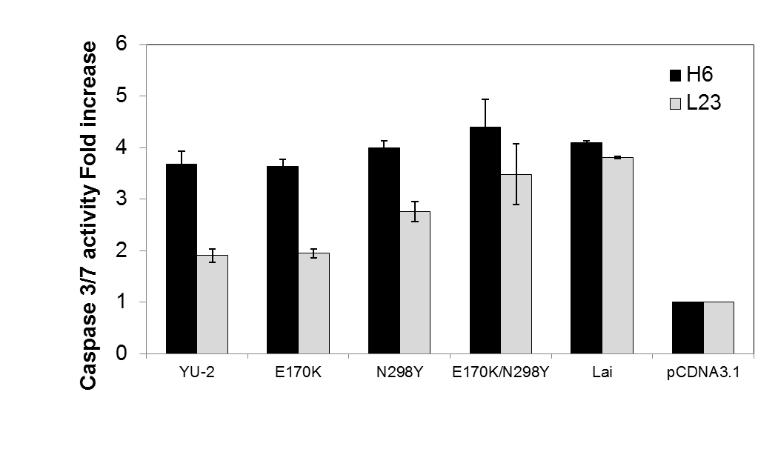
N298Y MUTATION INCREASES THE ENVs PATHOGENIC POTENTIAL

Slide 11
HOW DO VARIED CCR5 LEVELS AFFECT DISEASE PROGRESSION IN HIV+ PATIENTS?
CCR5 delta 32 decreases CCR5 levels on the surface.
Promoter polymorphisms also decrease CCR5 surface expression levels.

Slide 12
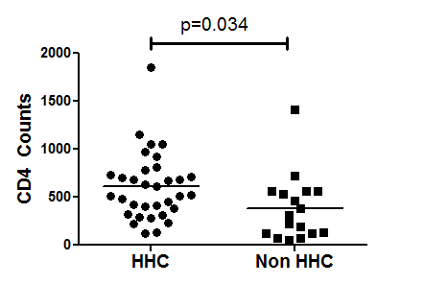
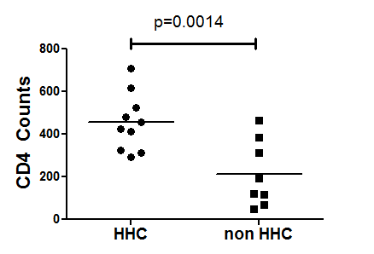
Haplotype | 58755 | 58934 | 59029 | 59353 | 59356 | 59402 | 59653
HHA | A | G | G | T | C | A | C
HHB | A | T | G | T | C | A | C
HHC | A | T | G | T | C | G | C
HHD | A | T | G | T | T | A | C
HHE | A | G | A | C | C | A | C
HHF | A | G | A | C | C | A | T
HHG | G | G | A | C | C | A | C
HHH | A | G | A | T | C | A | C
All HIV+
Viremic (100 copies >)

Slide 13
CONCLUSIONS
HIV adaptation to low CCR5 levels results in changes in the Envelope that enhance CCR5 binding, Env pathogenicity and increase resistance to CCR5 targeting drugs.
HIV infected patients with non-HHC type CCR5 promoter haplotype show lower CD4 counts.
CCR5 levels play a significant role in HIV evolution, drug resistance and pathogenesis.

Slide 14
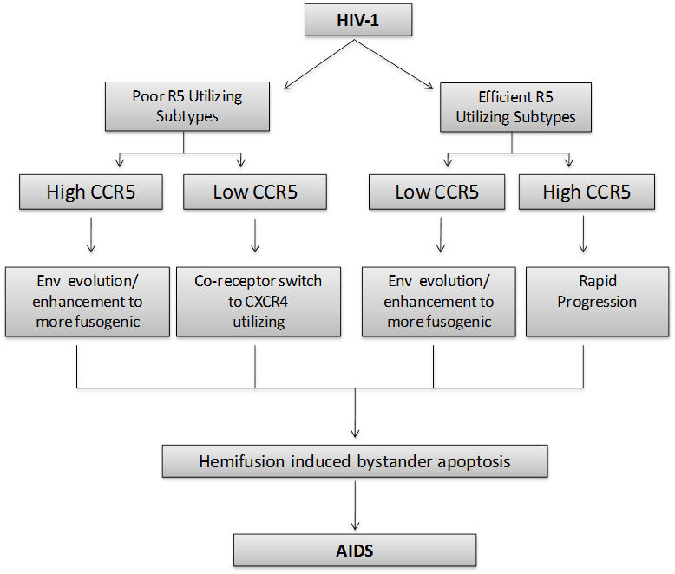
CCR5 LEVELS IN HIV PATHOGENESIS
Anjali Joshi et al. J. Biol. Chem. 2011;286:36404-36413

Slide 15
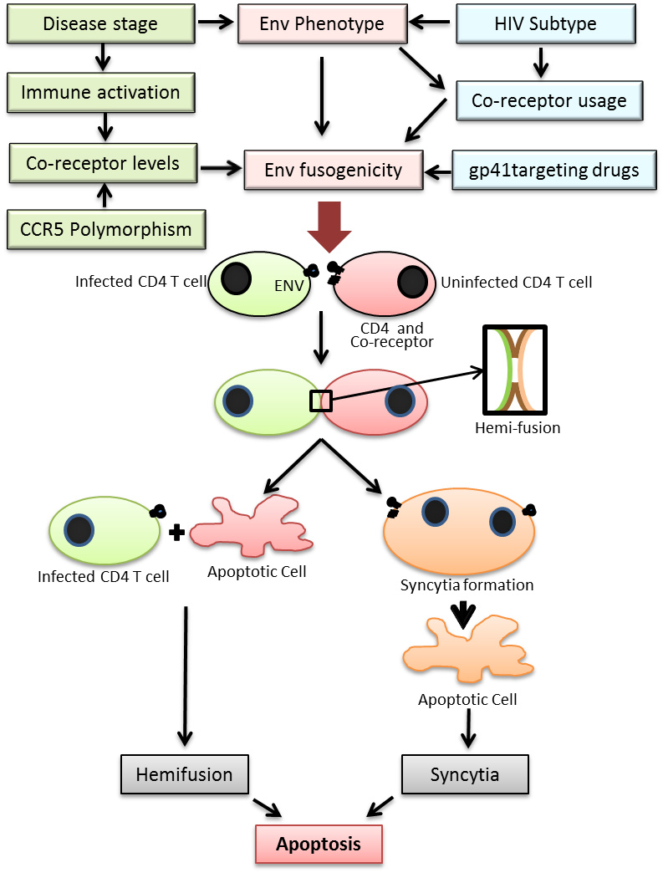
Garg and Joshi, Viruses, 2012.

Slide 16
ACKNOWLEDGEMENTS
Patients who participated in this study.
TTUHSC
Dr. Debabrata Mukherjee-Internal Medicine.
Dr. Armando Meza-Internal medicine.
Dr. Ogechika Alozie-TTUHSC HIV clinic.
Dr. Himanshu Garg-BMS.
Dr. Zuber Mulla-OB GYN
Dr. Jayanta Gupta-Biostatistics.
Melina Sedano and Erin Punke.
BII Singapore:
Raphalel Lee
Sebastian Maurer-Stroh .
Tan-Tock Seng Hospital Singapore:
Dr. Oon Tek NG
Dr. Palvinder Kaur.
Funding:
1RO3AI095040-01A1 PI: Joshi
R03AI102621-01A1 PI: Joshi
1 R15 AI116240-01A1 PI: Garg
TTUHSC intramural seed grant program.

Slide 17
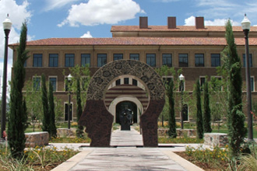
THANK-YOU
QUESTIONS?

