Slide 1
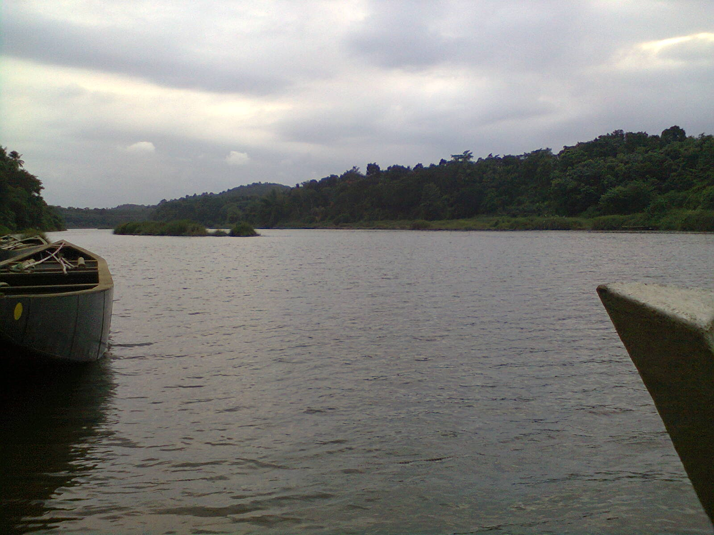

INTEGRATED RIVER BASIN MANAGEMENT IN WESTERN GHAT REGION THROUGH A CASE STUDY
Dr A B Anitha
Scientist F & Head
Surface Water Division
Centre for Water Resources Development and Management
Kozhikode ,Kerala
September 2014

Slide 2
Need for an Integrated River Basin Management
No interdepartmental cooperation among the user Departments
  Downstream users are not aware of the upstream interventions
Integrated River Basin Management should consider multiple water uses in a river basin
Coordination with other sectors and levels of government –(nation planning , regional planning)
  Will help the planners and decision makers in solving water management issues

Slide 3
Database
Survey of India Toposheets
Rainfall and Runoff data from IMD, CWC WRD, KSEB
IRS data for landuse classification
Present utilization and future demand of water from KWA, WRD, KSEB, KSPCB and Dept. of Industries
Block wise groundwater data from CGWB
Modern tools like GIS, GPS and Remote Sensing Techniques were used

Slide 4
Hydrological Analysis Done
Spatial and temporal water availability and demand
Water quality status
Present water resources utilization
Future water resources demand
Spatial water balance
Surplus/deficit
Management strategies

Slide 5
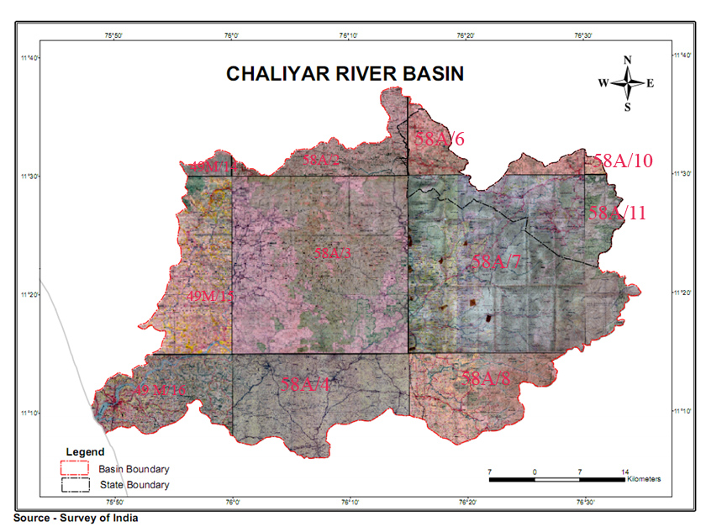
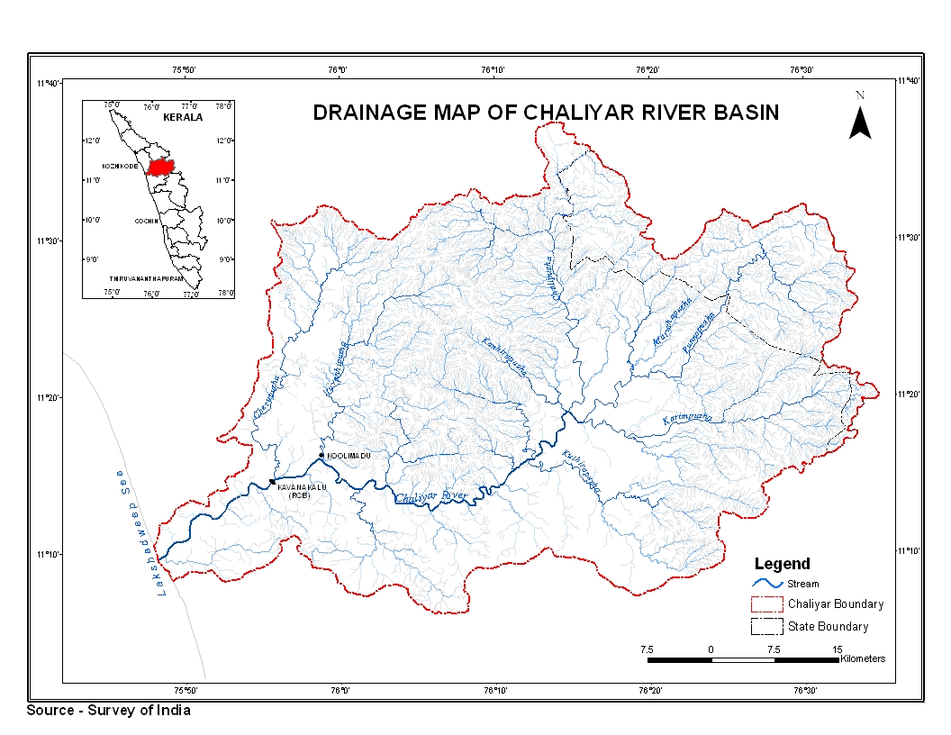
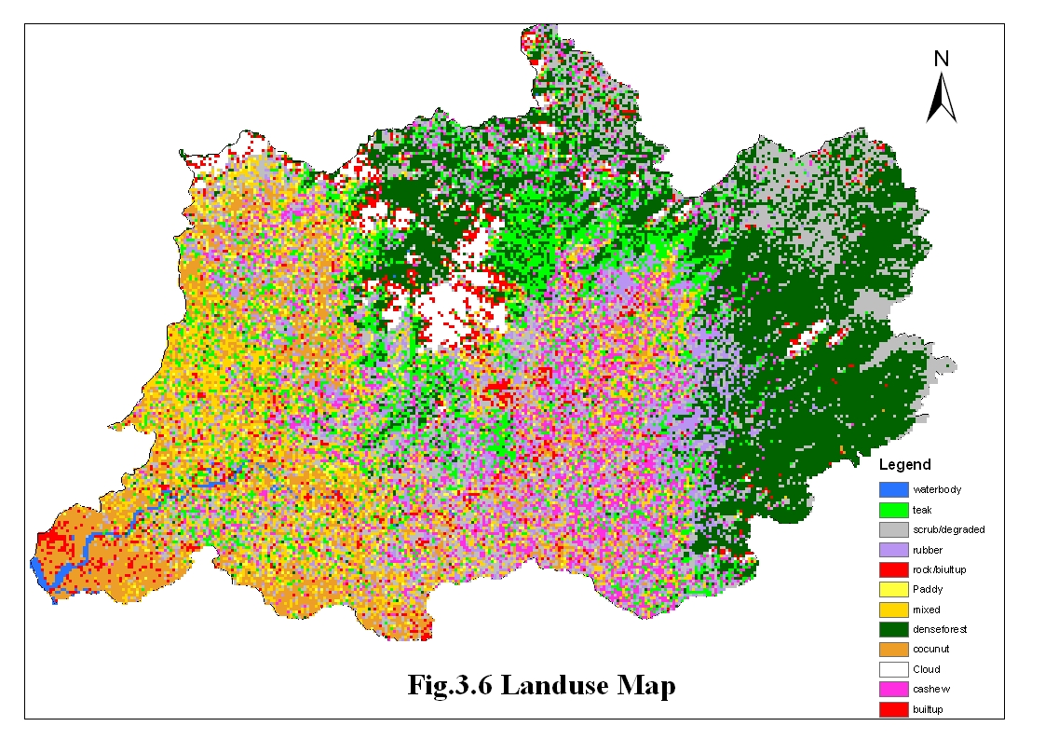
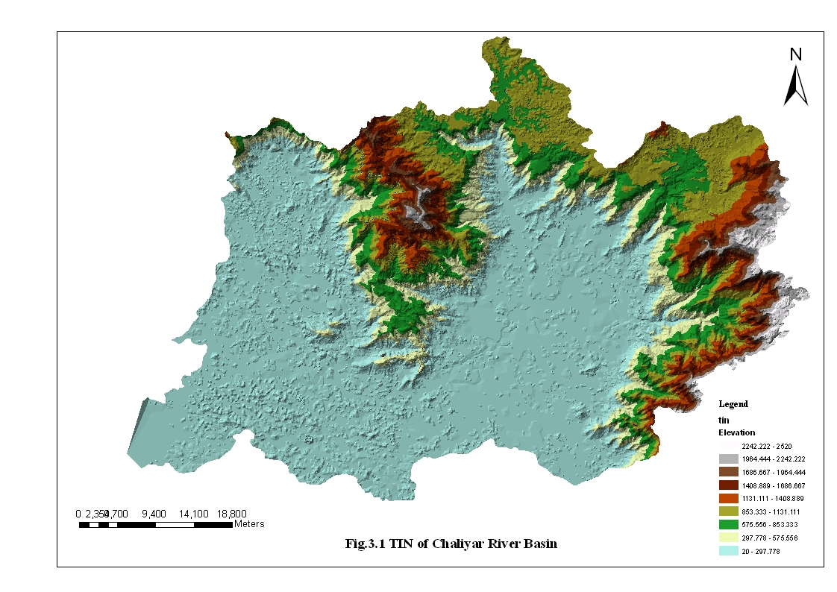

Slide 6
Spatial and Temporal Distribution of Rainfall
location details of raingauge stations.docx
Mean monthly rainfall.docx

Slide 7
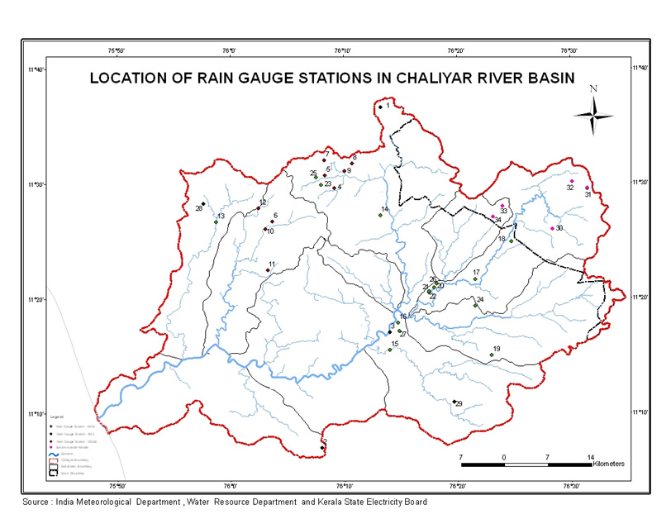

Slide 8
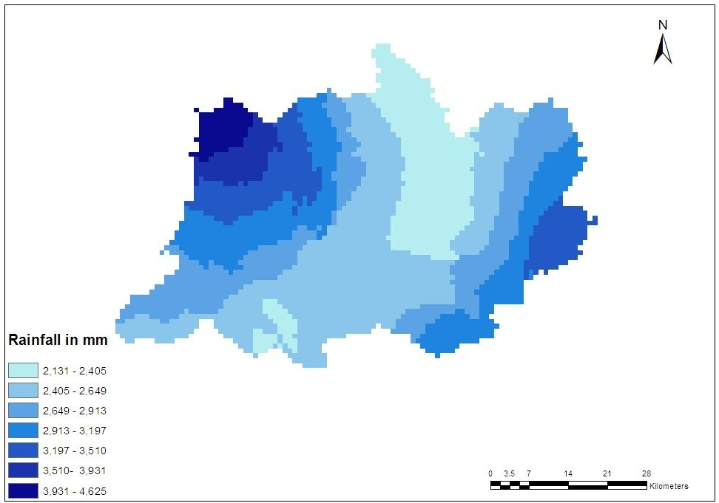
Isohyetal map of Chaliyar
Annual rainfall varies from 2130-4625 mm

Slide 9
Spatial and Temporal Analysis of Runoff
Location details of river gauging stations.docx

Slide 10
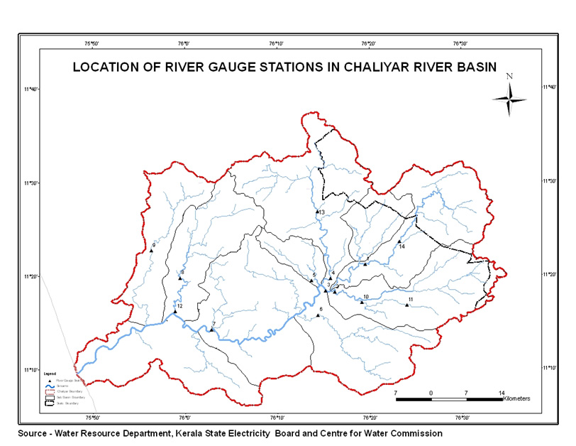

Slide 11
Mean monthly Surface Water Availability (MCM) in Chaliyar River Basin
Station | Area, Sq.km | Jun | Jul | Aug | Sep | Oct | Nov | Dec | Jan | Feb | Mar | Apr | May | Total
Kuniyil | 1876 | 626 | 1262.9 | 952.6 | 503.1 | 420.6 | 240.8 | 73.9 | 38.4 | 12.7 | 9.3 | 7 | 43.6 | 4190.9
Koodathai | 117 | 76.1 | 154.9 | 119 | 52.3 | 49.5 | 35.3 | 15.4 | 6.6 | 3.7 | 2.9 | 2.8 | 8.3 | 526.8
Mukkom | 206.3 | 189.8 | 354.2 | 250.2 | 98.4 | 80 | 47.2 | 15.8 | 7.7 | 3.7 | 3.4 | 4.4 | 14.5 | 1069.3
Total | 2199.3 | 891.9 | 1772 | 1321.8 | 653.8 | 550.1 | 323.3 | 105.1 | 52.7 | 20.1 | 15.6 | 14.2 | 66.4 | 5787
Ungauged area | 723.7 | 241.5 | 162.6 | 82.5 | 22.1 | 5.0 | 0.6 | 0.0 | 0.0 | 0.0 | 0.0 | 0.0 | 0.0 | 514.4
Total Catchment area | 2923 | 1133.4 | 1934.6 | 1404.3 | 675.9 | 555.1 | 323.9 | 105.1 | 52.7 | 20.1 | 15.6 | 14.2 | 66.4 | 6301.4
T N Area | 388 | 9.4 | 13.2 | 22.7 | 35.1 | 98.8 | 124.9 | 43.3 | 6.5 | 2.4 | 14.9 | 8.1 | 22.7 | 402
Kerala | 2535 | 1124.0 | 1921.4 | 1381.6 | 640.8 | 456.3 | 199.0 | 61.8 | 46.2 | 17.7 | 0.7 | 6.1 | 43.7 | 5899.4
Total Surface Water Availability in Kerala |  |  |  |  |  |  |  |  |  |  | 5899 MCM

Slide 12
Utilizable Yield (MCM) of Chaliyar river Basin
Station | Area, Sq.km | Jun | Jul | Aug | Sep | Oct | Nov | Dec | Jan | Feb | Mar | Apr | May | Total
Kuniyil | 1876.0 | 626.0 | 1262.9 | 952.6 | 503.1 | 420.6 | 240.8 | 73.9 | 38.4 | 12.7 | 9.3 | 7.0 | 43.6 | 4190.9
Highland | 1313.2 | 372.5 | 751.4 | 566.8 | 299.3 | 250.3 | 143.3 | 44.0 | 22.8 | 7.6 | 5.5 | 4.2 | 25.9 | 2493.6
Midland | 562.8 | 126.8 | 255.7 | 192.9 | 101.9 | 85.2 | 48.8 | 15.0 | 7.8 | 2.6 | 1.9 | 1.4 | 8.8 | 848.7
 | Total | 499.2 | 1007.2 | 759.7 | 401.2 | 335.4 | 192.0 | 58.9 | 30.6 | 10.1 | 7.4 | 5.6 | 34.8 | 3342.2
Koodathai | 117.0 | 76.1 | 154.9 | 119.0 | 52.3 | 49.5 | 35.3 | 15.4 | 6.6 | 3.7 | 2.9 | 2.8 | 8.3 | 526.8
Highland | 46.8 | 25.9 | 52.7 | 40.5 | 17.8 | 16.8 | 12.0 | 5.2 | 2.2 | 1.3 | 1.0 | 1.0 | 2.8 | 179.1
Midland | 70.2 | 25.1 | 51.1 | 39.3 | 17.3 | 16.3 | 11.6 | 5.1 | 2.2 | 1.2 | 1.0 | 0.9 | 2.7 | 173.8
 | Total | 51.0 | 103.8 | 79.7 | 35.0 | 33.2 | 23.7 | 10.3 | 4.4 | 2.5 | 1.9 | 1.9 | 5.6 | 353.0
Mukkom | 206.3 | 189.8 | 354.2 | 250.2 | 98.4 | 80.0 | 47.2 | 15.8 | 7.7 | 3.7 | 3.4 | 4.4 | 14.5 | 1069.3
Highland | 140.4 | 109.8 | 204.9 | 144.8 | 56.9 | 46.3 | 27.3 | 9.1 | 4.5 | 2.1 | 2.0 | 2.5 | 8.4 | 618.7
Midland | 66.1 | 40.0 | 74.6 | 52.7 | 20.7 | 16.9 | 9.9 | 3.3 | 1.6 | 0.8 | 0.7 | 0.9 | 3.1 | 225.3
 | Total | 149.8 | 279.6 | 197.5 | 77.7 | 63.1 | 37.3 | 12.5 | 6.1 | 2.9 | 2.7 | 3.5 | 11.4 | 844.0
Total Catchment | 2199.3 | 700.0 | 1390.5 | 1036.9 | 513.9 | 431.7 | 252.9 | 81.7 | 41.1 | 15.5 | 12.0 | 10.9 | 51.8 | 4539.2
Runoff in T N Area | 388.0 | 9.4 | 13.2 | 22.7 | 35.1 | 98.8 | 124.9 | 43.3 | 6.5 | 2.4 | 14.9 | 8.1 | 22.7 | 402.0
Utilizable yield in Kerala |  | 690.6 | 1377.3 | 1014.2 | 478.8 | 332.9 | 128.0 | 38.4 | 34.6 | 13.1 | -2.9 | 2.8 | 29.1 | 4137.2
Monsoon yield | 4021.9
Non monsoon yield | 115.2

Slide 13
50%, 75% and 90% dependable flows of sub basins of Chaliyar
Month | Dependability | Maruthapuzha | Punnapuzha | Karimpuzha | Chaliyar | Kanchirapuzha |  | Kuthirapuzha | Areacode | Mukkom | Koodathai | Kuniyil
Dec | 50% | 7.1 | 18.7 | 26.2 | 17.1 | 3.7 | 8.4 |  | 64 | 15.8 | 14 | 65.5
 | 75% | 5 | 14.3 | 16.6 | 8.7 | 2.5 | 6.3 |  | 31 | 8.8 | 7 | 45.6
 | 90% | 4 | 9.2 | 9 | 4.7 | 0.7 | 3.9 |  | 8.7 | 3.9 | 4.3 | 0
Jan | 50% | 4 | 10 | 11 | 9.1 | 2 | 5.1 |  | 33 | 7 | 4 | 29.3
 | 75% | 2.5 | 4.9 | 1 | 4.7 | 0.6 | 3 |  | 19.1 | 3.7 | 0 | 3.6
 | 90% | 1 | 2.8 | 0 | 1.1 | 0 | 0.9 |  | 5.5 | 0.2 | 0 | 0
Feb | 50% | 2.2 | 4.2 | 4.2 | 5.5 | 1 | 2.1 |  | 18 | 2 | 2 | 11.1
 | 75% | 1.7 | 1.4 | 0 | 3.1 | 0.2 | 1 |  | 7.3 | 0.9 | 0 | 0
 | 90% | 0 | 0 | 0 | 0 | 0 | 0 |  | 1.9 | 0 | 0 | 0
Mar | 50% | 2.2 | 3.2 | 1.5 | 5.1 | 0.2 | 1.2 |  | 14 | 2 | 1.6 | 4.7
 | 75% | 0.9 | 0 | 0 | 0 | 0 | 0 |  | 5.2 | 0 | 0 | 0
 | 90% | 0 | 0 | 0 |  | 0 | 0 |  | 1.1 | 0 | 0 | 0
Apr | 50% | 2.2 | 3.9 | 1.1 | 4.3 | 0.2 | 1.8 |  | 12 | 2.1 | 2.1 | 2.6
 | 75% | 1 | 0.5 | 0 | 0.7 | 0 | 0 |  | 2.5 | 0 | 0 | 0
 | 90% | 0 | 0 | 0 | 0 | 0 | 0 |  | 0.5 |  | 0 | 0
May | 50% | 3 | 5.9 | 8.1 | 6.7 | 1 | 6.3 |  | 20 | 9 | 4 | 12.3
 | 75% | 2 | 2.4 | 2 | 2 | 0 | 3.2 |  | 7.4 | 2 | 0 | 0
 | 90% | 0 | 0.6 | 0 | 0.6 | 0 | 0 |  | 2.7 | 0.6 | 0 | 0

Slide 14
Flow Duration Curves

Slide 15
  GROUNDWATER RESOURCES OF CHALIYAR
Groundwater resources of Chaliyar.docx

Slide 16
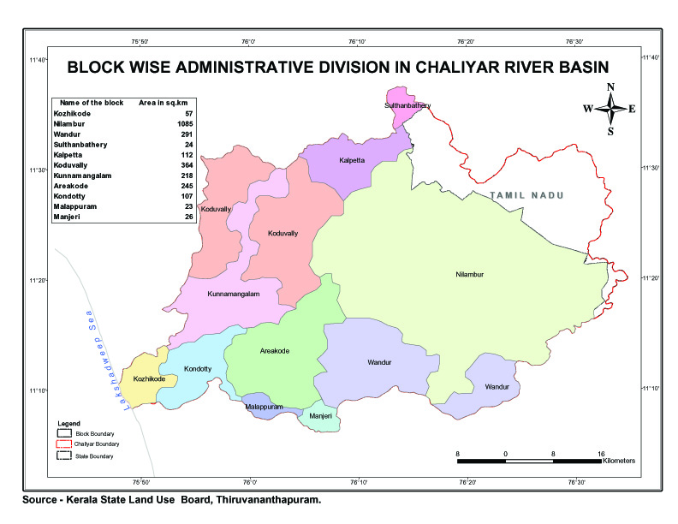

Slide 17
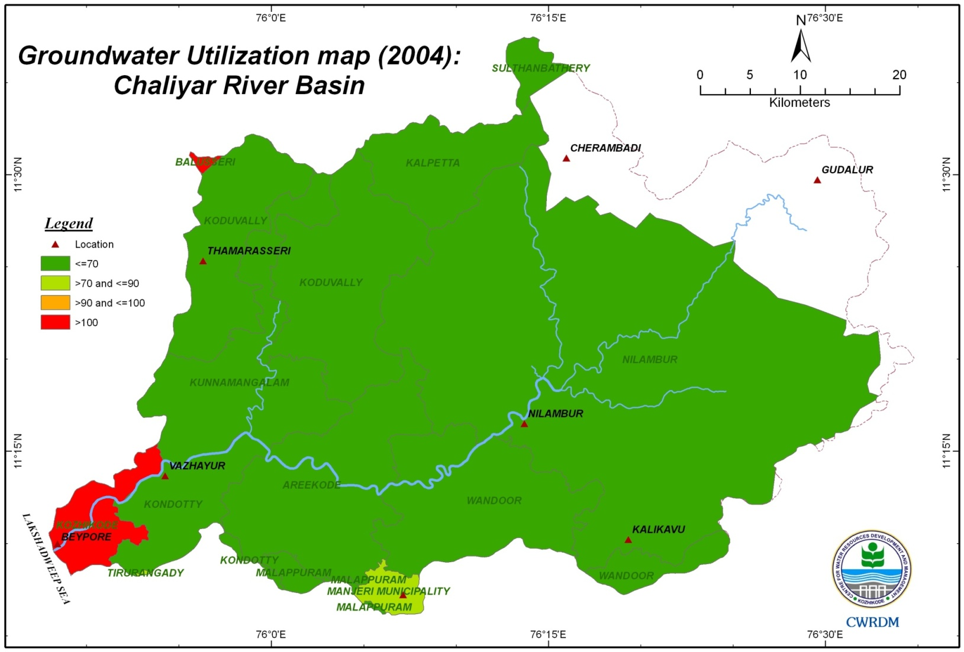

Slide 18
Water Availability
Surface Water
Monsoon flow: 5723 MCM
Non monsoon: 176 MCM
Utilizable flow
Monsoon flow: 4022 M MCM
Non monsoon: 115 MCM
Groundwater Potential:283.25 MCM
GW Draft : 140 MCM 4 blocks semi critical ;
8 Blocks safe

Slide 19
Water Quality Status
Higher level of dissolved solids in coastal region
75% of wells show significant level of nitrate
bore wells having high iron
Except for pH, all the quality variables comply with the desirable limit
The spatial trends of chloride, sulphate, sodium and calcium
Low concentrations of these constituents confirming the good quality of water except few wells in the coastal area.

Slide 20
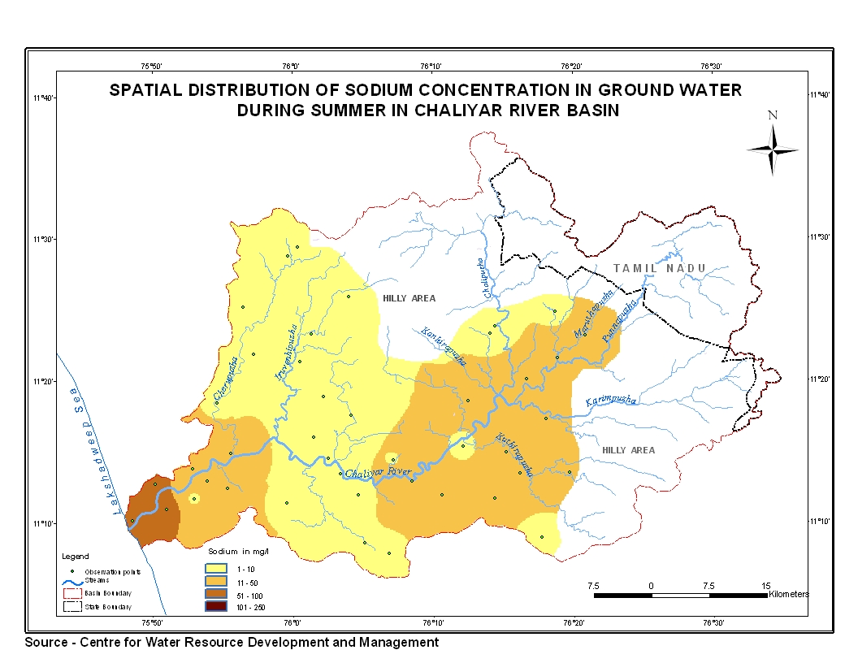
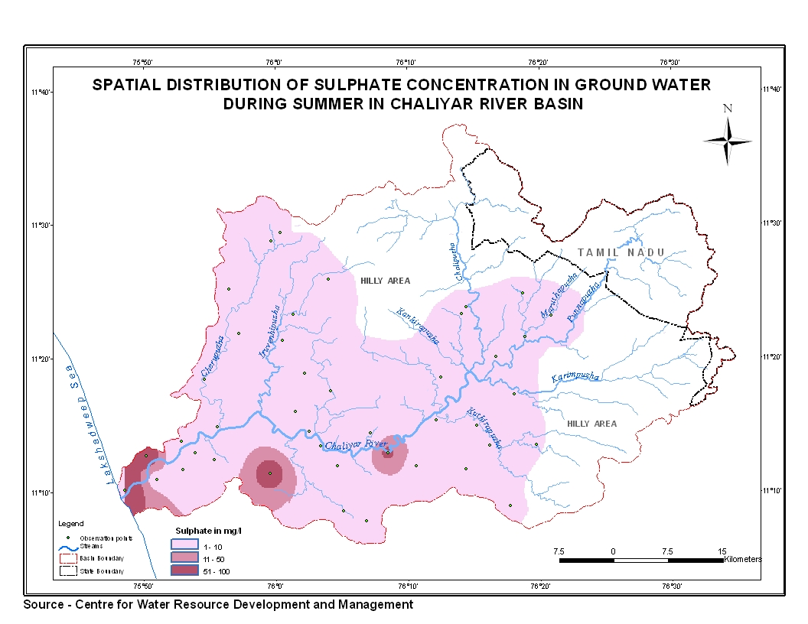
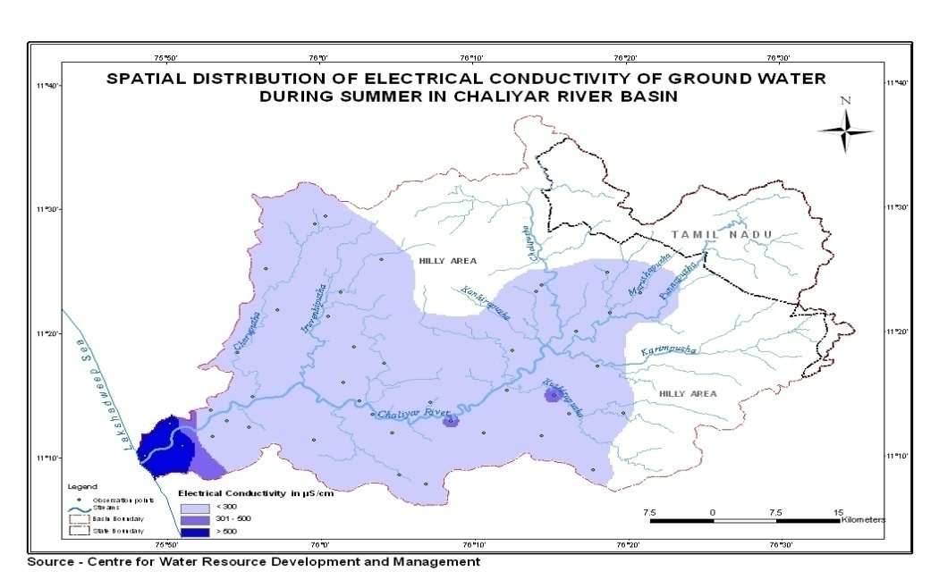
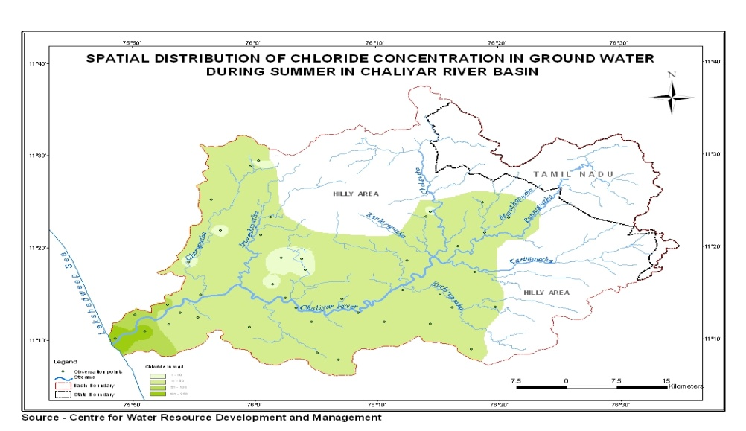

Slide 21
STATUS OF WATER RESOURCES UTILIZATION AND FUTURE DEMAND FOR VARIOUS PURPOSES

Slide 22
Water for Domestic Purpose
Present Utilization
  No. of Schemes: 42 Schemes in Kozhikode &
  Malappuram Districts
  - Water utilization - 218 MLD
  80 MCM
  Future Demand
    No. of new Schemes – 45
  Water utilization - 409 MLD
  150 MCM

Slide 23
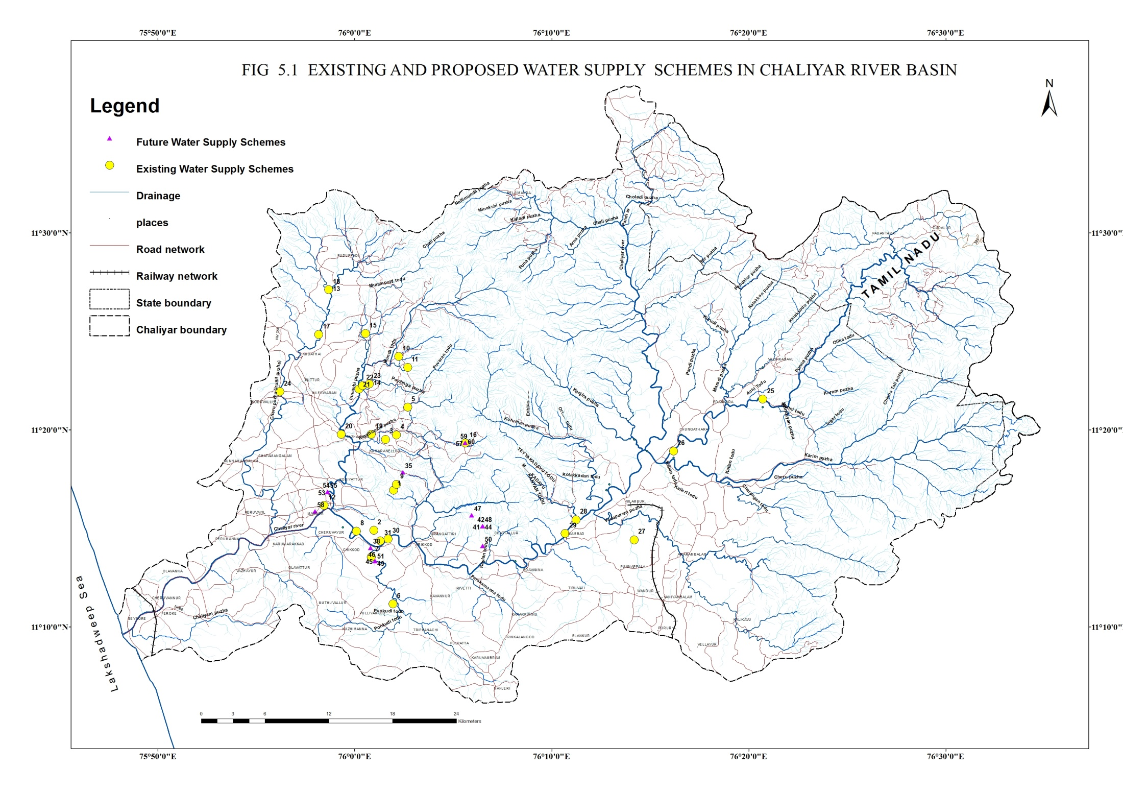

Slide 24
Water for Irrigation
No major schemes
One medium scheme for salinity arresting
  4 Diversion Schemes
  24 Lift Irrigation Schemes
  30 Vented Cross Bars
  4 Ongoing medium schemes
  Net irrigated area - 15,423 ha
  Proposed schemes
  - 6 major,5 medium and many check dams
  Net area to be irrigated – 20,368 ha

Slide 25
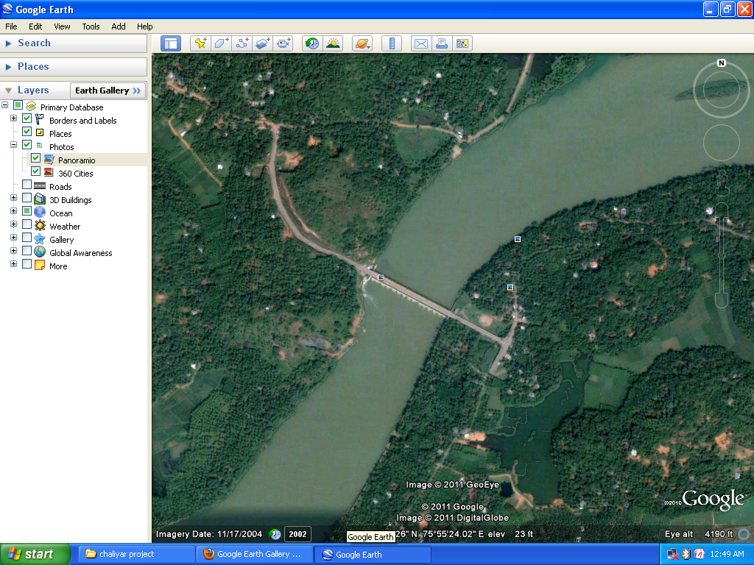
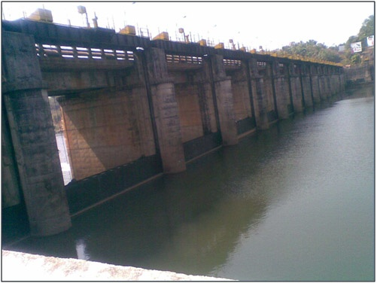
EXISTING WATER RESOURCES STRUCTURES
Topographical View of Regulator cum Bridge
at Kavanakkallu
Upstream view of Kavanakkallu Regulator-cum Bridge

Slide 26
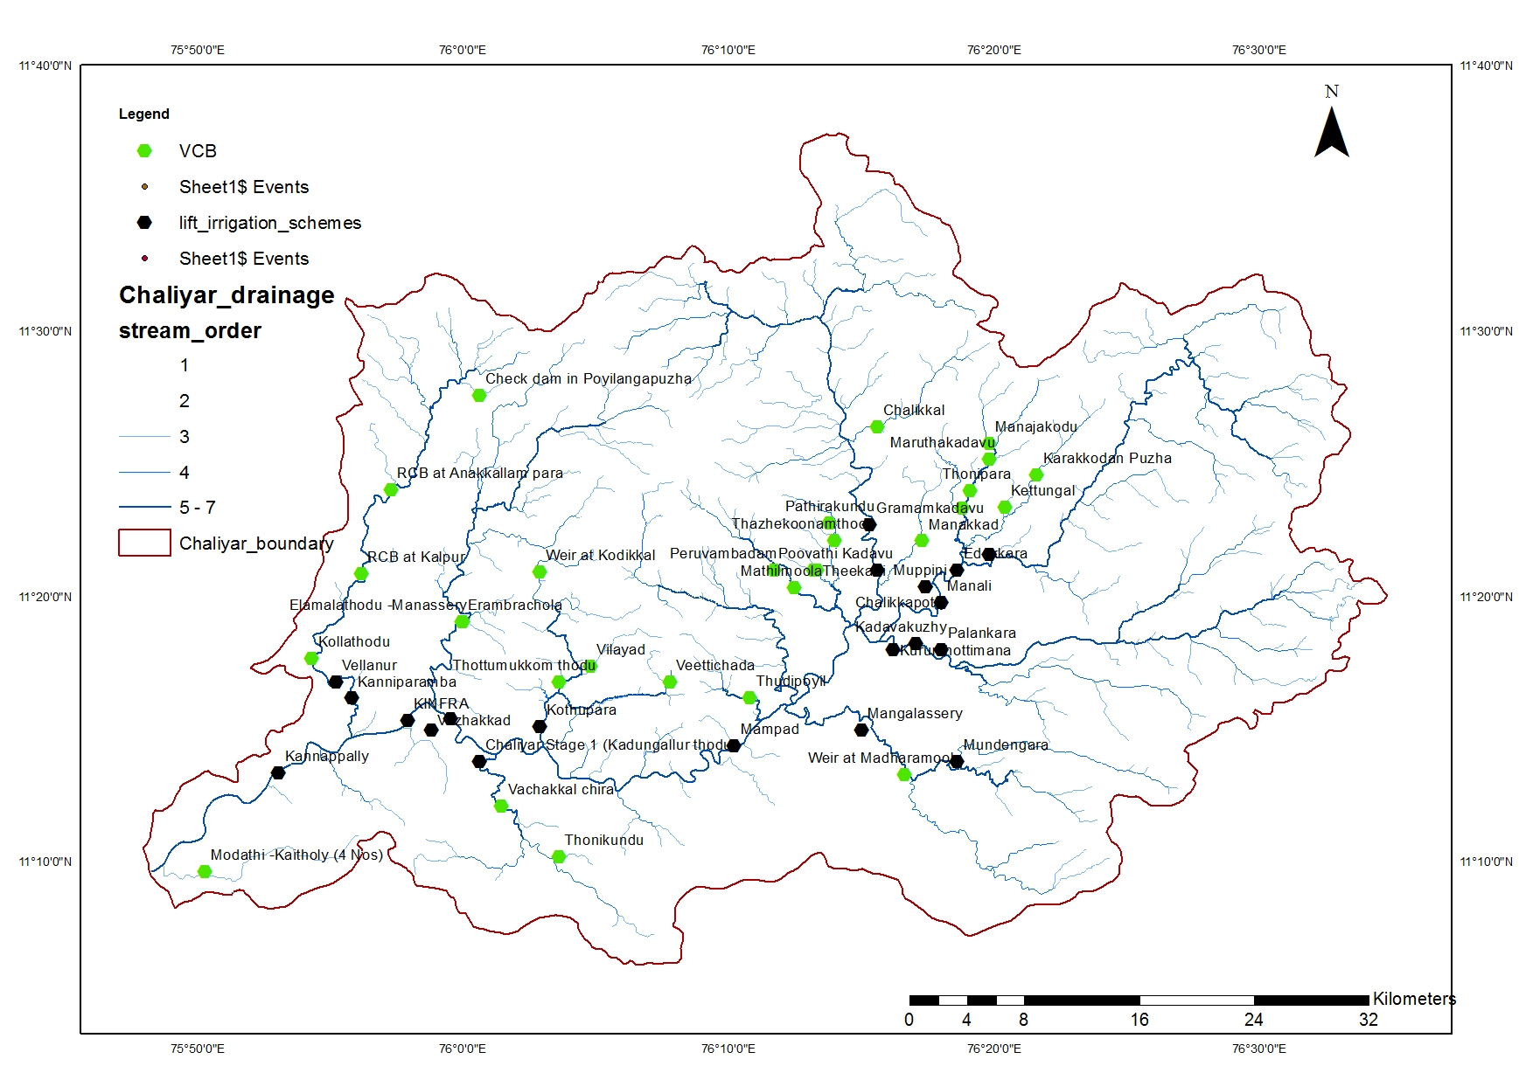

Slide 27
Hydel Power Generation
Present Utilisation
4 small hydro electric schemes in Chaliyar river basin which produces 16.6 MW power making use of 308 MCM of water.
Four schemes are under construction which can produce 17.7 MW power making use of 183 MCM of water
Future Schemes
- 3 major schemes
-12 small hydel schemes
- 15 small shcemes under feasibility stage
Power generation – 342 MW, 932.13 MU, 1437 MCM

Slide 28
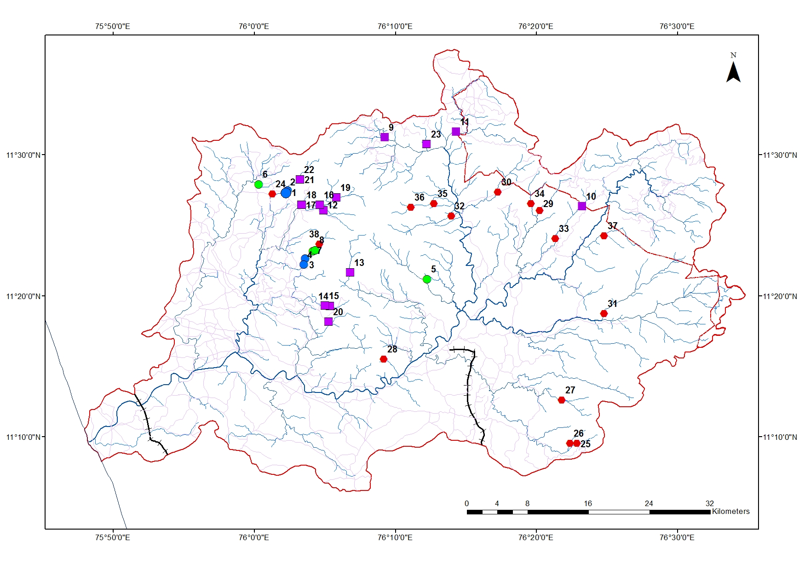

Slide 29
Water for other purposes
INDUSTRIAL WATER REQUIREMENT-12.35 MCM
WATER FOR SALINITY EXCLUSION-184MCM
INLAND NAVIGATION 39 Km length
  ECOLOGICAL BALANCE 10-15 % of Annual flow
  17 MCM during non monsoon months

Slide 30
Water Balance
Season | Utilizable potential, MCM |  |  | Present utilization, MCM | Surplus/Deficit MCM | Future DemandMCM | Surplus/Deficit MCM
 | Surface | Ground | Total
Monsoon | 4022 | 56 | 4078 | 46.5 | Surplus | 87 | Surplus
Non monsoon | 115 | 84 | 199 | 332.5 | Deficit (-133.5) | 413 | Deficit (-214)

Slide 31
CONCLUSIONS
Chaliyar basin is at present deficit by 133.5 MCM of water during non monsoon period and will have a deficit of fresh water of 214 MCM by 2040 AD
For successful planning, implementation and management of a river basin ,there should be an organization at the basin level for all developmental activities related to water resources irrespective of administrative boundaries
Few more projects are needed for the sustainable development of the river basin.

Slide 32
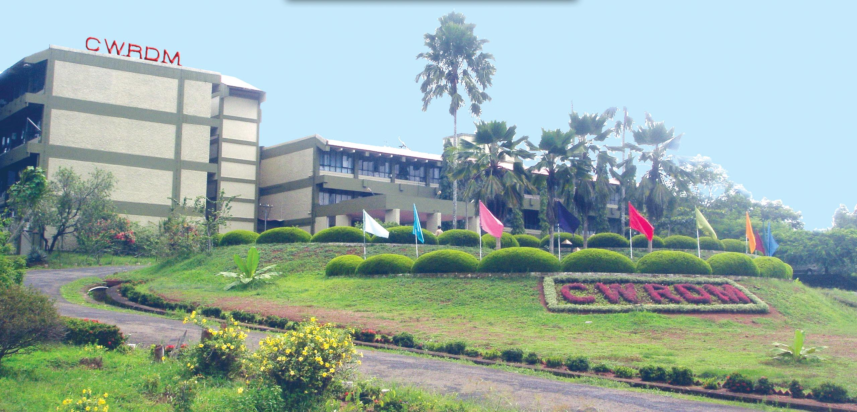
Thank you

