Slide 1


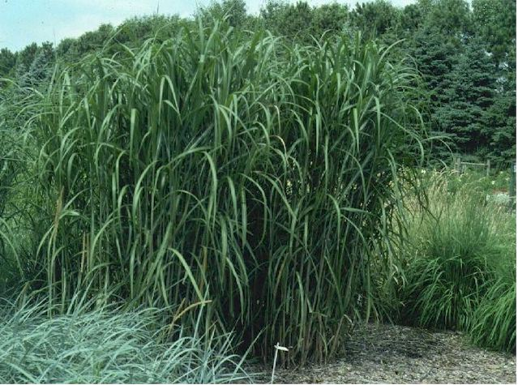
Hybrid thermochemical and biochemical conversion of biomass for renewable fuels and products
---- where value is recovered from every co-product of the biomass conversion processes
Animesh Dutta
Associate Professor and Director
Bio-Renewable Innovation Lab (BRIL)
School of Engineering, University of Guelph Ontario, Canada
World Bioenergy Congress and Expo, June 13-14, 2016 Rome, Italy

Slide 2





Three most important global issues
Food and water security
Global warming
Sustainable Biomass
Energy sustainability
http://www.itimes.com/lifestyle/global-warminghow-to-cool
http://www.green-the-world.net/what_is_renewable_energy.html
http://www.prweb.com/releases/2012/4/prweb9460370.htm

Slide 3
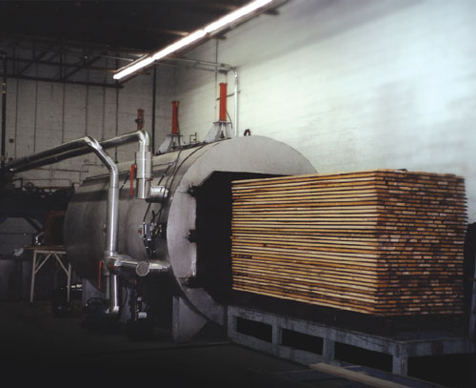
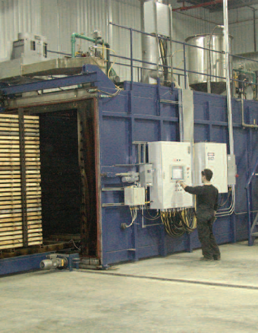
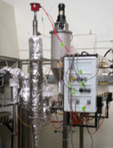
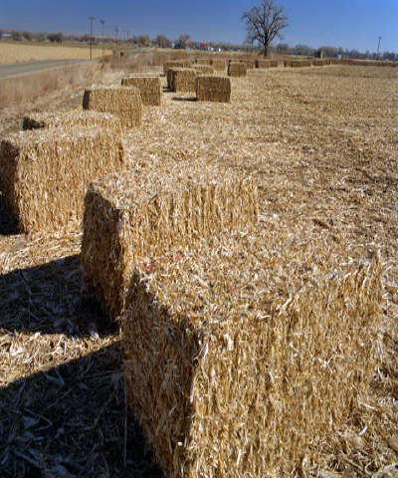
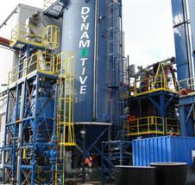
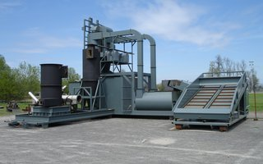
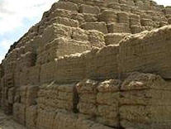

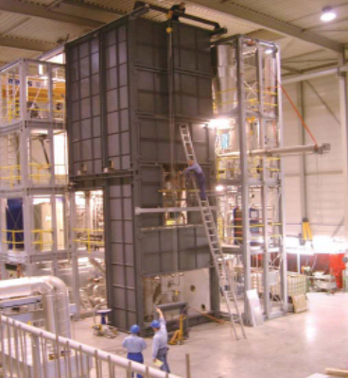
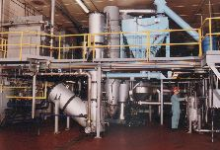
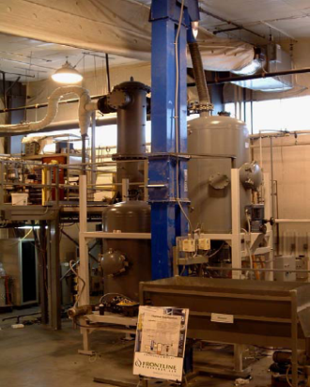

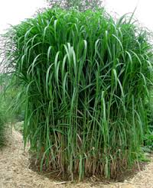
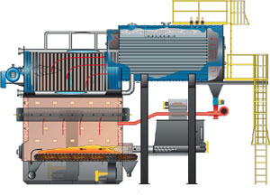
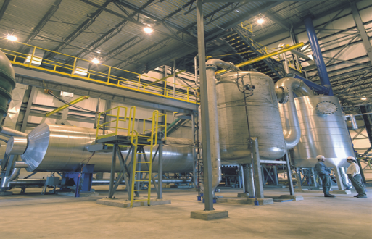
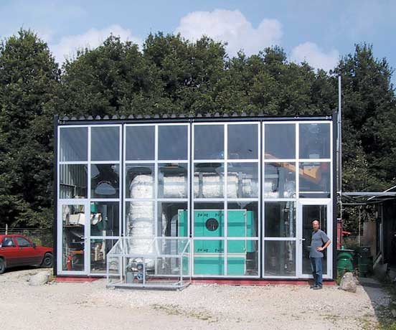

Biomass Thermo-chemical Conversion Technologies of Interest
Drying, Thermal Treatment and Dry and Wet Torrefaction (100-300 ºC)
Pyrolysis (350-600 ºC)
Biomass Characterization
Heat
Combustion and Incineration (over 1300 ºC)
Gasification (600-1200 ºC)

Slide 4

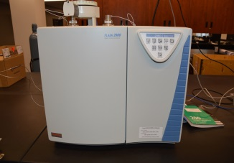
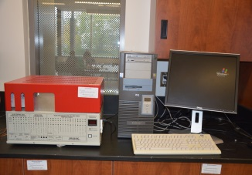
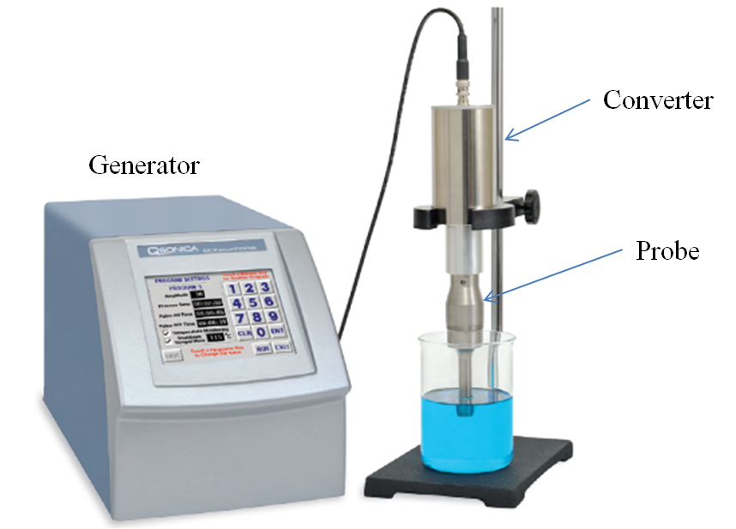
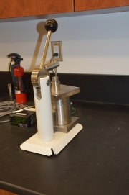
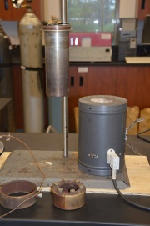
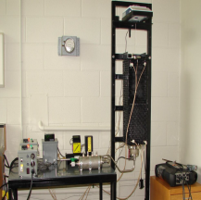
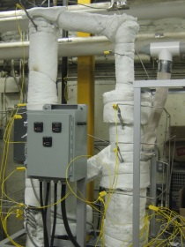
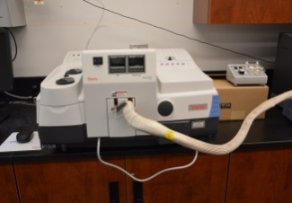
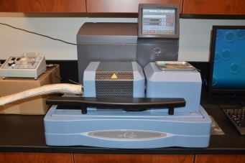
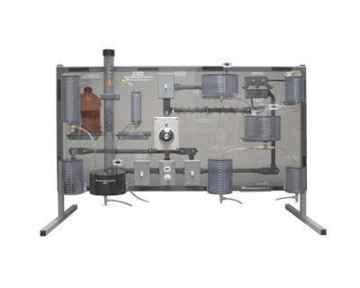
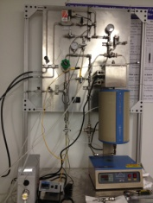
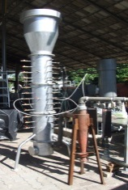
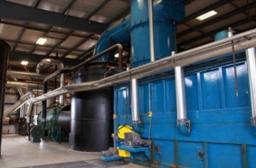
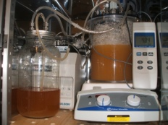
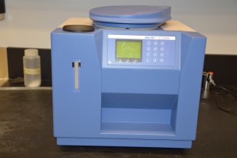
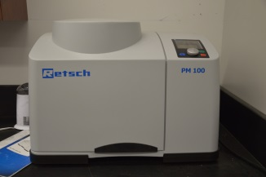
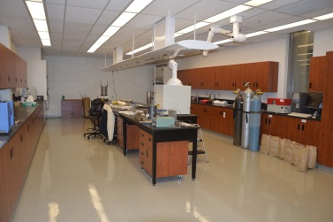
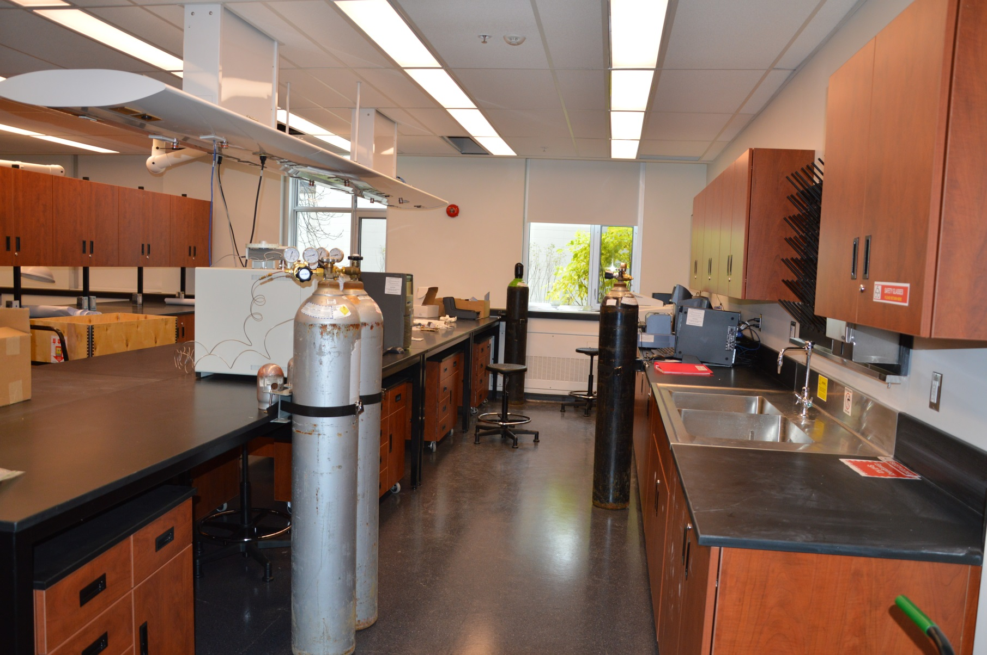
Bio-Renewable Innovation Lab at Guelph
INTRODUCTION
Bio-Renewable Innovation Lab (BRIL) at Guelph is built and located in the Thornbrough Building of University of Guelph.
BRIL composed of two parts: research pilot plant and analytical laboratory.
Research Pilot Plant
Analytical Laboratory
The pilot plant involves research facilities such as supercritical, chemical looping, multi-stage, and circulating fluidized bed reactors, which have helped our group achieving research in three different areas of biomass conversion.
Scientific analytical instruments for both qualification and quantification analyses.
1) Feedstocks pre-processing
2) Thermochemical conversion processes
Elemental Analyzer
(C, H, N, S, O)
GC-FID/TCD
Ultrasonic equipment
Hydrothermal
procesing
Moving bed reactor
Chemical Looping Gasifier
Pelletization
3) Bio-chemical conversion processes
FTIR
DSC-TGA
Bio-syngas Fermentation
Bioethanol and biodiesel facility
Supercritical flow reactor
Multi-Stage downdraft Gasifier
Two-Stage Gasifier-combustor
To know more
Animesh Dutta
(519) 824-4120 ext. 52441
adutta@uoguelph.ca
Bomb Calorimeter
Planetary Ball Mill
(Grinder)
School of Engineering, Mechanical Engineering Program, University of Guelph, Guelph, Ontario, Canada, N1G 2W1

Slide 5

Biomass Conversion Research Program at BRIL
Biomass conversion to Biochemical, Biofuels, and Bioenergy
Thermal gasification
Anaerobic digestion
Wet carbonization / liquefaction
Renewable liquid fuels and chemicals
Dry/steam reforming
Dry torrefaction
Bio-carbon for various application
Bio-carbon for various application
Chemical looping gasification
Process water with dissolved carbon /Biocrude oil
Combustion
Jet fuel/ Drop in Fuel
Renewable liquid fuels and chemicals
Supercritical Gasification
An industrial process of 1 ton/hr is proposed
Life Cycle analysis (LCA) and Life Cycle cost analysis (LCAA)

Slide 6
A hybrid concept for renewable fuels
Part I
Hydrothermal pretreatment
Part II
Part III
Part IV
Gas-to-renewable liquid fuels
Life cycle assessment (LCA)
Biomass Feedstocks Characterization
Syngas fermentation
Dry reforming of biogas from AD
Thermal and supercritical gasification
Life cycle cost analysis

Slide 7
Pros and Cons of Biomass
Carbon neutral, Lesser pollutants
Abundantly available
High alkali and alkaline metals
Fibrous nature-Poor Grindability
High moisture content
Low energy and bulk density
Renewable
“Therefore, biomass is not regarded as an Ideal fuel for energy conversion and hence needs to be pre-processed or pre-treated”

Slide 8
Pre-treatment of biomass research at Bio-renewable Innovation Lab

Slide 9
Research Questions?
Can we produce biocarbon/bioblack from this low quality biomass with similar properties to that of coal (low alkali metals, higher HHV, and higher grindability)?
Will there be any by-product? What can we do to have a value added product?
Reference:
J Minaret, A Dutta 2016. Comparison of liquid and vapor hydrothermal carbonization of corn husk for the use as a solid fuel. Bioresource Technology 200, 804-811
H. Kambo, A Dutta 2015. Comparative evaluation of torrefaction and hydrothermal carbonization of lignocellulosic biomass for the production of solid biofuel, Energy Conversion and Management 105, 746-755
H. Kambo, A. Dutta 2014. Strength, storage, and combustion characteristics of densified lignocellulosic biomass produced via torrefaction and hydrothermal carbonization, Applied Energy 135, 182–191

Slide 10

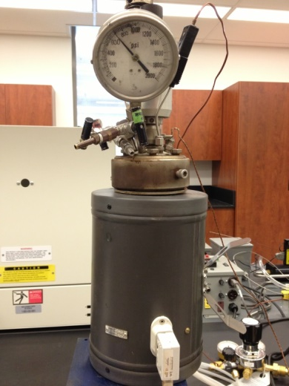
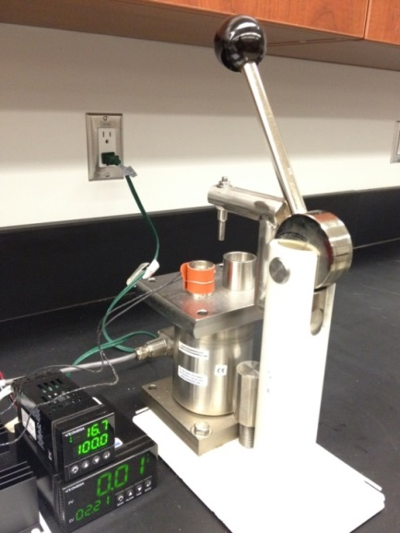
Methods investigated to produce biocabon
Slow Pyrolysis (torrefaction/carbonization)
Hydrothermal carbonization (HTC)
Hybrid HTC and slow pyrolysis
Custom build Macro TGA (a tubular reactor for slow pyrolysis (200-800 C)
Hydrothermal reactor
Pressure: ~ (1.2-5 MPa)
Temperature: 190-260°C
Pelletization
Pressure: ~ 9 MPa
Temperature: 100°C

Slide 11
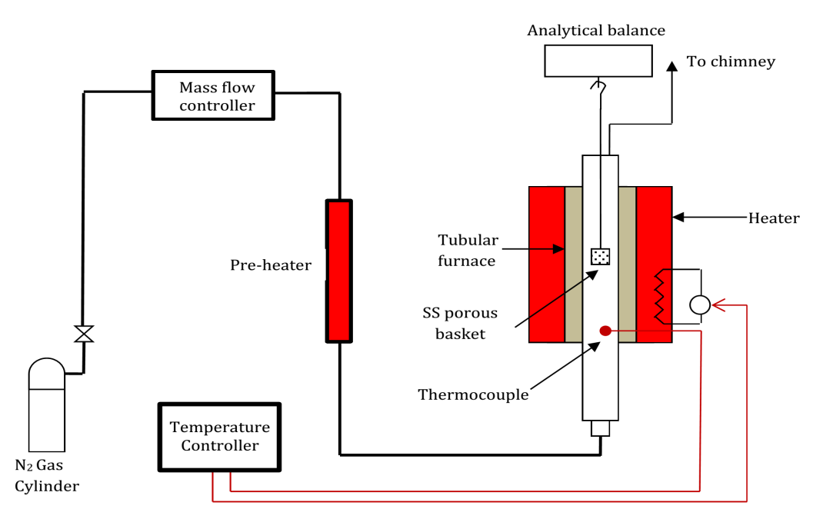
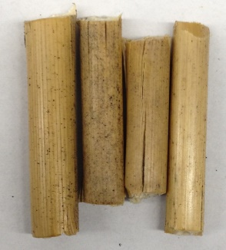
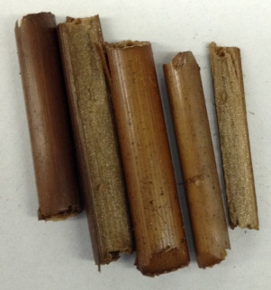
Torrefaction: a mild pyrolysis process
(Conventional/Dry Method)
Typically, biomass is heated in the temperature range of 200-300°C, with residence of 30min to couple of hours under reduced levels of oxygen and atmospheric pressure.
Does Torrefaction converts biomass to an ideal fuel?
Raw Biomass
Torrefied Biomass
Fig1. Schematic Diagram of Torrefaction Reactor

Slide 12
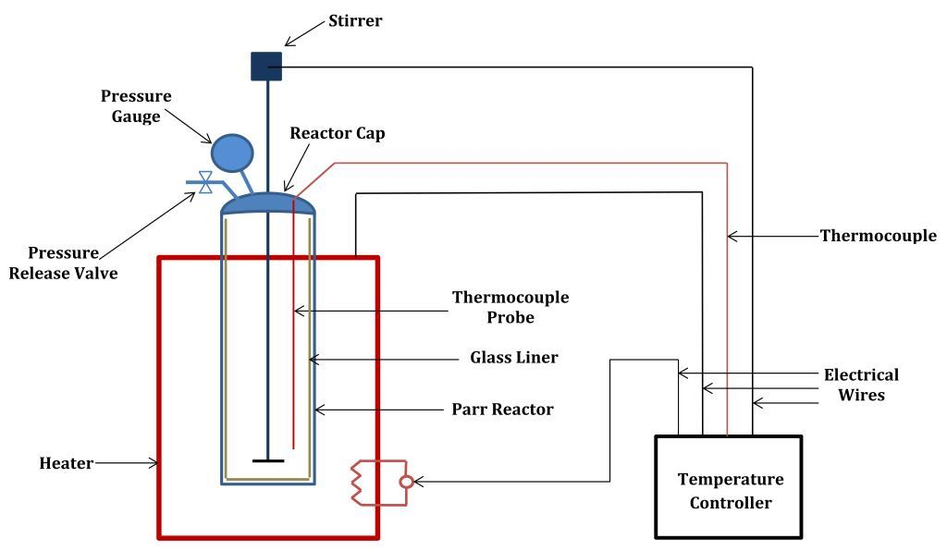
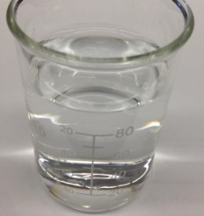
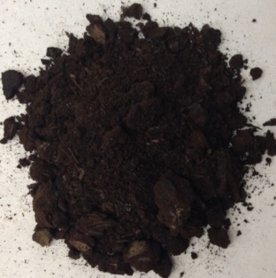
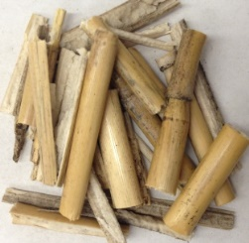
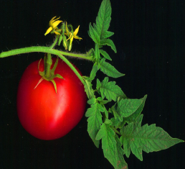
Hydrothermal Carbonisation (HTC)
(A Comparatively New Method)
Biomass is submerged in water and is heated to elevated temperatures (180-260°C) in a confined system, for reaction time of 5mins to couple of hours. Reaction pressure is not controlled and is autogenic with the corresponding temperature of water.
Water
+
HTC Biomass
Biomass
Fig2. Schematic Diagram of HTC reactor

Slide 13
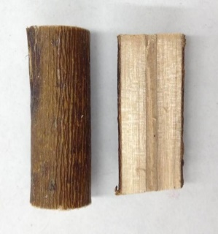
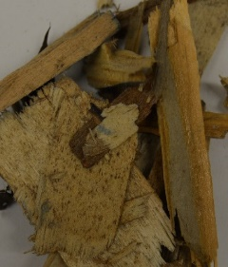
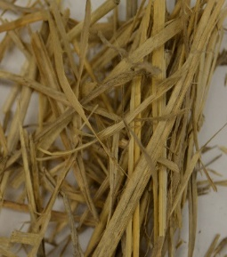
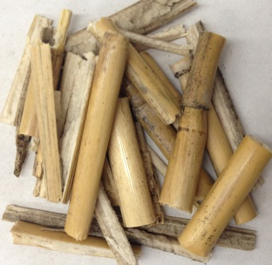
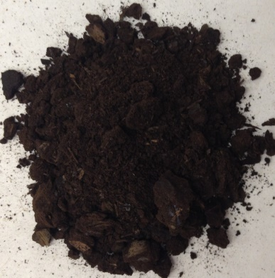
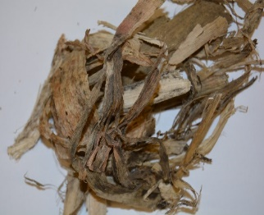
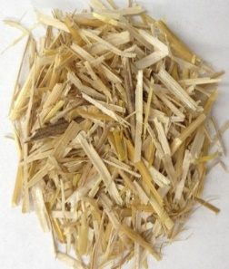


Bio-product development research at Guelph
Bio-carbon
  Soil amendment
Construction Waste
Woody
Biomass
Bio-carbon
  Heat and power production
Willow
Purpose Grown
Biomass
Miscanthus
Switchgrass
Bio-carbon
Charcoal
Wheat
Straw
  Metallurgy applications
Agricultural
Biomass
Corn Stover
Tomato
Vines
Activated Carbon
Wet
Biomass
Corn Husks
  Wastewater treatment

Slide 14



HTC Product Streams
Biocarbon
45-80%
+
15-50%
Gases
2-5%
The distributions & properties of products strongly depends on reaction conditions!

Slide 15

Effect of Pre-treatment on Polymeric Composition
Pre-treatment | Material (Miscanthus) | Hemicellulose (%) | Cellulose (%) | Lignin (%) | Extractives (%) | Ash (%)
HTC | Raw | 36.30 | 38.80 | 11.50 | 12.60 | 0.80
 | 190C-5min | 5.77 | 56.94 | 15.61 | 21.14 | 0.54
 | 225C-5min | 5.11 | 53.38 | 17.75 | 23.08 | 0.68
 | 260C-5min | 0.97 | 27.50 | 30.57 | 39.99 | 0.97
Torrefaction | 260C-30min | 21.46 | 36.21 | 41.31 | 6.20 | 1.02
Raw
HTC-190C
HTC-225C
HTC-260C
Torrefaction-260C
Grinded

Slide 16
Effect of HTC on Higher Heating Value (HHV)
Raw Miscanthus: 18.47MJ/kg

Slide 17
Corn Stover HTC Outcomes
HHV
SY
Notes:
The effect of temperature and time had opposite effects on the HHV and the SY of the hydrochar.
The HHV increased with an increase in temperature with a significant increase occurring from increasing the temperature from 230 to 260 C, while the solid yield decreased with an increase in temperature with a more significant decrease occurring from increasing the temperature from 230 to 260 C.

Slide 18
van Krevelen Diagram
Feedstock(Treatment)-Temp-Time-Pressure
200ºC
230ºC
260ºC
Increased Heating Value
Notes:
It can be observed that temperature and time both effect carbonization process, in fact they are each dependent on each other (i.e. interaction variables).

Slide 19

Van-krevalen diagram
(Effect on H/C-O/C Atomic Ratios)
Existing coal based infrastructure can be used

Slide 20

Effect of Pre-treatment on Alkali and Alkaline Content
HTC processing significantly improve the fuel quality and properties of agricultural biomass by removing most of the barriers that inhabits its wider application

Slide 21


SEM of Corn Husk HTC
Raw Corn Husk
Hydrochar Corn Husk
HTC
Notes:
The HTC process completely destroyed the stalk like structure of the raw CH for both the vapor and liquid HTC treatments.

Slide 22
Effect of pre-treatment on Grindability

Slide 23

Effect of pre-treatment on Hydrophobicity

Slide 24


Effect on Mass and Energy Density
Material | Reaction Time (mins) | Mass Density (kg/m³) | HHV (MJ/kg) | Energy Density (GJ/m³)
Raw Biomass |  | 321.09 | 18.47 | 5.93
Raw Pellet |  | 834.05 | 18.82 | 15.69
HTC-190 | 5 | 886.87 | 20.19 | 17.9
HTC-225 | 5 | 959.39 | 21.62 | 20.74
HTC-260 | 5 | 1035.99 | 25.97 | 26.9
HTC-260 | 30 | - | 29.52 | -
Torrefaction-260C | 30 | 819.55 | 20.34 | 16.66

Slide 25
HTC Product Streams
+
HTC Process Water
Gases
What is in HTC process water and what to do with it?

Slide 26

Characterization of HTC Process Water
HTC processing has the potential to be integrated with anaerobic digestion to enhance gas yield and co-processing of organic waste and agricultural biomass

Slide 27
Part II: Dry-reforming of biogas produced through Anaerobic Digestion and Gasification of biomass to produced syngas

Slide 28

Motivations!
A wide variety of liquid fuels and chemicals can be produced from syngas (CO, H₂)
Dry reforming of biogas:
  CH₄ and CO₂ are both abundant greenhouse gases (4-9% and 9-26% of greenhouse gases [Gaur 2011], respectively). Thus, their utilization as reactants for syngas production to produce liquid fuel and chemicals contributes to carbon footprint reduction and net greenhouse gas emissions mitigation.
Gasification of biomass
  Tar is one important problems of using producer gas from gasification
  Methods to reduce tar are wet scrubber, catalyst and thermal cracking
Ref: Gaur, Sarthak. Dry Reforming of Methane on Rhodium and Nickel Substituted Pyrochlore Catalysts. Thesis. Louisiana State University, Louisiana, 2011. Louisiana State University, Department of Chemical Engineering

Slide 29
Production of Synthesis Gas from Biogas
Steam reforming of methane (SRM).
CH₄ + H₂O → CO + 3H₂ (endothermic)
Dry reforming of methane (DRM).
CH₄ + CO₂ → 2CO + 2H₂ (endothermic)
Partial oxidation of methane.
CH₄ + ½ O₂ → CO + 2H₂ (exothermic)
*Optimal H₂/CO ratio (2:1) for FT synthesis.
Ref:
SG Gopaul, A Dutta 2015. Dry reforming of multiple biogas types for syngas production simulated using Aspen Plus: The use of partial oxidation and hydrogen combustion to achieve thermo-neutrality, International Journal of Hydrogen Energy 40 (19), 6307-6318

Slide 30


Dry-reforming research at BRIL
Simulated biogas (CH₄, H₂, CO₂ and low levels of H₂O) is being used to simulate a combination of DRM and SRM methods using Aspen Plus
Figure 1: Dry reforming- Variation of equilibrium composition with temperatures
(P = 1 bar and an initial ratio CH₄/CO₂ = 1 /1)
Figure 2: Dry reforming- Effect of total pressure on equilibrium composition
(T = 1023 K and CH₄/CO₂ = 1)

Slide 31





Catalytic Supercritical Gasification of Biocrude from Hydrothermal Liquefaction of Cattle Manure
MSHK Tushar, A Dutta, CC Xu 2016
Published in Applied Catalysis B: Environmental, 189, pp. 119–132
http://www.bettervegetablegardening.com/cow-manure-fertilizer.html
https://writersapprentices.wordpress.com/2015/04/20/the-pressure-cooker/
http://eng.marmore.com.tr/pyrolytic-oil-waste-to-crude-oil
http://www.ctgclean.com/tech-blog/2012/04/valves-backpressure-regulating-valves/
http://www.automoblog.net/2011/05/12/hydrogen-refueling-stations-slowly-sprouting-in-us/

Slide 32



FEEDSTOCK PREPARATION
T = 260 C, feed to water = 1:6, t = 30min
Single phase (liquid assisted) liquefaction for CH
Dual phase (vapor assisted) liquefaction for CM
Biocarbon
45-80%
+
Gases
2-5%
15-50%
Corn husk (CH)
Cattle manure (CM)
  Parr Instrument 600ml bench top batch reactor
Proximate and ultimate analyses
TOC, GC-MS and CHNS-O
http://gardenmama.typepad.com/my_weblog/2010/08/-corn-husk-dolls-tutorial-.html

Slide 33

REACTOR (Design and build through CFI_LOF Grant)
Mass flow
controller
Proportional relief valve
Maximum operating pressure and Temperature: 40 Mpa, 1100⁰C
BPR
Preheater
Condenser
Furnace
Preheater
controller
Furnace
controller
HPLC pump

Slide 34
RESULTS AND DISCUSSION
Comparison of hydrogen yield and CGE to other researches
Study and experimental conditions | Catalytic condition | Hydrogen Yield (mol/mol_{carbon}) | Carbon Gasification Efficiency
Present study Cattle manure biocrude (700 °C, 25 MPa) | Unanalyzed | 0.50 | 0.89
 | Ni10%-Ru0.08%/Al₂O₃-ZrO₂ | 1.10 | 0.95
Zhang et al. Sludge and waste newspaper biocrude (700 °C, 24 MPa) | Unanalyzed | 0.52 | 0.90
 | Ni10%-Ru0.1%/Al₂O₃ | 0.49 | 0.97
 | Ni10%-Ru0.1%/AC | 0.85 | 0.92
Byrd et al. Switchgrass biocrude (600 °C, 25 MPa) | Ru/TiO₂ | 0.81 | 0.78
 | Ru/ZrO₂ | -- | 0.67
 | Ni/TiO₂ | 0.69 | 0.74
 | Ni/ZrO₂ | 0.95 | 0.96
 | Co/TiO₂ | 0.56 | 0.83
 | Co/ZrO₂ | 0.71 | 1.02

Slide 35






Multistage air-steam gasification process
Apparatus: Gasifier
Hopper
Reactors
Ash Pit

Slide 36


Experimental Results: Multi-stage air-blow gasification
Wood Gasification: Temperature distribution
Ref: S. Jarungthammachote and A. Dutta. 2012. Experimental investigation of multi-stage air-blow and air-steam gasification. Int. J Energy Res. 36 (3), 335-345

Slide 37

Experimental Results: Multi-stage air-blow gasification
Wood Gasification: Producer gas

Slide 38

Hybrid updraft-downdraft gasification
Primary air flow (PA) | Secondary air flow (SA) | Tertiary air flow (TA) | CO | CO₂ | H₂ | *N₂ | Tar Content
l/min | l/min | l/min | Vol.% | Vol.% | Vol.% | Vol.% | mg/Nm³
60 | 60 | 80 | 23.5 | 7.5 | 9.5 | 59.5 | 19.35
80 | 100 | 80 | 26 | 5.8 | 3.4 | 64.8 | -
80 | 80 | 100 | 30 | 2.7 | 3.9 | 63.4 | -
100 | 120 | 100 | 18.5 | 12.6 | 12.4 | 56.5 | 16.58
80 | 80 | 120 | 32 | 2.3 | 4 | 61.7 | -
80 | 100 | 120 | 27.2 | 3.3 | 4 | 65.5 | -
80 | 120 | 120 | 27.9 | 3.3 | 4 | 64.8 | -
100 | 120 | 120 | 28.4 | 3.2 | 5.6 | 62.8 | 4.53
100 | 120 | 140 | 29 | 3.9 | 4.1 | 63 | -

Slide 39

Temperature distribution inside hybrid gasifier

Slide 40


Innovative Circulating Fluidized Bed-Calcium Looping Gasification developed
Unique features:
  Design is based on CFB technology which is more matured.
  CFB-CLG operates at moderate temperature and atmospheric pressure, thus this makes the operation and maintenance more simple.
Ref:
B. Acharya, A. Dutta, and P. Basu. 2012 An experimental study of calcination/carbonation cycle in a chemical looping gasifier, ACS Journal of Industrial & Engineering Chemistry Research. 51, 8652−8660
B. Acharya, A Dutta and P. Basu. 2010. An investigation on steam biomass gasification for Hydrogen Production with CaO. Int. J Hydrogen Energy, 35 (4), 1582-1589
B. Acharya, A. Dutta and P. Basu. 2009. Chemical looping gasification of biomass for hydrogen enriched gas production with in-process carbon dioxide capture, Energy and Fuels, 23 (10), 5077-5083

Slide 41

Energy balance of the CFB-CLG system
Energy efficiency =87.49 %
Exergy efficiency = 83.14%

Slide 42
Part III: Syngas fermentation for liquid fuels
Ref:
P Roy, A Dutta, and S. Chang 2016. Development and evaluation of a functional bioreactor for CO fermentation into ethanol in Bioresour. Bioprocess. 3:4 DOI 10.1186/s40643-016-0082-z, 1-8

Slide 43
Syngas-fermentation to ethanol-Why?
Gasification-fermentation may offer distinct advantages over both, hydrolysis-fermentation and syngas-metal catalytic conversion:
  the utilization of the whole biomass,
  the elimination of complex pre-treatment steps and costly enzymes,
  a higher specificity of biocatalysts, an independence of the H₂:CO ratio for FTS,
  bioreactor operation at ambient conditions,
  no issue with inorganic catalyst poising due to trace sulphur containing gas and simple gas cleaning.
  besides, traditional fermentations rely on carbohydrates as the carbon and energy source for the microbial growth, syngas fermentation utilizes microorganisms (for example; Clostridium family) capable of metabolizing a less expensive substrates, syngas, for the production of valuable chemicals.

Slide 44





Microbial culture & fermentation
Media
Microbes
Media preparation
Fermentation

Slide 45

Ethanol productivity
Ethanol
Propanol
Formaldehyde
Qualitative analysis of effluent.

Slide 46
Potential value added products
Compound | % (v)
Ethanol | 6.26
1-Propanol | 5.12
Acetic acid | 4.03
Propanoic acid, butyl ester | 0.86
Hydroperoxide, 1-ethylbutyl | 3.74
Propane, 1,1-dimethoxy- | 11.89
Glyceraldehyde | 1.80
Propanoic acid, 2,3-dihydroxy- | 0.64
Ether, 3-methyl-2-butenyl o-tolyl | 2.39
Benzaldehyde | 1.50
Ethyl mandelate | 0.66
4-(t-Butoxy)benzaldehyde | 1.02
.beta.-D-Ribopyranoside, methyl | 3.52
D(+)-Talose | 0.56
Nonanoic acid | 0.14
Propanoic acid | 0.24
Butanal, 3-hydroxy- | 0.60

Slide 47
Part IV: Life Cycle Analysis and Life Cycle Cost Assessment
Ref:
P Roy, A Dutta, B Deen 2015. Greenhouse gas emissions and production cost of ethanol produced from biosyngas fermentation process, Bioresource Technology, 192, 185-191

Slide 48

Life cycle of ethanol derived from biosyngas fermentation
Fig. System boundary.
Torrefaction: 275⁰C for 45 minutes (Acharya, 2013)
Gas cleaning: water scrubber
Distillation: membrane-assisted vapor stripping (MAVS)
Ethanol yield: 0.36–0.39 L/kg-miscanthus
Notes:
The evaluation of the life cycle (LC) of ethanol derived from miscanthus by enzymatic hydrolysis process revealed that miscanthus is a promising feedstock for environmentally and economically viable ethanol in Ontario, Canada.
The product gas can be cleaned with water scrubber or water wash process (Spath & Dayton, 2003; van Kasteren et al., 2005).
The benefit achieved in syngas cleaning process was assumed to be offset by the efforts required in the torrefaction and CLG gasification process.
Simulated (with Aspen Plus V7.3) data (gas composition) have been used to estimate cold gas efficiency and the ethanol yield.
Ethanol yields were normalized to untreated feedstock while evaluating the LC of ethanol, and energy, emission and cost breakdown were worked out.
Although mixed alcohol production has been reported by several authors, Clostridium Ljungdhalii can produce only ethanol from syngas.
Consequently, ethanol is only the final product in the syngas fermentation process.

Slide 49
Results and discussion
14.55
13.20
(S₁: Raw, S₂: Torrefied, S₃: Raw-CLG, S₄: Torrefied-CLG)
Fig. Energy consumption at various stages.
Miscanthus grown on marginal land

Slide 50
Results & discussion
1.27
0.90
0.88
0.81
(S₁: Raw, S₂: Torrefied, S₃: Raw-CLG, S₄: Torrefied-CLG)
Fig. Emission and cost breakdown.

Slide 51
Sensitivity analysis
Fig. Effect of CGE on GHG emissions and production cost.

Slide 52
Concluding remarks
As with every emerging technology, hydrothermal carbonization is currently hardly a competitive stand alone process on the open market.
But if the process can be implemented in an existing infrastructure e.g. AD, compost plant, sewage plant or other businesses which are confronted with large amounts of wet organic waste, HTC can be a financially feasible process.
HTC is a promising research and development field leading to new functional materials (application to biomaterials, energy, carbon sequestration, waste water treatment, Metallurgy, catalyst, biorefinary, nano technology and so on) based on renewable resources.
The economic viability of biocarbon /bioproduct would improve significantly further if it becomes tradable as a carbon offset and if Carbon Tax is applied, thereby making fossil fuels more expensive by comparison.

Slide 53

Take home Message
A Continuous flow pilot demonstration unit is a must before commercialization of this technology

Slide 54
Thank You!
Questions?
Contact:
Animesh Dutta
Associate Professor
School of Engineering, University of Guelph
Ontario, Canada
Email: adutta@uoguelph.ca
Web: www.uoguelph.ca/~adutta/
Citations: http://scholar.google.com/citations?user=UzKorbMAAAAJ&hl=en

