Slide 1
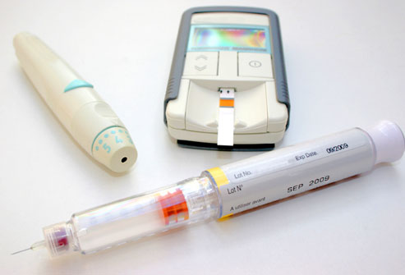
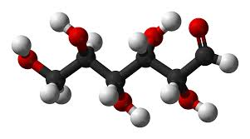
CONTROL OF delta(d) Glucose with Intensive Insulin Therapy is Fundamental to Renal Preservation in Diabetes
By Anil K. Mandal, MB, BS,
Fulbright Scholar
Consultant in Nephrology
Courtesy Clinical Professor of Medicine, University of Florida, Gainesville, Florida
Adjunct Professor of Pathology and Laboratory Medicine, University of North Carolina at Chapel Hill, USA
Mandal Diabetes Research Foundation
tax-exempt charitable organization
St. Augustine, Florida, USA
[1]
Endocrinology 2014
Chicago, Illinois
October 20-21, 2014

Slide 2
Background
Provocative Factors
1. Evidence-based vs Observational Studies
2. Prevailing commercialism in Diabetes Care is the Road to Diabetic Complications
3. High Incidence of Acute Renal Failure associated with use of Angiotensin Converting Enzymes (ACEI) and or Angiotensin Receptor Blocker (ARB)
4.High incidence of End Stage Renal Disease (ESRD) and Dialysis as per above.
[2]

Slide 3
2. Prevailing Commercialism in Diabetes Care is the Road to Diabetes Complications
1. Adult with elevated blood glucose or HbA1c receives automatic diagnosis of Type 2 diabetes
2. Automatic Prescription follows for:
  1. Metformin 500 mg P.O. BID
  2. ACEI/ARB: Lisinopril, Enalapril or Losartan
  3. HbA1c in 3 months
  Let us examine the consequence of these “Bird like” actions
  Answers Follows
[3]

Slide 4
A 75 year old white male went to a urologist’s office for difficulty in urination. Diabetes was detected and treated with Glucotrol XL 10mg PO daily, metformin 500mg PO BID, enalapril 10mg BID, furosemide 40mg daily. One year later admitted to a local hospital with acute renal failure. All previous medications discontinued. Glargine insulin prescribed twice daily and regular insulin by sliding scale. Although glucose control varied over the years, his renal function markedly improved and remained stable through the period.
[4]

Slide 5
3. High Incidence of Acute Renal Failure
42 Y WF, Hospital Admission , August 2012
Admitting Diagnosis: Vomiting, Low BP and ARF. History of Hypertension
Home Medication: Amitriptyline, Fluoxetine, Clonidine patch and Telmisartan (Micardis ®) 40mg daily and HCTZ 25mg daily.
BP 75/30
[5]

Slide 6
42 y WF (Continued)
Telmisartan discontinued
Bicarbonate Infusion (900 ml normal Saline Solution + Sodium bicarbonate 100 ml = 1000 ml) started at 60 ml/ hour for 72 hours.
Her BP increased rapidly requiring Atenolol 50mg P.O. daily and Chlorthalidone 25mg P.O. which brought her BP down to normal level
[6]
Serial Lab shown next …

Slide 7
42 y WF (Continued)
Date 2012 | BUN/Scr (mg/dL) | eGFR (ml/min) | Na+/ K+ (mmol/L) | C02 (mmol/L) | Hb (g/dL)
Aug 01 | 24/4.27 | 12 | 129/4.6 | 22 | 9.4
Aug 02 | 17/2.46 | 23 | 133/5.2 | 23 | 10.5
Aug 03 | 13/1.73 | 34 | 136/3.9 | 30 | 8.7
Aug 06 | 11/1.22 | 52 | 136/4.7 | 26 | 10.9
Aug 7 | 10/1.13 | 56 | 134/4.7 | 25 | 11.6
Scr= serum Creatinine eGFR= estimated glomerular filtration rate Hb= Hemoglobin
[7]

Slide 8
Patient retook Telmisartan by mistake after returning home.
Developed persistent vomiting and readmitted to hospital
Sodium Bicarbonate Infusion given
Date 2012 | BUN/Scr mg/dL | eGFR ml/min | Na+/K+ mmol/L | Co2 Mmol/L
Aug 11 | 27/3.90 | 14 | 136/3.3 | 25
Aug 12 | 26/4.26 | 12 | 134/3.5 | 22
Aug 13 | 16/2.68 | 21 | 135/3.6 | 31
Aug 14 | 12/2.24 | 26 | 140/4.1 | 32
Aug 15 | 10/1.93 | 30 | 136/3.7 | 33
Aug 16 | 10/1.82 | 33 | 141/4.3 | 30
Aug 17 | 7/1.67 | 36 | 140/4.4 | 27
Dec 15 | 11/1.74 | 34 | 137/4.5 | 26
Office visit in 2014
Feb 25 | 20/1.32 | 47 | 134/3.0 | 29
[8]

Slide 9
3. Causality of ACEI-ARF lead to high incidence of ESRD in diabetes
Acute kidney injury episodes are associated with cumulative risk for CKD in diabetes independent of other risk factors of progression [1].
[1] Thakar CV, etal. Clin J Am Soc Nephrol 2011; 6: 2567-2572
[9]

Slide 10
The power of commercial interest for high Incidence of ESRD
The pendulum has swung from glycemic control to proteinuria control, even to microalbuminuria control with ACEI and/or ARB. A published report described these drugs as renoprotective in diabetes.*
*Lewis EJ. The effect of angiotensin converting enzyme inhibition on diabetic nephropathy. N Engl J Med 1993; 329: 1456-1462.
Result: High incidence of ESRD.
[10]

Slide 11
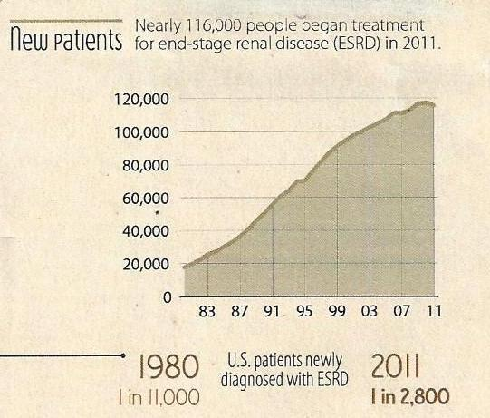
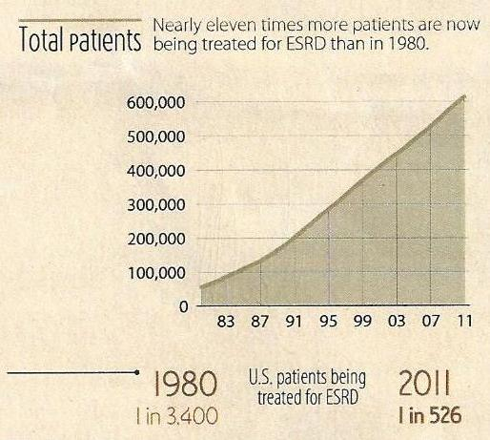
Question:
Why do so many patients including diabetics develop ESRD?
[11]

Slide 12
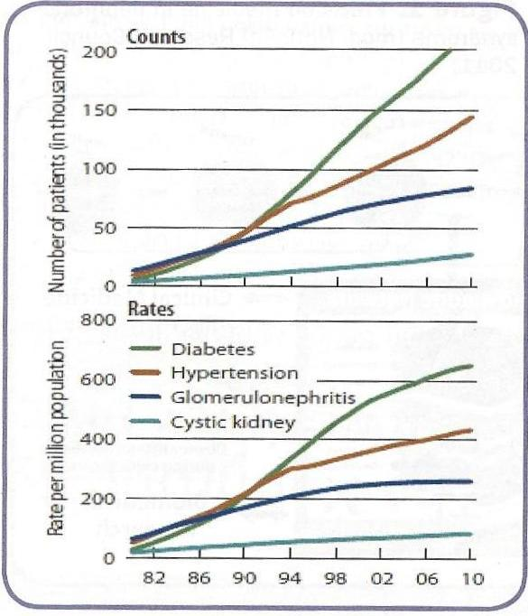
US RENAL DATA SYSTEM
Incidence of ESRD by Primary Diagnosis
QUESTION: Again Why and How?
[12]

Slide 13
New Horizon (Intent)
Intent: Preservation of Renal Function in Diabetes Steps taken by presenter to accomplish the goal:
Understanding pathobiology of high glucose medium (hyperglycemia) on vascular lining cells (endothelial cells).
Impact of 2hPPG on renal function.
Innovation of dglucose as Predictor of Renal Function
Effect of new paradigm of insulin therapy and complete exclusion of use of ACEI/ARB in treating diabetes.
2hPPG= 2-h Postprandial Glucose
[13]

Slide 14
Pathobiology of High Glucose
Mandal, et.al. Kidney Int 2000; 57: 2492 – 2501
Mandal, et.al. Histol Histopathol 2006; 21: 941-950
Vascular endothelial cells (ECs) of porcine and human origin cultured for growth of cells and treated with normal concentration of glucose (90mg/dL or 5mmol/L) or high concentration of glucose (540mg/dL or 30mmol/L) for 2, 6 or 10 days.
Why vascular ECs and not other cell types? Evidence indicates that vascular ECs are most vulnerable to injury by high glucose levels.
Brownlee M. Diabetes 2005; 54: 1615 - 1625
Scanning and transmission electron microscopy done to assess detailed morphological changes.
[14]

Slide 15
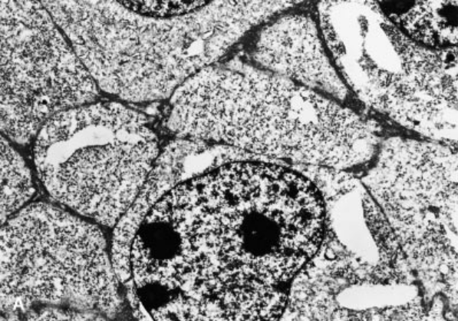
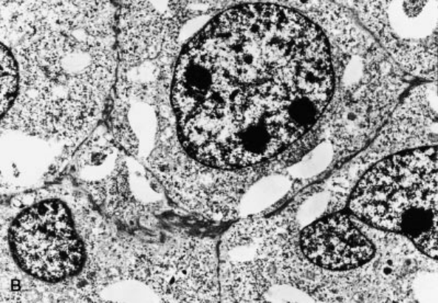
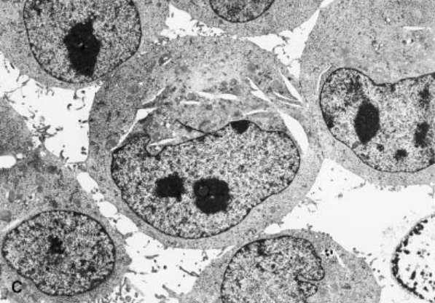
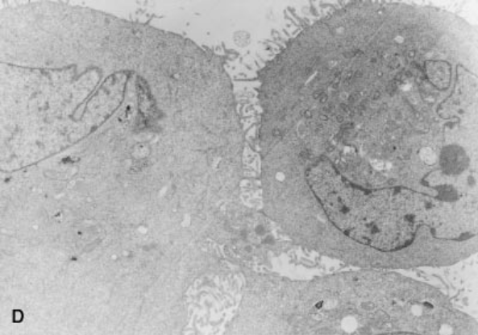
Transmission electron microscopy study of ECs.
(A) ECs treated with FCS (control) show complete adhesion between cells with intact intercellular membrane (36500).
(B) ECs treated with physiological concentration of glucose (5 mmol/L or 90 mg/dL) show no difference from control study (36500).
(C) ECs treated with pathological concentration of glucose (30 mmol/L or 540 mg/dL) show wide separation of the cells (as in Figs. 1B and 2A) with complete loss of intercellular microvilli. Intercellular microvilli have disappeared or fragmented (36500).
(D) Ecs treated with pathological concentration of glucose and insulin (20U/100 mL) show adequate intercellular microvilli and adhesion (36500).
C = crystalline structures suggesting glucose crystals in the middle cell.
[15]
adapted from: Mandal, et.al., Kidney Int 2000: 57: 2492-2501

Slide 16
Unified Mechanism for
Microvascular complications
Damaged Vascular Ecs
Shed off
Occlusion of microvascular apparatus
Slow ischemia
[16]
Brownlee M: Pathophysiology of diabetic complications: a unifying mechanism in Diabetes 2005; 54: 1615-1625

Slide 17
Prevention of
Endothelial Cell Damage
Treatment of high glucose with insulin results in mitigation of ECs damage and repair as shown
[17]

Slide 18
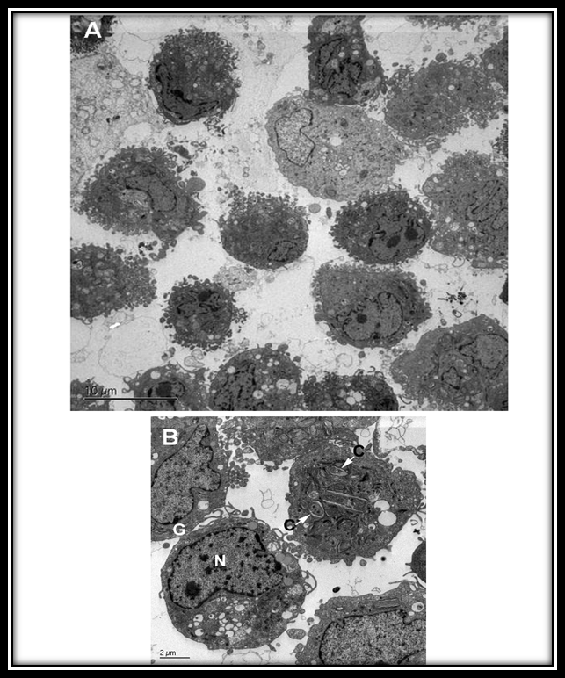
Endothelial Cell Damage (continued)
A. Glucose and Insulin
B. Glucose + Insulin + Heparin
[18]

Slide 19
Impact of 2hPPG
Patients with 2hPPG
> 11.1 mmol/L (>200mg/dL) even when FBG was unequivocally normal, are at the highest risk of developing complications*.
* Harris MI. Undiagnosed NIDDM: Clinical and public health issues. Diabetes Care 1993; 16: 642-652
[19]

Slide 20
Impact of 2-hPP Hyperglycemia (continued)
2-hPP hyperglycemia is well correlated to cardiovascular disorders in many studies. One such study is illustrated on the next slide.
[20]

Slide 21
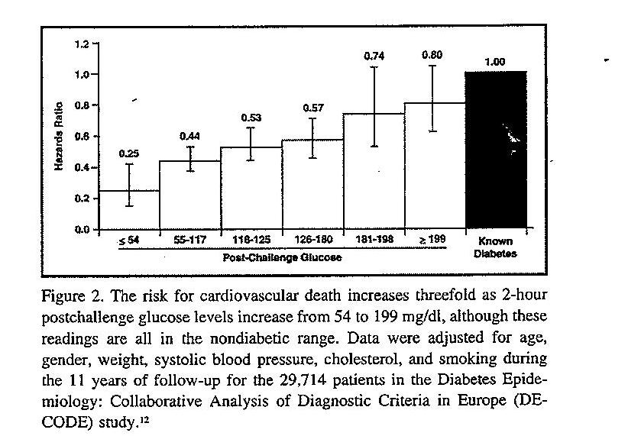
Impact of 2-hPP Hyperglycemia (continued)
Decode Study Group. Is the current definition of diabetes relevant to mortality risk from all causes and cardiovascular and non-cardiovascular disease? Diabetes Care 2003; 26: 288-696
*
[21]

Slide 22
Paradigm of Therapy by Mandal Diabetes Research Foundation
In order to obviate the dilemma between FBG and 2hPPG, we innovated the factor of dGlucose (2hPPG – FBG).
This is shown on the next two slides.
[22]

Slide 23
Paradigm of Therapy by
Mandal Diabetes Research Foundation
A novel approach with introduction of dGlucose (2hPPG – FBG) and related dglucose results with the same calculated differences for serum creatinine (dscr) and estimated glomerular filtration rate (deGFR) in a study of 56 insulin treated diabetic subjects.
Mean age 68.7 + 13.5 (years)
Results shown in next slide.
[23]

Slide 24
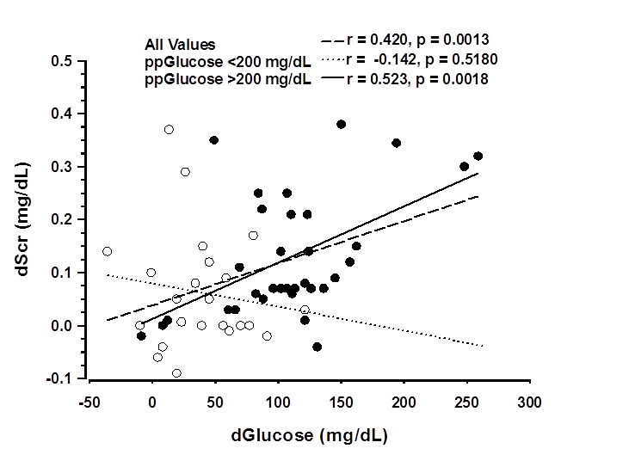
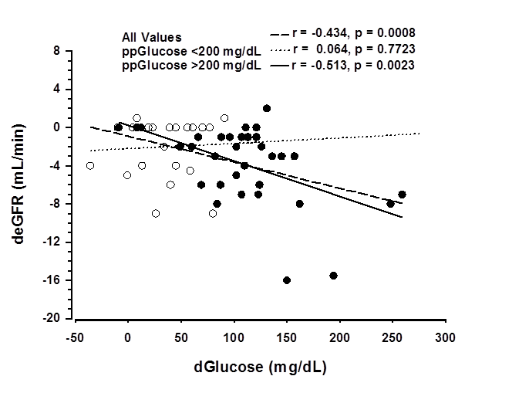
Correlation between dScr and dglucose and correlation coefficients and p values are shown for all 56 patients (dashed line, all data points), for patients whose 2hPP glucose is greater than 200 mg/dL (solid line, black circles, n = 33) and for patients whose 2hPP glucose is less than 200 mg/dL (dotted line, open circles, n = 23)
Correlation between deGFR and dglucose and correlation coefficients and p values are shown for all 56 patients (dashed line, all data points), for patients whose 2hPP glucose is greater than 200 mg/dL (solid line, black circles, n = 33) and for patients whose 2hPP glucose is less than 200 mg/dL (dotted line, open circles, n = 23).
Figures Adapted from Mandal AK and colleagues. Diab Res Clin Pract 2011; 91: 190-194
[24]

Slide 25
Control of dglucose (2hPP-F) is Fundamental to Renal Preservation in Diabetes (in Preparation)
We previously reported that dglucose is predictive of renal function changes in diabetes
This is an expanded study
85 diabetic patients M: F 34:51 60.8 ± 13.8 years
Mean Duration of Treatment 26.3 ± 24. 6 months
Diabetes Treatment: Combination of Glargine or detemir (12 h apart) and regular insulin before meals and bedtime.
BP control: Any antihypertensive drug with exclusion of ACEI/ ARB drugs.
[25]
Notes:
ssss

Slide 26
Results (ISD) Explain
Variable | First Visit | N | Last Visit | P Value
FBG (mg/dl) | 175.2 ± 83.6 | 59 | 166.2 ± 87.9 | NS
2hPP (mg/dl) | 244.0 ± 98.2 | 57 | 217.2 ± 94.8 | NS
FScr (mg/dl) | 1.11 ± 0.44 | 60 | 1.11 ± 0.45 | NS
2hPP SCR (mg/dl) | 1.22 ± 0.53 | 50 | 1.27 ± 0.60 | NS
FeGFR (ml/min) | 68.2 ± 26.3 | 60 | 65.8 ± 26.3 | NS
2hPP eGFR (ml/min) | 61 ± 24.3 | 50 | 58.3 ± 23 | NS
Dglucose (mg/dl) | 63.5 ± 68.1 | 41 | 36.6 ± 65.6 | 0.0449
Siting SBP (mmHg) | 133.1 ± 17.1 | 74 | 128.4 ± 13.9 | 0.0319
Sitting MBP (mmHg) | 98.9 ± 11.3 | 74 | 95.41 | 0.0151
HbA1c (%) | 8.2 ± 2.0 | 29 | 8.2 ± 1.8 | NS
SBP=Sitting systolic blood pressure
MBP=Mean arterial blood pressure
[26]

Slide 27
Correlation
Between
dglucose and
drenal function
Parameters
    Shown NEXT
[27]

Slide 28
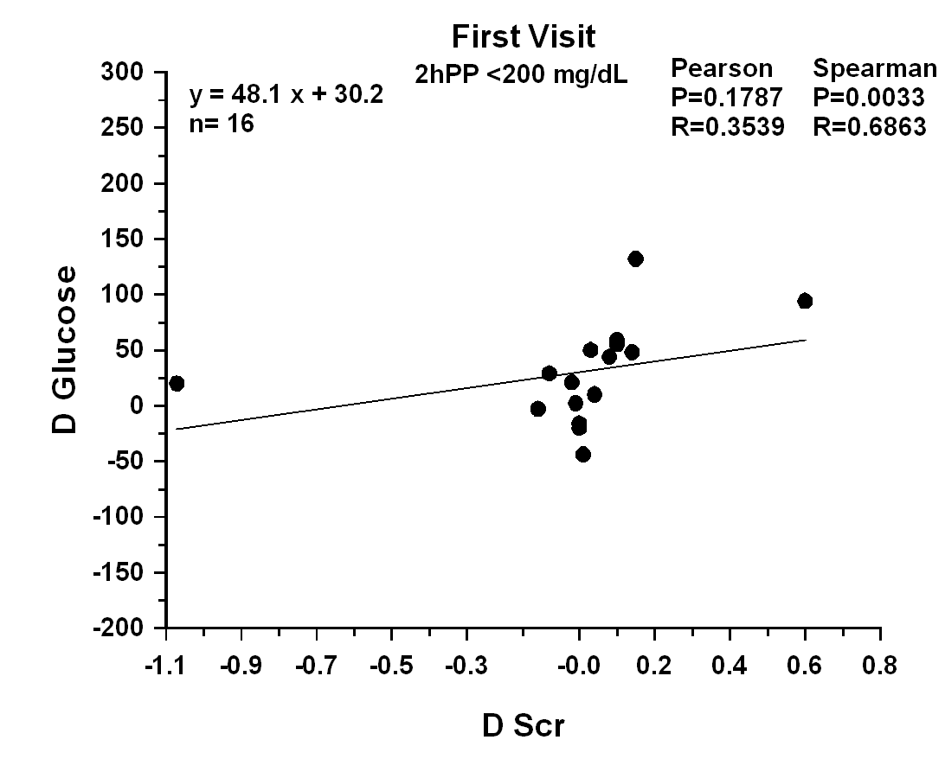
[28]

Slide 29
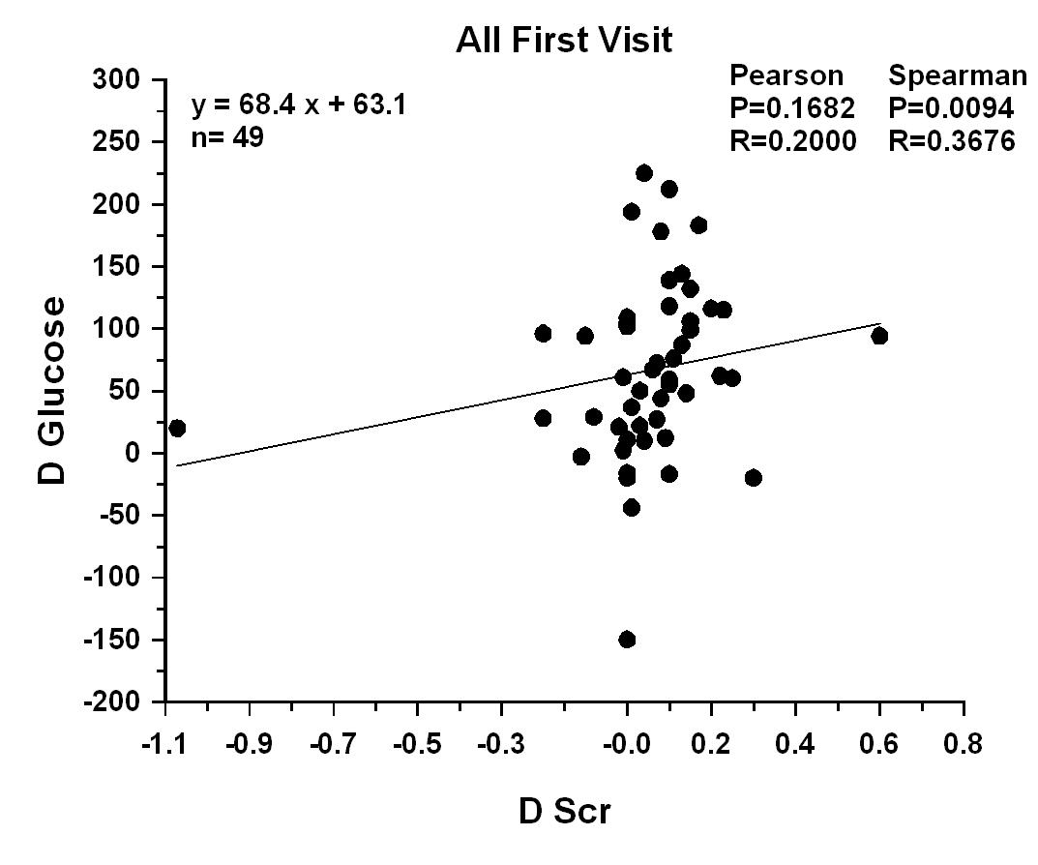
[29]

Slide 30
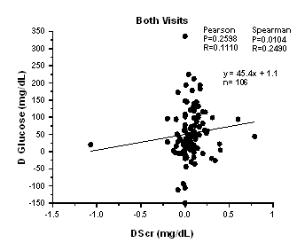
[30]

Slide 31
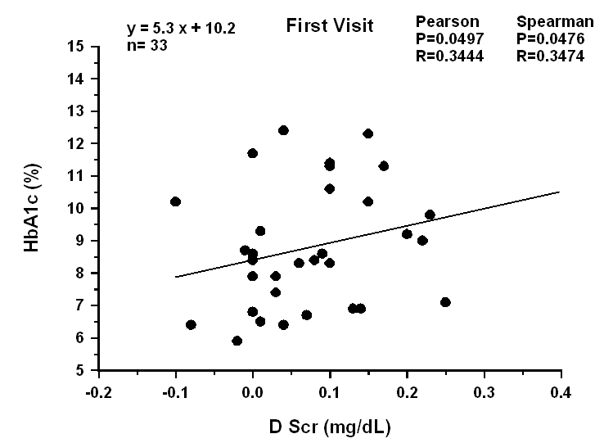
[31]

Slide 32
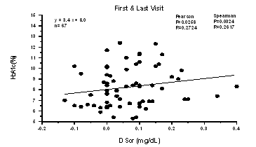
[32]

Slide 33
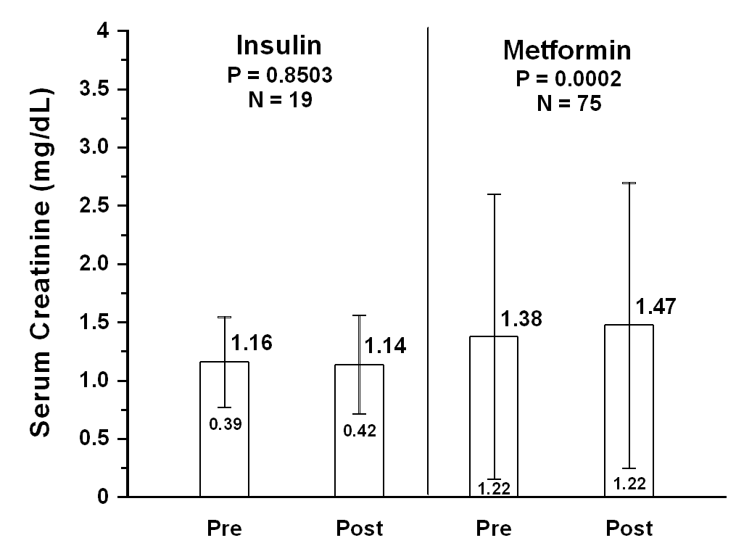
Serum Creatinine comparing Pre and Post Treatment in Insulin or Metformin Treated Patients
Serum creatinine was significantly increased in metformin but not insulin treated patients. Mean ± SD.
[33]
To be presented in American Society of Nephrology, November 15, 2014, Philadelphia

Slide 34
PEARL OF WISDOM
1. Renal function preservation in diabetes is attainable with insulin therapy and vigilant care*
*Mandal AK. Frequent Office Visits of patients with Chronic Kidney Disease is a prelude to prevention of dialysis. World Jour Nephrol 2014; 6: 1-5.
2. Application of d (2hPP-F) glucose is essential to determine relationship between glycemic control and renal function changes.
3. Thus it is essential to order Fasting and 2hPP basic metabolic panel in all diabetes patients
4. Our studies reinforce the importance of exclusion of ACEI/ARB in prevention of ESRD in diabetes.*
*To be presented in American Society of Nephrology November 15, 2014, Philadelphia
[34]

Slide 35
Reminiscent of Discovery of Diabetes and Insulin
Diabetes mellitus is due to a deficiency of the internal secretion of the pancreas. The main principle of treatment is to correct this deficiency.
If it is found that the patient is unable to keep sugar-free on a diet that is compatible with an active, useful life, sufficient insulin is administered to meet this requirement.
In severe cases, insulin to be administered subcutaneously three times daily, from one-half to three-quarters of an hour before meals. This was done so that the curve of hypoglycemia produced by insulin was superimposed on the curve of hyperglycemia produced by the meal.
In rare cases, a small fourth dose of insulin was given at bedtime to control nocturnal glycosuria.
The less severe cases could be satisfactorily treated on a morning and evening dose, or a single dose before breakfast.
Banting: Nobel Prize Speech delivered in Stockholm. September 25, 1925
[35]

Slide 36

Thank You
The practice of medicine is an art of observation and not all science.

