Slide 1

Movement of Arsenic in Amon (Monsoon) Rice Plants Cultivated on Arsenic Contaminated Agricultural Fields of Nadia District, West Bengal
Presented by:
Anil Barla
Indian Institute of Science Education & Research Kolkata
(IISER-K)

Slide 2
Introduction
India is one of the world's largest producers of rice, whereas W.B. is the largest producer in India.
For its cultivation huge volume of water is required.
Ground water of W.B. was also found to be contaminated with As (Kinniburgh, 2001 & Smith , 2000).
Long term use of As rich water results in increase the concentration of As in soil as well as in paddy plant

Slide 3
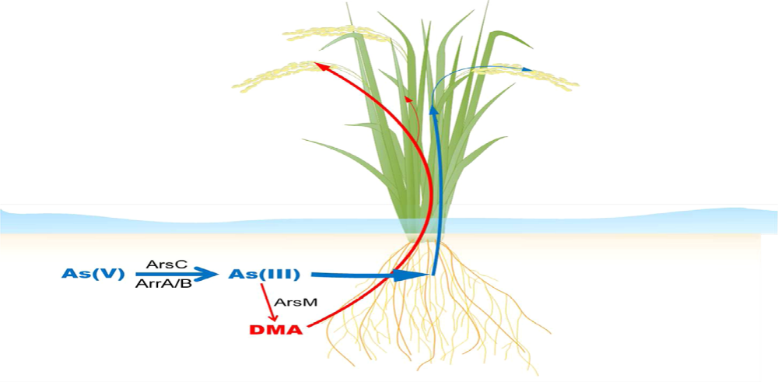
Fig 1. Movement of As from soil to plant (Zhao et al., 2013)

Slide 4
Aim & Objective
Aim:
Arsenic distribution in Amon rice plant during monsoon of Nadia District, West Bengal
Objective:
Analysis of rice paddy for the assessment of arsenic and other heavy metal uptake.

Slide 5
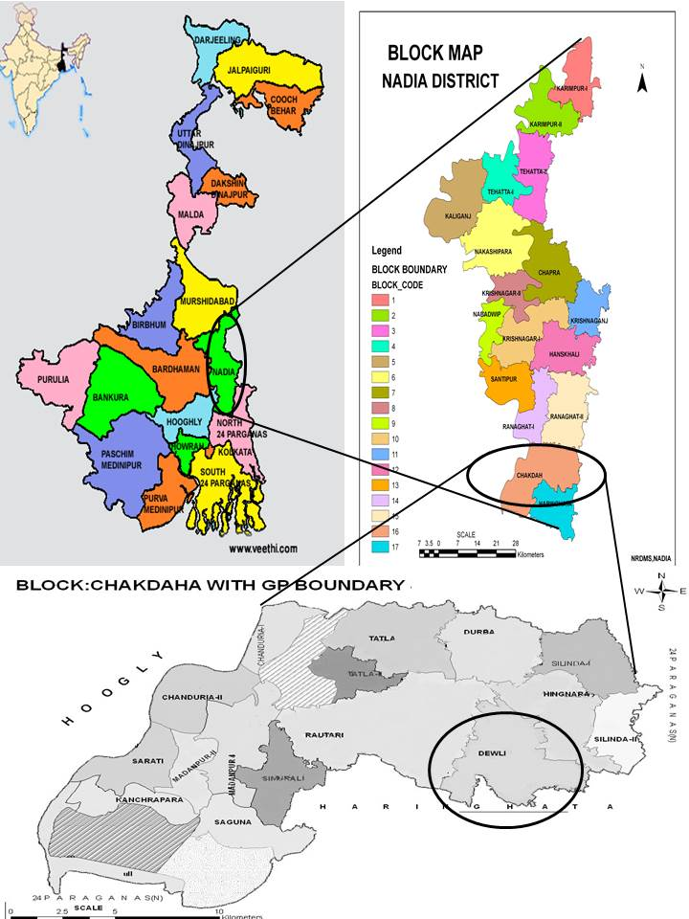
Study Area
Study has been done in
Sarapur, Chakdah Block,
Nadia District,West Bengal
(23° 01’ 14.27’’N, 88° 38’ 27.17’’E)

Slide 6
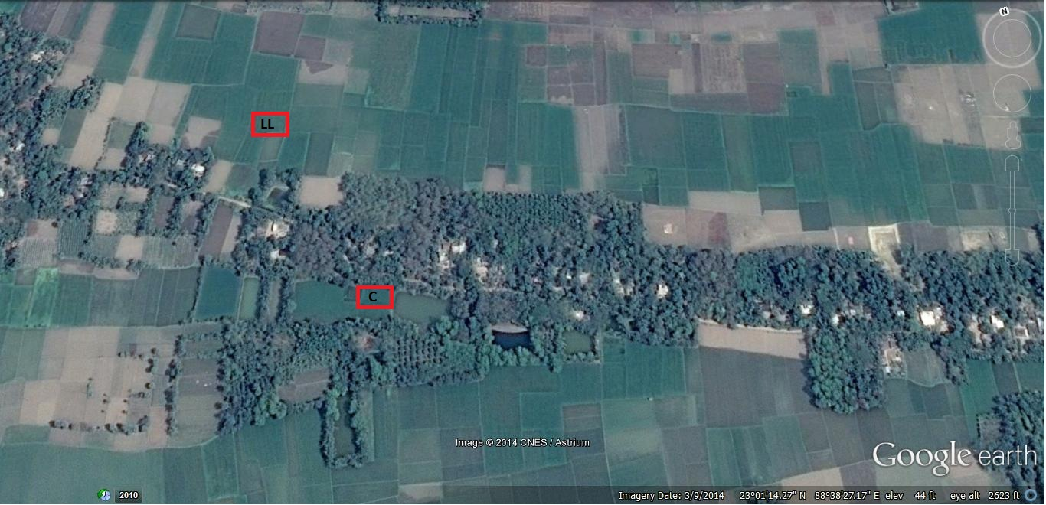
Image of field site
LL
C

Slide 7
Materials and Methods
pH, EC and ORP were measured by Hach kit.
Organic Carbon was determined by Walkey - Black method.
Water samples were acidified and analyzed using ICP-MS.
Soil and plant sample were digested and analyzed using ICP-MS.

Slide 8
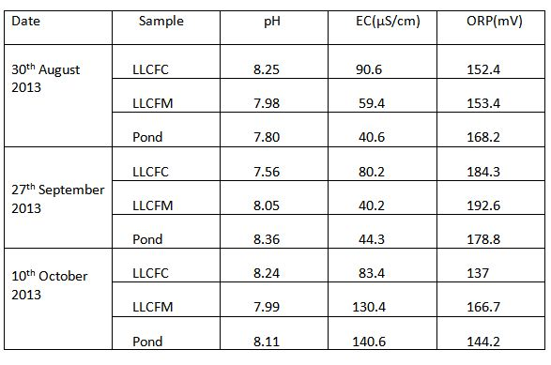
Results and Discussion
Table 1: Physicochemical analysis of soil
NB:
LLCFC- Low Land Continuous Flooding Corner
LLCFM-Low Land Continuous Flooding Middle

Slide 9
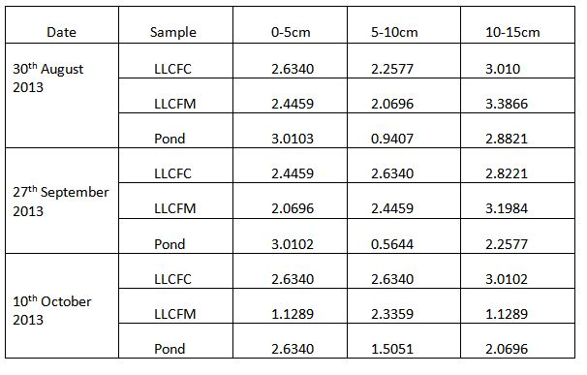
Table 2: Organic Carbon analysis of soil (%)
NB:
LLCFC- Low Land Continuous Flooding Corner
LLCFM-Low Land Continuous Flooding Middle

Slide 10
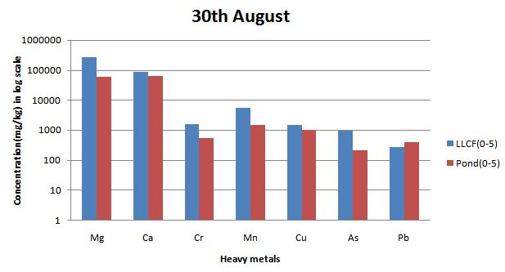
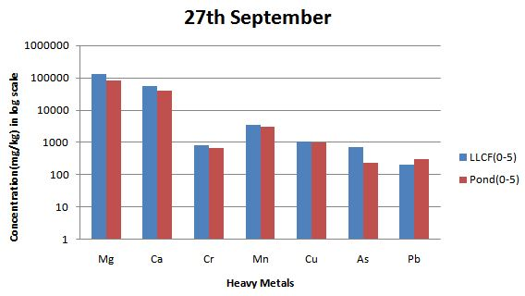
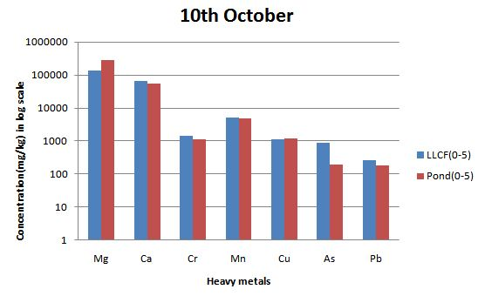
Graph 1: Comparison between Low Land and Control Field heavy metals content

Slide 11
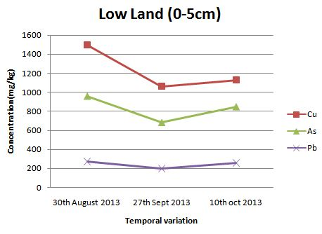
Soil profile wise temporal variation in heavy metals content
Graph 2: Showing temporal variation in 0-5cm in low land

Slide 12
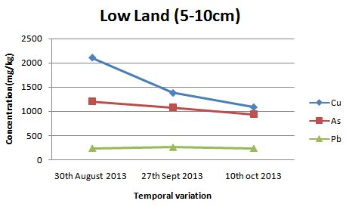
Contd..
Graph 3: Showing temporal variation in 5-10cm in low land

Slide 13
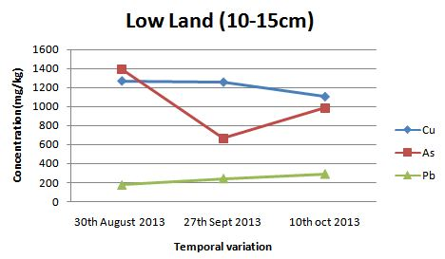
Contd..
Graph 4: Showing temporal variation in 10-15cm in low land

Slide 14
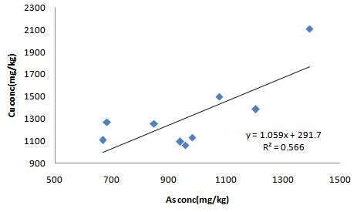
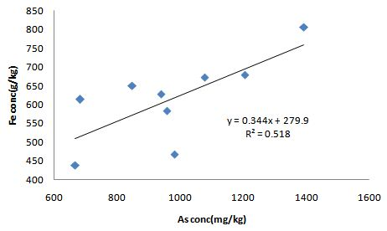
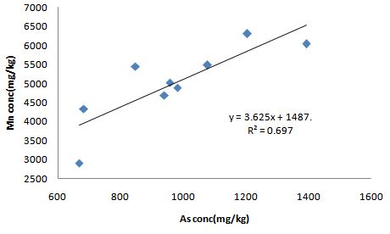
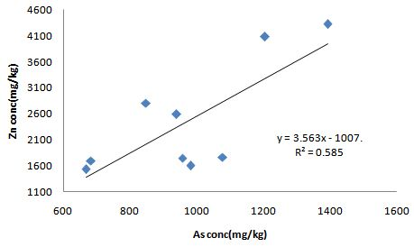
Graph 5: Correlation between As and different heavy metals in low land soil

Slide 15
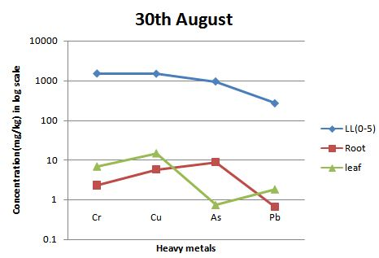
Bioaccumulation of different heavy metals by different rice plant part
Graph 6: Showing heavy metal content in low land soil and respective bioaccumulation in different rice plant parts on 30th Aug 2013

Slide 16
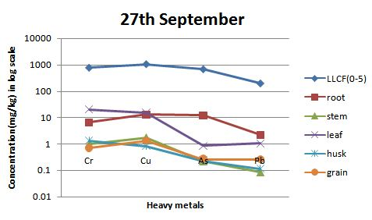
Contd..
Graph 7: Showing heavy metal content in low land soil and respective bioaccumulation in different rice plant parts on 27th Sept 2013

Slide 17
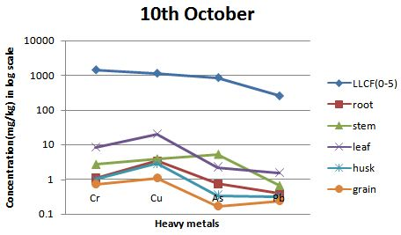
Contd..
Graph 8: Showing heavy metal content in low land soil and respective bioaccumulation in different rice plant parts on 10th Oct 2013

Slide 18
Comparative study of Arsenic in different rice paddy parts

Slide 19
Conclusions
Arsenic content in soil is positively correlated with different heavy metals.
Heavy metals content in low land is higher than the control field due to pre-amon, boro cultivation with heavy metal contaminated shallow ground water.
There is a gradual decrease in bioaccumulation of heavy metals content as we move from root to grain in rice paddy.
The present study reveals that rice grown in the study area is safe for consumption, for now. But, the arsenic accumulation in the crop should be monitored periodically as the level of arsenic toxicity in the study area is increasing day by day.

Slide 20
References
Bhattacharya I P, Samal A. C, Majumdar J. and Santra S. C.(2009)::Transfer of Arsenic from Groundwater and Paddy Soil toRice Plant (Oryza sativa L.): A Micro Level Study in West Bengal, India. World Journal of Agricultural Sciences 5 (4): 425-431,
Kinniburgh D G, Smedley P L. (2001) Arsenic Contamination of Groundwater in Bangladesh; British Geological Survey (BGS) and Bangladesh Department for Public Health Engineerin (DPHE): Keyworth, UK.
Meharg A A , Jardine L. (2003) Arsenite transport into paddy rice (Oryza sativa) roots. New Phytol. 157, 39–44
Smith A H, Lingas E O, Rahman M. (2000) Contamination of drinking-water by arsenic in Bangladesh: A public health emergency. Bull. W. H. O. 78, 1093–1103.
Walkey A, Black I A. (1934) An examination of the degtjareff method for determining soil organic matter and a proposed modification of the chromic acid titration method. Soil Sci. 37, 29–38.
Zhao F J, Zhu Y G, Meharg A A. (2013) Methylated arsenic species in rice: geographical variation, origin and uptake mechanisms. Environ Sci Technol. 47, 3957-3966.

Slide 21
Acknowledgement
I would like to thank Hydrology & Meteorology 2014 and OMICS group for providing me a platform to present my work.
I would also like to thank Dr. Sutapa Bose (Ramanujan Fellow, Principle Investigator) for guiding me throughout the project.
I would also like to thank Ms. Anamika Shrivastava and Mr. Surjit Singh for their support
Finally, I would like to thank UGC for providing Contingency grant

Slide 22
Thank you !!!

