Slide 1
Is the current analysis of MAHs of ‘off-label use’ constructive?

Slide 2
Current landscape
Off-label use is the intentional use of a drug outside the authorised product information.
Off-label use might be done due to unavailable authorised products for a specific age group (e.g. off label use in children) or therapeutic groups (e.g. anti-bacterial agents).
Off-label use has to be collected by MAHs for further assessment and evaluation.

Slide 3
Impact
Off-label use might be done due to unavailable authorised products for a specific age group (e.g. off label use in children)
Safety risk of patient health
Off-label use in therapeutic groups (e.g. anti-bacterial agents)
Impact on general public health in case of increase in resistance

Slide 4

What MAHs do
Collect and track any off-label use (regardless if reported directly as such or indirectly)
Request for further information (follow-up)
Literature reviews
Drug Utilisation Studies

Slide 5
What MAHs receive
Nearly 80% of follow-up requests without further reply
Literature review providing vague information about safety
DUS providing only general overview

Slide 6
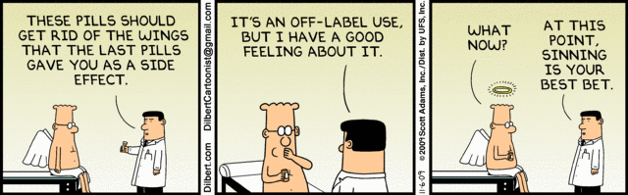
Are MAHs in the position to perform meaningful ‚off-label use‘ analysis?
Within the European Union, a recent study revealed that a majority of published studies reporting levels of 20% or higher for the use of off-label medication and more than 55% when looking at the percentage of doctors prescribing off-label.

Slide 7
Methodology
Database: European database of adverse drug reaction reports
Analysis: The total number of reported cases and the number of reported off-label use was calculated for 7 antibiotics. The data include all reports up to March 2017.
Real data: Based on feedback from physicians via interviews, nearly 50% prescribed antibiotics off-label.

Slide 8
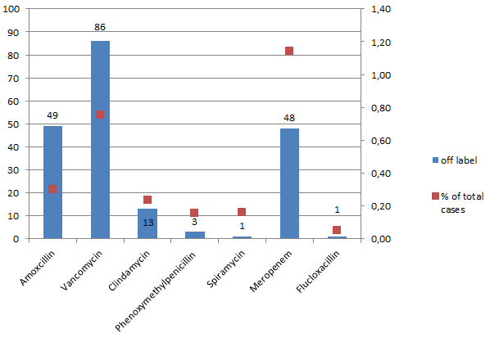
Reported Off-label use
The total number of reported ‘off-label use’ cases for specific antibiotics and percentage in regards to the total number of reported cases in the European database of adverse drug reaction reports

Slide 9
Conclusion
There is an underreporting of off-label use cases to MAHs.
Leading to data of poor quality and evaluability
Taking appropriate measures not possible for MAHs
Any benefits for treating physicians?

Slide 10
Are changes required?
Focus should be that collection of ‘off-label use’ results in meaningful and useable data.
The analysis process of off-label use should therefore be adopted to reflect the current situation which might lead to a better use of knowledge and current treatment methods of physicians.

Slide 11
Suggestions for improvement
Independent off label analysis done by research groups for authorities (no MAH involvement)
Change of market authorisation process
Change of legal frameworks to issue temporary recommendations for use and permission to prescribe (e.g. a system where prescribers or their organisations have to ask for permission to use a product off-label)
Change of treatment guidelines
Better information process for physicians and patients/consumers

Slide 12
Thank you for your attention
Any questions?

