Slide 1
How to ensure high quality output in a constantly changing work environment?

Slide 2
Current landscape
Since 2012 the requirements for Pharmacovigilance changed constantly.
The new GVP modules within the EEA provided guidelines, but could still be interpreted differently by competent authorities and MAHs leading to
differences in feedback within the same authority,
differences in feedback between authorities, and
constantly changing working instructions within companies.

Slide 3
Impact
How and what kind of data was collected and processed changed with gaps in implementation of changes
Differences in data quality
Differences in interpretation of pharmacovigilance data

Slide 4

What all want in PV
High quality data output and performance throughout the complete life cycle of a product

Slide 5
How to achieve good data output
Usually: Constant trainings
Done via annual re-fresher trainings following success control via tests
Problem: Lacking efficacy and risk assessments of trainings

Slide 6

Is the current training model fitting to the needs?
New changes in requirements results in
‘best to one’s knowledge’ practice,
waiting for feedback from authorities.
Therefore, is the current training model within drug safety/Pharmacovigilance still adequate?

Slide 7
Methodology
Assumption: Lack of training results in incorrect or missing activities of MAHs. Authorities can find these deficiencies through inspections of MAHs.
Analysis: Public Pharmacovigilance metrics reports from the MHRA were analyzed to see the changes in the number of findings over time.
The data include all findings from 2012 to 2016.

Slide 8
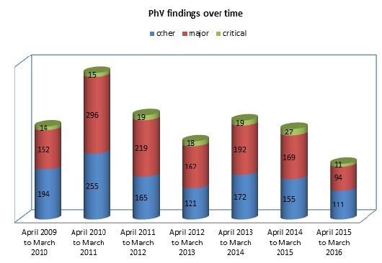
Pharmacovigilance findings over time
The total number of findings during inspections as reported by the MHRA in their metrics reports.

Slide 9
Conclusion
The introduction of the new Pharmacovigilance guidelines in 2012 led to another peak of findings in the period April 2013 to March 2014.
The current general trend in total numbers is showing a decrease in findings but fluctuation in number of critical findings.
Does the decrease really means increase in data quality and hence efficient trainings?

Slide 10
Suggestions for improvement
Following GMP guideline for qualification and validation
Life-cycle-approach for Pharmacovigilance training is chosen which means
continuous monitoring of personal qualification,
effectiveness measurements of training, and
risk management of training

Slide 11
Thank you for your attention
Any questions?

