Slide 1



Cytokine analysis to differentiate immunomodulatory properties of Lactobacillus paracasei strains and for the identification of potentially unsafe strains
Angelo Sisto¹, Palmira De Bellis¹, Lucia Treppiccione², Paola Lavermicocca¹, Mauro Rossi²
¹Institute of Sciences of Food Production, CNR, Bari, Italy
²Institute of Food Sciences, CNR, Avellino, Italy

Slide 2
Lactobacillus paracasei is generally recognized as a safe species and L. paracasei strains are frequently present in fermented food products and also used as probiotic strains.
Probiotic strain (As indicated by the manufacturer) | Type of product | Identification on the basis of DNA analysis
L. casei (Actimel) | Yogurt drink | L. paracasei
L. casei (Shirota) | Probiotic drink | L. paracasei
L. casei | Yogurt | L. paracasei
L. casei | Yogurt | L. paracasei
Holzapfel W.H. et al., Am J Clin Nutr 2001; 73:365S
Nevertheless, it is noteworthy that same L. paracasei strains have been associated with cases of infective endocarditis.
Oakey H.J. et al., J App Bacteriol 1995; 78:142
Daniel C. et al., App Environ Microbiol 2006; 72:5799
Vankerckhoven V. et al., J Med Microbiol 2007; 56:1017

Slide 3
Aim of the study
Comparison of genetically characterized Lactobacillus paracasei strains to reveal their immunomodulatory properties and the potential relationship between the immune response and their different behaviors.
To ascertain if immunological tests can be useful to predict peculiar probiotic aptitudes and the safety of a new proposed probiotic strain.
Therefore, bacterial strains were characterized by using the fAFLP technique and their ability to modulate the immune response of mouse dendritic cells (DCs) was evaluated.

Slide 4
Bacterial strains used in this study
Species | Strains | Relevant characteristics
L. paracasei | IMPC 2.1 (LMG P-22043) | Probiotic strain, isolated from human intestine
 | LMG P-17806 | Probiotic strain, isolated from human intestine
 | IMPC 4.1 | Isolated from human intestine
 | LMG 23554 | Unsafe strain, Isolated from human blood of a patient with infective endocarditis. The strain is also capable of exacerbating colitis in mice and of translocation to extra-intestinal organs
 | ATCC 334 | Reference strain, isolated from dairy product
 | ISPA 882 | Isolated from processed meat
 | ISPA 1040 | Isolated from dairy product
 | ATCC 27216 | Isolated from human saliva
 | B44f3t (ISPA 960) | Isolated from dairy product
 | B8S (ISPA 613) | Isolated from dairy product
L. casei | ATCC 393 | Reference strain, Isolated from dairy product

Slide 5
Molecular characterization by fAFLP analysis
N. of DNA fragments
Strains
s_{D}
30
40
50
60
70
80
90
100
ISPA 882 (254)
LMG P-17806 (244)
LMG 23554 (251)
IMPC 2.1 (273)
IMPC 4.1 (265)
L. paracasei
ATCC 27216 (241)
ISPA 960 (240)
ISPA 613 (237)
ISPA 1040 (236)
ATCC 334 (239)
ATCC 393 (231)
L. casei

Slide 6
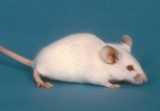
Evaluation of bacterial immunomodulotory properties
immature dedritic cells (iDC)
mature dedritic cells (mDC)
LPS
BALB/c mice
Treatment
with L. paracasei strains
Effect on DC maturation: CD11c, CD40, CD80, CD86
Effect on cytokine production: TNF-α, IL-2, IL-10, IL-12
Effect on cytokine production: TNF-α, IL-2, IL-10, IL-12

Slide 7
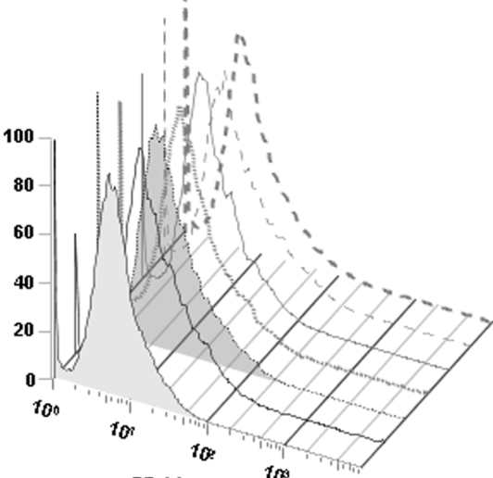
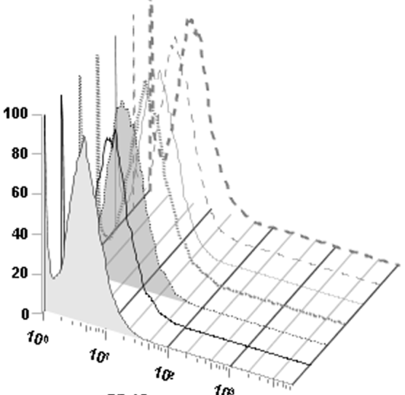
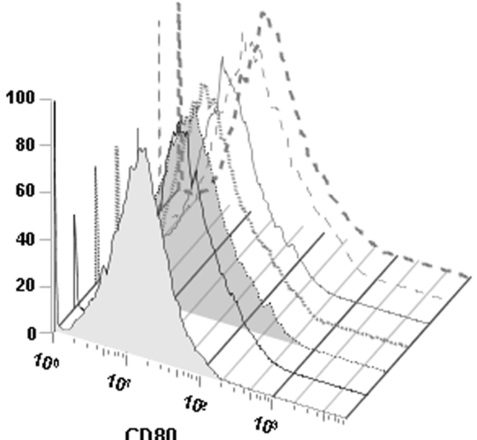
Effects of L. paracasei strains on the maturation of mice bone-marrow DCs
All strains increased the surface expressions of CD11c and CD80, but not of CD40, in iDCs at levels comparable with LPS stimulation.
% of Max
% of Max
% of Max
LMG 23554
LMG P-17806
ATCC 334
LMG 23554
IMPC 4.1
LMG 23554
IMPC 2.1
LMG 23554
LMG P-17806
LMG P-17806
+ LPS
LMG P-17806
ATCC 334
ATCC 334
DCs alone
ATCC 334
10⁰
IMPC 4.1
10⁰
IMPC 4.1
10⁰
IMPC 4.1
10¹
IMPC 2.1
10¹
IMPC 2.1
10¹
IMPC 2.1
10²
10³
+ LPS
10²
10³
+ LPS
10²
+ LPS
CD11c
DCs alone
CD40
DCs alone
CD80
10³
DCs alone

Slide 8
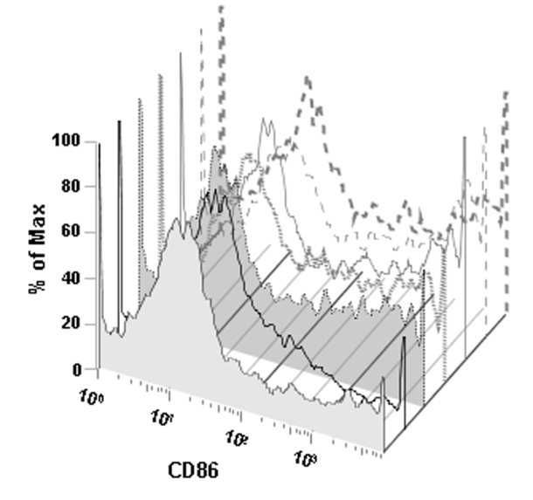
Surface expression of CD86, following incubation with bacterial strains, was even higher than the expression caused by LPS stimulation. Up-regulation of CD86 is consistent with other studies in which probiotic Lactobacillus species caused a similar enhancement.
% of Max
LMG 23554
LMG P-17806
ATCC 334
IMPC 4.1
IMPC 2.1
CD86
+ LPS
DCs alone

Slide 9
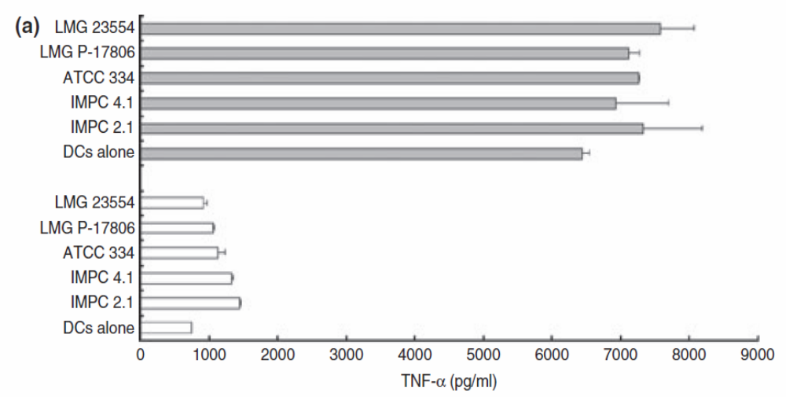
Effect of Lactobacillus paracasei strains on cytokine production by dendritic cells (DCs)
TNF-α
+ LPS
no LPS

Slide 10
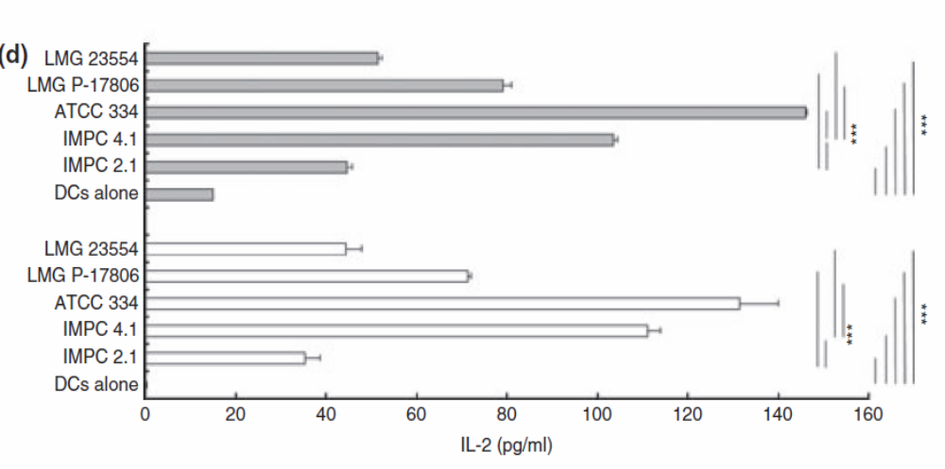
IL-2
+ LPS
no LPS

Slide 11
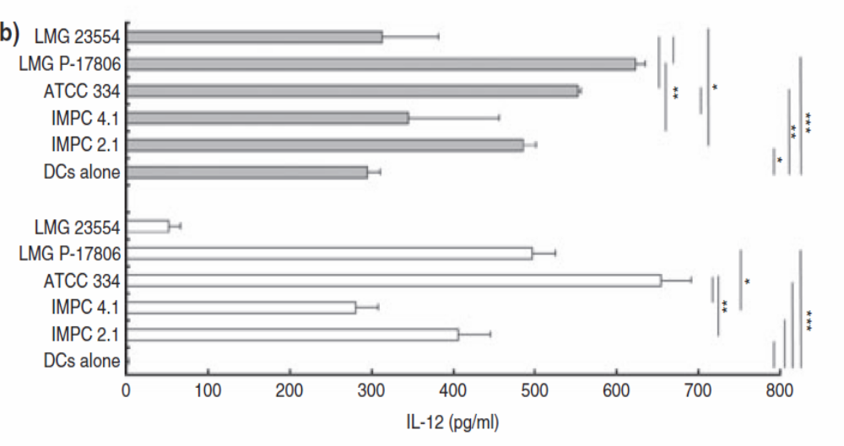
IL-12
+ LPS
no LPS

Slide 12
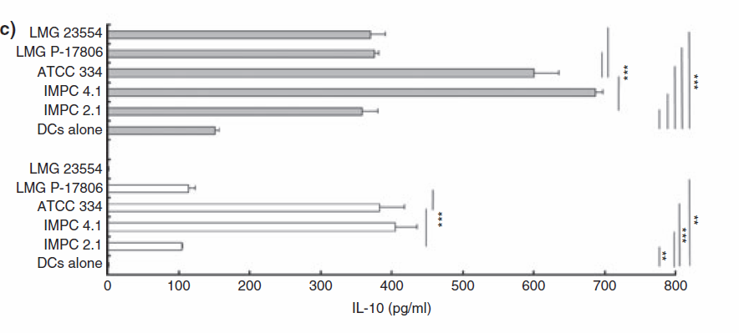
IL-10
+ LPS
no LPS

Slide 13
Conclusions
Our results confirm that each single strain of a bacterial species appears to influence the immune system in a peculiar manner: strain IMPC 4.1 showed an interesting anti-inflammatory ability (high IL-10/IL-12); probiotic strains IMPC 2.1 and LMG P-17806 were characterized by a similar and intermediate ability to induce cytokine secretion in contrast to the very low ability of strain LMG 23554 to stimulate production of IL-10 and IL-12.
The evaluation of the different types and⁄or levels of cytokines whose secretion is induced by each strain could be relevant to define its pro- or anti-inflammatory properties and its more appropriate clinical use.

Slide 14
Our results suggest that cytokine (IL-10, IL-12) pattern analysis of DCs stimulated with bacterial cells can be considered as an useful in vitro method to predict potentially unsafe features of new proposed probiotic strains before embarking on time-consuming clinical studies.
In fact, in this regard, the unsafe strain LMG 23554 was clearly differentiated from the other L. paracasei strains and its low ability to stimulate IL-10 and IL-12 production could explain the ability of the strain to cross the intestinal mucosal barrier and ⁄ or persist in the extra-intestinal organs or circulation.

